Slide 1
New Results on
Binary Comparison
Search Trees
Marek Chrobak, Neal Young
UC Riverside
Mordecai Golin
HKUST
Ian Munro U Waterloo

Slide 2
Early version of paper at arxiv.org
Optimal search trees with 2-way comparisons
Marek Chrobak, Mordecai Golin, J. Ian Munro, Neal E. Young
arXiv:1505.00357

Slide 3
Main Result
Constructing Min-Cost Binary Comparison Search Trees
Wasn’t this completely understood 45 years ago??!!
Yes and No …

Slide 4
Outline
History
  Binary Search Trees
  Hu-Tucker Trees
  AKKL Trees
Optimal Binary Comparison Search Trees with Failures
  Problem Models
  List of New Results
New Results
  The Main Lemma
  Structural Properties of OBCSTs
  Dynamic Programming for OBCSTs
  Proof of The Main Lemma (Sketch)
Extensions and Open Problems

Slide 5

Knuth’s Optimal BSTs
Knuth [1971] gave algorithm for constructing Optimal Binary Search Trees
Known: n keys K1, K2, …., Kn.
Preprocess keys to create binary tree. Tree query compares query value Q to keys. and returns appropriate response from
  i such that Q = Ki
  i such that Ki < Q < Ki+1
  Q < K1 or Kn < Q
Input: probability of successful and unsuccessful searches

Slide 6
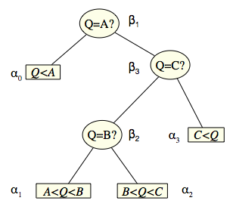
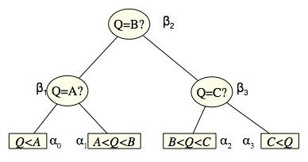
Knuth’s Optimal BSTs

Slide 7
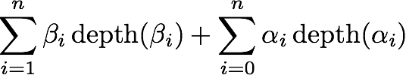
Knuth’s Optimal BSTs
Knuth [1971] gave algorithm for constructing Optimal Binary Search Trees
Input was probability of successful and unsuccessful searches
Cost of tree was average path length
Dynamic Programming Algorithm
  Constructed O(n^2) DP table
    Knuth reduced O(n^3) running time to O(n^2)
    Technique later generalized as Quadrangle Inequality method by F. Yao

Slide 8
Knuth’s Optimal BSTs
Cost = 0.85
Cost = 1.10
Cost = 1.05
Cost = 0.80

Slide 9
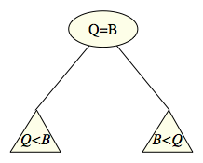
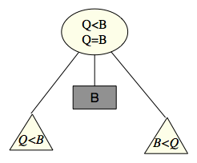
Hu-Tucker Binary Comparison Search Trees
Knuth constructed
optimal binary search trees
Trees structure was binary but nodes used ternary comparisons. Each node needed two binary comparisons to implement the search
In a binary comparison search tree, each internal node performs only one comparison. Searches all terminate at leaves.
First such trees constructed by
Hu-Tucker, also in 1971. O(n log n)

Slide 10
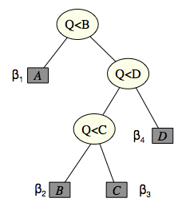
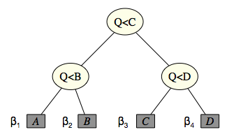
Hu-Tucker Binary Comparison Search Trees
Hu Tucker (1971) & Garsia-Wachs (1977)
Assumes all searches are successful; no failures allowed.
Input is only β1, β2, …, βn, with no αi s.
Internal nodes are < comparisons.
Searches all terminate at leaves
Problem is to find tree with
minimum weighted (average) external path length
O(n log n) algorithm

Slide 11
Outline
History
  Binary Search Trees
  Hu-Tucker Trees
  AKKL Trees
Optimal Binary Comparison Search Trees with Failures
  Problem Models
  List of New Results
New Results
  The Main Lemma
  Structural Properties of OBCSTs
  Dynamic Programming for OBCSTs
  Proof of The Main Lemma (Sketch)
Extensions and Open Problems

Slide 12
Adding Equality Comparisons
The Knuth trees use three-way comparisons at each node.
These are implemented in modern machines using two two-way comparisons (one < and one =).
Hu-Tucker trees use only one two-way comparison (a <) at each node.
. . . machines that cannot make three-way comparisons at once. . . will have to make two comparisons. . . it may well be best to have a binary tree whose internal nodes specify either an equality test or a less-than test but not both.
D. E. Knuth. The Art of Computer Programming, Volume 3: Sorting and Searching.
Addison-Wesley, 2nd edition, 1998. [§6.2.2 ex. 33],

Slide 13
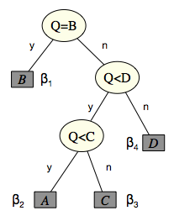
Adding Equality Comparisons: AKKL[2001]
Hu-Tucker Tree
AKKL Tree
AKKL trees are min cost trees with more power.
instead of being restricted to be <, comparisons can be = OR <
AKKL trees include HT Trees
AKKL trees can be cheaper than HT Trees if some βi much larger
than others
AKKL trees more difficult to construct

Slide 14
Adding Equality Comparisons: AKKL[2001]
Anderson, Kannan, Karloff, Ladner [2002] extended Hu-Tucker by allowing
= comparisons. AKKL find min-cost tree when the n-1 internal node comparisons are allowed to be in {=,<}.
Useful when some βi are very large (relatively)
AKKL algorithm runs in O(n⁴) time.
  AKKL note this improves running time of O(n⁵) claimed by Spuler [1994] in his thesis
  Spuler only states O(n⁵) algorithm but doesn’t prove that it produces optimal tree, so AKKL is really first polynomial time algorithm
Reason problem is difficult is that equality nodes can create holes in ranges. This could dramatically (exponentially?) increase search space, destroying DP approach
  AKKL show that if equality comparison exists, then it is always largest probability in range. Allows recovering DP approach with ranges of description size O(n³) (compared to Knuth’s O(n²))

Slide 15
Adding Equality Comparisons: AKKL[2001]
Hu-Tucker Tree
AKKL Tree
Comment 1 : Other problem in AKKL is how to deal with repeated weights
This was hardest part.
Comment 2: Both Hu-Tucker and AKKL only work when failures don’t occur.
I.e., only βi are allowed and not αi.

Slide 16
So Far + Obvious Open Problem
Optimal Binary Search Trees
  Input:
  O(n²) Knuth
Optimal Binary Comparison Search Trees
  Input:
  C = {<}: O(n logn) Hu-Tucker & Garsia-Wachs
  C = {=,<}: O(n⁴) AKKL
Obvious Questions
  Can we build OBCSTs that allow failures?
    If yes, for which sets of comparisons?
  Answer is yes, (for all sets of comparisons)
  but first need to define problem models

Slide 17
Outline
History
  Binary Search Trees
  Hu-Tucker Trees
  AKKL Trees
Optimal Binary Comparison Search Trees with Failures
  Problem Models
  List of New Results
New Results
  The Main Lemma
  Structural Properties of OBCSTs
  Dynamic Programming for OBCSTs
  Proof of The Main Lemma (Sketch)
Extensions and Open Problems

Slide 18
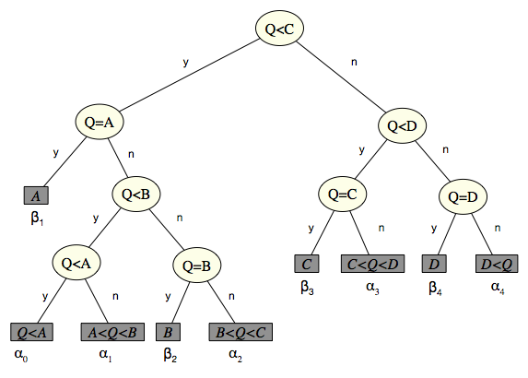
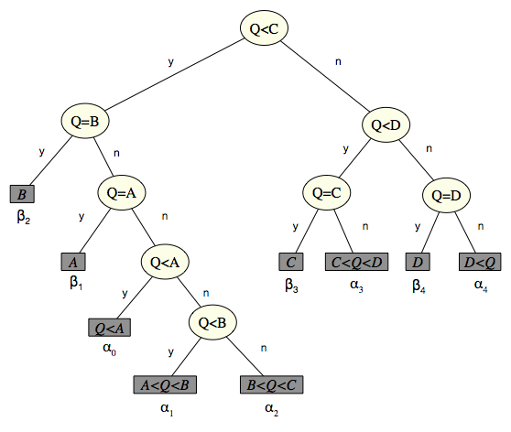
BCSTs with Failure Probabilities
Allows Failures (βi and αi).
  Call this complete input. HT has restricted input.
Tree for n keys has 2n+1 leaves
Distinguishing between Q==Ki and Ki < Q < Ki+1
always requires querying (Q=Ki)

Slide 19
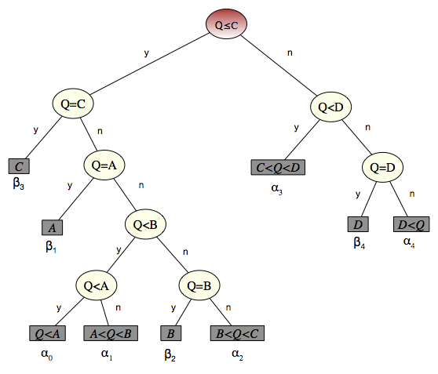
Using Different Types of Comparisons
Left Tree uses {<,=}. Right Tree uses {<, ≤, =}
  Minimum cost BCST is minimum taken over all trees using given set of comparisons C, e.g., C={<,=} or C={<, ≤, =}
C is input to the problem.
  Algorithm is different for different Cs.

Slide 20
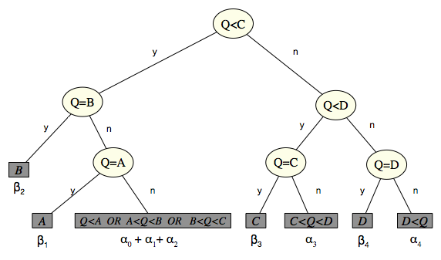
How Much Information is Needed for Failure? Comparisons
Tree on left shows Explicit Failure
  every failure leaf reports unique failure interval, Ki < Q < Ki+1.
Tree on right shows Non-Explicit Failure:
  Failure leaves only report failure. Don’t need to specify exact
  interval. Leaf can be concatenation of successive failure intervals .

Slide 21
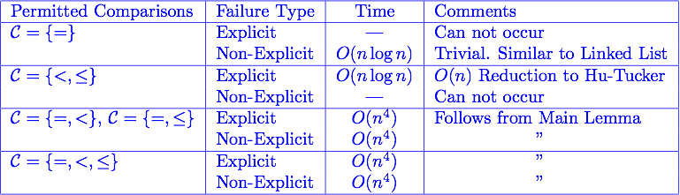
New Algorithms: OBCSTs with Failures FFFailueComparisons
DP Algorithms for last 4 cases are very similar
Differ slightly in
  Design of Recurrence Relations
    {=,<} and {=,<, ≤) yield slightly different recurrences
  Initial conditions
    Explicit and Non-Explicit Failures force different I.C.s

Slide 22
Outline
History
  Binary Search Trees
  Hu-Tucker Trees
  AKKL Trees
Optimal Binary Comparison Search Trees with Failures
  Problem Models
  List of New Results
New Results
  The Main Lemma
  Structural Properties of OBCSTs
  Dynamic Programming for OBCSTs
  Proof of The Main Lemma (Sketch)
Extensions and Open Problems

Slide 23
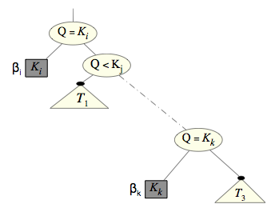
Main Lemma:
Lemma
Let T be a Optimal BCST.
If (Q=Kk) is a Descendant of (Q=Ki)
Then βk ≤βi
Note: This is true regardless of which
inequality comparisons are used and
which model BCST is used
Corollary: If T is an OBCST and (Q=Kk) an internal node in T, then βk ≤ βj for all (Q=Kj) on the path from the root to (Q=Kk),
i.e., equality weights decrease walking down the tree

Slide 24
Outline
History
  Binary Search Trees
  Hu-Tucker Trees
  AKKL Trees
Optimal Binary Comparison Search Trees with Failures
  Problem Models
  List of New Results
New Results
  The Main Lemma
  Structural Properties of OBCSTs
  Dynamic Programming for OBCSTs
  Proof of The Main Lemma (Sketch)
Extensions and Open Problems

Slide 25
Structural Properties of BCSTs
Henceforth assume distinct key weights,
i.e., all of the β1, β2, …, βn are different
Also assume C={<,=}
Every tree node N corresponds to search range
of subtree rooted at N
Root of BSCT is search range [K0,Kn+1)
(where K0=-∞ and Kn+1=∞)
Comparisons cuts ranges
  A (Q<Ki) splits [Ki,Kj) into [Ki,Kk) and [Kk,Ki)
  A (Q=Ki) removing Ki from range,
Range of subtree rooted at N is some [Ki,Kj) with some keys removed
Keys removed (holes) are Kk s.t. (Q=Kk) is on the path from N to the root of T.
[-∞,∞)
[-∞,C)
[C,∞)
[-∞,C)-{B}
[C,D)
[D,∞)
[-∞,C)-{A,B}
[A,C)-{A,B}

Slide 26
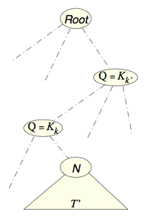
Structural Properties of OBCSTs
Range associated with Node N is
[Ki,Kj) with some (h) keys Kk removed.
Kk removed are s.t. (Q=Kk) are equality nodes
on path from N to root (that fall within [Ki,Kj))
From previous Lemma, if T is an OBCST, βi of nodes path to N are larger than βi of all equality nodes in T’.
∀k, (Q=Kk) appears somewhere in T.
Immediately implies that the h missing keys must be the largest weighted keys in [Ki,Kj)
Define punctured range [i,j: h) to be range [Ki,Kj) with the h highest weighted keys in [Ki,Kj) removed
=> every range associated with an internal node of an OBCST is a punctured range

Slide 27
Structural Properties of OBCSTs
[i,j: h) is range [Ki,Kj) with the h highest weighted keys in [Ki,Kj) removed
Range associated with an internal node of an OBCST is some [i,j: h)
Define OPT(i,j: h) to be the cost of an optimal BCST for range [i,j: h)
Goal is to find OPT(0,n+1: 0)
and associated tree
Will use Dynamic programming to fill in table.
Table has size O(n³)
We will (recursively) evaluate OPT(i,j: h) in O(j-i) time, yielding a O(n⁴) algorithm.
[0,n+1:0)
[i,j:h)

Slide 28
Outline
History
  Binary Search Trees
  Hu-Tucker Trees
  AKKL Trees
Optimal Binary Comparison Search Trees with Failures
  Problem Models
  List of New Results
New Results
  The Main Lemma
  Structural Properties of OBCSTs
  Dynamic Programming for OBCSTs
  Proof of The Main Lemma (Sketch)
Extensions and Open Problems

Slide 29
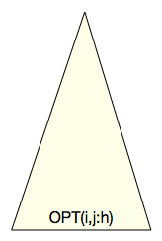
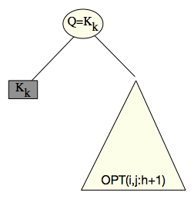
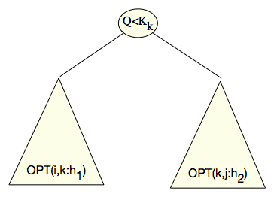
Dynamic programming for OBCSTs
Let T be an OBCST for [i,j: h)
T Has two possible structures
1. Root is a (Q=Kk)
2. Root is a (Q<Kk)

Slide 30
Dynamic programing for OBCSTs
1. Root of OPT(i,j: h) is a (Q=Kk)
Kk must be largest key weight in [i,j: h)
which is (h+1)^{st} largest key weight in [i,j)
Right subtree missing h+1 largest weights
in [i,j) so right subtree is OPT(i,j: h+1)
Cost of full tree is sum of
cost of left subtree 0
cost of right subtree OPT(i,j: h+1)
Total weight of left + right subtree Wi,j:h
where Wi,j:h = sum of all βi,αi in (i,j: h]

Slide 31
Dynamic programing for OBCSTs
2. Root of OPT(i,j: h) is a (Q<Kk)
Range is split into <k and ≥k
h holes (largest keys) in [i,j) are split, with
h1(k) on left and h2(k) =h-h1(k) on right
h1(k) keys must be heaviest in [i,k)
h2(k) keys must be heaviest in [k,j)
So left and right subtrees are OBCSTs for
[i,k: h1(k)) and [k,j: h2(k))
Cost of tree is Wi,j:h + OPT(i,k: h1(k)+ OPT(k,j: h2(k))
Don’t know what k is, so minimize over all possible k

Slide 32
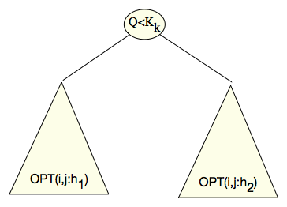
Dynamic programing for OBCSTs
OPT(i,j: h) has two possible structures
1. Root is a (Q=Kk)
2. Root is a (Q<Kk)
This immediately implies
But every case seen can construct a BCST with that cost, so

Slide 33

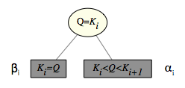
Dynamic programing for OBCSTs
Set initial conditions for ranges OPT(i,i+1,*)
OPT(i,i+1,1)=0
OPT(i,i+1,0)= βi + αi
Comments
Must restrict h ≤ j-i (can’t have more holes than keys in interval)
Need to fill in table in proper order, e.g.,
(a) d= 0 to n, (b) i=0 to n-d, j=i+d+1, (c) h =(j-i) downto 0
Need O(1) method for computing hi(k)
  => O(j-i) to calculate OPT(i,j: h)
  => O(n^4) to fill in complete table
OPT(0,n+1:0) is optimal cost. Use standard DP backtracking to construct corresponding optimal tree

Slide 34
Perturbing for Key Weight Uniqueness (I)
Strongly used assumption βi are all distinct to find `weightiest’ keys
  Assumption can be removed using perturbation argument
All values constructed/compared in algorithm are subtree costs
  in form ∑ aiαi + ∑biβi where 0 ≤ ai,bi ≤ 2n are integral node depths
Perturb input by setting α’i=αi , β’i = βi+i𝝐 where 𝝐 is very small
  => β’i are all distinct
Since β’i are all distinct, algorithm gives correct result for α’i ,β’i
  Easy to prove that optimum tree for α’i ,β’i is optimum for αi ,βi
  => resulting tree is optimum for original α’i ,β’i
In fact don’t actually need to know value of 𝝐

Slide 35
Perturbing for Key Weight Uniqueness (II)
Perturb input: α’i=αi , β’i = βi+i𝝐 where 𝝐 is very small
  Need to find optimum tree for α’i ,β’i (which is also optimum for α’i ,β’i )
Recall that algorithm only performs additions/comparisons
  All values are subtree costs ∑ aiαi + ∑biβi where 0 ≤ ai,bi ≤ 2n are integral
Don’t actually need to know or store value of 𝝐
Every value in algorithm is in form x = x1+x2𝝐, where x2=O(n³) is an integer
  Forget 𝝐. Store pair (x1,x2)
(A) Addition is pairwise-addition
  (x1,x2) + (y1,y2) = (x1+y1, x2+y2)
(C) Comparison is lexicographic-comparison
  (x1,x2) < (y1,y2) iff x1<y1 or x1=y1 and x2=<y2
Both (A) and (C) can be implemented in O(1) time without knowing 𝝐
Perturbed algorithm has same asymptotic running time as regular one

Slide 36
Odds and Ends
Designed O(n⁴) algorithm for constructing OBCSTs
when C={<,=} and need to report Exact Failures
Strongly used assumption βi are all distinct
  Assumption can be removed using perturbation argument
To solve problem C={<,=} with Non-Exact failures
  only need to modify initial conditions
Symmetry argument gives algorithms for C={≤, =}
Algorithms for C={<, ≤, =} requires only slight modifications of SPLIT(i,j: h)
If C={<, ≤}, ranges have no holes and problem can be solved in O(n log n) similar to Hu-Tucker

Slide 37
Outline
History
  Binary Search Trees
  Hu-Tucker Trees
  AKKL Trees
Optimal Binary Comparison Search Trees with Failures
  Problem Models
  List of New Results
New Results
  The Main Lemma
  Structural Properties of OBCSTs
  Dynamic Programming for OBCSTs
  Proof of The Main Lemma (Sketch)
Extensions and Open Problems

Slide 38
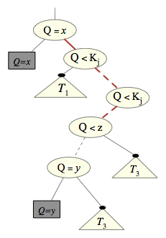
Proof of Main Lemma
Let T be an OBCST. Assume
y<x (x>y is symmetric)
(Q=x) is above (Q=y)
=> βx < βy will show contradiction
=> βx ≥ βy and Thm correct
All comparisons between
(Q=x) and (Q=y) are inequalities
  otherwise ∃ (Q=w) on path with either
  βx < βw or βw < βy and can show
  contradiction with (x,w) or (w,y)
x,y ∈ Range((Q=x)) by definition
If x,y ∈ Range((Q=y))
then could swap (Q=X) and (Q=y)
to get cheaper tree.

Slide 39
Proof of Main Lemma
Let T be an OBCST. Assume
y<x (x>y is symmetric)
(Q=x) is above (Q=y)
=> βx < βy will show contradiction
All comparisons between
(Q=x) and (Q=y) are inequalities
Since x∉ Range((Q=y)
=> Path (Q=x) to (Q=y) contains (Q<z)
s.t z’s children’s ranges are [i,z,h’), [z,j,h’’)
where y∈ [i,z) and x ∈[z,j).
z is called splitter.
P’ is (red) path from (Q=x) to (Q=y)
x would
be here

Slide 40
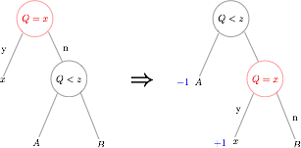
Proof of Main Lemma
P is path in T from (Q=x) to (Q=y). y< x. z is x-y splitter on P
P’ is path from (Q=x) to (Q=z)
Proof will be case analysis of structure of P’
For every P’, will show can build cheaper OBCST T’
contradicting optimality of T
Case 1: P’ is one edge
y∈A
=> Weight(A) ≥ βy > βx
=> replacing left subtree by right
subtree in T yields new BCST T’
with lower cost than T,
contradicting T being OBCST

Slide 41
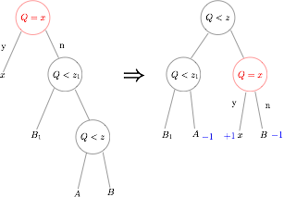
Proof of Main Lemma
P is path in T from (Q=x) to (Q=y). y<x. z is x-y splitter on P
P’ is path from (Q=x) to (Q=z)
Case 2: P’ is two edges ≠≮
y∈A
=> Weight(A) ≥ βy > βx
=> again replacing left tree by
right tree in T yields new BCST T’
with lower cost than T,
contradicting T being OBCST

Slide 42
Proof of Main Lemma
P is path in T from (Q=x) to (Q=y). y<x. z is x-y splitter on P
P’ is path from (Q=x) to (Q=z)
Proof will be case analysis of structure of P’
Already saw first two cases of P’
  Showed for each that assumptions allow replacing subtree
  rooted at (Q=x) with cheaper subtree for some range.
  Replacement leads to cheaper BCST, contradicting optimality
  of T
The full proof splits P’ into 7 cases.
  For each, can show replacement with cheaper subtree,
  contradicting optimality of T.

Slide 43
Outline
History
  Binary Search Trees
  Hu-Tucker Trees
  AKKL Trees
Optimal Binary Comparison Search Trees with Failures
  Problem Models
  List of New Results
Our Results
  The Main Lemma
  Structural Properties of OBCSTs
  Dynamic Programming for OBCSTs
  Proof of The Main Lemma
Extensions and Open Problems

Slide 44
Extensions & Open Problems
If the βi,αi are probabilities (sum to 1) can show an O(n) algorithm that constructs BCST within additive error 3 of optimal for Exact Failure Case
  Modification of similar algorithm for Hu-Tucker case.
O(n⁴) is quite high for worst case.
  Can we do better?

