Slide 1
Lecture 13 – Perceptrons
Machine Learning
March 16, 2010

Slide 2
Last Time
Hidden Markov Models
  Sequential modeling represented in a Graphical Model

Slide 3
Today
Perceptrons
Leading to
  Neural Networks
  aka Multilayer Perceptron Networks
  But more accurately: Multilayer Logistic Regression Networks

Slide 4
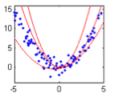
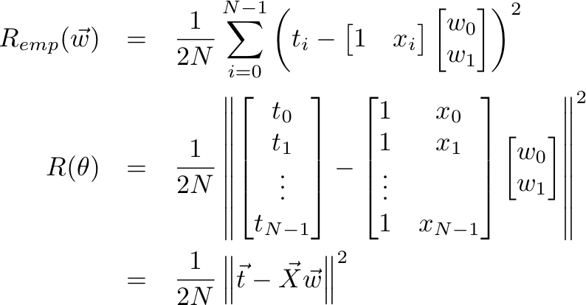
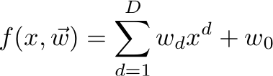
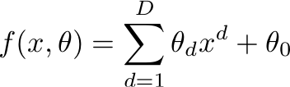
Review: Fitting Polynomial Functions
Fitting nonlinear 1-D functions
Polynomial:
Risk:
Notes:
R_{emp}(\vec{w})&=&\frac{1}{2N}\sum_{i=0}^{N-1}\left(t_i - \begin{bmatrix} 1&x_i\end{bmatrix} \begin{bmatrix} w_0\\w_1\end{bmatrix}\right)^2\\R(\theta)&=&\frac{1}{2N} \left\lVert\begin{bmatrix} t_0\\t_1\\\vdots\\t_{N-1}\end{bmatrix} - \begin{bmatrix} 1&x_0\\1&x_1\\\vdots\\1&x_{N-1}\end{bmatrix}\begin{bmatrix} w_0\\w_1\end{bmatrix}\right\rVert^2\\&=&\frac{1}{2N}\left\lVert\vec{t} - \vec{X}\vec{w} \right\rVert^2
f(x, \theta) = \sum_{d=1}^D\theta_dx^d + \theta_0

Slide 5

Review: Fitting Polynomial Functions
Order-D polynomial regression for 1D variables is the same as D-dimensional linear regression
Extend the feature vector from a scalar.
More generally
Notes:
\vec{x}_i = \left[\begin{matrix}x_i^0&x_i^1&x_i^2&\ldots&x_i^D\end{matrix} \right]^T
\vec{x}_i = \left[\begin{matrix}\phi_0(x_i)&\phi_1(x_i)&\phi_2(x_i)&\ldots&\phi_D(x_i)\end{matrix} \right]^T

Slide 6
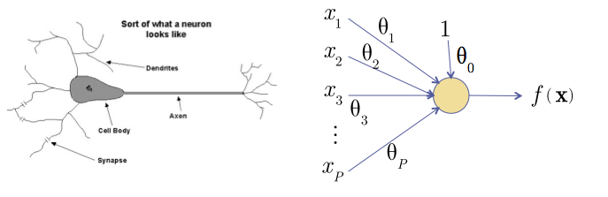
Neuron inspires Regression
Graphical Representation of linear regression
  McCullough-Pitts Neuron
  Note: Not a graphical model

Slide 7
Neuron inspires Regression
Edges multiply the signal (x_{i}) by some weight (θ_{i}).
Nodes sum inputs
Equivalent to Linear Regression

Slide 8

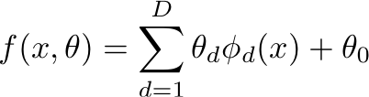
Introducing Basis functions
Graphical representation of feature extraction
Edges multiply the signal by a weight.
Nodes apply a function, ϕ_{d}.
Notes:
f(x, \theta) = \sum_{d=1}^D\theta_d\phi_d(x) + \theta_0

Slide 9

Extension to more features
Graphical representation of feature extraction
Notes:
f(\vec{x}, \theta) = \sum_{n=0}^{N-1}\sum_{d=1}^D\theta_d\phi_d(x_n) + \theta_0

Slide 10

Combining function
How do we construct the neural output
Linear Neuron
Notes:
f(\vec{x}, \theta) = \sum_{n=0}^{N-1}\sum_{d=1}^D\theta_d\phi_d(x_n) + \theta_0
f(\vec{x}, \theta) = \theta^T\vec{x}

Slide 11
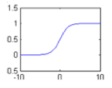


Combining function
Sigmoid function or Squashing function
Classification using the
same metaphor
Logistic Neuron
Notes:
f(\vec{x}, \theta) = g(\theta^T\vec{x})

Slide 12
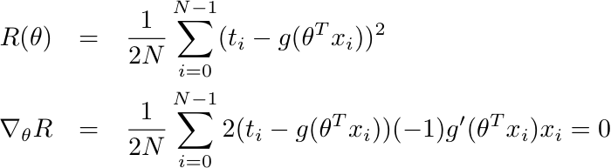
Logistic Neuron optimization
Minimizing R(θ) is more difficult
Bad News: There is no “closed-form” solution.
Good News: It’s convex.
Notes:
R(\theta)&=&\frac{1}{2N}\sum_{i=0}^{N-1}(t_i - g(\theta^Tx_i))^2\\\nabla_\theta R&=&\frac{1}{2N}\sum_{i=0}^{N-1}2(t_i - g(\theta^Tx_i))(-1)g'(\theta^Tx_i)x_i = 0

Slide 13
Aside: Convex Regions
Convex: for any pair of points x_{a} and x_{b} within a region, every point x_{c} on a line between x_{a} and x_{b} is in the region

Slide 14
Aside: Convex Functions
Convex: for any pair of points x_{a} and x_{b} within a region, every point x_{c} on a line between x_{a} and x_{b} is in the region

Slide 15
Aside: Convex Functions
Convex: for any pair of points x_{a} and x_{b} within a region, every point x_{c} on a line between x_{a} and x_{b} is in the region

Slide 16
Aside: Convex Functions
Convex functions have a single maximum and minimum!
How does this help us?
(nearly) Guaranteed optimality of Gradient Descent

Slide 17

Gradient Descent
The Gradient is defined (though we can’t solve directly)
Points in the direction of fastest increase
Notes:
\nabla_\theta R&=&\frac{1}{2N}\sum_{i=0}^{N-1}2(t_i - g(\theta^Tx_i))(-1)g'(\theta^Tx_i)x_i = 0

Slide 18
Gradient Descent
Gradient points in the direction of fastest increase
To minimize R, move in the opposite direction
Notes:
\nabla_\theta R&=&\frac{1}{2N}\sum_{i=0}^{N-1}2(t_i - g(\theta^Tx_i))(-1)g'(\theta^Tx_i)x_i = 0

Slide 19
Gradient Descent
Gradient points in the direction of fastest increase
To minimize R, move in the opposite direction
Notes:
\nabla_\theta R&=&\frac{1}{2N}\sum_{i=0}^{N-1}2(t_i - g(\theta^Tx_i))(-1)g'(\theta^Tx_i)x_i = 0

Slide 20
Gradient Descent
Initialize Randomly
Update with small steps
(nearly) guaranteed to converge to the minimum
Notes:
\nabla_\theta R&=&\frac{1}{2N}\sum_{i=0}^{N-1}2(t_i - g(\theta^Tx_i))(-1)g'(\theta^Tx_i)x_i = 0

Slide 21
Gradient Descent
Initialize Randomly
Update with small steps
(nearly) guaranteed to converge to the minimum
Notes:
\nabla_\theta R&=&\frac{1}{2N}\sum_{i=0}^{N-1}2(t_i - g(\theta^Tx_i))(-1)g'(\theta^Tx_i)x_i = 0

Slide 22
Gradient Descent
Initialize Randomly
Update with small steps
(nearly) guaranteed to converge to the minimum
Notes:
\nabla_\theta R&=&\frac{1}{2N}\sum_{i=0}^{N-1}2(t_i - g(\theta^Tx_i))(-1)g'(\theta^Tx_i)x_i = 0

Slide 23
Gradient Descent
Initialize Randomly
Update with small steps
(nearly) guaranteed to converge to the minimum
Notes:
\nabla_\theta R&=&\frac{1}{2N}\sum_{i=0}^{N-1}2(t_i - g(\theta^Tx_i))(-1)g'(\theta^Tx_i)x_i = 0

Slide 24
Gradient Descent
Initialize Randomly
Update with small steps
(nearly) guaranteed to converge to the minimum
Notes:
\nabla_\theta R&=&\frac{1}{2N}\sum_{i=0}^{N-1}2(t_i - g(\theta^Tx_i))(-1)g'(\theta^Tx_i)x_i = 0

Slide 25
Gradient Descent
Initialize Randomly
Update with small steps
(nearly) guaranteed to converge to the minimum
Notes:
\nabla_\theta R&=&\frac{1}{2N}\sum_{i=0}^{N-1}2(t_i - g(\theta^Tx_i))(-1)g'(\theta^Tx_i)x_i = 0

Slide 26
Gradient Descent
Initialize Randomly
Update with small steps
(nearly) guaranteed to converge to the minimum
Notes:
\nabla_\theta R&=&\frac{1}{2N}\sum_{i=0}^{N-1}2(t_i - g(\theta^Tx_i))(-1)g'(\theta^Tx_i)x_i = 0

Slide 27
Gradient Descent
Initialize Randomly
Update with small steps
Can oscillate if η is too large
Notes:
\nabla_\theta R&=&\frac{1}{2N}\sum_{i=0}^{N-1}2(t_i - g(\theta^Tx_i))(-1)g'(\theta^Tx_i)x_i = 0

Slide 28
Gradient Descent
Initialize Randomly
Update with small steps
Can oscillate if η is too large
Notes:
\nabla_\theta R&=&\frac{1}{2N}\sum_{i=0}^{N-1}2(t_i - g(\theta^Tx_i))(-1)g'(\theta^Tx_i)x_i = 0

Slide 29
Gradient Descent
Initialize Randomly
Update with small steps
Can oscillate if η is too large
Notes:
\nabla_\theta R&=&\frac{1}{2N}\sum_{i=0}^{N-1}2(t_i - g(\theta^Tx_i))(-1)g'(\theta^Tx_i)x_i = 0

Slide 30
Gradient Descent
Initialize Randomly
Update with small steps
Can oscillate if η is too large
Notes:
\nabla_\theta R&=&\frac{1}{2N}\sum_{i=0}^{N-1}2(t_i - g(\theta^Tx_i))(-1)g'(\theta^Tx_i)x_i = 0

Slide 31
Gradient Descent
Initialize Randomly
Update with small steps
Can oscillate if η is too large
Notes:
\nabla_\theta R&=&\frac{1}{2N}\sum_{i=0}^{N-1}2(t_i - g(\theta^Tx_i))(-1)g'(\theta^Tx_i)x_i = 0

Slide 32
Gradient Descent
Initialize Randomly
Update with small steps
Can oscillate if η is too large
Notes:
\nabla_\theta R&=&\frac{1}{2N}\sum_{i=0}^{N-1}2(t_i - g(\theta^Tx_i))(-1)g'(\theta^Tx_i)x_i = 0

Slide 33
Gradient Descent
Initialize Randomly
Update with small steps
Can oscillate if η is too large
Notes:
\nabla_\theta R&=&\frac{1}{2N}\sum_{i=0}^{N-1}2(t_i - g(\theta^Tx_i))(-1)g'(\theta^Tx_i)x_i = 0

Slide 34
Gradient Descent
Initialize Randomly
Update with small steps
Can oscillate if η is too large
Notes:
\nabla_\theta R&=&\frac{1}{2N}\sum_{i=0}^{N-1}2(t_i - g(\theta^Tx_i))(-1)g'(\theta^Tx_i)x_i = 0

Slide 35
Gradient Descent
Initialize Randomly
Update with small steps
Can oscillate if η is too large
Notes:
\nabla_\theta R&=&\frac{1}{2N}\sum_{i=0}^{N-1}2(t_i - g(\theta^Tx_i))(-1)g'(\theta^Tx_i)x_i = 0

Slide 36
Gradient Descent
Initialize Randomly
Update with small steps
Can stall if is ever 0 not at the minimum
Notes:
\nabla_\theta R&=&\frac{1}{2N}\sum_{i=0}^{N-1}2(t_i - g(\theta^Tx_i))(-1)g'(\theta^Tx_i)x_i = 0

Slide 37
Back to Neurons
Linear Neuron
Logistic Neuron
Notes:
f(\vec{x}, \theta) = \sum_{n=0}^{N-1}\sum_{d=1}^D\theta_d\phi_d(x_n) + \theta_0
f(\vec{x}, \theta) = \theta^T\vec{x}

Slide 38

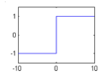
Perceptron
Classification squashing function
Strictly classification error
Perceptron
Notes:
f(\vec{x}, \theta) = \sum_{n=0}^{N-1}\sum_{d=1}^D\theta_d\phi_d(x_n) + \theta_0
f(\vec{x}, \theta) = \theta^T\vec{x}

Slide 39

Classification Error
Only count errors when a classification is incorrect.
Sigmoid leads to
greater than
zero error on correct
classifications

Slide 40

Classification Error
Only count errors when a classification is incorrect.
Perceptrons use
strictly classification
error
Notes:
R(\theta)=\frac{1}{N}\sum_{i=0}^{N-1}\text{step}(-t_i\theta^Tx_i)

Slide 41
Perceptron Error
Can’t do gradient descent on this.
Perceptrons use
strictly classification
error

Slide 42
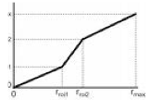

Perceptron Loss
With classification loss:
Define Perceptron Loss.
  Loss calculated for each misclassified data point
  Now piecewise linear risk rather than step function
vs
Notes:
R(\theta) = -\frac{1}{N}\sum_{i\in error}t_i(\theta^Tx_i)

Slide 43


Perceptron Loss
Perceptron Loss.
  Loss calculated for each misclassified data point
  Nice gradient descent
Notes:
R(\theta) = -\frac{1}{N}\sum_{i\in error}t_i(\theta^Tx_i)

Slide 44
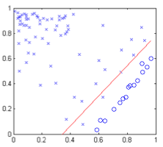
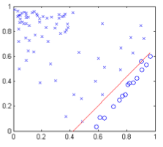
Perceptron vs. Logistic Regression
Logistic Regression has a hard time eliminating all errors
  Errors: 2
Perceptrons often do better. Increased importance of errors.
  Errors: 0

Slide 45
Stochastic Gradient Descent
Instead of calculating the gradient over all points, and then updating.
Update the gradient for each misclassified point at training
Update rule:
Notes:
\theta_{t+1} = \theta_t-\eta \nabla_\theta R(\theta) = \theta_t +\eta t_ix_i

Slide 46
Online Perceptron Training
Online Training
  Update weights for each data point.
Iterate over points x_{i} point,
  If x_{i} is correctly classified
  Else
Theorem: If x_{i} in X are linearly separable, then this process will converge to a θ* which leads to zero error in a finite number of steps.
Notes:
\theta_{t+1} = \theta_t-\eta \nabla_\theta R(\theta) = \theta_t +\eta t_ix_i
\theta_{t+1} = \theta_t +t_ix_i

Slide 47
Linearly Separable
Two classes of points are linearly separable, iff there exists a line such that all the points of one class fall on one side of the line, and all the points of the other class fall on the other side of the line

Slide 48
Linearly Separable
Two classes of points are linearly separable, iff there exists a line such that all the points of one class fall on one side of the line, and all the points of the other class fall on the other side of the line

Slide 49
Next Time
Multilayer Neural Networks

