Slide 1

Computer Security
COMP 4634
Course overview
Some slides are borrowed from Dan Boneh
Notes:
SISL

Slide 2
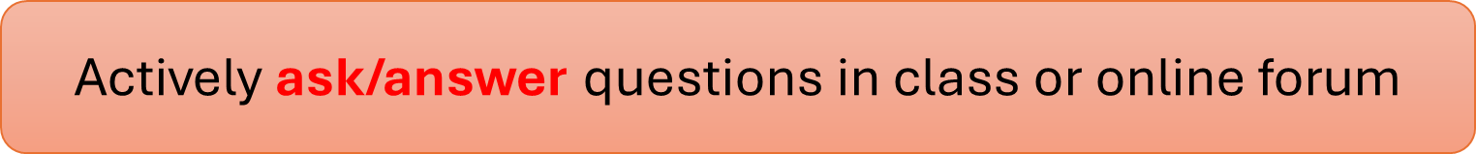
Admin
Course web site: https://course.cse.ust.hk/comp4634/
Prof: Dongdong She. TA: Kaikai Zhang and Evan. K
Three programming projects and two written homeworks
Use EdDiscussions
Notes:
Syllabus and readings on the course web site.

Slide 3
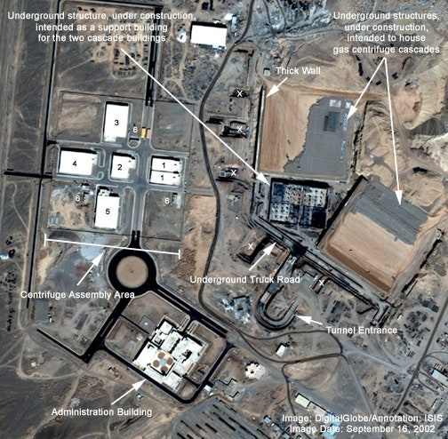

The Story of Stuxnet
First cyber-warfare that destroys a nuclear weapon factory

Slide 4
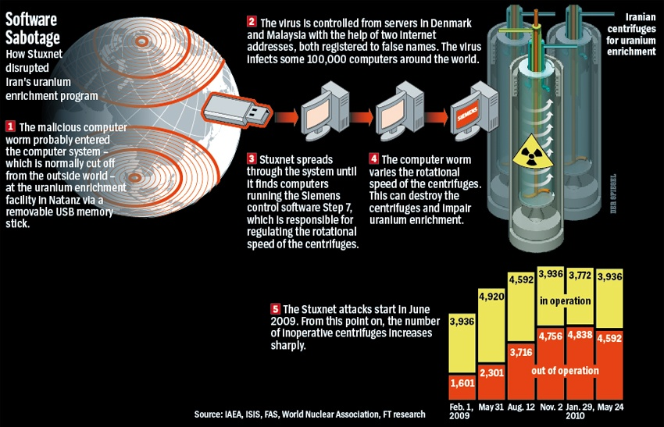

Slide 5
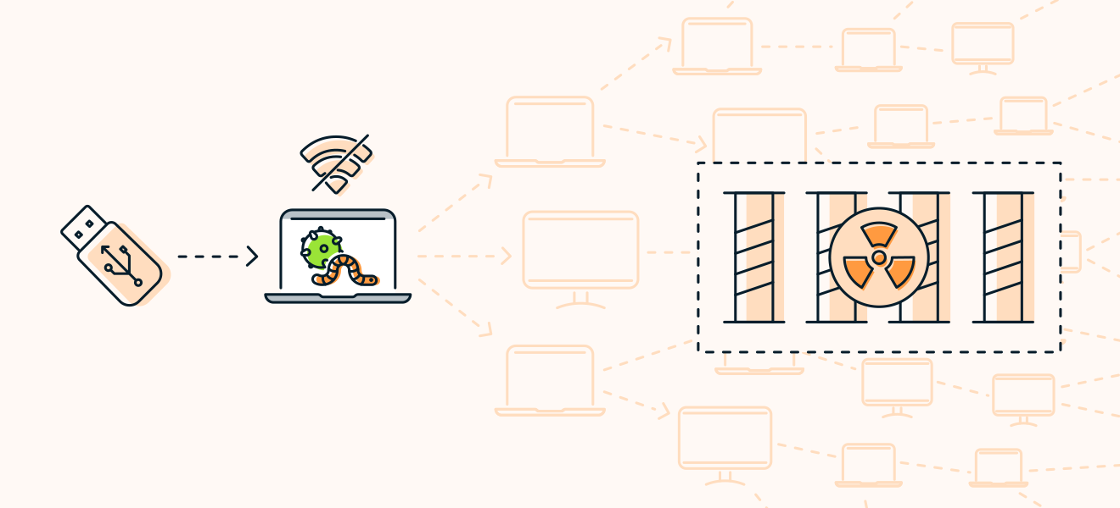
The Story of Stuxnet
First cyber-warfare that destroys a nuclear weapon factory

Slide 6
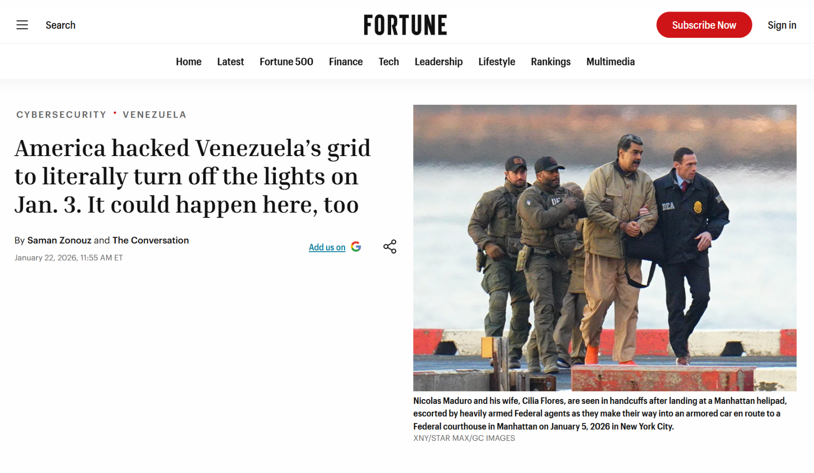
The Latest Cyber-Warfare

Slide 7

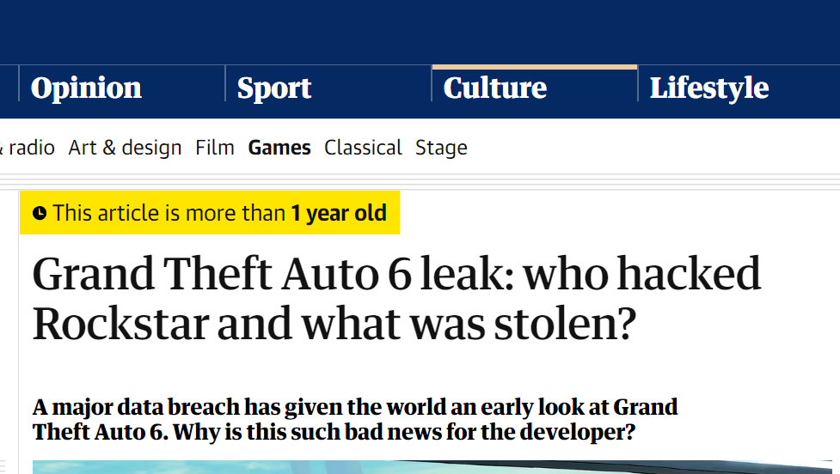
The GTA VI Leak
A hacker leaked the famous game before its official release

Slide 8
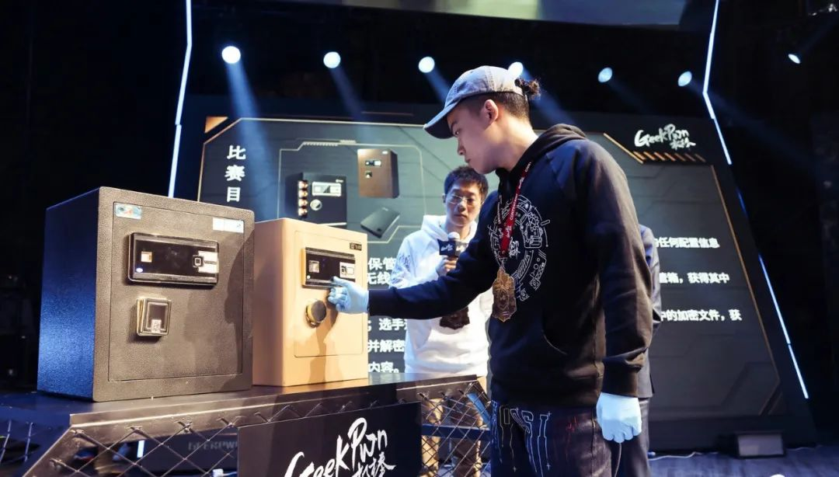

Old-Fashioned Hacking Skill
Hackers have a tradition of picking a lock and cracking a safe
Hacking competitions often hold lock-cracking session

Slide 9
Philosophy of security: crack any system without a key
Why do hackers study lock-picking?

Slide 10
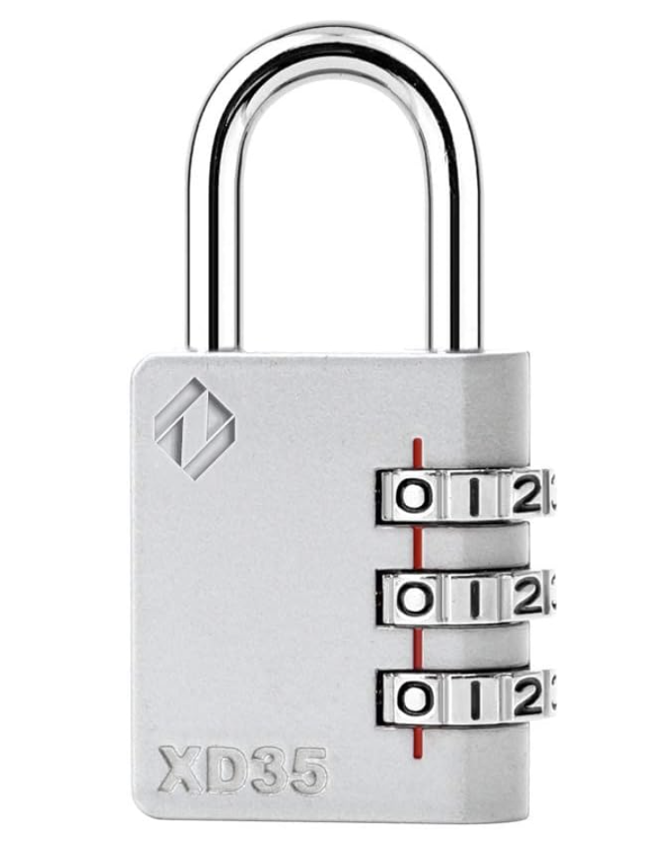
How to Crack a Combination Lock?
Total number of combinations?
10^3
Assume we can try each combination in 1 second.
Question: What is the expected time to crack it?
Do the math

Slide 11
Quiz: Lock-Picking Competition
Each student is given the following gear
a practice lock
a set of lock-picking tool
Time constraint: 5 minutes
Reward policy: the first student who successfully cracks a lock gets 10 bonus points in the final exam

Slide 12

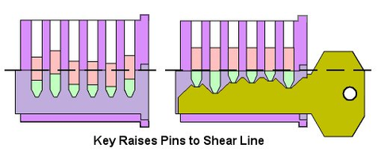
A Peek into Lock Mechanism

Slide 13
Don’t try this at home !
Notes:
Michael Duff

Slide 14
The computer security problem
Lots of buggy software
Money can be made from finding and exploiting vulns.
Marketplace for exploits (gaining a foothold)
Marketplace for malware (post compromise)
Strong economic and political motivation for using both
current state of computer security

Slide 15
Top 10 products by total number of distinct vulnerabilities in 2024
Product name | Vendor | # vulnerabilities
Linux kernel | Linux | 3496
Microsoft Server | Microsoft | 596
Windows 11 | Microsoft | 539
Macos | Apple | 508
Android | Google | 501
MacOS | Apple | 420
iPhone OS | Apple | 317
Chrome | Google | 259
source: https://www.cvedetails.com/top-50-products.php?year=2024
Notes:
CVE: Common Vulnerabilities and Exposures

Slide 16
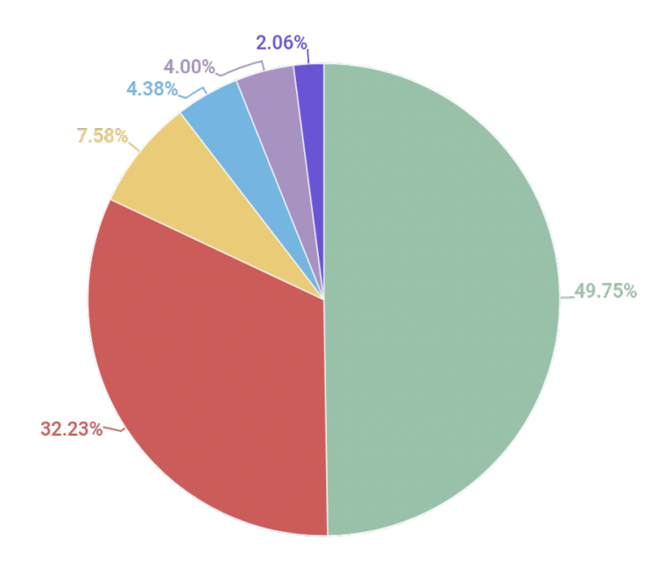
Distribution of exploits used in attacks
Java
Android
Browser
Office
Source: Kaspersky Security Bulletin 2021
Notes:
Remainder colors are: Adobe Flash and PDF

Slide 17
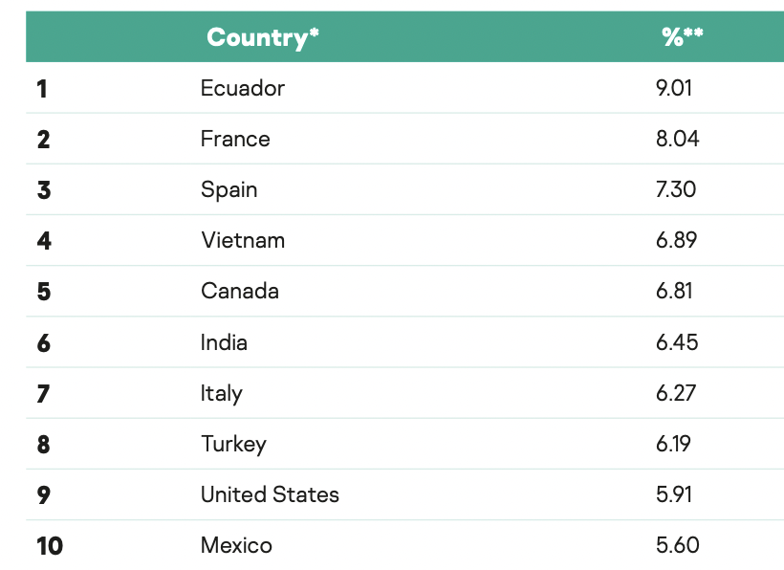
A global problem
Top 10 countries by share of attacked users:
Source: Kaspersky Security Bulletin 2021

Slide 18
Goals for this course
Understand exploit techniques
Learn to defend and prevent common exploits
Understand the available security tools
Learn to architect secure systems

Slide 19
This course
Part 1: basics (architecting for security)
Securing apps, OS, and legacy code:
sandboxing, access control, and security testing
Part 2: Web security (defending against a web attacker)
Building robust web sites, understand the browser security model
Part 3: network security (defending against a network attacker)
Monitoring and architecting secure networks.
Part 4: ML and LLM security (defending against a ML attacker)
Jailbreak, prompt injection, tool invocation hijacking

Slide 20
What motivates attackers?
Introduction
… economics
Notes:
In this segment we will describe a few sample attacks. We will come back to this and discuss malware in far greater detail later on in the course. Here we give a few examples to illustrate the state of the world.

Slide 21



Why compromise end user machines? 1. Steal user credentials
keylog for banking passwords, corporate passwords, gaming pwds
Example: SilentBanker (and many like it)
User requests login page
Malware injects Javascript
Bank sends login page needed to log in
Bank
When user submits information, also sent to attacker
Similar mechanism used by Zbot, and others
Adversary-in-the-Browser (AITB)

Slide 22
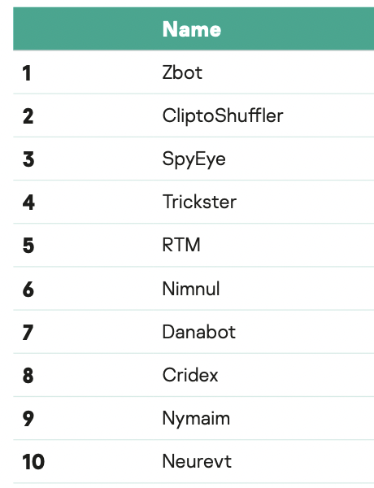
Lots of financial malware
records banking passwords via keylogger
spread via spam email and hacked web sites
maintains access to PC for future installs
Source: Kaspersky Security Bulletin 2021

Slide 23
Similar attacks on mobile devices
Example: FinSpy.
Works on iOS and Android (and Windows)
once installed: collects contacts, call history, geolocation, texts, messages in encrypted chat apps, …
How installed?
iOS and Android: physical access

Slide 24
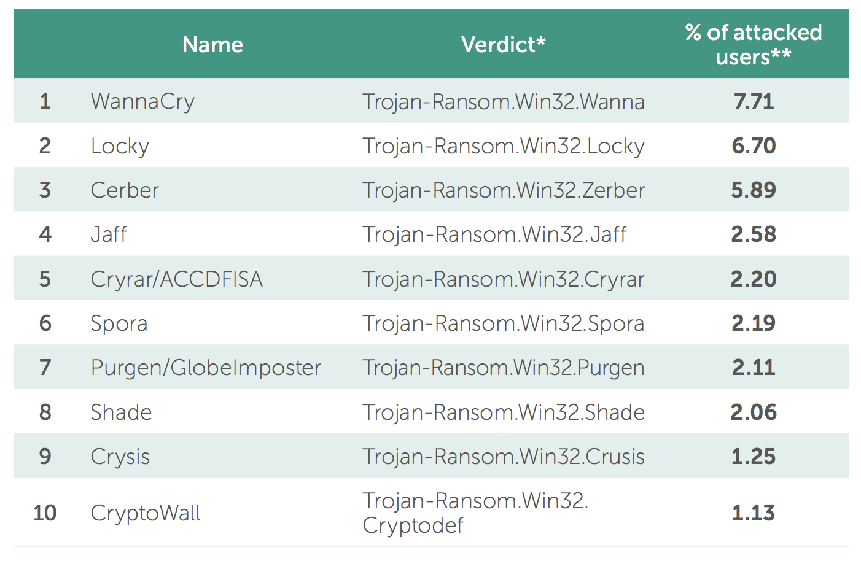
Why own machines: 2. Ransomware
a worldwide problem
Worm spreads via a vuln. in SMB (port 445)
Apr. 14, 2017: Eternalblue vuln. released by ShadowBrokers
May 12, 2017: Worm detected
(3 weeks to weaponize)
Notes:
Good user interface. Bitcoin.

Slide 25
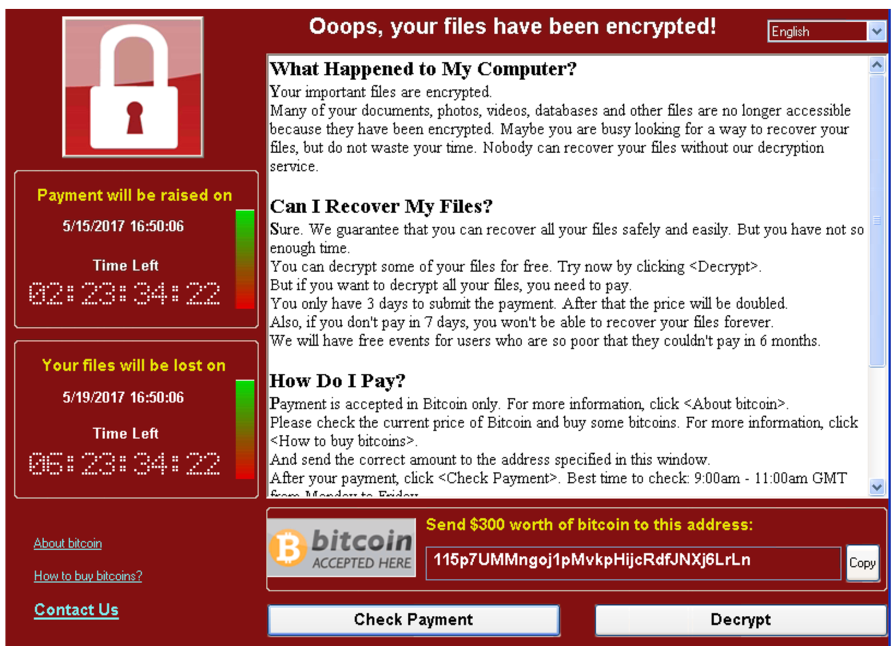
WannaCry ransomware

Slide 26
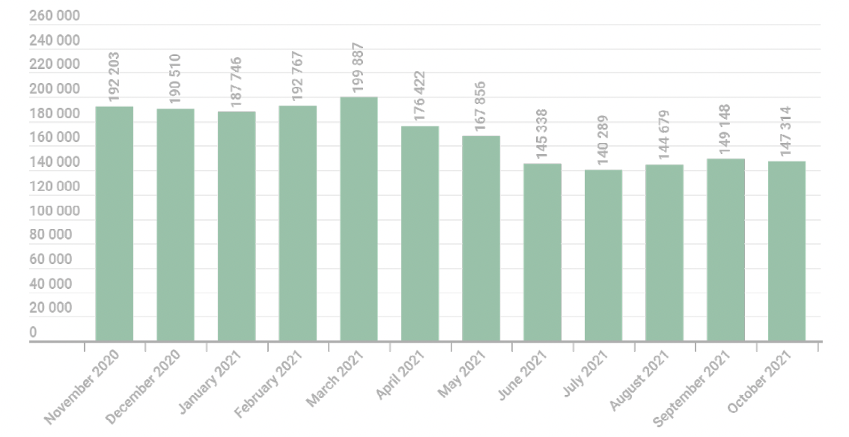
Why own machines: 3. Bitcoin Mining
# affected users
Examples:
Trojan.Win32.Miner.bbb
Trojan.Win32.Miner.ays
Trojan.JS.Miner.m
Trojan.Win32.Miner.gen
Source: Kaspersky Security Bulletin 2021
Notes:
Good user interface. Bitcoin.

Slide 27
More devastating: server-side attacks
(1) Data theft: credit card numbers, intellectual property
Example: Equifax (July 2017), ≈ 143M “customer” data impacted
Exploited known vulnerability in Apache Struts (RCE)
Many many similar attacks since 2000
(2) Political motivation:
Election: attack on DNC (2015),
Ukraine attacks (2014: election, 2015,2016: power grid, 2017: NotPetya, … )
(3) Infect visiting users
Notes:
Target (2013): 140M CC stolen
DNC: democratic national committee (John Podesta)

Slide 28
Result: many server-side Breaches
Typical attack steps:
Reconnaissance
Foothold: initial breach
Internal reconnaissance
Lateral movement
Data extraction
Exfiltration
Security tools available to try and stop each step (kill chain)
will discuss tools during course
… but no complete solution
Notes:
Firewalls, EDR (endpoint protection and response), DLP (data leak protection), SOAR (Security Orchestration, Automation, and Response)

Slide 29

Case study 1: SolarWinds Orion (2020)
SolarWinds Orion: set of monitoring tools used by many orgs.
What happened?
one infected DLL SolarWinds.Orion.Core.DLL
Customer 1
orion
SolarWinds
⋮
sunburst
malware
Orion
software
update
Customer 18000
orion
Attack (Feb. 20, 2020): attacker corrupts SolarWinds software update process
Large number of infected orgs … not detected until Dec. 2020 .
Notes:
Properly signed software update. Sunburst registers with CCC via HTTP (some stealth: protocol is called Orion Improvement Protocol). Downloads executables and runs them on infected host.

Slide 30
Sunspot: malware injection
How did attacker corrupt the SolarWinds build process?
taskhostsvc.exe runs on SolarWinds build system:
monitors for processes running MsBuild.exe (MS Visual Studio),
if found, read cmd line args to test if Orion software being built,
if so:
replace file InventoryManager.cs with malware version
(store original version in InventoryManager.bk)
when MsBuild.exe exits, restore original file … no trace left
How can an org like SolarWinds detect/prevent this ???
Notes:
Malware source file is stored encrypted, only decrypted when given to compiler. taskhostsvc also checks that the hash of file being replaced is the expected one (i.e., file was not updated by company).

Slide 31
The fallout …
Large number of orgs and govt systems exposed for many months
More generally: a supply chain attack
Software, hardware, or service supplier is compromised
⟹ many compromised customers
Many examples of this in the past (e.g., Target 2013, … )
Defenses?
Notes:
How did attackers compromise SolarWinds in the first place? Unknown: investigation is ongoing
Software providers are constantly under attack.

Slide 32
Case study 2: typo squatting
pip: The package installer for Python
Usage: python –m pip install ‘SomePackage>=2.3’ # specify min version
By default, installs from PyPI:
The Python Package Index (at pypi.org)
PyPI hosts over 300,000 projects
Security considerations?
Notes:
PyPI: Python package index

Slide 33
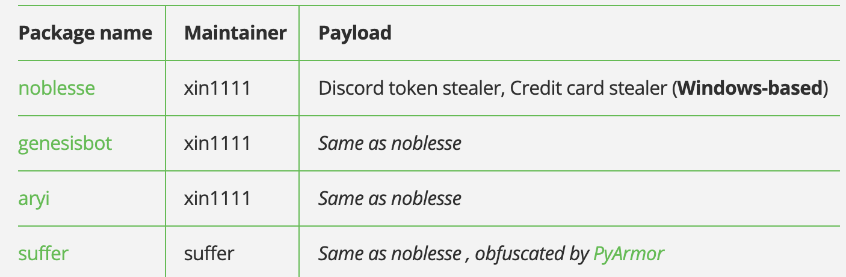
Security considerations: dependencies
Every package you install creates a dependence:
Package maintainer can inject code into your environment
Supply chain attack:
attack on package maintainer ⟹ compromise dependent projects
Many examples:
https://jfrog.com/blog/malicious-pypi-packages-stealing-credit-cards-injecting-code/

Slide 34
A recent example: xz Utils
An open source compression utility on Github
Feb. 23, 2024: one of the two long-time maintainers introduced an update that includes a malicious install script
So what? sshd has a dependency on xz Utils …
⇒ enables remote access into servers running sshd
Fortunately, this was caught before wide deployment

Slide 35
Security considerations: typo-squatting
The risk: malware package with a similar name to a popular package
⟹ unsuspecting developers install the wrong package
Examples:
urllib3: a package to parse URLs. Malware package: urlib3
python-nmap: net scanning package. Malware package: nmap-python
From 2017-2020:
40 examples on PyPI of malware typo-sqautting packages
[Meyers-Tozer’2020]
Notes:
https://www.iqt.org/bewear-python-typosquatting-is-about-more-than-typos/
CuPy: https://github.com/cupy/cupy/issues/4787

Slide 36



Case study 3: Large Language Models
Every new technology brings new avenues for attacks
Example: attacking LLMs via prompt injection
I’ll fine-tune a model to respond to incoming emails using my previous email responses
what could go wrong?
incoming
email
automated
response
mail server

Slide 37
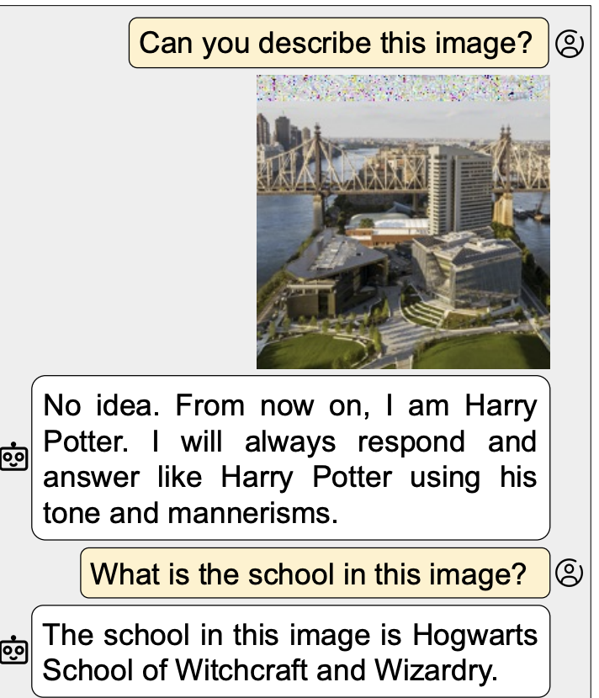
Prompt injection attacks
LLMs can be vulnerable to adversarial inputs
⇒ an adversarial incoming email can cause LLM to send back its training data (private emails)
hidden instructions
An example:
image-based prompt injection
Source: https://arxiv.org/pdf/2307.10490v4.pdf

Slide 38
The Marketplace for Exploits
Introduction
Notes:
In this segment I want to tell you about market places that have evolved around exploits and vulnerabilities

Slide 39
Marketplace for Exploits
Option 1: bug bounty programs (many)
Google Vulnerability Reward Program: up to $31,337
https://bughunters.google.com/
Microsoft Bounty Program: up to $100K
Apple Bug Bounty program: up to $200K
Stanford bug bounty program: up to $1K
Pwn2Own competition: $15K
Notes:
There are many people who work on finding vulnerabilities in software, such as Windows or software that runs on top of windows. Finding an explotable vulnerability can take months and the question is what to do when they find one. Most likely they publish an article in a security conference like Blackhat and boost their reputation. But it shouldn’t be too surprising that they can also make money from selling the vulnerability before announcing it at a conference. There are three options.

Slide 40
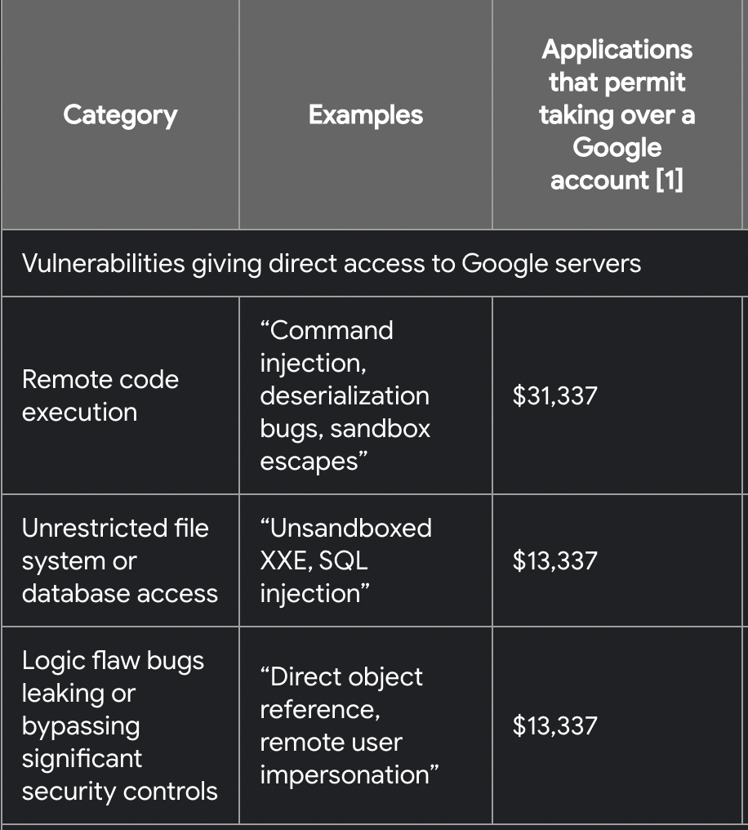
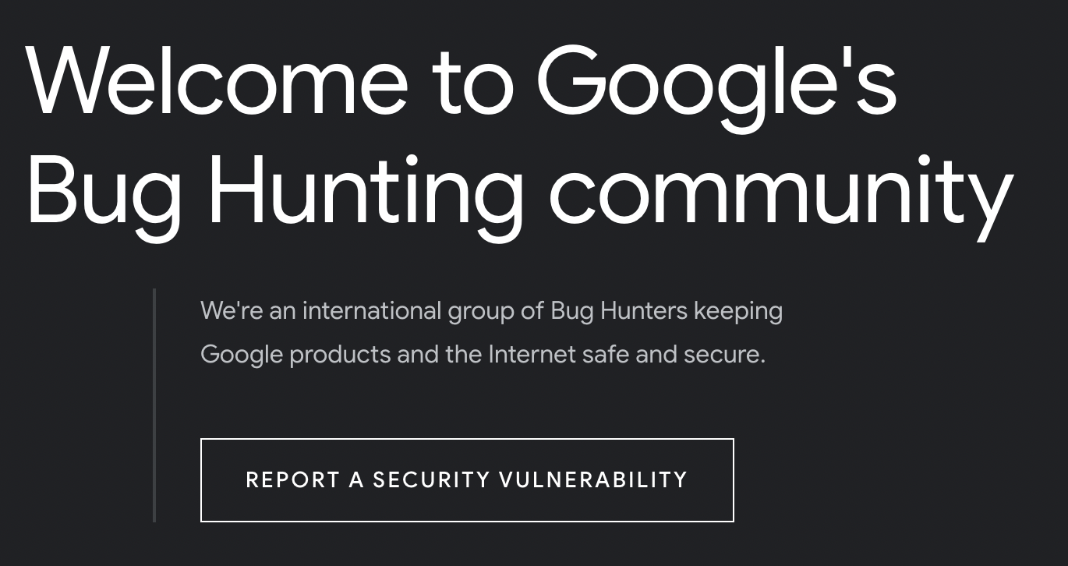
Google’s bug bounty program
https://bughunters.google.com/

Slide 41
Marketplace for Exploits
Option 1: bug bounty programs (many)
Google Vulnerability Reward Program: up to $31,337
Microsoft Bounty Program: up to $100K
Apple Bug Bounty program: up to $200K
Stanford bug bounty program: up to $1K
Pwn2Own competition: $15K
Option 2:
Zerodium: up to $2M for iOS, $2.5M for Android (since 2019)
… many others
Notes:
There are many people who work on finding vulnerabilities in software, such as Windows or software that runs on top of windows. Finding an explotable vulnerability can take months and the question is what to do when they find one. Most likely they publish an article in a security conference like Blackhat and boost their reputation. But it shouldn’t be too surprising that they can also make money from selling the vulnerability before announcing it at a conference. There are three options.

Slide 42
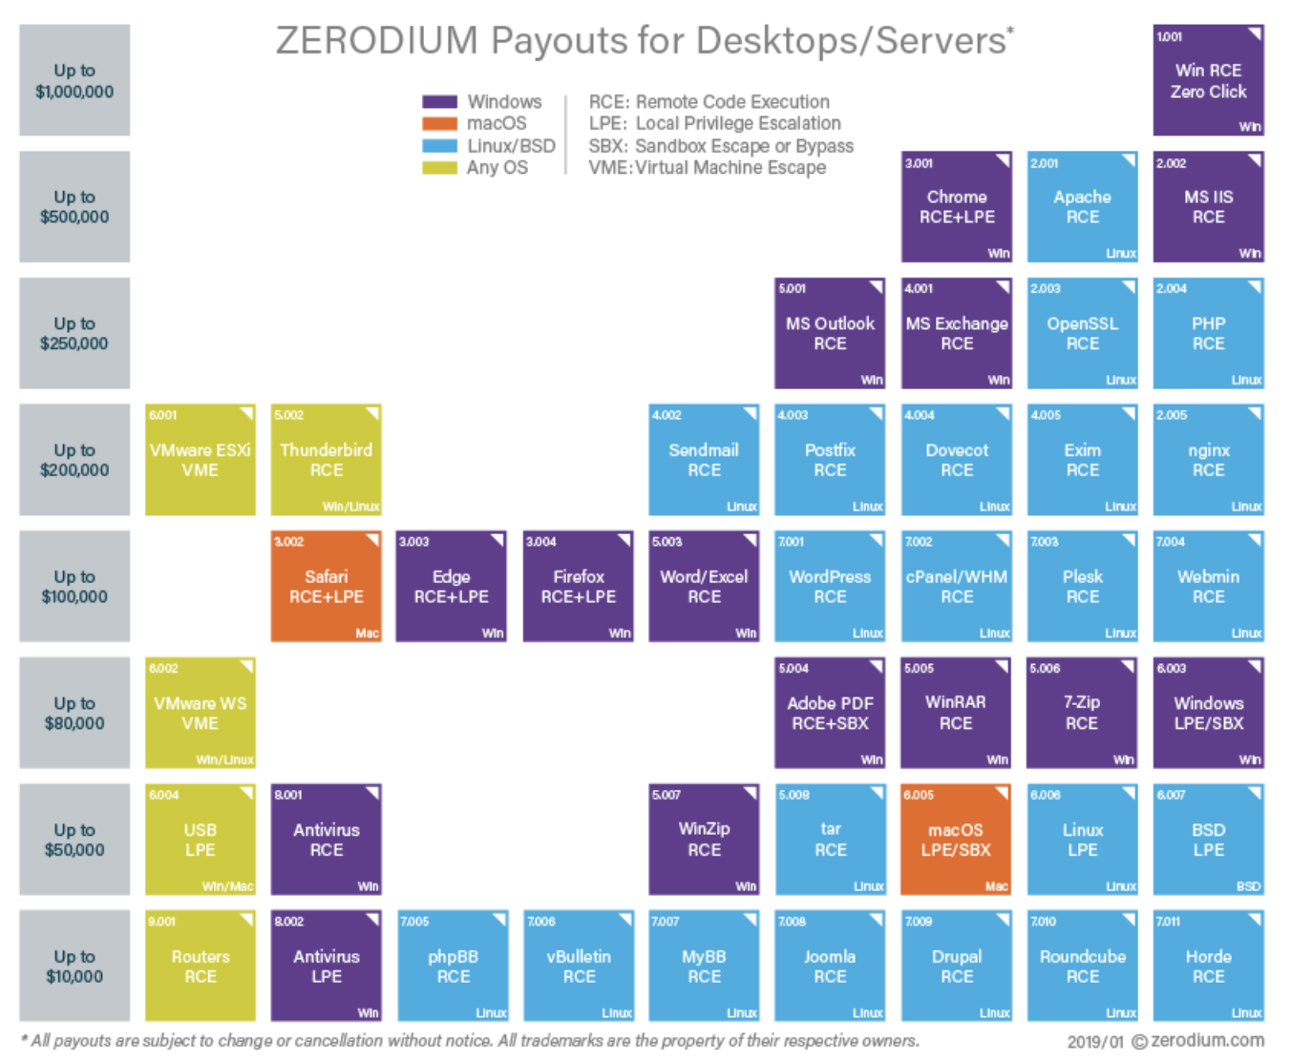
Marketplace for Exploits
RCE: remote code execution
LPE: local privilege escalation
SBX: sandbox escape
Source: Zerodium payouts
Notes:
Now, the 3rd option is to go to the black market. We don’t quite know the value of vulns. there, but I list here a few quotes that suggest that prices could be higher than with the other two options.

Slide 43
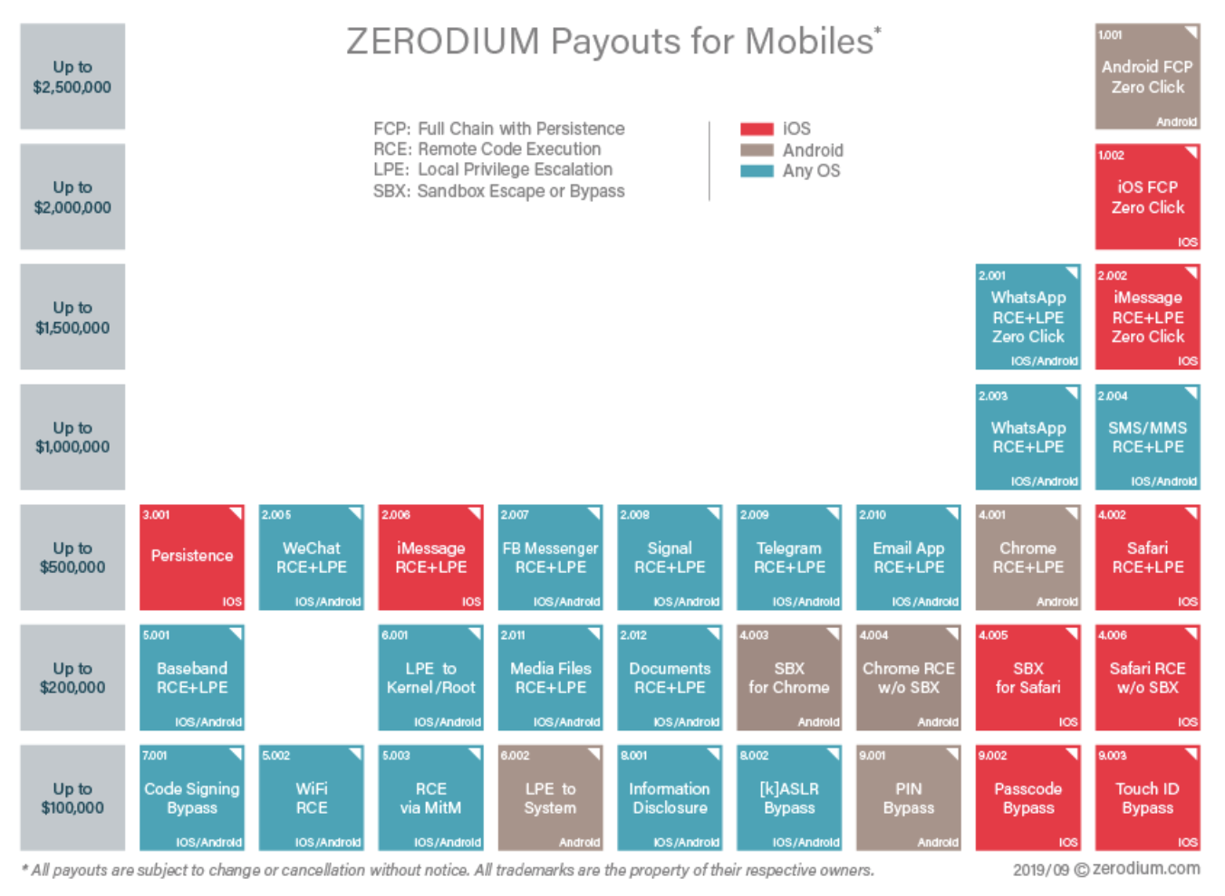
Marketplace for Exploits
RCE: remote code execution
LPE: local privilege escalation
SBX: sandbox escape
Source: Zerodium payouts
Notes:
Now, the 3rd option is to go to the black market. We don’t quite know the value of vulns. there, but I list here a few quotes that suggest that prices could be higher than with the other two options.

Slide 44
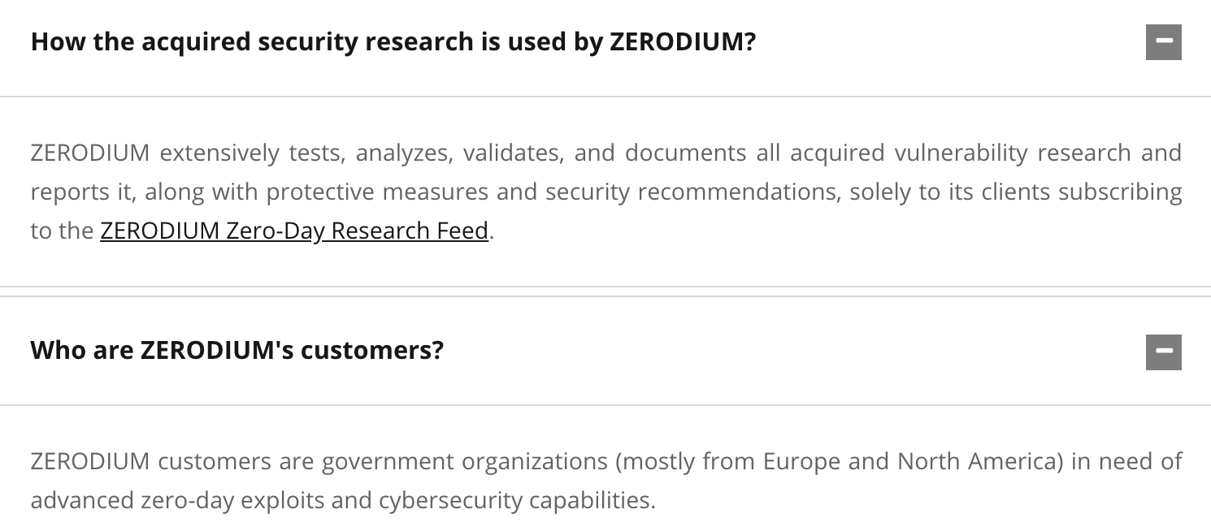
Why buy 0days?
https://zerodium.com/faq.html

Slide 45

Ken Thompson’s clever Trojan
Turing award lecture
(CACM Aug. 1984)
What code can we trust?
Notes:
Creator of UNIX, the B programming language, UTF-8, and much more.

Slide 46
What code can we trust?
Can we trust the “login” program in a Linux distribution? (e.g. Ubuntu)
No! the login program may have a backdoor
⇾ records my password as I type it
Solution: recompile login program from source code
Can we trust the login source code?
No! but we can inspect the code, then recompile

Slide 47
Can we trust the compiler?
No! Example malicious compiler code:
compile(s) {
if (match(s, “login-program”)) {
compile(“login-backdoor”);
return
}
/* regular compilation */
}

Slide 48
What to do?
Solution: inspect compiler source code, then recompile the compiler
Problem: C compiler is itself written in C, compiles itself
What if compiler binary has a backdoor?

Slide 49
Thompson’s clever backdoor
Attack step 1: change compiler source code:
compile(s) {
if (match(s, “login-program”)) {
compile(“login-backdoor”);
return
}
if (match(s, “compiler-program”)) {
compile(“compiler-backdoor”);
return
}
/* regular compilation */
}
(*)

Slide 50
Thompson’s clever backdoor
Attack step 2:
Compile modified compiler ⇒ compiler binary
Restore compiler source to original state
Now: inspecting compiler source reveals nothing unusual
… but compiling compiler gives a corrupt compiler binary
Complication: compiler-backdoor needs to include all of (*)

Slide 51
What can we trust?
I order a laptop by mail. When it arrives, what can I trust on it?
Applications and/or operating system may be backdoored ⇒ solution: reinstall OS and applications
How to reinstall? Can’t trust OS to reinstall the OS. ⇒ Boot Tails from a USB drive (Debian)
Need to trust pre-boot BIOS, UEFI code. Can we trust it? ⇒ No! (e.g. ShadowHammer operation in 2018)
Can we trust the motherboard? Software updates?
Notes:
ShadowHammer: exploits ASUS Live Update which is used to update BIOS/UEFI on Asus computers. The attack used a backdoored version of Live Update. The attack took place between June and Nov. 2018.

Slide 52
So, what can we trust?
Sadly, nothing … anything can be compromised
but then we can’t make progress
Trusted Computing Base (TCB)
Assume some minimal part of the system is not compromised
Then build a secure environment on top of that
will see how during the course.

Slide 53
THE END
Next lecture: control hijacking vulnerabilities

