Slide 1
Participation + Quiz (10% of grade)
Winning tips:
Actively join the discussion in-class and online. Write your name in the participation sheet after class. TA will collect the high-quality discussion in Ed Discussion in the end of class.
Submit your answer during the in-class quiz. (50% attendance + 50% correctness)

Slide 2
Tutorial Session
TA: Kaikai Zhang, (kzhangcq@cse.ust.hk), Wednesday 9:30-10:20am, Room 2302, academic building, lift 17-18
Self-paced Lab where TA will provide help to programming assignment and written assignment
3 mini-tutorials to bootstrap three programming assignments
No attendance required but strongly recommended if you need help with the hw

Slide 3

Basic Control Hijacking Attacks
Control Hijacking
Some slides are borrowed from Dan Boneh

Slide 4
Control hijacking attacks
Attacker’s goal:
  Take over target machine (e.g. web server)
    Execute arbitrary code on target by hijacking application control flow
Examples:
  Buffer overflow and integer overflow attacks
  Format string vulnerabilities
  Use after free

Slide 5
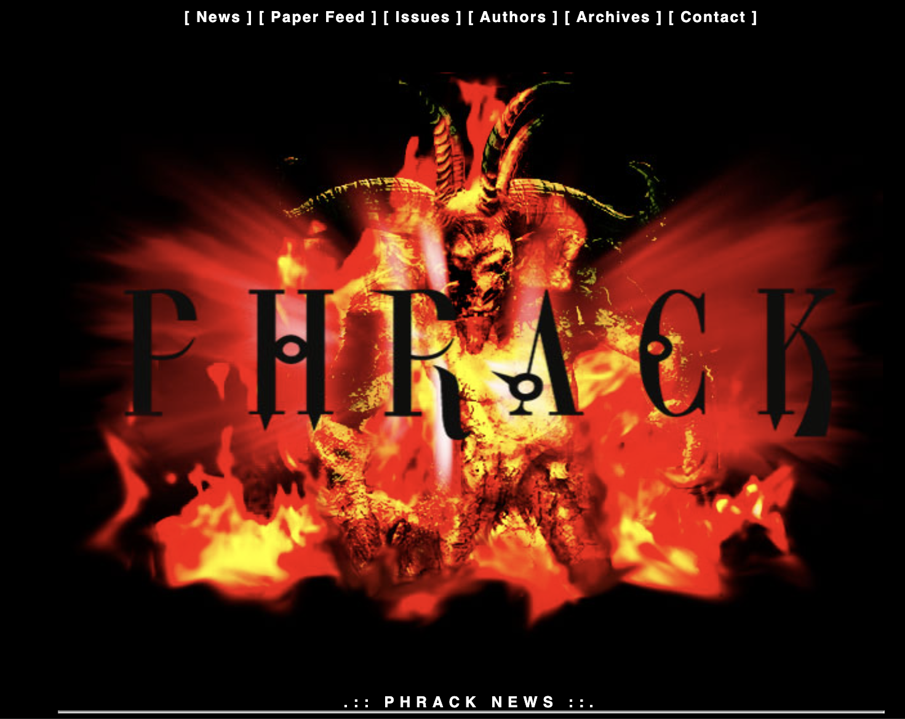
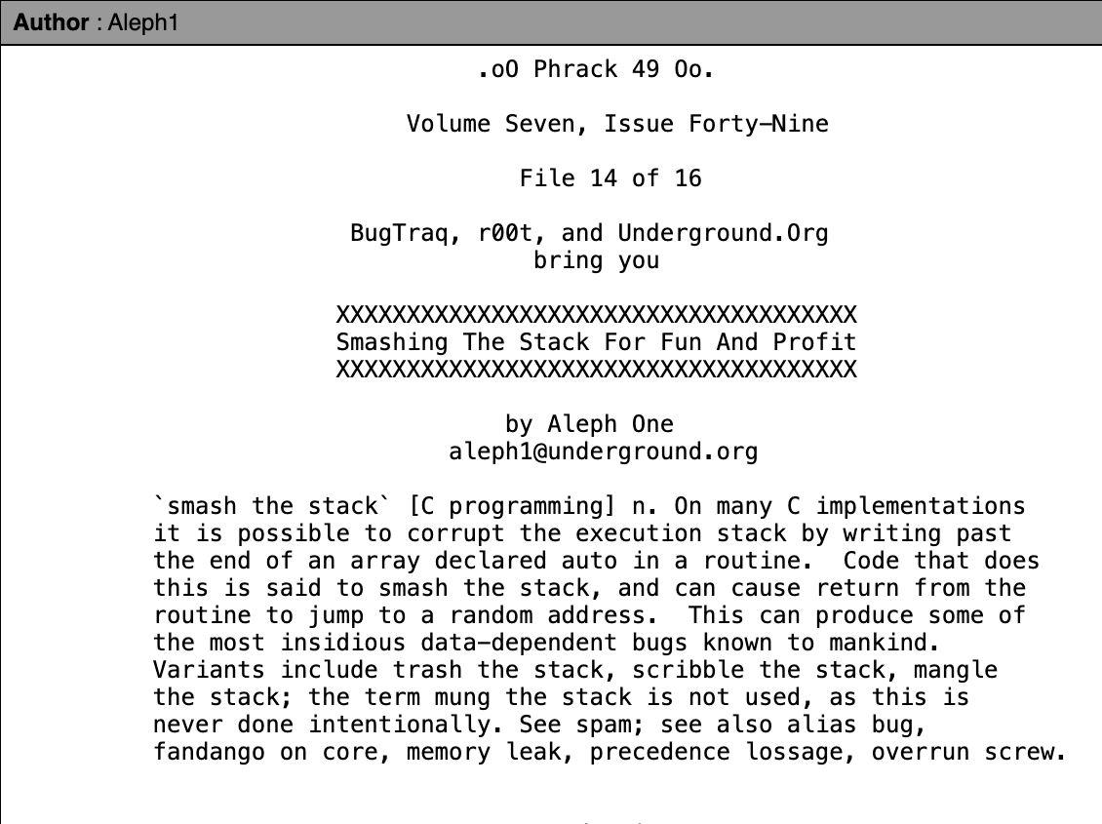
History of Buffer Overflow
Phrack : an online magazine by and for hackers since 1985

Slide 6
First example: buffer overflows
Extremely common bug in C/C++ programs.
First major exploit: 1988 Internet Worm. Fingerd.
Whenever possible avoid C/C++
Often cannot avoid C/C++ :
Need to understand
attacks and defenses
Feb. 2024: White House support for memory safety
Source: web.nvd.nist.gov

Slide 7
What is needed
Understanding C functions, the stack, and the heap.
Know how system calls are made
The exec() system call
Attacker needs to know which CPU and OS used on the target machine:
  Our examples are for x86-64 running Linux or Windows
  Details vary slightly between CPUs and OSs:
    Stack Frame structure (Unix vs. Windows, x86 vs. ARM)
    Little endian vs. big endian

Slide 8
Linux process memory layout (x86-64)
0x0000 7FFF FFFF FFFF
(128 TB)
user stack
%rsp
(stack pointer)
(esp in 32-bit mode)
shared libraries
0x0000 7F1F6 XXXX XXXX
run time heap
Loaded
from executable
text and data
0x0000 0000 0040 0040
unused
0
Notes:
Space above 0x0000 7FFF FFFF FFFF is non canonical until 0xFFFF 7FFF FFFF FFFF after which is OS.

Slide 9
Stack Frame
high
arguments
return address
rbp
stack base pointer
exception handlers
local variables
Stack
Growth
callee saved registers
rsp
low
(esp in 32-bit mode)
Notes:
rbp: base pointer register

Slide 10
What are buffer overflows?
Suppose a web server contains a function:
void func(char *str) {
char buf[128];
strcpy(buf, str);
do-something(buf);
}
After func() is called stack looks like:
argument: str
return address
stack base pointer
Quiz?
char buf[128]
rsp

Slide 11
What are buffer overflows?
What if *str is 144 bytes long?
After strcpy:
void func(char *str) {
char buf[128];
strcpy(buf, str);
do-something(buf);
}
argument: str
return address
stack base pointer
Poisoned return address!
Problem:
no bounds checking in strcpy()
*str
char buf[128]
rsp

Slide 12
Basic stack exploit
Stack
Program P
high
Suppose *str is such that
after strcpy stack looks like:
Program P: exec(“/bin/sh”)
When func() exits, the user gets shell !
Note: attack code P runs in stack.
(exact shell code by Aleph One)
return address
char buf[128]
low
Notes:
Aleph one: Elias Levy, moderator of Bugtraq and founder of SecurityFocus. Phrack 49, 1996.

Slide 13
The NOP slide
Stack
Program P
high
Problem: how does attacker
determine ret-address?
Solution: NOP slide
Guess approximate stack state
when func() is called
Insert many NOPs before program P:
nop (0x90) , xor eax,eax , inc ax
NOP Slide
return address
char buf[128]
low

Slide 14
Details and examples
Some complications:
  Program P should not contain the ‘\0’ character.
  Overflow should not crash program before func() exits.
(in)Famous remote stack smashing overflows:
  Overflow in Windows animated cursors (ANI). LoadAniIcon()
  Buffer overflow in Symantec virus detection (May 2016)
    overflow when parsing PE headers … kernel vuln.
Quiz?
Notes:
Animated cursor on web page or email message would result in arbitrary code execution. Used for rendering cursors, animated cursors, and icons.
Symantec: https://bugs.chromium.org/p/project-zero/issues/detail?id=820

Slide 15
Many unsafe libc functions
strcpy (char *dest, const char *src)
strcat (char *dest, const char *src)
gets (char *s)
scanf ( const char *format, … ) and many more.
“Safe” libc versions strncpy(), strncat() are misleading
  e.g. strncpy() may leave string unterminated.
Windows C run time (CRT):
  strcpy_s (*dest, DestSize, *src): ensures proper termination
Why?

Slide 16
Buffer overflow opportunities
Exception handlers: (… more on this in a bit)
  Overwrite the address of an exception handler in stack frame.
Function pointers: (e.g. PHP 4.0.2, MS MediaPlayer Bitmaps)
  Overflowing buf will override function pointer.
Longjmp buffers: longjmp(pos) (e.g. Perl 5.003)
  Overflowing buf next to pos overrides value of pos.
Heap
or
stack
buf[128]
FuncPtr
Notes:
Windows media player bitmaps (skins) – heap overflow, Feb. 2006
setjmp – used for exception handling (jump to global error handling code in case of error). Or for setting a checkpoint.

Slide 17
Heap exploits: corrupting virtual tables
Compiler generated function pointers (e.g. C++ code)
After overflow of buf :
method #1
FP1
vptr
FP2
method #2
FP3
method #3
data
vtable
Object T
NOP
slide
shell
code
buf[256]
vtable
vptr
data
object T

Slide 18
An example: exploiting the browser heap
Request web page
Web page with exploit
malicious web server
victim browser
Attacker’s goal is to infect browsers visiting the web site
How: send javascript to browser that exploits a heap overflow

Slide 19
A reliable exploit?
<SCRIPT language="text/javascript">
shellcode = unescape("%u4343%u4343%..."); // allocate in heap
overflow-string = unescape(“%u2332%u4276%...”);
cause-overflow(overflow-string ); // overflow buf[ ]
</SCRIPT>
Problem: attacker does not know where browser
places shellcode on the heap
???
buf[256]
vtable
ptr
data
shellcode

Slide 20
Heap Spraying [SkyLined]
Idea: 1. use Javascript to spray heap
with shellcode (and NOP slides)
2. then point vtable ptr anywhere in spray area
NOP slide
shellcode
heap
vtable
heap spray area

Slide 21
Javascript heap spraying
var nop = unescape(“%u9090%u9090”)
while (nop.length < 0x100000) nop += nop;
var shellcode = unescape("%u4343%u4343%...");
var x = new Array ()
for (i=0; i<1000; i++) {
x[i] = nop + shellcode;
}
Pointing function-ptr almost anywhere in heap will
cause shellcode to execute.

Slide 22

Ad-hoc heap overflow mitigations
Why?
Better browser architecture:
  Store JavaScript strings in a separate heap from browser heap
OpenBSD and Windows 8 heap overflow protection:
  In theory: allocate every object on a separate page (eFence, Archipelago’08)
  ⟹ not practical: too wasteful in physical memory
prevents
cross-page
overflows
guard pages (non-writable pages in virtual memory)
Notes:
eFence: electric fence, Linux debugging tool. Also works against use after free by marking deallocated memory as not writable. Not as good as Valgrind, but simpler.

Slide 23
Finding overflows by fuzzing
To find overflow:
  Run web server on local machine
  Use AFL to issue malformed requests (ending with “$$$$$” )
    Fuzzers: automated tools for this (next week)
  If web server crashes,
  search core dump for “$$$$$” to find overflow location
Construct exploit (not easy given latest defenses in next lecture)
Notes:
AFL: American Fuzzy Lop

Slide 24
More Control Hijacking Attacks
Control Hijacking

Slide 25
More Hijacking Opportunities
Integer overflows: (e.g. MS DirectX MIDI Lib)
Double free: double free space on heap
  Can cause memory mgr to write data to specific location
  Examples: CVS server
Use after free: using memory after it is freed
Format string vulnerabilities

Slide 26
Integer Overflows (see Phrack 60)
Problem: what happens when int exceeds max value?
int m; (32 bits) short s; (16 bits) char c; (8 bits)
c = 0x80 + 0x80 = 128 + 128 ⇒ c = 0
s = 0xff80 + 0x80 ⇒ s = 0
m = 0xffffff80 + 0x80 ⇒ m = 0
Can this be exploited?

Slide 27
An example
void func( char *buf1, *buf2, unsigned int len1, len2) {
char temp[256];
if (len1 + len2 > 256) {return -1} // length check
memcpy(temp, buf1, len1); // cat buffers
memcpy(temp+len1, buf2, len2);
do-something(temp); // do stuff
}
What if len1 = 0x80, len2 = 0xffffff80 ?
⇒ len1+len2 = 0
Second memcpy() will overflow heap !!
Notes:
Correct check should also check size of len1 and len2.

Slide 28
An example: a better length check
void func( char *buf1, *buf2, unsigned int len1, len2) {
char temp[256];
// length check
if (len1 > 256) || (len2 > 256) || (len1+ len2 > 256)
return -1;
memcpy(temp, buf1, len1); // cat buffers
memcpy(temp+len1, buf2, len2);
do-something(temp); // do stuff
}
Notes:
Correct check should also check size of len1 and len2.

Slide 29
Integer overflow exploit stats
Dec. 2020: integer underflow in F5 Big IP
if (8190 − nlen <= vlen ) // length check
return -1;
Source: NVD/CVE
Notes:
nlen: current length of data in buffer. vlen: length of data to add to buffer. Problem: nlen can be 8192. (allocated buffer size is 8192)

Slide 30
Format string bugs

Slide 31
Format string problem
int func(char *user) {
fprintf(stderr, user);
}
Problem: what if *user = “%s%s%s%s%s%s%s” ??
  Most likely program will crash: DoS.
  If not, program will print memory contents. Privacy?
  Full exploit using user = “%n”
Correct form: fprintf( stdout, “%s”, user);

Slide 32
Vulnerable functions
Any function using a format string.
Printing:
printf, fprintf, sprintf, …
vprintf, vfprintf, vsprintf, …
Logging:
syslog, err, warn

Slide 33
Exploit
Dumping arbitrary memory:
  Walk up stack until desired pointer is found.
  printf( “%08x.%08x.%08x.%08x|%s|”)
Writing to memory:
  printf( “hello %n”, &temp) -- writes ‘6’ into temp.
  printf( “%08x.%08x.%08x.%08x.%n”) -- difficult to exploit

Slide 34
Use after free exploits

Slide 35
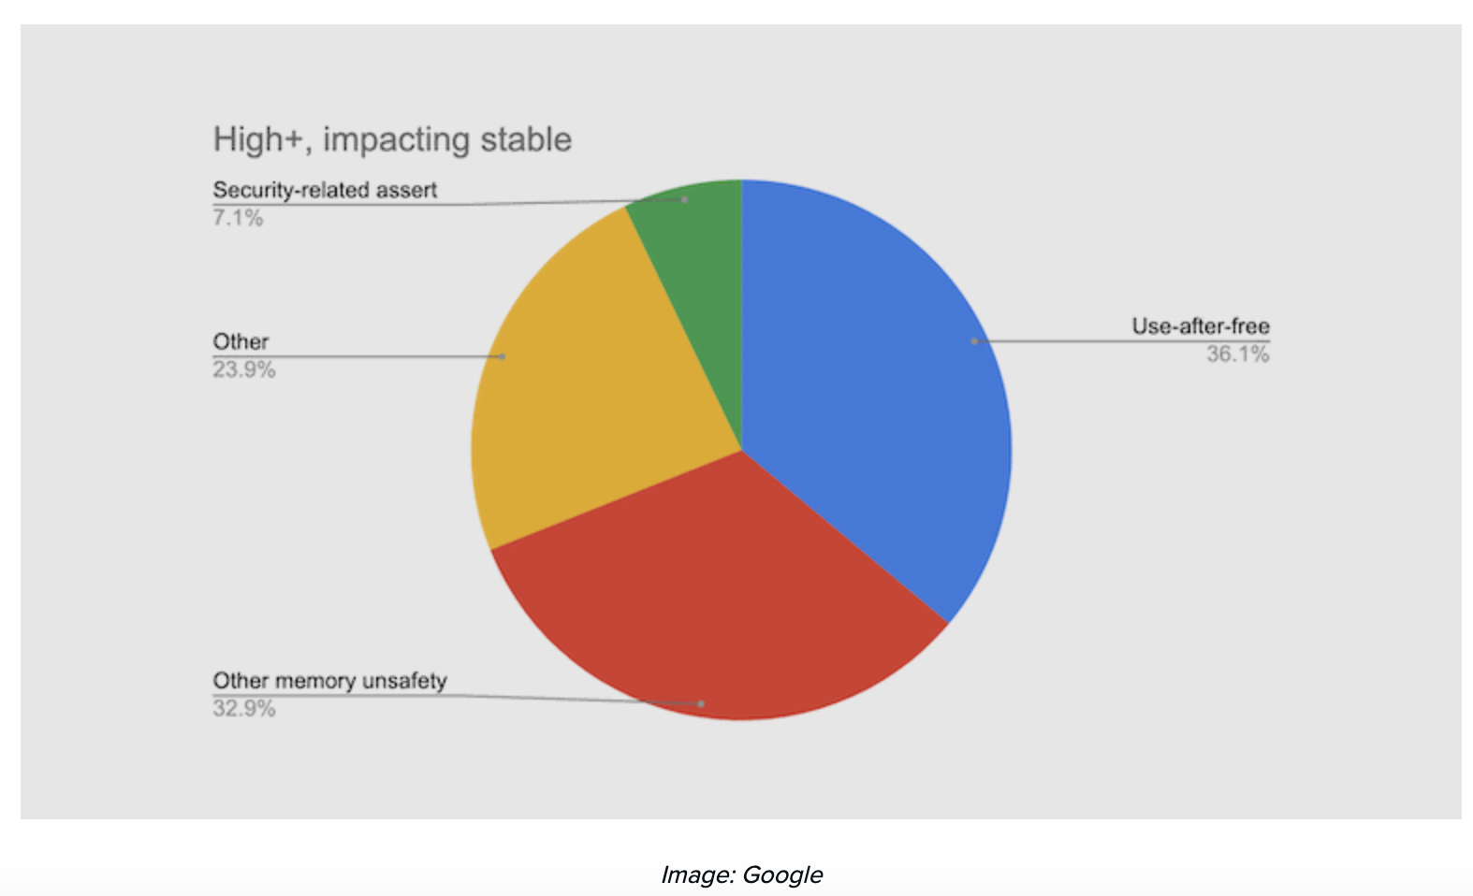
High impact security vulns. in Chrome 2015 – 2020 (C++)
70% due to memory management bugs

Slide 36
IE11 Example: CVE-2014-0282 (simplified)
(IE11 written in C++)
<form id="form">
<textarea id="c1" name="a1" ></textarea>
<input id="c2" type="text" name="a2” value="val">
</form>
<script>
function changer() {
document.getElementById("form").innerHTML = "";
CollectGarbage(); // erase c1 and c2 fields
}
document.getElementById("c1").onpropertychange = changer;
document.getElementById("form").reset();
</script>
Loop on form elements:
c1.DoReset()
c2.DoReset()
Notes:
c1.doReset() causes changer() to be called and free object c2.

Slide 37
What just happened?
c1.doReset() causes changer() to be called and free object c2
object c2
doSomething
FP1
vptr
FP2
doReset
FP3
doSomethingElse
data
vtable

Slide 38
What just happened?
c1.doReset() causes changer() to be called and free object c2
object c2
FP1
vptr
FP2
ShellCode
FP3
data
vtable
Use after free !
Suppose attacker allocates a string of same size as vtable
When c2.DoReset() is called, attacker gets shell

Slide 39
The exploit
<script>
function changer() {
document.getElementById(”form").innerHTML = "";
CollectGarbage();
--- allocate string object to occupy vtable location ---
}
document.getElementById("c1").onpropertychange = changer;
document.getElementById("form").reset();
</script>
Lesson: use after free can be a serious security vulnerability !!

Slide 40
Next lecture …
DEFENSES
Notes:
Defense against use after free from Usenix Security 2021: https://www.usenix.org/conference/usenixsecurity21/presentation/wickman

Slide 41
THE END

Slide 42
References on heap spraying
[1] Heap Feng Shui in Javascript,
by A. Sotirov, Blackhat Europe 2007
[2] Engineering Heap Overflow Exploits with JavaScript
M. Daniel, J. Honoroff, and C. Miller, WooT 2008
[3] Interpreter Exploitation: Pointer inference and JiT spraying,
by Dion Blazakis

