Slide 1

Control Hijacking: Defenses
Control Hijacking
Some slides are borrowed from Dan Boneh

Slide 2
Recap: control hijacking attacks
Stack smashing: overwrite return address or function pointer
Heap spraying: reliably exploit a heap overflow
Use after free: attacker writes to freed control structure, which then gets used by victim program
Integer overflows
Format string vulnerabilities
⋮

Slide 3
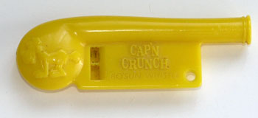
The mistake: mixing data and control
An ancient design flaw:
enables anyone to inject control signals
1971: AT&T learns never to mix control and data

Slide 4
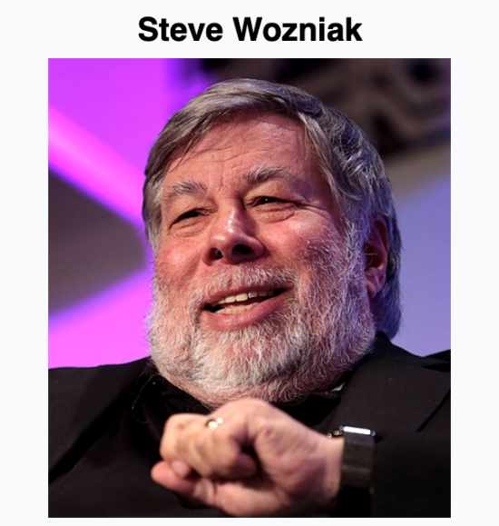
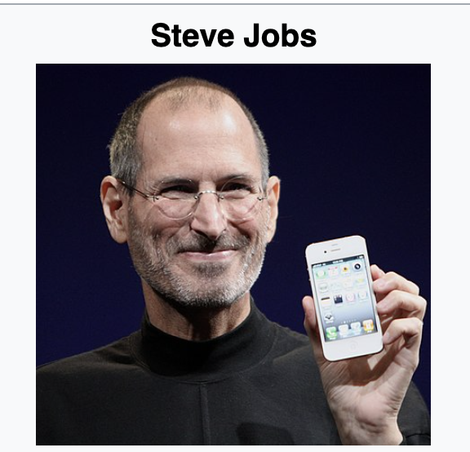
Fun Story of Blue Box
What did these folks do back in the 1970s before they started apple?
Founders of Apple
Build and sell the Blue Box (an illegal phone hacking toolset)

Slide 5
Who are the phone phreaks?
People who study, explore, and experiment with telecommunications equipment.
Listen to patterns and tones on telephone lines and attempt to decipher them
Read obscure technical journals about the inner workings of the telephone system
Impersonate operators or other telco employees
Build devices to make the telephone network act in ways not intended by the designers
For the most part, primarily interested in knowledge, but sometimes ended up in legal trouble…

Slide 6





The Phone Network
In reality, you are not directly connected to your conversation partner.
1
OK!
5
2
Telephone Office
6
3
7
4
8
Please connect me to 5!

Slide 7
The Phone Network
In reality, you are not directly connected to your conversation partner.
1
5
2
Telephone Office
6
3
7
4
8
The telephone office makes connections based on how you dial the keypad (telephone signaling).

Slide 8
Multi-Frequency Signaling
Idea: have phones communicate with the network using tones (i.e., different frequency), over the same wires!
The phones “sing” to the receivers inside the telephone office, which direct the call accordingly.
Your cell phone still makes these tones!
Internally, the phone network also uses tones to communicate (but over different frequencies)
In-Band Signaling: happens over the same connection as your voice.

Slide 9
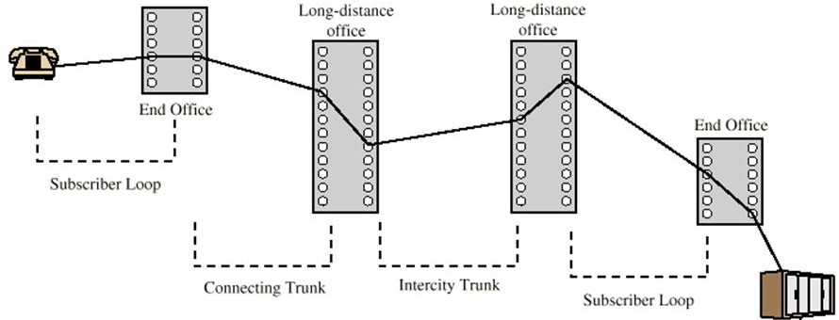


Long Distance Connections
Seattle
New York
Long distance calls travel through multiple offices that need to find unused lines through which connections can be made.

Slide 10
Long Distance Connections
How can the offices figure out whether a long- distance telephone line is free?
Play a tone over unused lines (typically 2600 Hz).
When you dial a long-distance number…
Your local office looks for an unused long-distance line (i.e., one with a 2600 Hz tone).
It then plays the tones for the phone number you want to call over the line so that receiving office knows where to connect you.
The receiving office finishes the connection.

Slide 11
Long Di$tance Connection$
Long distance calls were expensive.
Your local telephone office kept track of how much you use the long-distance telephone lines and charged you accordingly.
How might you trick this system into making these calls for free?
Hint: think about toll-free numbers.

Slide 12
How To Make Free Calls
Call a toll-free (1-800) number that connects you somewhere outside of your local telephone office. (Request a free line)
Play a 2600 Hz tone over the phone line, causing the receiving office to think that you’ve hung up. (Take over the free line)
Somehow play the tones for the number you actually want to call, and the receiving office will connect you (but the local office will still think your call is toll-free!)
(Send out control signal over phone)

Slide 13
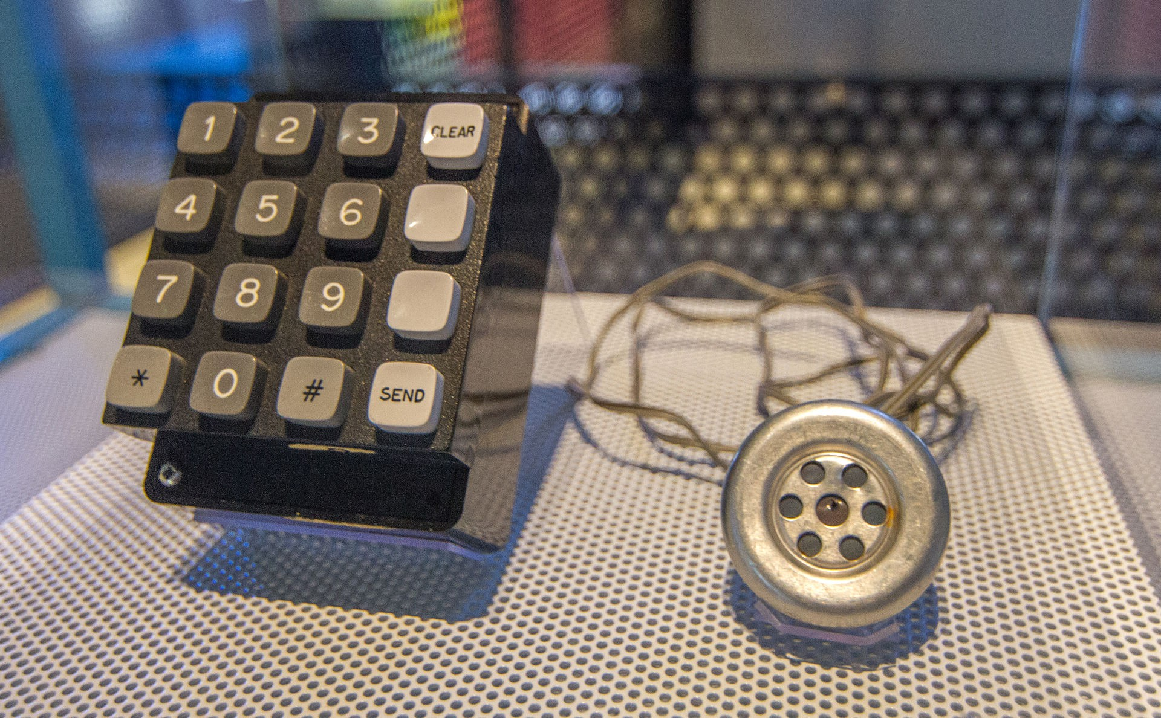
The Blue Box
A device that could generate the tones used internally by the telephone network to connect long-distance lines.
The Blue Box made by Woz and sold by Steve
Computer History Museum
Mountain View, CA
Also the first product that Steve Jobs and Steve Wozniak ever sold together.

Slide 14
How did they figure this out?
Lots and lots of experimentation, reading found technical manuals, and some good luck.
Calling random phone numbers and trying to decipher the “beeps and boops” that went on inside the network as the call travelled through it.
Playing certain tones into the handset microphone and seeing what happened.
Intentionally trying to route calls through obscure offices to learn about different switching equipment.
Later: using early computers to automatically call lots of phone numbers, play tones, and see what happened.

Slide 15
Phone Phreaking & Hacker Culture
Phone phreaking was closely intertwined with the hacker culture of the later 20th century.
Many of the important figures were in Silicon Valley around the time that computers and computer kits were becoming accessible.
Used their skills with building & experimenting around electronics.
Did phone phreaking indirectly lead to the creation of Apple? Maybe…

Slide 16
Control hijacking attacks
The problem: mixing data with control flow in memory
local variables
SFP
ret
addr
arguments
stack frame
data overwrites
return address
Later we will see that mixing data and code is also the reason for XSS (web security) and prompt injection(LLM security)

Slide 17
Preventing hijacking attacks
Fix bugs:
Audit software
Automated tools: Coverity, Infer, … (more on this next week)
Rewrite software in a type safe languange (Java, Go, Rust)
Difficult for existing (legacy) code …
Platform defenses: prevent attack code execution
Harden executable to detect control hijacking
Halt process and report when exploit detected
StackGuard, ShadowStack, Memory tagging (ASan, MTE), …
Transform:
Complete Breach
Why
Denial of service

Slide 18
Platform Defenses
Control Hijacking

Slide 19
Marking memory as non-execute (DEP)
Prevent attack code execution by marking stack and heap as non-executable
NX-bit on AMD64, XD-bit on Intel x86 (2005), XN-bit on ARM
disable execution: an attribute bit in every Page Table Entry (PTE)
Deployment:
All major operating systems
Windows DEP: since XP SP2 (2004) (Visual Studio: /NXCompat[:NO])
Limitations:
Some apps need executable heap (e.g., JITs in web browser).
Can be easily bypassed using Return Oriented Programming (ROP)
Notes:
/NXCOMPAT: tells linker that app is compatible with DEP. :NO indicates don’t use DEP.
DEP: data execute prevention
NX: no execute, XD: execute disabled, XN: execute never

Slide 20
Attack: Return Oriented Programming (ROP)
Control hijacking without injecting code:
Quiz
stack
libc.so
args
ret-addr
exec()
sfp
printf()
local buf
“/bin/sh”
Notes:
NX wasted effort?

Slide 21
ROP: in more detail
To run /bin/sh we must direct stdin and stdout to the socket:
dup2(s, 0) // map stdin to socket
dup2(s, 1) // map stdout to socket
execve("/bin/sh", 0, 0);
Quiz
execve("/bin/sh")
dup2(s, 0)
ret
dup2(s, 1)
ret
Gadgets in victim code:
Stack (set by attacker):
overflow-str 0x408400 0x408500 0x408300
ret-addr
Stack pointer moves up on pop

Slide 22
Attack: Return Oriented Programming (ROP)
Control hijacking without injecting code:
stack
libc.so
args
ret-addr
exec()
sfp
printf()
local buf
“/bin/sh”
Notes:
NX wasted effort?

Slide 23
ROP: in more detail
To run /bin/sh we must direct stdin and stdout to the socket:
dup2(s, 0) // map stdin to socket
dup2(s, 1) // map stdout to socket
execve("/bin/sh", 0, 0);
execve("/bin/sh")
dup2(s, 0)
ret
dup2(s, 1)
ret
Gadgets in victim code:
Stack (set by attacker):
overflow-str 0x408400 0x408500 0x408300
ret-addr
Stack pointer moves up on pop

Slide 24
ROP: in even more detail
execve("/bin/sh", 0, 0): implemented using gadgets in victim code:
0x408100
0x408200
0x408300
0x408400
5f
pop rdi
ret
5e
pop rsi
pop rdx
ret
58
pop rax
ret
syscall
ret
c3
5a
c3
c3
Stack (set by attacker):
overflow-str 0x408100 0x6F2500 0x408200 0 0 0x408300 59 0x408400
new ret-addr
(rdi ⟵ address of “/bin/sh”)
(rsi ⟵ 0) (rdx ⟵ 0)
(rax ⟵ 59)
syscall #59

Slide 25
What to do?? Randomization
ASLR: (Address Space Layout Randomization)
On load: randomly shift base of code & data in process memory
⇒ Attacker does not know location of code gadgets
Deployment: (/DynamicBase)
Since Windows 8: 24 bits of randomness on 64-bit processors
Base of everything must be randomized on load:
libraries (DLLs, shared libs), application code, stack, heap
Other randomization ideas (not used in practice):
Sys-call randomization: randomize sys-call id’s
Instruction Set Randomization (ISR)
Notes:
Combination of NX and ASLR is effective.
/DynamicBase: Visual Studio flag to indicate that application works with ASLR.

Slide 26
A very different idea: kBouncer
kernel
pop rdi
ret
pop rsi
pop rdx
ret
pop rax
ret
syscall
ret
kBouncer
Observation: abnormal execution sequence
ret returns to an address that does not follow a call
Idea: before a syscall, check that every prior ret is not abnormal
How: use Intel’s Last Branch Recording (LBR)
Why

Slide 27
A very different idea: kBouncer
kernel
pop rdi
ret
pop rsi
pop rdx
ret
pop rax
ret
syscall
ret
kBouncer
Inte’s Last Branch Recording (LBR):
store 16 last executed branches in a set of on-chip registers (MSR)
read using rdmsr instruction from privileged mode
kBouncer: before entering kernel, verify that last 16 rets are normal
Requires no app. code changes, and minimal overhead
Limitations: attacker can ensure 16 calls prior to syscall are valid

Slide 28
Hardening the executable
Control Hijacking Defenses

Slide 29
Run time checking: StackGuard
Many run-time checking techniques …
we only discuss methods relevant to overflow protection
Method 1: StackGuard
Run time tests for stack integrity.
Embed “canaries” in stack frames and verify their integrity prior to function return.
What is integrity?
Frame 2
Frame 1
top of stack
local
canary
sfp
ret
str
local
canary
sfp
ret
str

Slide 30
Canary Types
Random canary:
Random string chosen at program startup
Insert canary string into every stack frame
Verify canary before returning from function
Exit program if canary changed. Turns potential exploit into DoS.
To corrupt, attacker must learn/guess current random string
Terminator canary: Canary = {0, newline, linefeed, EOF}
String functions will not copy beyond terminator
Attacker cannot use string functions to corrupt stack.
How to bypass it?

Slide 31
StackGuard (Cont.)
StackGuard implemented as a GCC patch
Program must be recompiled
Minimal performance effects: 8% for Apache

Slide 32
StackGuard enhancement: ProPolice
ProPolice - since gcc 3.4.1. (-fstack-protector)
Rearrange stack layout to prevent ptr overflow.
String Growth
args
ret addr
Protects pointer args and local pointers from a buffer overflow
SFP
CANARY
Stack Growth
local string buffers
local non-buffer variables
pointers, but no arrays
copy of pointer args
Notes:
/ProPolice: replicates pointers in arguments to bottom of local vars area.
ProPolicy: also called SSP – stack smashing protection.
/GS: Arguments, return address, cookie, arrays, local variables, copies of some pointer arguments, alloca

Slide 33
MS Visual Studio /GS (BufferSecurityCheck)
Compiler /GS option:
Combination of ProPolice and Random canary.
If cookie mismatch, default behavior is to call _exit(3)
Function prolog:
sub esp, 4 // allocate 4 bytes for cookie
mov eax, DWORD PTR ___security_cookie
xor eax, esp // xor cookie with current esp
mov DWORD PTR [esp+4], eax // save in stack
Function epilog:
mov ecx, DWORD PTR [esp+4]
xor ecx, esp
call @__security_check_cookie@4
add esp, 4
Protects all stack frames, unless can be proven unnecessary
Notes:
DWORD PTR: the value pointed to is 32 bits (on both x86 and x64).
The reason for the “xor eax, esp” is so that the canary is different for different stack frames. A leak of the canary will not fully reveal the secret cookie (weak defense).

Slide 34
/GS stack frame
args
String Growth
ret addr
Canary protects ret-addr and exception handler frame
SFP
exception handlers
CANARY
Stack Growth
local string buffers
local non-buffer variables
pointers, but no arrays
copy of pointer args
Notes:
/GS: Arguments, return address, cookie, arrays, local variables, copies of some pointer arguments, alloca

Slide 35
Evading /GS with exception handlers
When exception is thrown, dispatcher walks up exception list until handler is found (else use default handler)
After overflow: handler points to attacker’s code
exception triggered ⇒ control hijack
Main point: exception is triggered before canary is checked
0xffffffff
SEH frame
SEH frame
high
mem
next
handler
buf
next
next
ptr to attack code
handler
next
handler
Notes:
SEH: structured exception handler

Slide 36
Defenses: SAFESEH and SEHOP
/SAFESEH: linker flag
Linker produces a binary with a table of safe exception handlers
System will not jump to exception handler not on list
/SEHOP: platform defense (since win vista SP1)
Observation: SEH attacks typically corrupt the “next” entry in SEH list.
SEHOP: add a dummy record at top of SEH list
When exception occurs, dispatcher walks up list and verifies dummy record is there. If not, terminates process.
Notes:
SAFESEH: safe structured exception handling
SEHOP: structured exception handling overwrite protection. Enabled with a regkey DisableExceptionChainValidation.

Slide 37
Summary: Canaries are not full proof
Canaries are an important defense tool, but do not prevent all control hijacking attacks:
Some stack smashing attacks leave canaries unchanged
Heap-based attacks still possible
Integer overflow attacks still possible
How?

Slide 38
Even worse: canary extraction
A common design for crash recovery:
When process crashes, restart automatically (for availability)
Often canary is unchanged (reason: relaunch using fork)
Danger:
canary extraction byte by byte
Why?
⋯
local buffer
A
C A N A R Y
ret addr
crash
⋯
B
C A N A R Y
ret addr
local
buffer
crash
⋯
C
C A N A R Y
ret addr
local buffer
No crash
⋯
local buffer
C A
C A N A R Y
ret addr
No crash

Slide 39
Similarly: extract ASLR randomness
A common design for crash recovery:
When process crashes, restart automatically (for availability)
Often canary is unchanged (reason: relaunch using fork)
Danger:
Extract ret-addr to de-randomize app. code ASLR
⋯
local buffer
A
C A N A R Y
ret addr
crash
⋯
B
C A N A R Y
ret addr
local
buffer
crash
⋯
C
C A N A R Y
ret addr
local buffer
No crash
⋯
local buffer
C A
C A N A R Y
ret addr
No crash

Slide 40
What if can’t recompile: Libsafe
Solution 2: Libsafe (Avaya Labs)
Dynamically loaded library (no need to recompile app.)
Intercepts calls to strcpy (dest, src)
Validates sufficient space in current stack frame: |frame-pointer – dest| > strlen(src)
If so, does strcpy. Otherwise, terminates application
top of stack
sfp
ret-addr
dest
src
buf
sfp
ret-addr
Libsafe strcpy
main

Slide 41
How robust is Libsafe?
low memory
sfp
ret-addr
dest
src
buf
sfp
ret-addr
high memory
Libsafe strcpy
main
strcpy() can overwrite a pointer between buf and sfp.

Slide 42
More methods: Shadow Stack
Shadow Stack: keep a copy of the stack in memory
On call: push ret-address to shadow stack on call
On ret: check that top of shadow stack is equal to ret-address on stack. Crash if not.
Security: memory corruption should not corrupt shadow stack
Shadow stack using Intel CET: (supported in Windows 10, 2020)
New register SSP: shadow stack pointer
Shadow stack pages marked by a new “shadow stack” attribute: only “call” and “ret” can read/write these pages
Notes:
CET: Control-flow Enforcement. Deployed in Intel TigerLake (2020)

Slide 43
ARM Memory Tagging Extension (MTE)
Idea: (1) every 64-bit memory pointer P has a 4-bit “tag” (in top byte)
(2) every 16-byte user memory region R has a 4-bit “tag”
Processor ensures that: if P is used to r/w R then tags are equal
otherwise: hardware exception
Tags are created using new HW instructions:
LDG, STG: load and store tag to a memory region (used by malloc and free)
ADDG, SUBG: pointer arithmetic on an address preserving tags
Notes:
LDG, STG: load and store tag to a memory region
ADDG, SUBG: pointer arithmetic

Slide 44
Tags prevent buffer overflows and use after free
tags (4 bits):
8
E
E
E
Example:
B
B
B
7
7
5
5
p
p+48
16 bytes
(1) char *p = new char(40); // p = 0x B000 6FFF FFF5 1240 (*p tagged as B)
(2) p[50] = ’a’; // B≠7 ⟹ tag mismatch exception (buffer overflow)
(3) delete [] p; // memory is re-tagged from B to E
(4) p[7] = ‘a’; // B≠E ⟹ tag mismatch exception (use after free)
Note: out of bounds access to p[44] at (2) will not be caught.
Notes:
Another problem: in C++, Inter-object overflow will not be detected.
AddressSanitizer does something similar in a software only solution ⟹ 2x slow down.

Slide 45
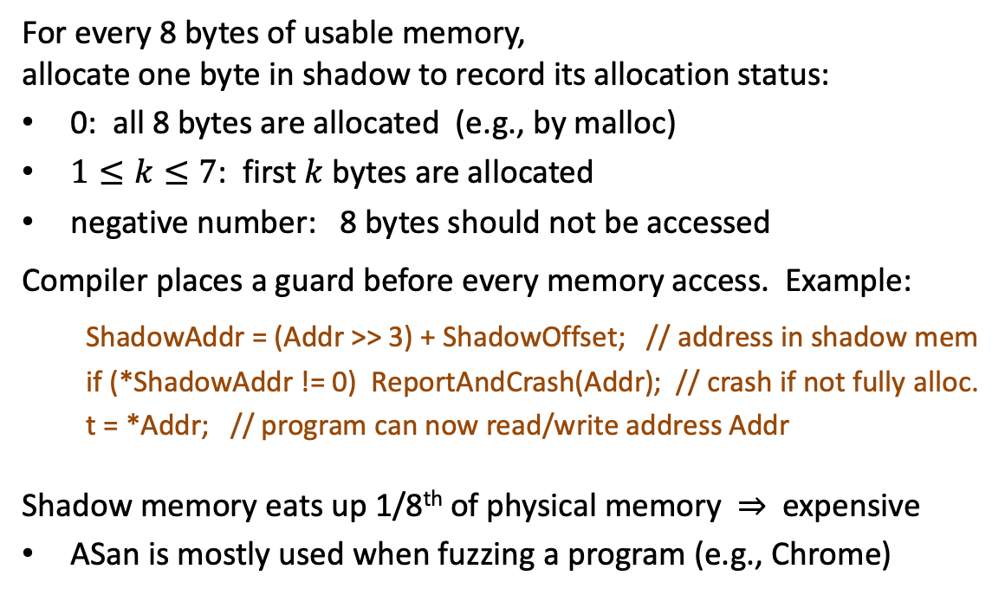
AddressSanitizer (ASan): a software tool
For every 8 bytes of usable memory, allocate one byte in shadow to record its allocation status:
0: all 8 bytes are allocated (e.g., by malloc)
$1≤k≤7$: first $k$ bytes are allocated
negative number: 8 bytes should not be accessed
Compiler places a guard before every memory access. Example:
ShadowAddr = (Addr >> 3) + ShadowOffset; // address in shadow mem
if (*ShadowAddr != 0) ReportAndCrash(Addr); // crash if not fully alloc.
t = *Addr; // program can now read/write address Addr
Shadow memory eats up 1/8th of physical memory ⇒ expensive
ASan is mostly used when fuzzing a program (e.g., Chrome)
Shadow Memory
Usable Memory
https://storage.googleapis.com/gweb-research2023-media/pubtools/pdf/37752.pdf
Notes:
ASan is implemented as an LLVM patch: guards are output in the last pass of LLVM.

Slide 46
AddressSanitizer (ASan): a software tool
Using ASan to detect a buffer overflow on stack or heap:
Shadow Memory
rz
mem1
rz
mem2
rz
mem3
rz
Usable Memory
tags: -1 0 0 0 0 0 4 -1 0 0 0 0 0 0 0 0 6 -1 0 0 0 0 -1
in shadow memory
5×8+4 = 44 bytes
8×8+6 = 70 bytes
4×8 = 32 bytes
overflow will cause an access to a red zone (rz) ⇒ crash program
after mem2 is freed:
rz
mem1
rz
freed mem2
rz
mem3
rz
tags: -1 0 0 0 0 0 4 -1 -1 -1 -1 -1 -1 -1 -1 -1 0 0 0 0 -1
use-after-free at mem2 ⇒ crash program
https://storage.googleapis.com/gweb-research2023-media/pubtools/pdf/37752.pdf
Notes:
The shadow byte is zero means that all 8 bytes are allocated.

Slide 47
Control Flow Integrity (CFI)
Control Hijacking Defenses

Slide 48
Control flow integrity (CFI) [ABEL’05, …]
Ultimate Goal: ensure control flows as specified by code’s flow graph
Coarse CFI: ensure that every indirect call and indirect branch leads to a valid function entry point or branch target
void HandshakeHandler(Session *s, char *pkt) {
...
s->hdlr(s, pkt)
}
Compile time: build list of possible call targets for s->hdlr
Run time: before call, check that s->hdlr value is on list
Notes:
Say, s->hdlr could point to 3 functions. Coarse CFI ensures that s->hdlr is one of 100 function entry points. Fine grained CFI ensures that s->hdlr is one of the three functions.
Lots of academic research on CFI systems: CCFIR (2013), kBouncer (2013), FECFI (2014), CSCFI (2015), …

Slide 49
Coarse CFI: Control Flow Guard (CFG) (Windows 10)
Coarse CFI:
Protects indirect calls by checking against a bitmask of all valid function entry points in executable
ensures target is the entry point of a function

Slide 50
Coarse CFI using EndBranch (Intel) and BTI (ARM)
New instruction EndBranch (Intel) and BTI (ARM):
After an indirect JMP or CALL: the next instruction in the instruction stream must be EndBranch
If not, then trigger a #CP fault and halt execution
Ensures an indirect JMP or CALL can only go to a valid target address ⇒ no func. ptr. hijack
(compiler inserts EndBranch at valid locations)
⦚
call eax
⦚
EndBranch
add ebp, 4
⦚
⦚
Notes:
CET: Control-flow Enforcement. Deployed in Intel TigerLake (2020).
ARM BTI (in ARM 8.5): Branch Target Identification. BTI c: target of an indirect call, BTI j: target of an indirect jump, BTI jc: target of an indirect jump or call.

Slide 51
CFG, EndBranch, BTI: limitations
Poor man’s version of CFI:
Protects indirect calls by checking against a bitmask of all valid function entry points in executable
Does not prevent attacker from causing a jump to a valid wrong function
Hard to build accurate control flow graph statically
ensures target is the entry point of a function

Slide 52
An example
void HandshakeHandler(Session *s, char *pkt) {
s->hdlr = &LoginHandler;
... Buffer overflow over Session struct ...
}
void LoginHandler(Session *s, char *pkt) {
bool auth = CheckCredentials(pkt);
s->dhandler = &DataHandler;
}
void DataHandler(Session *s, char *pkt);
Attacker controls handler
Static CFI: attacker can call DataHandler to
bypass authentication

Slide 53
Cryptographic Control Flow Integrity (CCFI) (ARM PAC - pointer authentication)
Threat model: attacker can read/write anywhere in memory,
program should not deviate from its control flow graph
CCFI approach: Every time a jump address is written/copied anywhere in memory: compute 64-bit AES-MAC and append to address
On heap: tag = AES(k, (jump-address, 0 ll source-address) )
on stack: tag = AES(k, (jump-address, 1 ll stack-frame) )
Before following address, verify AES-MAC and crash if invalid
Where to store key k? In xmm registers (not memory)

Slide 54
Back to the example
void HandshakeHandler(Session *s, char *pkt) {
s->hdlr = &LoginHandler;
... Buffer overflow in Session struct ...
}
void LoginHandler(Session *s, char *pkt) {
bool auth = CheckCredentials(pkt);
s->dhandler = &DataHandler;
}
void DataHandler(Session *s, char *pkt);
Attacker controls handler
CCFI: Attacker cannot create a valid MAC for DataHandler address
Notes:
Example seems a bit complicated
add a picture of heap showing Session + buffer next to it

Slide 55
THE END

