Slide 1
DoS Attacks and Network Defenses
COMP4634 Cybersecurity
Notes:
Before we start any new material, I want to quickly review what we went over last time since we covered most of CS144 in about an hour.

Slide 2


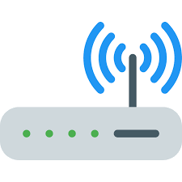



Notation: On Path Attacker
Attacker has access to read, manipulate,
and drop traffic because they are on the path that
the traffic takes across the Internet

Slide 3
Notation: Off Path Attacker
Attacker can inject traffic (including
from fake source addresses), but can’t
read/modify traffic

Slide 4
No security guarantees
Confidentiality — Ethernet, IP, UDP, and TCP do not provide any confidentiality. All traffic is in cleartext.
On-path attacker can do anything. ARP and BGP attacks allow an off-path attacker to become on-path and MITM connections.
Integrity — No guarantees that attacker hasn’t modified traffic. Ethernet, IP and UDP have no protection against spoofed packets. TCP provides weak guarantee of source authentication against off-path attacker
Availability — Attackers can attempt to inject packets or launch “denial of service” attacks against services
Notes:
GO DISCUSS HOW A LAN PLAYS OUT AND HAS A ROUTER

Slide 5
Assume network is malicious
The network is out to get you.
Solution: Always use TLS if you want any protection against large-scale eavesdropping or guarantee that data hasn’t been modified or corrupted by an on-path (or off-path since less strong) attacker
Note! HTTPS and TLS aren’t just for sensitive material! There have been attacks where malicious Javascript or malware is injected into websites.
Notes:
GO DISCUSS HOW A LAN PLAYS OUT AND HAS A ROUTER

Slide 6
Building a network protocol
Don’t build network proto from scratch
  - Never roll your own crypto
  - Many opportunities to mess up parsing network packets
  gRPC: http2 + TLS 1.3 RPC framework
  - Safe parsing in 11 languages
  - Exceptionally efficient
  - Streaming/Sync/Async
  - TLS-based authentication
  Or, REST on top of HTTP/2 + TLS 1.3
syntax = "proto3";
package calc;
message AddRequest {
int32 n1 = 1;
int32 n2 = 2;
}
message AddReply{
int64 res = 1;
}
service Calculator {
rpc Add(AddRequest) returns (AddReply) {}
rpc Substract(SubRequest) returns (SubReply) {}
rpc Multiply(MultRequest) returns (MultReply) {}
rpc Divide(DivideRequest) returns (DivideReply) {}
}
Notes:
GO DISCUSS HOW A LAN PLAYS OUT AND HAS A ROUTER

Slide 7
DNSSEC
Adds authentication and integrity to DNS responses
Authoritative DNS servers sign DNS responses using cryptographic key
Clients can verify that a response is legitimate by checking signature through PKI similar to HTTPS
Most people don’t use DNSSEC and never will. Use TLS.
Notes:
GO DISCUSS HOW A LAN PLAYS OUT AND HAS A ROUTER

Slide 8
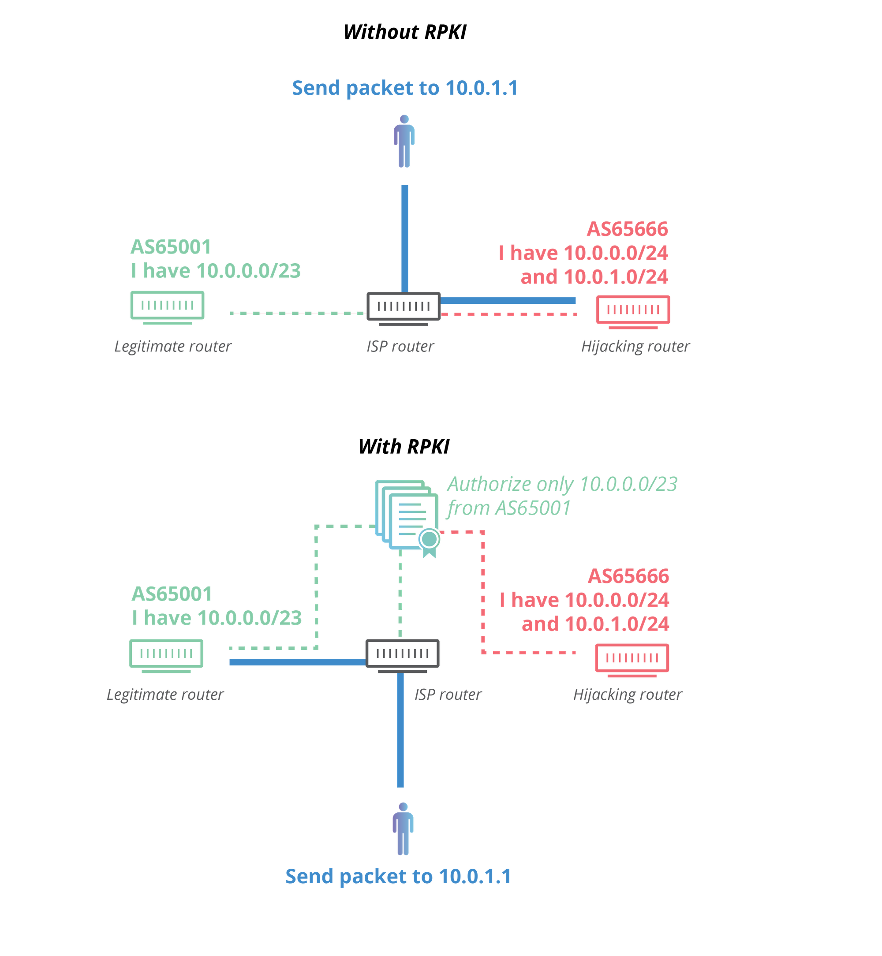
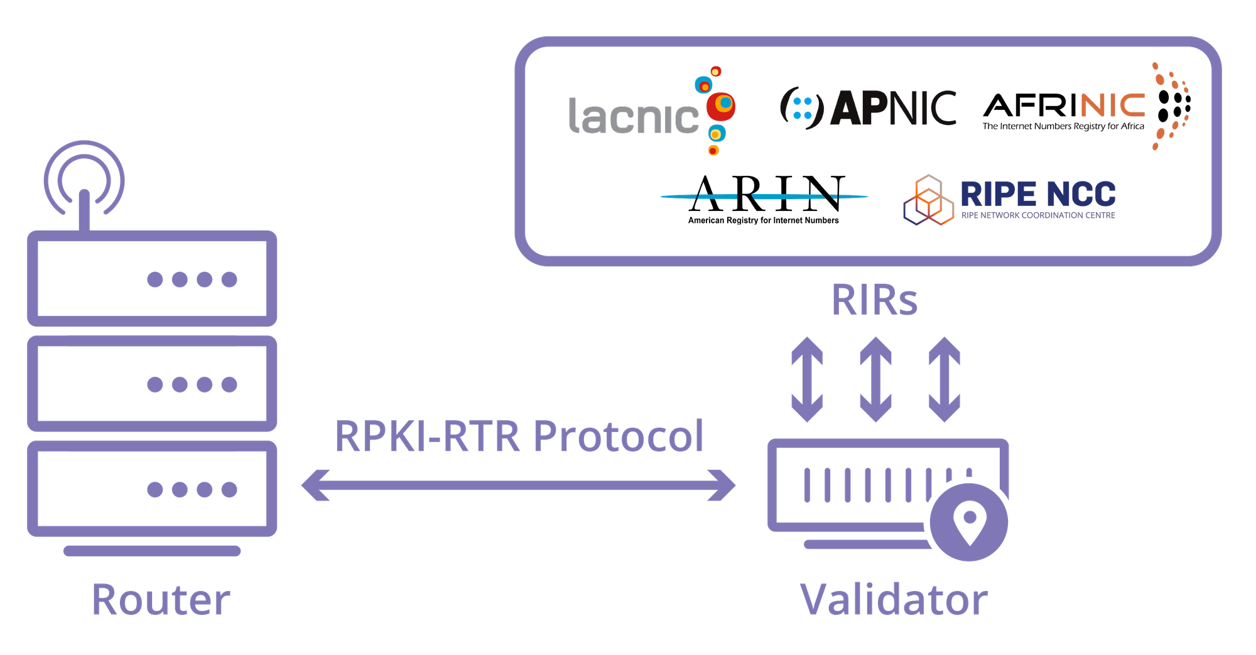
Resource Public Key Infrastructure (RPKI)
RPKI is a relatively new PKI to help improve BGP security
Networks ask regional registrars to sign a “Route Origin Authorization” that indicates a specific ASN is allowed to advertise a given IP range
Networks validate signed ROA against the PKI before deciding to accept a new advertisement
Images from
Cloudflare
Notes:
GO DISCUSS HOW A LAN PLAYS OUT AND HAS A ROUTER

Slide 9
Denial of Service (DOS)
Attacks
Notes:
GO DISCUSS HOW A LAN PLAYS OUT AND HAS A ROUTER

Slide 10
Denial of Service Attacks
Goal: take large service/network/org offline by overwhelming it with network traffic such that they can’t process real requests
How: find mechanism where attacker doesn’t spend a lot of effort, but requests are difficult/expensive for victim to process
Notes:
GO DISCUSS HOW A LAN PLAYS OUT AND HAS A ROUTER

Slide 11
Types of Attacks
DoS Bug: design flaw that allows one machine to disrupt a service. Generally a protocol asymmetry, e.g., easy to send request, difficult to create response. Or requires server state.
DoS Flood: control a large number of requests from a botnet or other machines you control
Notes:
GO DISCUSS HOW A LAN PLAYS OUT AND HAS A ROUTER

Slide 12
DoS Opportunities at Every Layer
Link Layer: send too much traffic for switches/routers to handle
TCP/UDP: require servers to maintain large number of concurrent connections or state
Application Layer: require servers to perform expensive queries or cryptographic operations
Notes:
GO DISCUSS HOW A LAN PLAYS OUT AND HAS A ROUTER

Slide 13
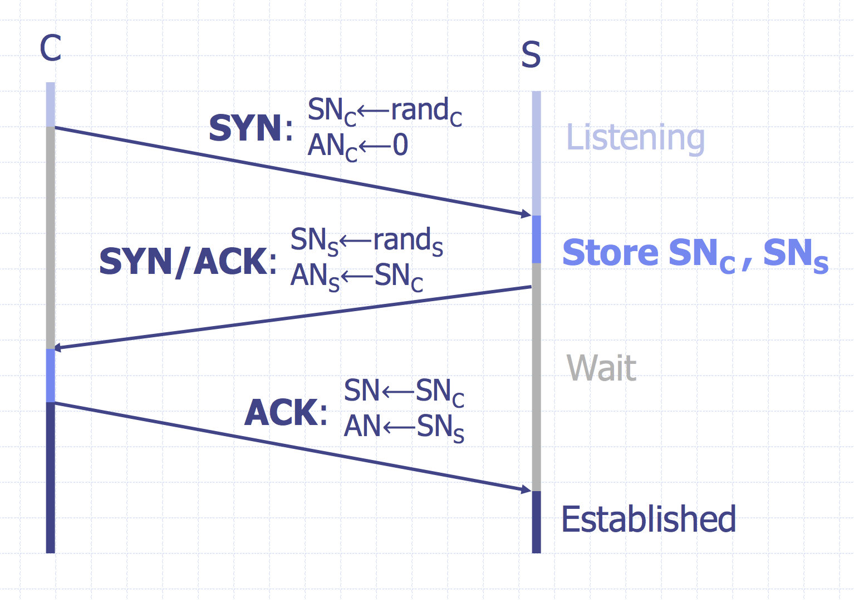
TCP Handshake
Notes:
GO DISCUSS HOW A LAN PLAYS OUT AND HAS A ROUTER

Slide 14
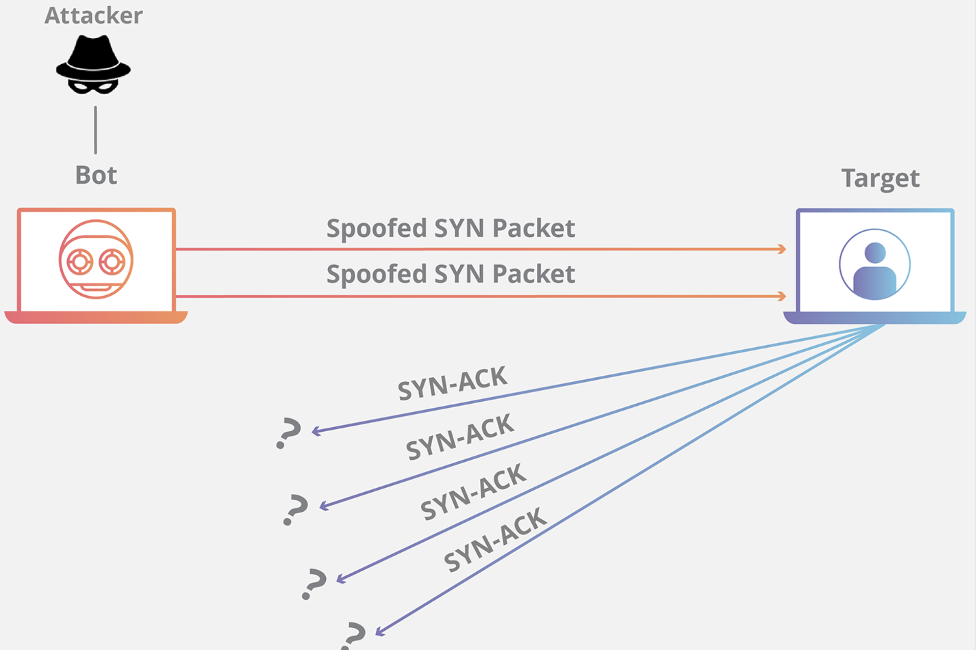
SYN Floods
Notes:
GO DISCUSS HOW A LAN PLAYS OUT AND HAS A ROUTER

Slide 15
Core Problem
Problem: server commits resources (memory) before confirming identify of the client (when client responds)
Bad Solution:
- Increase backlog queue size
- Decrease timeout
Real Solution: Avoid state until 3-way handshake completes
Notes:
GO DISCUSS HOW A LAN PLAYS OUT AND HAS A ROUTER

Slide 16
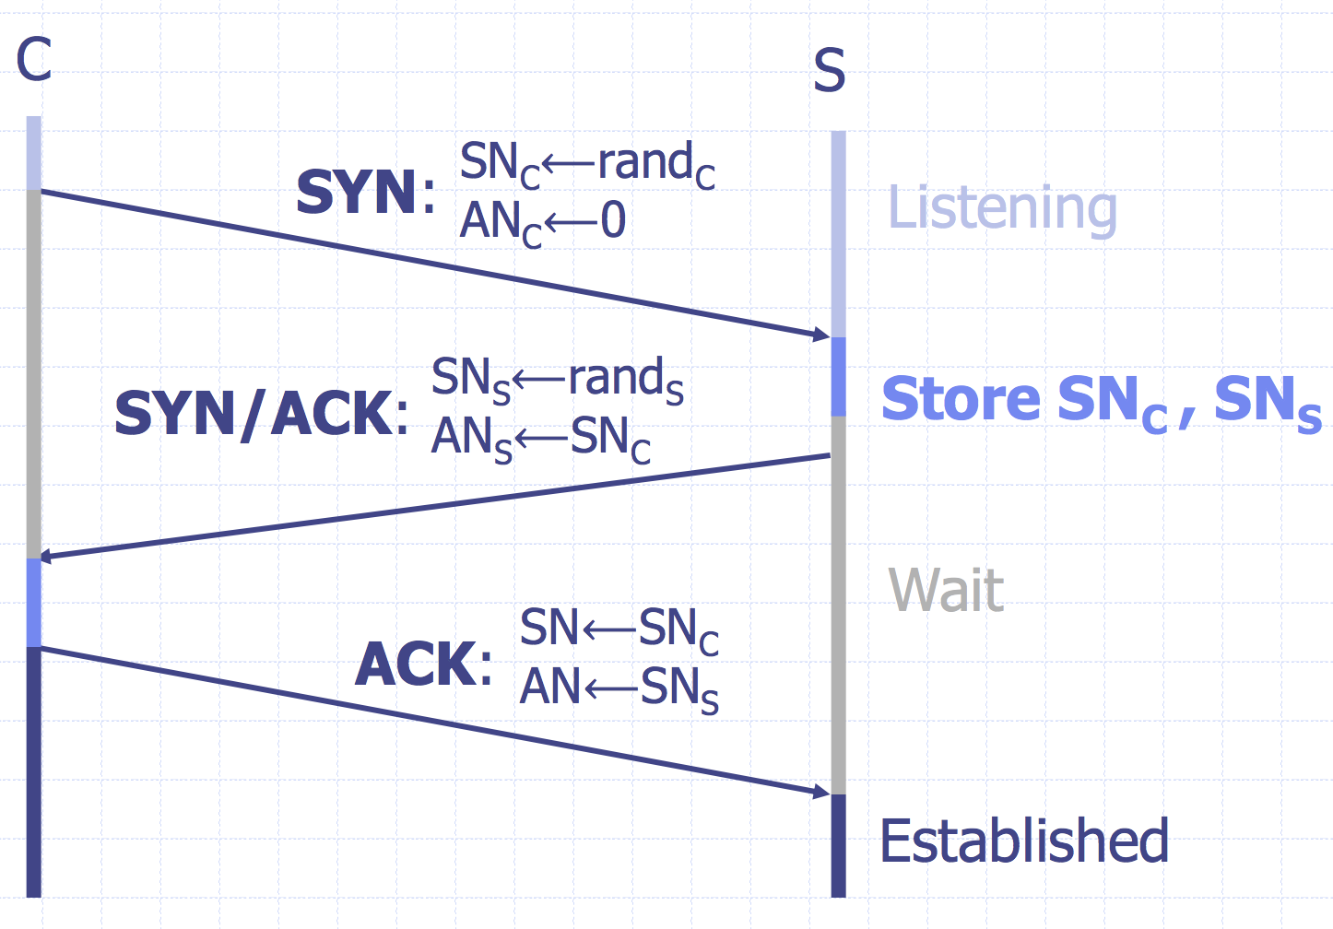
SYN Cookies
Idea: Instead of storing SNc and SNs…
send a cookie back to the client.
L = MACkey (SAddr, SPort, DAddr, DPort, SNC, T)
key: picked at random during boot
T = 5-bit counter incremented every 64 secs.
SNs = ( T || mss || L )
Honest client sends ACK (AN=SNs , SN=SNC+1)
Server allocates space for socket only if valid SNs
Server does not save state
(loses TCP options)
Notes:
GO DISCUSS HOW A LAN PLAYS OUT AND HAS A ROUTER

Slide 17
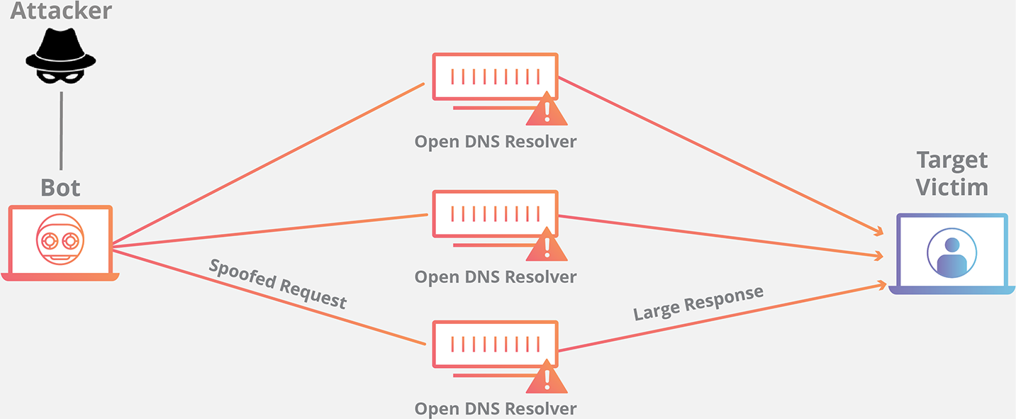
Amplification Attacks
Services that respond to a single (small) UDP packet with a large UDP packet can be used to amplify DOS attacks
Attacker forges packet and sets source IP to victim’s IP address. When service responds, it sends large amount of data to the spoofed victim
The attacker needs a large number of these services to amplify packets. Otherwise, the victim could just drop the packets from the small number of hosts
MX mx1.example.com.
MX mx1.example.com.
MX mx1.example.com.
MX mx1.example.com.
MX mx1.example.com.
MX mx1.example.com.
MX mx1.example.com.
MX mx1.example.com.
A 1.2.3.8
A 1.2.3.9
A 1.2.3.4
A 1.2.3.5
A 1.2.3.6
A 1.2.3.7
A 1.2.3.8
A 1.2.3.9
DNS ANY example.com.
60-70x Increase in Size
Notes:
GO DISCUSS HOW A LAN PLAYS OUT AND HAS A ROUTER

Slide 18
Common UDP Amplifiers
DNS: ANY query returns all records server has about a domain
NTP: MONLIST returns list of last 600 clients who asked for the time recently
DNS: Do not have recursive resolvers on the public Internet.
NTP: Do not respond to commands like MONLIST
Both are considered misconfigurations today, but often 100Ks of misconfigured hosts on the public Internet
Notes:
GO DISCUSS HOW A LAN PLAYS OUT AND HAS A ROUTER

Slide 19
Amplification Attacks
2013: DDoS attack generated 300 Gbps (DNS)
- 31,000 misconfigured open DNS resolvers, each at 10 Mbps
- Source: 3 networks that allowed IP spoofing
2014: 400 Gbps DDoS attacked used 4,500 NTP servers
Notes:
GO DISCUSS HOW A LAN PLAYS OUT AND HAS A ROUTER

Slide 20
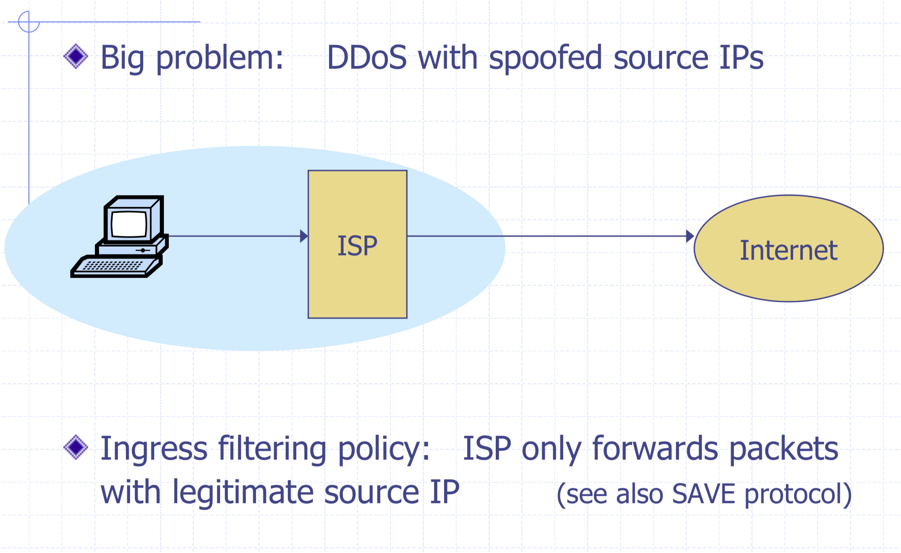
Ingress Filtering
Notes:
GO DISCUSS HOW A LAN PLAYS OUT AND HAS A ROUTER

Slide 21
Ingress Filtering
All ISPs need to do this — requires global coordination
  If 10% of networks don’t implement, there’s no defense
  No incentive for an ISP to implement — doesn’t affect them
As of 2017 (from CAIDA):
  33% of autonomous systems allow spoofing
  23% of announced IP address space allow spoofing
  2013 300 Gbps attack sent attack traffic from only 3 networks
Notes:
GO DISCUSS HOW A LAN PLAYS OUT AND HAS A ROUTER

Slide 22

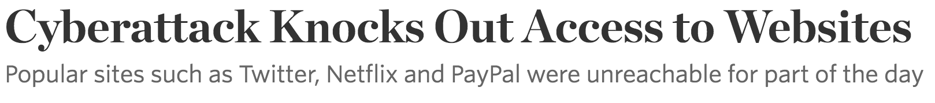
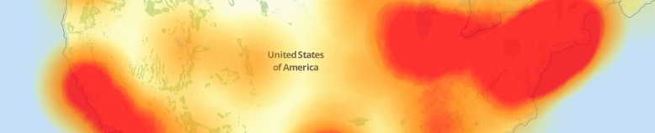









October 21, 2016
Notes:
Sometimes also just organic traffic

Slide 23
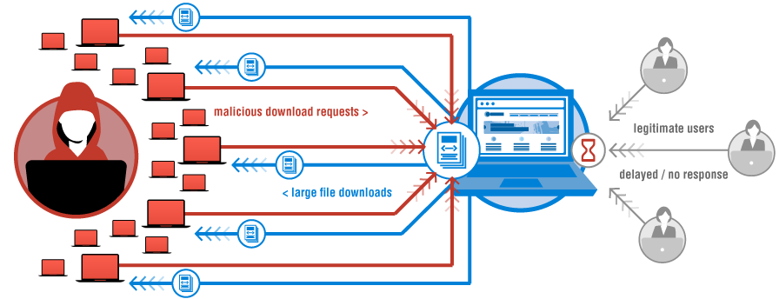

“We are still working on analyzing the data but the estimate at the time of this report is up to 100,000 malicious endpoints. […] There have been some reports of a magnitude in the 1.2 Tbps range; at this time we are unable to verify that claim.”
Image: Verisign
Notes:
This outage was due to a large DDoS attack that targeted a large DNS provider — Dyn. However, while Dyn was one of hte

Slide 24

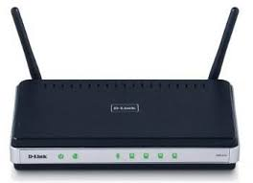
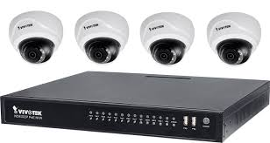

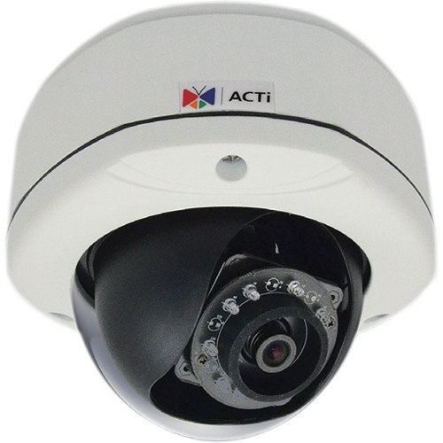



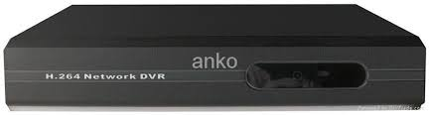
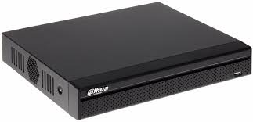
A Botnet of IoT Devices
GRE
HTTP
TLS
Bot Master
OVH/Dyn/Krebs
200K IoT devices
Not Amplification.
Flood with SYN, ACK, UDP, and GRE packets

Slide 25
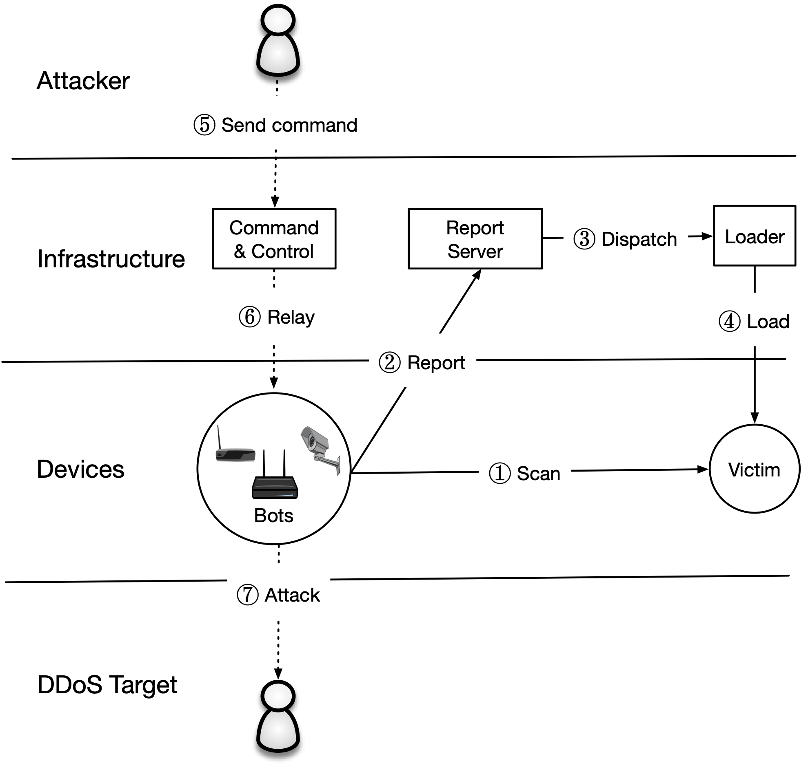
The Mirai Malware
Bot master will issue commands to scan
or start an attack
Attack Command:
  Action (e.g., START, STOP)
  Target IP(s)
  Attack Type (e.g., GRE, DNS, TCP)
  Attack Duration

Slide 26
What made Mirai Successful?
The Mirai malware is (astoundingly) badly written. It uses no new or complex techniques.
Mirai was successful because:
IoT security bar is very low
Attack simplicity enabled the malware to compromise heterogeneous hardware
Stateless scanning was an improvement over prior versions
Lizkebab
BASHLITE
Qbot
Torlus
Gafgyt
LizardStresser
Mirai
Notes:
Mirai wasn’t the first piece of malware that has targeted IoT devices. However, it was by far the most successful. Why?

Slide 27
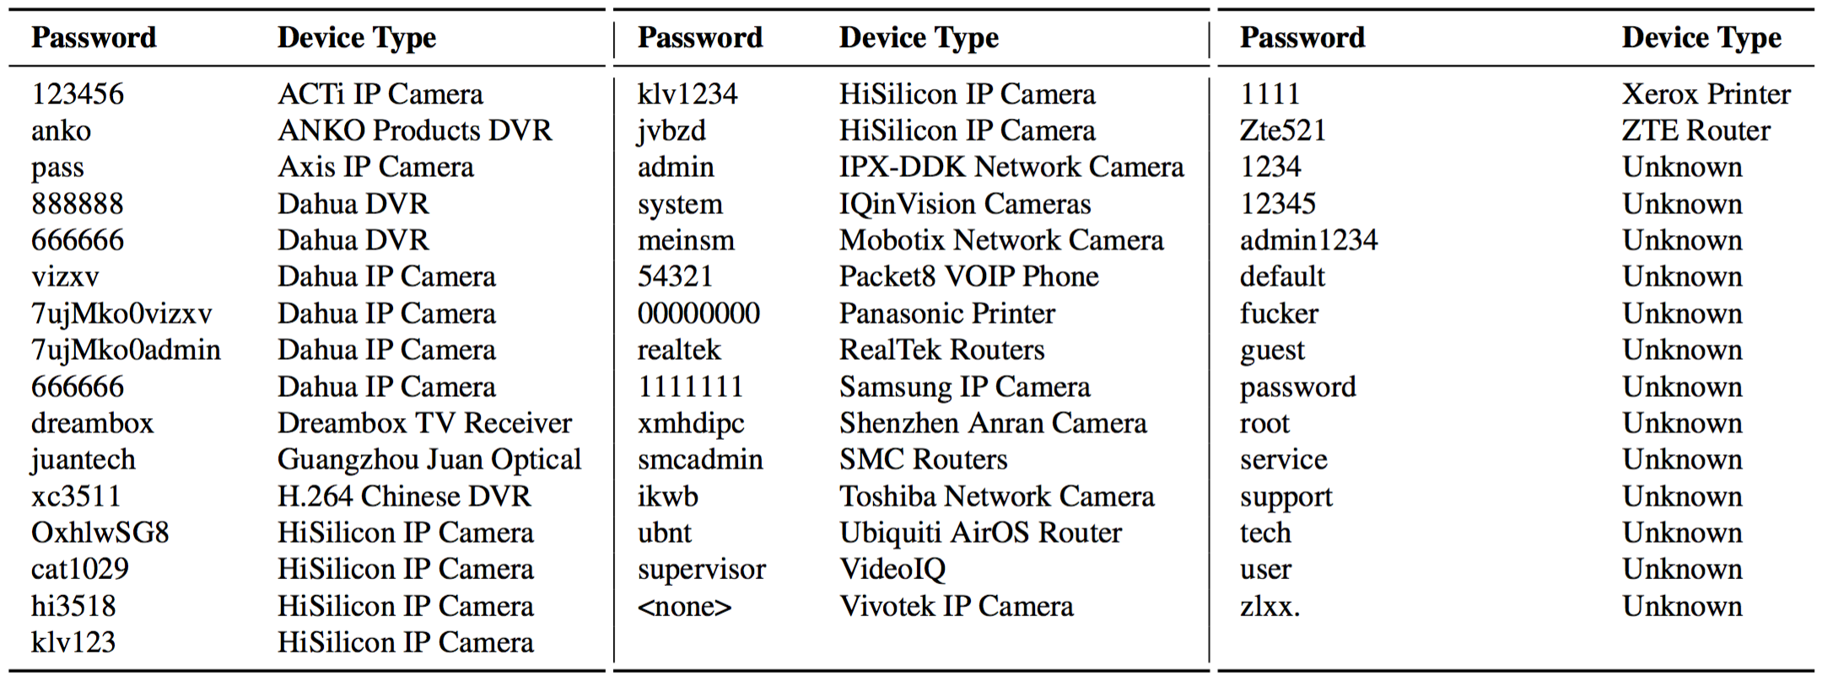
Password Guessing
Notes:
While most folks in the United States weren’t directly affected until the Dyn outage, the attack on Dyn was the third of four very large and somewhat unique DDoS attacks in September and October of 2016.
The first was on September 18 and attacked OVH…

Slide 28
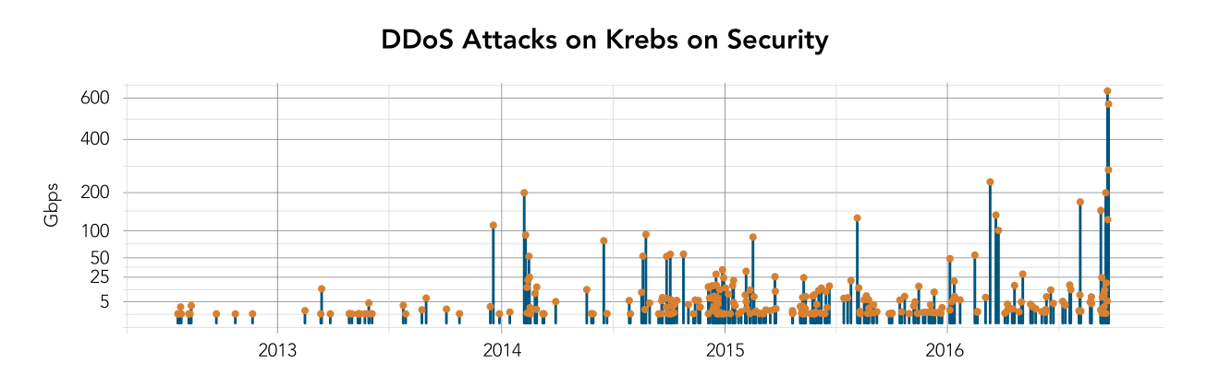
Krebs Graph
“The magnitude of the attacks seen during the final week were significantly larger than the majority of attacks Akamai sees on a regular basis. […] In fact, while the attack on September 20 was the largest attack ever mitigated by Akamai, the attack on September 22 would have qualified for the record at any other time, peaking at 555 Gbps.”
Source: 2017 Akamai State of the Internet
Notes:
Largest Akamai had ever seen—620 Gbps—almost double the prior 363 Gbps.

Slide 29
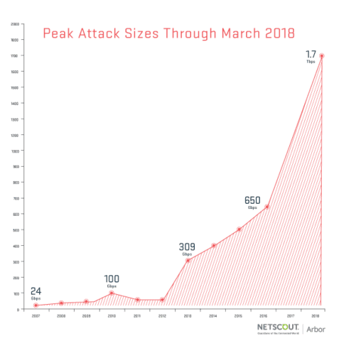
Memcache
Memcache: retrieve large record
The server responds by firing back as much as 50,000 times the data it received.
Exist both a UDP and TCP version. Only works for UDP! TCP would require a three-way handshake and server would realize IP had been spoofed.
Notes:
These attacks were different in two ways. The first difference was just the sheer magnitude of the size of attack. The attack against Brian was the largest DDoS attack that Akamai had ever seen—620 Gbps—almost double the prior 363 Gbps.

Slide 30
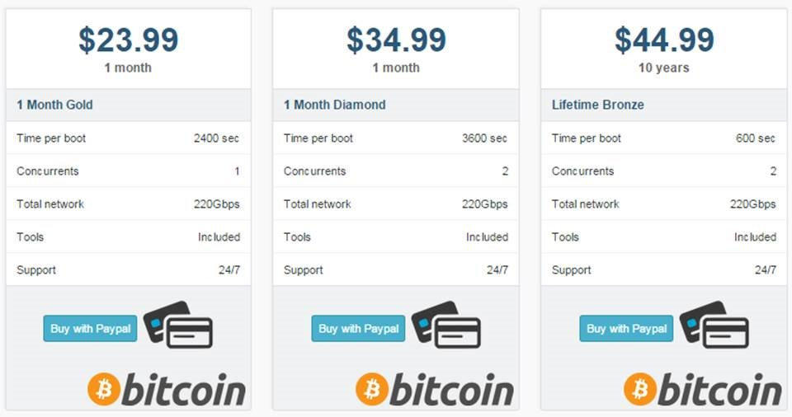
Booter Services
Notes:
GO DISCUSS HOW A LAN PLAYS OUT AND HAS A ROUTER

Slide 31
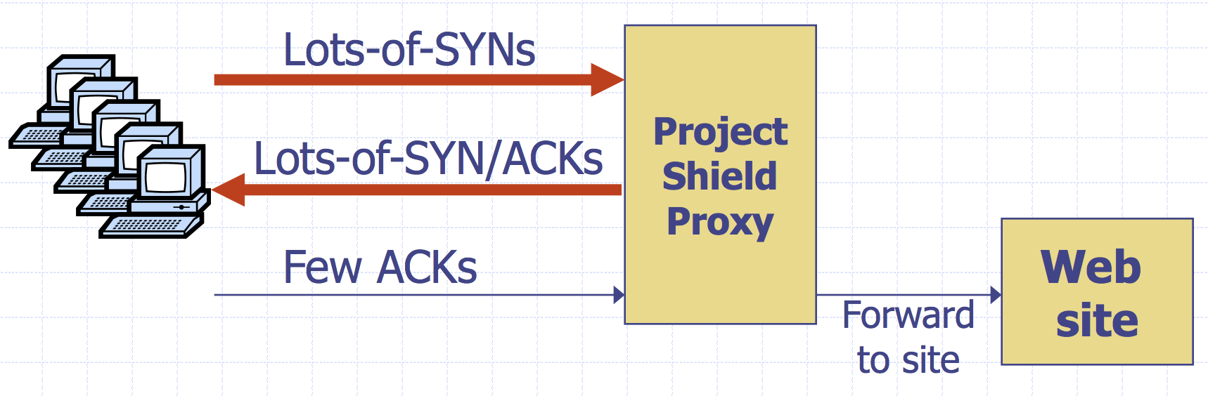
Google Project Shield
DDoS Attacks are often used to censor content. In the case of Mirai, Brian Kreb’s blog was under attack.
Google Project shield uses Google bandwidth to shield vulnerable websites (e.g., news, blogs, human rights orgs)
Notes:
GO DISCUSS HOW A LAN PLAYS OUT AND HAS A ROUTER

Slide 32
Moving Up Stack: GET Floods
Command bot army to:
* Complete real TCP connection
* Complete TLS Handshake
* GET large image or other content
Will bypass flood protections…. but attacker can no longer use random source IPs
Victim site can block or rate limit bots
Notes:
GO DISCUSS HOW A LAN PLAYS OUT AND HAS A ROUTER

Slide 33
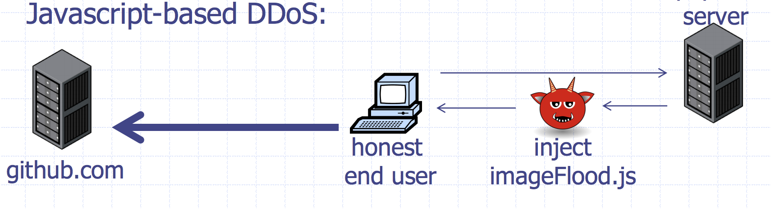
Github Attacks
1.35 Tbps attack against Github caused by JS injected into web requests
More reason that you should always use HTTPS!
Notes:
GO DISCUSS HOW A LAN PLAYS OUT AND HAS A ROUTER

Slide 34
Client Puzzles
Idea: What if we force every client to do moderate amount of work for every connection they make?
Example:
1) Server Sends: C
2) Client: find X | LSBn(SHA1(C || X)) = 0^{n}
Assumption:
Puzzle takes 2^{n} for the client to compute (0.3 s on 1Ghz core)
Solution is trivial for server to check (single SHA-1 hash)
Notes:
GO DISCUSS HOW A LAN PLAYS OUT AND HAS A ROUTER

Slide 35
Client Puzzles
Not frequently used in the real world
Benefits:
- Can change n based on amount of attack traffic
Limitations:
- Requires changes to both protocols, clients, and servers
- Hurts low power legitimate clients during attack (e.g., phones)
Notes:
GO DISCUSS HOW A LAN PLAYS OUT AND HAS A ROUTER

Slide 36
Network Defenses

Slide 37
Local Network Services
Review: Popular TCP and UDP services live on standardized ports. HTTPS servers listen on TCP/443. SSH on TCP/22.
Some services you don’t want listening on the public Internet.
Recursive DNS Resolvers: allows attackers to mount DDoS attacks
Windows File Sharing: historically full of vulnerabilities. What if a local machine doesn’t have a secure password on it?
Notes:
GO DISCUSS HOW A LAN PLAYS OUT AND HAS A ROUTER

Slide 38


Port Scanning
Send a SYN or application-specific UDP packet to a port to see if any service is listening
Vertical Scan: Try large number of ports on a single host. Typically use Nmap.
Horizontal Scan: Try a single port on a large number of hosts. Typically ZMap.
Notes:
GO DISCUSS HOW A LAN PLAYS OUT AND HAS A ROUTER

Slide 39
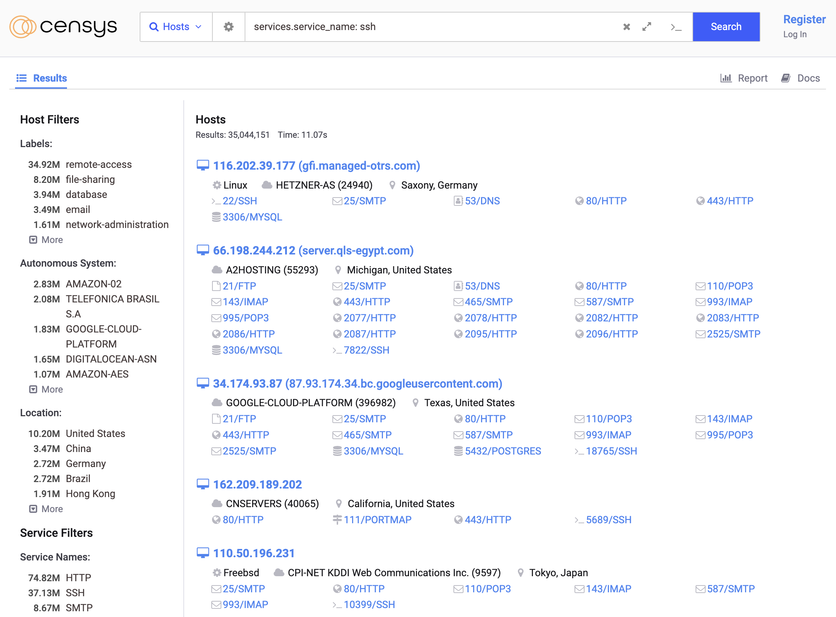
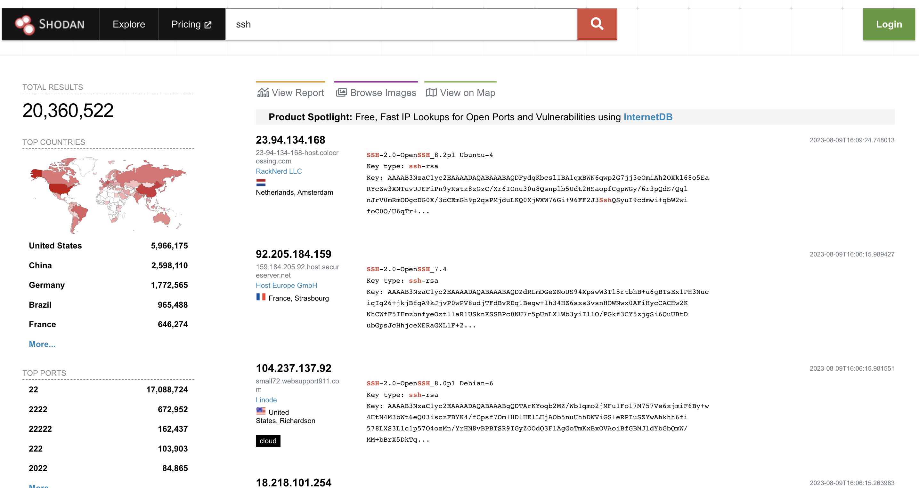
Service Search Engines
Public services like Shodan and Censys index all of the publicly available services on the Internet
Notes:
GO DISCUSS HOW A LAN PLAYS OUT AND HAS A ROUTER

Slide 40

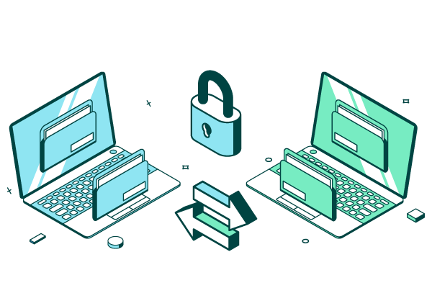
Attacks Against Internet Services
MOVEit is a piece of software that allows file transfer between organizations
Vulnerable to multiple login-field SQL injection vulnerabilities
Ransomware’d/Extorted Companies based on the data on their Internet MOVEit Servers
Notes:
GO DISCUSS HOW A LAN PLAYS OUT AND HAS A ROUTER

Slide 41
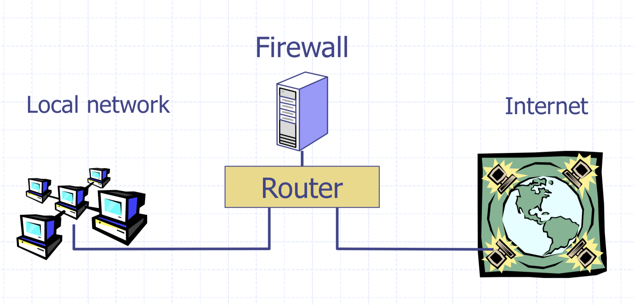
Firewalls
Separate local area network (LAN) from the Internet. Only allow some traffic to transit.
Sometimes rules on a router. Sometimes a standalone device.
Notes:
GO DISCUSS HOW A LAN PLAYS OUT AND HAS A ROUTER

Slide 42
Basic Packet Filtering
Uses transport and IP layer information only
- IP Source Address, Destination Address
- Protocol (TCP, UDP, ICMP, etc.)
- TCP and UDP source and destination ports
Examples:
“Do not allow external hosts to connect to Windows File Sharing”
-> DROP ALL INBOUND PACKETS TO TCP PORT 445
Notes:
GO DISCUSS HOW A LAN PLAYS OUT AND HAS A ROUTER

Slide 43
What’s the rule?
What if you have a network with lots of servers but only want outsiders to be able to access a web server?
DROP ALL INBOUND PACKETS IF DEST PORT != 80
All outbound connections also have a source port! Their responses will blocked!
Notes:
GO DISCUSS HOW A LAN PLAYS OUT AND HAS A ROUTER

Slide 44
IANA Port Numbering
System or Well-Known Ports [1,1023]:
Common services, e.g., HTTP -> 80, SSH -> 22
User or registered ports [1024, 49151]
Less well-known services
Ephemeral/Dynamic/Private Ports [49152, 65535]
Short lived connections
Notes:
GO DISCUSS HOW A LAN PLAYS OUT AND HAS A ROUTER

Slide 45
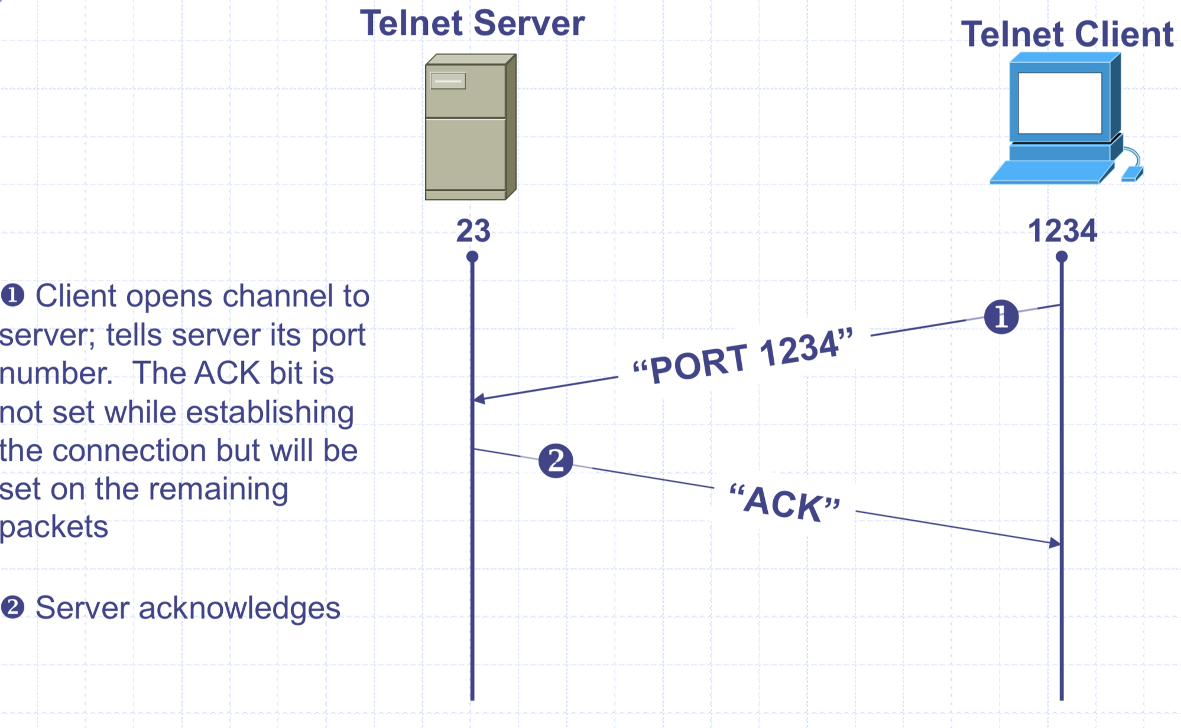
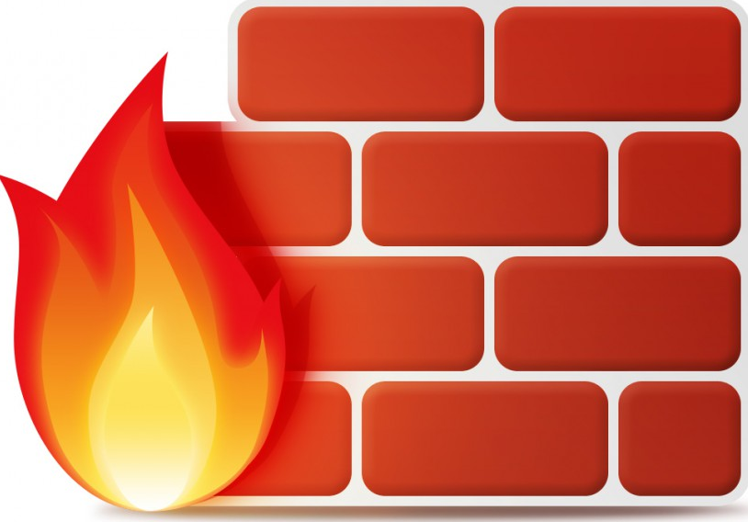
Stateful Filtering
Firewall tracks outgoing connections and allows associated inbound traffic back through
Notes:
GO DISCUSS HOW A LAN PLAYS OUT AND HAS A ROUTER

Slide 46
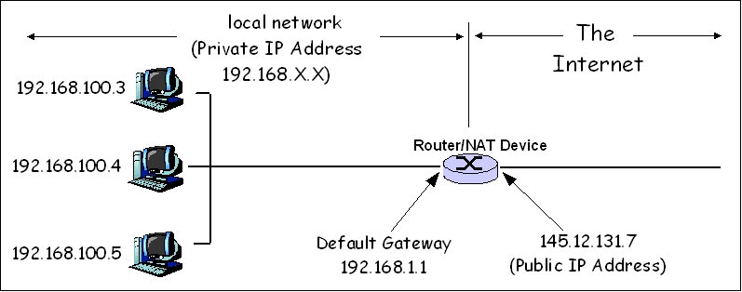
Network Address Translation (NAT)
NATs map between two different address spaces. Most home routers are NATs and firewalls.
Private Subnets
10.0.0.0 – 10.255.255.255
172.16.0.0 – 172.31.255.255
192.168.0.0 – 192.168.255.255
Notes:
GO DISCUSS HOW A LAN PLAYS OUT AND HAS A ROUTER

Slide 47
Local vs. Network Firewall
Firewalls we’ve discussed so far have all been network firewalls. Most have lived at the edge of the organization.
Firewalls also run on individual hosts. Linux servers use iptables.
Typically have a combination of network and host firewalls
sudo iptables -A INPUT -m conntrack --ctstate ESTABLISHED,RELATED -j ACCEPT
sudo iptables -A INPUT -p tcp --dport 22 -m conntrack --ctstate NEW,ESTABLISHED -j ACCEPT
Notes:
GO DISCUSS HOW A LAN PLAYS OUT AND HAS A ROUTER

Slide 48
Local vs. Network Firewall
Organizations typically have a combination of network and host firewalls
  Border (Network) Firewall will block malicious traffic from the outside and limit inbound traffic to accessing only servers intended to be accessed by the public
  Host Firewalls protect hosts from other hosts (e.g., protect against internal compromise and malicious insiders)
  Think of firewall rules in terms of “Defense in Depth"
Notes:
GO DISCUSS HOW A LAN PLAYS OUT AND HAS A ROUTER

Slide 49
Next Generation Firewalls (NGFW)
So far, firewalls operate by allowing access to a specific host or protocol — but what about malicious application traffic?
Next Generation Firewalls (Industry term for Application-Layer firewall)s protect for attacks within L7 traffic
For Example:
- Virus scanning for SMTP
- Need to understand protocol, MIME encoding, ZIP files, etc
- Look for SQL injection attacks in HTTP POSTs
- Look for a large number of authentication attempts or malformed requests
Notes:
GO DISCUSS HOW A LAN PLAYS OUT AND HAS A ROUTER

Slide 50
Intrusion Detection Systems (IDS)
Software/device to monitor network traffic for attacks or policy violations
Violations are reported to a central security information and event management (SIEM) system where analysts can later investigate
Signature Detection: maintains long list of traffic patterns (rules) associated with attacks
Anomaly Detection: attempts to learn normal behavior and report deviations
Notes:
Think of it like a burglar alarm for your network
Most attackers run scripts to probe for vulnerabilities, then return later to exploit them
Probes tend to come in waves as new holes are discovered
Probes look very different than typical network use
Actual attack may come long after probe

Slide 51



Open Source IDS
Three Major Open Source IDS (and a tremendous number of commercial products)
Snort
Bro Zeek
Suricata
Notes:
GO DISCUSS HOW A LAN PLAYS OUT AND HAS A ROUTER

Slide 52
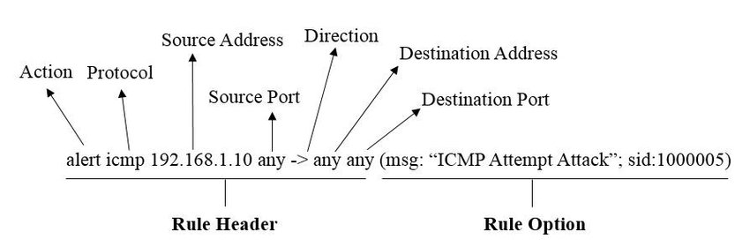
Example Snort Rule
Notes:
GO DISCUSS HOW A LAN PLAYS OUT AND HAS A ROUTER

Slide 53
Outbound Too!
Organizations will often inspect outbound traffic as well
- Block access to sites with known malicious behavior
- Prevent exfiltrating data
- Block services like bit torrent
Be careful on enterprise networks! Sometimes companies will even install their own root certificates on employee workstations to monitor TLS traffic.
Notes:
GO DISCUSS HOW A LAN PLAYS OUT AND HAS A ROUTER

Slide 54
Remote Access

Slide 55
Virtual Private Networks (VPNs)
Problem: How do you provide secure communication for non-TLS protocols across the public Internet?
VPNs create a fake shared network on which traffic is encrypted
Two Broad Types:
- Remote client (e.g., traveler with laptop) to corporate network
- Connect two remote networks across Internet
Notes:
GO DISCUSS HOW A LAN PLAYS OUT AND HAS A ROUTER

Slide 56
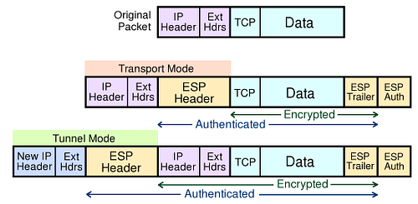
IPSec
Several VPN protocols exist (PPTP, L2TP, IPsec, OpenVPN)
Most popular is IPsec. OpenVPN is open source.
Notes:
GO DISCUSS HOW A LAN PLAYS OUT AND HAS A ROUTER

Slide 57
Wireguard
Recently introduced VPN that has gained significant following in the past 5 years over options like OpenVPN:
Simpler protocol and much more performant than OpenVPN. Relatively few configuration options reduces opportunity for error
Utilizes modern cryptographic primitives like Noise protocol framework, Curve25519, ChaCha20, Poly1305,
Notes:
GO DISCUSS HOW A LAN PLAYS OUT AND HAS A ROUTER

Slide 58
Cisco AnyConnect
Stanford and many other organizations use Cisco AnyConnect
Encapsulates traffic in TLS! Initial handshake uses normal TCP-based TLS for initial handshake and then DTLS (UDP-based TLS) to transport data
Notes:
GO DISCUSS HOW A LAN PLAYS OUT AND HAS A ROUTER

Slide 59
Gooey Middle
VPNs support the idea of having a secure internal network and untrusted public Internet. Unfortunately, attacker has a ton of access once the network perimeter is breached.
Unfortunately, internal networks aren’t that secure. Computers are compromised all the time and attackers have free rein.
Notes:
GO DISCUSS HOW A LAN PLAYS OUT AND HAS A ROUTER

Slide 60
Zero Trust Security (BeyondCorp)
Google: assume internal network is also out to get you. Remove privileged intranet and put all corporate applications on the Internet.
Access depends solely on device and user credentials, regardless of a user’s network location
Protect applications, not the network
Notes:
GO DISCUSS HOW A LAN PLAYS OUT AND HAS A ROUTER

