Slide 1
Privacy, Anonymity, and Censorship
COMP4634 Cybersecurity
Notes:
Come next week for Eric Rescorla’s research

Slide 2
Privacy

Slide 3
What is Privacy?
Privacy is control over your own information. Freedom from intrusion into personal matters
Privacy is a person’s right or expectation to control the disclosure of his/her personal information, including activity metadata
Privacy is the “right to be let alone” — Louis Brandeis
Privacy means something like what the Founders meant by “liberty”
Free speech, free association, autonomy, …
freedom from censorship and constant surveillance
Privacy-motivating examples in U.S. History
Martin Luther King Jr. “blackmailed” by FBI
McCarthyism witch-hunt for communists
Notes:
Privacy refers to the freedom from intrusion into one's personal matters, and personal information.
Different than security. Privacy Applies to the Person. Confidentiality applies to data.
Nothing to Hide argument: used as justification for surveillance, ignores non-secrecy understandings of privacy. Often used to justify surveillance while ignoring the potential problems of data aggregation and lack of transparency in information processing.

Slide 4

Direct Sharing
Notes:
Difference between securely buying products and Target being able to derive that you’re pregnant.

Slide 5

Notes:
Not unheard of companies figuring out that customers are pregnant before they realize they are…
Privacy very much linked to surveillance. When a dossier of information collected about you, this can be used to construct stories about you. This story may be made up of a series of facts, but the picture it paints not necessarily accurate.

Slide 6
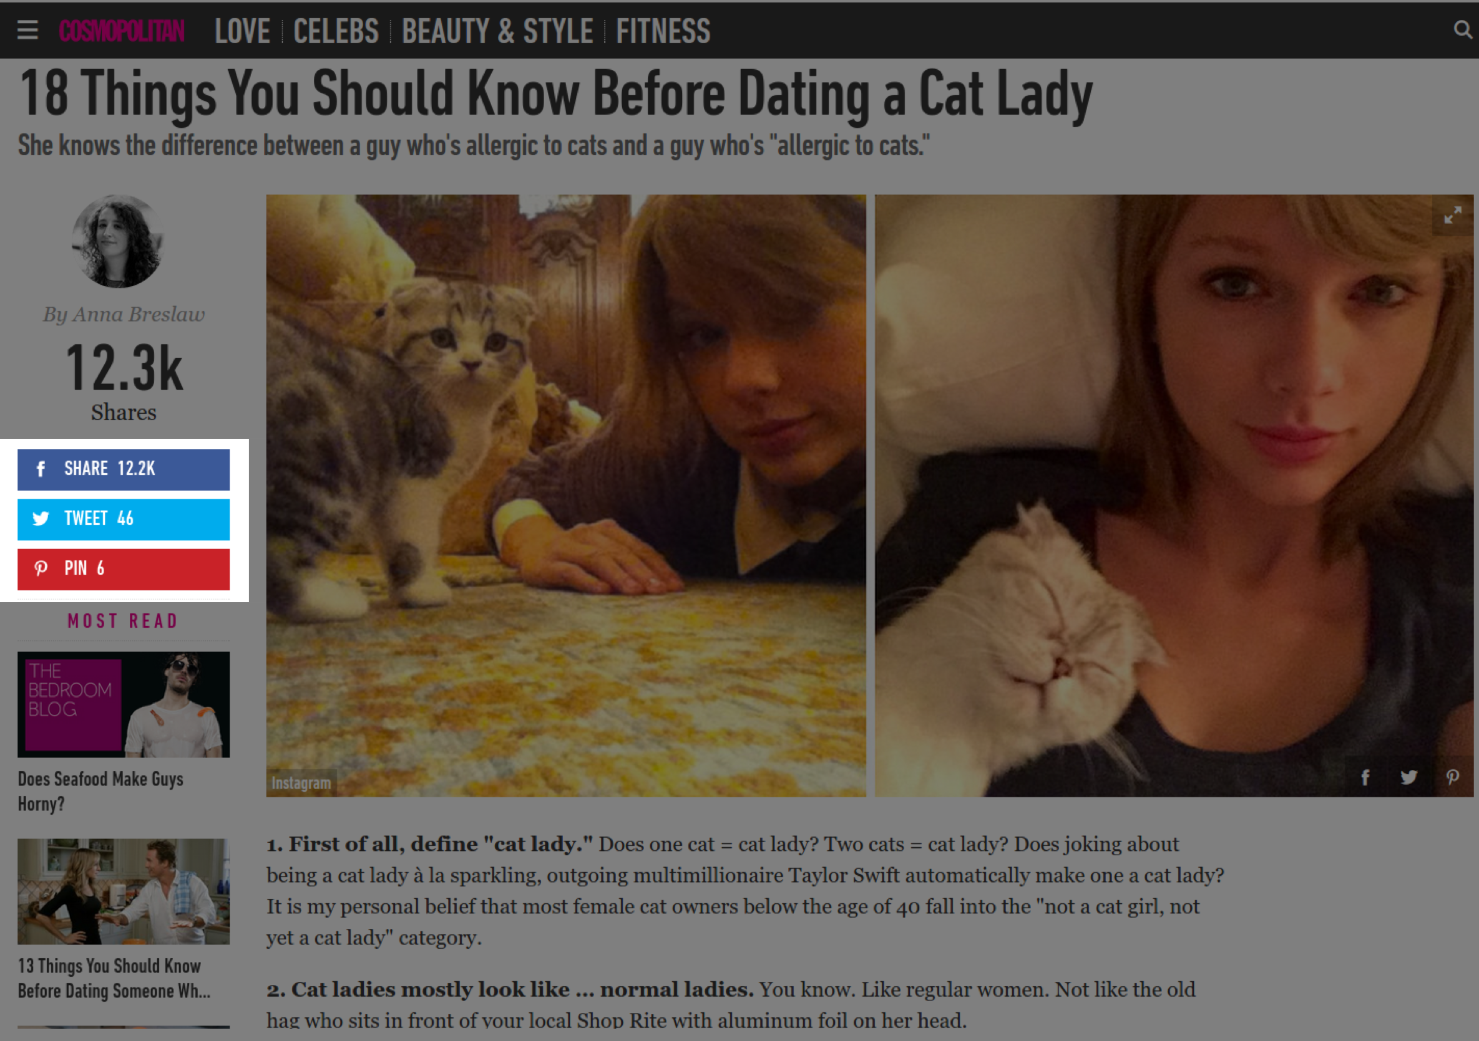
Third Party Tracking
Notes:
Not always direct though. Significant problems with third party tracking through ads.
Imagine visiting websites about healthcare, etc.

Slide 7
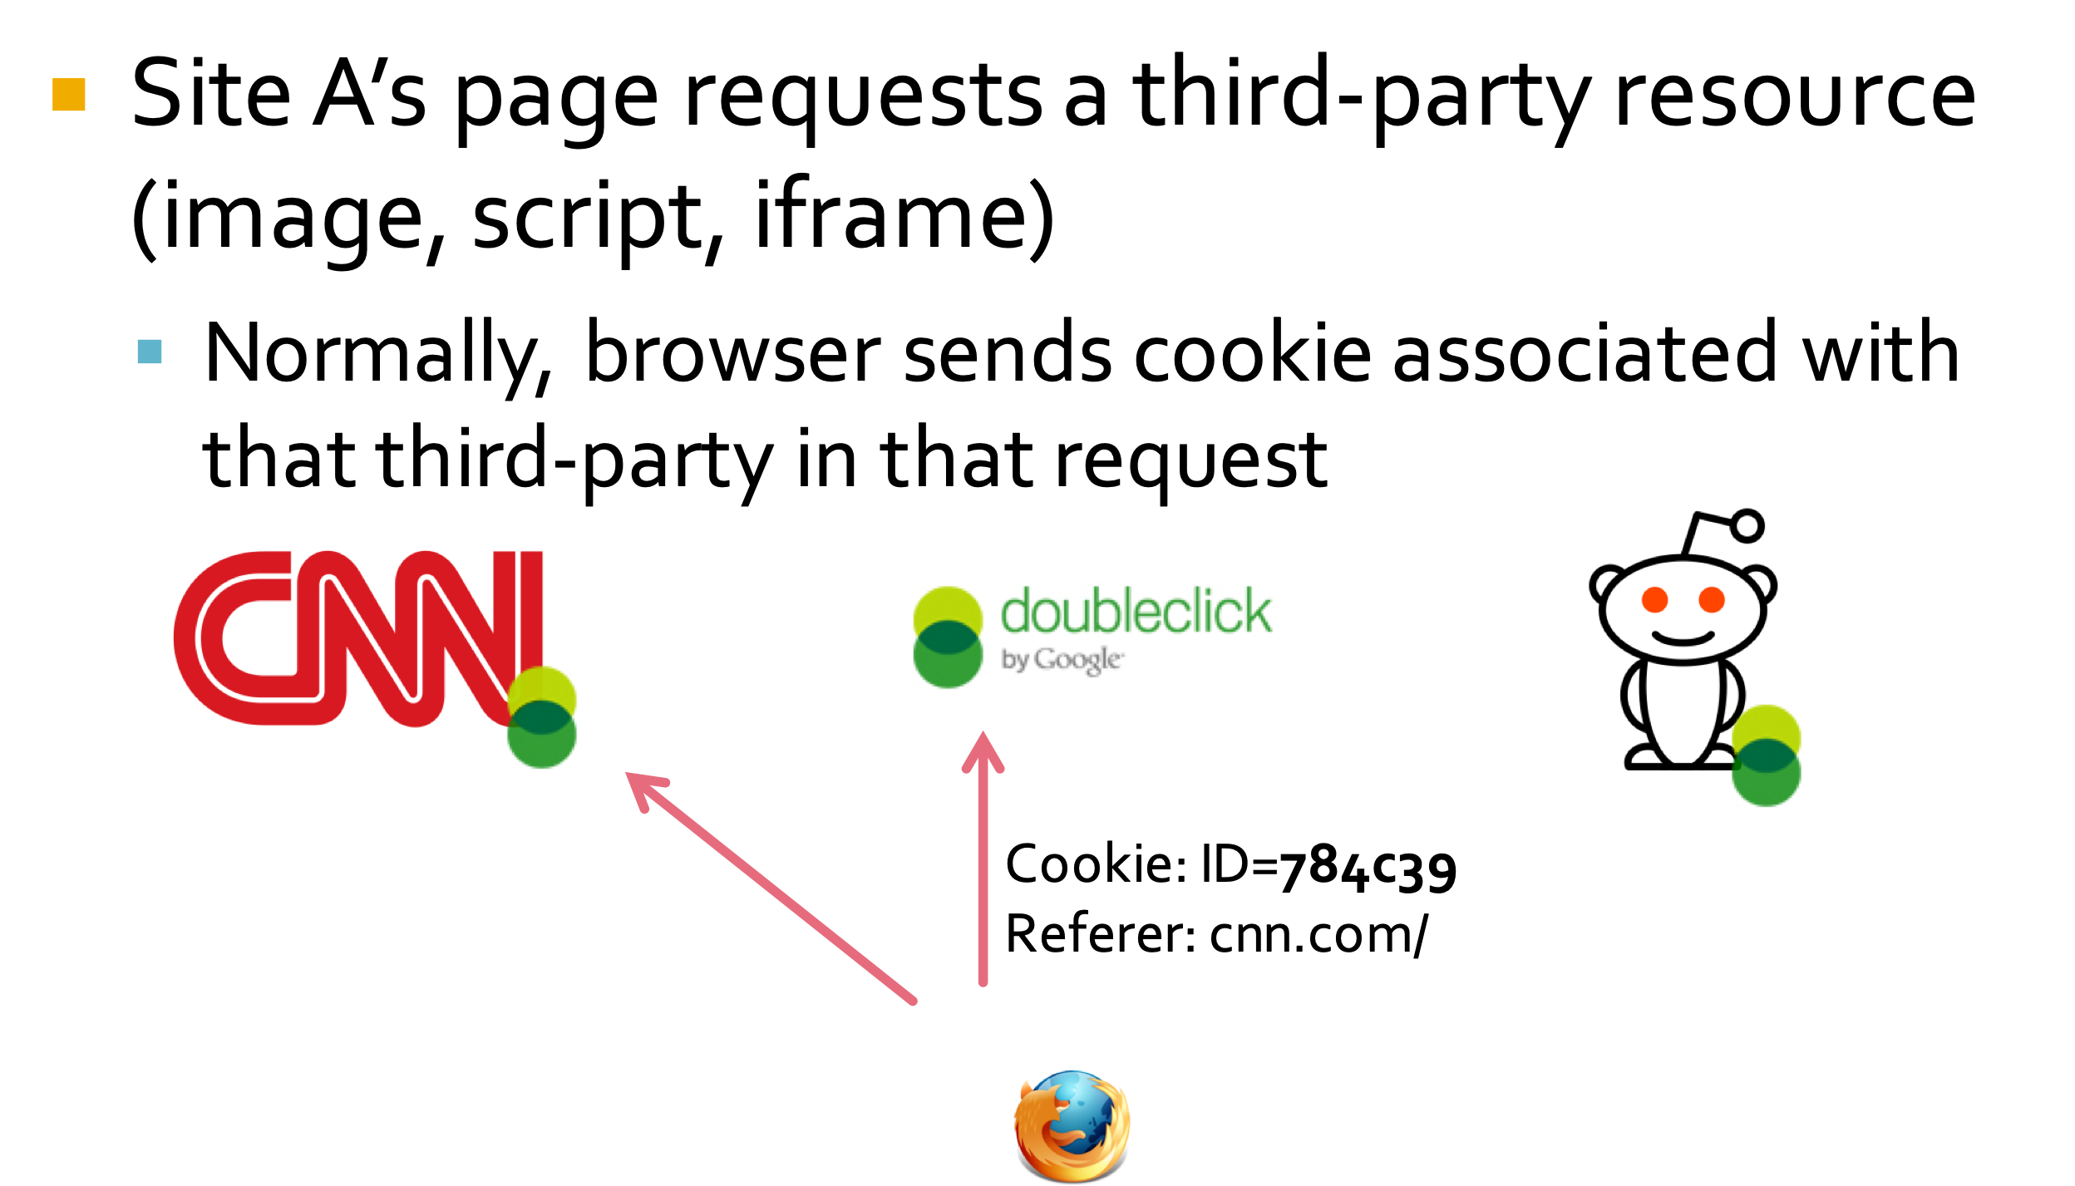
Third Party Cookies
Notes:
Third-party cookies are cookies that are set by a website other than the one you are currently on.

Slide 8



Third-Party Web Tracking
Cookies and Code
(CNN)
GET / HTTP/3
GET /facebook-like.js HTTP/3
Cookie: User=Deepak, Referer=cnn.com
(Facebook)
With this request, companies can link your cookie to your browsing data (e.g., through Referer header, Host headers, Origin, or just JavaScript)

Slide 9
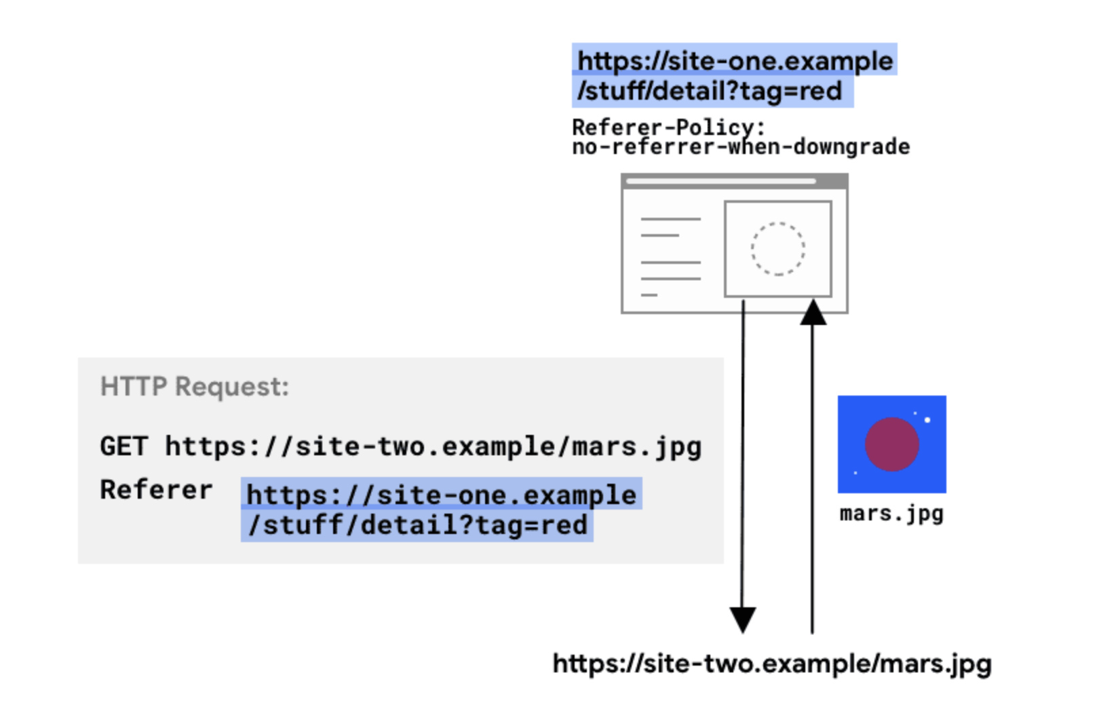
Web Tracking
Cookies and Code
What exactly is sent in the referer?

Slide 11
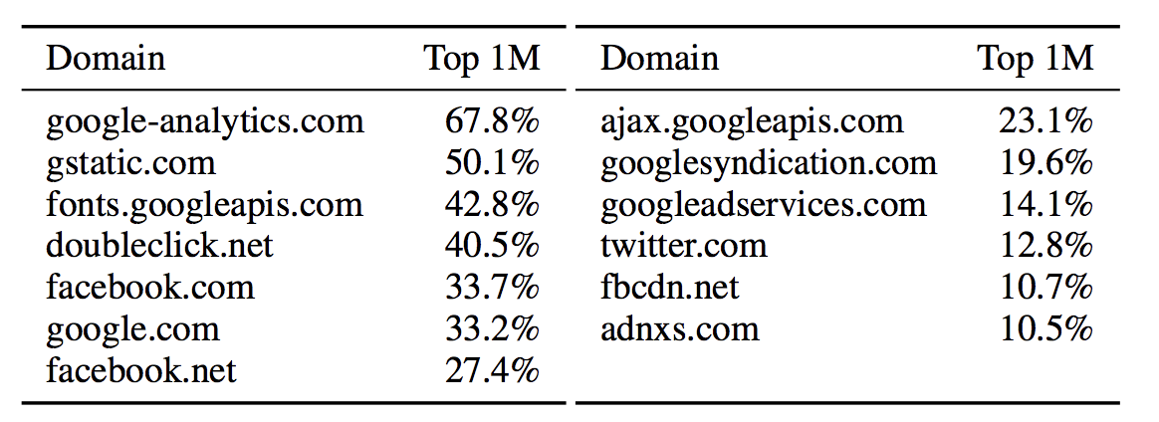
Third Party Cookies
Facebook, DoubleClick, etc. know much more about you than actual website does because they can track you across websites.
Notes:
Imagine visiting websites about healthcare, etc.

Slide 12
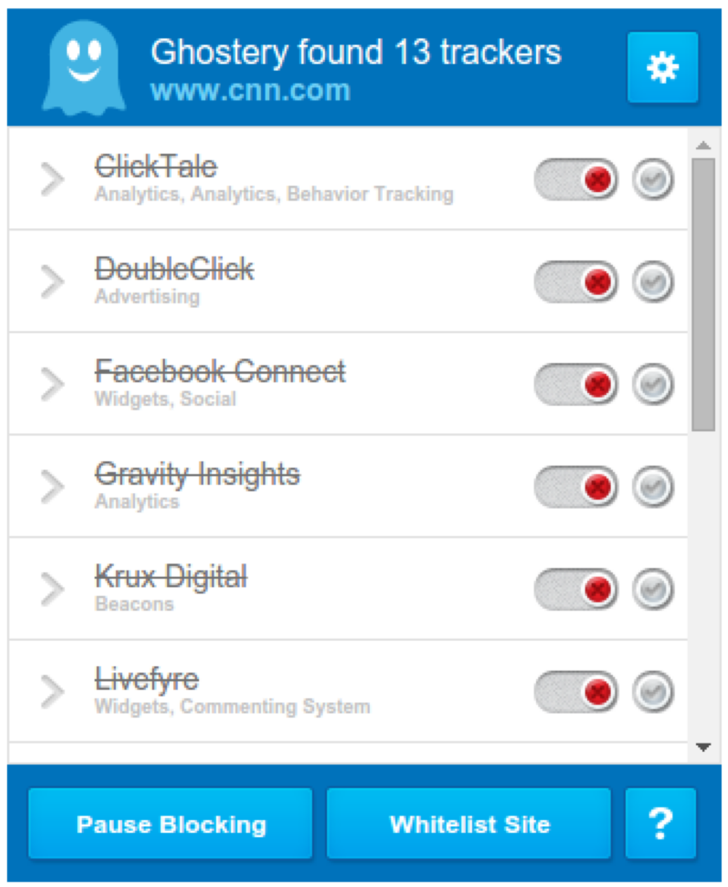
Ghostery
Notes:
Imagine visiting websites about healthcare, etc.

Slide 13
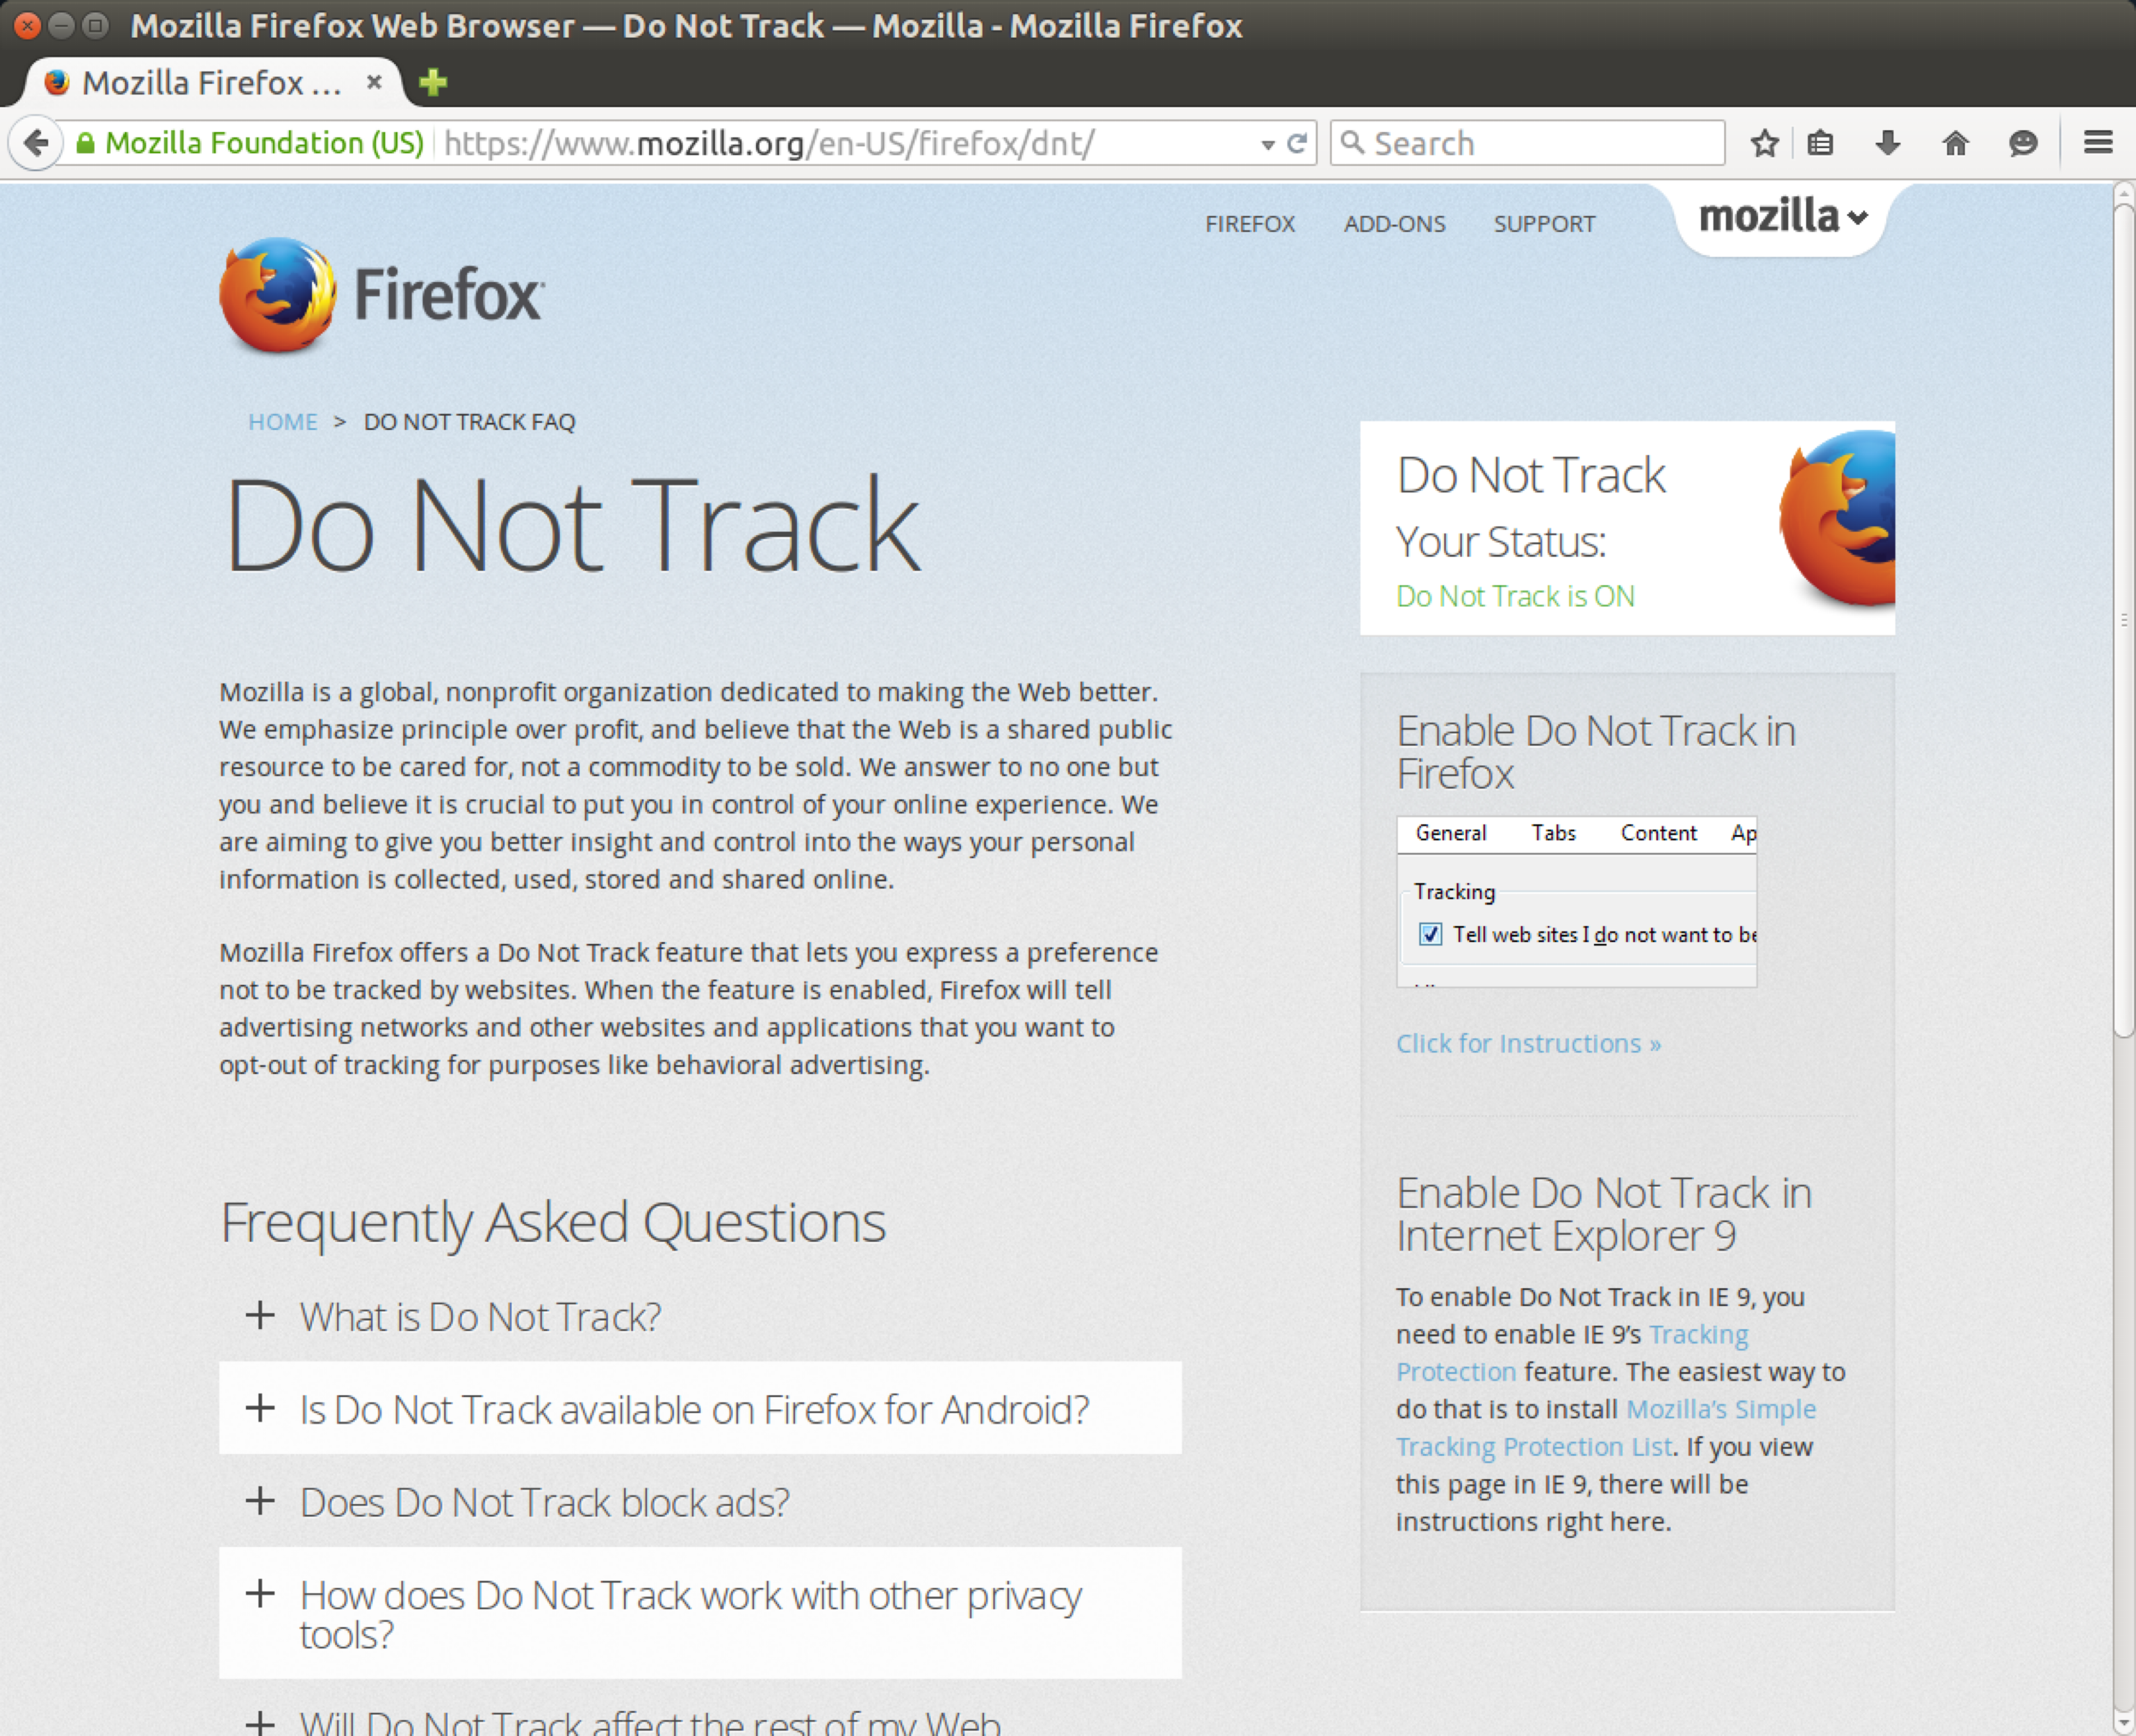
DNT
Notes:
There are no legal or technological requirements for the use of DNT. Websites and advertisers may either honor or ignore DNT requests. The Digital Advertising Alliance, Council of Better Business Bureaus and the Direct Marketing Association does not require its members to honor DNT signals. There are organizations such as DataNeutrality that are involved in setting DNT guidelines for private companies involved in data collection.

Slide 14
2024 — The Year of the End of Third Party Cookies?
Firefox:
  Third-Party Cookies from known trackers are dropped
  Third-party cookies use separate cookie jar per site, so they can't be used to track users across sites
Safari: Blocks third-party cookies
IE: blocks some third-party cookies based on baked-in blacklist
Edge does not block third-party cookies by default
Chrome announced that they will drop support for third party cookies by the end of 2024

Slide 15
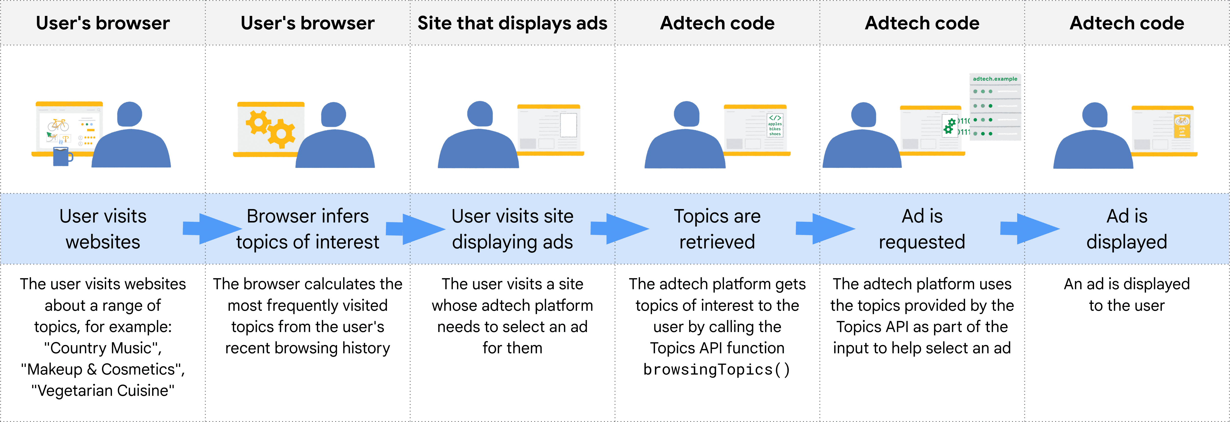
Google Topics
Topics are selected from a taxonomy consisting of hierarchical categories such as /Arts & Entertainment/Music & Audio/Soul & R&B and /Business & Industrial/Agriculture & Forestry.
The (maximum) three topics returned for a user are chosen at random from the top five for the past three epochs (with a 5% chance of getting a random topic).

Slide 16
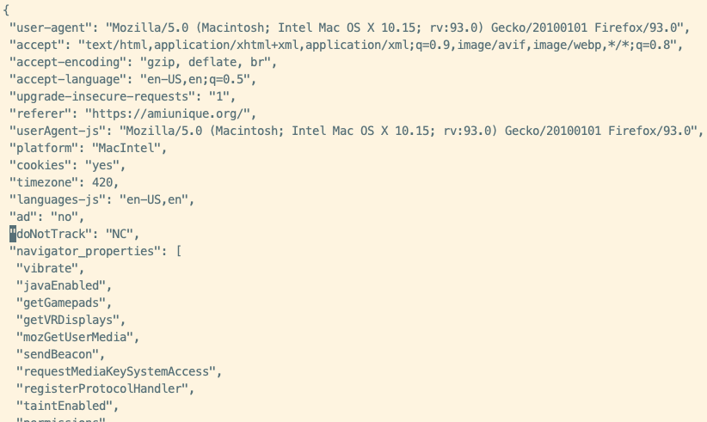
Web Tracking
Browser Fingerprinting
Websites can also fingerprint you effectively with browser fingerprinting, which is a technique that leverages all your settings to identify you, and stores this in a cookie on your browser
  https://amiunique.org/
So long as JavaScript can run (by third-parties), you run the risk of being “followed” on the web

Slide 17
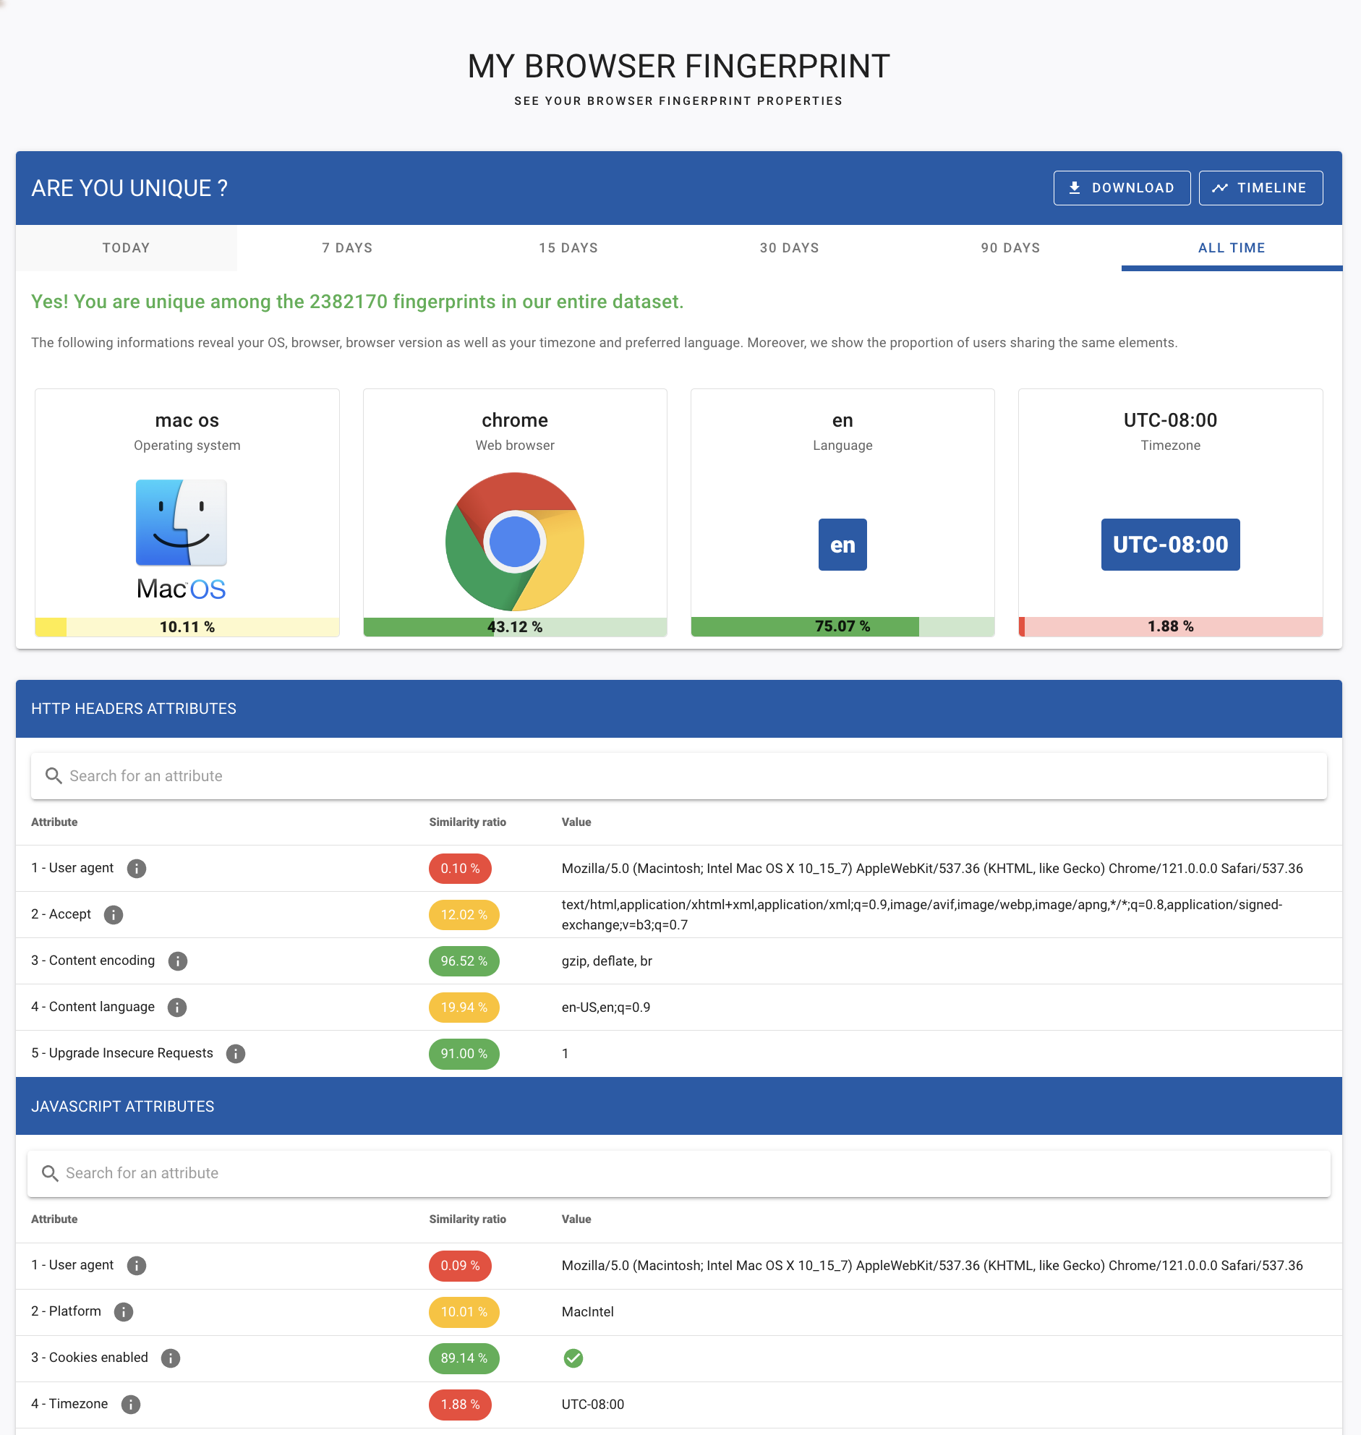
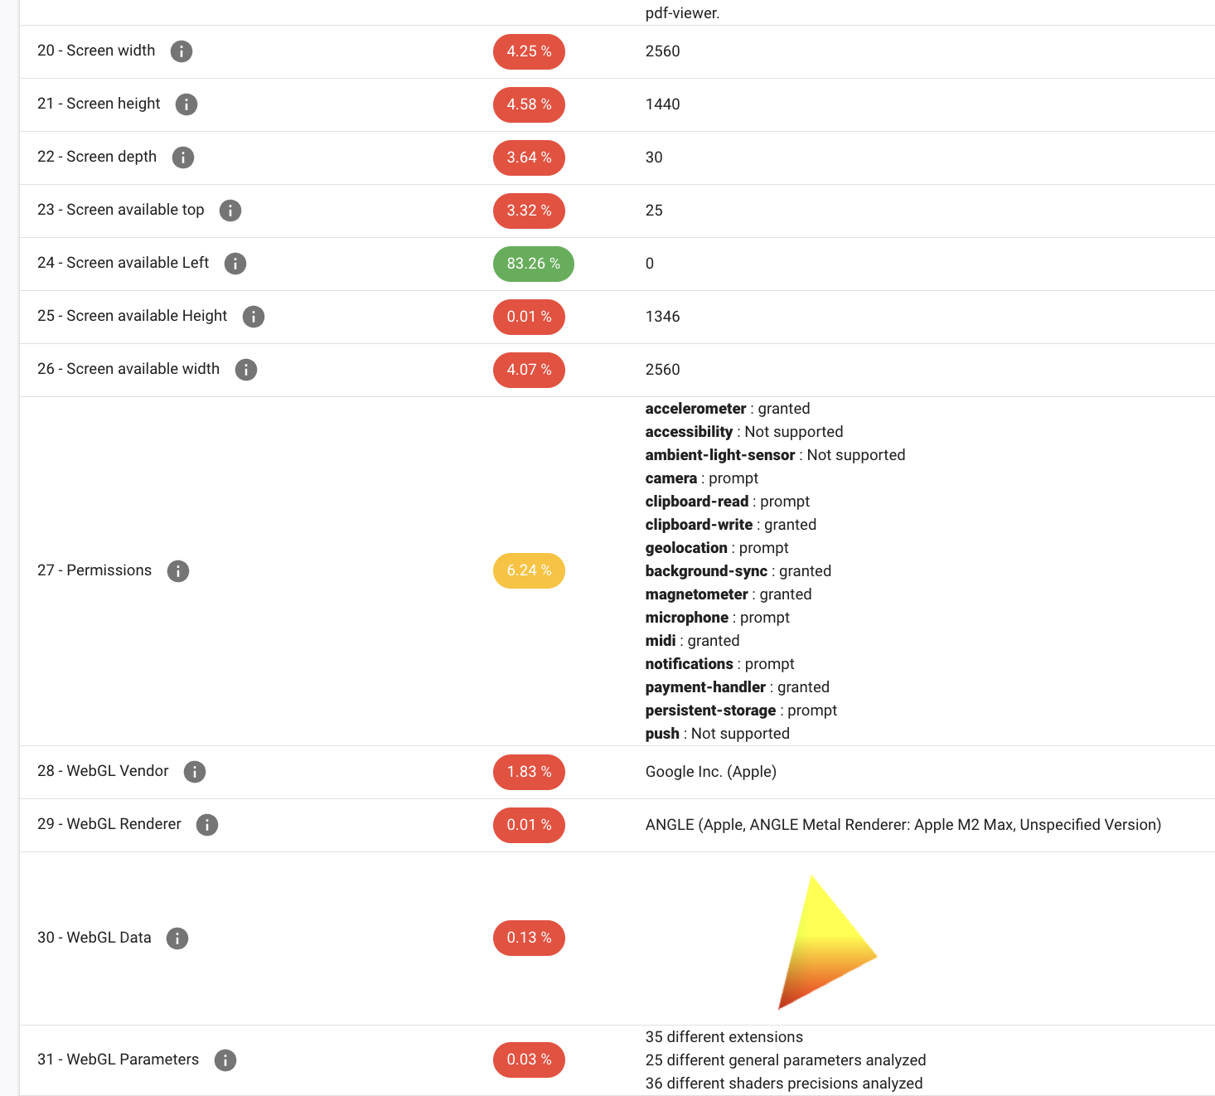

Slide 18
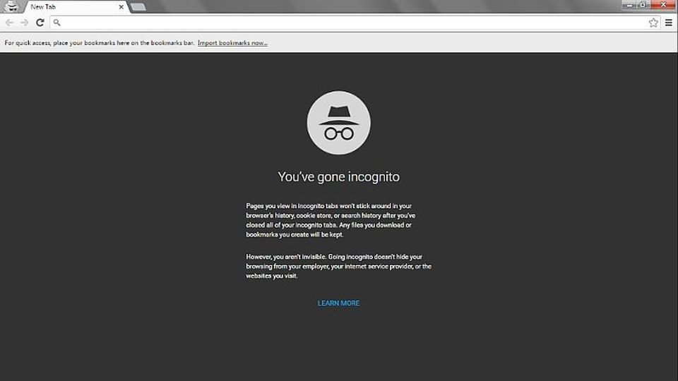
Notes:
Imagine visiting websites about healthcare, etc.

Slide 19
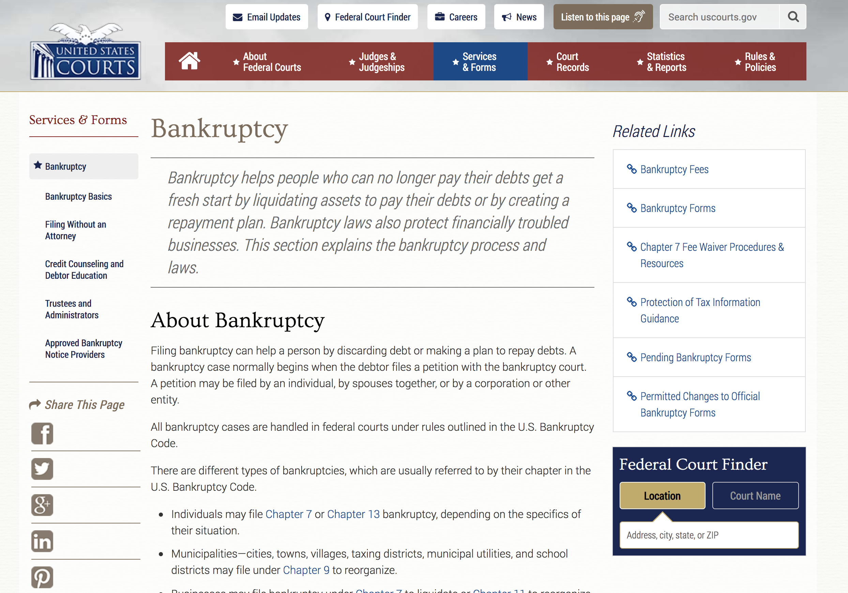
Notes:
You also probably don’t want your landlord to know you’re pregnant either though…

Slide 20
Privacy Enhancing Technologies
  Methods for protecting personal data
  Most Common/Successful? TLS.
  Comes with browser. Also used for protecting email. It just works, without you having to configure anything. Protects contents of communication from passive eavesdroppers and active MITM attacks.
  Tools that provide confidentiality also provide some privacy. You probably don't want your landlord or coffee shop customers to learn things about you.
Notes:
Nothing to Hide argument: used as justification for surveillance, ignores non-secrecy understandings of privacy. Often used to justify surveillance while ignoring the potential problems of data aggregation and lack of transparency in information processing.
Privacy very much linked to surveillance. When a dossier of information collected about you, this can be used to construct stories about you. This story may be made up of a series of facts, but the picture it paints not necessarily accurate.

Slide 21
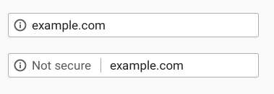
Encouraging HTTPS Adoption
2014: HTTPS used as a page rank indicator
Early 2018: Mozilla announces that new features will require HTTPS
Late 2018: New Chrome HTTPS indicators
(HTTPS)
(HTTP)

Slide 22
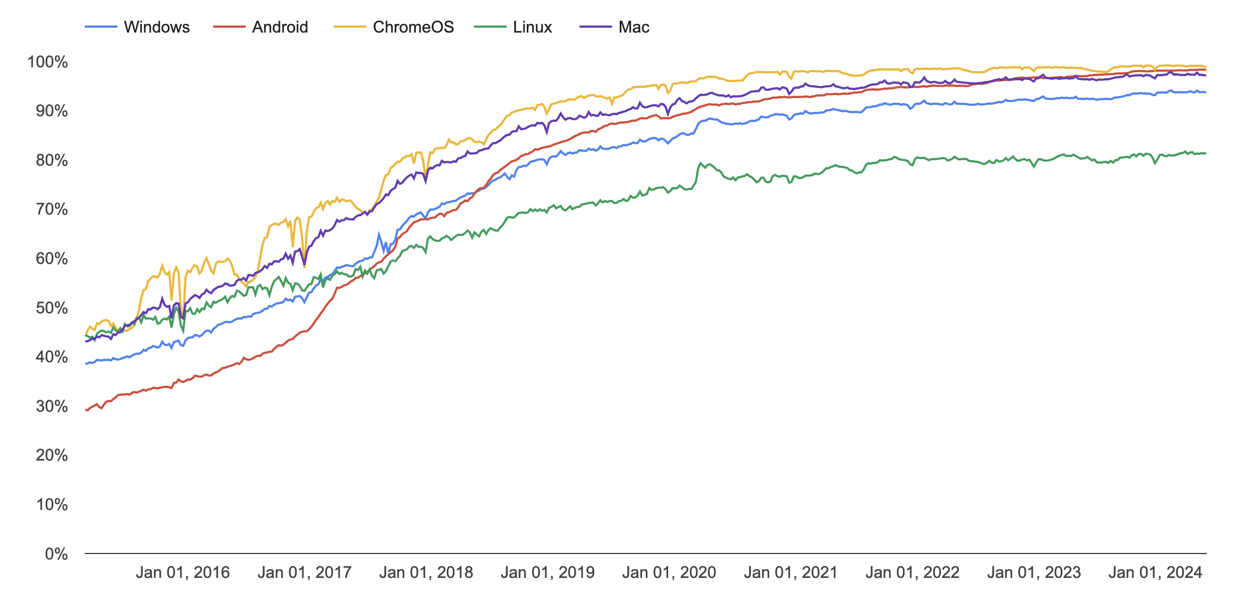
Chrome Page Loads over HTTPS
Google Transparency Report

Slide 23
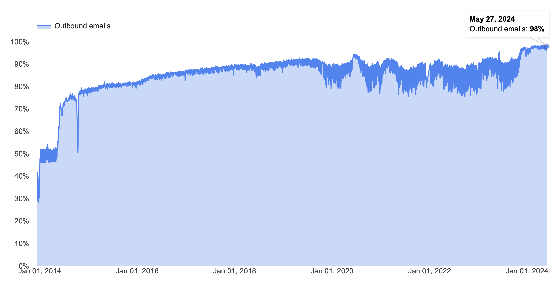
STARTTLS as seen by Gmail

Slide 24
Protecting Metadata
  TLS only protects content. What doesn’t TLS protect against?
  We may want to protect metadata:
  Who is visiting what websites? Who is sending messages to whom?
  Gov’t might not like that you’re visiting Human Rights Watch website
  Gov’t might not be amused that you’re sending messages to Human Rights Watch
  We may want to hide the existence of the message (maybe sending an encrypted message at all is going to cause you problems)

Slide 25
What is Anonymity?
  Anonymity (“without name’’) means that a person is not identifiable within a set of subjects
  Unlinkability of action and identity
  - For example, sender and his email are no more related after adversary’s observations than they were before
  - Who talks to whom
  Unobservability
  - Adversary cannot tell whether someone is using a particular system and/or protocol
Notes:
Often times, what folks want is “anonymity”

Slide 26
Why Anonymity?
  To protect privacy:
  - Avoid tracking by advertising companies
  - Viewing sensitive content
  - Information on medical conditions
  - Advice on bankruptcy
  Protection from prosecution
  - Not every country guarantees free speech
  To prevent chilling-effects
  - It’s easier to voice unpopular or controversial opinions if you are anonymous
Notes:
Nothing to Hide argument: used as justification for surveillance, ignores non-secrecy understandings of privacy. Often used to justify surveillance while ignoring the potential problems of data aggregation and lack of transparency in information processing.
Privacy very much linked to surveillance. When a dossier of information collected about you, this can be used to construct stories about you. This story may be made up of a series of facts, but the picture it paints not necessarily accurate.

Slide 27
Anonymity is Hard
  Internet anonymity is hard…
Right there in every packet is the source and destination IP address
ISPs store communications records
- Law enforcement can subpoena these records
  Wireless traffic can be trivially intercepted
  Tier 1 ASs and IXPs are compromised — NSA, GCHQ, “Five Eyes”
Notes:
Nothing to Hide argument: used as justification for surveillance, ignores non-secrecy understandings of privacy. Often used to justify surveillance while ignoring the potential problems of data aggregation and lack of transparency in information processing.
Privacy very much linked to surveillance. When a dossier of information collected about you, this can be used to construct stories about you. This story may be made up of a series of facts, but the picture it paints not necessarily accurate.

Slide 28
Anonymity
Difficult if not impossible to achieve on your own
You generally need help.
State of the art technique: Ask someone else to send it for you
Notes:
Nothing to Hide argument: used as justification for surveillance, ignores non-secrecy understandings of privacy. Often used to justify surveillance while ignoring the potential problems of data aggregation and lack of transparency in information processing.
Privacy very much linked to surveillance. When a dossier of information collected about you, this can be used to construct stories about you. This story may be made up of a series of facts, but the picture it paints not necessarily accurate.

Slide 29
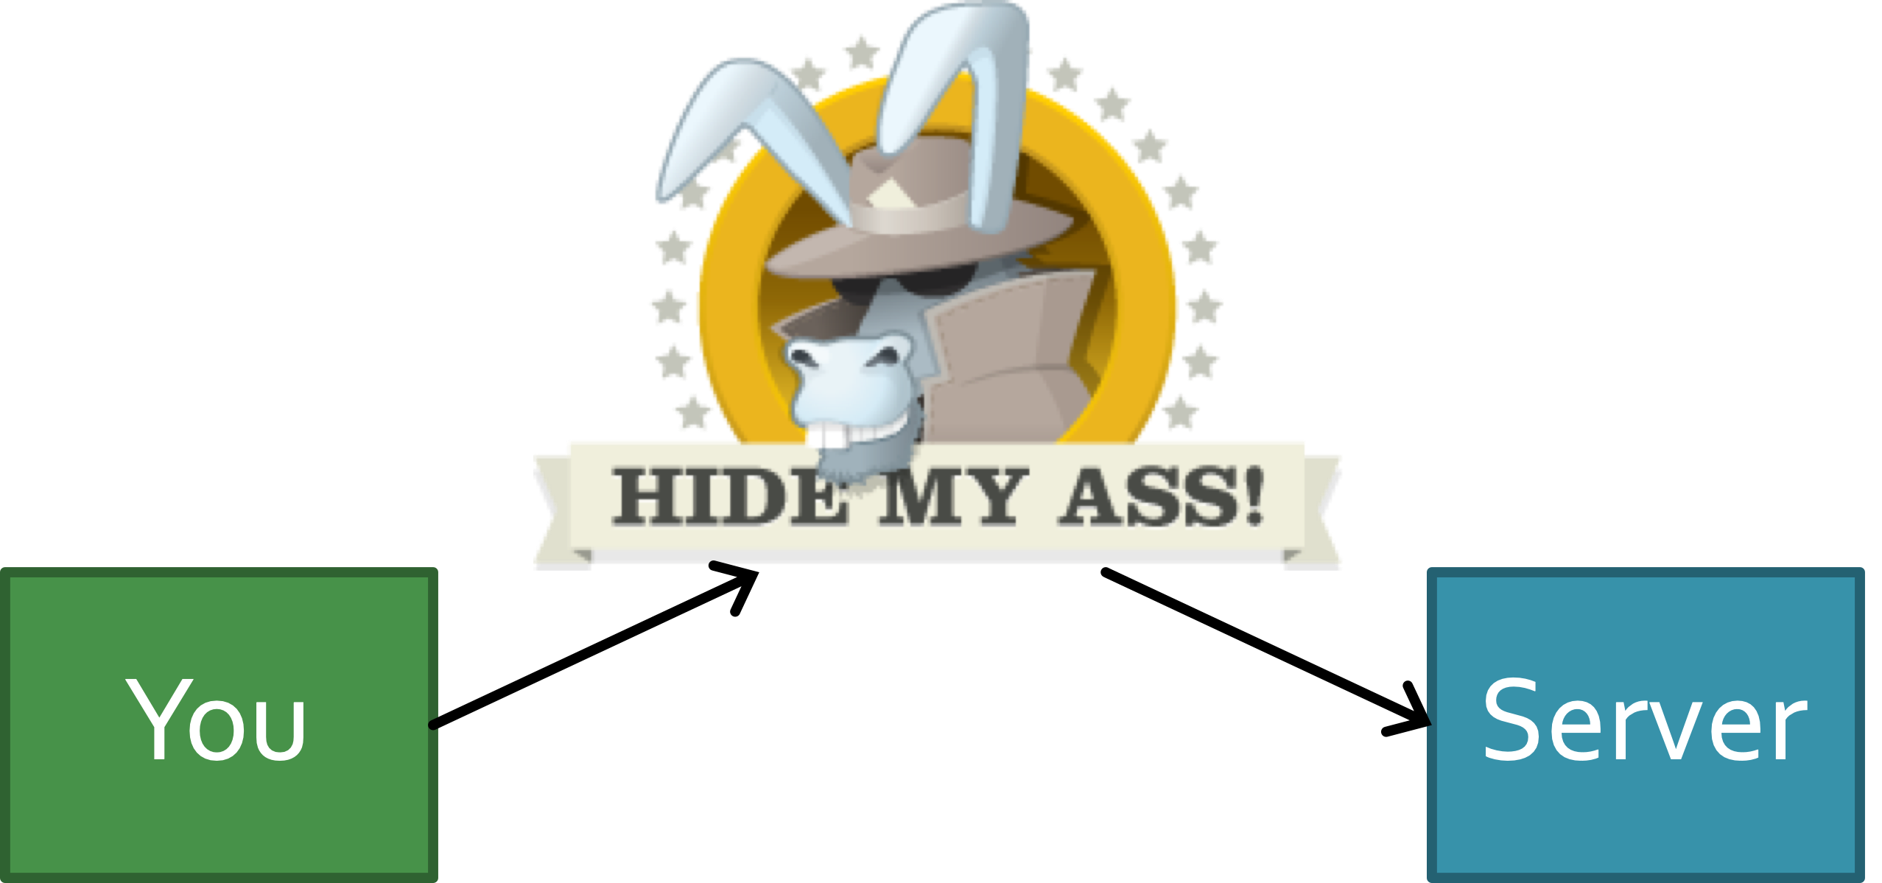
Naive approach .... VPNs
Notes:
Technical problems:
-VPNs generally not designed with anonymity in mind (e.g., ability to work remotely and connect to corporate networks)
-Even a single leaked DNS request or TCP SYN can identify user, but this might be OK for original purpose of VPN
-using a single browser for both anonymous and non-anonymous browsing - e.g., leaked cookies
-browser fingerprinting can uniquely identify you
Non-techical problems:
- You have to trust the VPN completely.
- One single point of failure with full visibility into your metadata (and, if you are using e2e with destination, content)

Slide 30
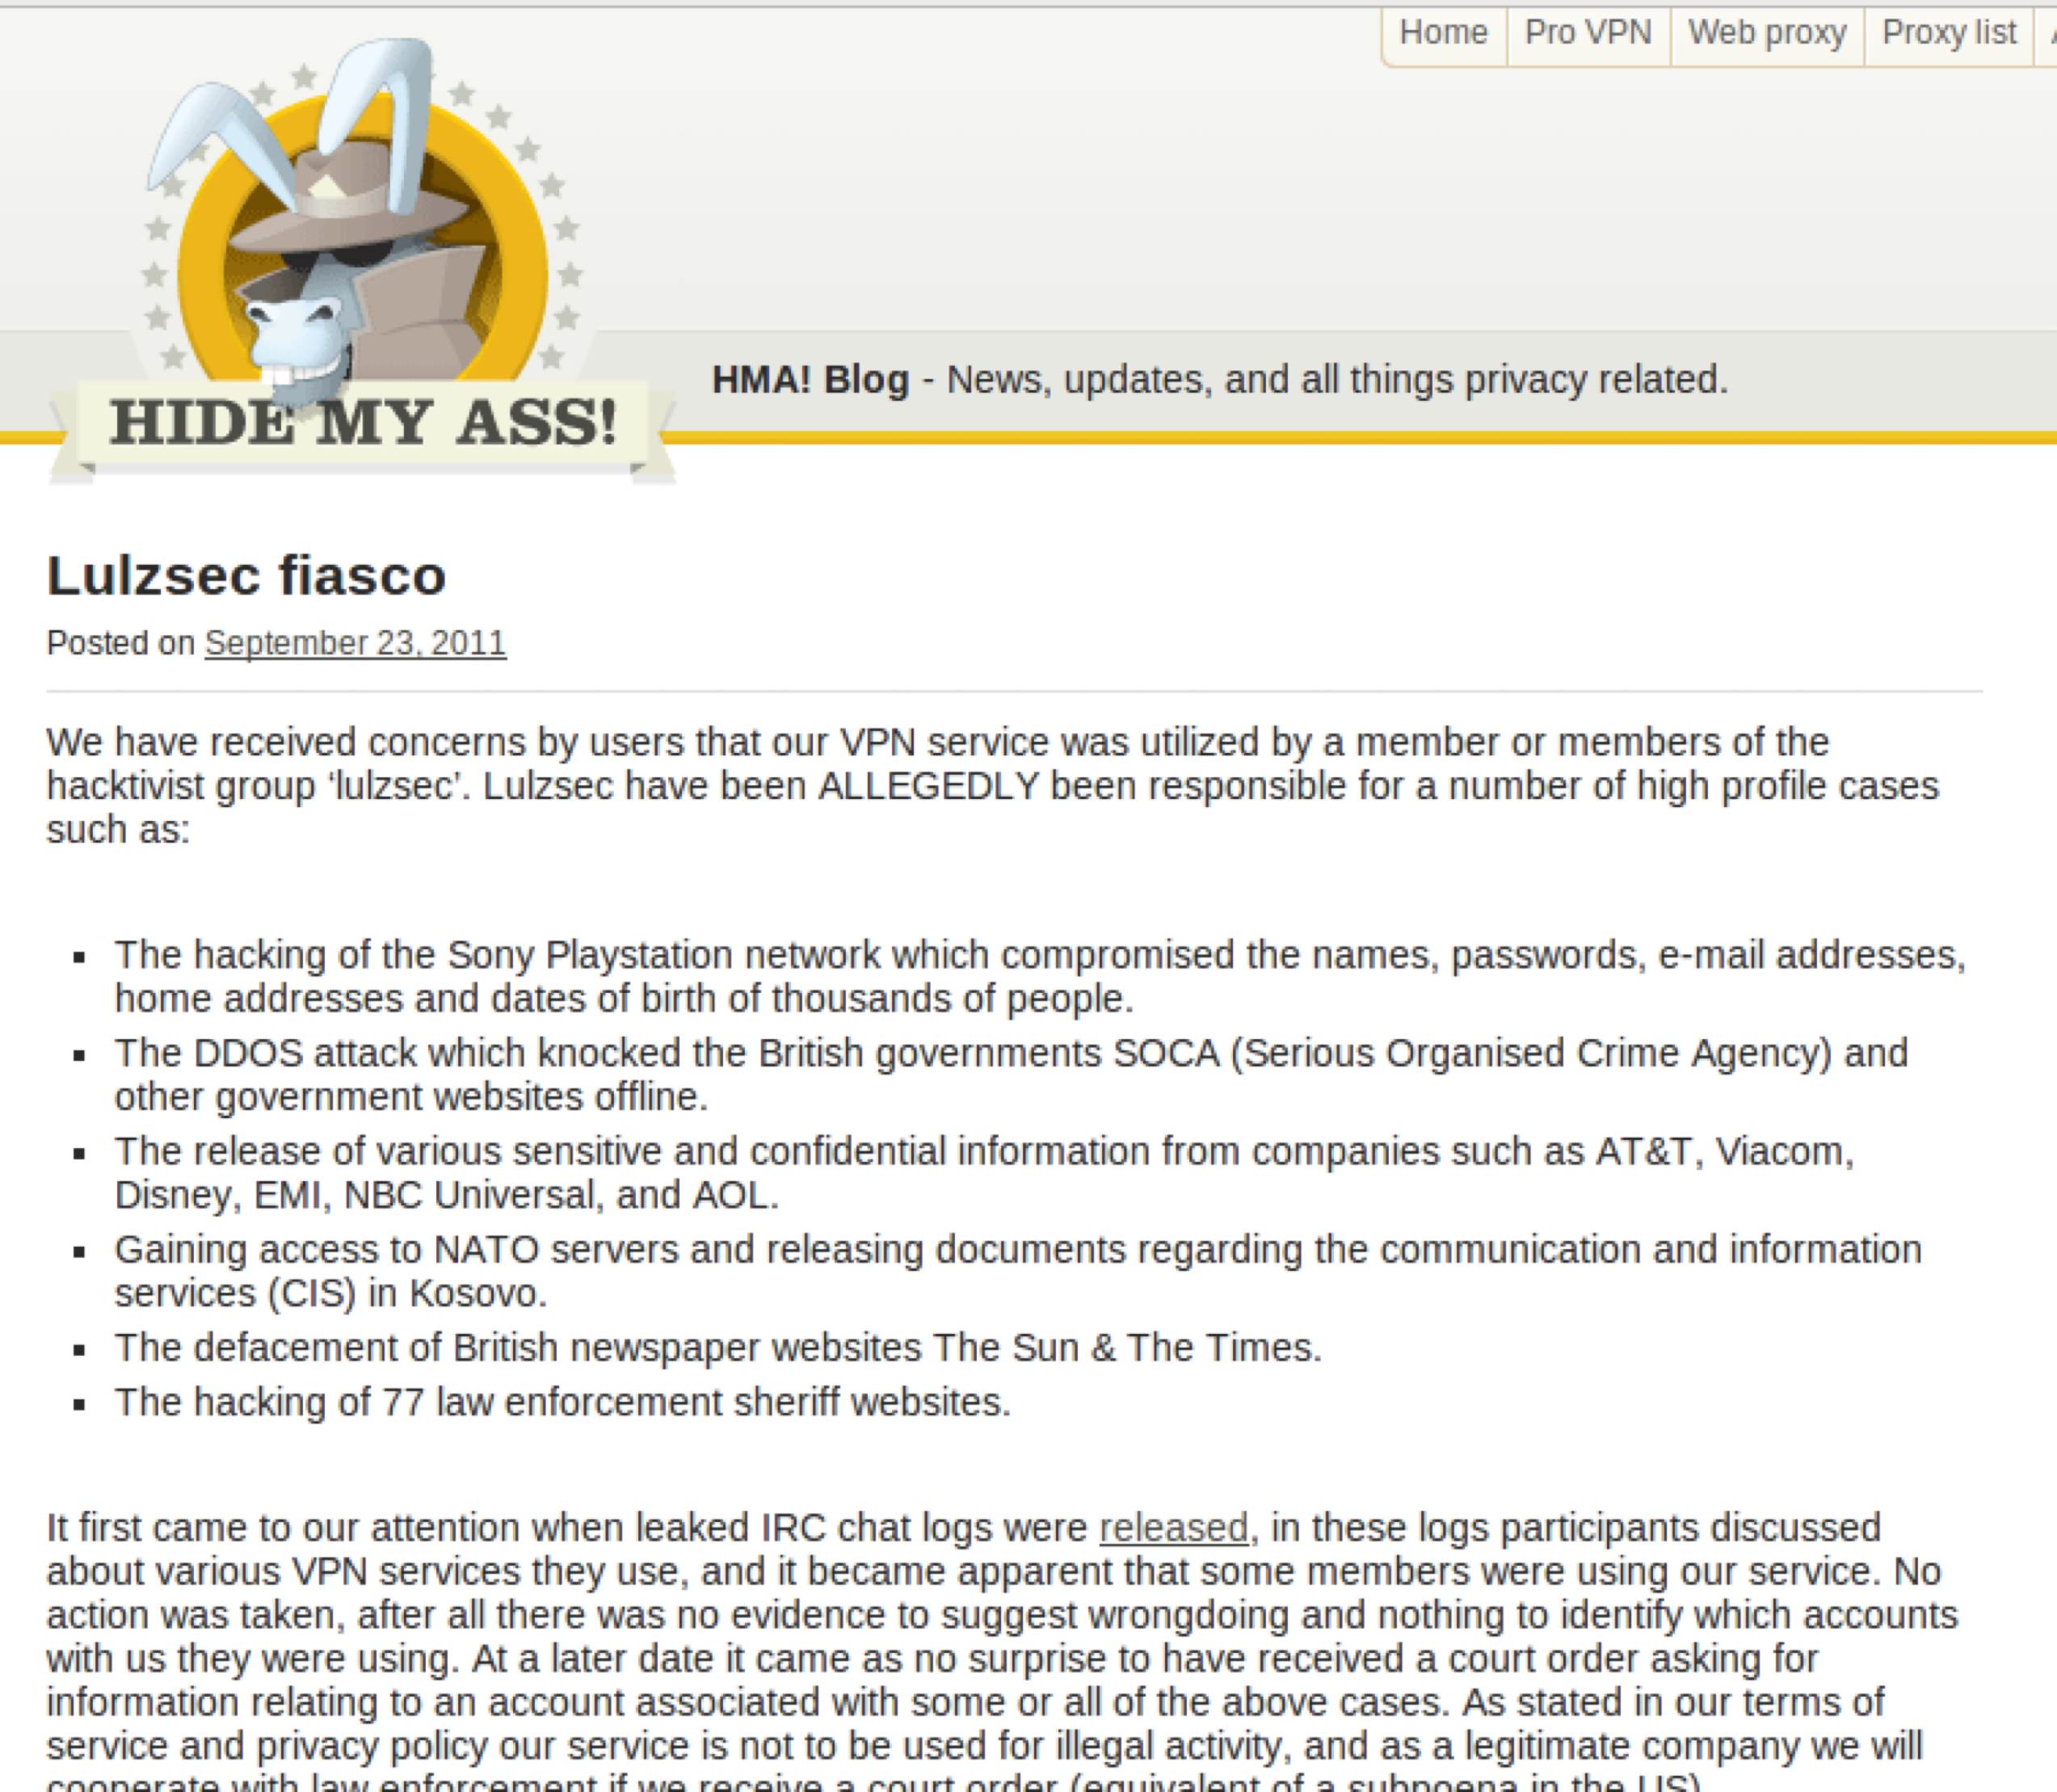
Naive approach .... VPNs

Slide 31
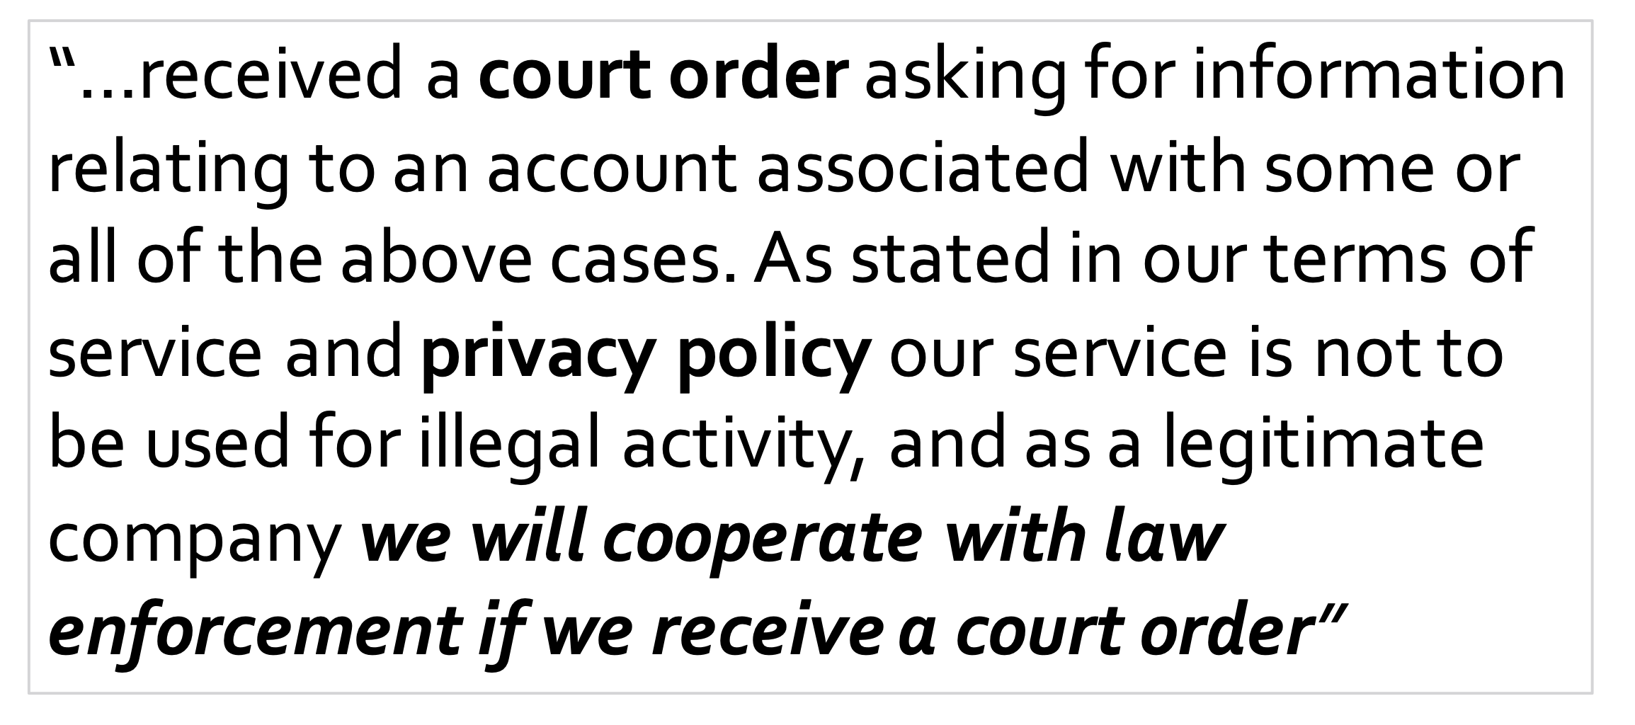
Naive approach .... VPNs
Notes:
Not that hidemyass.com is doing anything wrong here – they are simply complying with the local laws (otherwise THEY get shut down or go to jail). But it shows it’s not a great technical solution for anonymity, as it ultimately trusts the government.

Slide 32

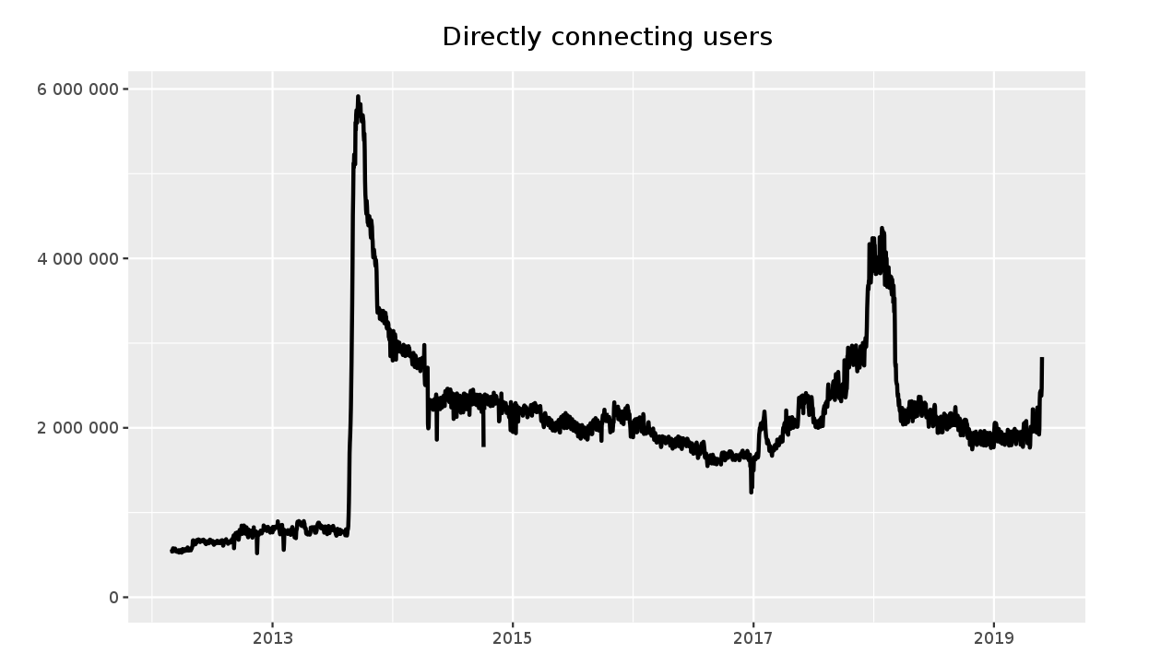
Tor is a successful privacy enhancing technology that works at the transport layer
Millions of active users.
Normally, a TCP connection reveals your IP address
Tor allows TCP connections without revealing your IP
Notes:
Nothing to Hide argument: used as justification for surveillance, ignores non-secrecy understandings of privacy. Often used to justify surveillance while ignoring the potential problems of data aggregation and lack of transparency in information processing.
Privacy very much linked to surveillance. When a dossier of information collected about you, this can be used to construct stories about you. This story may be made up of a series of facts, but the picture it paints not necessarily accurate.

Slide 33
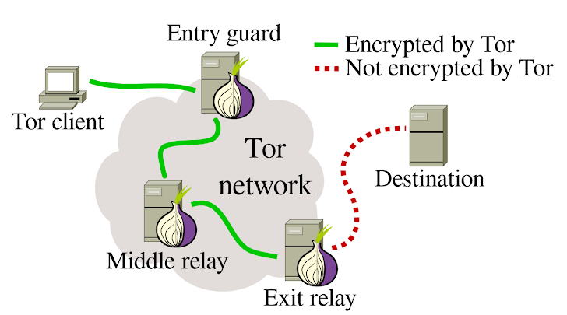
Tor (“The Onion Router”)
  Tor operates by tunneling traffic through multiple “onion routers” using public key cryptography
Notes:
Nothing to Hide argument: used as justification for surveillance, ignores non-secrecy understandings of privacy. Often used to justify surveillance while ignoring the potential problems of data aggregation and lack of transparency in information processing.
Privacy very much linked to surveillance. When a dossier of information collected about you, this can be used to construct stories about you. This story may be made up of a series of facts, but the picture it paints not necessarily accurate.

Slide 34
Who Knows What?
Entry node: knows Alice is using Tor, and identity of middle node, but not destination
Exit node: knows some Tor user is connecting to destination, but not which user
Destination: knows a Tor user is connecting to it via the exit node
Tor does not provide encryption between exit and destination (use HTTPS!)
Notes:
Nothing to Hide argument: used as justification for surveillance, ignores non-secrecy understandings of privacy. Often used to justify surveillance while ignoring the potential problems of data aggregation and lack of transparency in information processing.
Privacy very much linked to surveillance. When a dossier of information collected about you, this can be used to construct stories about you. This story may be made up of a series of facts, but the picture it paints not necessarily accurate.

Slide 35
Does Tor Provide Anonymity?
  Tor provides for anonymity in TCP connections over the Internet, both unlinkably (long-term) and linkably (short-term).
  What does this mean?
  • There’s no long-term identifier for a Tor user
  • If a web server gets a connection from Tor today, and another one tomorrow, it won’t be able to tell whether those are from the same person
  • But two connections in quick succession from the same Tor node are more likely to in fact be from the same person
Notes:
Nothing to Hide argument: used as justification for surveillance, ignores non-secrecy understandings of privacy. Often used to justify surveillance while ignoring the potential problems of data aggregation and lack of transparency in information processing.
Privacy very much linked to surveillance. When a dossier of information collected about you, this can be used to construct stories about you. This story may be made up of a series of facts, but the picture it paints not necessarily accurate.

Slide 36
Tor Challenges
Performance: message bounces around a lot (can be slow)
Attack: government can coerce server operates in one country
Defense: use mix servers in different legal jurisdictions
Attack: adversary operates all of the mixes
Defense: have lots of mix servers (Tor has ~7,000 onion routers today). Use diverse set.
Attack: adversary observes when Alice sends and when Bob receives, links the two together
A side channel attack – exploits timing information
Defenses: pad messages, introduce significant delays
Tor does the former, but notes that it’s not enough for defense

Slide 37
Guard Relays
How do you protect against an adversary creating a large number of onion routers and performing timing observation at entrance and exits?
Limit the servers used for initial connection to a subset of trusted nodes:
- Have long and consistent uptimes…
- Have high bandwidth…
- Are manually vetted by the Tor community
Tor client selects 3 guard relays and uses them for 3 months

Slide 38
Exit Nodes
Relays must self-elect to be exit nodes. Why?
- Legal problems
- If someone does something malicious or illegal using Tor and the police trace the traffic, the trace leads to the exit node

Slide 39
Tor Hidden Services
As described, Tor protects the identity of the client, but not the server
What if we want to run an anonymous service?
- a website, where nobody knows the IP address?
Tor supports Hidden Services…
- Allows you to run a server without disclosing the IP or DNS name
Many hidden services
- Duck Duck Go, Tor Chat, Wikileaks

Slide 40
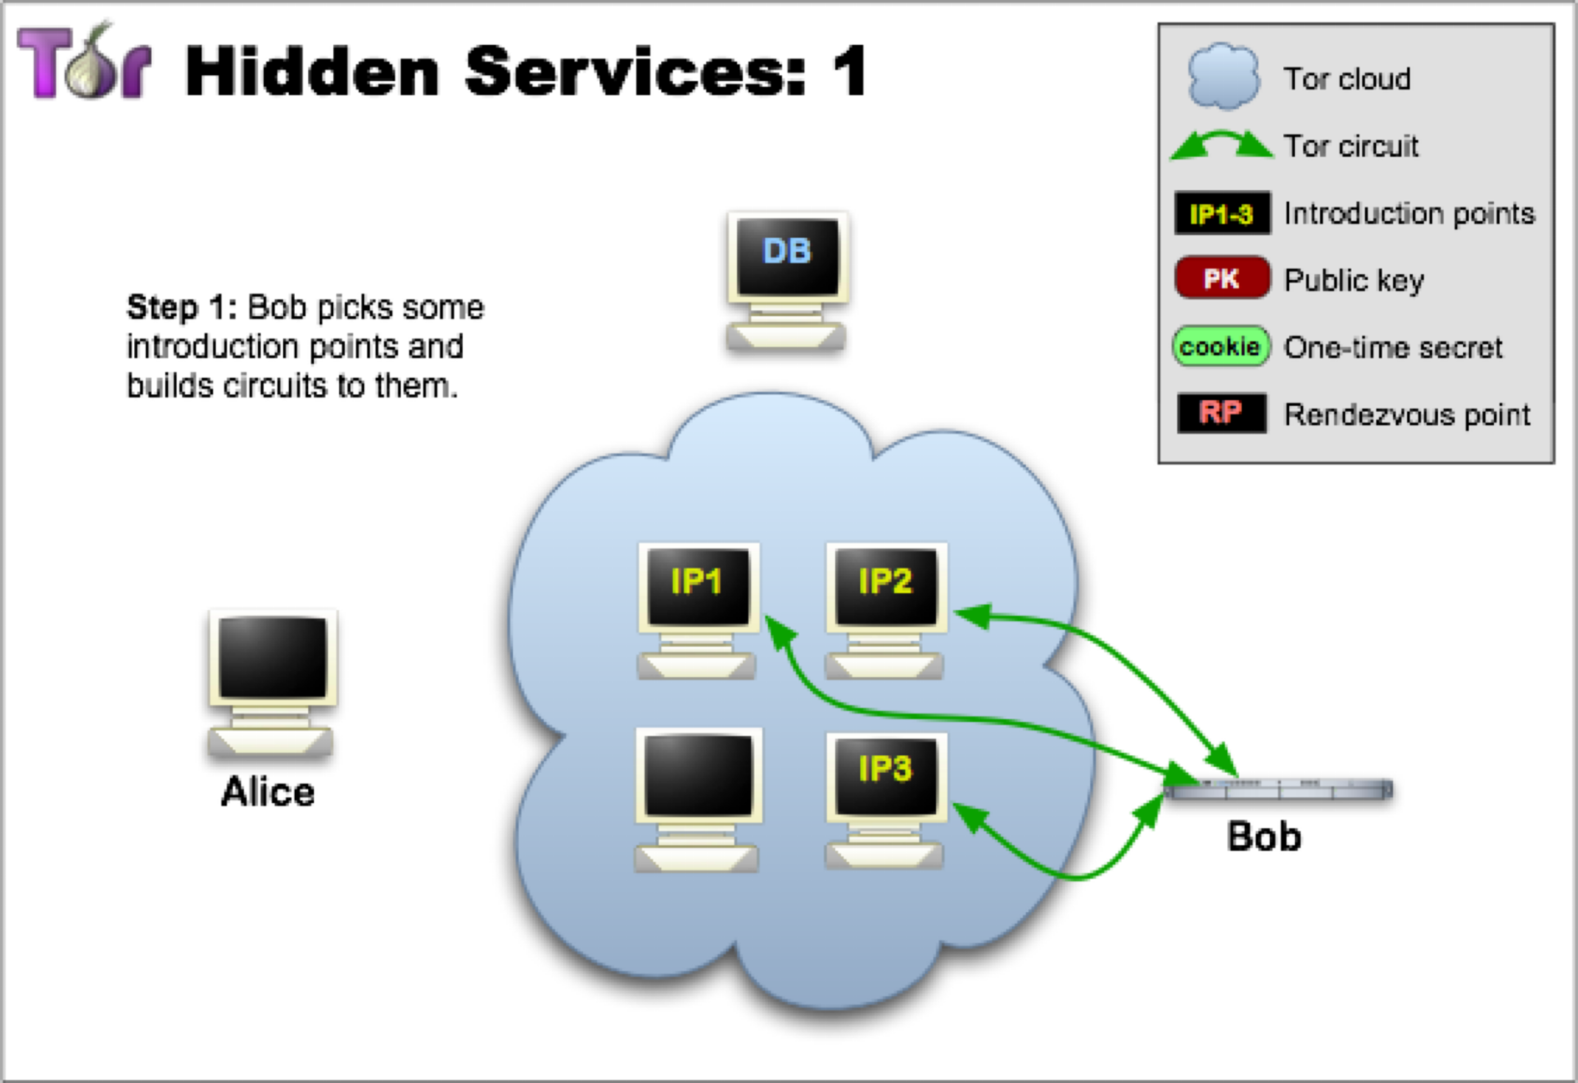

Slide 41
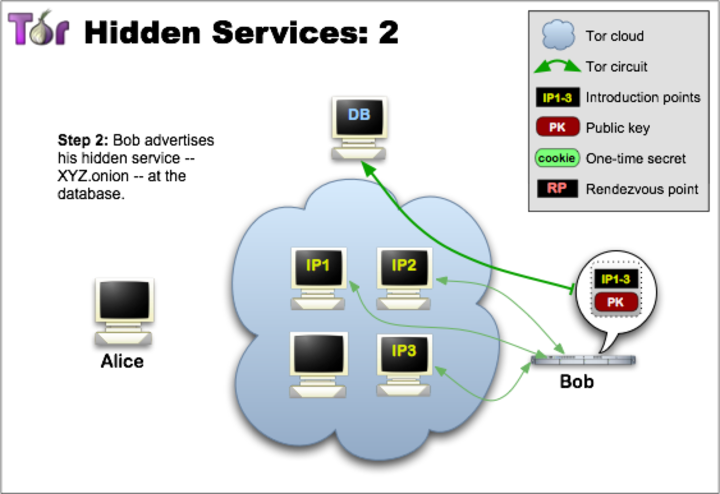

Slide 42
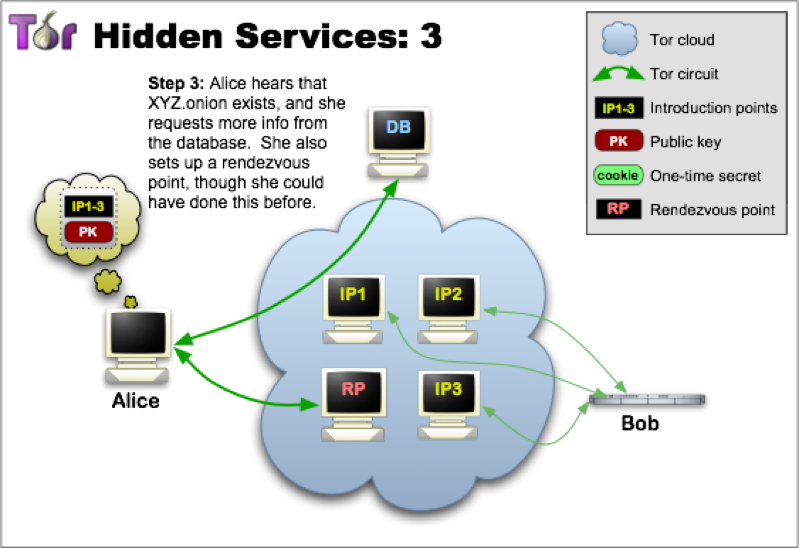

Slide 43
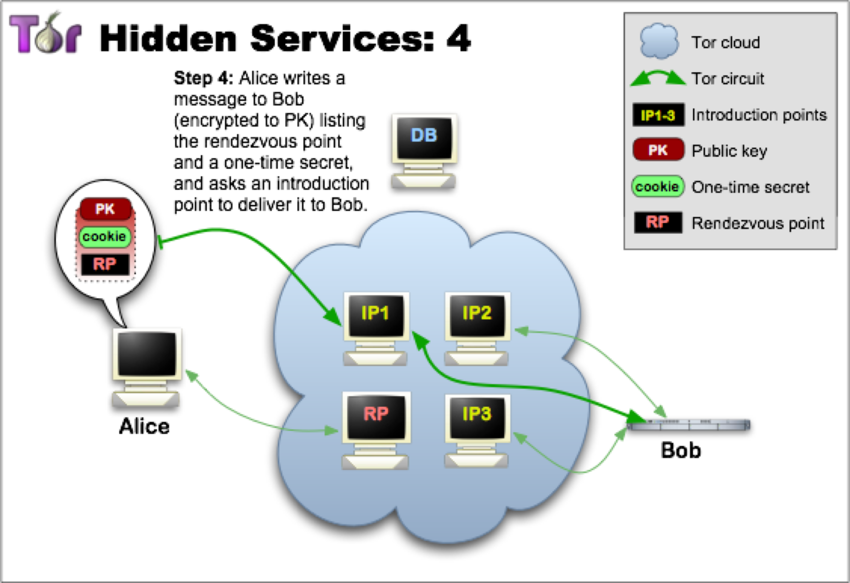

Slide 44
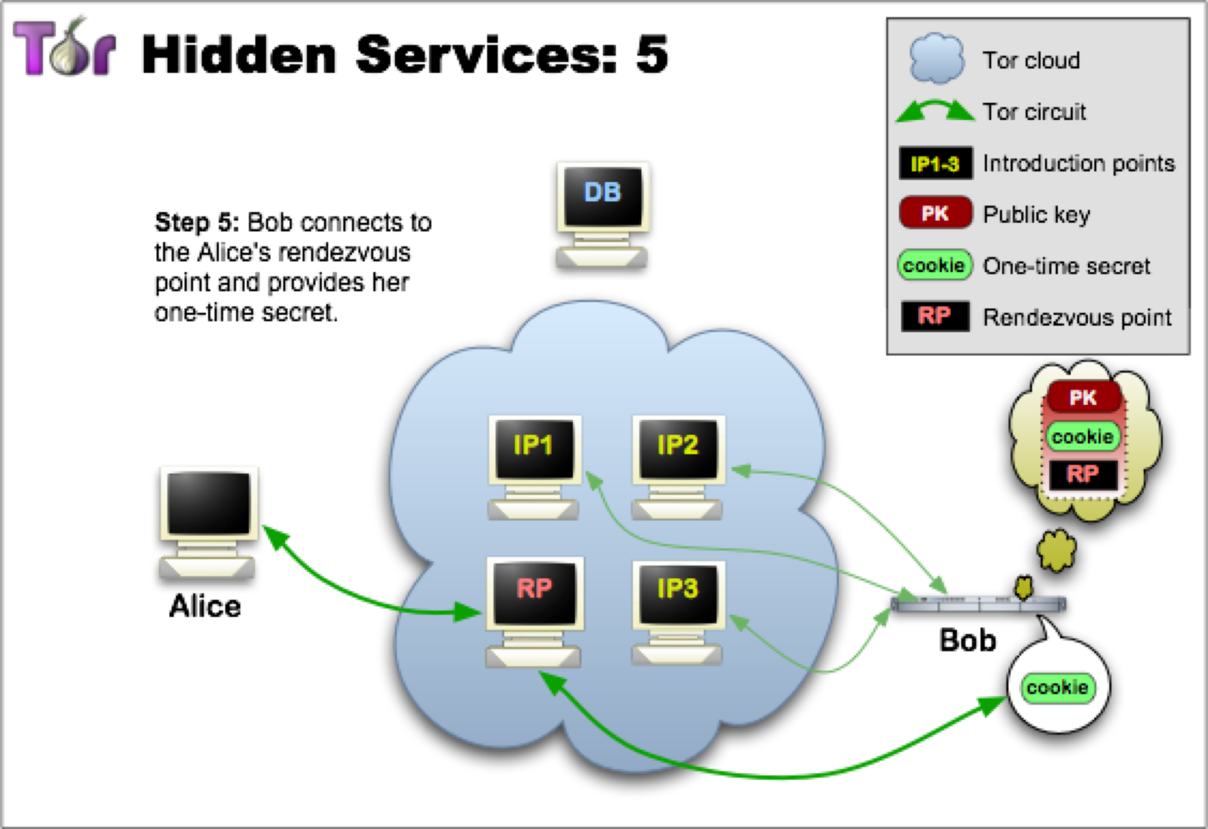

Slide 45
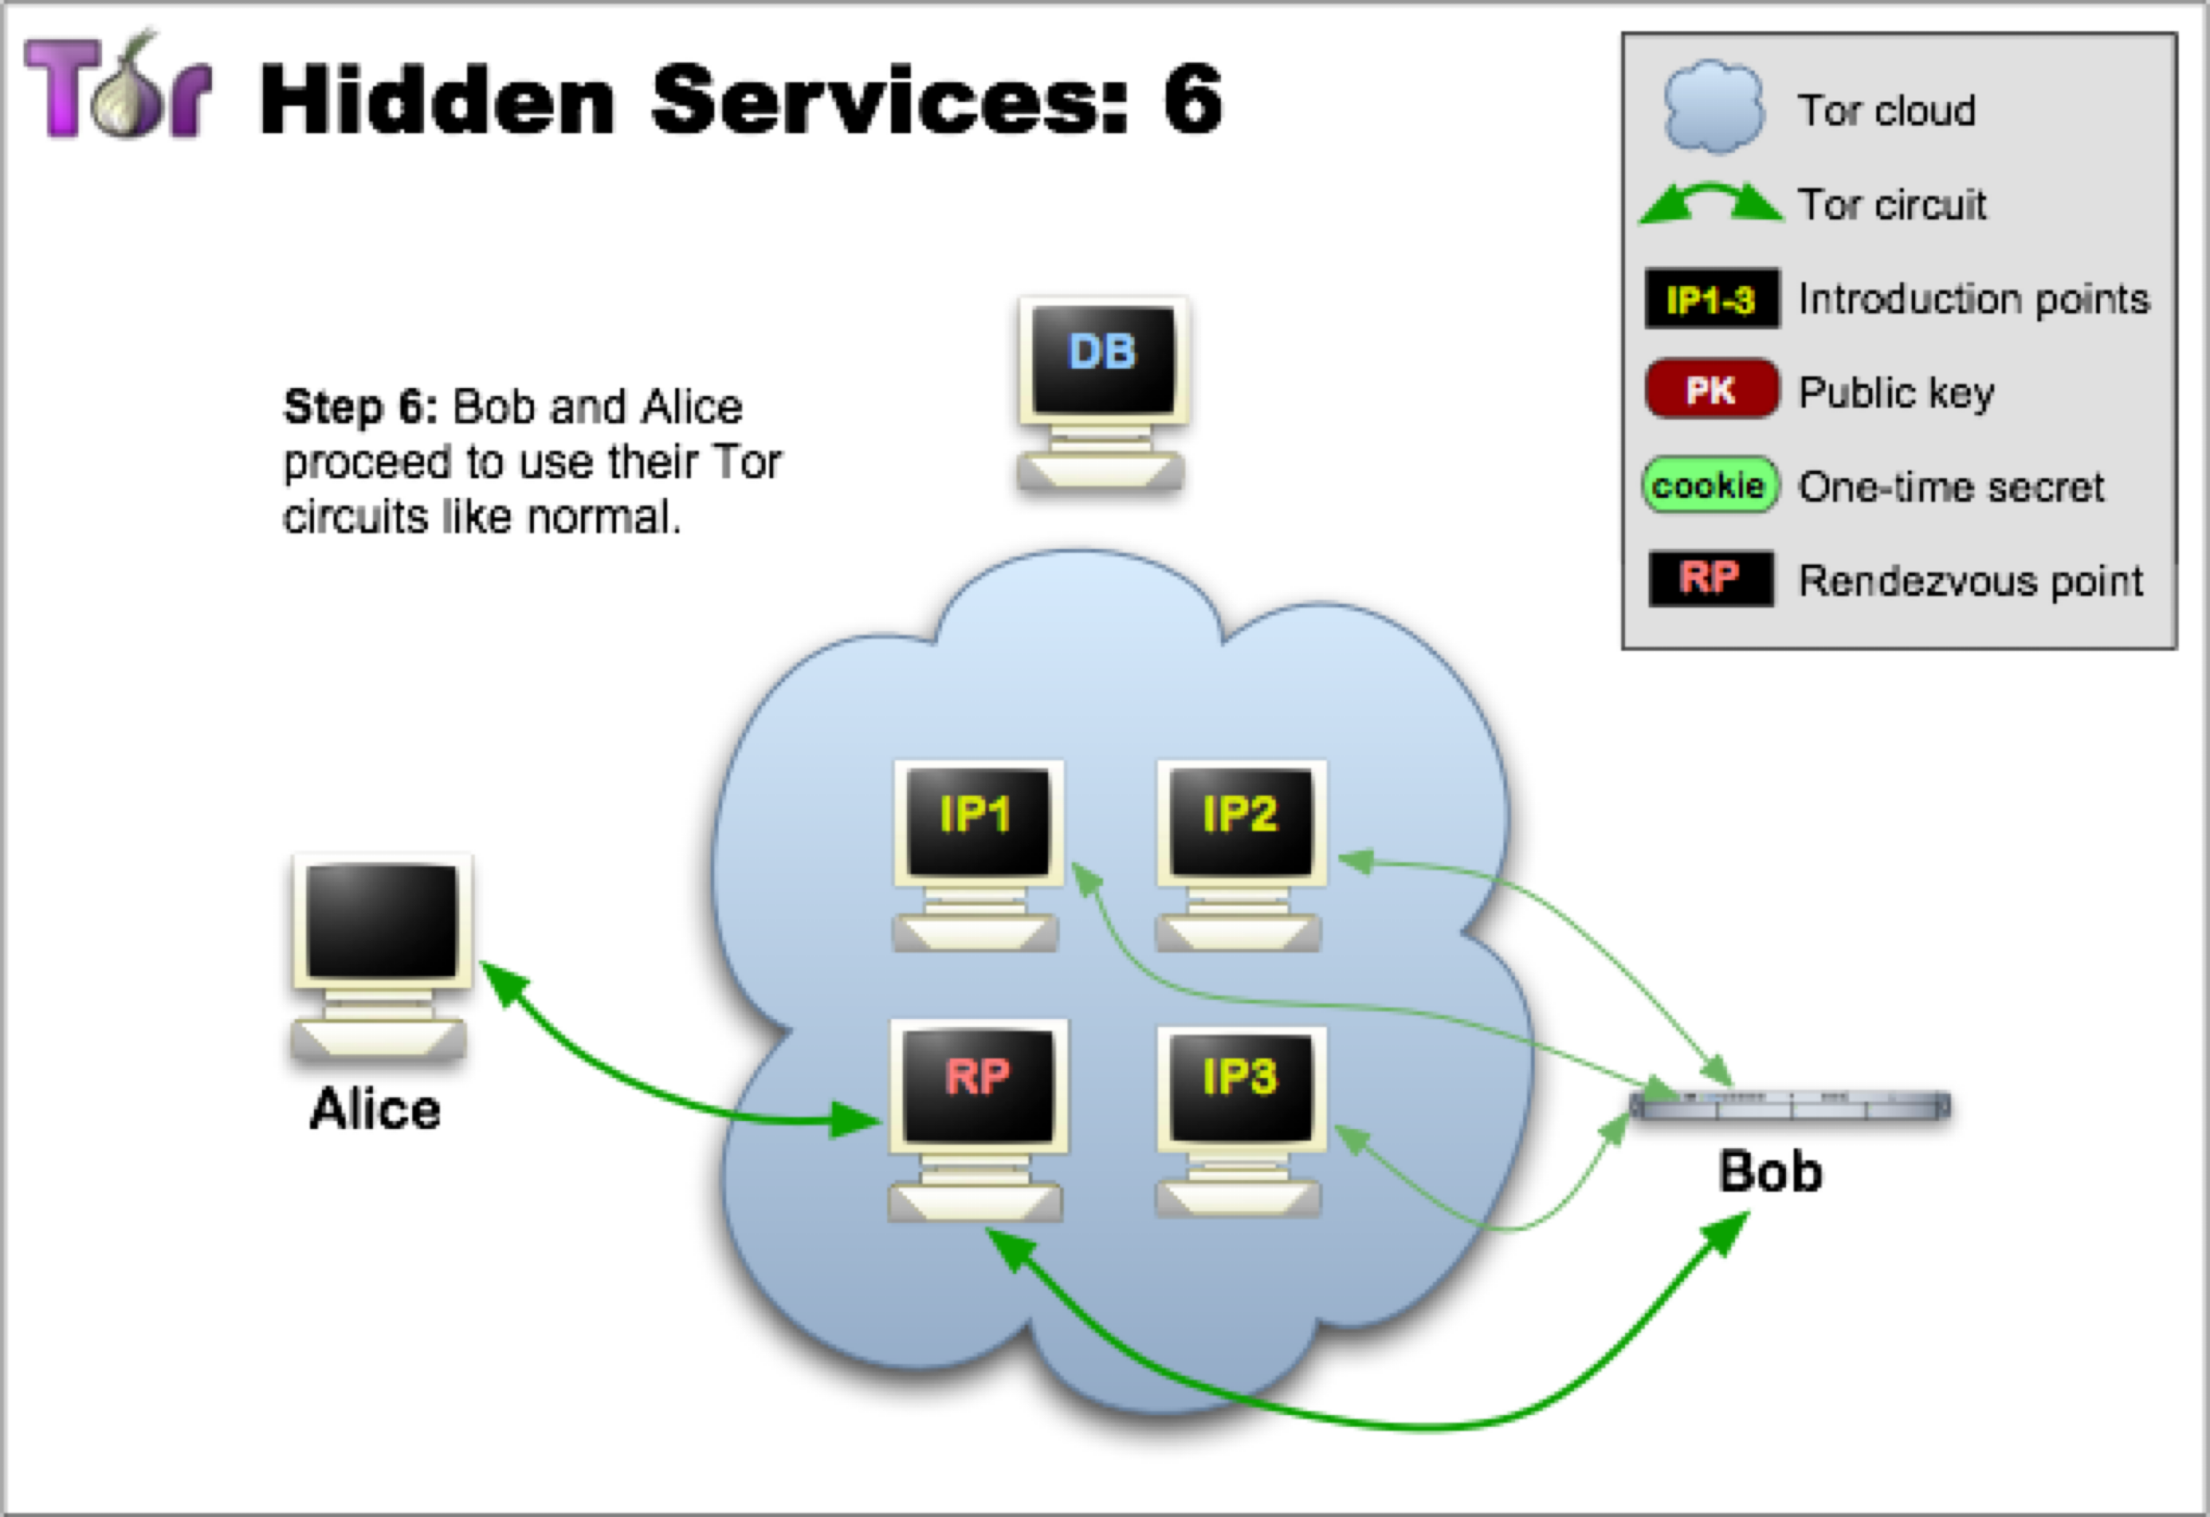

Slide 46
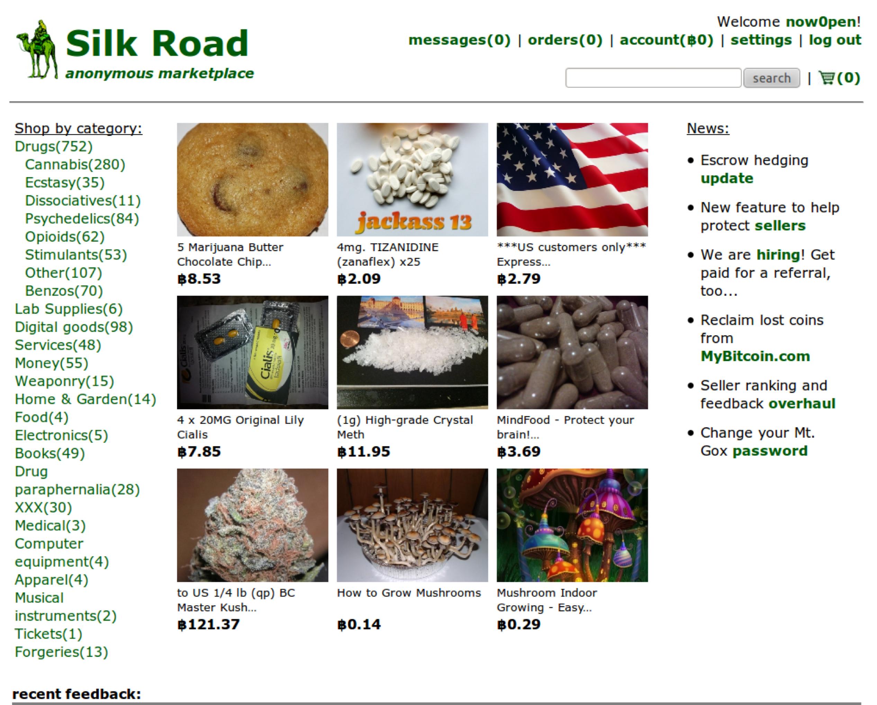

Slide 47
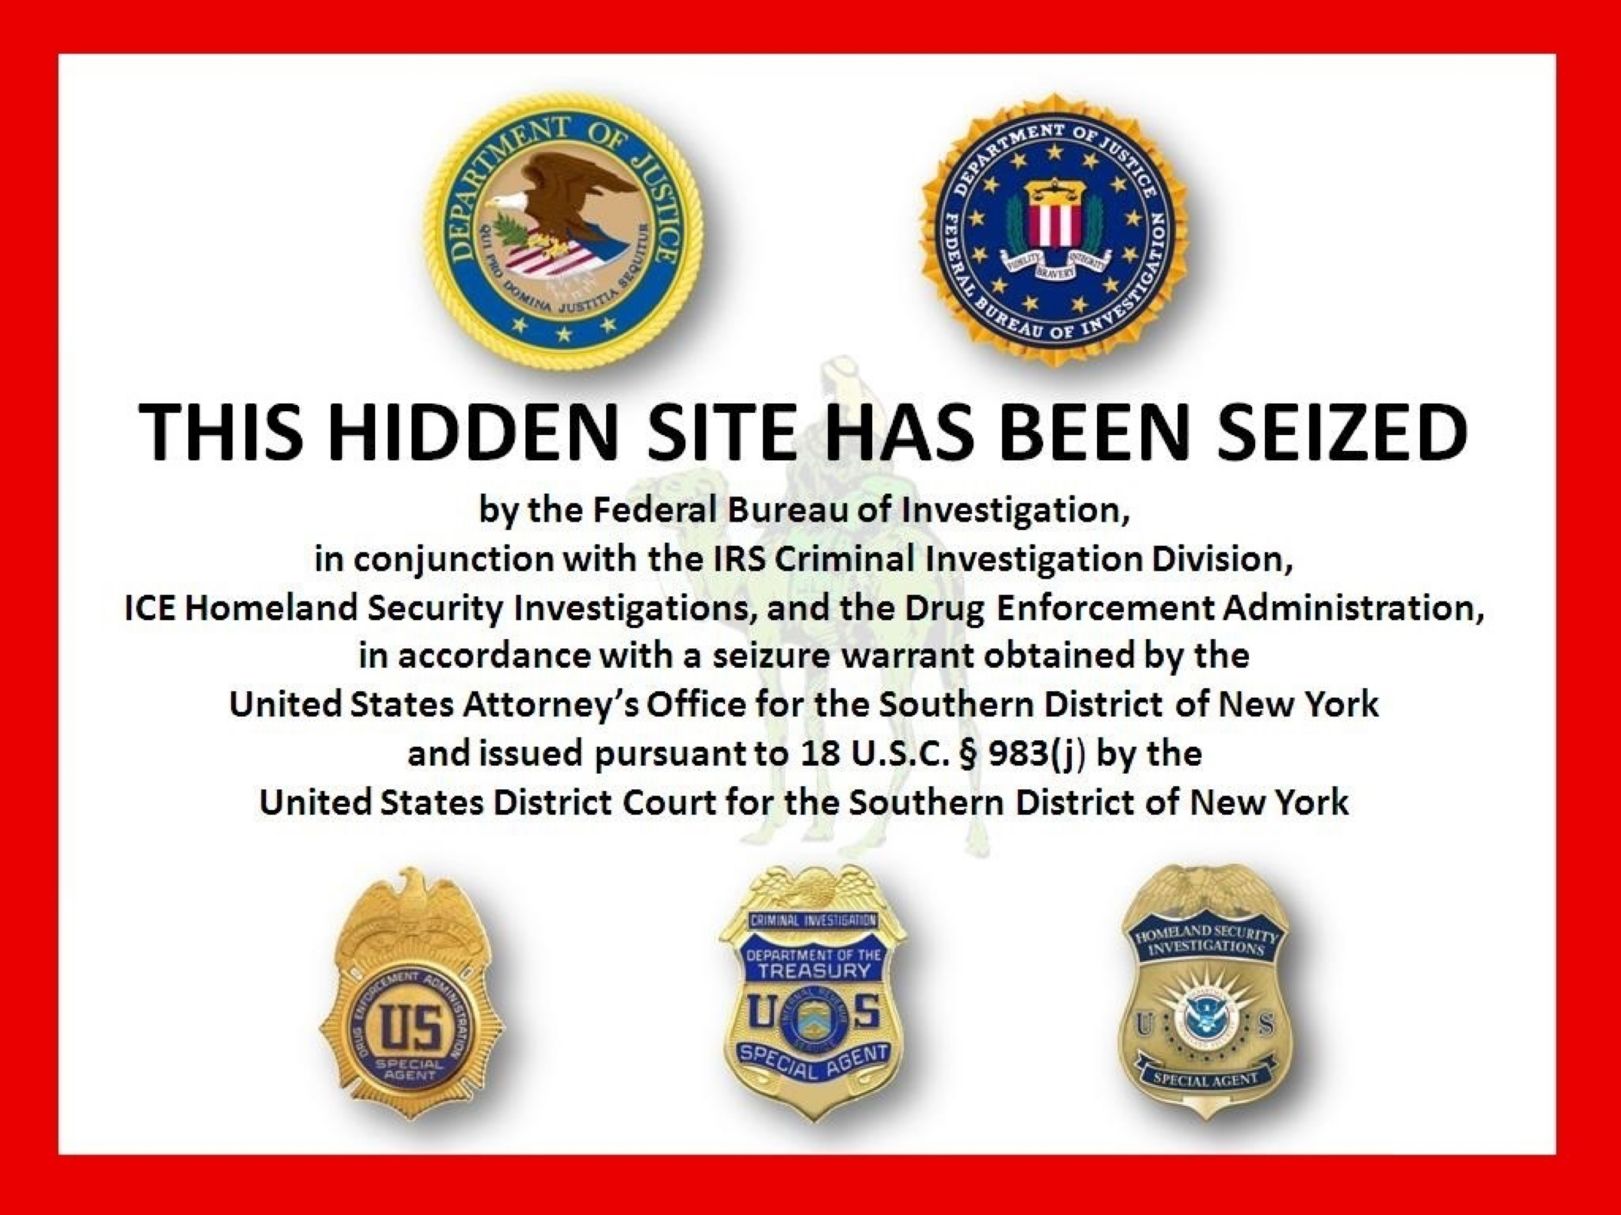
Silk Road Marketplace
Notes:
Linked through online posts using shared usernames etc.
In March 2012, a user registered on the coding Q&A site Stack Overflow with Ulbricht’s email address and the username 'Ross Ulbricht'. He then proceeded to post the question “How can I connect to a Tor hidden service using curl in php?”.
“Ulbricht elaborates, obliquely, that he has since focused on ‘creating an economic simulation’ designed to ‘give people a first-hand experience of what it would be like to live in a world without the systemic use of force’ by ‘institutions and governments’… I believe that this ‘economic simulation’ referred to by Ulbricht is Silk Road.”

Slide 48
Who uses anonymity systems?
“If you’re not doing anything wrong, you shouldn’t have anything to hide.”
- Implies that anonymous communication is for criminals
The truth: who uses Tor?
- Journalists, Law Enforcement, Human Rights Activists, Business Executives, Intelligence/Military, Normal People

Slide 49
Internet Censorship
Government censors
Block websites containing “offensive” content
Commonly employ blacklist approach
Observed techniques
IP blocking, DNS blackholes, forged RST packets
Popular countermeasures
Mostly proxy based — Tor, Freenet, Ultrasurf, …
Problem: Cat-and-mouse game

Slide 50
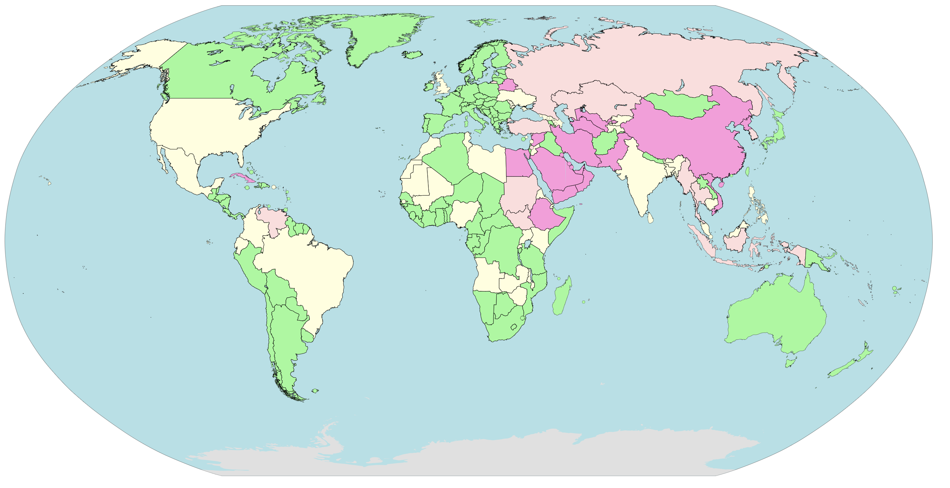
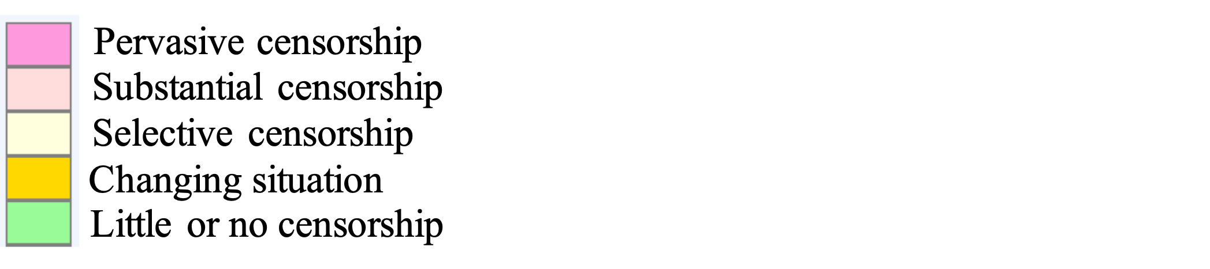
Internet Censorship
Notes:
Problem is _government_ internet censorship
Many governments censor for many reasons [political, pornographic, religious]
Dynamic (and disputed) list of countries
image credit: http://en.wikipedia.org/wiki/File:Internet_blackholes.svg

