Slide 1
Phishing

Slide 2
What do Passwords Protect Against?
A strong password can protect against:
Password spray: Testing a weak password against large number of accounts
Brute force: Testing multiple passwords from dictionary or other source against a single account
But do not protect against:
Credential stuffing: Replaying passwords from a breach
Phishing: Man-in-the-middle, credential interception
Keystroke logging: Malware, sniffing
Extortion: Blackmail, insider threat

Slide 3
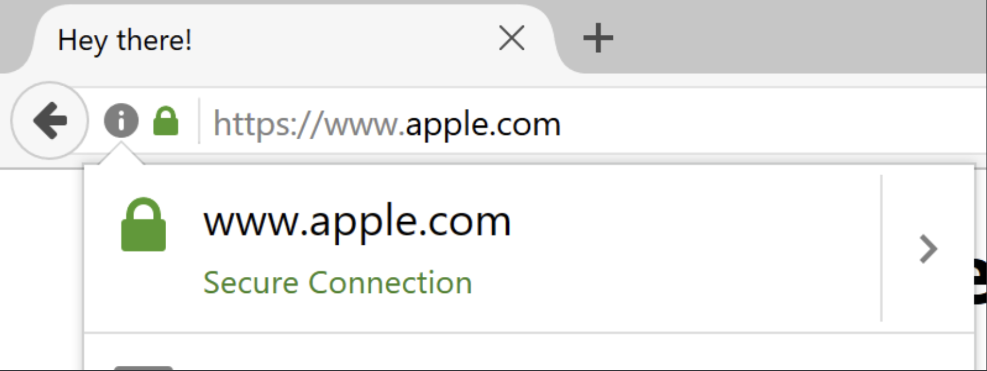
Phishing
Acting like a reputable entity to trick the user into divulging sensitive information such as login credentials or account information
Often easier than attacking the security of a system directly
Just get the user to tell you their password

Slide 4
Internationalized Domain Names (IDN)
Domain names consist of ASCII characters
Hostnames containing Unicode characters are transcoded to subset of ASCII consisting of letters, digits, and hyphens called punycode
Allows registering domains with foreign characters!
münchen.example.com → xn--mnchen-3ya.example.com

Slide 5
IDN homograph attack
Many Unicode characters are difficult to distinguish from common ASCII characters
аpple.com vs. apple.com
xn--pple-43d.com
apple.com

Slide 6
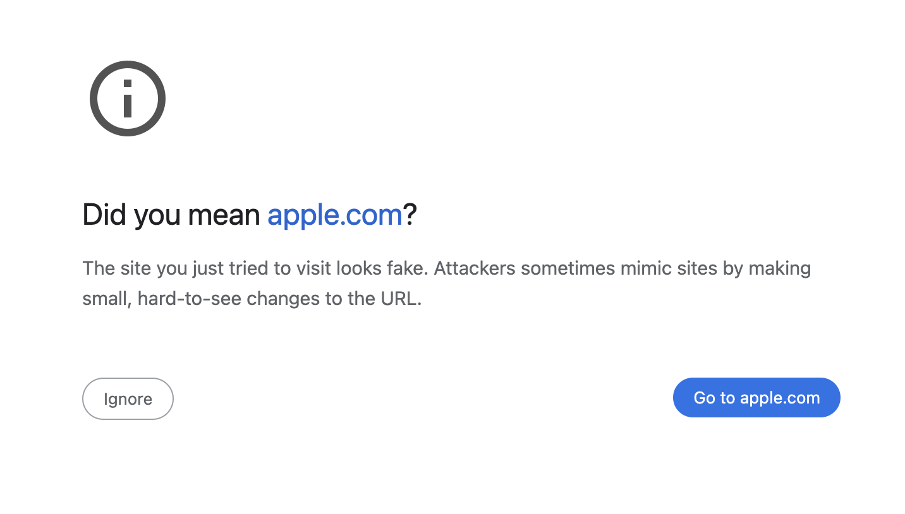

Slide 7
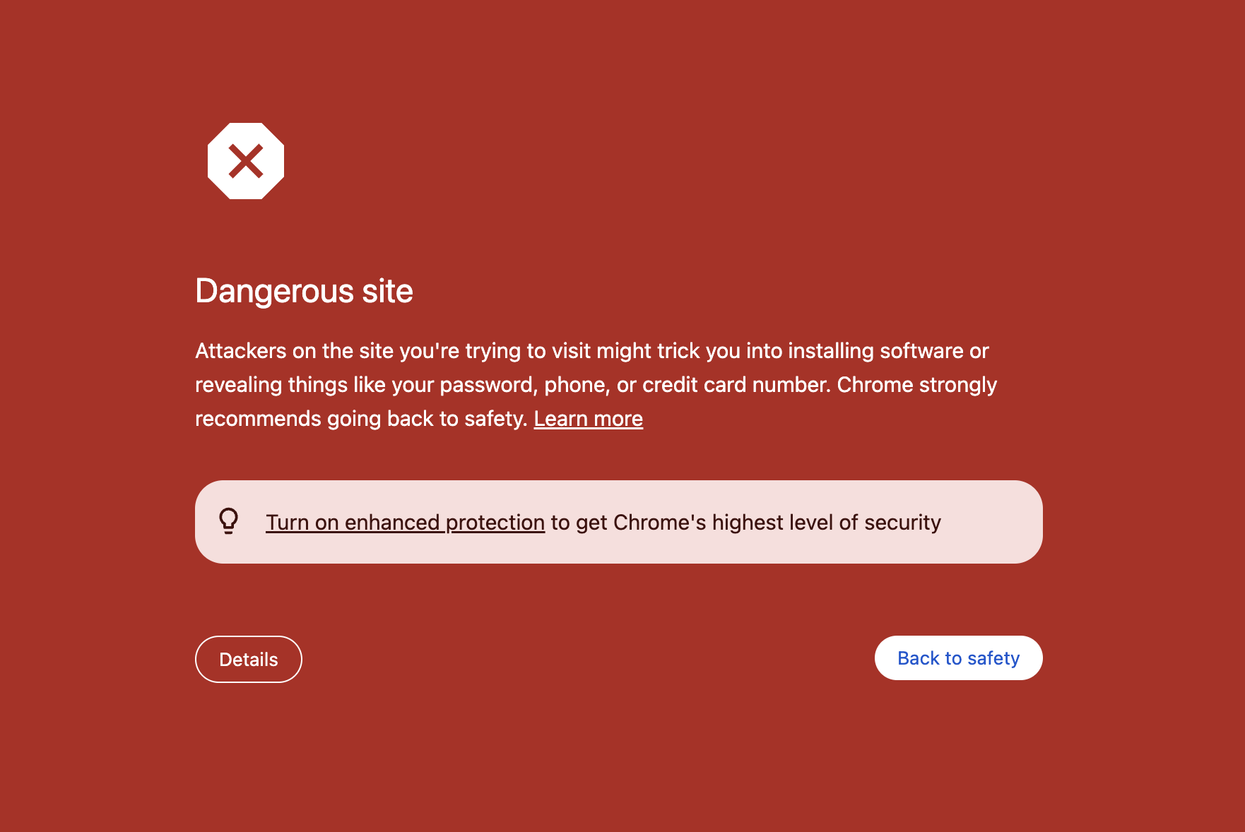
Google Safe Browsing
Google maintains a list of known malware and phishing URLs — tries to protect user
But, how do you let users look up dangerous sites without leaking all traffic to Google?

Slide 8
Safe Browsing Approach
Web Browser
Safe Browsing
Server
Get Unsafe Hash Prefixes
DB
['036b8320', '1a020a78', 'bac8de13', ‘bb90a0f1']

Slide 9
Safe Browsing Approach
Web Browser
Safe Browsing
Server
Get Unsafe Hash Prefixes
DB
['036b8320', '1a020a78', 'bac8de13', ‘bb90a0f1']
Is “evil.example.com/blah"
safe?

Slide 10
Safe Browsing Approach
Web Browser
Safe Browsing
Server
Get Unsafe Hash Prefixes
DB
['036b8320', '1a020a78', 'bac8de13', ‘bb90a0f1']
Is “evil.example.com/blah"
safe?
Calculate: combinations = [ H(“evil.example.com"), H(“example.com"), H(“evil.example.com/blah"), H(“example.com/blah")
] = ['1a02…28', 'bb90…9f', '7a9e…67', ‘bac8…fa']

Slide 11
Safe Browsing Approach
Web Browser
Safe Browsing
Server
Get Unsafe Hash Prefixes
DB
['036b8320', '1a020a78', 'bac8de13', ‘bb90a0f1']
Is “evil.example.com/blah"
safe?
Are any of [‘1a02…’, 'bb90…', '7a9e…', ‘bac8…’] present?
DB

Slide 12

Safe Browsing Approach
Web Browser
Safe Browsing
Server
Get Unsafe Hash Prefixes
DB
['036b8320', '1a020a78', 'bac8de13', ‘bb90a0f1']
Is “evil.example.com/blah"
safe?
Are any of [‘1a02…’, 'bb90…', '7a9e…', ‘bac8…’] present?
DB
No
Safe!

Slide 13

Safe Browsing Approach
Web Browser
Is “evil.example.com/blah"
safe?
Safe Browsing
Server
Are any of [‘1a02…’, 'bb90…', '7a9e…', ‘bac8…’] present?
DB
Yes (‘1a02’)
Unknown

Slide 14
Safe Browsing Approach
Web Browser
Is “evil.example.com/blah"
safe?
Safe Browsing
Server
Are any of [‘1a02…’, 'bb90…', '7a9e…', ‘bac8…’] present?
DB
Yes (‘1a02’)
Unknown
What are the unsafe hashes with the prefix?

Slide 15
Safe Browsing Approach
Web Browser
Is “evil.example.com/blah"
safe?
Safe Browsing
Server
Are any of [‘1a02…’, 'bb90…', '7a9e…', ‘bac8…’] present?
DB
Yes (‘1a02’)
Unknown
What are the unsafe hashes with the prefix ‘1a02’ ?
[‘1a02….af’, ‘1a02….23’, … ]
Check for Exact Match

Slide 16
Beyond Passwords

Slide 17
What do Passwords Protect Against?
A strong password can protect against:
Password spray: Testing a weak password against large number of accounts
Brute force: Testing multiple passwords from dictionary or other source against a single account
But do not protect against:
Credential stuffing: Replaying passwords from a breach
Phishing: Man-in-the-middle, credential interception
Keystroke logging: Malware, sniffing
Extortion: Blackmail, insider threat

Slide 18
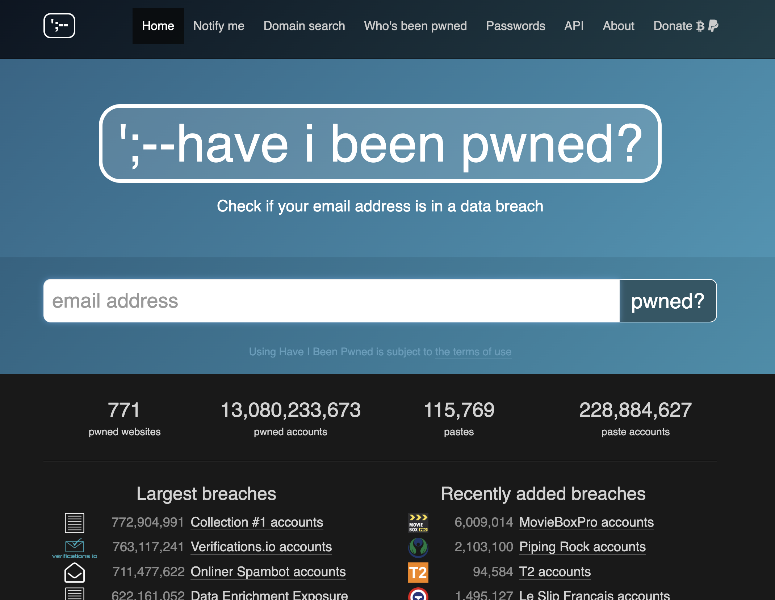
Notes:
In Lecture 7, I incorrectly stated that you cannot make never make XMLHttpRequests that cross origins unless CORS allows you, which has some confusion.
I incorrectly stated

Slide 19

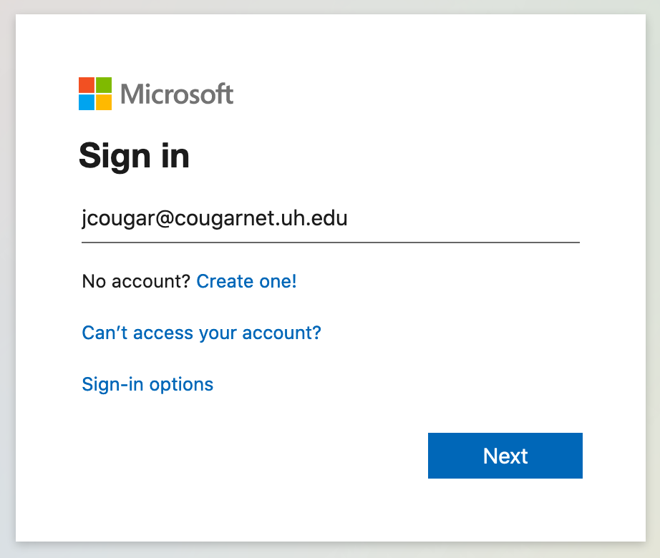
Multi-Factor Authentication
Microsoft: “Based on our studies, your account is more than 99.9% less likely to be compromised if you use MFA”
How are accounts compromised in practice?
Credential Stuffing — attackers try to log in using purchased lists of usernames and passwords
Phishing — users are deceived into entering their password

Slide 20
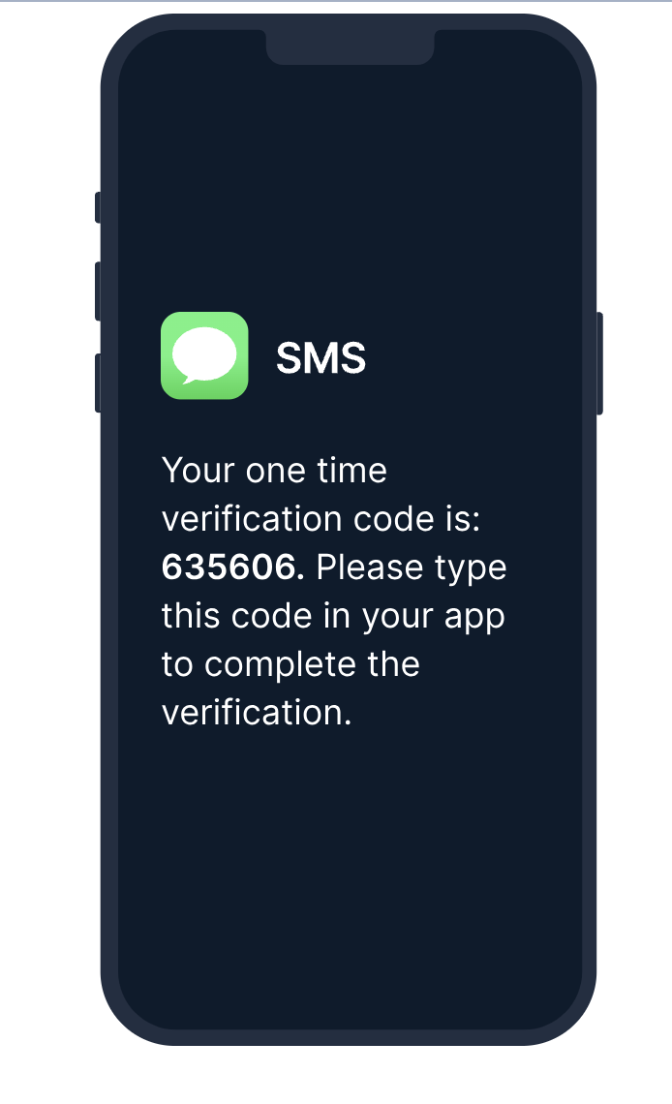
SMS-Based Two Factor
Prevents attackers from logging in using stolen credential by sending One Time Code (OTC) to user
Now considered obsolete. Fails against:
Phishing sites
SIM Swapping
Social Engineering Attacks

Slide 21
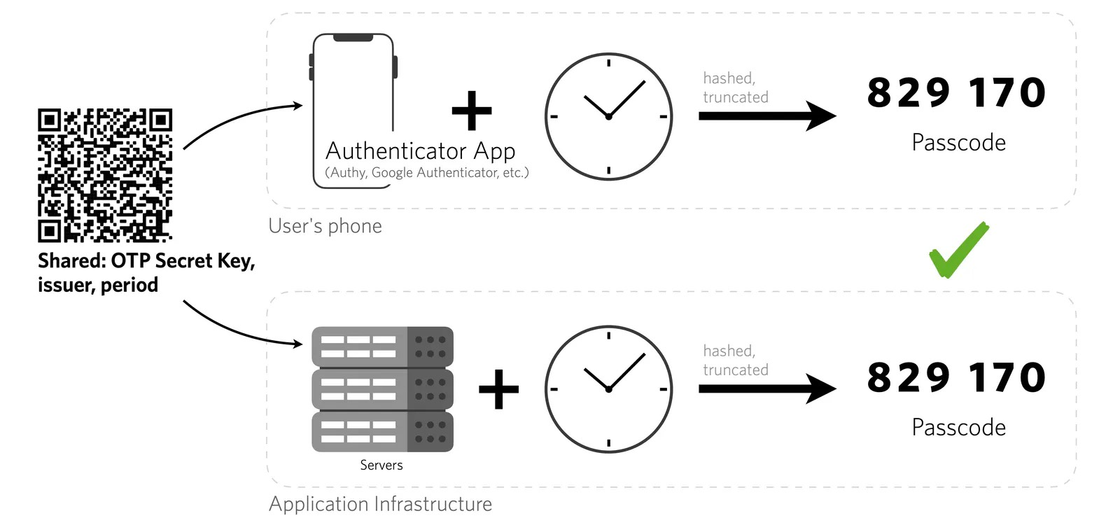
Time-based One-Time Passwords (TOTP)
SIM Swapping
Source: Twilio

Slide 22
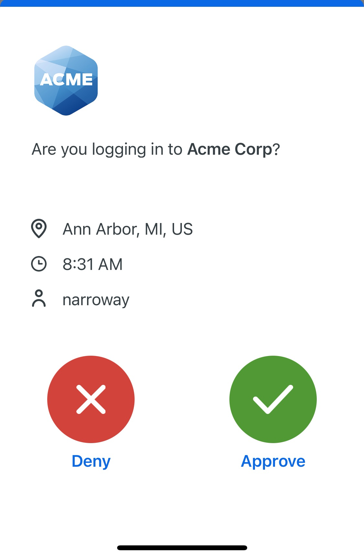
Duo Push Notifications
Duo (or similar) Push Notifications prevent doesn’t show a code — can’t be stolen by an attacker
Doesn’t provide full-proof defense against “push phishing”:
User clicking Approve out of habit
Real-Time Phishing Site attacks

Slide 23
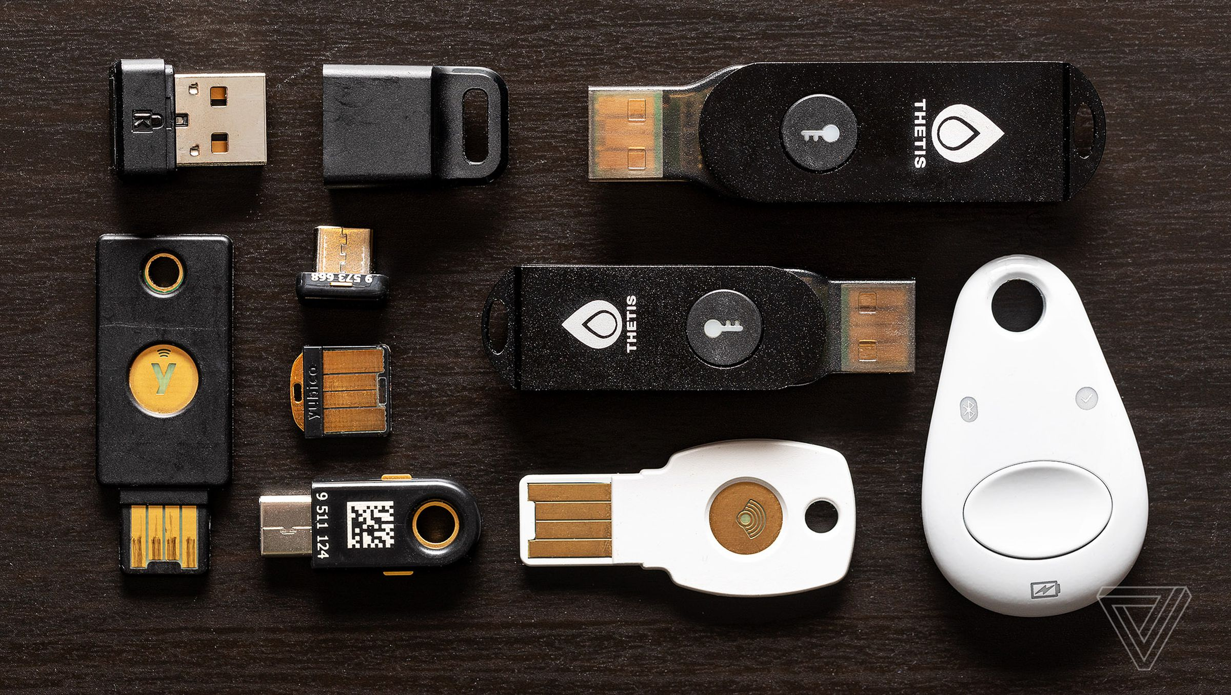
How to provide foolproof 2FA?
Most secure solutions rely on cryptographic operation that’s tied to the website being visited by the user
We have fool-proof solutions today: physical security tokens and Passkeys

Slide 24
Physical Tokens
Each token has a public and private key pair
Private key cannot be extracted from the device
Pushing button signs a challenge presented to the device

Slide 25


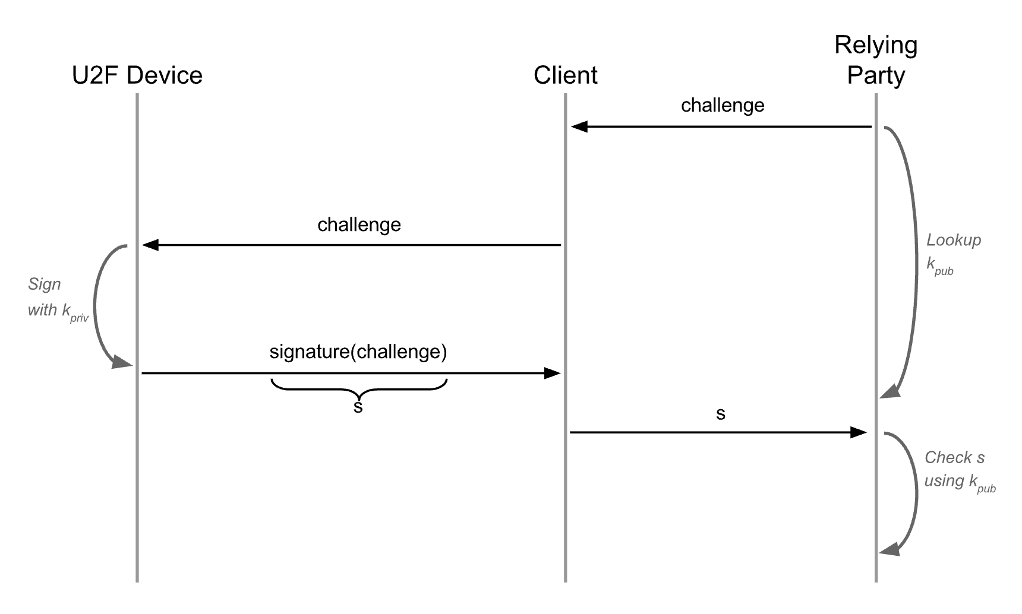
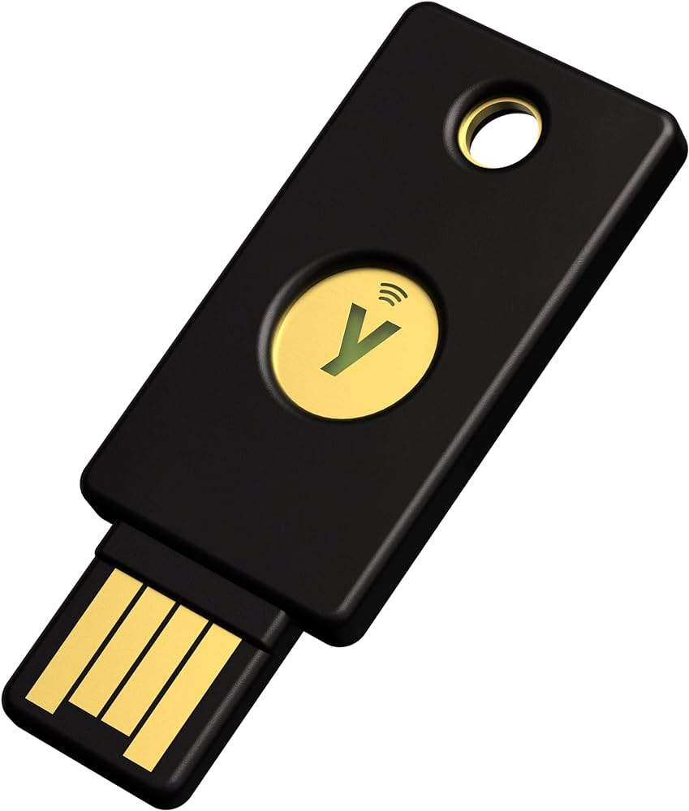
U2F Protocol

Slide 26
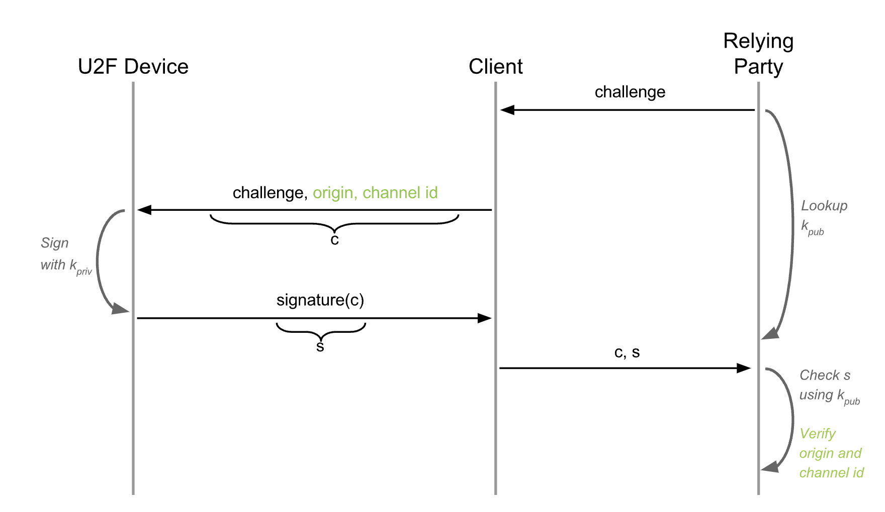
U2F Protocol
Challenge is Bound to Website by Browser

Slide 27
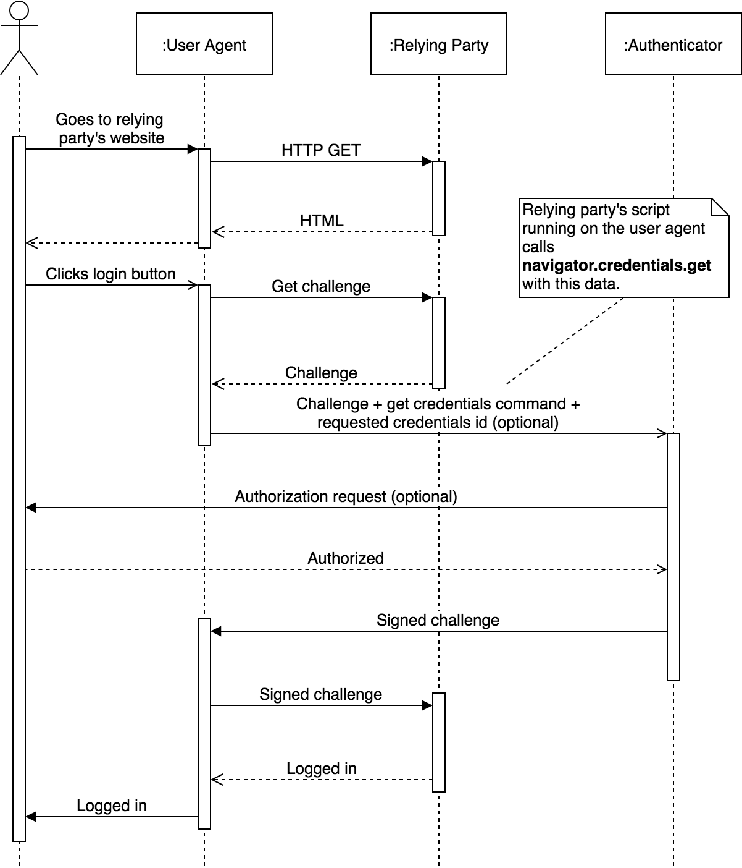

FIDO2/WebAuthN
U2F Protocol only allowed hardware tokens to be used as a second factor
FIDO2 allows them to be used as primary authentication mechanism
Allows authenticators beyond hardware token (e.g., TouchID)

Slide 28
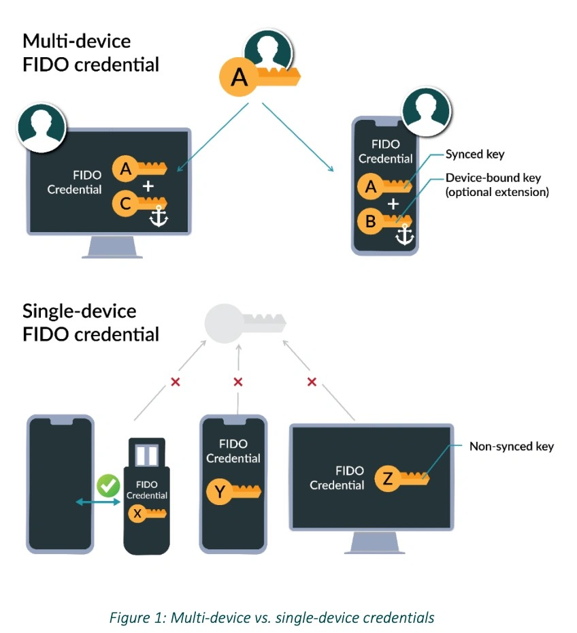
Pass Keys
Technical Name: “Multi-Device FIDO Credentials”
Public/Private key pair that is synchronized across devices (e.g., by Google or Apple) and can be used through WebAuthN API

Slide 29
Building a Secure Web Application

Slide 30
Many Steps Involved
Best Advice: Use a modern web framework — many security precautions are built in today — but don't assume!
Protect Against CSRF: Never depend on cookies to signal user intent! Use CORS Pre-Flight or CSRF Tokens. Set cookies as sameSite and secure.
Protect Against XSS: Set a Content Security Policy and do not use any inline scripts. Use httpOnly cookies.
Protect Against SQL Injection: Use Parameterized SQL or Object Relational Mapper (ORM)
Notes:
In Lecture 7, I incorrectly stated that you cannot make never make XMLHttpRequests that cross origins unless CORS allows you, which has some confusion.
I incorrectly stated

Slide 31
Many More Steps Involved
Protect Against Data Breach: Use modern hashing algorithm like BCRYPT and salt passwords
Protect Against Clickjacking: Set Content Security Policy that prevents you from being shown in an IFRAME
Protect Against Malicious Third Parties: Use Iframes, CSP, and HTML5 Sandboxes
Protect Against Compromised Third Parties: Use Sub-Resource Integrity Headers
Protect Against Credential Compromise and Phishing: Use U2F

