Slide 1
Week 1 – Virtualization and Kali Linux

Slide 2
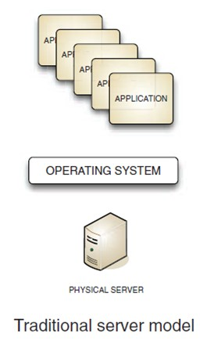
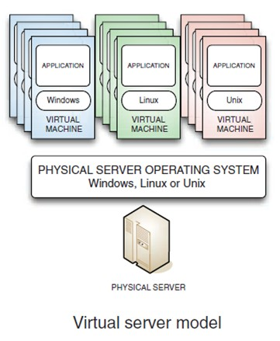
What is Virtualization
Server Models
Any security risk?

Slide 3
Virtual Machine Basis
VM is a software emulation of a physical computer
Host machine: hardware provides resource access
Guest machine: VM itself
Hypervisor: software manages VM
Type1 (Bare-metal): run directly on host’s hardware, e.g., Microsoft Hyper-V, Xen
Type2 (Hosted): run on host’s OS, e.g., VMware Workstation, Oracle VirtualBox

Slide 4
Virtual Machines
VM2
VM1
Apps
Apps
Guest OS 2
Guest OS 1
Virtual Machine Monitor (VMM, hypervisor)
Host OS
Hardware
single HW platform with isolated components

Slide 5
Why so popular?
VMs in the 1960’s:
Few computers, lots of users
VMs allow many users to shares a single computer
VMs 1970’s – 2000: non-existent
VMs since 2000:
Too many computers, too few users
Print server, Mail server, Web server, File server, Database , …
VMs heavily used in private and public clouds

Slide 6
Hypervisor security assumption
Hypervisor Security assumption:
Malware can infect guest OS and guest apps
But malware cannot escape from the infected VM
Cannot infect host OS
Cannot infect other VMs on the same hardware
Requires that hypervisor protect itself and is not buggy
(some) hypervisors are much simpler than a full OS

Slide 7
Kali Linux

Slide 8
One note about Kali Linux
Notes:
https://www.theregister.co.uk/2020/02/14/silly_police_infosec_parental_advice_poster/

Slide 9
References
Wireshark Dissector Plugins
Bitcoin dissector, https://github.com/lbotsch/wireshark-bitcoin
LoRaWAN Dissector, https://github.com/ltn22/LoRaWAN-Wireshark-Dissector
World of Warcraft Wireshark dissector, https://github.com/chaodhib/Wow-wireshark-dissector
More Wireshark Dissector, https://github.com/topics/wireshark-dissector-plugin
Lightning Dissector, https://github.com/nayutaco/lightning-dissector
TCPdump commands
https://danielmiessler.com/study/tcpdump/
https://www.tcpdump.org/manpages/tcpdump.1.html

