Slide 1
Week 2 – IAM, Authentication, Authorization

Slide 2
Have U been pwned?
https://haveibeenpwned.com
Notes:
https://haveibeenpwned.com

Slide 3
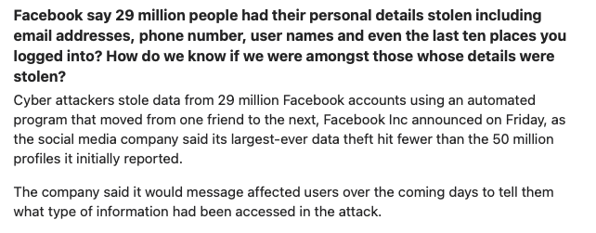
Facebook personal data breach (Apr 2021)
Notes:
https://www.bleepingcomputer.com/news/security/how-to-check-if-your-info-was-exposed-in-the-facebook-data-leak/
https://www.quora.com/unanswered/533-million-Facebook-users-phone-numbers-and-personal-details-leaked-How-do-you-check-online-whether-your-details-are-available-online-or-not
https://externals.io/message/113981

Slide 4
Authentication, Access Control, Authorization
Identification
Authentication
Access Control
Authorization
Who are you?
How to prove you are you?
Owner managed the rights of the object
Verify you have the rights to access the object

Slide 5
What is Access Control?

Slide 6
What is Access Control
In addition to authentication, limit user permission to access other resources according to the assigned privilege
Art of limiting who can access to which resources
Entire set of procedures performed using hardware, software and administrators to monitor access, identify users requesting access
Prevent data from unauthorized viewing, modification or copying
Prevent system from unauthorized use, modification or denial of service

Slide 7
Access Control Nomenclature
The System Path to identify the person
Identification
Authentication
Authorization
Accountability
Notes:
In this online session we will focus on several key topics in access control :
We will start with some basic concepts and methodologies about access control , then we will move onto introduction of various techniques and models .
Then we move on to several key topics in access control – user account management, identification and authentication technique , and intrusion detection response
By the end of the session , you should get a foundation of access control before you move to the face-to-face session.

Slide 8
From Authorization to Authentication

Slide 9
Authentication vs Authorization
AuthN
AuthZ
Notes:
https://medium.com/@wdevon99/what-the-hell-is-oauth-6ba19f236612

Slide 10
Password Storage Scheme

Slide 11
News about Facebook password (Mar 2019)
Facebook users may have had their account passwords stored in plain text and searchable by more than 20,000 Facebook employees.
My Facebook insider said access logs showed some 2,000 engineers or developers made approximately nine million internal queries for data elements that contained plain text user passwords.
In the course of our (Facebook) review, we have been looking at the ways we store certain other categories of information — like access tokens — and have fixed problems as we’ve discovered them.
Notes:
https://krebsonsecurity.com/2019/03/facebook-stored-hundreds-of-millions-of-user-passwords-in-plain-text-for-years/
https://newsroom.fb.com/news/2019/03/keeping-passwords-secure/

Slide 12
Hacker leaks passwords for more than 500,000 servers, routers, and IoT devices (Jan 2020)
The list, which was published on a popular hacking forum, includes each device's IP address, along with a username and password for the Telnet service, a remote access protocol that can be used to control devices over the internet.
Most of these IPs do not allow access via their Telnet port anymore. Gevers says that 2,174 still allow an attacker to log on via its Telnet port, and 1,775 of the published credentials still work.
Notes:
https://www.zdnet.com/article/hacker-leaks-passwords-for-more-than-500000-servers-routers-and-iot-devices/
https://www.bleepingcomputer.com/news/security/someone-published-a-list-of-telnet-credentials-for-thousands-of-iot-devices/

Slide 13
Linux Password
Quiz:
What does each field mean?
Why use the “X” to represent password?
/etc/passwd format
1. Username
2. Password
3. User ID
4. Group ID
5. Commentary
6. Home Directory
7. Shell
Notes:
http://thepronotes.blogspot.com/2013/07/linux-etcpasswd-file-formats-linux.html

Slide 14
Linux Password
/etc/shadow file:
1. Username | 5. Maximum number of days
2. Password password format is set to $id$salt$hashed $1$ is MD5 $2a$ is Blowfish $2y$ is Blowfish $5$ is SHA-256 $6$ is SHA-512 | 6. Warn number of days before password expire
3. Last password change (lastchanged) | 7. Inactive, number of days after password expired
4. Minimum number of days | 8. Expire absolute date
Notes:
https://www.cyberciti.biz/faq/where-are-the-passwords-of-the-users-located-in-linux/

Slide 15
Password Hash Salting
Question:
Why salted password will help?
https://www.wordfence.com/learn/how-passwords-work-and-cracking-passwords/
Notes:
https://www.wordfence.com/learn/how-passwords-work-and-cracking-passwords/

Slide 16
Salting
Prevents deriving passwords from password file
Stored representation differs
Side effect: defeats pre-computed hash attacks
Why?
Alice:root:b4ef21:3ba4303ce24a83fe0317608de02bf38d
Bob:root:a9c4fa:3282abd0308323ef0349dc7232c349ac
Cecil:root:209be1:a483b303c23af34761de02be038fde08
Same Password
Notes:
‹#›

Slide 17
Password Cracking

Slide 18
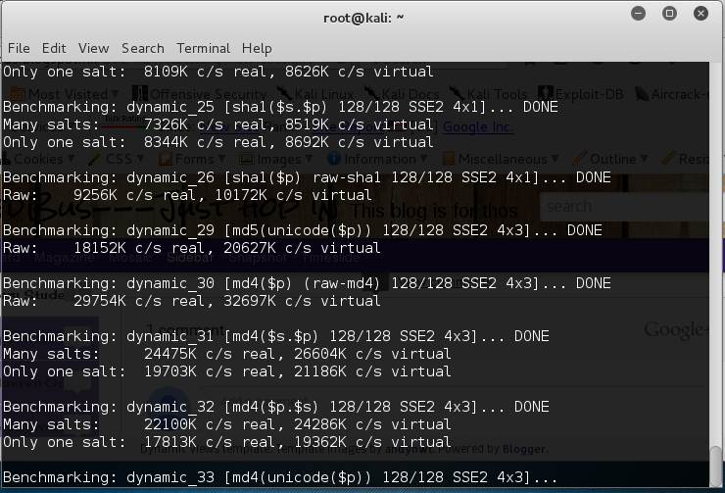
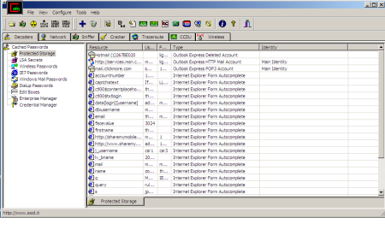
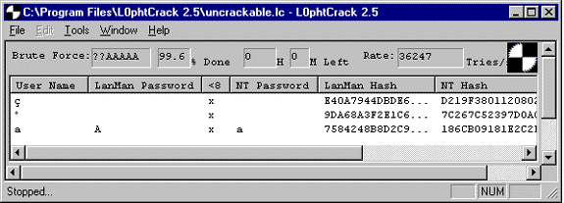
Password cracking
John the ripper
L0PHTCrack
Cain & Abel
Notes:
http://www.admin-magazine.com/Articles/John-the-Ripper

Slide 19
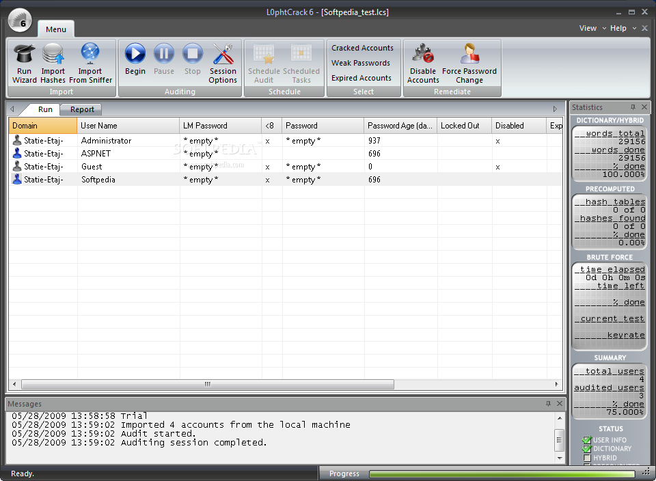
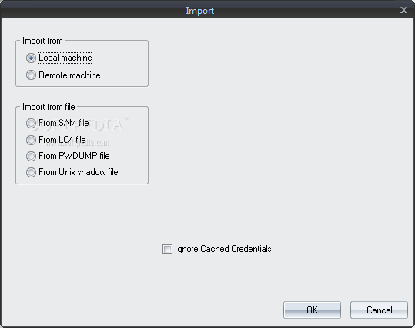
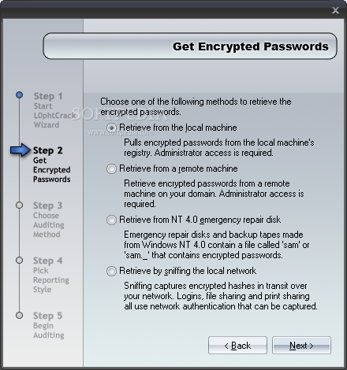
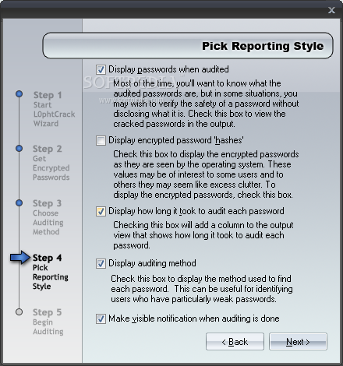
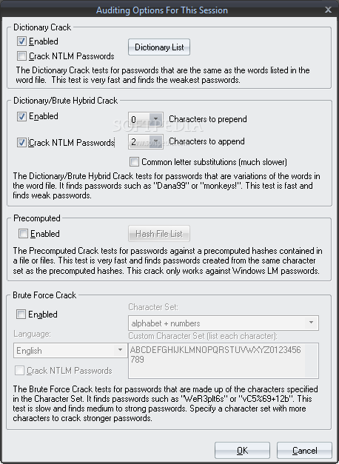
Password cracking
Notes:
http://www.softpedia.com/get/Security/Password-Managers-Generators/L0phtCrack.shtml#sgal_0

Slide 20
What is Rainbow Table
A rainbow table is a precomputed table for reversing cryptographic hash functions, usually for cracking password hashes.
Tables are usually used in recovering a password (or credit card numbers, etc.) up to a certain length consisting of a limited set of characters.
It is a practical example of a space–time tradeoff, using less computer processing time and more storage than a brute-force attack which calculates a hash on every attempt, but more processing time and less storage than a simple lookup table with one entry per hash. (Hash function and Reduction function)
Rainbow tables were invented by Philippe Oechslin[1] as an application of an earlier, simpler algorithm by Martin Hellman.[2]
Paper by Martin Hellman at www-ee.stanford.edu/~hellman/publications/36.pdf
Notes:
https://en.wikipedia.org/wiki/Rainbow_table
https://security.stackexchange.com/questions/379/what-are-rainbow-tables-and-how-are-they-used

Slide 21
What is Rainbow Table
Suppose we have a password hash function H and a finite set of passwords P. The goal is to precompute a data structure that, given any output h of the hash function, can locate an element p in P such that H(p) = h
The only requirement for the reduction function is to be able to return a "plain text" value in a specific size.
If password = 7 bytes, hash = 8 bytes, approximately 112 TB would be required
Notes:
https://en.wikipedia.org/wiki/Rainbow_table
https://security.stackexchange.com/questions/379/what-are-rainbow-tables-and-how-are-they-used

Slide 22
Pass the Hash Attack
In cryptanalysis and computer security, pass the hash is a hacking technique that allows an attacker to authenticate to a remote server or service by using the underlying hash of a user's password, instead of requiring the associated plaintext password as is normally the case.
Native Windows applications ask users for the cleartext password, then call APIs like LsaLogonUser that convert that password to one or two hash values and then send that to the remote server during authentication.
If an attacker has the hashes of a user's password, they do not need to brute-force the cleartext password; they can simply use the hash of an arbitrary user account that they have harvested to authenticate against a remote system and impersonate that user.
PassTheHashAttack – DataSheet from Microsoft.com
Notes:
https://en.wikipedia.org/wiki/Pass_the_hash

Slide 23
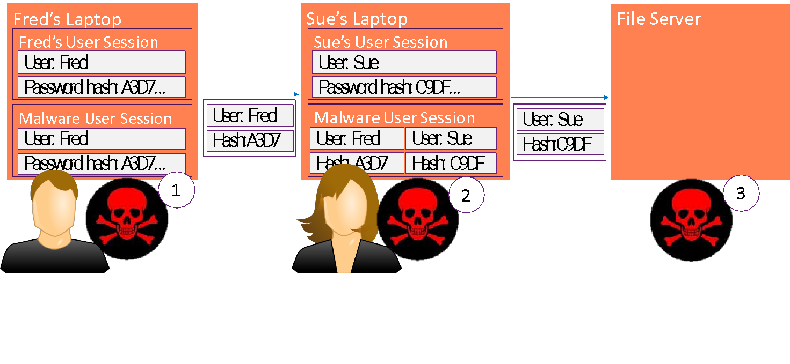
Mimikatz
Mimikatz is a Windows post-exploitation tool written by Benjamin Delpy (@gentilkiwi). It allows for the extraction of plaintext credentials from memory, password hashes from local SAM/NTDS.dit databases, advanced Kerberos functionality, and more.
Pass the Hash (PtH)
From DCIM-B359 by Mark Russinovich
Notes:
https://gallery.technet.microsoft.com/scriptcenter/Invoke-Mimikatz-and-will-d6c40fac#content
https://technet.microsoft.com/en-us/security/dn785092

Slide 24
Defense against PtH
From DCIM-B359 by Mark Russinovich

Slide 25
Reference Books
Related content | Book | Chapter
W10: Authentication | Cryptography and Network Security (2011) | Chapter 15: User Authentication Protocols
W10: Authentication | The InfoSec Handbook (2014) | Chapter 4: Access Controls
W10: Authentication | Computer Security Principles and Practice (2012) | Chapter 3: User Authentication
W10: Authentication | Computer Security Principles and Practice (2012) | Chapter 4: Access Control
W10: Federated Identity | Federated Identity Primer | Chapter 1 – 4

