Slide 1

Practicing Cybersecurity
Dongdong She
*Some slides are borrowed from Dan Boneh and Ricci IEONG
COMP 4632
Notes:
SISL

Slide 2
Admin
Course web site: https://cse.hkust.edu.hk/~dongdong/comp4632.html
Instructor: Prof. Dongdong She.
TA: Qiao Zhang
11 Lab assignments and 3 programming assignments
Curved grading => top 20%~25% of students can get A
Actively ask/answer questions in class => 10% in-class participation
Notes:
Syllabus and readings on the course web site.

Slide 3


The Story of Stuxnet
First cyber-warfare that destroys a nuclear weapon factory

Slide 4
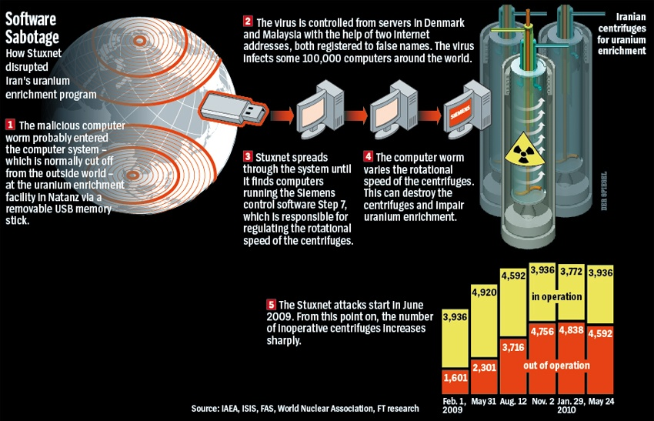

Slide 5
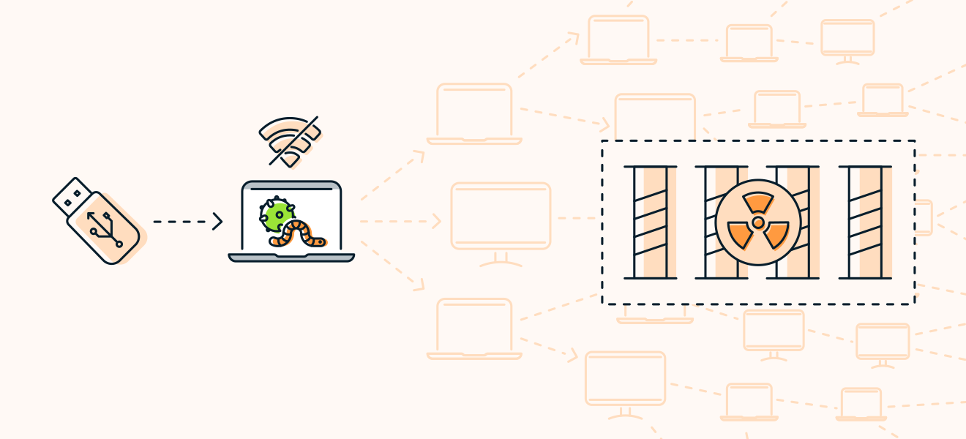
The Story of Stuxnet
First cyber-warfare that destroys a nuclear weapon factory

Slide 6


The GTA VI Leak
A hacker leaked the famous game before its official release

Slide 7
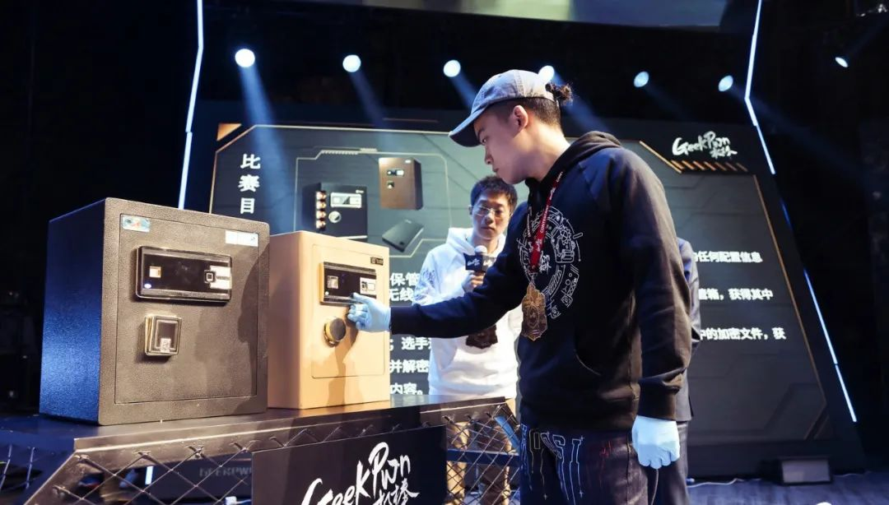
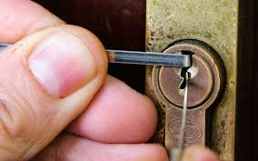
Old-Fashioned Hacking Skill
Hackers have a tradition of picking a lock and cracking a safe
Hacking competitions often hold lock-cracking session

Slide 8
Philosophy of security: crack any system without a key
Why do hackers study lock-picking?

Slide 9
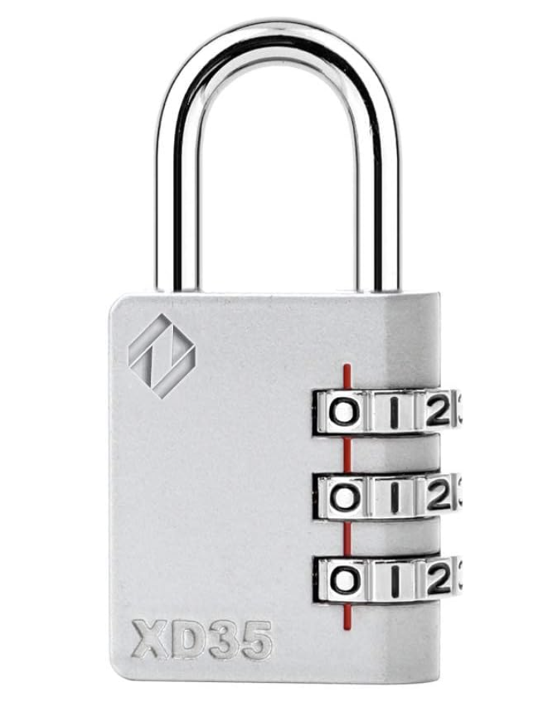
How to Crack a Combination Lock?
Total number of combinations?
10^3
Assume we can try each combination in 1 second.
What is the expected time to crack it?
Do the math

Slide 10
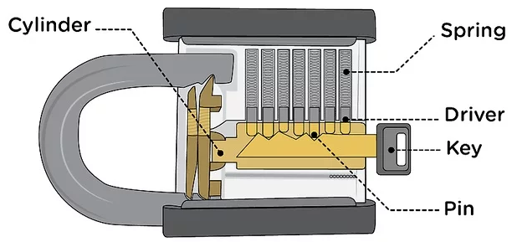

A Peek into Lock Mechanism

Slide 11
Don’t try this at home !
Notes:
Michael Duff

Slide 12
Quiz: Lock-Picking Competition
Each student is given the following gear
  a practice lock
  a set of lock-picking tool
Reward policy: the top 3 students who successfully crack two different locks gets 5 bonus points in the final exam

Slide 13
Top 10 products by total number of distinct vulnerabilities in 2023
Product name | Vendor | # vulnerabilities
Android | Google | 1422
Microsoft Server | Microsoft | 2059
Fedora | Fedora Project | 540
Windows 11 | Microsoft | 1004
Debian Linux | Debian | 487
MacOS | Apple | 418
Chrome | Google | 296
iPhone OS | Apple | 269
source: https://www.cvedetails.com/top-50-products.php?year=2023
Notes:
CVE: Common Vulnerabilities and Exposures

Slide 14
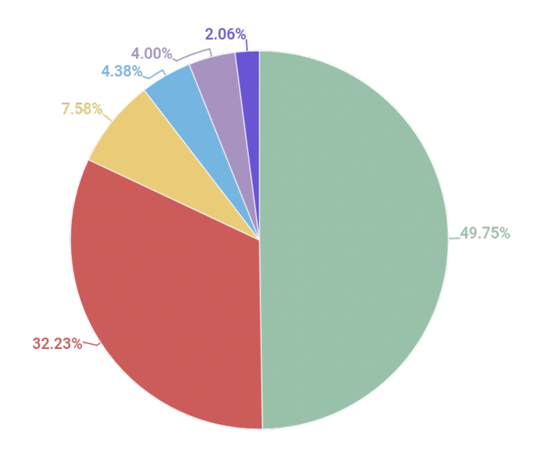
Distribution of exploits used in attacks
Java
Android
Browser
Office
Source: Kaspersky Security Bulletin 2021
Notes:
Remainder colors are: Adobe Flash and PDF

Slide 15
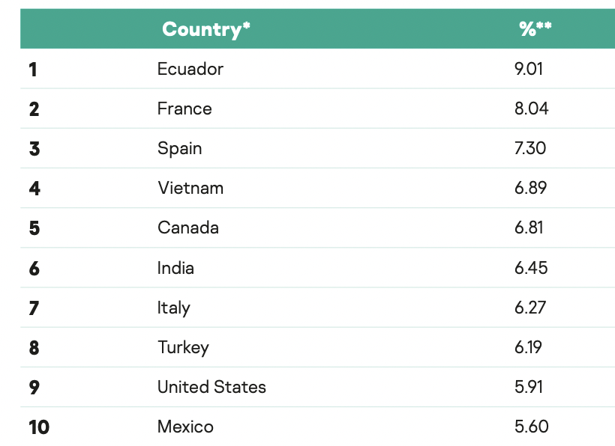
A global problem
Top 10 countries by share of attacked users:
Source: Kaspersky Security Bulletin 2021

Slide 16
Goals for this course
Learn exploit techniques
  Learn to defend and prevent common exploits
Understand the available security tools
Learn to build and architect secure systems

Slide 17
Important notes
You can use your laptop in the class as most of the lab session are operating in isolated environment within the VM environment
Do your assignment in lab but you can also contact us for assistance.
The course is a practical course – Practice, Practice and Practice
IT Security is ever changing and growing world – so this is just the beginning of your IT security life
Notes:
Please keep the original password and don’t change that.

Slide 18
Our labs in 2024

Slide 19
Important notes
You can use your laptop in the class as most of the lab session are operating in isolated environment within the VM environment
Please keep the original password and don’t change that.
Do your assignment in lab but you can also contact us for assistance.
The course is a practical course – Practice, Practice and Practice
IT Security is ever changing and growing world – so this is just the beginning of your IT security life

Slide 20
Environment to be used
Your own PC with Virtualization software (VMWare Preferred)
CS Lab 3
Amazon Web Services (AWS) with Cloud instance

Slide 21
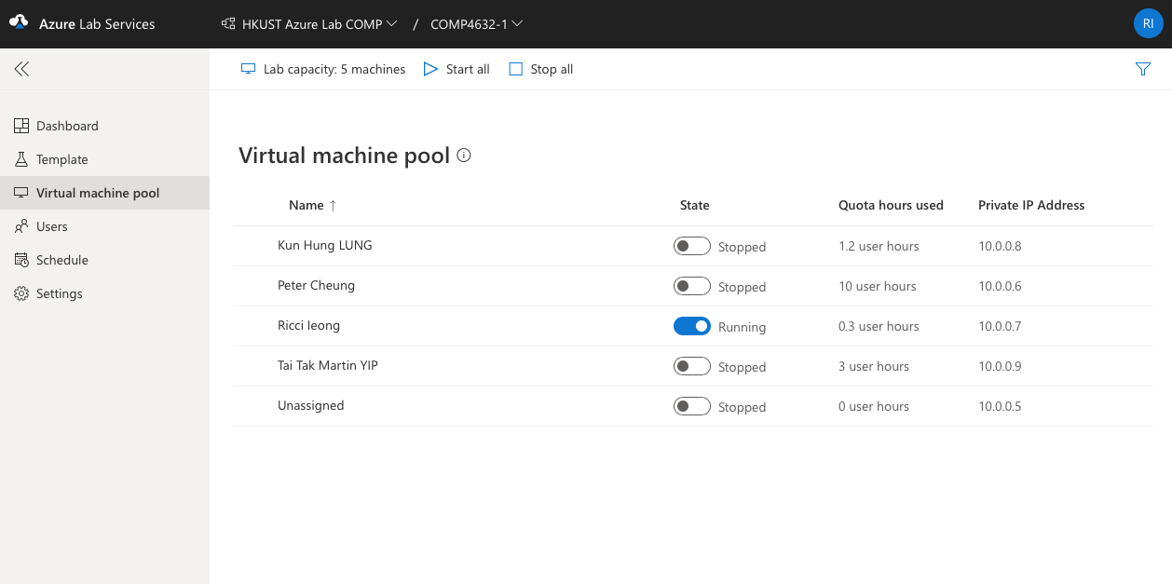
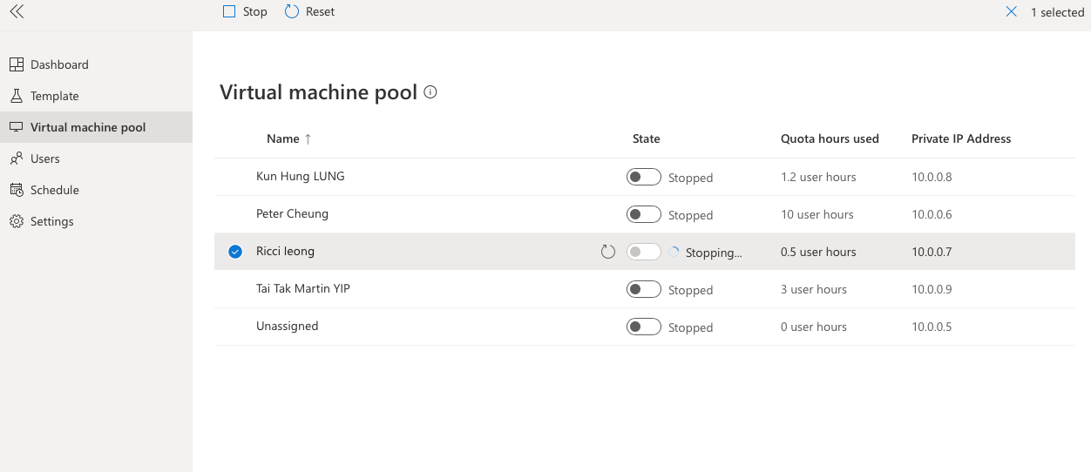
One thing to remember – Power-off <> Powered off

Slide 22
On campus environment setting (in CS Lab 3)

Slide 23
Your Computer Accounts
You have two computer accounts:
Your ITSC account
  This is given to you
  when you join UST
  This is your main
  email account at UST
Your CSD account
  This is given to you when you first join a COMP course
All the class and labs are taught in the Computer Science Department (CSD) lab rooms 4213 (CS Lab 3)]
Before you can work in those lab rooms, you need to enable your CSD account

Slide 24
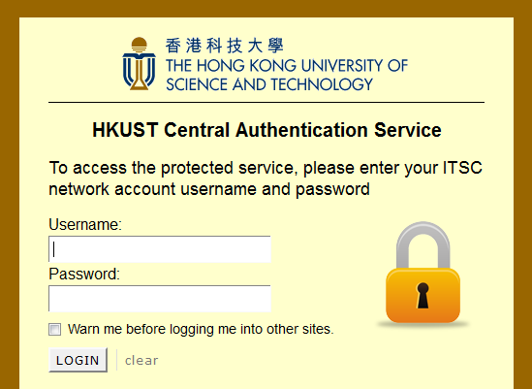
How to Enable Your CSD Account
Don’t wait for the day of the lab to do this!
Go to a computer in one of the Barns at UST
Start a browser, go to:
https://password.cse.ust.hk:8443/pass.html
Log on using
your ITSC
details

Slide 25
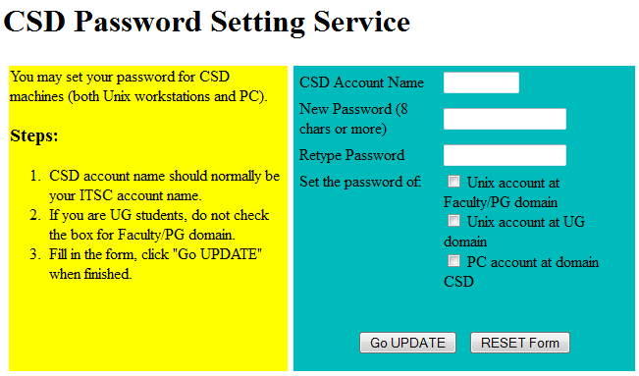
CSD Password Setting Service
Tick the bottom two check boxes
(“Unix account at UG domain” and
“PC account at domain CSD”)
Enter your ITSC account name and password (your CSD account name is the same as your ITSC account name)
Finally, click ‘Go UPDATE’

Slide 26
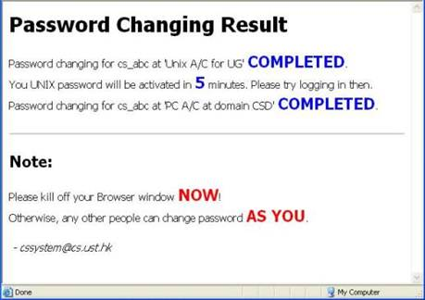
CSD Password Setting Service
You may need to wait a few minutes before
your CSD account is activated
Then you can access any CSD computers
e.g. the computers you will use in CS lab 3
Enable your account before the first lab begins!

Slide 27
Lab Settings
For PC in CS Lab
  All VM file sources can be found in D:\COMP4632\* (VM22H2 and Kali*)
  The VM file sources folder are read-only folders
  Only files stored in D:\COMP4632\YourUserName\ will be kept throughout the course period. Files stored outside D:\COMP4632\Users would be erased after reboot
  Files that stored in D:\COMP4632\YourUserName\ will be read write executable by students
Notes:
  If ova files cannot be started (e.g. if administrator password is required), reboot the machine
  If the OVA files and ISO files cannot be executed in your PC, copy them to D:\COMP4632\YourUserName\ or other locations.

Slide 28
Reference Books
Bosworth S., Kabay M. and Whyne E. (2014). Computer Security Handbook. Sixth Edition, Volume 1. John Wiley & Sons, Inc
Donaldson S., Siegel S., Williams C. and Aslam A. (2014). Enterprise Cybersecurity, How to build a successful cyberdefense program against advanced threats. Apress Open
Kurose J. and Ross K. (2013). Computer Networking, A Top-Down Approach. Sixth Edition. Addison-Wesley
Joseph Migga Kizza (2020). Guide to Computer Network Security. Third Edition. Springer-Verlag London
OWASP (2020). OWASP Testing Guide 4.2
Umesh Hodeghatta Rao and Nayak U. (2014). The InfoSec Handbook – An Introduction to Information Security. Apress Open
National Institute of Standards and Technology (2018). Framework for Improving Critical Infrastructure Cybersecurity. Version 1.1.
Stallings, W. (2017). Cryptography and Network Security, Principles and Practice. Seventh Edition. Prentice Hall.
Pramanik, S., Ghonge, M. M., Mangrulkar, R., & Le, D. N. (Eds.). (2022). Cyber Security and Digital Forensics: Challenges and Future Trends. John Wiley & Sons.

Slide 29
Reference Books
Top 11 Best Free Penetration Testing Tools 2020
  1. Hacking: The Art of Exploitation (2nd Ed.), Author: Jon Erickson
  2. The Art of Invisibility: The World’s Most Famous Hacker Teaches You How to Be Safe in the Age of Big Brother and Big Data, Author: Kevin Mitnick
  3. Ghost in the Wires: My Adventures as the World’s Most Wanted Hacker, Author(s): Kevin Mitnick, William L. Simon
  4. The Code Book: The Science of Secrecy from Ancient Egypt to Quantum Cryptography, Author(s): Simon Singh
  5. Cult of the Dead Cow: How the Original Hacking Supergroup Might Just Save the World, Author(s): Joseph Menn
  6. Social Engineering: The Science of Human Hacking, Author(s): Christopher Hadnagy
  7. Practical Malware Analysis, Author(s): Michael Sikorski
  8. The CERT Guide to Insider Threats, Author(s): Dawn M. Cappelli, Andrew P. Moore, Randall F. Trzeciak
  9. The Cyber Effect, Author(s): Mary Aiken
  10. Hacking Exposed 7: Network Security Secrets and Solutions, Author(s): Stuart McClure, Joel Scambray, George Kurtz
  11. Threat Modeling: Designing for Security, Author(s): Adam Shostack
Notes:
https://www.thesslstore.com/blog/the-best-cyber-security-books/

Slide 30
10 must-read cybersecurity books for 2024 (from HelpNetSecurity)
1. Cyber for Builders: The Essential Guide to Building a Cybersecurity Startup
2. Cybersecurity Career Master Plan: Proven techniques and effective tips to help you advance in your cybersecurity career
3. Evading EDR: The Definitive Guide to Defeating Endpoint Detection Systems
4. If It’s Smart, It’s Vulnerable
5. Operationalizing Threat Intelligence: A guide to developing and operationalizing cyber threat intelligence programs
6. Practical Cybersecurity Architecture: A guide to creating and implementing robust designs for cybersecurity architects
7. Project Zero Trust: A Story about a Strategy for Aligning Security and the Business
8. The Art of Social Engineering: Uncover the secrets behind the human dynamics in cybersecurity
9. The DevSecOps Playbook: Deliver Continuous Security at Speed
10. The Language of Deception: Weaponizing Next Generation AI
https://www.helpnetsecurity.com/2024/02/06/cybersecurity-books-2024/
Notes:
https://www.helpnetsecurity.com/2024/02/06/cybersecurity-books-2024/

