Slide 1
Software Security

Slide 2
Exploitations

Slide 3
Exploits and Metasploits
Notes:
https://www.youtube.com/watch?v=6YhTjEsIddE
https://www.youtube.com/watch?v=8FhEK296jPg (MS12-020)
https://www.youtube.com/watch?v=EYxLtSuzwDM (hacking a website with Metasploit)

Slide 4
Exploits and Vulnerability Database
https://www.exploit-db.com
https://github.com/offensive-security/exploit-database (SearchSploit for Exploit-db.com)
http://www.securityfocus.com (Bugtraq ID)
http://packetstormsecurity.com
http://www.cvedetails.com (CVE)
https://cve.mitre.org/cve/index.html (CVE)
http://www.rapid7.com/db/vulnerabilities (from Rapid 7)
http://www.rapid7.com/db/modules (Modules for Metasploit)
http://www.tenable.com/pvs-plugins (Tenable Nessus)

Slide 5
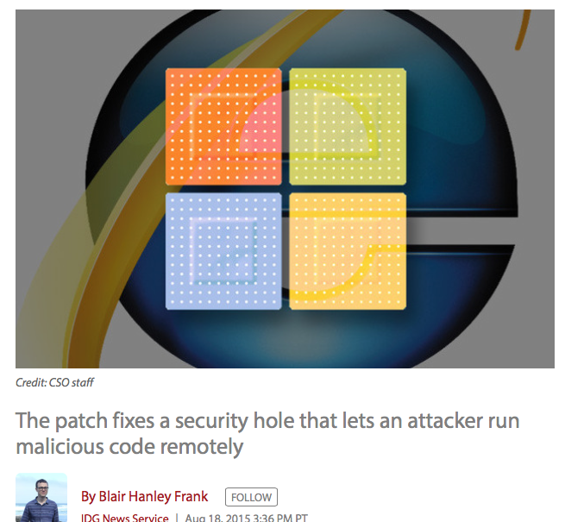
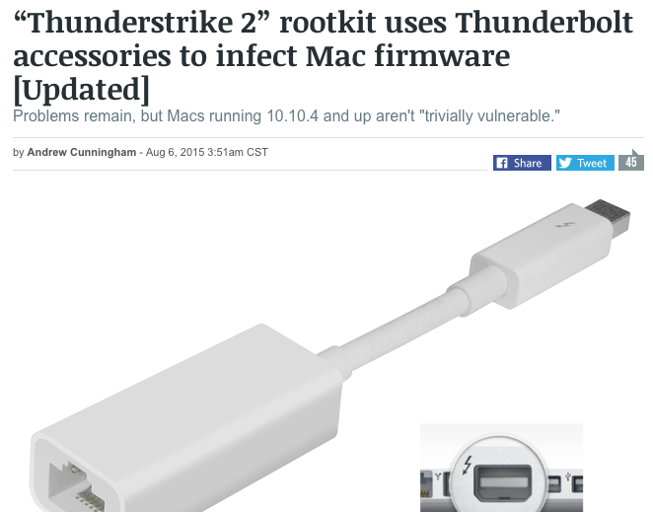
Exploits (Recent cases)
Internet Explorer vulnerabilities
StageFright
Thunderstrike 2
Notes:
http://www.computerworld.com/article/2973097/microsoft-windows/microsoft-pushes-out-an-emergency-update-for-ie-flaw.html#tk.rss_news
http://arstechnica.com/apple/2015/08/thunderstrike-2-rootkit-uses-thunderbolt-accessories-to-infect-mac-firmware/

Slide 6
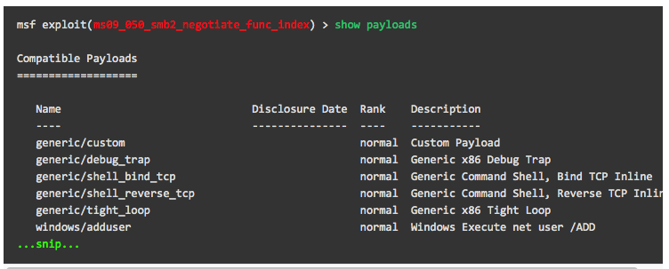
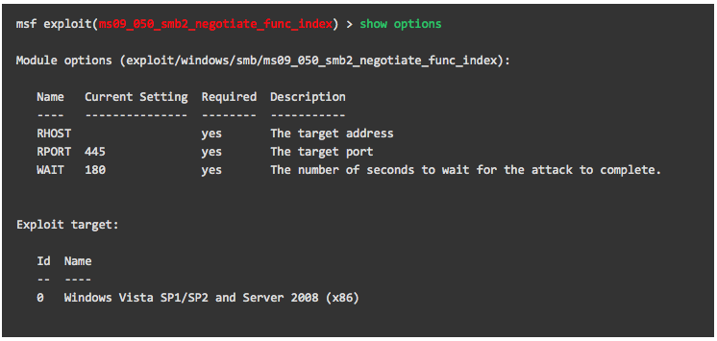
Metasploit
Notes:
https://www.offensive-security.com/metasploit-unleashed/using-exploits/

Slide 7
Metasploit
Payloads
Payload, in simple terms, are simple scripts that the hackers utilize to interact with a hacked system.
Singles
Singles are payloads that are self-contained and completely standalone.
Stagers
Stagers setup a network connection between the attacker and victim and are designed to be small and reliable.
Metasploit will use the best one when it can and fall back to a less-preferred one when necessary.
Stages
Stages are payload components that are downloaded by Stagers modules
no size limits such as Meterpreter, VNC Injection, and the iPhone ‘ipwn’ Shell.
Notes:
https://www.offensive-security.com/metasploit-unleashed/payloads/
https://www.tutorialspoint.com/metasploit/metasploit_payload.htm

Slide 8
Metasploit
https://informationtreasure.wordpress.com/2014/07/24/penetration-testing-crash-windows-7-using-metasploit-and-remote-desktop-connection-vulnerability/

Slide 9
First example: buffer overflows
Extremely common bug in C/C++ programs.
First major exploit: 1988 Internet Worm.
Whenever possible avoid C/C++
Often cannot avoid C/C++ :
Need to understand attacks and defenses
Feb. 2024: White House support for memory safety
Source: web.nvd.nist.gov

Slide 10
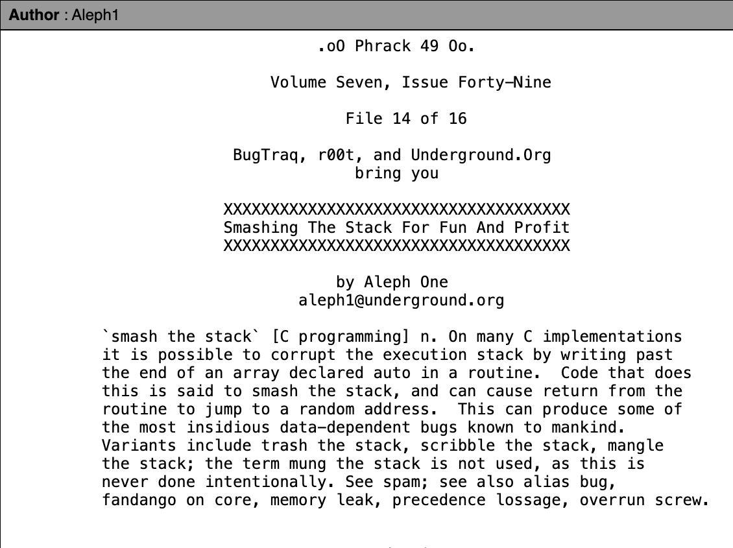
First example: buffer overflows
Phrack : an online magazine by and for hackers since 1985

Slide 11
What is needed
Understanding C functions, the stack, and the heap.
Know how system calls are made
The exec() system call
Attacker needs to know which CPU and OS used on the target machine:
Our examples are for x86-64 running Linux or Windows
Details vary slightly between CPUs and OSs:
Stack Frame structure (Unix vs. Windows, x86 vs. ARM)
Little endian vs. big endian

Slide 12
Linux process memory layout (x86-64)
0x0000 7FFF FFFF FFFF
(128 TB)
user stack
%rsp
(stack pointer)
(esp in 32-bit mode)
shared libraries
A concrete example
0x0000 7F1F6 XXXX XXXX
run time heap
Loaded from executable
(code and global vari)
text and data
0x0000 0000 0040 0040
unused
0
Notes:
Space above 0x0000 7FFF FFFF FFFF is non canonical until 0xFFFF 7FFF FFFF FFFF after which is OS.

Slide 13
Stack Frame
What is rbp, rsp, rip?
high
arguments
return address
rbp
stack base pointer
exception handlers
local variables
Stack
Growth
rsp
callee saved registers
low
(esp in 32-bit mode)
Notes:
rbp: base pointer register

Slide 14
What are buffer overflows?
Suppose a web server contains a function:
void func(char *str) { char buf[128];
strcpy(buf, str); do-something(buf); }
After func() is called stack looks like:
argument: str
return address
stack base pointer
char buf[128]
rsp

Slide 15
What are buffer overflows?
What if *url is too long?
Quiz: what url length could cause overflow?
void func(char *url) { char buf[128];
strcpy(buf, url); do-something(buf); }
argument: str
return address
stack base pointer
Poisoned return address!
Problem: no bounds checking in strcpy()
*str
char buf[128]
rsp

Slide 16
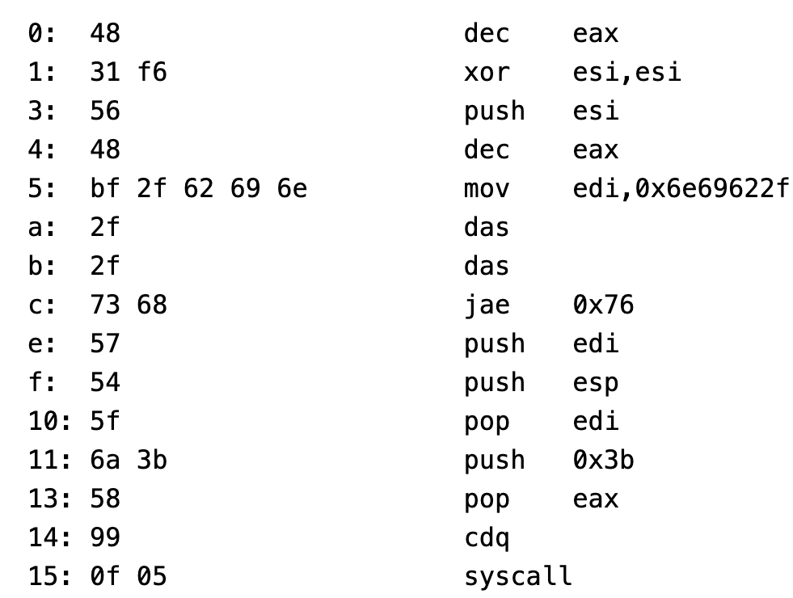
Shell Code
A piece of executable code used as a payload
Often injected from shell
"\x48\x31\xF6\x56\x48\xBF\x2F\x62\x69\x6E\x2F\x2F\x73\x68\x57\x54\x5F\x6A\x3B\x58\x99\x0F\x05"
What is the goal?

Slide 17
Basic stack exploit
Stack
Program P
high
Suppose *url is such that after strcpy stack looks like:
Program P: exec(“/bin/sh”)
When func() exits, the user gets shell !
Note: attack code P runs in stack.
(exact shell code by Aleph One)
return address
char buf[128]
low
Notes:
Aleph one: Elias Levy, moderator of Bugtraq and founder of SecurityFocus. Phrack 49, 1996.

Slide 18
The NOP slide
Stack
Program P
high
Problem: how does attacker determine ret-address?
Solution: NOP slide
Guess approximate stack state when func() is called
Insert many NOPs before program P:
nop (0x90)
NOP Slide
return address
char buf[128]
What is the stack memory layout?
low

Slide 19
Details and examples
Why?
How to avoid ‘\0’ byte?
Some complications:
Program P should not contain the ‘\0’ character.
Overflow should not crash program before func() exits.
(in)Famous remote stack smashing overflows:
Overflow in Windows animated cursors (ANI). LoadAniIcon()
Buffer overflow in Symantec virus detection (May 2016)
overflow when parsing PE headers … kernel vuln.
Notes:
Animated cursor on web page or email message would result in arbitrary code execution. Used for rendering cursors, animated cursors, and icons.
Symantec: https://bugs.chromium.org/p/project-zero/issues/detail?id=820

Slide 20
Many unsafe libc functions
strcpy (char *dest, const char *src)
strcat (char *dest, const char *src)
gets (char *s)
scanf ( const char *format, … ) and many more.
“Safe” libc versions strncpy(), strncat() are misleading
e.g. strncpy() may leave string unterminated.
Windows C run time (CRT):
strcpy_s (*dest, DestSize, *src): ensures proper termination
What would happen?
How to implement?

Slide 21
Buffer overflow opportunities
Exception handlers: (… more on this in a bit)
Overwrite the address of an exception handler in stack frame.
Function pointers: (e.g. PHP 4.0.2, MS MediaPlayer Bitmaps)
Overflowing buf will override function pointer.
Longjmp buffers: longjmp(pos) (e.g. Perl 5.003)
Overflowing buf next to pos overrides value of pos.
Heap or stack
buf[128]
FuncPtr
Notes:
Windows media player bitmaps (skins) – heap overflow, Feb. 2006
setjmp – used for exception handling (jump to global error handling code in case of error). Or for setting a checkpoint.

Slide 22
Finding overflows by fuzzing
To find overflow:
Run web server on local machine
Use AFL to issue malformed requests (ending with “$$$$$” )
Fuzzers: automated tools for this (next week)
If web server crashes, search core dump for “$$$$$” to find overflow location
Construct exploit (not easy given latest defenses in next lecture)
Notes:
AFL: American Fuzzy Lop

Slide 23
Automated Approaches to Find Vulnerabilities
Fuzzing
Static/Dynamic analysis
Formal verification
Symbolic execution
Simple and effective
Light-weight and scalable
Widely-used in industry
Notes:
The good news is that researchers have come up with many automated approaches to find vulnerabilities, such as static analysis and dynamic analysis, formal verification, symbolic executions and fuzzing. Among them, fuzzing is a very popular approach. It is simple and effective and can scale to large real-world programs. It is also widely used in industry. Linus Torvalds even says fuzzing is improving Linux kernel security.

Slide 24
Wide Application in Industry
Tech companies have built large-scale fuzzing infrastructure with thousands of CPUs
Google: OSS-Fuzz. Find 45,000+ bugs in 650 projects and 4,000 bugs in chromium[1]
Microsoft: OneFuzz
Meta: Rustaceans
[1] https://google.github.io/oss-fuzz/

Slide 25
Diverse Fuzzing Applications
binary fuzzing[1]
kernel fuzzing[2]
network protocol fuzzing[3]
ML system fuzzing[4]
smart contract fuzzing[5]
IoT
Fuzzing[6]
CPU
Fuzzing[7]
[1] Pham et al. Model-based whitebox fuzzing for program binaries. ASE’16.
[2] Schumilo et al. kAFL: Hardware-Assisted Feedback Fuzzing for OS Kernels. Security’17.
[3] Pham et al. AFLNET: A Greybox Fuzzer for Network Protocols. ICST’20.
[4] Deng et al. Fuzzing Deep-Learning Libraries via Automated Relational API Inference. ICSE’22.
[5] Jiang et al. ContractFuzzer: fuzzing smart contracts for vulnerability detection. ASE’18.
[6] Chen et al. IoTFuzzer: Discovering Memory Corruptions in IoT Through App-based Fuzzing. NDSS’18.
[7] Serebryany et al. SiliFuzz: Fuzzing CPUs by proxy. arXiv:2110.11519.
Notes:
Fuzzing has been used in diverse application domains. Such as binary, kernel, network

Slide 26
What is Fuzzing?
Popular software testing technique
Find inputs to trigger vulnerabilities and maximize code coverage
Generate a large number of random inputs
Execute tested program
Monitor any abnormal program behaviors
Notes:
A bit of background fuzzing. What is fuzzing? It is a popular software testing technique. Specifically, it finds a set of inputs that can trigger vulnerabilities and maximize the code coverage by generating a large number of random inputs, then execute tested programs with these inputs to see if there are any abnormal behaviors such as crashes or hangs. A simple example of fuzzing is monkey testing. As shown in the figure on the right. Imagine we have a monkey sitting in front of a computer. Each time, the monkey types a random input. You can see a large number of meaningless inputs generated by the monkey. All these inputs will be sent into tested programs and see if they find abnormal program behaviors.

Slide 27
A General Workflow of Fuzzing
aaaa
bbbb
bbxx
bbbb
bbxx
…
Seed Scheduling
Seed Mutation
Program
cccc
Seed Corpus
Yes
Save?
No
Fuzzing is an iterative searching loop consisting of two steps (seed scheduling and seed mutation)
Notes:
Real-world fuzzer cannot use monkeys’ random generation because most of them are invalid. In order to generate more valid testcases, a real-world fuzzer starts with a valid seed and applies mutation on it. Let’s look at a general workflow of fuzzing. It starts with a set of valid seed corpus, consisting of multiple test cases, we call seed. Then seed scheduling module selects a seed from the corpus. For example, it chooses the seed “bbbb” like this. Next, the seed mutation module mutates the selected seed to generate a new input, “bbxx”. Then the new input “bbxx” are sent into the tested program for dynamic execution. Fuzzer will monitor the dynamic execution of the new input. If there is abnormal or new behaviors found, the new input will be saved and added to the seed; else, discarded. You may find that this process is a loop. Fuzzing is essentially an iterative searching loop consisting of two steps

Slide 28
Popular Fuzzer
AFL, widely used fuzzer
AFL++, integrates academic research into AFL, maintained by community
LibFuzzer, maintained by Google
LibAFL, maintained by commuity

Slide 29
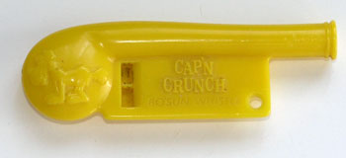
The mistake: mixing data and control
An ancient design flaw: Phone Phreaking
enables anyone to inject control signals
A whistle that can make 2600Hz sound

Slide 30
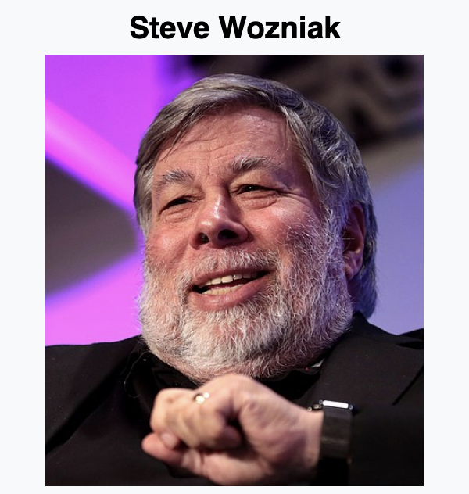
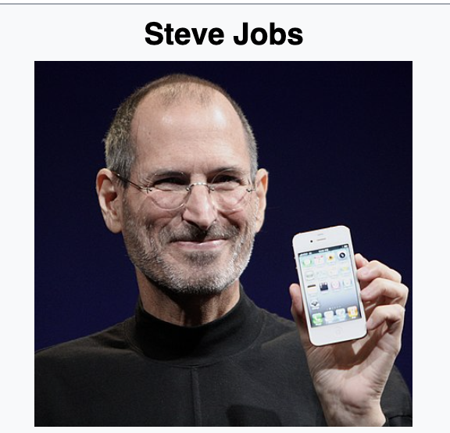
Fun Story of Blue Box
What did these folks do back in the 1970s before they started apple?
Founders of Apple
Build and sell the Blue Box (an illegal phone hacking toolset)

Slide 31
How To Make Free Calls
Call a toll-free (1-800) number that connects you somewhere outside of your local telephone office. (Request a free line)
Play a 2600 Hz tone over the phone line, causing the receiving office to think that you’ve hung up. (Take over the free line)
Somehow play the tones for the number you actually want to call, and the receiving office will connect you (but the local office will still think your call is toll-free!)
(Send out control signal over phone)

Slide 32
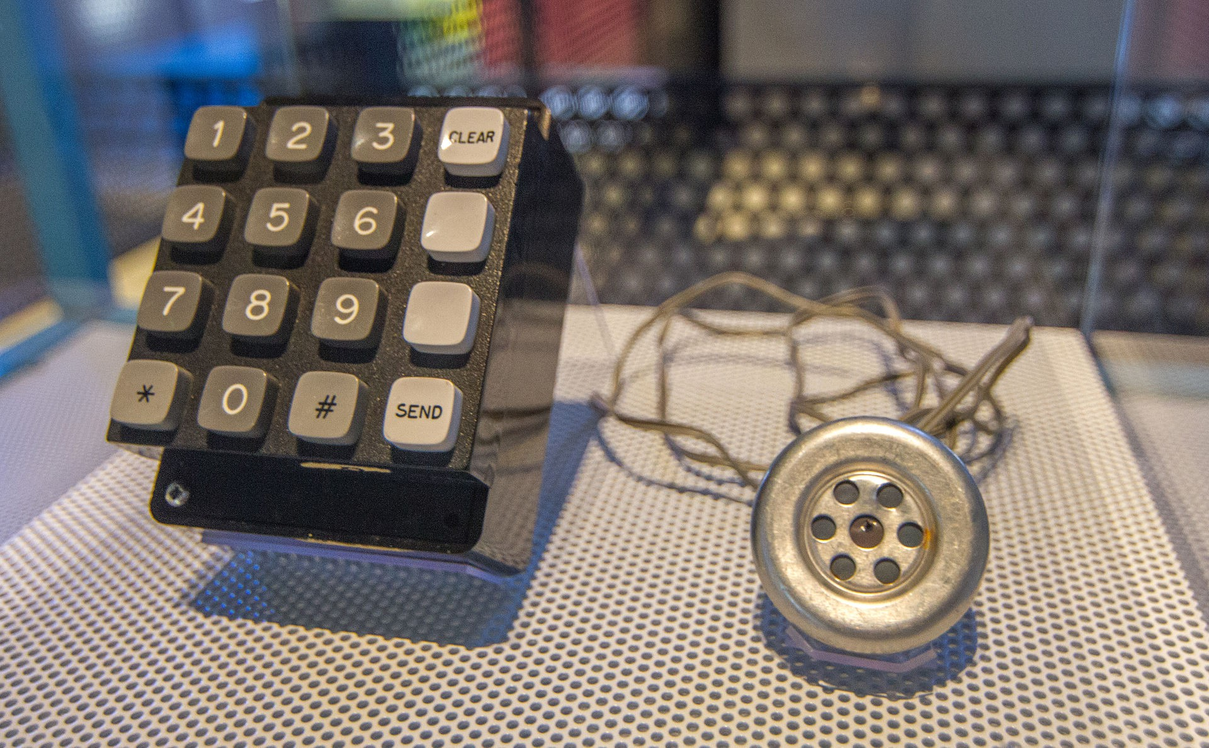
The Blue Box
A device that could generate the tones used internally by the telephone network to connect long-distance lines.
The Blue Box made by Woz and sold by Steve
Computer History Museum
Mountain View, CA
Also the first product that Steve Jobs and Steve Wozniak ever sold together.

Slide 33
Control hijacking attacks
The problem: mixing data with control flow in memory
local variables
SFP
ret
addr
arguments
stack frame
data overwrites
return address
Later we will see that mixing data and code is also the reason for XSS, a common web vulnerability

Slide 34
Marking memory as non-execute (DEP)
Prevent attack code execution by marking stack and heap as non-executable
NX-bit on AMD64, XD-bit on Intel x86 (2005), XN-bit on ARM
disable execution: an attribute bit in every Page Table Entry (PTE)
Deployment:
All major operating systems
Windows DEP: since XP SP2 (2004) (Visual Studio: /NXCompat[:NO])
Limitations:
Some apps need executable heap (e.g. JITs).
Can be easily bypassed using Return Oriented Programming (ROP)
Notes:
/NXCOMPAT: tells linker that app is compatible with DEP. :NO indicates don’t use DEP.
DEP: data execute prevention
NX: no execute, XD: execute disabled, XN: execute never

Slide 35
Attack: Return Oriented Programming (ROP)
Control hijacking without injecting code:
stack
libc.so
args
ret-addr
exec()
sfp
printf()
local buf
“/bin/sh”
Return to LibC Attack
Notes:
NX wasted effort?

Slide 36
Attack: Return Oriented Programming (ROP)
Control hijacking without injecting code:
Recap on the stack memory layout
stack
libc.so
args
ret-addr
exec()
sfp
printf()
local buf
“/bin/sh”
Return to LibC Attack
Notes:
NX wasted effort?

Slide 37
Attack: Return Oriented Programming (ROP)
Control hijacking without injecting code:
stack
libc.so
args
ret-addr
exec()
sfp
printf()
local buf
“/bin/sh”
Return to LibC Attack
Notes:
NX wasted effort?

Slide 38
Defense: Stack Canary
Many run-time checking techniques …
we only discuss methods relevant to overflow protection
Method: StackGuard
Run time tests for stack integrity.
Embed “canaries” in stack frames and verify their integrity prior to function return.
What is the function call sequences for the following stack frame?
Frame 2
Frame 1
local
canary
sfp
ret
arg
local
canary
sfp
ret
arg
top of stack

