Slide 1
Week 10 – Network Infrastructure Security

Slide 2
Virtual Private Network

Slide 3
What is Virtual Private Network
Secure private communications over public internet
Private IP packets encapsulated within public packets (tunnel)
Protecting the Network channel over untrusted network
Protect through the use of encryption
Either through IPSEC, or other encryption scheme
Compliance issue
Categorized in
Remote Access
Site-to-Site
Extranet
Notes:
https://www.youtube.com/watch?v=8ZeerKipr3g

Slide 4
VPN
1. Encrypt your data
2. Mask your IP addr
3. Route traffic through an encrypted tunnel (server location chosen by user)

Slide 5
How VPNs Works

Slide 6
VPN and Internet Censorship
1. DNS poisoning -> Use VPN server’s own DNS
2. IP blocking -> IP masking and traffic rerouting
3. Deep packet inspection -> Packet encryption
4. URL filtering -> IP masking
How to visit OpenAI GPT (servers in the US) from HK?
Use VPN to bypass regional IP blocking

Slide 7
TOR Router

Slide 8
What is Tor
The Onion Router
Enabling anonymous communication
Volunteer Operation
Mainly focus on provide anonymous web browser
Also provide Hidden Services

Slide 9
How Tor’s Works

Slide 10
How Tor’s Works

Slide 11
How Tor’s Works

Slide 12
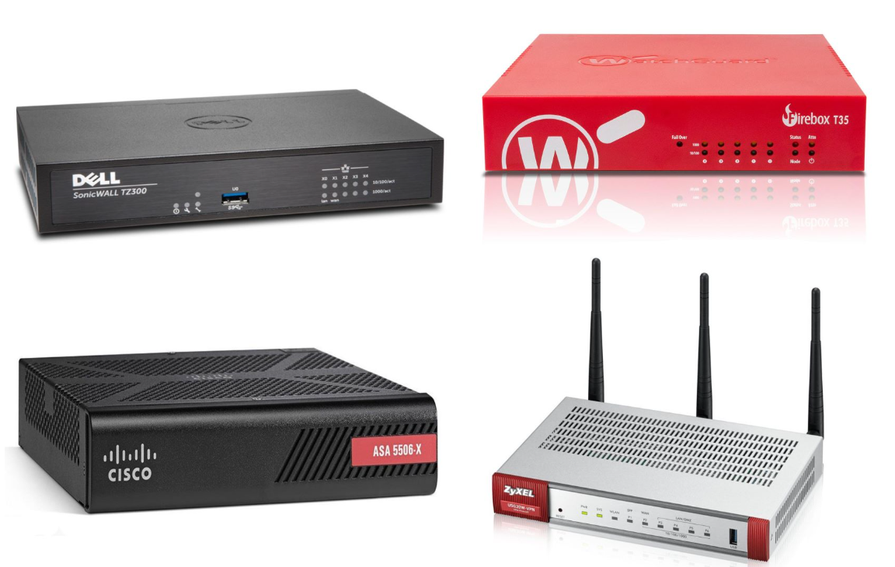
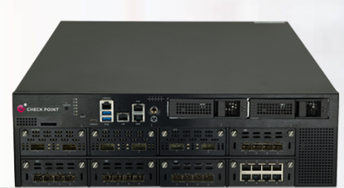
Firewall
Hardware/software used to implement security policies governing the network traffic between networks. (alike a router)
Stop unwanted network traffic
Protect information

Slide 13
Firewall – Packet Filtering
Specify packets to filter (discard/reject) during the routing process
source/destination ip address
protocol
port
time
length
Not efficient for dynamic protocol:
RPC, FTP, Streaming, etc.

Slide 14
Packet Filter
Using filtering of packets on network level

Slide 15
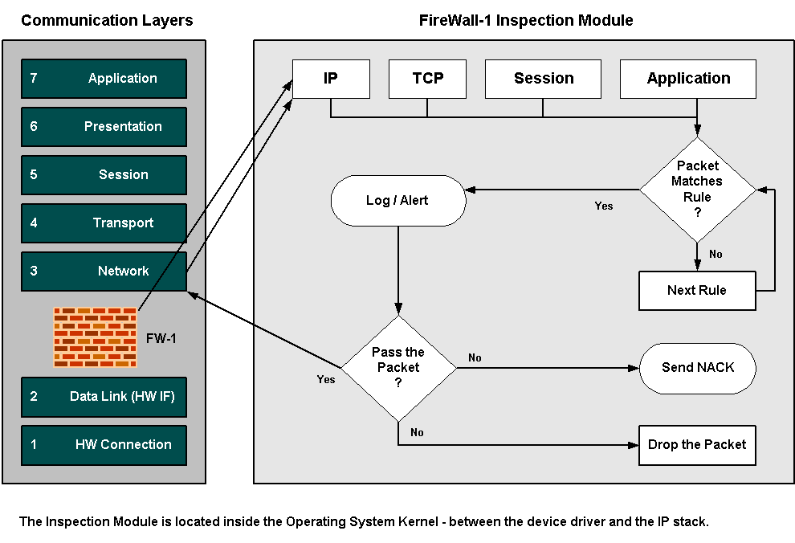
Flow of Packets through Inspect Engine

Slide 16
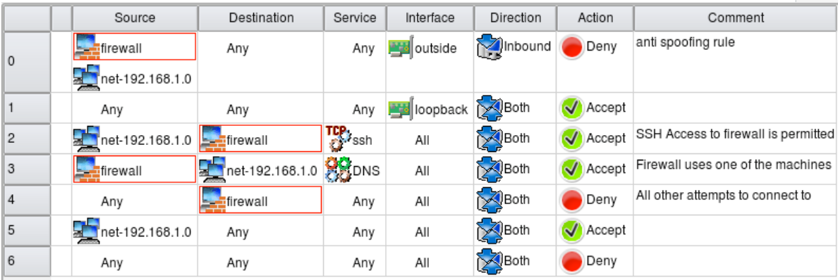
Firewall Rules
Notes:
https://community.checkpoint.com/t5/Management/Layers-and-the-cleanup-rule/td-p/6553#
https://fwbuilder.sourceforge.net/4.0/docs/users_guide5/global-policy.shtml

Slide 17
Firewall Rules (NAT Rules)
Notes:
https://docs.fortinet.com/document/fortigate/6.2.15/cookbook/497952/policy-views-and-policy-lookup

Slide 18
Denial of Service Attacks
Goal: take large site offline by overwhelming it with network traffic such that they can’t process real requests
How: find mechanism where attacker doesn’t have to spend a lot of effort, but requests are difficult/expensive for victim to process
Notes:
GO DISCUSS HOW A LAN PLAYS OUT AND HAS A ROUTER

Slide 19
Types of Attacks
DoS Bug: design flaw that allows one machine to disrupt a service. Generally, a protocol asymmetry, e.g., easy to send request, difficult to create response. Or requires server state.
DoS Flood: control a large number of requests from a botnet of machines you control
Notes:
GO DISCUSS HOW A LAN PLAYS OUT AND HAS A ROUTER

Slide 20
Possible at Every Layer
Link Layer: send too much traffic for switches/routers to handle
TCP/UDP: require servers to maintain large number of concurrent connections or state
Application Layer: require servers to perform expensive queries or cryptographic operations
Notes:
GO DISCUSS HOW A LAN PLAYS OUT AND HAS A ROUTER

Slide 21
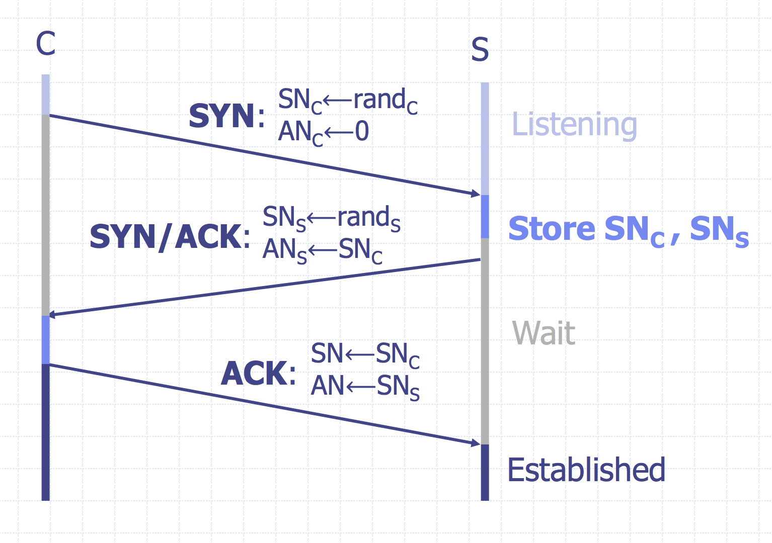
TCP Handshake
Question: what happens if there are many syn request packets?
Notes:
GO DISCUSS HOW A LAN PLAYS OUT AND HAS A ROUTER

Slide 22
SYN Floods
Notes:
GO DISCUSS HOW A LAN PLAYS OUT AND HAS A ROUTER

Slide 23
Core Problem
Problem: server commits resources (memory) before confirming identify of client (when client responds)
Bad Solution:
- Increase backlog queue size
- Decrease timeout
Real Solution: Avoid state until 3-way handshake completes
Notes:
GO DISCUSS HOW A LAN PLAYS OUT AND HAS A ROUTER

Slide 24
DoS: Amplification Attacks
Problem: attacker only controls a small number of bots
Why?
a small volume of network traffic in DoS
One query => One response
How to launch DoS with a small number of bots?
Image: Cloudflare

Slide 25
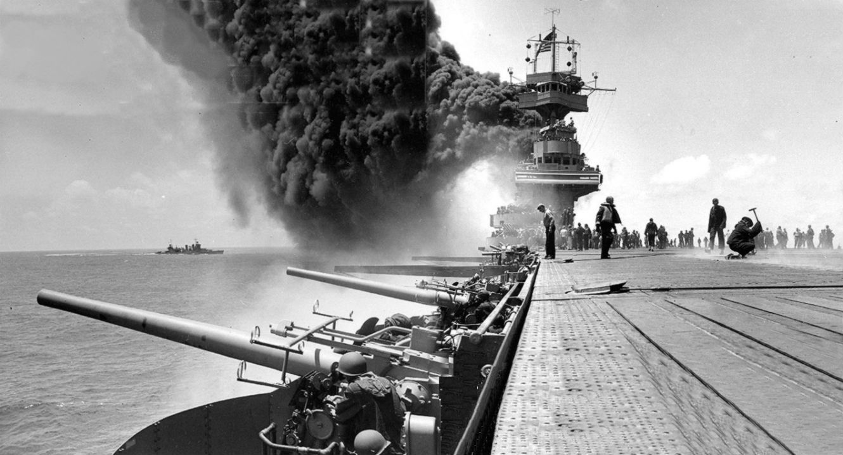
Loss Exchange Ratio
Ratio of loss sustained by the two conflicting sides
Battle of Midway
WWII, US vs. Japan
US lost 1 fleet carrier
Japan lost 4 fleet carriers
1 vs. 4

Slide 26
DoS: Amplification Attacks
Problem: attacker only controls a small number of bots
Why?
a small volume of network traffic in DoS
One query => One response
How to launch DoS with a small number of bots?
High exchange ratio
Image: Cloudflare

Slide 27
DoS: Amplification Attacks
Problem: attacker only controls a small number of bots
Why?
a small volume of network traffic in DoS
One small query => One large response
How to launch DoS with a small number of bots?
High exchange ratio
Image: Cloudflare

Slide 28
Common UDP Amplifiers
Open DNS Resolver: publicly available DNS servers
Google: 8.8.8.8 or 8.8.4.4
OpenDNS: 208.67.222.222 and 208.67.220.220
DNS ANY query: returns all records server has about a domain
NTP(network time protocol) MONLIST query: returns list of last 600 clients who asked for the time recently
Only works if you can receive a big response by sending a single packet — otherwise spoofing doesn’t help you.
Notes:
GO DISCUSS HOW A LAN PLAYS OUT AND HAS A ROUTER

Slide 29
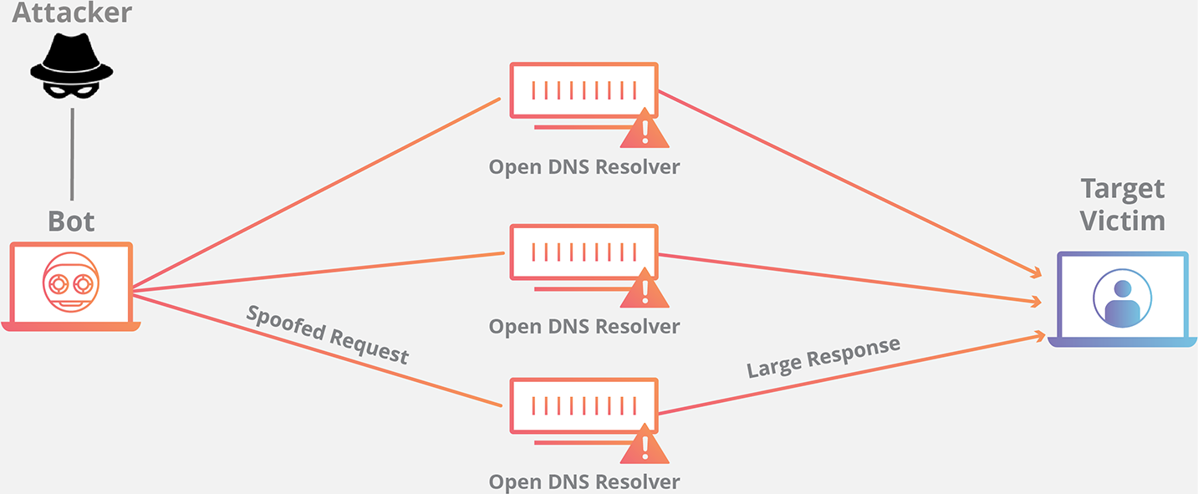
DoS: Amplification Attacks
MX mx1.example.com.
MX mx1.example.com.
MX mx1.example.com.
MX mx1.example.com.
MX mx1.example.com.
MX mx1.example.com.
MX mx1.example.com.
MX mx1.example.com.
A 1.2.3.8 A 1.2.3.9
A 1.2.3.4 A 1.2.3.5 A 1.2.3.6
A 1.2.3.7 A 1.2.3.8 A 1.2.3.9
DNS ANY example.com.
60-70x Increase in Size
Image: Cloudflare

Slide 30
Amplification Attacks
2013: DDoS attack generated 300 Gbps (DNS) - 31,000 misconfigured open resolvers, each at 10 Mbps
- Source: 3 networks that allowed IP spoofing
2014: 400 Gbps DDoS attacked used 4500 NTP servers
How to ensure all traffic is sent to victim instead of attacker ?
What is the throughput for NTP server?
Notes:
GO DISCUSS HOW A LAN PLAYS OUT AND HAS A ROUTER

Slide 31
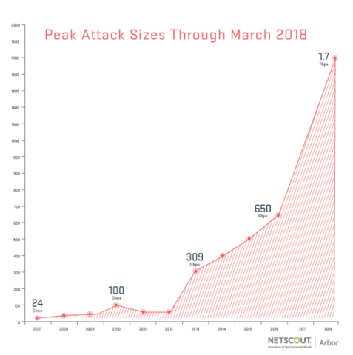
Memcache
Memcache: retrieve large record
The server responds by firing back as much as 50,000 times the data it received.
Exchange ratio:
1vs. 50,000
Exchange ratio:
1vs. 50,000
Notes:
These attacks were different in two ways. The first difference was just the sheer magnitude of the size of attack. The attack against Brian was the largest DDoS attack that Akamai had ever seen—620 Gbps—almost double the prior 363 Gbps.

Slide 32
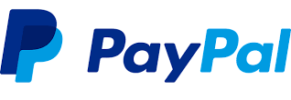
October 21, 2016
Notes:
Sometimes also just organic traffic

Slide 33
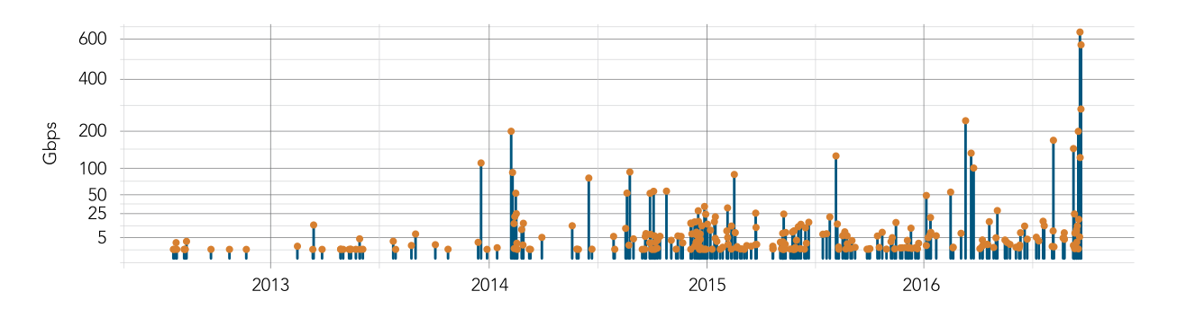
Krebs Graph
“The magnitude of the attacks seen during the final week were significantly larger than the majority of attacks Akamai sees on a regular basis. […] In fact, while the attack on September 20 was the largest attack ever mitigated by Akamai, the attack on September 22 would have qualified for the record at any other time, peaking at 555 Gbps.”
Source: 2017 Akamai State of the Internet
Notes:
These attacks were different in two ways. The first difference was just the sheer magnitude of the size of attack. The attack against Brian was the largest DDoS attack that Akamai had ever seen—620 Gbps—almost double the prior 363 Gbps.

Slide 34
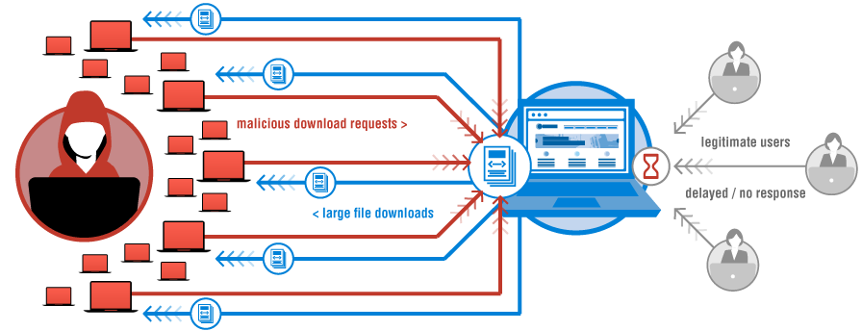
“We are still working on analyzing the data but the estimate at the time of this report is up to 100,000 malicious endpoints. […] There have been some reports of a magnitude in the 1.2 Tbps range; at this time we are unable to verify that claim.”
Image: Verisign
Notes:
This outage was due to a large DDoS attack that targeted a large DNS provider — Dyn. However, while Dyn was one of hte

Slide 35
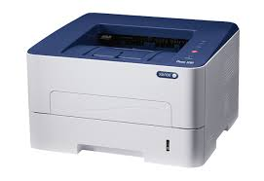
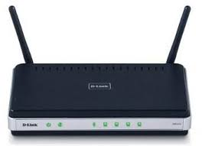
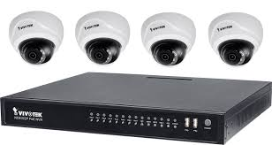
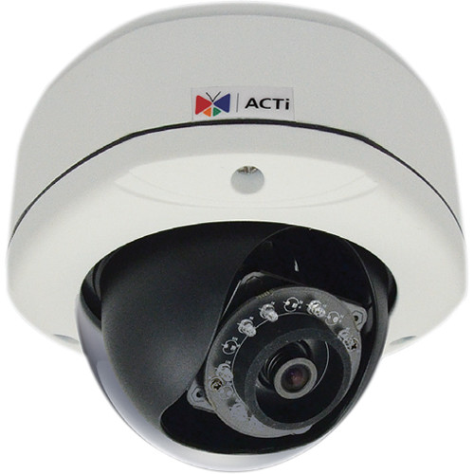
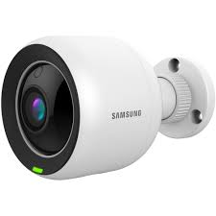
A Botnet of IoT Devices
GRE HTTP TLS
Bot Master
OVH/Dyn/Krebs
≈ 200K Hosts
200K IoT devices
Not Amplification. Flood with SYN, ACK, UDP, and GRE packets

Slide 36
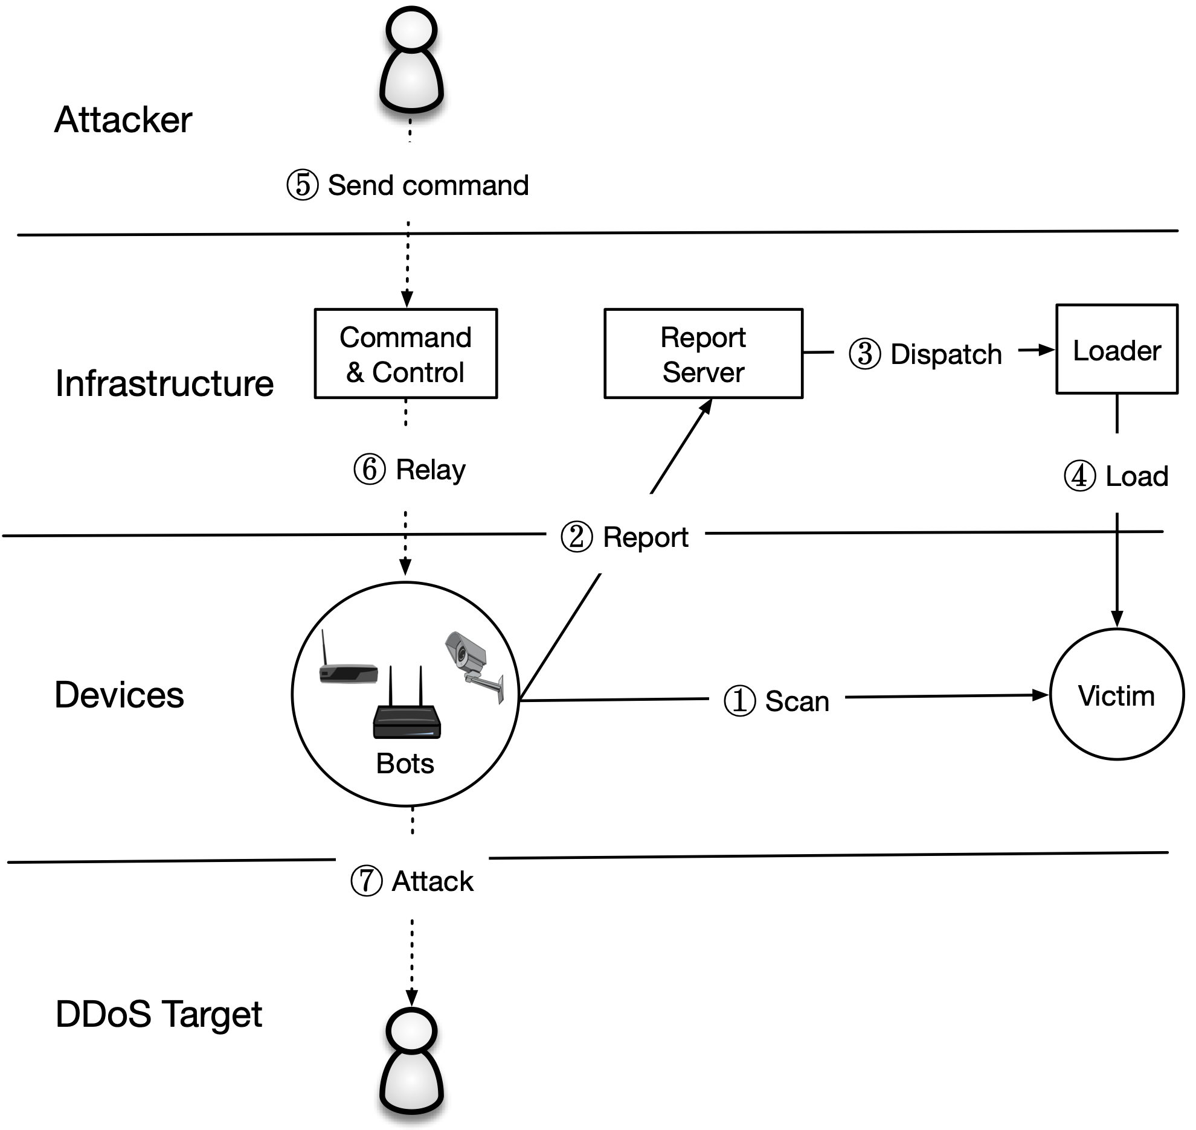
The Mirai Malware
Later, the bot master will issue commands to pause scanning and to start an attack
Attack Command:
Action (e.g., START, STOP)
Target IP(s)
Attack Type (e.g., GRE, DNS, TCP)
Attack Duration

Slide 37
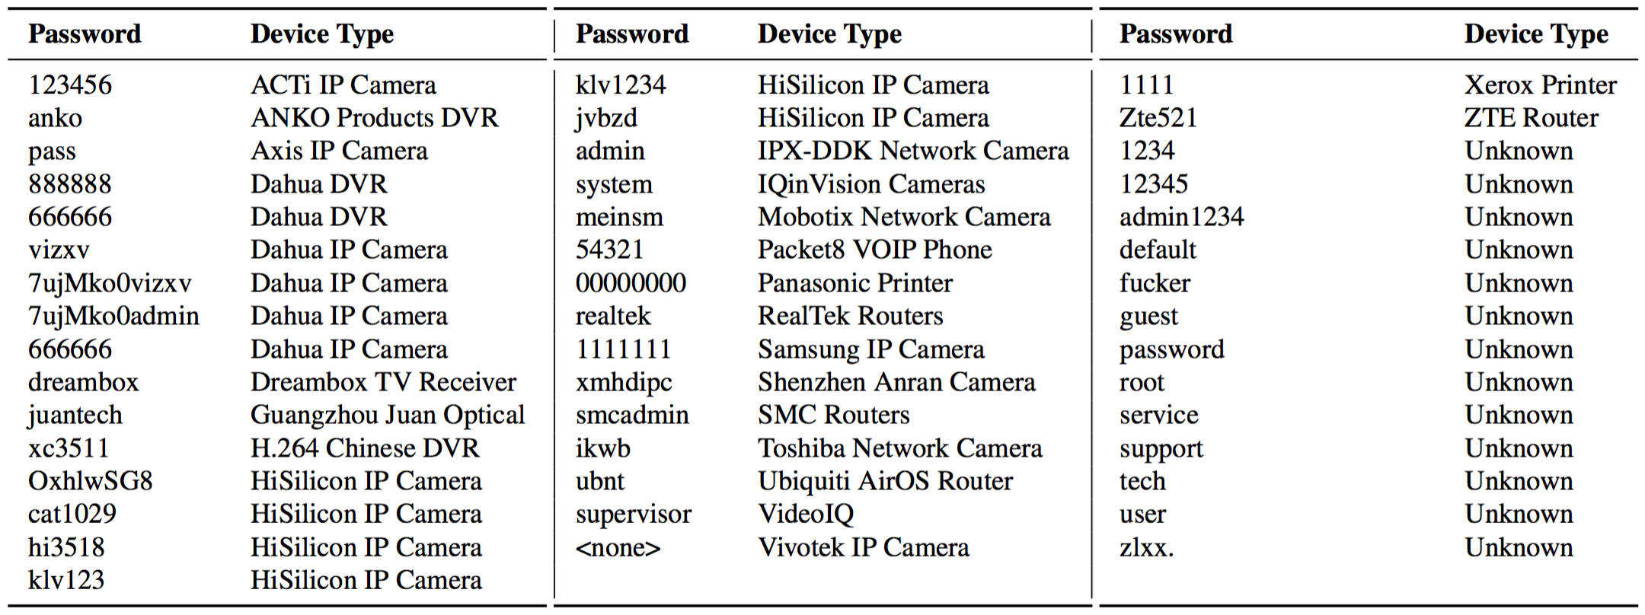
Password Guessing
Notes:
While most folks in the United States weren’t directly affected until the Dyn outage, the attack on Dyn was the third of four very large and somewhat unique DDoS attacks in September and October of 2016.
The first was on September 18 and attacked OVH…

Slide 38
Mirai Population
~600K devices compromised
Notes:
These attacks were different in two ways. The first difference was just the sheer magnitude of the size of attack. The attack against Brian was the largest DDoS attack that Akamai had ever seen—620 Gbps—almost double the prior 363 Gbps.

Slide 39
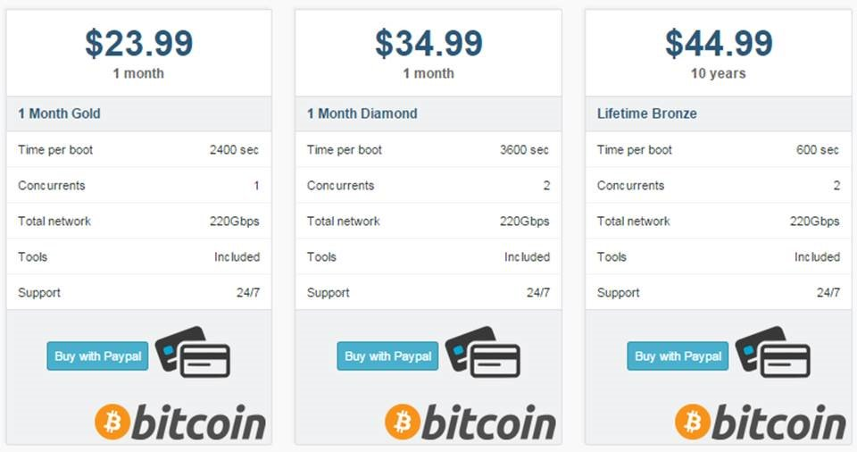
Booter Services
Notes:
GO DISCUSS HOW A LAN PLAYS OUT AND HAS A ROUTER

Slide 40
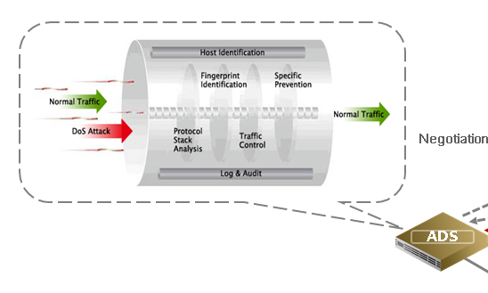
Anti-DDoS solution
Solution against bandwidth/resources type DDoS attack
Firewall
Behavioral IDS detection
http://www.nsfocus.com/images/adsfa04.png
http://www.vilayer.com/sec-layer-anti-ddos.html

Slide 41
Google Project Shield
DDoS Attacks are often used to censor content. In the case of Mirai, Brian Kreb’s blog was under attack.
Google Project shield uses Google bandwidth to shield vulnerable websites (e.g., news, blogs, human rights orgs)
Notes:
GO DISCUSS HOW A LAN PLAYS OUT AND HAS A ROUTER

Slide 42
What is Honeypot
Honeypot is a computer security mechanism set to detect, deflect, or, in some manner, counteract attempts at unauthorized use of information systems.
Consists of 3 types
Pure honeypots
High-interaction honeypots (imitate most services)
Low-interaction honeypots (imitate frequently used services)
http://honeypots-the-trap-of-computing.wikia.com/wiki/Honeypots:_The_Trap_of_Computing_Wiki
https://en.wikipedia.org/wiki/Honeypot_(computing)

