Slide 1
Week 4 – Network and WIFI Security

Slide 2
TCP/IP Model
OSI Model
TCP/IP Model
defines 4 layers:
Application Layer
FTP, HTTP, DNS, SMTP, …
Host-to-Host Transport Layer
TCP, UDP
Internet Layer
IP, ARP, ICMP
Network Link Layer
Ethernet
Application Layer
Application Layer
Presentation Layer
Session Layer
Transport Layer
Transport Layer
Network Layer
Network Layer
Data Link Layer
Data Link Layer
Physical Layer

Slide 3
Ethernet Frame
Frame format

Slide 4
MAC Addresses
ISO/IEC 8802 standard
Every Ethernet Network Card has a 6 Bytes MAC addresses
Each manufacturer has their own 3-bytes Organizational Unique Identifier (OUI)
https://standards.ieee.org/develop/regauth/oui/public.html

Slide 5
Ethernet Illustration

Slide 6
Internet Protocol (IP)
unreliable, connectionless datagram delivery
provide host-to-host data delivery
“Routing”
map all hosts in the network an IP address (32-bits)

Slide 7
IPv4
IP (Datagram) Header Format

Slide 8
IP Illustration

Slide 9
Internet Control Messages Protocol (ICMP)
Contains error messages and other conditions that require attention
Code | Description | Type
0 | Echo Reply | Query
3 | Destination Unreachable | Error
5 | Redirect | Error
8 | Echo request | Query
11 | Time exceeded | Error
13/14 | Timestamp request/reply | Query

Slide 10
ICMP
ICMP Header Format

Slide 11
ICMP Illustration

Slide 12
Address Resolution Protocol (ARP)
Map between address of internet layer and network link layer
Dynamic / Static
Broadcast for address resolution
32-bit Internet Address
ARP
RARP
Sample ARP cache
48-bit Ethernet Address

Slide 13
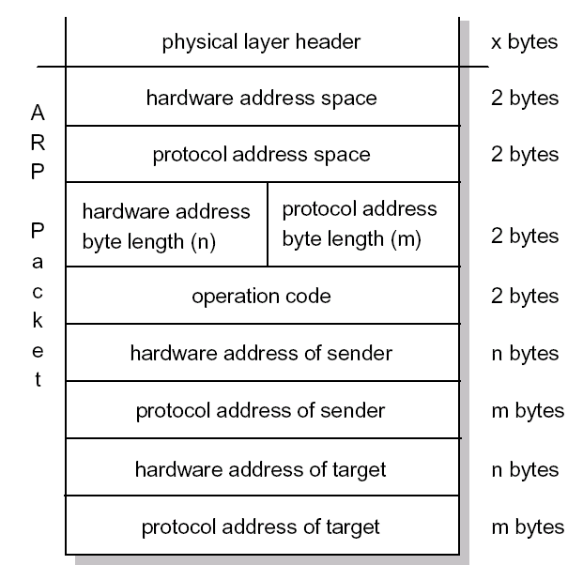
ARP
ARP Request/Reply Packet

Slide 14
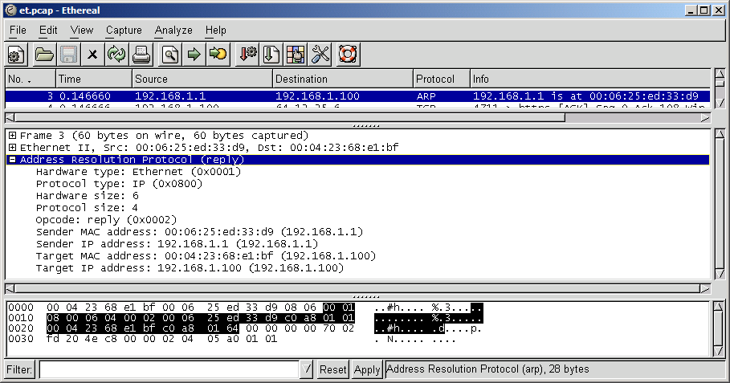
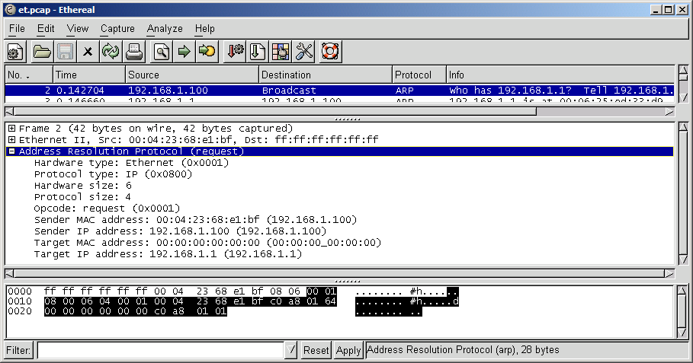
ARP Illustration

Slide 15
User Datagram Protocol (UDP)
simple, datagram-oriented
Each output operation by a process produces exactly one UDP datagram
fast
unreliable
source ports dynamically assigned, > 1023

Slide 16
UDP
UDP Header Format

Slide 17
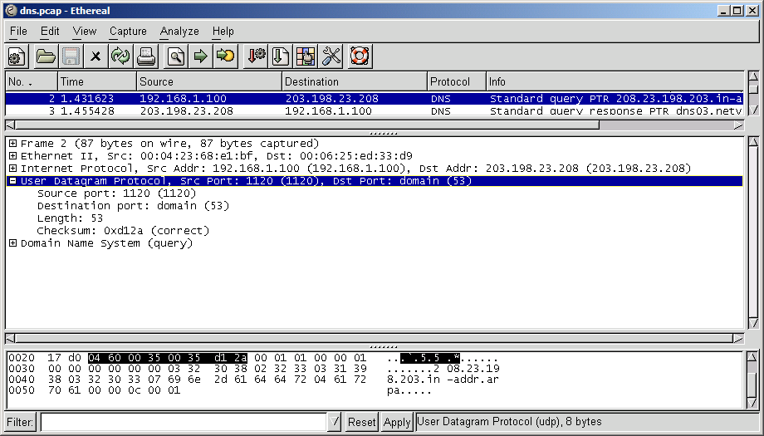
UDP Illustration

Slide 18
Transport Control Protocol (TCP)
full-duplex, connection-oriented, reliable, virtual circuit
slower than UDP
reliable data transport:
received a segment -> sent an acknowledge
unacknowledged segment -> retransmitted
segments sequenced back in proper order
manageable data flow
source ports dynamically assigned, > 1023

Slide 19
TCP
TCP Header Format

Slide 20
TCP Illustration

Slide 21
TCP Flags
URG: Urgent pointer field is significant in this segment
ACK: Acknowledgement field is significant in this segment
PSH: Push function
RST: Resets the connection
FIN: No more data from sender
SYN: Synchronize sequence numbers to initiate a connection

Slide 22
TCP Connection Establishment
Client
Server
SYN_{n}
SYN_{m}, ACK_{n+1}
ACK_{m+1}

Slide 23
TCP Connection Termination
Client
Server
FIN_{n},ACK_{m}
ACK_{n+1}
FIN_{m},ACK_{n+1}
ACK_{m+1}

Slide 24
TCP Connection States
LISTENING: The socket is listening for incoming connections.
SYN_SENT: The socket is actively attempting to establish a connection.
SYN_RECV: A connection request has been received from the network.
ESTABLISHED: The socket has an established connection.
FIN_WAIT1: The socket is closed, and the connection is shutting down.
FIN_WAIT2: Connection is closed, and the socket is waiting for a shutdown from the remote end.

Slide 25
TCP Connection States
TIME_WAIT: The socket is waiting after close to handle packets still in the network.
LAST_ACK: The remote end shut down, and the socket is closed. Waiting for acknowledgement.
CLOSING: Both sockets are shut down but we still don't have all our data sent.
CLOSE_WAIT: The remote end has shut down, waiting for the socket to close.
CLOSED: The socket is not being used.
UNKNOWN: The state of the socket is unknown.

Slide 26
Client
Server
LISTENING
SYN_SENT
SYN_{n}
SYN_RCVD
SYN_{m}, ACK_{n+1}
ACK_{m+1}
ESTABLISHED
ESTABLISHED
Data Communication …
FIN_{n},ACK_{m}
FIN_WAIT1
CLOSE_WAIT
ACK_{n+1}
FIN_WAIT2
LAST_ACK
FIN_{m},ACK_{n+1}
CLOSING
TIME_WAIT
ACK_{m+1}
CLOSED
CLOSED

Slide 27
Common Port Numbers
HTTP:80, DNS:53, FTP:21, HTTPS:443, …
Reference:
Internet Assigned Number Authority (IANA) Port Numbers http://www.iana.org/assignments/port-numbers
DNS Server: # nslookup –q=txt 80.tcp.portsdb.org # nslookup –q=txt 53.udp.portsdb.org # nslookup –q=txt icq.tcp.portsdb.org # nslookup –q=txt domain.udp.portsdb.org

Slide 28
Application Layer
User process cooperating with another process on the same or different host
E.g.
HTTP, SMTP, DNS, FTP, …

Slide 29
Application Layer - HTTP
GET / HTTP/1.1 Accept: */* Accept-Language: en-us,zh-hk;q=0.5 Accept-Encoding: gzip, deflate User-Agent: Mozilla/4.0 (…) Host: www.ust.hk Connection: Keep-Alive Cookie: WTO_CLIENT=1
HTTP/1.1 200 OK Date: Sat, 03 Jul 2004 12:01:30 GMT Server: Apache/1.3.12 (Unix) mod_ssl/2.6.3 OpenSSL/0.9.5a Last-Modified: Tue, 25 Jun 2002 09:59:10 GMT ETag: "1a0a64-e4-3d183eee“ Accept-Ranges: bytes Content-Length: 228 Keep-Alive: timeout=15, max=100 Connection: Keep-Alive Content-Type: text/html
<data……>
GET /en/index.html HTTP/1.1 Accept: */* Accept-Language: en-us,zh-hk;q=0.5 Accept-Encoding: gzip, deflate If-Modified-Since: Thu, 15 Jan 2004 06:21:45 GMT; length=208 User-Agent: Mozilla/4.0 (…) Host: www.ust.hk Connection: Keep-Alive Cookie: WTO_CLIENT=1
HTTP/1.0 304 Not Modified Date: Sat, 03 Jul 2004 12:01:27 GMT Server: Apache/1.3.27 (Unix) mod_ssl/2.8.12 OpenSSL/0.9.6b ETag: "439a3-d0-40063179"

Slide 30
Application Layer - SMTP
220 imsmq09.netvigator.com ESMTP Sendmail 8.12.10/8.12.10; Sat, 3 Jul 2004 20:17:39 +0800
HELO DEMO
250 imsmq09.netvigator.com Hello pcd633218.netvigator.com [218.102.165.218], pleased to meet you
MAIL FROM: <sender@netvigator.com>
250 2.1.0 <sender@netvigator.com>... Sender ok
RCPT TO: <receiver@cs.ust.hk>
250 2.1.5 <receiver@cs.ust.hk>... Recipient ok
RSET
250 2.0.0 Reset state
MAIL FROM: <sender@netvigator.com>
250 2.1.0 <sender@netvigator.com>... Sender ok
RCPT TO: <receiver@cs.ust.hk>
250 2.1.5 <receiver@cs.ust.hk>... Recipient ok
DATA
354 Enter mail, end with "." on a line by itself
.
250 2.0.0 i63CHdJe015428 Message accepted for delivery
QUIT
221 2.0.0 imsmq09.netvigator.com closing connection

Slide 31
Presentation Layer – SMTP
Message-ID: <006f01c460f7$bbf3c440$6401a8c0@Jeep>
From: "Sender" <sender@netvigator.com>
To: "Receiver" <receiver@cs.ust.hk>
Subject: Demo
Date: Sat, 3 Jul 2000 20:17:36 +0800
MIME-Version: 1.0
Content-Type: multipart/mixed;
boundary="----=_NextPart_000_006C_01C4613A.C7BFF4E0"
This is a multi-part message in MIME format.
------=_NextPart_000_006C_01C4613A.C7BFF4E0
Content-Type: text/plain;
charset="big5"
Content-Transfer-Encoding: 7bit
Vincent IP
------=_NextPart_000_006C_01C4613A.C7BFF4E0
Content-Type: image/bmp;
name="my tiredness graph.BMP"
Content-Transfer-Encoding: base64
Content-Disposition: attachment;
filename="my tiredness graph.BMP"
Qk1KlgAAAAAAAEoAAAAoAAAAfAEAAMgAAAABAAQAAAAAAAAAAAB0EgAAdBIAAAUAAAAFAAAA////
… … …
------=_NextPart_000_006C_01C4613A.C7BFF4E0--

Slide 32
Session Layer – SSL
CONNECTED(00000790)
depth=2 /C=US/O=VeriSign, Inc./OU=Class 3 Public Primary Certification Authority
Certificate chain
… … …
Server certificate
… … …
No client certificate CA names sent
SSL handshake has read 2769 bytes and written 330 bytes
---
New, TLSv1/SSLv3, Cipher is RC4-MD5
Server public key is 1024 bit
SSL-Session:
Protocol : TLSv1
Cipher : RC4-MD5
Session-ID: 0000E554D99EB7AA5858585858585858585858585858585840E6A6CA00000285
Session-ID-ctx:
Master-Key: D708B9C625E3183AE8E48D18723BE2ECE0E73F6A366283D07A34D69604D1AA15………
Key-Arg : None
Start Time: 1088857802
Timeout : 300 (sec)
Verify return code: 19 (self signed certificate in certificate chain)
---
[ CAN USE HTTP PROTOCOL HERE! ]

Slide 33
Wireless Technologies
WAN
(Wide Area Network)
MAN
(Metropolitan Area Network)
LAN
(Local Area Network)
PAN
(Personal Area Network)
 | PAN | LAN | MAN | WAN
Standards | Bluetooth | 802.11 HiperLAN2 | 802.11 MMDS, LMDS, WiMAX | GSM, GPRS, CDMA, 2.5-3G
Speed | < 1Mbps | 11 to 54 Mbps | 11 to 100+ Mbps | 10 to 384Kbps
Range | Short | Medium | Medium-Long | Long
Applications | Peer-to-Peer Device-to-Device | Enterprise networks | T1 replacement, last mile access | Mobile Phones, cellular data

Slide 34
WLAN IEEE 802.11 Standards
802.11 | Descriptions
802.11a | 5GHz, 54Mbps
802.11b | 2.4GHz, 11Mbps
802.11c | Wireless Bridging
802.11d | Multiple regulatory domains
802.11e | QoS and streaming extensions for 802.11a/g/h
802.11f | Roaming for 802.11a/g/h Inter Access Point Protocol IAPP (Access Point Interoperability)
802.11g | 54 Mbps WLAN in the 2.4 GHz band
802.11h | Dynamic Frequency Selection (DFS) and Transmit Power Control (TPC) (Interference)
802.11i | Authentication and Encryption (Security)
802.11j | Japan 802.11a additional Channels (4.9-5.1 GHz)
802.11k | Exchange of capability information between client and access point
802.11m | “Maintenance”, publication of standard updates
802.11n | Next Generation WLAN with at least 100 Mbps
802.11ac | Developed by 2013 and labelled as WiFi 5
802.11ax | Published in Feb 2021 and labelled as WiFi 6 (1 – 6 GHz) and WiFi 6E (5.925 GHz – 7.125 GHz).
802.11be | To be adopted by 2024 and labelled as WiFi 7
Notes:
https://en.wikipedia.org/wiki/IEEE_802.11ax
https://en.wikipedia.org/wiki/IEEE_802.11ac-2013
https://www.tp-link.com/us/wifi-6e/

Slide 35
Network Layers in Wireless LAN

Slide 36
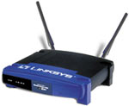
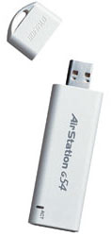
Basic Wi-Fi Network
Two basic components
Access Points (AP) or Gateways.
Base stations - A bridge between wireless and wired networks
Wired network interface and Bridging software
Aggregates access for multiple wireless stations to wired network
Radio
Aggregates access for multiple wireless stations to wired network. Wi-Fi radios
Embedded or attached to the PCs (e.g.: USB)
Notebooks embedded or with PCMCIA
Mobile devices

Slide 37
Infrastructure Mode
An access point (AP) is a shared device
Performance issues of shared hubs
Bridges allow for interconnection
Protocols/ applications work seamlessly

Slide 38
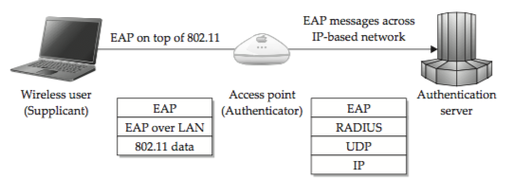
Wireless Security Focus Areas
Authenticity
Via BSSID (Basic Service Set ID), SSID, Wireless Encryption Scheme
Confidentiality
Via encryption, Wireless Encryption Scheme
Integrity
Via Wireless Encryption Scheme
From “Hacking Exposed Wireless 2nd Edition”

Slide 39
WLAN Authentication Concept
802.11 Authentication
Non-cryptographic
Cryptographic (RC4)
Identity based
Challenge-Response
Closed System Authentication (with SSID)
Open System Authentication
Can join network with
empty SSID
Can join network
with valid SSID
Need SSID and WEP / WPA / WPA2

Slide 40
WiFi settings
http://www.wi-fiplanet.com
Notes:
http://www.wi-fiplanet.com/img/2005/09/ap_wpapsk.gif

Slide 41
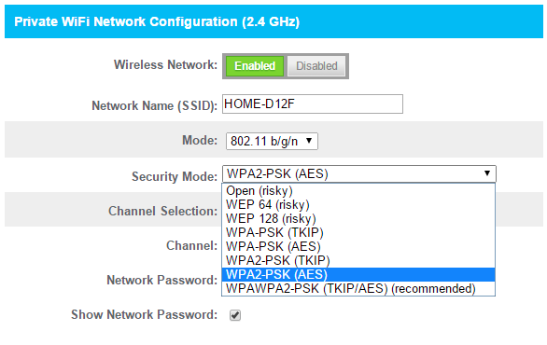
WiFi security related settings
http://www.howtogeek.com/204697/wi-fi-security-should-you-use-wpa2-aes-wpa2-tkip-or-both/
Notes:
http://www.howtogeek.com/204697/wi-fi-security-should-you-use-wpa2-aes-wpa2-tkip-or-both/

Slide 42
Wireless Network Attack – Getting SSID

Slide 43
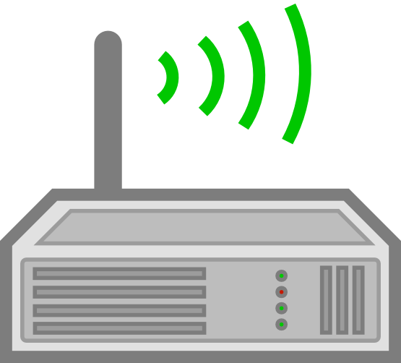
How to find hidden SSID
Get it from the access point
2. Get it from the client

Slide 44
I am here
I am here
I am here
I am here
Beacon Frames

Slide 45
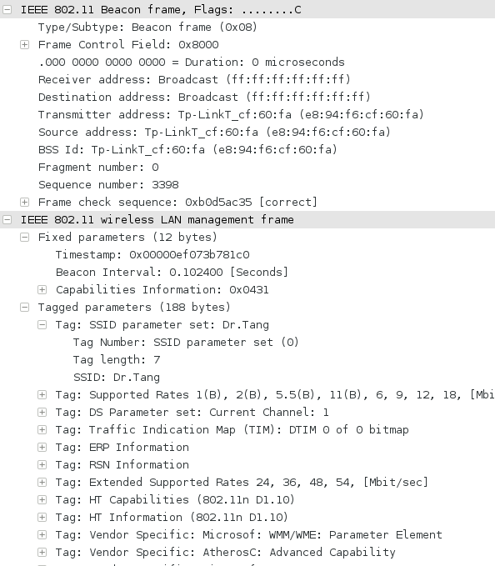
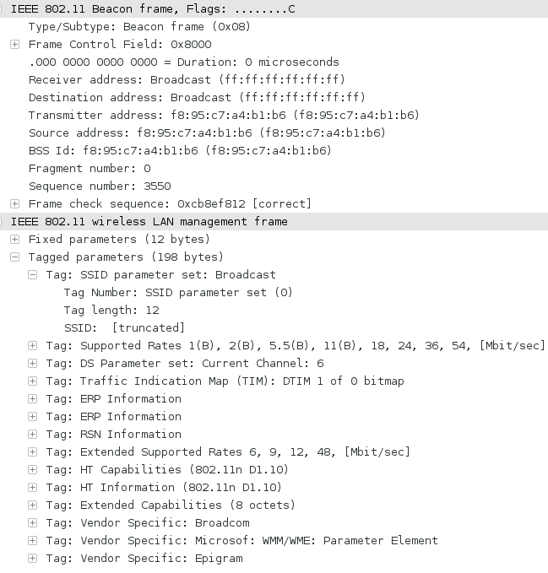
Not Hidden
Hidden

Slide 46
Is “sMobile” here?
Is “home”here?
Is “GovWifi” here?
Probe Request

Slide 47
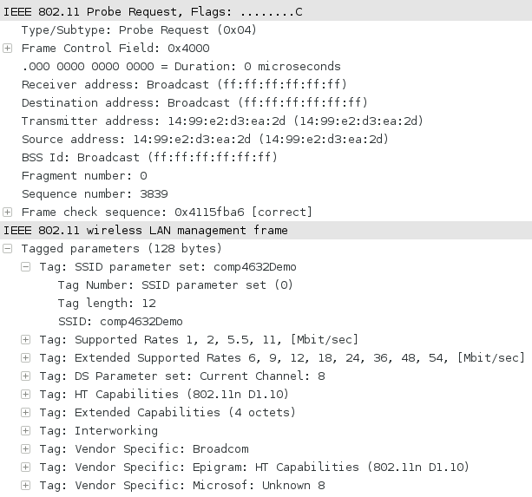

Slide 48
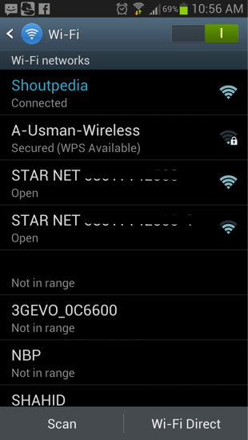
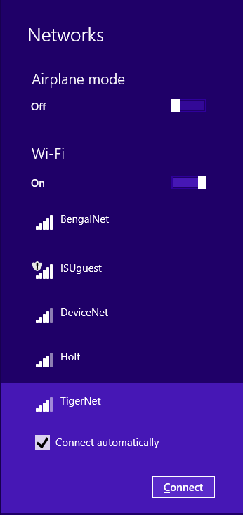
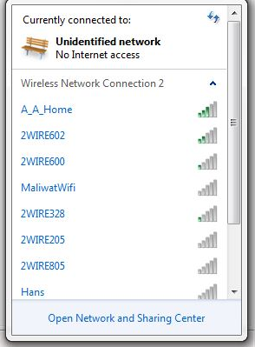

Slide 49
WEP Attack and Password Attack

Slide 50
Password Cracking
You need a dictionary

Slide 51
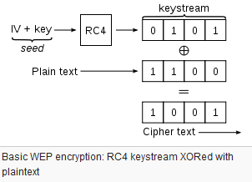
WEP Cracking

Slide 52
Stream Cipher Reuse Example
A XOR K
B XOR K
From: https://cryptosmith.com/2008/05/31/stream-reuse/

Slide 53
Stream Cipher Reuse Example
(A XOR K) XOR (B XOR K) = A XOR B
From: https://cryptosmith.com/2008/05/31/stream-reuse/

Slide 54
What can I do…
If I have both SSID & Password
Decrypt the wifi traffic

