Slide 1
Week 3b –Encryption and Usage (Part 2)

Slide 2
Symmetric Encryption
-----
-----
-----
?
Given: both parties already know the same secret
Goal: send a message confidentially
Any communication system that aims to guarantee
confidentiality must solve this problem

Slide 3
Asymmetric Encryption
public key
?
public key
private key
Alice
Bob
Given: Everybody knows Bob’s public key
- How is this achieved in practice?
Only Bob knows the corresponding private key
Goals: 1. Alice wants to send a message that
only Bob can read
2. Bob wants to send a message that
only Bob could have written

Slide 4
SSL protocol

Slide 5
Application Layer - HTTP
GET / HTTP/1.1
Accept: */*
Accept-Language: en-us,zh-hk;q=0.5
Accept-Encoding: gzip, deflate
User-Agent: Mozilla/4.0 (…)
Host: www.ust.hk
Connection: Keep-Alive
Cookie: WTO_CLIENT=1
HTTP/1.1 200 OK
Date: Sat, 03 Jul 2004 12:01:30 GMT
Server: Apache/1.3.12 (Unix) mod_ssl/2.6.3 OpenSSL/0.9.5a
Last-Modified: Tue, 25 Jun 2002 09:59:10 GMT
ETag: "1a0a64-e4-3d183eee“
Accept-Ranges: bytes
Content-Length: 228
Keep-Alive: timeout=15, max=100
Connection: Keep-Alive
Content-Type: text/html
<data……>
GET /en/index.html HTTP/1.1
Accept: */*
Accept-Language: en-us,zh-hk;q=0.5
Accept-Encoding: gzip, deflate
If-Modified-Since: Thu, 15 Jan 2004 06:21:45 GMT; length=208
User-Agent: Mozilla/4.0 (…)
Host: www.ust.hk
Connection: Keep-Alive
Cookie: WTO_CLIENT=1
HTTP/1.0 304 Not Modified
Date: Sat, 03 Jul 2004 12:01:27 GMT
Server: Apache/1.3.27 (Unix) mod_ssl/2.8.12 OpenSSL/0.9.6b
ETag: "439a3-d0-40063179"

Slide 6
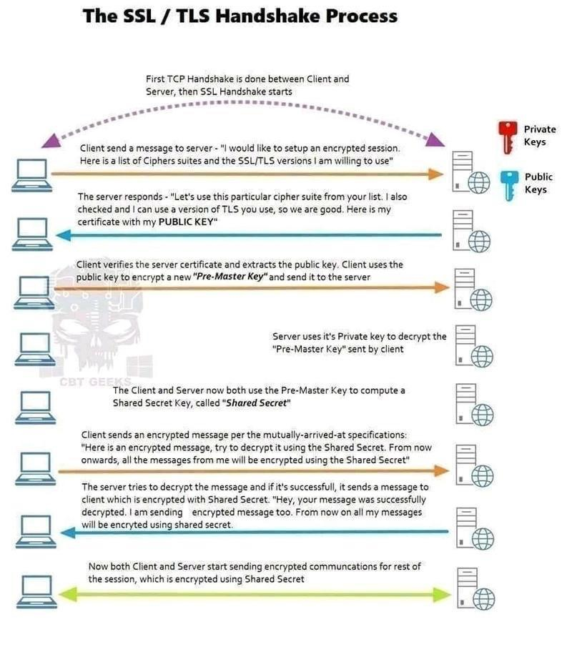
SSL/TLS Handshake Process

Slide 7
SSL - Secure Socket Layer Protocol
SSL Handshake
Protocol
SSL Change Cip. Spec Protocol
SSL Alert
Protocol
HTTP
SSL Record Protocol
TCP
IP
SSL connection
  Transport (RM OSI) that provides suitable type of services. Every connection is associated with one session.
SSL session
  An association between a client and a server. Sessions are created by the Handshake protocol (defines set of cryptographic security parameters, that can be shared among multiple connections)
Copyright © eWalker Consulting Limited 2013

Slide 8
SSL - Secure Socket Layer Protocol (Cont.)
SSL Record Protocol - provides two services for SSL connections
  Confidentiality - handshake protocol defines shared secret key for encryption of SSL payloads
  Integrity - handshake protocol defines shared secret key to form message authentication code MAC
Operations of SSL Record Protocol
  Fragment
  Compress
  Add MAC
  Encryption

Slide 9
SSL - Secure Socket Layer Protocol (Cont.)
Change Cipher Spec Protocol
  Uses the SSL Record protocol
  The simplest of SSL protocols
  Only single byte message with value 1 and causes the pending state to be copied into the current state (updates cipher suite to be used in this connection)

Slide 10
SSL - Secure Socket Layer Protocol (Cont.)
Alert Protocol
  Used to convey SSL-related alerts to the peer entity
  Two types of alerts: warning and fatal
  In the case of fatal alert SSL immediately terminates the connection (the other connections of the session can continue but no new one is established)

Slide 11
SSL - Secure Socket Layer Protocol (Cont.)
Handshake Protocol
  The most complex part of SSL
  Allows server and client to authenticate each other
  Negotiates an encryption and MAC algorithm and cryptographic keys to be used to protect data sent in an SSL
  Is used before any application data are transmitted
  Consists of four phases

Slide 12
SSL - Secure Socket Layer Protocol (Cont.)
Handshake Protocol, Phase 1- Establish Security Capabilities
Client
Server
client_hello
Establishes security capabilities, including protocol version, session ID, cipher suite, compression method, and initial random numbers
server_hello
Time

Slide 13
SSL - Secure Socket Layer Protocol (Cont.)
Handshake Protocol, Phase 2-Server Authentication and Key Exchange
Client
Server
Server may send certificate, key exchange and request certificate. Server signals end of hello message phase.
Dotted transfers are optional or situation-dependent messages that are not always sent
certificate
server_key_exchange
certificate_request
server_hello_done
Time

Slide 14
SSL - Secure Socket Layer Protocol (Cont.)
Handshake Protocol, Phase 3-Client Authentication and Key Exchange
Client
Server
certificate
Client sends certificate, if requested. Client sends key exchange. Client may send certificate verification.
Dotted transfers are optional or situation-dependent messages that are not always sent
client_key_exchange
certificate_verify
Time

Slide 15
SSL - Secure Socket Layer Protocol (Cont.)
Handshake Protocol, Phase 4-Finish
Client
Server
change_cipher_spec
Changes cipher suite and finishes handshake protocol.
finished
change_cipher_spec
finished
Time

Slide 16
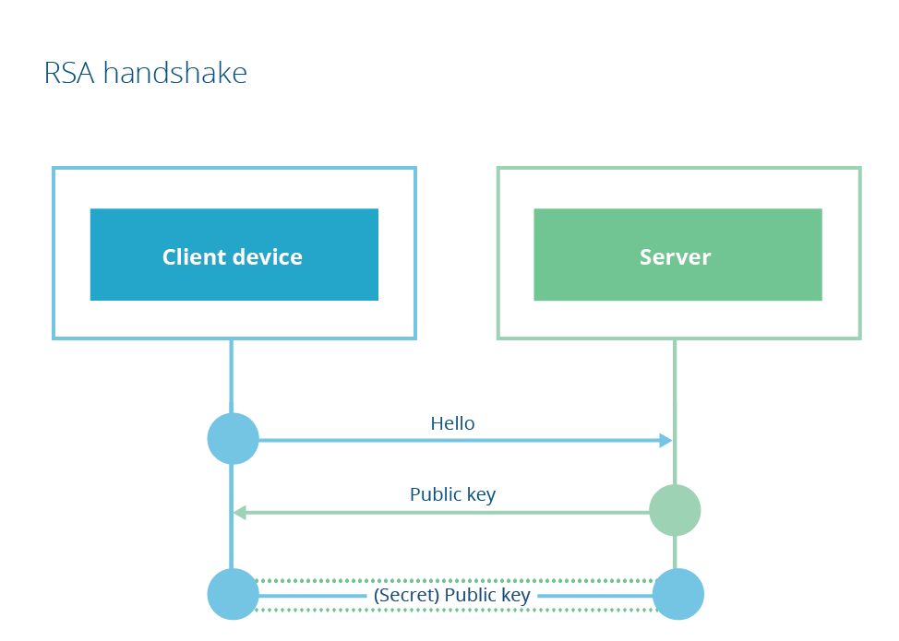
SSL - Secure Socket Layer Protocol (Cont.)
Supported key exchange methods
  RSA - secret key is encrypted with the receiver’s RSA public key (receiver’s certificate available)
  Fixed Diffie-Hellman - server’s certificate contains the D-H public parameters
  Ephemeral Diffie-Hellman - the D-H public keys are exchanged, signed using the sender’s private RSA or DSS key
  Anonymous Diffie-Hellman - base D-H algorithm is used with no authentication
  Fortezza
Notes:
https://blog.cloudflare.com/rfc-8446-aka-tls-1-3/

Slide 17
SSL - Secure Socket Layer Protocol (Cont.)
Supported cipher algorithms:
  RC4, RC2, DES, 3DES, DES40, IDEA, Fortezza
  Supported MAC algorithms:
  MD5, SHA-1
Transport Layer Security (TLS)
  IETF standardisation initiative for producing an Internet standard version of SSL. (Current version of TLS is very similar to SSLv3.)

Slide 18
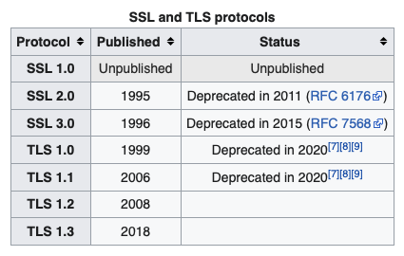
TLS
Successor of SSL
The Transport Layer Security (TLS) protocol was released in January 1999 to create a standard for private communications.
implementation of the TLS protocol on two levels: the TLS record protocol and TLS handshake protocol
There are seven main differences between SSL and TLS.
  Protocol version number
  Alert protocol message types
  message authentication
  Key material generation
  Certificate verify
  Finished
  Baseline cipher suites

Slide 19
TLS
TLS 1.1
  Added protection against cipher-block chaining (CBC) attacks.
    The implicit initialization vector (IV) was replaced with an explicit IV.
    Change in handling of padding errors.
TLS 1.2
  TLS Extensions definition and AES cipher suites were added
TLS 1.3
  Remove support for a number of options and functions
    Remove support for weak and less-used ciphers
    Remove support for MD5 and SHA-224 cryptographic hash functions
    Remove Compression, 32-bit timestamp as part of the Random parameter in the client_hello message
    Remove Change Cipher Spec Protocol
    Remove Static RSA and DH key exchange
  TLSv1.3 uses Diffie–Hellman or Elliptic Curve Diffie–Hellman for key exchange and does not permit RSA. Because with DH or ECDH, a new key is negotiated for each handshake.
  TLSv1.3 allows for a “1 round trip time” handshake by changing the order of message sent with establishing a secure connection.
  Encrypts all handshake messages after the ServerHello

Slide 20
SSL related vulnerabilities
Recently, there are a number of SSL related vulnerabilities:
  Heartbleed (2014)
  POODLE (2014)
  Critical SSL flaw that Apple patched in OS X and iOS (2014)
  FREAK (2015)
Notes:
https://grahamcluley.com/2015/03/freak-attack-what-is-it-heres-what-you-need-to-know/
http://www.computerweekly.com/news/2240241648/US-policy-exposes-Apple-and-Google-devices-to-Freak-attack?asrc=EM_EDA_40314331&utm_medium=EM&utm_source=EDA&utm_campaign=20150304_PayPal%20buys%20mobile%20payments%20startup%20Paydiant_

Slide 21
HeartBleed Vulnerability
The flaw is called ‘Heartbleed' because it comes from a programming mistake in OpenSSL's implementation of the TLS/DTLS (transport layer security protocols) ‘heartbeat' extension. It affects websites using OpenSSL 1.0.1 through to version 1.0.1f.
Heartbleed bug is only present in the OpenSSL implementation of SSL and TLS
At the time of disclosure, about 17% of the world’s “secure” websites were said to be vulnerable to the bug.
The Heartbleed bug itself was introduced in December 2011, in fact it appears to have been committed about an hour before New Year’s Eve
Some websites have been set up where CISOs and end users can check whether the websites they run or use are vulnerable. Two such sites are:
  http://filippo.io/Heartbleed/
  https://lastpass.com/heartbleed/
Notes:
http://www.scmagazineuk.com/heartbleed-flaw-threatens-millions-of-websites/article/341821/
http://www.troyhunt.com/2014/04/everything-you-need-to-know-about.html
http://www.scmagazineuk.com/cyber-attacks-are-targeting-heartbleed-flaw-says-us-cert/article/342274/

Slide 22

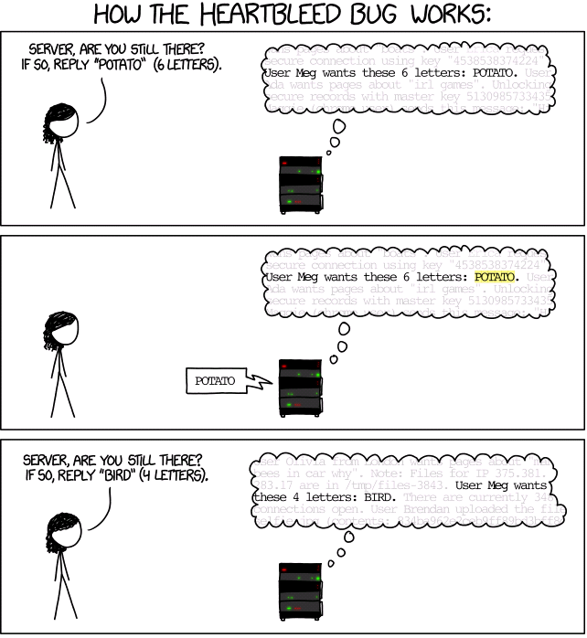
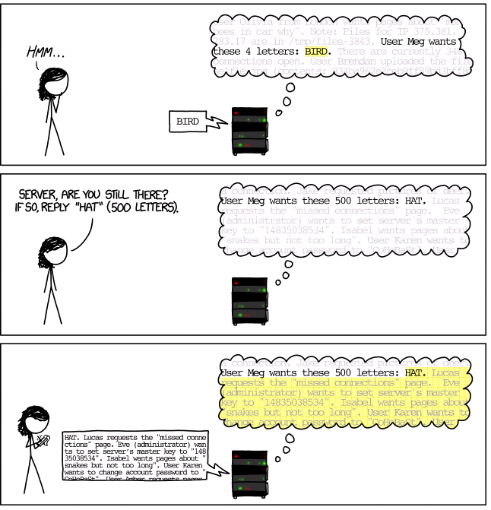
HeartBleed
http://xkcd.com/1354/

Slide 23
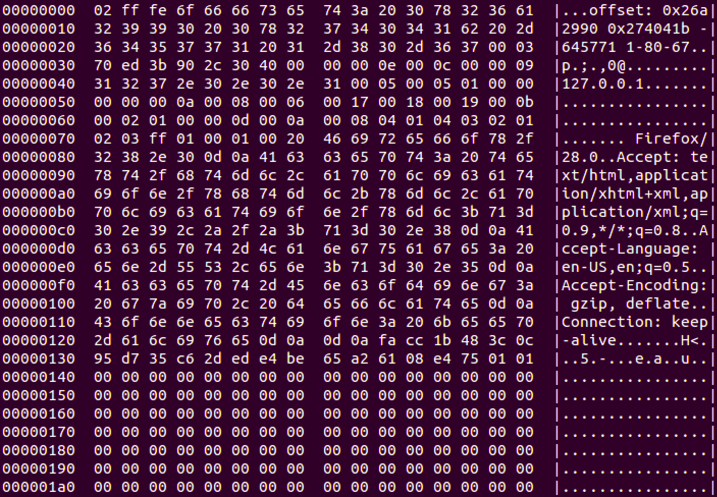
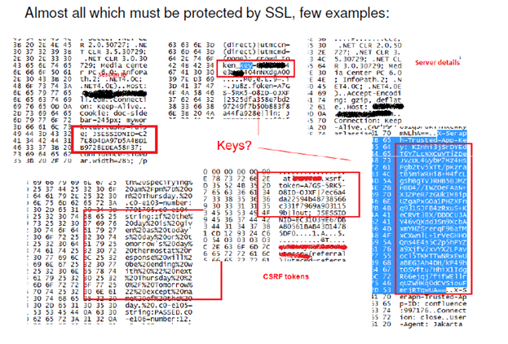
HeartBleed
Some of them are session-related information such as session ID, different tokens, keys, and some other sensitive internal information such as queries, internal data, etc. A real example shows what we can receive in the response
https://www.youtube.com/watch?v=lkst_tSwB9o
https://www.youtube.com/watch?v=D5Igbv-c1dY (Metasploit – OpenSSL Heartbeat)
Notes:
http://resources.infosecinstitute.com/exploiting-heartbleed/
http://blog.cloudflare.com/answering-the-critical-question-can-you-get-private-ssl-keys-using-heartbleed
https://www.youtube.com/watch?v=D5Igbv-c1dY (Metasploit – OpenSSL Heartbeat)

Slide 24
Transport Layer Security
Transport Layer Security (TLS) and its predecessor, Secure Sockets Layer (SSL), are cryptographic protocols designed to provide communications security over a computer network.
As of 2014 the 3.0 version of SSL is considered insecure as it is vulnerable to the POODLE attack that affects all block ciphers in SSL; and RC4, the only non-block cipher supported by SSL 3.0, is also feasibly broken as used in SSL 3.0
Notes:
http://en.wikipedia.org/wiki/Transport_Layer_Security
https://www.acunetix.com/blog/articles/tls-vulnerabilities-attacks-final-part/

Slide 25
POODLE attack (Sep 2014)
The POODLE attack (which stands for "Padding Oracle On Downgraded Legacy Encryption") is a man-in-the-middle exploit which takes advantage of Internet and security software clients' fallback to SSL 3.0
As of 2014 the 3.0 version of SSL is considered insecure as it is vulnerable to the POODLE attack that affects all block ciphers in SSL; and RC4 (the only non-block cipher supported by SSL 3.0) is also feasibly broken as used in SSL 3.0
In cryptography, a padding oracle attack is an attack which is performed on the padding of a cryptographic message.
The plain text message often has to be padded (expanded) to be compatible with the underlying cryptographic primitive.
Leakage of information about the padding may occur mainly during decryption of the ciphertext. Padding oracle attacks are mostly associated with ECB or CBC mode decryption used within block ciphers.
In symmetric cryptography, the padding oracle attack is most commonly applied to the CBC mode of operation, where the "oracle" (usually a server) leaks data about whether the padding of an encrypted message is correct or not.
Such data can allow attackers to decrypt (and sometimes encrypt) messages through the oracle using the oracle's key, without knowing the encryption key.
Notes:
http://en.wikipedia.org/wiki/POODLE
https://wiki.centos.org/Security/POODLE

Slide 26
POODLE attack (Sep 2014)
If attackers successfully exploit this vulnerability, on average, they only need to make 256 SSL 3.0 requests to reveal one byte of encrypted messages
POODLE to attack it are CVE-2014-3566 and CVE-2014-8730
Migration
  To mitigate the POODLE attack, one approach is to completely disable SSL 3.0 on the client side and the server side
  To prevent this attack, one could append an HMAC (Hash-based message authentication code) to the ciphertext. Without the key used to generate the HMAC, an attacker won't be able to produce valid ciphertexts.
Notes:
http://en.wikipedia.org/wiki/POODLE
https://www.us-cert.gov/ncas/alerts/TA14-290A
http://en.wikipedia.org/wiki/Transport_Layer_Security

Slide 27
POODLE attack (Sep 2014)
The vulnerability exists in Cipher Block Chaining mode.
Since Block Ciphers have fixed length, if the data in the last block is not a multiple of its size, then padding is added to fill the extra space.
One of the problems is that padding value is ignored by the server and checks only if padding length is correct as well as Message Authentication Code (MAC) of the plaintext.
That means the receiver (Server) cannot verify if padding value has been modified.
This means that once every 256 requests, the server will accept the modified value. The attacker does not need to know the encryption method or key to pull off this attack.
Notes:
https://www.acunetix.com/blog/articles/tls-vulnerabilities-attacks-final-part/

