Slide 1
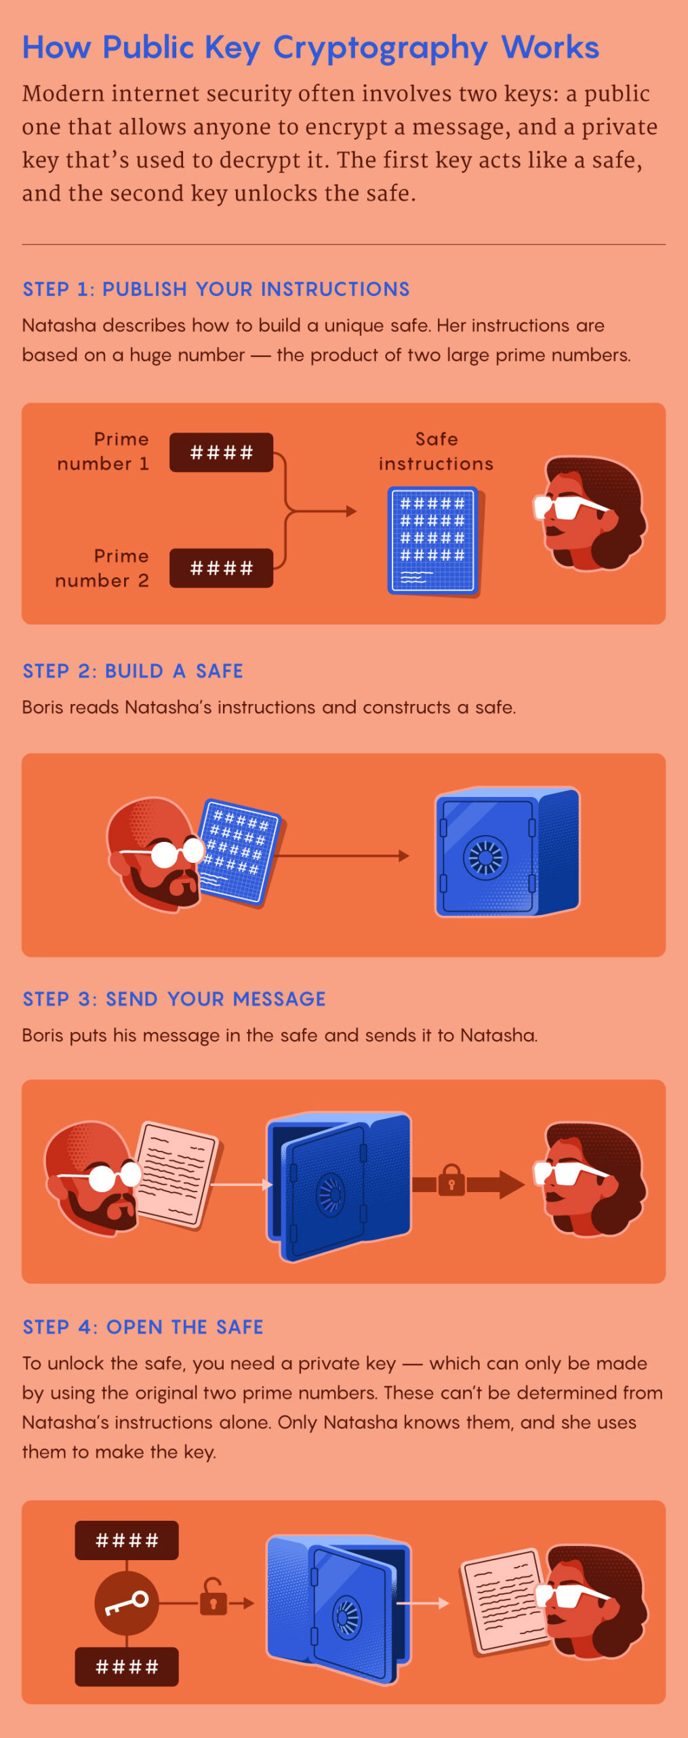

Slide 2
Week 4 – Network Security

Slide 3
Agenda
Web-based scanning
Network Scanning, Sniffing
Vulnerability Scanning
Denial of Services

Slide 4
What’s the attack methods?
Destructive
Security
Understand how network based attack can be initiated

Slide 5
Extend from Host to Network

Slide 6
How hacker attack the IT systems?
5. Email phishing attack
6. DNS attack
7. Identity theft
1. Denial of Service Attack
2. Web Attack
3. Network Scanning
4. Malware/APT attack
8. Internal attack
9. Botnet
10. Ransomware
11. Hijacking
14. Data theft
15. Backdoor implant
12. Password cracking
13. WiFi cracking

Slide 7
Network Attack

Slide 8
Attacks on each layer in OSI model
Buffer Overflow
SQL Injection
Authentication Brute Force
SSL DoS
SSL MITM
Session Hijacking
DNS Poisoning
TCP Flooding
UDP Flooding
Ping Flood
Port scanning
Fingerprinting
Packet sniffing
MAC Address Spoofing
VLAN Attack
ARP Cache Poisoning
Keystroke Logging
Lockpicking
Cutting Cable

Slide 9
Domain Name System DNS
Domain Name System DNS
Entries take a human friendly name, such as store.example.com, and translates it to an IP address. DNS can be quickly updated with some propagation time
Number of DNS Entries you are able to create
A Record
CNAME
MX Entry
TXT Record
SRV Record
AAAA Record
DNS Glossary
Copyright © 2018 Ho Chuen, Pak Ho, Karson Chan, Information Security and Forensics Society & HKU Cyberport Institute of Hong Kong
9

Slide 10
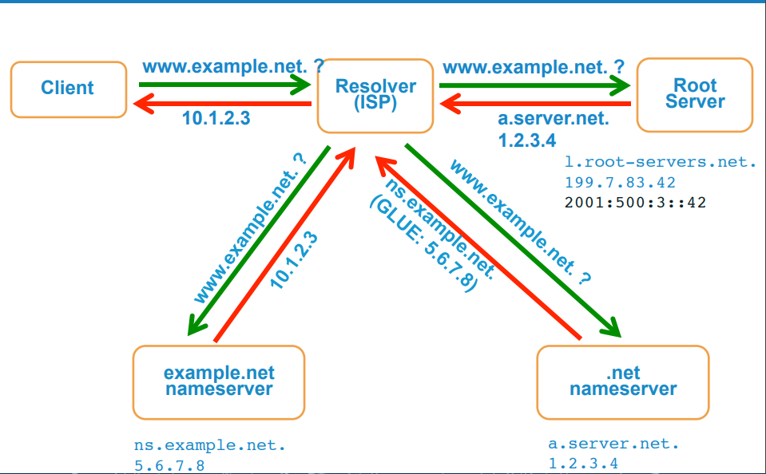
DNS Resolution
Source: ICANN present slides of “Understanding and Deploying DNSSEC”
Copyright © 2018 Ho Chuen, Pak Ho, Karson Chan, Information Security and Forensics Society & HKU Cyberport Institute of Hong Kong
10

Slide 11
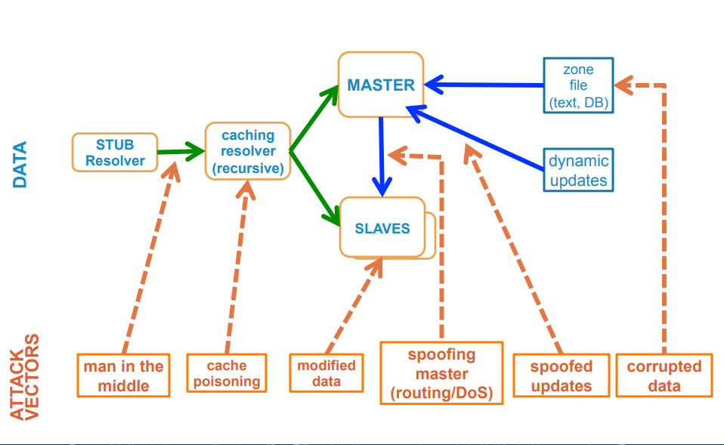
DNS Data Flow / Attack Vector
Source: ICANN present slides of “Understanding and Deploying DNSSEC”
Copyright © 2018 Ho Chuen, Pak Ho, Karson Chan, Information Security and Forensics Society & HKU Cyberport Institute of Hong Kong
11

Slide 12
Security Issues in TCP/IP
Fundamental Design
Communications are based on ports
open and self discipline
not for commercial uses
Software flaws
Insecure Operating Systems
Poor configurations

Slide 13
Security Issues in TCP/IP
Plaintext protocol – Sniffing
Weak integrity – Injection, Poisoning
Connection-less – Spoofing
Weak authentication – Masquerading
Weak sessions – Hijacking, Spoofing, DoS, Man-in-the-middle
Weak routing – Source Routing, Re-routing
Weak Quality of Service – DoS
Non-standard implementation – fingerprinting

Slide 14
Software flaw
Buffer Overflow
Out-of-Band data
bugs and vulnerabilities in the protocol stack
bugs in the browser and server
Software flaw can usually be fixed but can never be eliminated.

Slide 15
BGP Traffic Hijack
Notes:
https://thehackernews.com/2024/01/orange-spain-faces-bgp-traffic-hijack.html

Slide 16
Web based Scanning

Slide 17
Web-based check tools
Multi-usage tools
Whois
https://dnslytics.com
https://viewdns.info
http://www.netcraft.com
http://www.all-nettools.com/toolbox
https://mxtoolbox.com/SuperTool.aspx
http://www.traceroute.net
https://www.hkdnr.hk/en/func/whois/
https://whois.domaintools.com/
http://www.zoneedit.com/lookup.html?ad=whois
https://bgp.he.net/
Notes:
https://sitereport.netcraft.com

Slide 18
TCPIPUTILS (https://dnslytics.com)

Slide 19
https://viewdns.info

Slide 20
Looking Glass
http://noc.ilan.net.il/LG/
http://lg.cern.ch/
http://www.belwue.de/ueberuns/netz/looking.html

Slide 21
http://coffer.com/mac_find/

Slide 22
Zone-h
Notes:
http://www.zone-h.org/archive/special=1

Slide 23
Web search site
https://censys.io
https://www.shodan.io

Slide 24
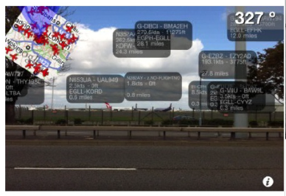
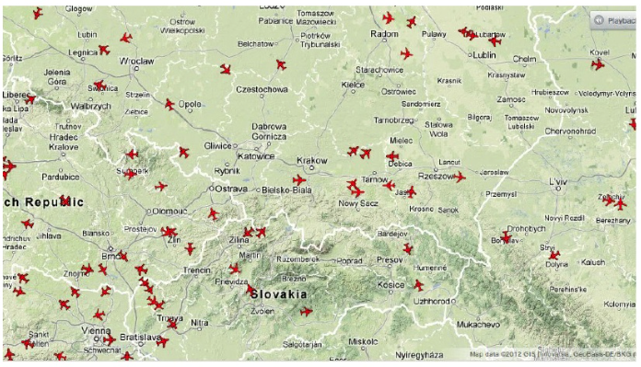
Public access to plane information
Planefinder.net can aggregates data from all over the world
User provided ground stations and data then, it can generates near real time (~10 min delay) Google Map of air traffic
http://www.scribd.com/doc/99333579/RenderMan-Hacker-Airplanes-No-Good-Can-Come-of-This
http://planefinder.net

Slide 25
Public access to plane information
http://www.flightradar24.com/

Slide 26
ShipFinder
http://www.shipfinder.com
Notes:
https://www.vesselfinder.com
http://www.shipfinder.com
https://www.myshiptracking.com

Slide 27
Network scanning

Slide 28
Port Scanning
Different types of Scanning
Standard scanning methods
Vanilla connect scanning
Half-open SYN flag scanning
Stealth TCP scanning methods
Inverse TCP flag scanning
ACK flag probe scanning
TCP fragmentation scanning
Third-party and spoofed TCP scanning methods
FTP bounce scanning
Proxy bounce scanning
Sniffer-based spoofed scanning
IP ID header scanning
Notes:
IP Network Scanning & Reconnaissance, Hacking for Techies, www.trustmatta.com

Slide 29
Port Scanning – using SuperScan

Slide 30
Port Scanning – using Nmap

Slide 31
Vulnerability Scanning – using Tenable Nessus
/opt/nessus/sbin/nessusd start

Slide 32
Flooding & Spoofing

Slide 33
Simple Spoofing (Non-blind)
IP-spoofing is the act of forging IP packets
Non-blind spoofing (NBS) interferes a connection that sends packets along the spoofer’s subnet (so typically the spoofer is on the same subnet as one of the 2 hosts being spoofed)
Blind spoofing interferes with a connection that does not send packets that the spoofer can sniff off. It is more difficult.
Spoofing may lead to connection being “hijacked”.

Slide 34
ARP Spoofing
Use arpspoof utility to ARP spoof the gateway of network
Poison a hosts ARP cache by setting the gateway’s MAC address to broadcast address
Arpspoof –t x.x.x.x gateway.ip

Slide 35
ARP Spoofing
Attacker mimics the ARP entry of the target host
E.g. the target host’s physical address:

Slide 36
ARP Spoofing: Sending spoof packets

Slide 37
ARP Spoofing: Victim
Do you see the diff.?

Slide 38
ARP Spoofing Autopsy
Attacker floods the network with spoofed ARP packet

Slide 39
Denial of Services Attack

Slide 40
What is Denial of Services Attack
In computing, a denial-of-service attack (DoS attack) or distributed denial-of-service attack (DDoS attack) is an attempt to make a machine or network resource unavailable to its intended users

Slide 41
Denial of Services
Syn Flooding (e.g. synflood.c)
A TCP connection request (SYN) is sent to the target computer
The source IP address in the packet is "spoofed" or replaced with an address that is not in use on the Internet, or that belongs to another computer
An attacker will send many of these TCP SYNs to tie up as many resources as possible on the target computer
Notes:
Upon receiving the connection request, the target computer allocates resources to handle and track the new connection, then responds with a "SYN-ACK". In this case, the response is sent to the "spoofed" non-existent IP address.
No response is received to the SYN-ACK. A default-configured Windows NT 3.5x or 4.0 computer will retransmit the SYN-ACK 5 times, doubling the time-out value after each retransmission.
<Demo>
SynDrop.c (Linux)
* Syndrop source_add dest_add -s source_port -t dest_port -n times
* syndrop 143.89.124.184 143.89.124.183 -s 139 -t 139 -n 10
+ synful.c (Linux)
* synful target IP
* synful 143.89.124.183

Slide 42
Denial of Services (Cont.)
SYN
A
B
SYN/ACK
SYN/ACK
Notes:
Upon receiving the connection request, the target computer allocates resources to handle and track the new connection, then responds with a "SYN-ACK". In this case, the response is sent to the "spoofed" non-existent IP address.
No response is received to the SYN-ACK. A default-configured Windows NT 3.5x or 4.0 computer will retransmit the SYN-ACK 5 times, doubling the time-out value after each retransmission.
<Demo>
SynDrop.c (Linux)
* Syndrop source_add dest_add -s source_port -t dest_port -n times
* syndrop 143.89.124.184 143.89.124.183 -s 139 -t 139 -n 10
+ synful.c (Linux)
* synful target IP
* synful 143.89.124.183

Slide 43
Denial of Services (Cont.)
A
SYN
A
SYN
A
SYN
A
SYN
A
B
SYN
A
SYN
A
SYN
Notes:
Upon receiving the connection request, the target computer allocates resources to handle and track the new connection, then responds with a "SYN-ACK". In this case, the response is sent to the "spoofed" non-existent IP address.
No response is received to the SYN-ACK. A default-configured Windows NT 3.5x or 4.0 computer will retransmit the SYN-ACK 5 times, doubling the time-out value after each retransmission.
<Demo>
SynDrop.c (Linux)
* Syndrop source_add dest_add -s source_port -t dest_port -n times
* syndrop 143.89.124.184 143.89.124.183 -s 139 -t 139 -n 10
+ synful.c (Linux)
* synful target IP
* synful 143.89.124.183

Slide 44
From DoS to DDoS Attacks

Slide 45
Slow HTTP Test
SlowHTTPTest is a highly configurable tool that simulates some Application Layer Denial of Service attacks.
Slowloris and Slow HTTP POST DoS attacks rely on the fact that the HTTP protocol, by design, requires requests to be completely received by the server before they are processed.
If an HTTP request is not complete, or if the transfer rate is very low, the server keeps its resources busy waiting for the rest of the data.
If the server keeps too many resources busy, this creates a denial of service.
This tool is sending partial HTTP requests, trying to get denial of service from target HTTP server.
slowhttptest -c 1000 -H -i 10 -r 200 -t GET -u http://172.16.110.166 -x 24 -p 3
Notes:
http://www.blackmoreops.com/2015/06/07/attack-website-using-slowhttptest-in-kali-linux/

Slide 46
Over 11M SSH Servers are Vulnerable
Notes:
https://cybersecuritynews.com/11m-ssh-servers-terrapin-attack/

Slide 47
Reference List of Tools
Top 10 Best Free Penetration Testing Tools 2020
Metasploit
NMAP
Wireshark
Aircrack
Nessus
Social Engineering Toolkit
W3AF
Burp Suite
BeEF
SQLmap
https://cybersecuritynews.com/penetration-testing-tools/
Notes:
https://cybersecuritynews.com/penetration-testing-tools/

Slide 48
Reference List of Tools
Red Teaming/Adversary Simulation Toolkit
Reconnaissance
Weaponization
Delivery
Command and Control
Lateral Movement
Establish Foothold
Escalate Privileges
Data Exfiltration
Misc
References
https://0xsp.com/offensive/red-teaming-toolkit-collection
Notes:
https://0xsp.com/offensive/red-teaming-toolkit-collection

Slide 49
References
Related content | Book | Chapter
W5: Network Attack | Computer Security Principles and Practice (2012) | Chapter 8: Intrusion Detection
W5: Network Attack | Cryptography and Network Security (2011) | Chapter 20: Intruders
W5: DoS | Computer Security Principles and Practice (2012) | Chapter 7: Denial-of-Service Attacks
W5: DoS | Computer Security Handbook (2014) | Chapter 18: Denial-of-Service Attacks

