Slide 1
COMP4632
OS System Security

Slide 2
Agenda
System attack
Kernel attack
Patch management
Trusted system security

Slide 3
What is Operating System
An operating system (commonly abbreviated OS and O/S) is the infrastructure software component of a computer system; it is responsible for the management and coordination of activities and the sharing of the limited resources of the computer
A program that acts as an intermediary between a user of a computer and the computer hardware.
Provide an environment in which a user can execute programs
Notes:
3

Slide 4
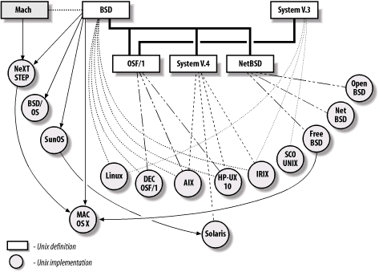

Major versions of Unix
From Practical Unix Internet Security, 3rd Edition
Notes:
4

Slide 5
Components of a Computer System
User1
Use2
User3
Users
Application
Program
Application
Program
Application
Program
Application
Program
Operating System
BIOS
Hardware
Notes:
5

Slide 6
Operating System Architecture
User interface (CLI, GUI etc.)
  The interface provided by the operating system to allow users to enter commands and interact with the computer. This can be, for example, a graphical user interface (GUI) or a command-line interface (CLI).
Applications
  The programs that are run on the computer.
Kernel
  The major part of the operating system that everybody (including us on this unit) talks about.
Device drivers
  An interface layer between the operating system and the hardware that enables the operating system to control the hardware. Device drivers might be provided by vendors of either the hardware or the operating system.
Hardware
  The hardware of the actual machine itself: the computer, the disk drives, the CPU, the memory, etc.
Notes:
6
From KC’s slides

Slide 7
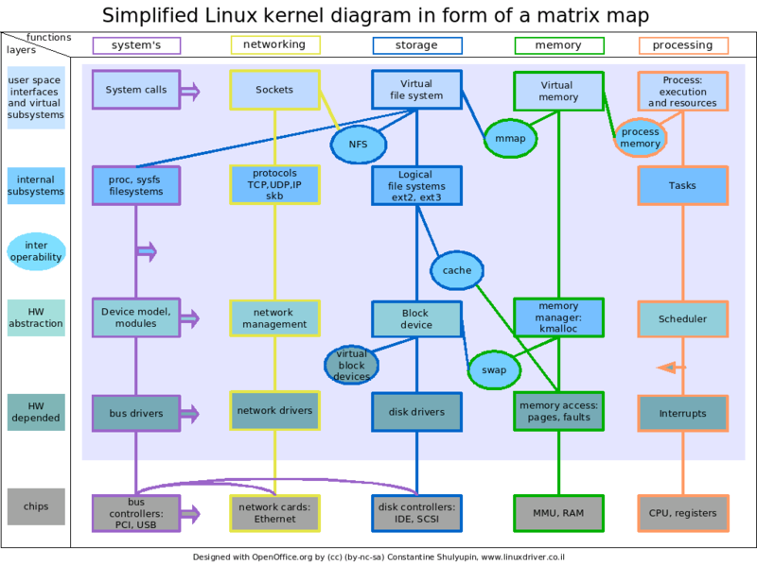
Linux Kernel (as example)
Notes:
7
http://en.wikipedia.org/wiki/Image:Linux_kernel_diagram.png
http://en.wikipedia.org/wiki/Linux_kernel

Slide 8
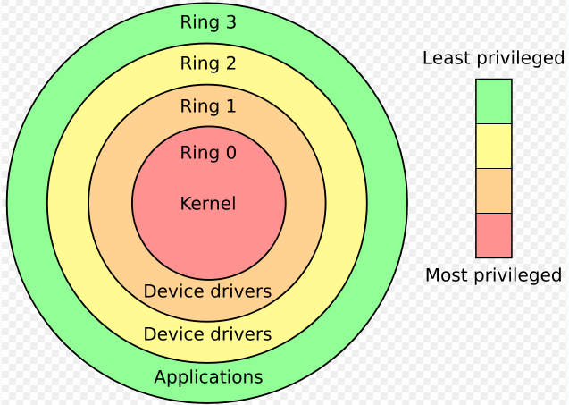

Layered Protection
Known as hierarchical protection domains, or protection rings.
A protection ring is one of two or more hierarchical levels or layers of privilege within the architecture of computer system
This model is very helpful because it provides clearly identification where security controls can be applied within an operating system.
Notes:
8

Slide 9
System attack

Slide 10
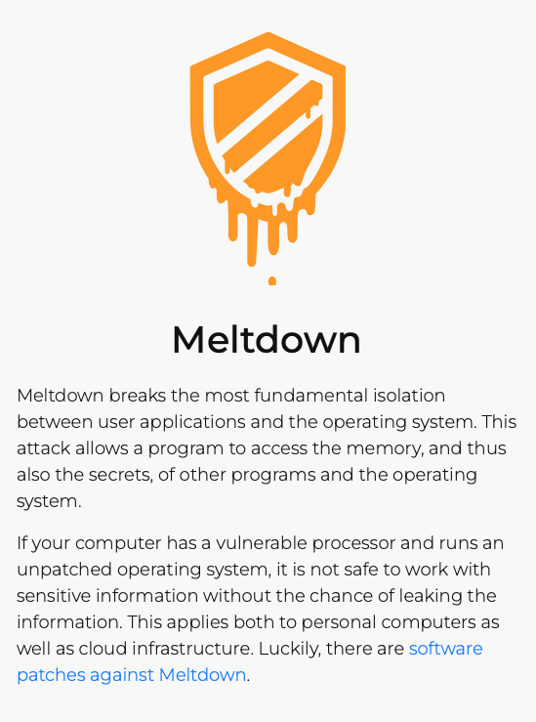
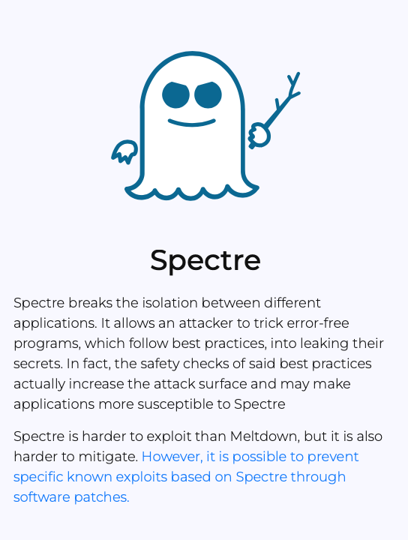
CPU level attack
https://meltdownattack.com
Notes:
https://meltdownattack.com

Slide 11
The Spectre attack
Speed vs. security in HW
[slides credit: Paul Kocher]

Slide 12
Performance drives CPU purchases
Clock speed maxed out:
  Pentium 4 reached 3.8 GHz in 2004
  Memory latency is slow and not improving much
To gain performance, need to do more per cycle!
  Reduce memory delays ⟶ caches
  Work during delays ⟶ speculative execution

Slide 13
Memory caches (4-way associative)
Caches hold local (fast) copy of recently-accessed 64-byte chunks of memory
CPU
Sends address,
Receives data
MEMORY
CACHE
Set | Addr | Cached Data ~64B
0 | F0016280 31C6F4C0 339DD740 614F8480 | B5 F5 80 21 E3 2C.. 9A DA 59 11 48 F2.. C7 D7 A0 86 67 18.. 17 4C 59 B8 58 A7..
1 | 71685100 132A4880 2A1C0700 C017E9C0 | 27 BD 5D 2E 84 29.. 30 B2 8F 27 05 9C.. 9E C3 DA EE B7 D9.. D1 76 16 54 51 5B..
2 | 311956C0 002D47C0 91507E80 55194040 | 0A 55 47 82 86 4E.. C4 15 4D 78 B5 C4.. 60 D0 2C DD 78 14.. DF 66 E9 D0 11 43..
3 | 9B27F8C0 8E771100 A001FB40 317178C0 | 84 A0 7F C7 4E BC.. 3B 0B 20 0C DB 58.. 29 D9 F5 6A 72 50.. 35 82 CB 91 78 8B..
4 | 6618E980 BA0CDB40 89E92C00 090F9C40 | 35 11 4A E0 2E F1.. B0 FC 5A 20 D0 7F.. 1C 50 A4 F8 EB 6F.. BB 71 ED 16 07 1F..
MAIN MEMORY
Big, slow
e.g. 16GB SDRAM
Address:
132E1340
Addr: 2A1C0700
Data:
AC 99 17 8F 44 09..
hash(addr) to map to cache set
Fast
2A1C0700
Data: 9E C3 DA EE B7 D3..
Addr: 132E1340
Reads change system state:
Read to newly-cached location is fast
Read to evicted location
is slow
Data: AC 99 17 8F 44 09..
Slow
Addr: 132E1340
Fast
Evict to make room
132E1340
AC 99 17 8F 44 09..
Data: AC 99 17 8F 44 09..

Slide 14
Speculative execution
CPUs can guess likely program path and do speculative execution
  Example:
  if (uncached_value == 1) // load from memory
  a = compute(b)
  Branch predictor guesses if() is ‘true’ (based on prior history)
  Starts executing compute(b) speculatively
  When value arrives from memory, check if guess was correct:
      Correct: Save speculative work ⇒ performance gain
      Incorrect: Discard speculative work ⇒ no harm
????
Notes:
Prior history: branch predictor.

Slide 15
Architectural Guarantee
Register values eventually match
result of in-order execution
Speculative Execution
CPU regularly performs incorrect calculations, then deletes mistakes
Is making + discarding mistakes the same as in-order execution?
The processor executed instructions that were not supposed to run !!
The problem: instructions can have observable side-effects

Slide 16
Conditional branch (Variant 1) attack
if (x < array1_size)
y = array2[ array1[x]*4096 ];
Suppose unsigned int x comes from untrusted caller
Execution without speculation is safe:
  array2[array1[x]*4096] not eval unless x < array1_size
What about with speculative execution?

Slide 17
Conditional branch (Variant 1) attack
if (x < array1_size)
y = array2[array1[x]*4096];
Memory & Cache Status
array1_size = 00000008
Memory at array1 base:
8 bytes of data (value doesn’t matter)
Memory at array1 base+1000:
09 F1 98 CC 90...(something secret)
array2[ 0*4096]
array2[ 1*4096]
array2[ 2*4096]
array2[ 3*4096]
array2[ 4*4096]
array2[ 5*4096]
array2[ 6*4096]
array2[ 7*4096]
array2[ 8*4096]
array2[ 9*4096]
array2[10*4096]
array2[11*4096]
Before attack:
  Train branch predictor to expect if() is true
  (e.g. call with x < array1_size)
  Evict array1_size and
  array2[] from cache
Contents don’t matter
only care about cache status
Uncached
Cached
• • •

Slide 18
Conditional branch (Variant 1) attack
if (x < array1_size)
y = array2[array1[x]*4096];
Memory & Cache Status
array1_size = 00000008
Memory at array1 base:
8 bytes of data (value doesn’t matter)
Memory at array1 base+1000:
09 F1 98 CC 90...(something secret)
array2[ 0*4096]
array2[ 1*4096]
array2[ 2*4096]
array2[ 3*4096]
array2[ 4*4096]
array2[ 5*4096]
array2[ 6*4096]
array2[ 7*4096]
array2[ 8*4096]
array2[ 9*4096]
array2[10*4096]
array2[11*4096]
Attacker calls victim with x=1000
Speculative exec while waiting for array1_size:
    Predict that if() is true
    Read address (array1 base + x)
    (using out-of-bounds x=1000)
    Read returns secret byte = 09
    (in cache ⇒ fast )
Contents don’t matter
only care about cache status
Uncached
Cached
• • •

Slide 19
Conditional branch (Variant 1) attack
if (x < array1_size)
y = array2[array1[x]*4096];
Memory & Cache Status
array1_size = 00000008
Memory at array1 base:
8 bytes of data (value doesn’t matter)
Memory at array1 base+1000:
09 F1 98 CC 90...(something secret)
array2[ 0*4096]
array2[ 1*4096]
array2[ 2*4096]
array2[ 3*4096]
array2[ 4*4096]
array2[ 5*4096]
array2[ 6*4096]
array2[ 7*4096]
array2[ 8*4096]
array2[ 9*4096]
array2[10*4096]
array2[11*4096]
Attacker calls victim with x=1000
  Next:
  Request mem at (array2 base + 09*4096)
  Brings array2[09*4096] into the cache
  Realize if() is false: discard speculative work
proceed to next instruction
Contents don’t matter
only care about cache status
Uncached
Cached
• • •

Slide 20
Conditional branch (Variant 1) attack
if (x < array1_size)
y = array2[array1[x]*4096];
Memory & Cache Status
array1_size = 00000008
Memory at array1 base:
8 bytes of data (value doesn’t matter)
Memory at array1 base+1000:
09 F1 98 CC 90...(something secret)
array2[ 0*4096]
array2[ 1*4096]
array2[ 2*4096]
array2[ 3*4096]
array2[ 4*4096]
array2[ 5*4096]
array2[ 6*4096]
array2[ 7*4096]
array2[ 8*4096]
array2[ 9*4096]
array2[10*4096]
array2[11*4096]
Attacker calls victim with x=1000
Attacker: (another process or core)
for i=0 to 255:
measure read time for array2[i*4096]
When i=09 read is fast (cached),
reveals secret byte !!
Repeat with x=1001,1002,… (10KB/s)
Contents don’t matter
only care about cache status
Uncached
Cached
• • •

Slide 21
Violating JavaScript’s sandbox
Browsers run JavaScript from untrusted websites
  JIT compiler inserts safety checks, including bounds checks on array accesses
Speculative execution runs through safety checks…
JIT thinks this check ensures index < length, so it omits bounds check in next line. Separate code evicts length for attack passes
index will be in-bounds on training passes,
and out-of-bounds on attack passes
Do the out-of-bounds read on attack passes!
if (index < simpleByteArray.length) {
index = simpleByteArray[index | 0];
index = (((index * TABLE1_STRIDE)|0) & (TABLE1_BYTES-1))|0;
localJunk ^= probeTable[index|0]|0;
}
“|0” is a JS optimizer trick
(makes result an integer)
4096 bytes = memory page size
Need to use the result so the operations aren’t optimized away
Keeps the JIT from adding unwanted bounds checks on the next line
Leak out-of-bounds read result into cache state!
Can evict length and probeTable from JavaScript (easy)
… then use timing to detect newly-cached location in probeTable

Slide 22
Kernel attack

Slide 23
Kernels
Monolithic kernels
  Entire kernel run in kernel space in supervisor mode
  Kernel defines high-level virtual interface over computer hardware, with a set of primitives or system calls to implement operating system services such as process management, concurrency, and memory management in one or more modules
  All the systems such as the file system management run in an area called the kernel mode.
  Many modules are dynamically load (and unload) at runtime.
  Linux and most Unix kernel are a monolithic kernel

Slide 24
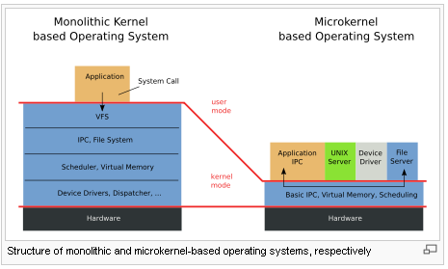
Kernels (Cont.)
Microkernel
  Minimal computer operating system kernel which, in its purest form, provides no operating-system services at all, only the mechanisms needed to implement such services, such as low-level address space management, thread management, and inter-process communication (IPC)
  OS services are provided by user-mode
  Uses vertically-layered structure

Slide 25
Security in Kernel
Security benefit of microkernel is that
  Minimality principle
  Principle of least privilege
  Able to meet the Trusted computing base (TCB) easily
  Designed for high-security applications (e.g. KeyKOS, EROS)
  Able to meet CC at highest assurance level (EAL7)

Slide 26
Security issues in LKM
  LKM can be abused by an attacker on a compromised system to prevent detection of his processes or files, allowing him to maintain control over the system.
  Many rootkits make use of LKMs in this way
      first rootkits using lkm's could be easily detected because they where listed when issuing a lsmod
Notes:
http://doc.bughunter.net/rootkit-backdoor/

Slide 27
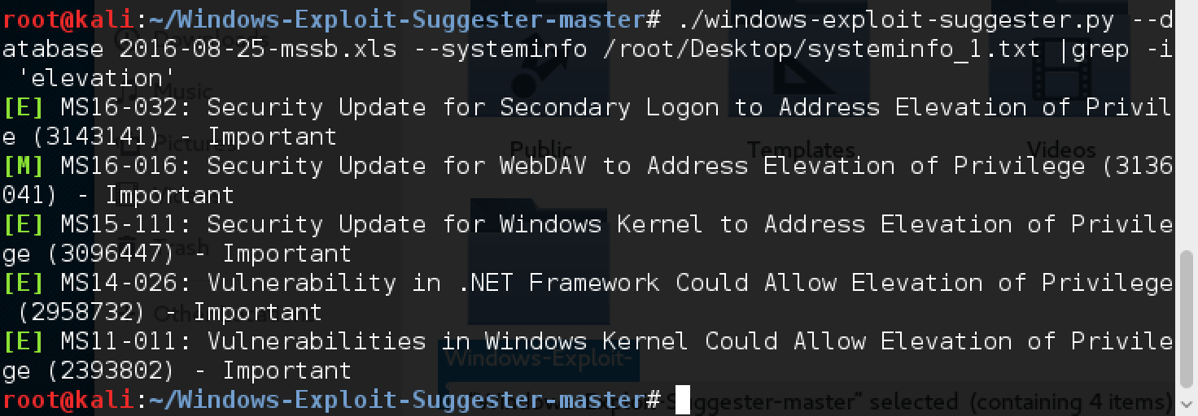
Determine the vulnerability of the Windows
Notes:
http://resources.infosecinstitute.com/windows-exploit-suggester-an-easy-way-to-find-and-exploit-windows-vulnerabilities/

Slide 28
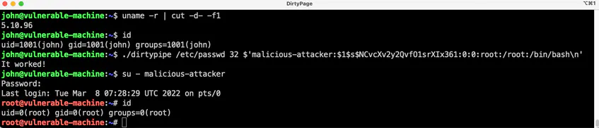
Linux Dirty Pipe Vulnerability CVE-2022-0847 (Feb 2022)
This is the story of CVE-2022-0847, a vulnerability in the Linux kernel since 5.8 which allows overwriting data in arbitrary read-only files. (https://dirtypipe.cm4all.com)
This leads to privilege escalation because unprivileged processes can inject code into root processes.
CVE-2022-0847 was discovered while using the splice() system call. Basically, this system call moves data between a file descriptor and a pipe, without requiring the data to cross the usermode/kernelmode address space boundary, which helps compute performance.
https://github.com/Arinerron/CVE-2022-0847-DirtyPipe-Exploit
Notes:
https://www.ithome.com.tw/news/149763
https://jfrog.com/blog/dirtypipe-cve-2022-0847-the-new-dirtycow/
https://www.datadoghq.com/blog/dirty-pipe-vulnerability-overview-and-remediation/
https://www.youtube.com/watch?v=WfSf61e2yec

Slide 29
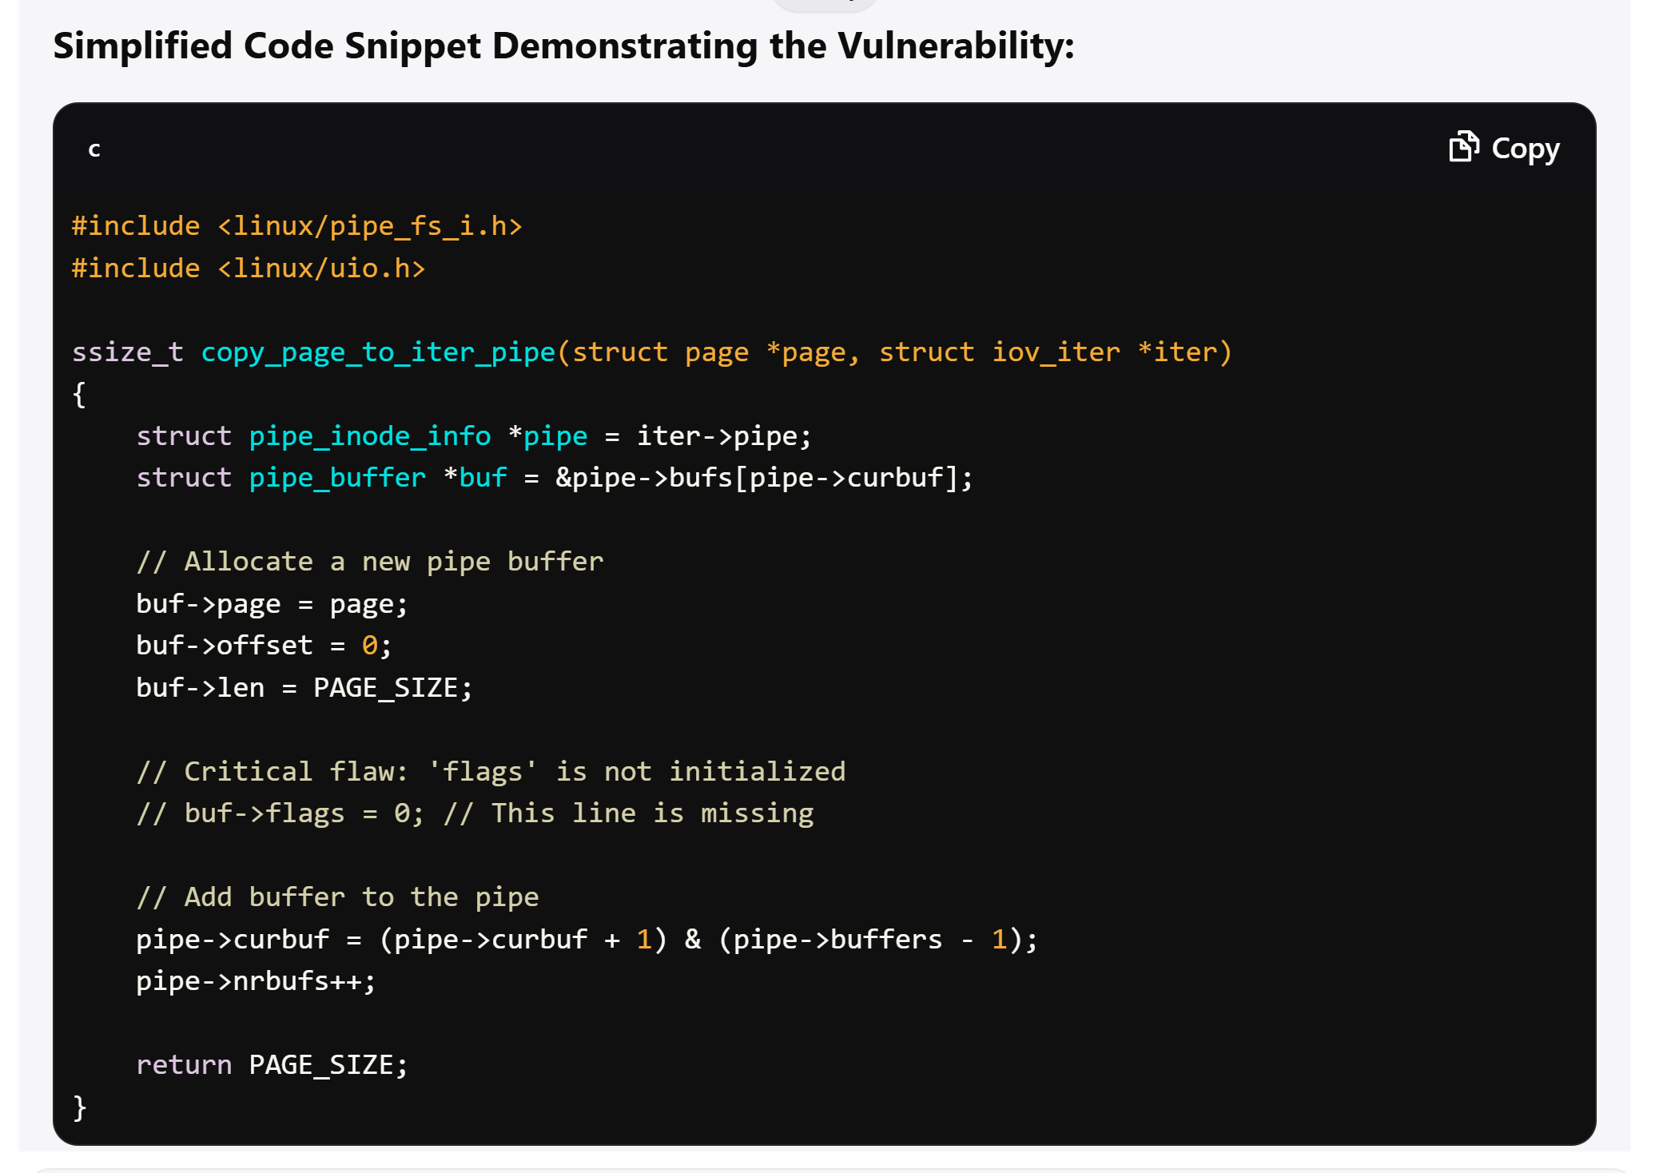

Slide 30
Patch management

Slide 31
Patch and Package Management
A package management system is a collection of tools to automate the process of installing, upgrading, configuring, and removing software packages from a computer.
Packages are distributions of software and metadata such as the software's full name, description of its purpose, version number, vendor, checksum, and a list of dependencies necessary for the software to run properly. Upon installation, metadata is stored in a local package database.
Notes:
http://en.wikipedia.org/wiki/Package_management_system

Slide 32
Patch and Package Management
Software | AIX | HP-UX | LINUX(RedHat) | SOLARIS | Tru64
Install Software | installp -a | swinstall | rpm -i package | pkgadd | setld -l
Uninstall software | installp -u | swremove | rpm -e package | pkgrm | setld -d
List installed software | lslpp -L all | swlist | rpm -qa | pkginfo | setld -i
Verify installed software | lppchk -v | swlist -l fileset -a state | rpm -V package | pkginfo -i pkginfo -p | setld -v
List all files | lslpp -f fileset | swlist -l file fileset | rpm -ql package | pkgchk -l package | setld -i package
List installed patches | instfix -i | swlist -l patch what /stand/vmunix | rpm –qa | grep patch (RPM) | patchadd -p | dupatch -track -type patch
Package owner | lslpp -w path | swlist -l file | grep path | rpm -qf file | pkgchk -l -p path
SW Directory | /usr/lpp | /var/adm/sw/ | /var/lib/rpm | /var/sadm | /var/adm/smlogs

Slide 33
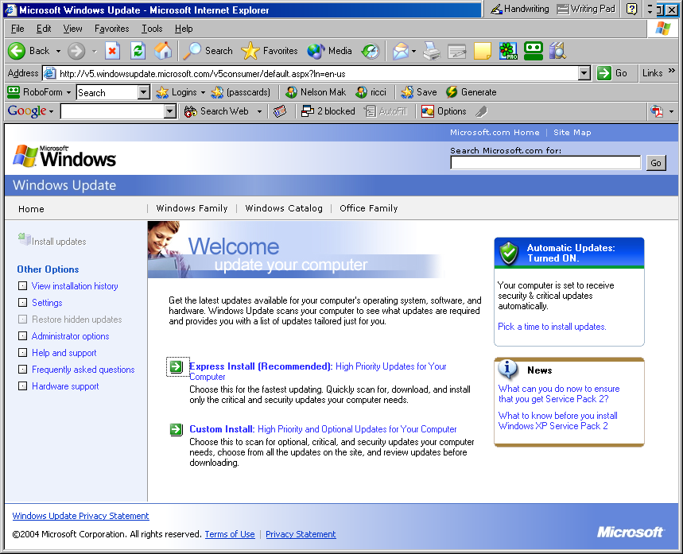
Automating Windows Patch Management – Windows Update
Notes:
https://www.microsoft.com/en-us/download/details.aspx?id=7558

Slide 34
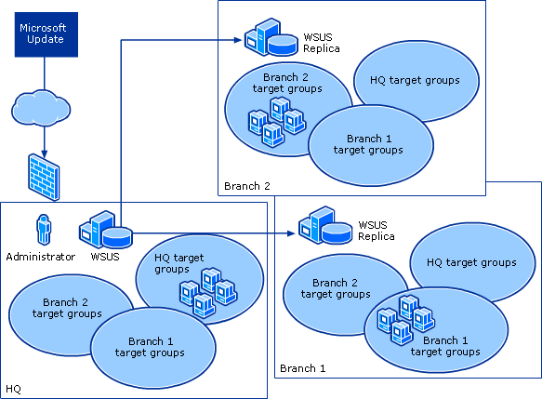
WSUS

Slide 35
Sandboxing
A sandbox is a security mechanism for separating running programs.
It is often used to execute untested or untrusted programs or code, possibly from unverified or untrusted third parties, suppliers, users or websites, without risking harm to the host machine or operating system
Various example of implementation
  Network-access restrictions (Jail)
  Rule-based execution
  Virtual machines emulation
  Sandboxing on native hosts
  Java virtual machines
Notes:
https://en.wikipedia.org/wiki/File:AppVirtual.svg

Slide 36
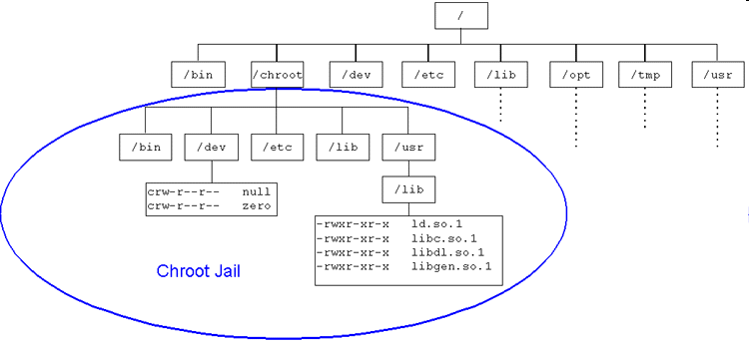
Sandboxing - Chroot
E.g. of using BIND in Chroot jail
  The terms chroot jail or chroot cage (now frequently referred to as a sandbox) are named from the system call chroot("/base/directory");, which takes a base directory argument and does not let the application read or write outside the base directory.
  All referenced files and paths within the chrooted application are appended to the base directory. Thus, if the chroot base directory is /var/named/chroot and the application accesses a file called /etc/named.conf, then the full path is translated to be /var/named/chroot/etc/named.conf.
Should be run as non-root user
Restrict access to the whole /chroot to the root user
  # chown root /chroot
  # chmod 700 /chroot

Slide 37
Trusted system security

Slide 38
Trusted Operating System
  OS that provides sufficient support for multilevel security and evidence of correctness to meet a particular set of government requirements
  Most common set of criteria is Common Criteria
  Certified trusted operating system
      HP-UX 10.26
      Microsoft Windows
      PitBull for AIX 5L
      Trusted Solaris
      Trusted UNICOS 8.0 (Rated B1)
      XTS-400

Slide 39
Comparison of Security Features in Different Linux Distributions
Distribution | Compile Time Buffer Checks | Mandatory access control | Software executable space protection | grsecurity | RSBAC
Fedora | Yes | Yes (SELinux) | Yes (Exec Shield) | No | No
Gentoo |  | Optional (SELinux) | Optional (PaX) | Optional | Optional
Mandriva Linux |  | Yes (AppArmor) |  |  | Yes
Notes:
39

Slide 40
Standard vs SELinux
 | Standard Linux | SE Linux
Access Control | Discretionary | Mandatory + Discretionary
Security Level | Single Level | Multilevel (based on BLP)
Process security attributes | Real & effective user and group IDs | Security context
Object security attributes | Access modes and file, user and group IDs | Security context
Basis for access control | Process user/group ID and file’s access modes based on file’s user/group ID | Permissions allowed between process type and file type
Notes:
Bell-LaPadula Model ( read down and write up model)
ps -Z
ls -Z

Slide 41
SELinux Features
  SELinux can potentially control which activities a system allows each user, process, and daemon, with very precise specifications. It is used to confine daemons such as database engines or web servers that have clearly defined data access and activity rights.
  This limits potential harm from a confined daemon that becomes compromised.
  These provide general support for enforcing many kinds of mandatory access control policies, including
    Type Enforcement
        - ensures that the rules governing domains are always observed
      Role-Based Access Control (RBAC)
        - limits user access to domains
      Multi-Level security
  It confines user programs and system servers to minimum amount of privilege they require to do their jobs
Notes:
https://en.wikipedia.org/wiki/Security-Enhanced_Linux

Slide 42
Mandatory Access Control in SELinux
It defines how all processes can interact with other parts of the server such as:
  Pipes
  Files
  Network ports
  Sockets
  Directories
  Other process
SELinux puts restrictions on each of the above object according to a policy.
For example, an apache user with full permission can only access /var/www/html directory, but can not touch other parts of the system such as /etc directory without policy modification.
If an attacker managed to gain access to sendmail mail or bind dns or apache web server, would only have access to exploited server and the files normally has access as defined in the policy for the server.
Notes:
https://www.cyberciti.biz/faq/what-is-selinux/

Slide 43
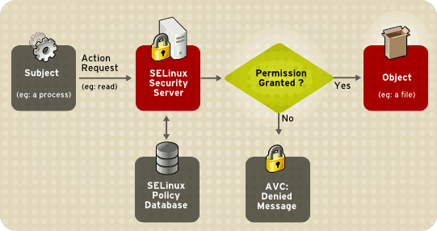
Security features in SELinux
Protect users’ data from unauthorized access.
Protect other daemons or programs from unauthorized access.
Protect network ports / sockets / files from unauthorized access.
Protect server against exploits.
Avoid privilege escalation and much more.
Notes:
https://www.cyberciti.biz/faq/what-is-selinux/
http://www.tocadotux.com.br/2019/03/the-nsa-makes-ghidra-powerful-ferramenta-de-engenharia-reversa-para-ciberseguranca.html

