Slide 1
Machine Learning Security: Adversarial Examples & Defenses
COMP 4634
Dongdong She

Slide 2
Roadmap
ML Background Primer
Adversarial Examples: Attacks
Defense
Wrap-up & Big Picture

Slide 3
What Is a Machine Learning Model?
Data-driven function: f(x) = y
Human Knowledge/Heuristics
Data
x
Learnable
Parameters
y
x
Rule
y
Rule-based system
Data-driven system
Fixed program logic/mathematical equations vs. adaptive numerical weights
Example: image classifier

Slide 4
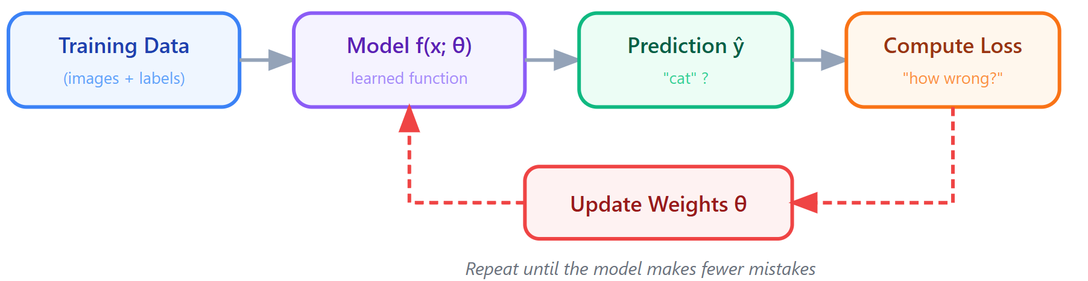
Supervised Learning
Training Data: pairs of (x, y)
(input, correct answer) => (photo of cat, "cat")
Labels: y, correct answers provided by humans, ground truth
Loss function: how wrong is current model prediction
Training process: minimize error of model (i.e., loss function value)

Slide 5
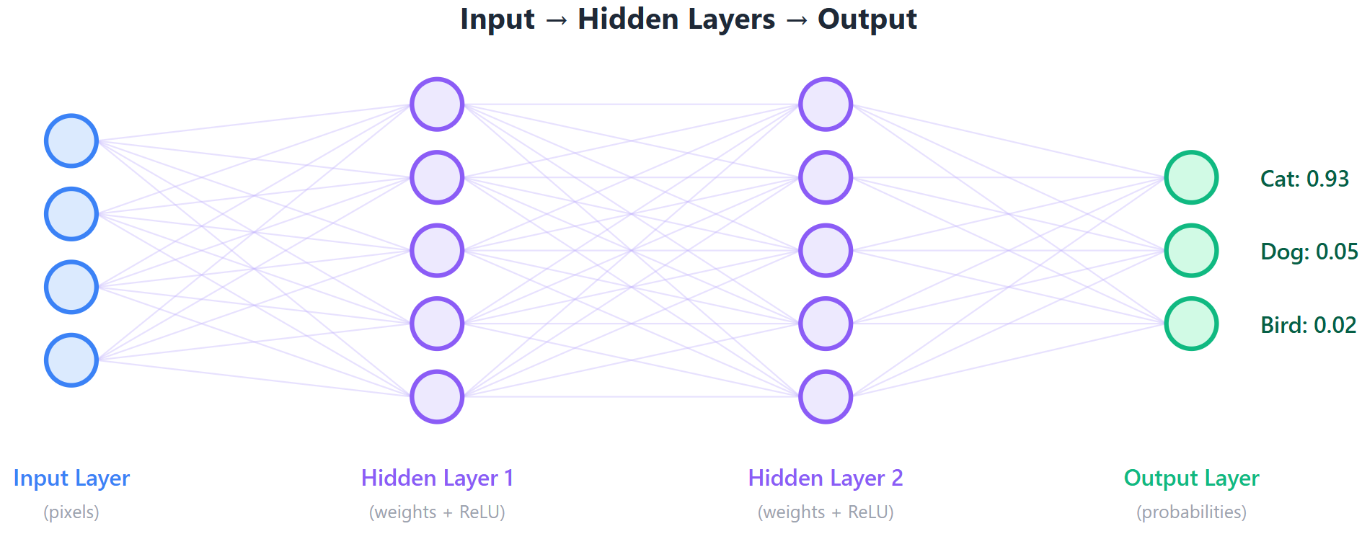
Neural Network
Neural network: a function built from layers of computations
Each layer includes many learnable parameters (weights)
Weights are adjusted during training

Slide 6
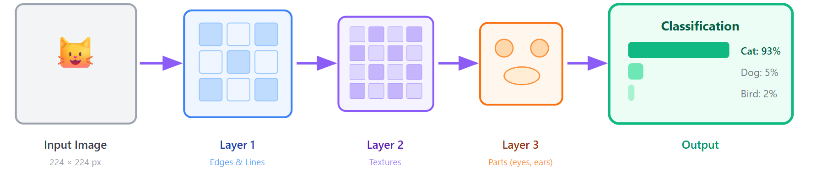
Vision Model: Convolutional Neural Network (CNN)
Problem: Images are huge
- A fully connected network would need billions of weights, e.g., 224 × 224 × 3 = 150,528 numbers.
Key Idea: Use small filters to identify local patterns
- 3×3 pixel windows
Early layers learn simple patterns
- edges, corners, color blobs
Later layers combine simple patterns into complex ones
- eyes → face → "cat"

Slide 7
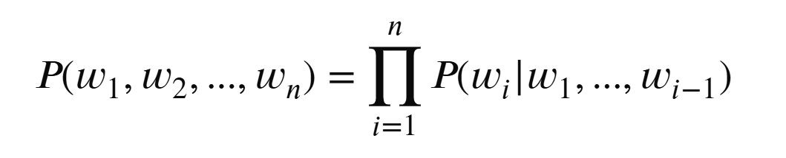
Language model
A model predicts the next word (token) in a sequence
- Given history words, what is the most likely next word?
Embeddings: words are represented as vectors
Modern LLMs (GPT, Claude, Gemini, Deepseek, Qwen, Kimi, GLM…) are very large next-token predictors trained on massive text data

Slide 8
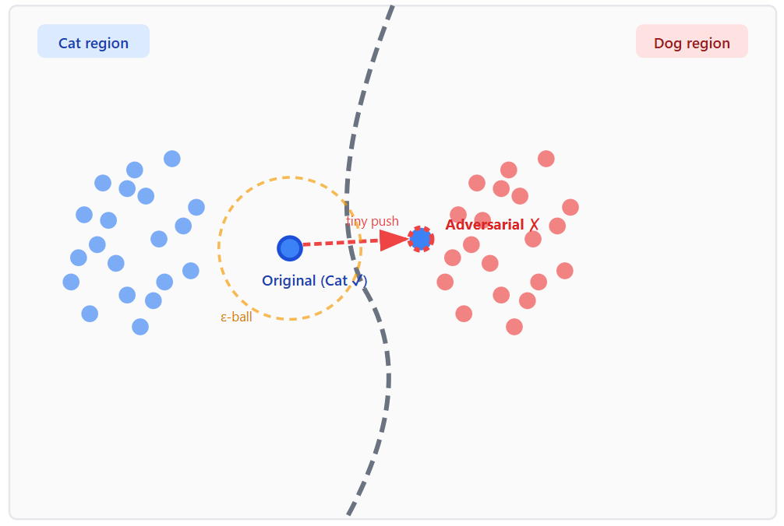
Decision Boundaries
ML Classifier: divide input space into classes
Decision boundary: the actual line separate the space
Clear partition => safe model
Confused partition => unsafe model

Slide 9
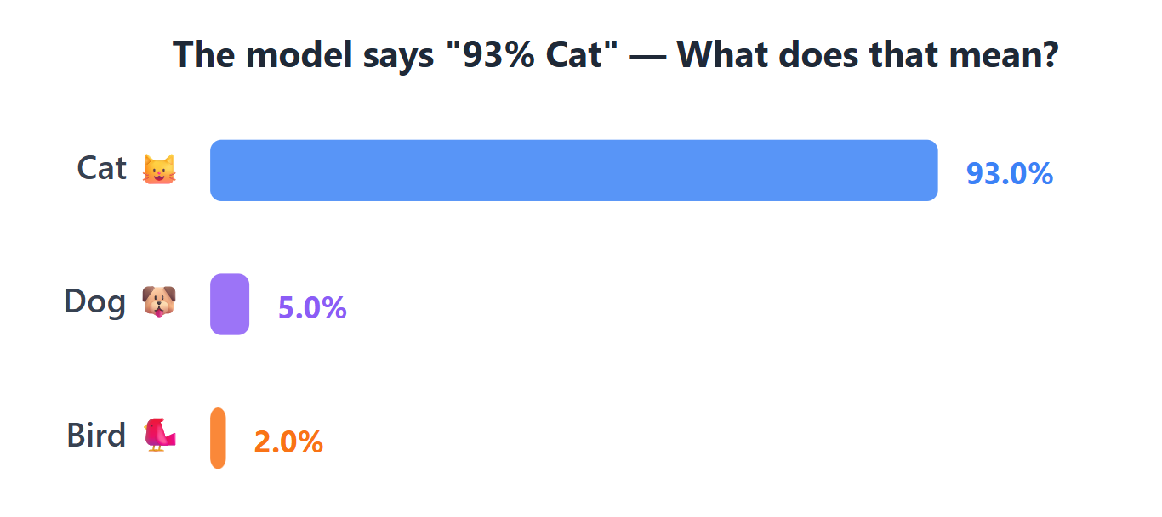
Confidence Scores
ML classifier outputs a raw score (logits) for each class
Quiz: Does high confidence mean correct prediction?
High confidence does not equal correct!!! 93% confidence can be wrong.

Slide 10
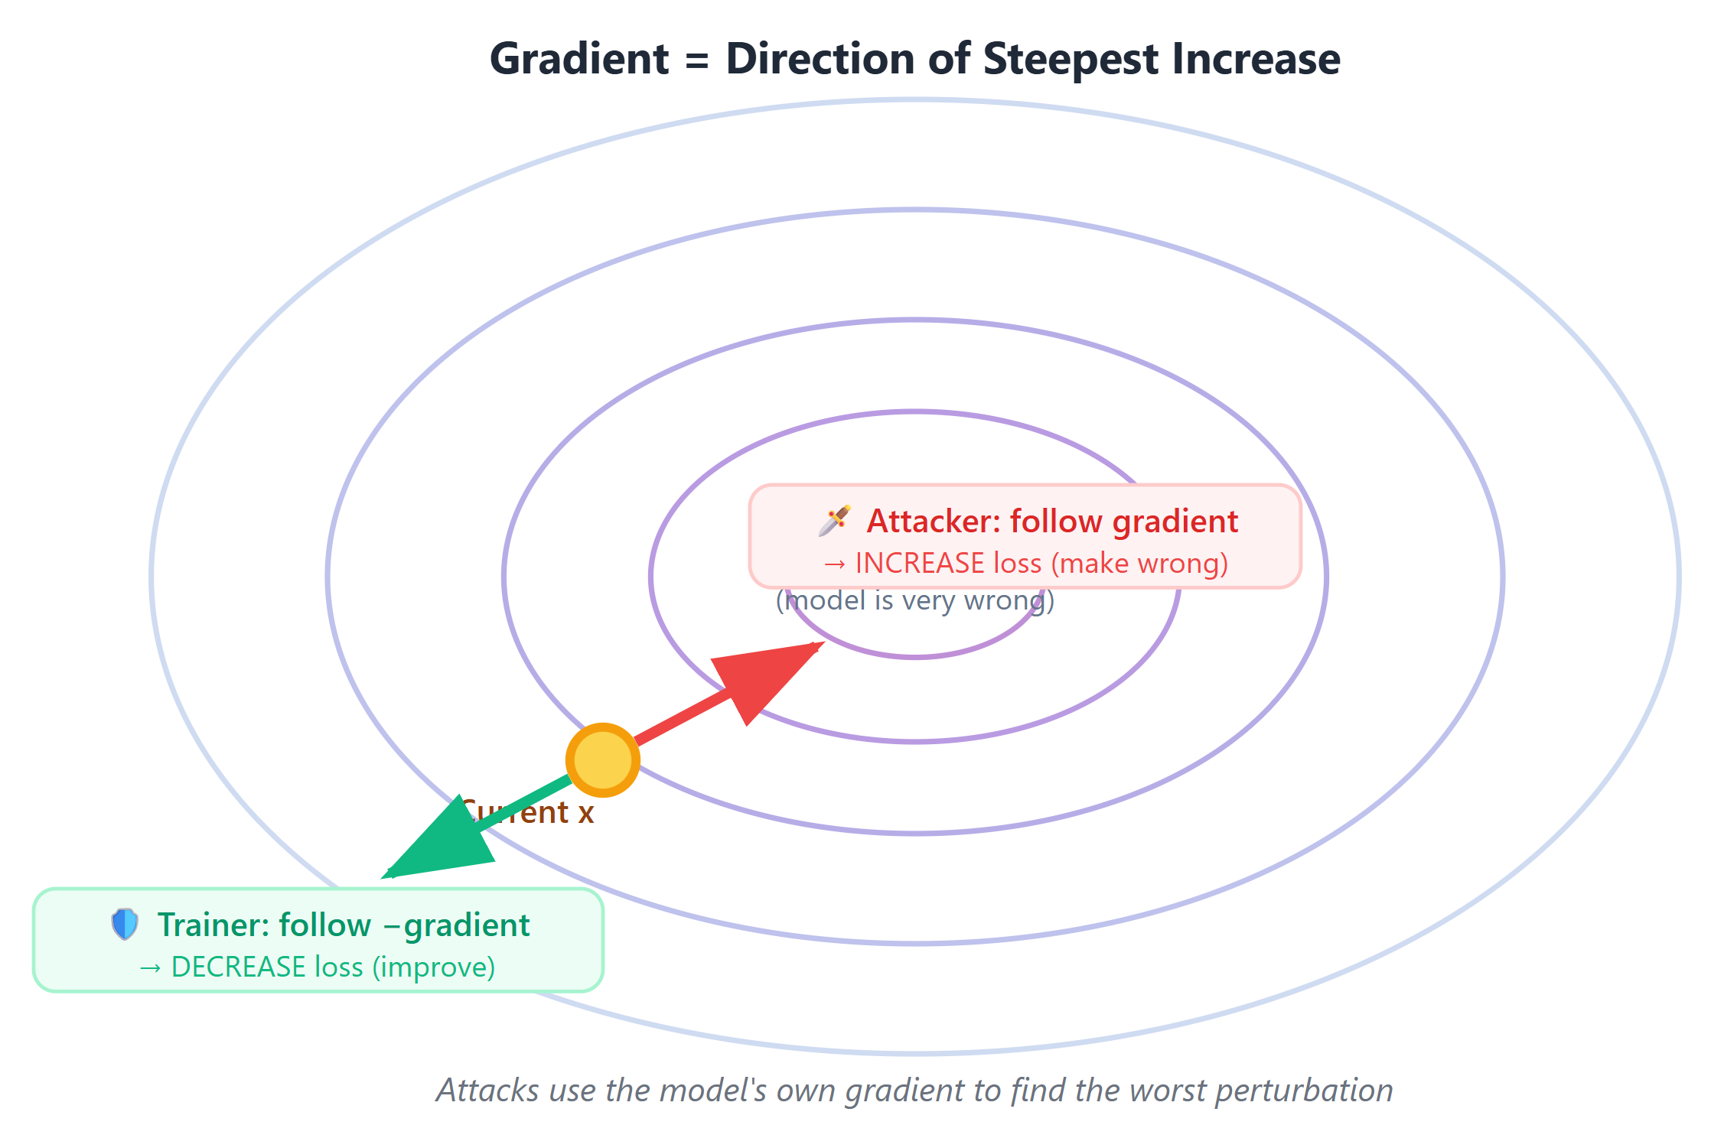
What is a Gradient? The Key to Attacks
Gradient: direction of steepest increase of a function

Slide 11
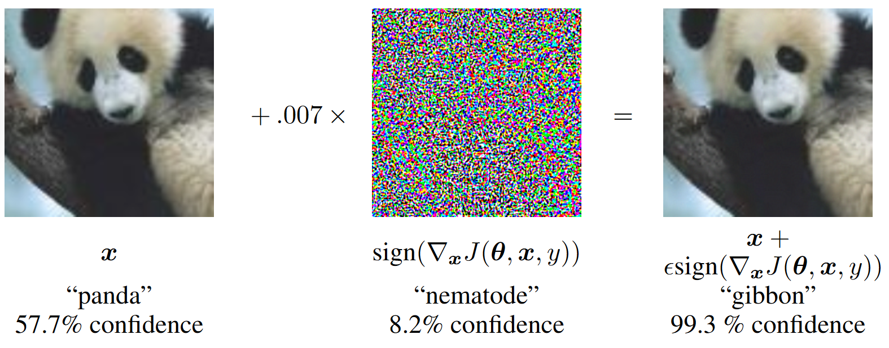
Adversarial Example
An adversarial example is an input to an ML model that has been intentionally and slightly modified to cause the model to make a mistake, while appearing unchanged to a human.

Slide 12
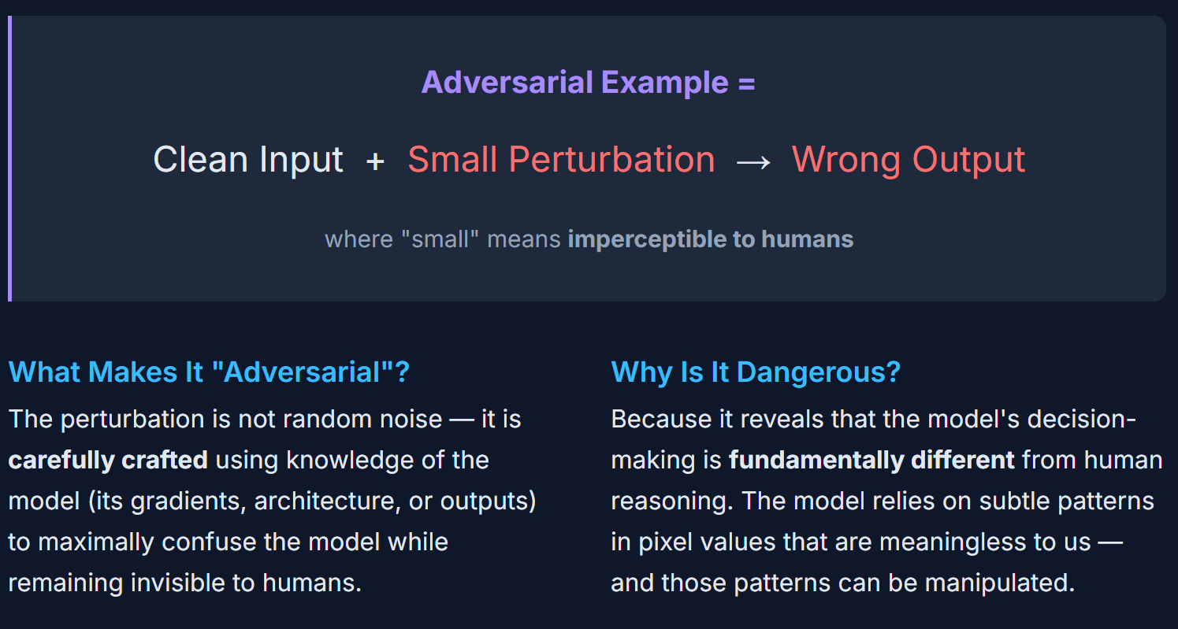
Core Idea of Adversarial Example

Slide 13
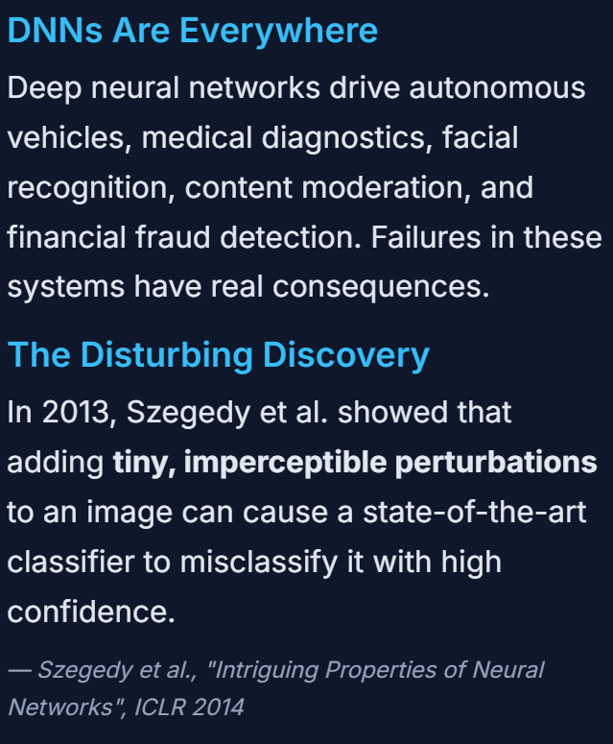
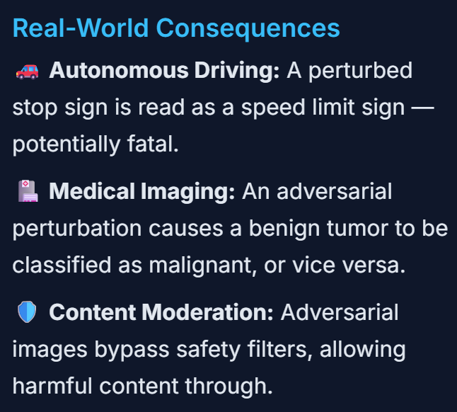
Why Should We Care?

Slide 14
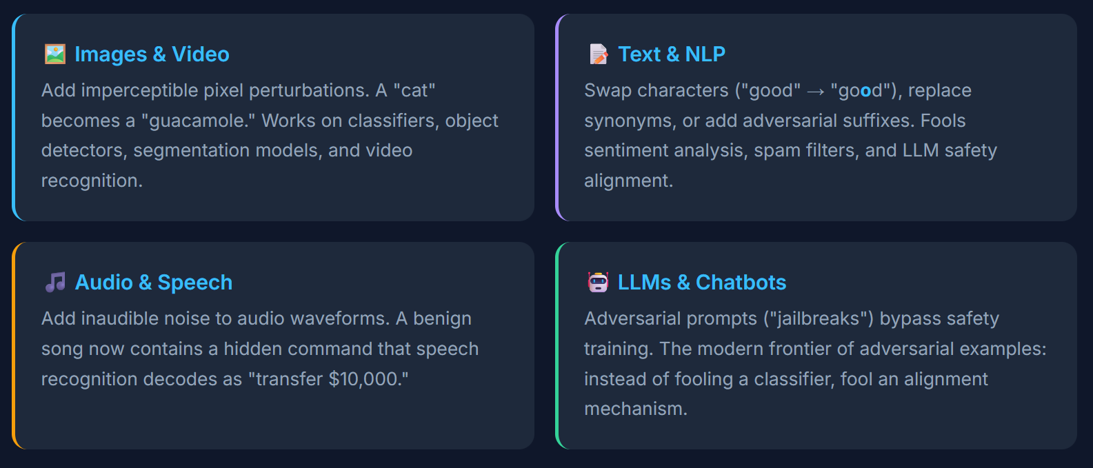
Adv Example Across Every Modality
Adversarial examples are not limited to images.
The gap between human perception and model perception

Slide 15
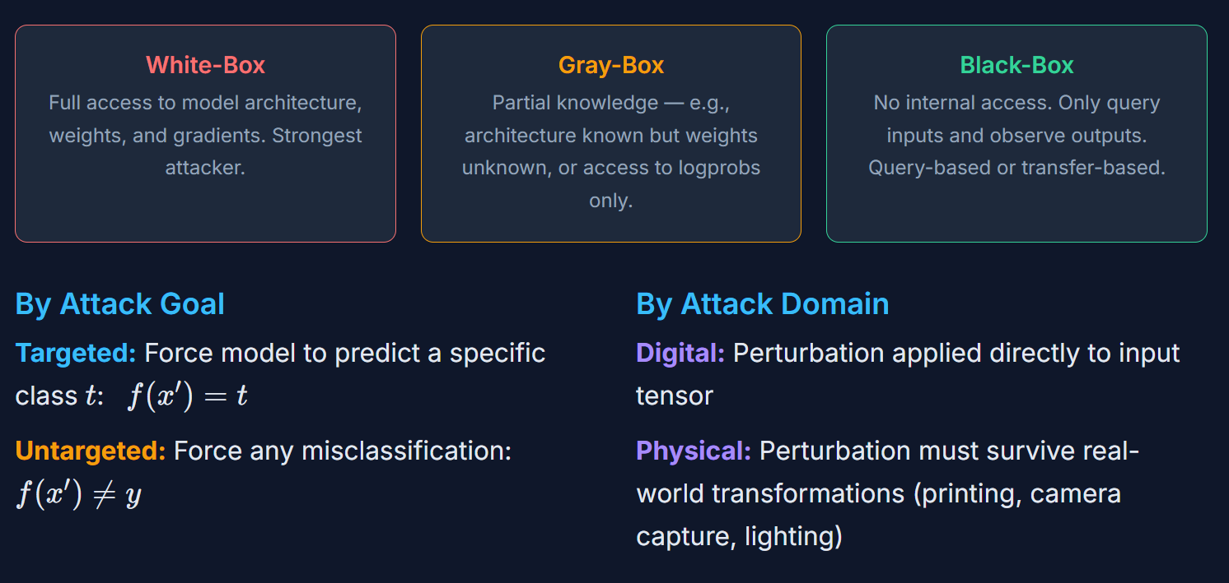
Threat Models of Adv Example

Slide 16
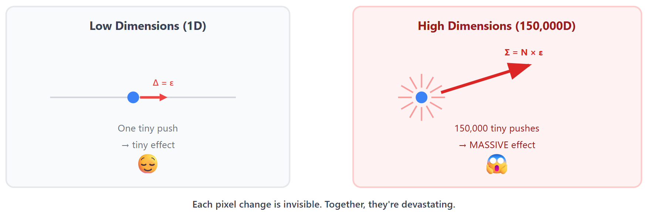
The Linear Hypothesis
Why do adversarial examples exist? => Linear nature of ML model + high-dimensional accumulation

Slide 17

Fast Gradient Sign Method (FGSM)
Foundational paper by Goodfellow. et. al.
Core idea:
Compute the gradient of loss w.r.t input
Perturb pixel in the gradient direction
Gradient

Slide 18
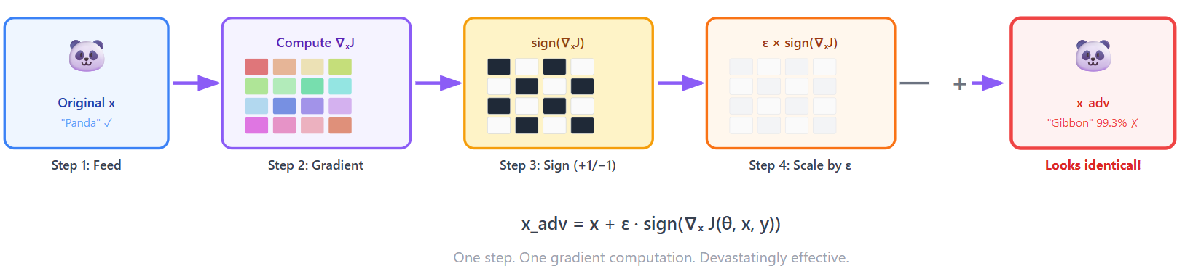
FGSM (Step by Step)

Slide 19
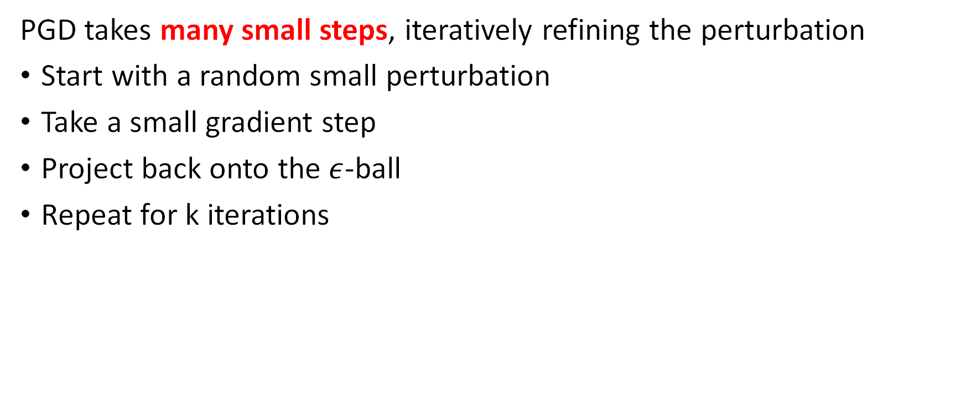
Projected Gradient Descent (PGD)
PGD takes many small steps, iteratively refining the perturbation
Start with a random small perturbation
Take a small gradient step
Project back onto the $ε$-ball
Repeat for k iterations
PGD is stronger than FGSM because of iterative refinement.

Slide 20
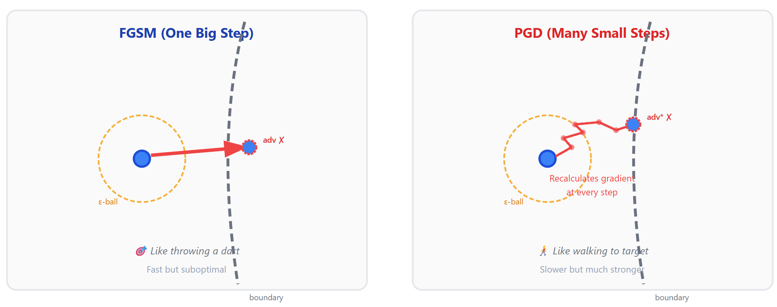
Projected Gradient Descent (PGD)

Slide 21
C&W Attack
An optimization to minimize perturbation distance while maximizing misclassification
Minimize perturbation vs. maximizing loss as FGSM/PGD
Developed by Carlini (security researcher in Claude now) and Wagner in 2017 (IEEE S&P 2017)
Stronger than PGD

Slide 22
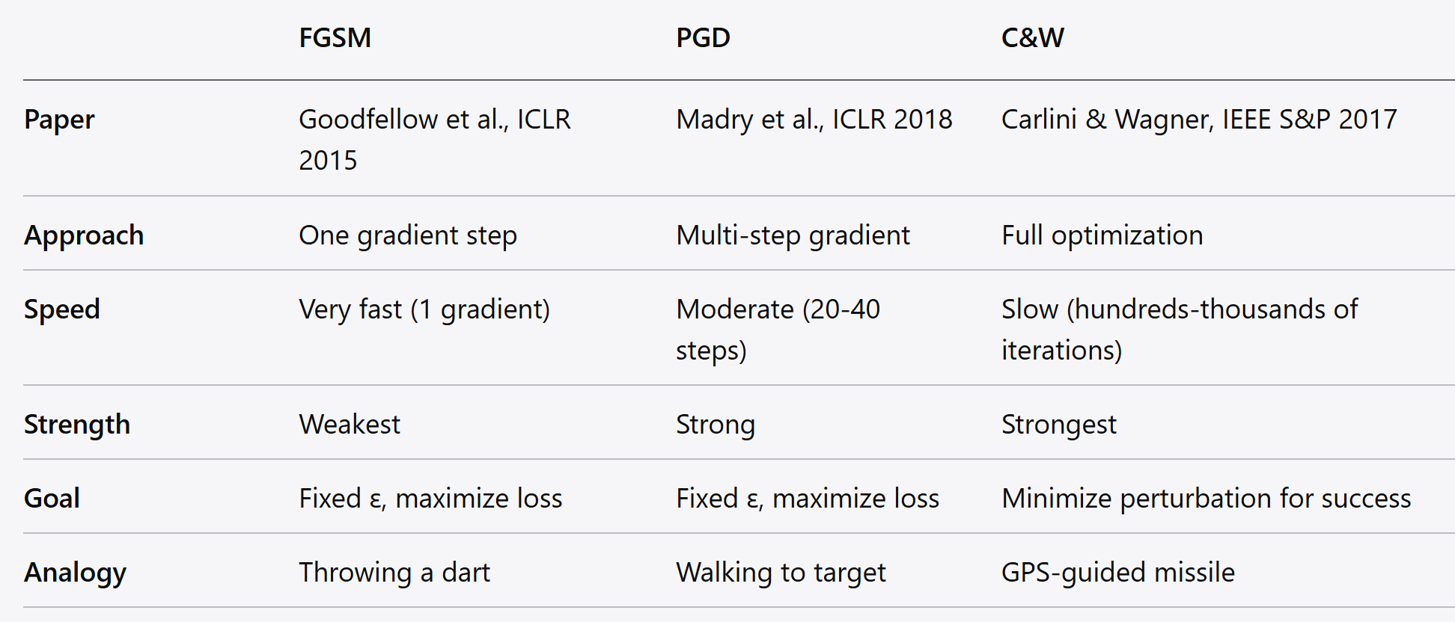
Summary

Slide 23
Transferability of Adv Example
Attack model A, fool model B
Attack their own model (surrogate model)
Generate adversarial examples against their model
These examples transfer and fool other target models
Turn white-box attack into black-box attack

Slide 24
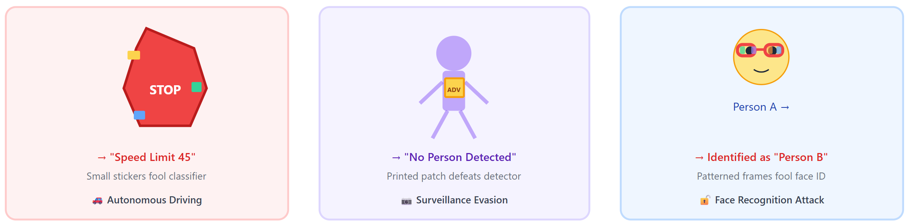
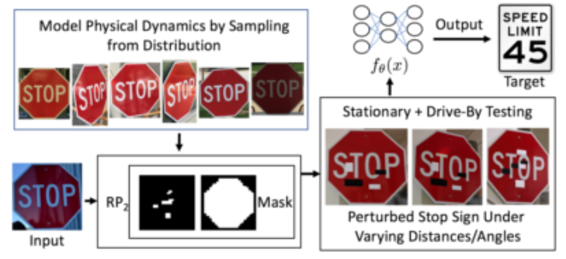
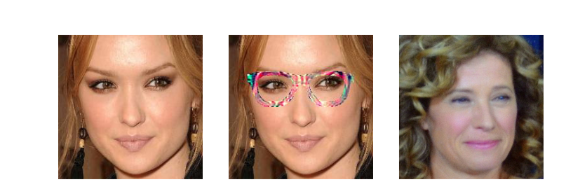
Physical-Word Adversarial Examples

Slide 25
Adversarial Examples on NLP Models
Adversarial examples to text classifier (spam filters, sentiment analysis, content moderation)
Character-level:
Insert: “good” -> “go0d”
Delete: “good” -> “god”
Homoglyph: “good” -> “good” (Latin g -> script g)
Word-level:
Semantic replacement in embedding space
Importance-guided replacement on model model
Small, human-imperceptible text change => flip NLP model output

Slide 26
Adversarial Examples on Audio Models
AE on speech recognition systems (Siri, Alexa, Google Assistant)
Audio clip sounds like music to human => “transfer $10,000 to account X”
Inaudible perturbation => voice commands
Real-world concern: voice-controlled system in smart home, cars and phones

Slide 27
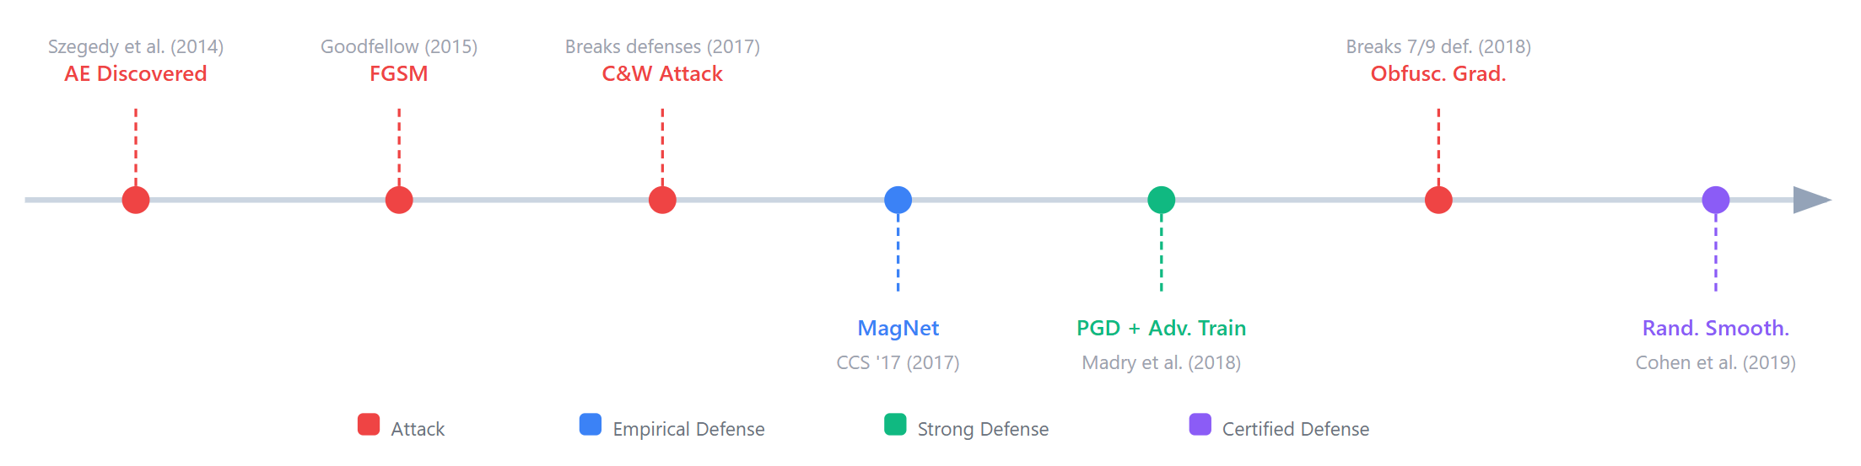
Defense on Adversarial Example
Arms race for decades, like anti-virus vs. malware
Attacker has a fundamental advantage: they can adapt to any defense

Slide 28
Defense 1: Adversarial Training
Train model on adversarial examples.
Generate adversarial examples from current training batch
Train the model to correctly classify both benign and adversarial examples
Repeat for every training batch
Defense cost: 10-20% lower accuracy on clean images
Most reliable empirical defense so far

Slide 29
Defense 2: Input Sanitization (MagNet)
Clean the input before it reaches ML model
Two-pronged approach:
Detector: Identify and reject inputs that look adversarial
Reformer: reconstruct adversarial examples
The ML-based defense itself is prone to AE

Slide 30
Defense 3: Certified Defenses
Empirical defense (adversarial training, input transformation) provides no guarantee against new, unknown attacks.
Certified defense: mathematical guarantee (no attack within perturbation budget can flip prediction)
Deterministic certification: verify the exact worst-case behavior (expensive, limited to small networks)
Probabilistic certification: provide a high-probability guarantee (more scalable)
Give a lower bound on robustness

Slide 31
Defense 4: Randomized Smoothing
Gaussian noise + majority vote
Take the input image
Add random Gaussian noise to image many times (e.g., 1000 copies)
Run all noisy copies through ML model
Smooth prediction via majority vote

Slide 32
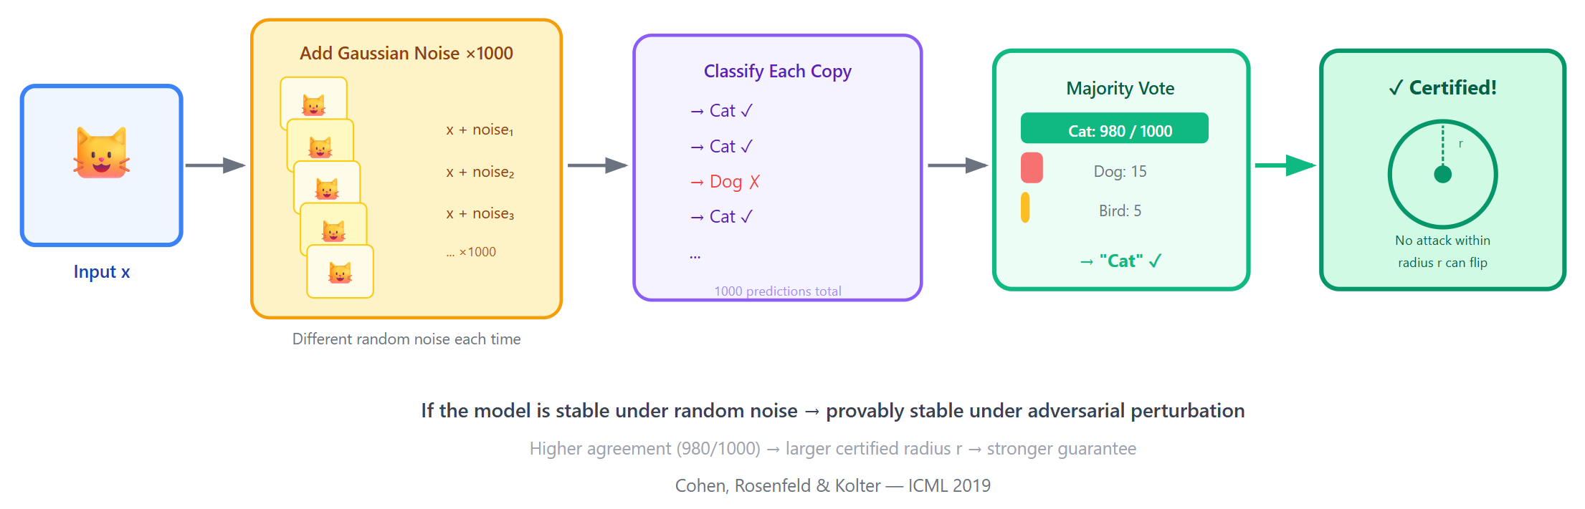
Defense 4: Randomized Smoothing

Slide 33
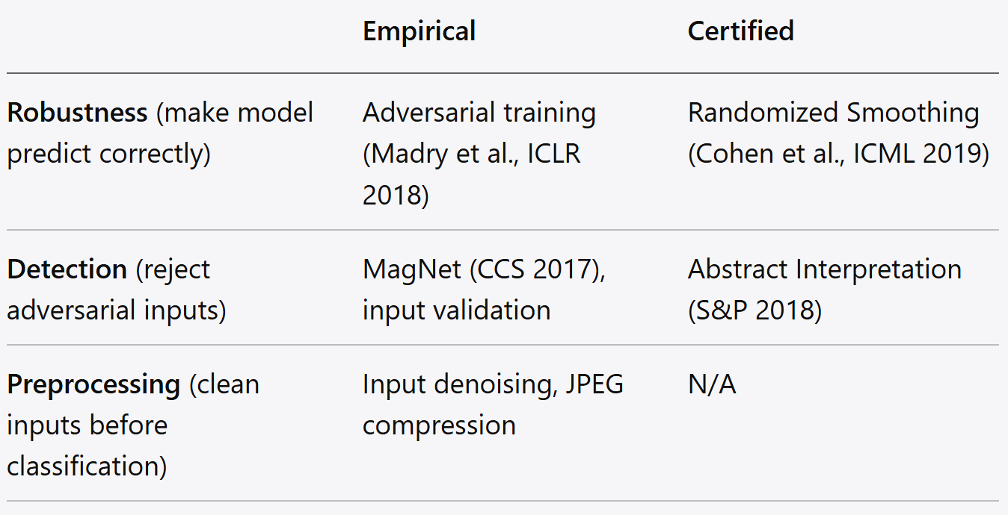
Summary of Defense

Slide 34
Robustness-Accuracy Trade-Off
Robust model hurts prediction accuracy on clean data
On CIFAR-10 (a standard benchmark):
Vanilla model: 95% clean accuracy, 0% robust accuracy
Adv training model: 85% accuracy, 60% robust under PGD
Is this trade-off fundamental (mathematically necessary)?

Slide 35
Jailbreaks as Generalized AE
The Conceptual Bridge
Classical AE: perturb input to fool a ML classifier
Jailbreaks: perturb the prompt to fool safety alignment in LLMs
Find an AE to cross the decision boundary

