Slide 1

HTTPS
Web security

Slide 2
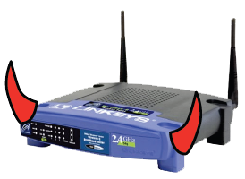
Threat Model: Network Attacker
Network Attacker:
Controls network infrastructure: Routers, DNS
Eavesdrops, injects, blocks, and modifies packets
Examples:
Wireless network at Internet Café
Internet access at hotels (untrusted ISP)

Slide 3
HTTP overview
Goal: Browser and Server want a shared secret, known to attacker
Browser
Server
attacker ??

Slide 4

HTTPS overview
Goal: Browser and Server want a shared secret, unknown to attacker
Browser
Server
attacker ??
key
key

Slide 5
Internet Protocol Security

Slide 6




The Internet
141.212.120.7
Global network that provides best-effort delivery
of packets between connected hosts
Packet: a structured sequence of bytes
Header: metadata used by network
Payload: user data to be transported
Every host has a unique identifier — IP address
Series of routers receive packets, look at destination address on the header and send it one hop towards the destination IP address
8.8.8.8
Notes:
• Network is dumb
• Simple, robust service
• Shift complexity to endpoints

Slide 7
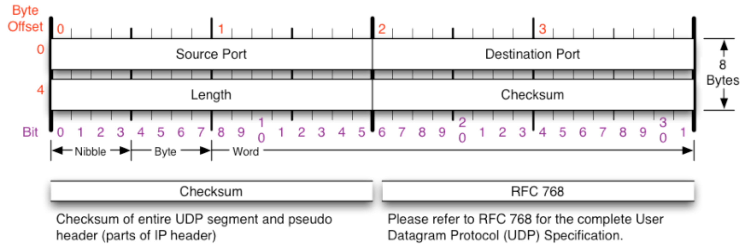
Network Protocols
We define how hosts communicate in published network protocols
Syntax: How communication is structured (e.g., format and order of messages)
Semantics: What communication means. Actions taken on transmit or receipt of message, or when a timer expires. What assumptions can be made.
Example: What bytes contain each field in a packet header
Notes:
We have to coordinate how packets are structured, what packets are sent when, etc. Everyone has to agree ahead of time so that receiver knows what to do when they receive a packet.

Slide 8
Protocol Layering
Networks use a stack of protocol layers
- Each layer has different responsibilities.
- Layers define abstraction boundaries
Lower layers provide services to layers above
- Don’t care what higher layers do
Higher layers use services of layers below
- Don’t worry about how it works
Application
Transport
Network
Data Link
Physical
Notes:
Big shift today! Next four lectures are going to be about the web.

Slide 9
OSI 5 Layer Model
Physical
How do bits get translated into electrical, optical, or radio signals
Notes:
Big shift today! Next four lectures are going to be about the web.

Slide 10
OSI 5 Layer Model
Data Link
How to get packet to the next hop. Transmission of data frames between two nodes connected by a physical link.
Physical
How do bits get translated into electrical, optical, or radio signals
Notes:
Big shift today! Next four lectures are going to be about the web.

Slide 11
OSI 5 Layer Model
Network
Packet forwarding. How to get a packet to the final destination
when there are many hops along the way.
Data Link
How to get packet to the next hop. Transmission of data frames between two nodes connected by a physical link.
Physical
How do bits get translated into electrical, optical, or radio signals
Notes:
Big shift today! Next four lectures are going to be about the web.

Slide 12
OSI 5 Layer Model
Transport
Allows a client to establish a connection to specific services
(e.g., web server on port 80). Provides reliable communication.
Network
Packet forwarding. How to get a packet to the final destination
when there are many hops along the way.
Data Link
How to get packet to the next hop. Transmission of data frames between two nodes connected by a physical link.
Physical
How do bits get translated into electrical, optical, or radio signals
Notes:
Big shift today! Next four lectures are going to be about the web.

Slide 13
OSI 5 Layer Model
Application
Defines how individual applications communicate. For example, HTTP defines how browsers send requests to web servers.
Transport
Allows a client to establish a connection to specific services
(e.g., web server on port 80). Provides reliable communication.
Network
Packet forwarding. How to get a packet to the final destination
when there are many hops along the way.
Data Link
How to get packet to the next hop. Transmission of data frames between two nodes connected by a physical link.
Physical
How do bits get translated into electrical, optical, or radio signals
Notes:
Big shift today! Next four lectures are going to be about the web.

Slide 14
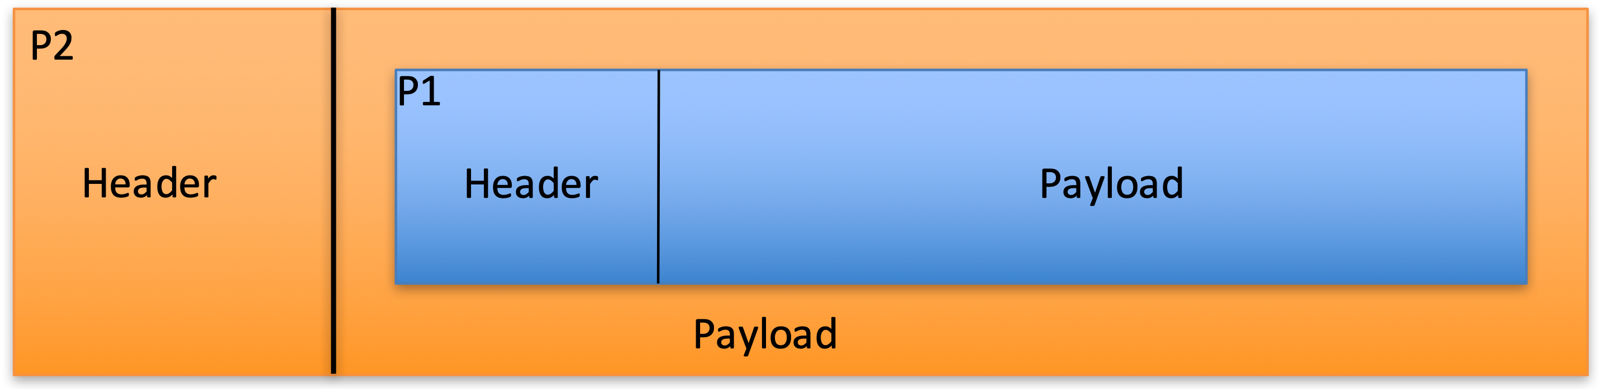
Packet Encapsulation
Protocol N1 can use the services of lower layer protocol N2
A packet P1 of N1 is encapsulated into a packet P2 of N2
The payload of p2 is p1
The control information of p2 is derived from that of p1
IP
TCP
TCP
HTTP Request
Notes:
Big shift today! Next four lectures are going to be about the web.

Slide 15
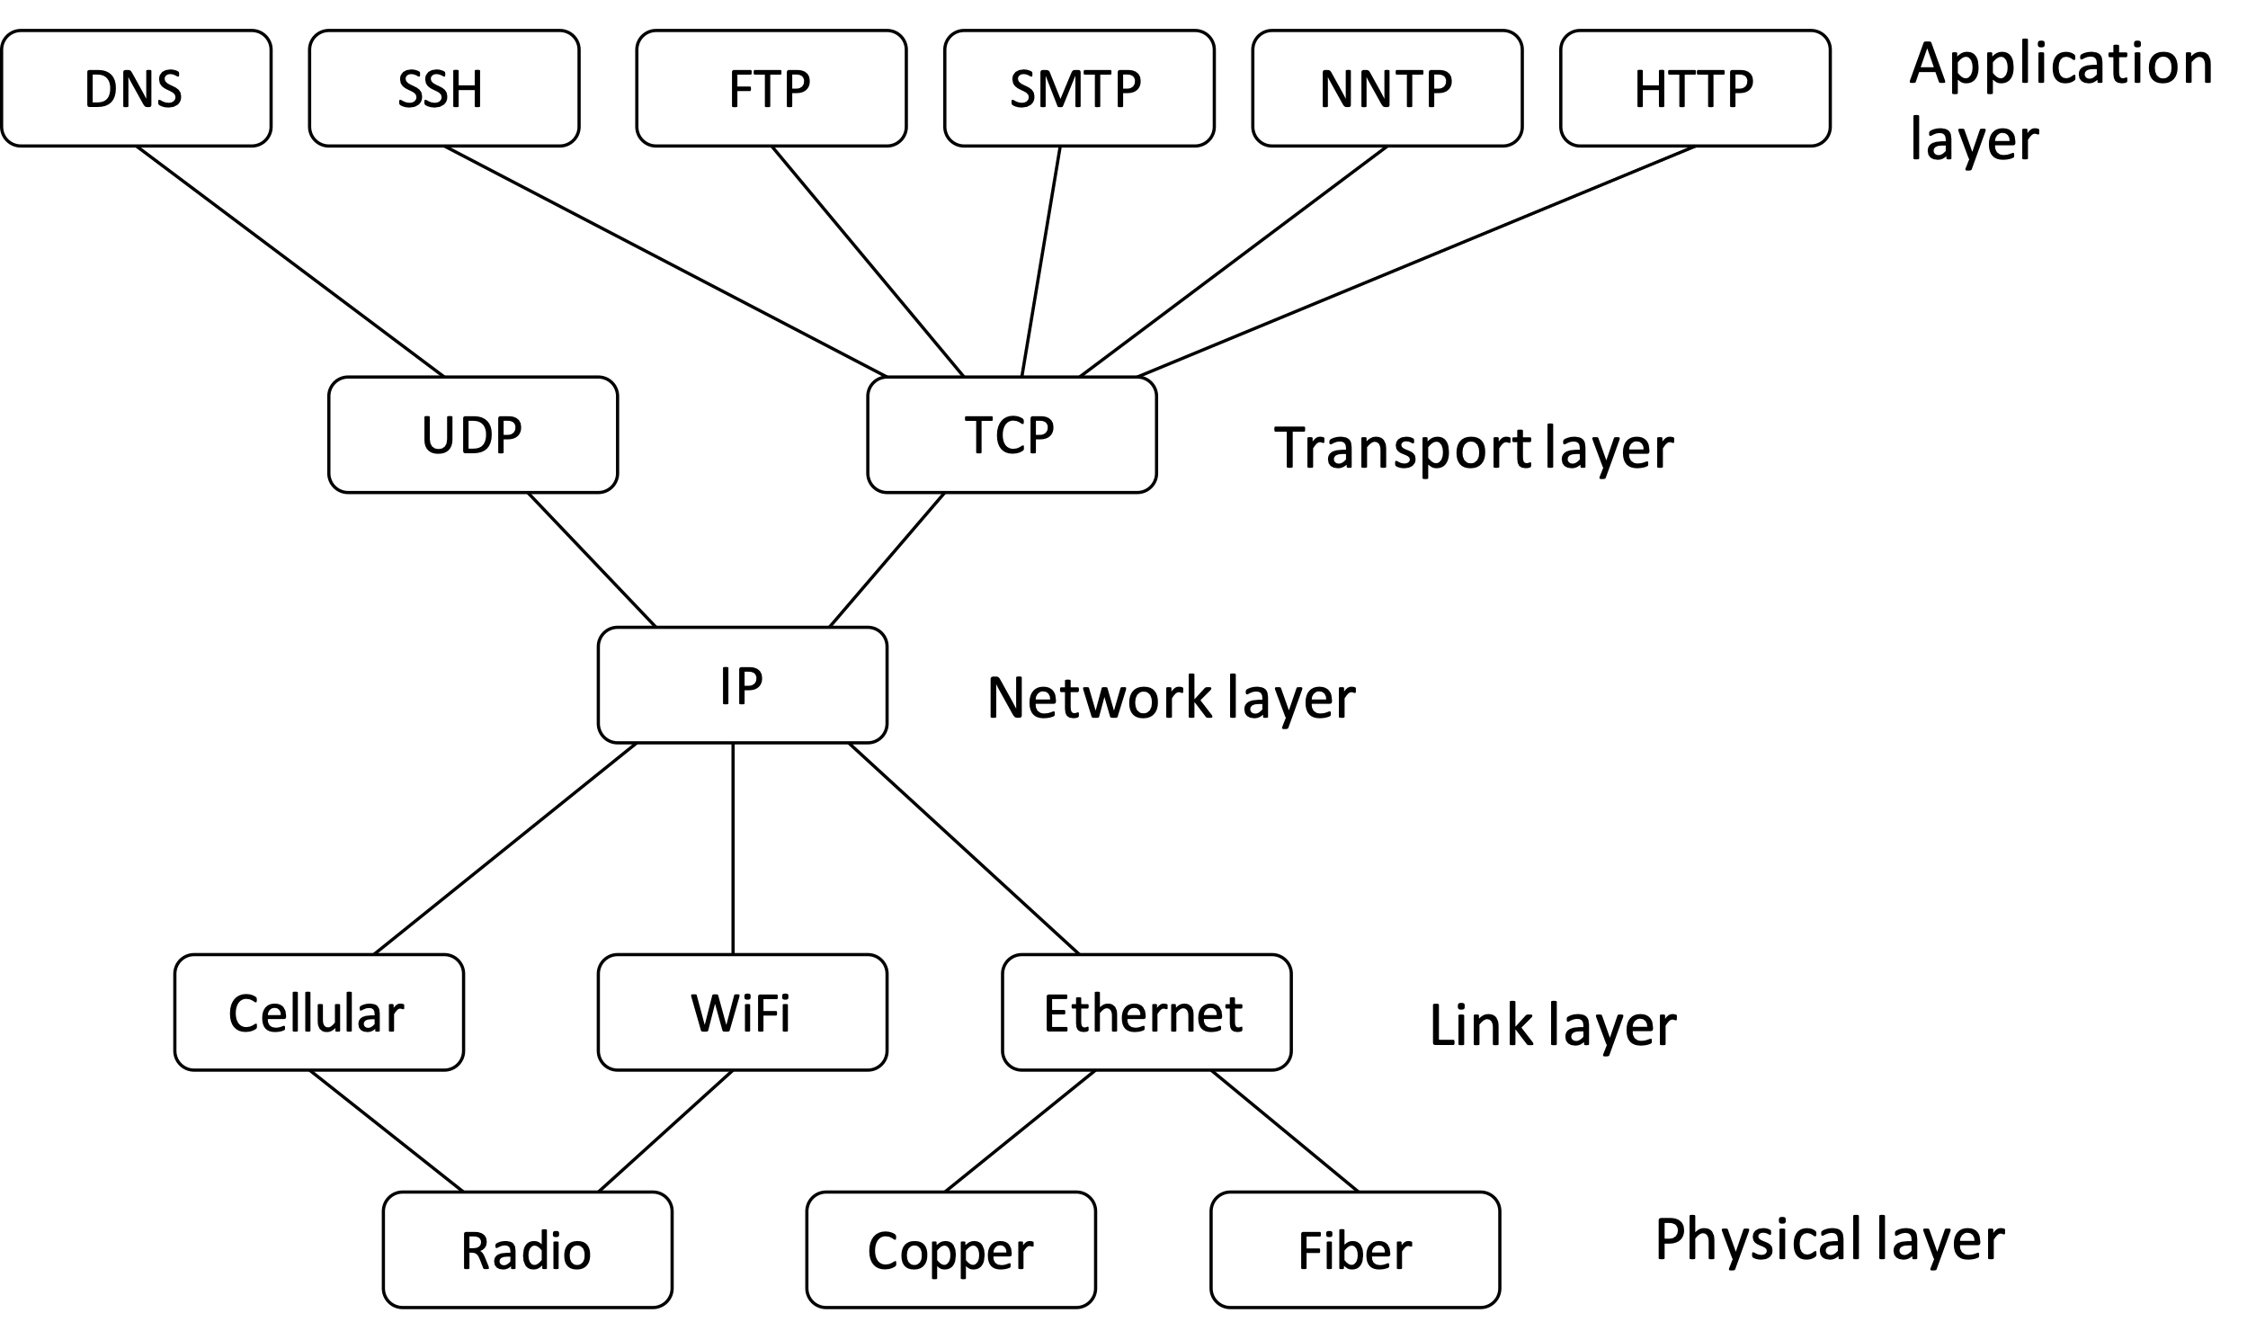
IP — The Narrow Waist
How does Application
structure data?
How do I get to the right service?
How do I have a reliable “stream” of data?
How a does packet final destination?
How do I get to next hop?
Notes:
Big shift today! Next four lectures are going to be about the web.

Slide 16
Link Layer
Assumes: Local nodes are physically connected
Task: Transfer bytes between two hosts on the physically connected network

Slide 17
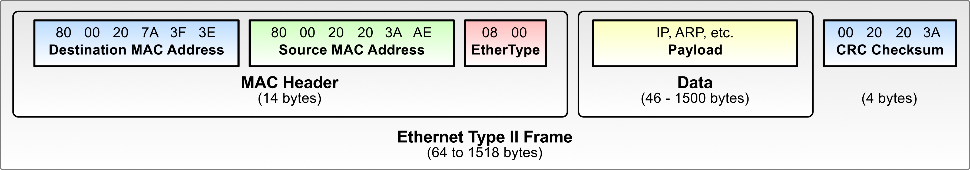
Ethernet
Most common Link Layer Protocol. Let’s you send packets to other local hosts.
At layer 2 (link layer) packets are called frames
MAC addresses: 6 bytes, universally unique
EtherType gives layer 3 protocol in payload
0x0800: IPv4
0x0806: ARP
0x86DD: IPv6
Notes:
Big shift today! Next four lectures are going to be about the web.

Slide 18
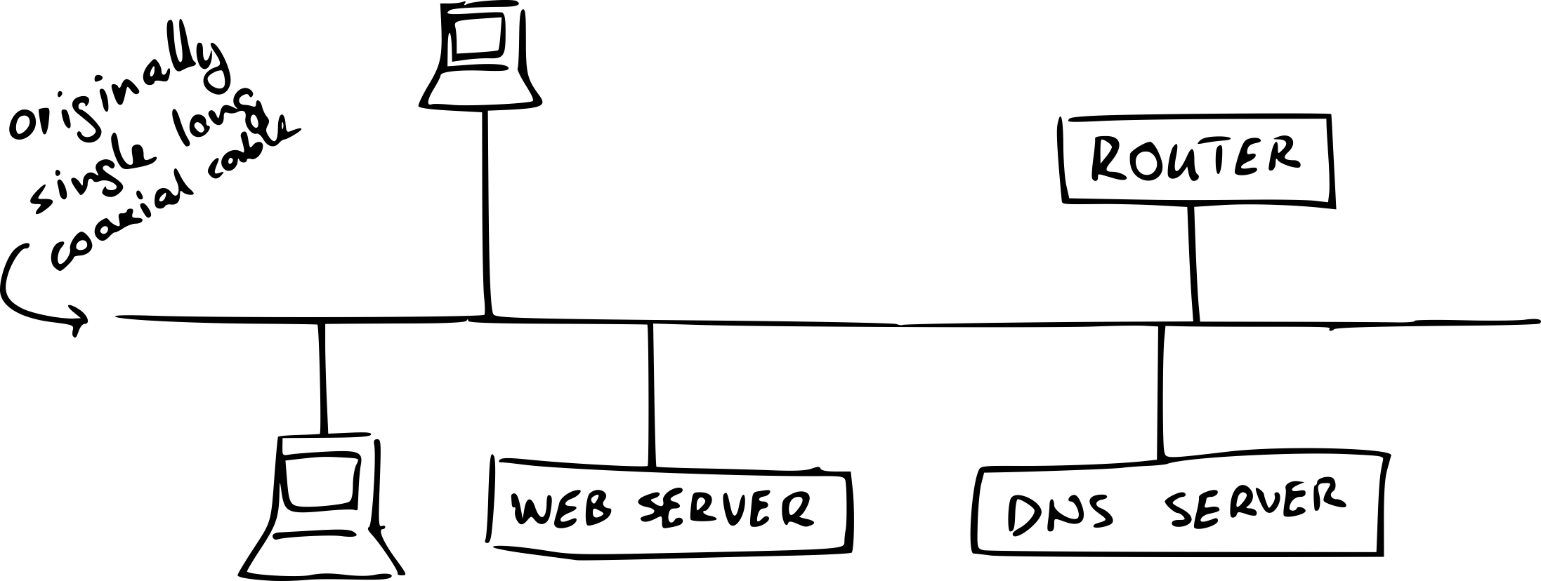
Ethernet
Originally broadcast. Every local computer got every packet.
Notes:
Big shift today! Next four lectures are going to be about the web.

Slide 19
Switched Ethernet
With switched Ethernet, the switch learns at which physical port each MAC address lives based on MAC source addresses
If switch knows MAC address M is at port P,
it will only send a packet for M out port P
If switch does not know which port MAC address M lives at, will broadcast to all ports

Slide 20
MAC Addresses
Media Access Control address
unique hardware identification number
48 bits (6 bytes) long, written as 12 hexadecimal digits,
Format: MM:MM:MM:SS:SS:SS
Example: 00:1A:2B:3C:4D:5E
Notes:
Big shift today! Next four lectures are going to be about the web.

Slide 21
IP Addresses
Quiz: how many combinations in IPv4 and IPv6?
IPv4: 32-bit host addresses
Written as 4 bytes (4 * 1) in form A.B.C.D
where A,...,D are 8-bit integers in decimal
(called dotted quad) e.g. 192.168.1.1
IPv6: 128 bit host addresses
Written as 16 bytes (8 * 2) in form AAAA:BBBB:CCCC:DDDD:EEEE:FFFF:GGGG:HHHH
where AAAA,...,HHHH are 16 bit integers in hexadecimal
and :: implies consecutive zero bytes
e.g. 2620:0:e00:b::53 = 2620:0:e00:b:0:0:0:53
Notes:
Big shift today! Next four lectures are going to be about the web.

Slide 22
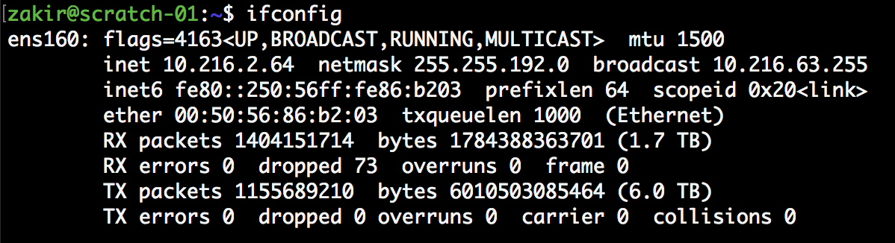
Ethernet
Quiz: what is IPv4 addr, IPv6 addr and MAC addr?
Notes:
Big shift today! Next four lectures are going to be about the web.

Slide 23
Internet Protocol (IP)
Internet Protocol (IP) defines what packets that cross the Internet need to look like to be processed by routers
Every host is assigned a unique identifier (“IP Address”)
Every packet has an IP header that indicates its sender and receiver
Routers forward packet along to try to get it to the destination host
Rest of the packet should be ignored by the router
Notes:
Big shift today! Next four lectures are going to be about the web.

Slide 24
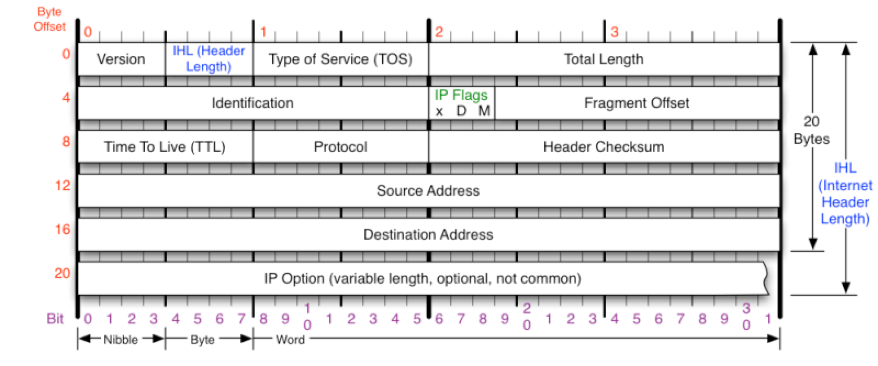
IPv4 Header
Instruct routers and hosts what to do with a packet
All values are filled in by the sending host
Notes:
Big shift today! Next four lectures are going to be about the web.

Slide 25

Destination Address
Sender sets destination address
Routers try to forward packet to that address
Notes:
Big shift today! Next four lectures are going to be about the web.

Slide 26
Source Address
Source Address (sender)
Sender fills in. Routers due not verify.
Notes:
Big shift today! Next four lectures are going to be about the web.

Slide 27
Checksum
Quiz: what is the checksum’s goal?
16-bit Simple Header checksum (filled in by sender)
Notes:
AFTER THIS SLIDE, GO BACK TO WHITEBOARD

Slide 28
IP Security
Client is trusted to embed correct source IP
Easy to override using lower level network sockets
Libnet: a library for formatting raw packets with arbitrary IP headers
Anyone who owns their machine can send packets with arbitrary source IP
Denial of Service Attacks
Anonymous infection (if one packet)

Slide 29
Internet Protocol (IP)
Yes:
Routing. If host knows IP of destination host, route packet to it.
Fragmentation and reassembly: Split data into packets and reassemble
Error Reporting: (maybe, if you’re lucky) tell source it dropped your packet
No:
Everything else. No ordering. No retransmission. No (real) error checking. No acknowledgement of receipt. No “connections”. No security. Just packets.

Slide 30
Two Problems
Local: How does a host know what MAC address their destination has given an IP address?
Internet: How does each router know where to send each packet next?
Notes:
GO DISCUSS HOW A LAN PLAYS OUT AND HAS A ROUTER

Slide 31
ARP: Address Resolution Protocol
ARP is a Network protocol that lets hosts map IP addresses to MAC addresses
Host who needs MAC address M corresponding to IP address N broadcasts an ARP packet to LAN asking, “who has IP address N?”
Host that has IP address N will reply, “IP N is at MAC address M.”
Notes:
GO DISCUSS HOW A LAN PLAYS OUT AND HAS A ROUTER

Slide 32
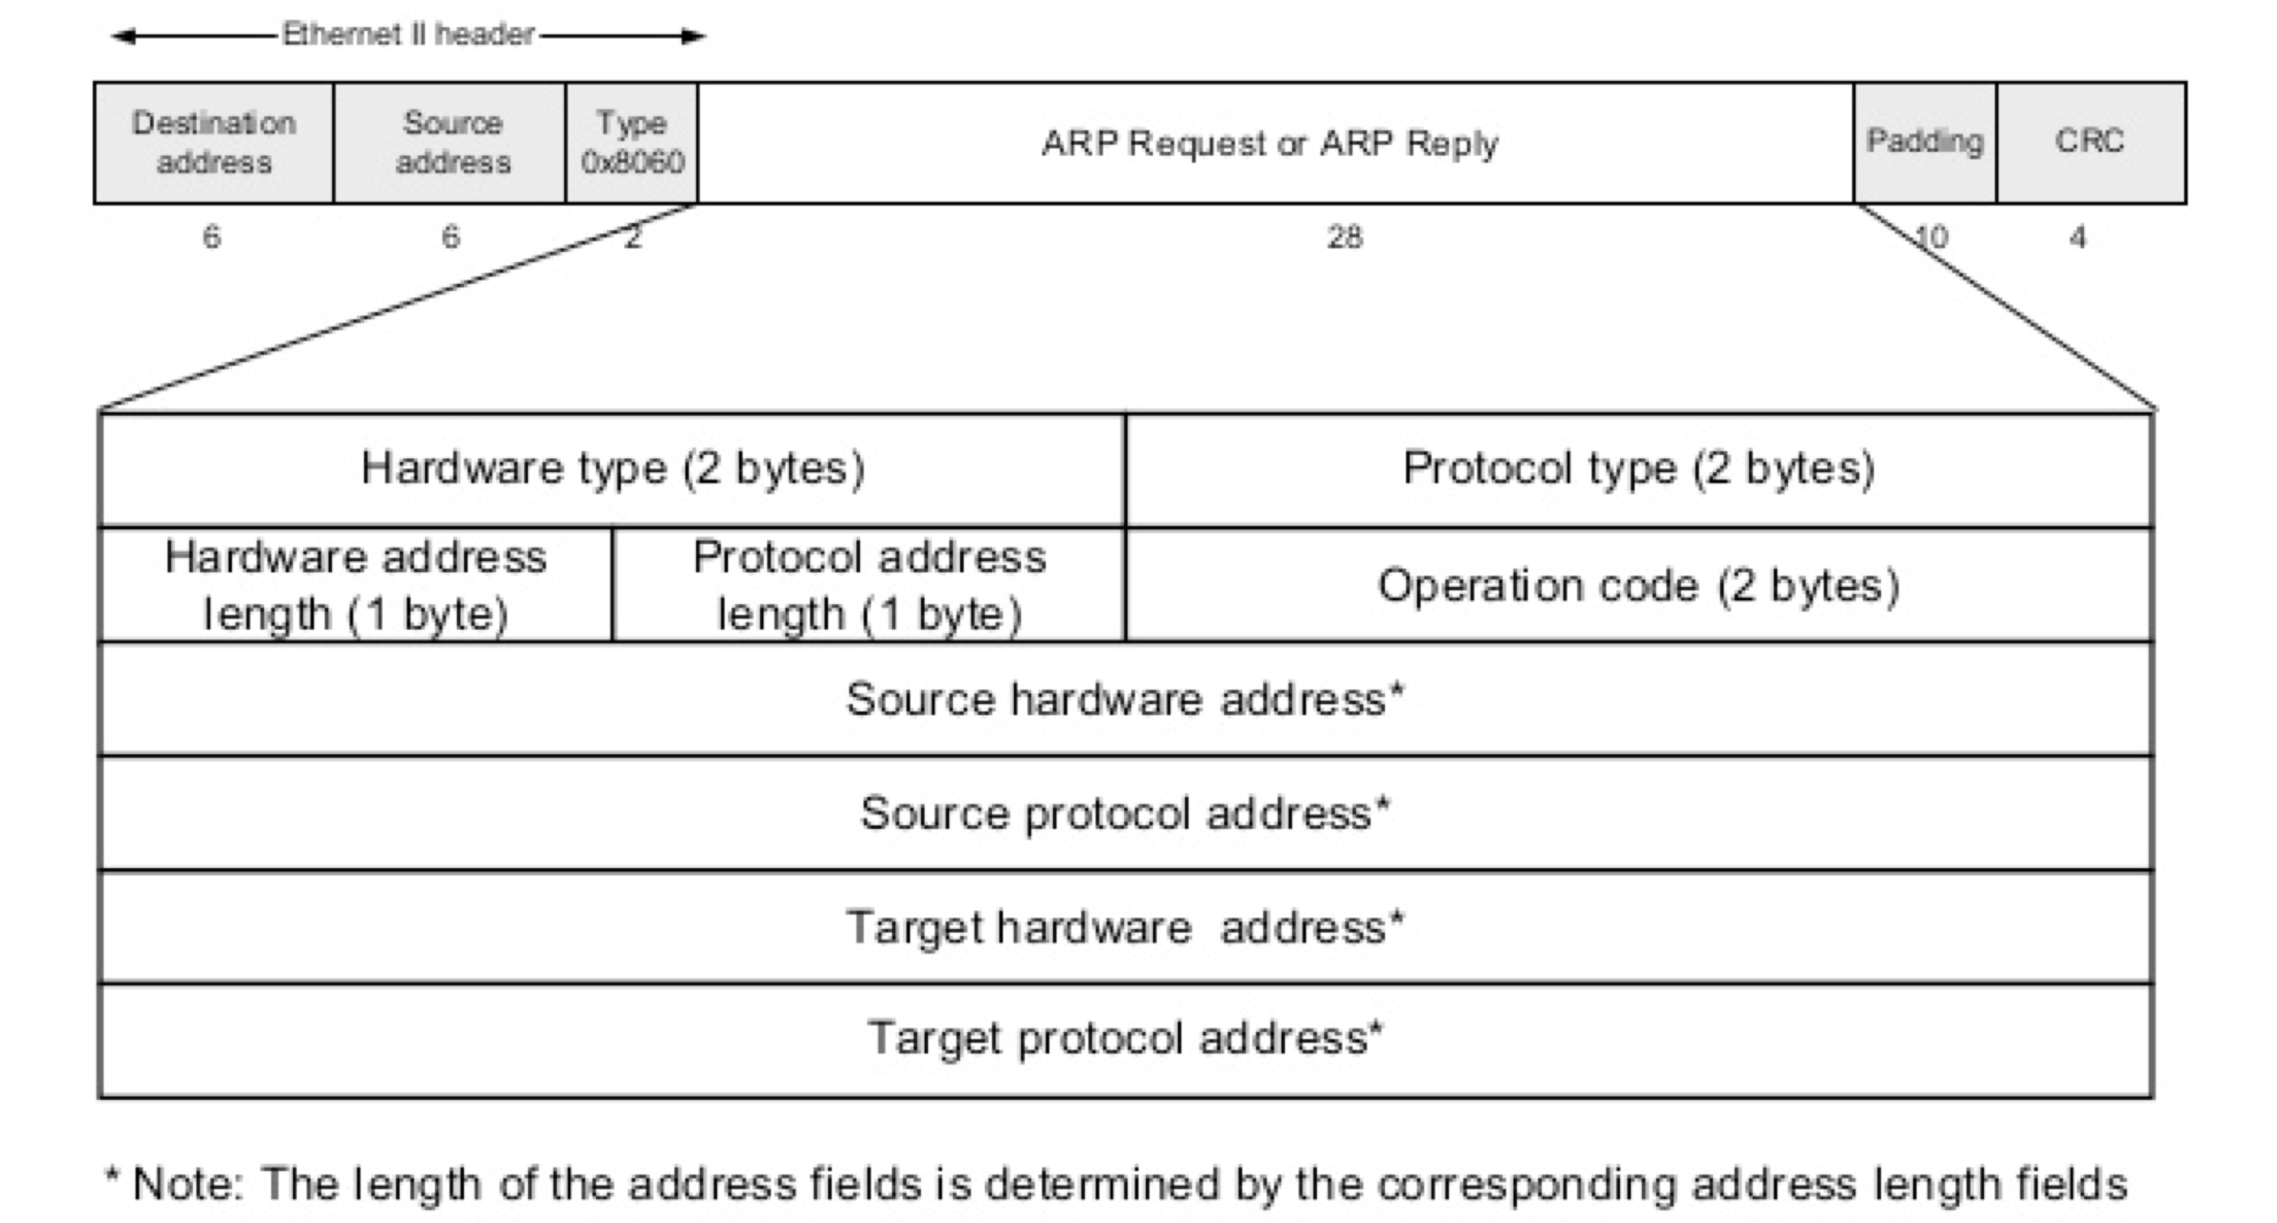
ARP Packet

Slide 33
ARP Security
Any host on the LAN can send ARP requests and replies: any host can claim to be another host on the local network!
This is called ARP spoofing
This allows any host X to force IP traffic between any two other hosts A and B to flow through X (MitM!)
Claim IPA is at attacker’s MAC address MX
Claim IPB is at attacker’s MAC address MX
Notes:
GO DISCUSS HOW A LAN PLAYS OUT AND HAS A ROUTER

Slide 34
Routing (BGP)
BGP (Border Gateway Protocol): protocol that allows routers to exchange information about their routing tables
Each router announces what it can route to all of its neighbors.
Every router maintains a global table of routes
Notes:
GO DISCUSS HOW A LAN PLAYS OUT AND HAS A ROUTER

Slide 35
Pakistan hijacks YouTube
On 24 February 2008, Pakistan Telecom (AS 17557) began advertising a small part of YouTube’s (AS 36561) assigned network
PCCW (3491) did not validate Pakistan Telecom’s (17557) advertisement for 208.65.153.0/24
Youtube offline.

Slide 36
Protocol Layering
How does Application
structure data?
How do I get to the right service?
How do I have a reliable “stream” of data?
How do I get to final destination?
How do I get to next hop?
Notes:
Great. So, at this point, we know how to get packets from one host to another….

Slide 37
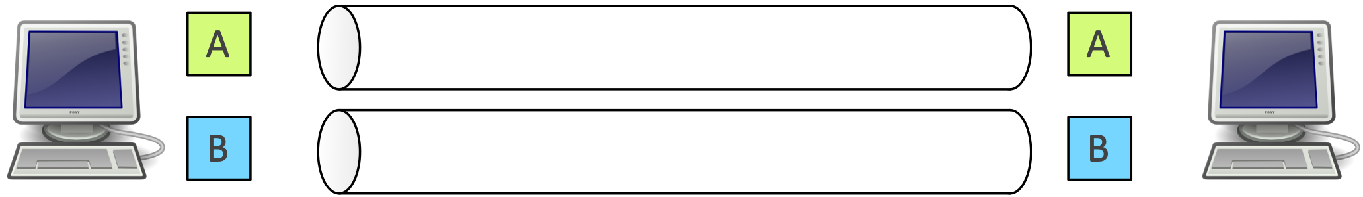
Ports
Each application on a host is identified by a port number
TCP connection established between port A on host X to port B on host Y
Ports are 1–65535 (16 bits)
Some destination port numbers used for specific applications by convention
Notes:
GO DISCUSS HOW A LAN PLAYS OUT AND HAS A ROUTER

Slide 38
Common Ports
Port | Application
80 | HTTP (Web)
443 | HTTPS (Web)
25 | SMTP (mail)
67 | DHCP (host config)
22 | SSH (secure shell)
23 | Telnet
Notes:
GO DISCUSS HOW A LAN PLAYS OUT AND HAS A ROUTER

Slide 39
UDP (User Datagram Protocol)
User Datagram Protocol (UDP) is a transport layer protocol that is essentially a wrapper around IP
Adds ports to demultiplex traffic by application

Slide 40
From Packets to Streams
Most applications want a stream of bytes delivered reliably and in-order between applications on different hosts
Transmission Control Protocol (TCP) provides…
  - Connection-oriented protocol with explicit setup/teardown
  - Reliable in-order byte stream
  - Congestion control
  Despite IP packets being dropped, re-ordered, and duplicated

Slide 41
TCP Sequence Numbers
Two data streams in a TCP session, one in each direction
Bytes in data stream numbered with a 32-bit sequence number
Every packet has sequence number that indicates where data belongs
Receiver sends acknowledgement number that indicates data received
Notes:
GO DISCUSS HOW A LAN PLAYS OUT AND HAS A ROUTER

Slide 42
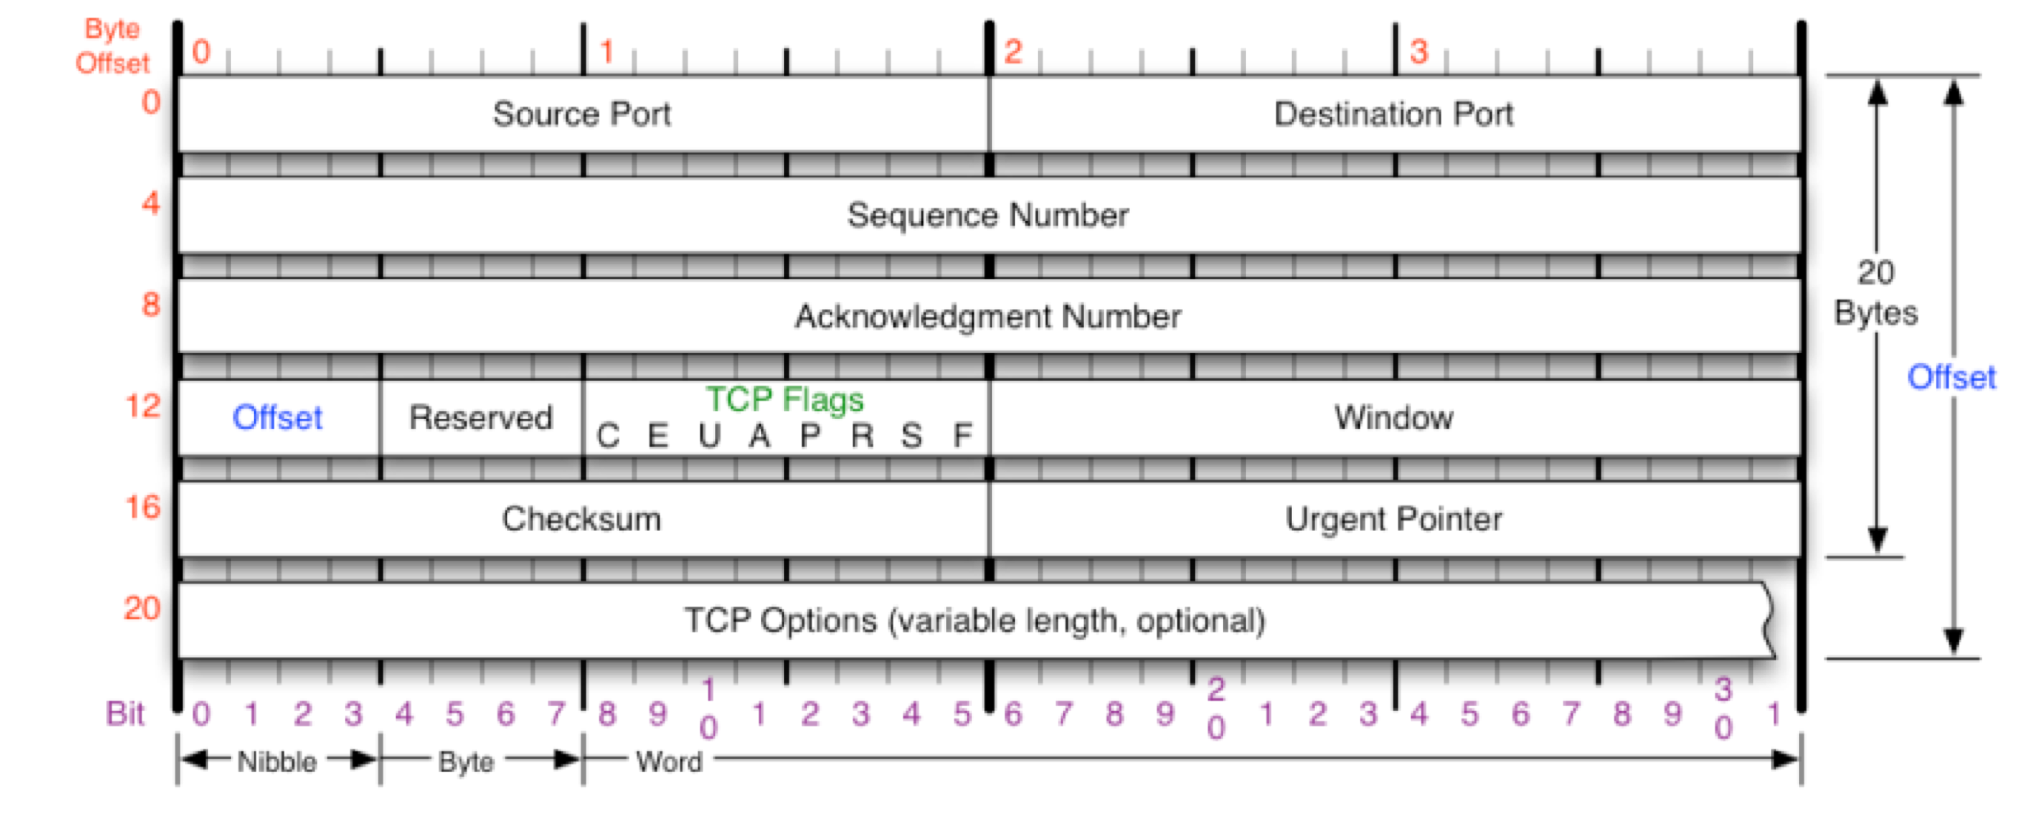
TCP Packet
Notes:
GO DISCUSS HOW A LAN PLAYS OUT AND HAS A ROUTER

Slide 43
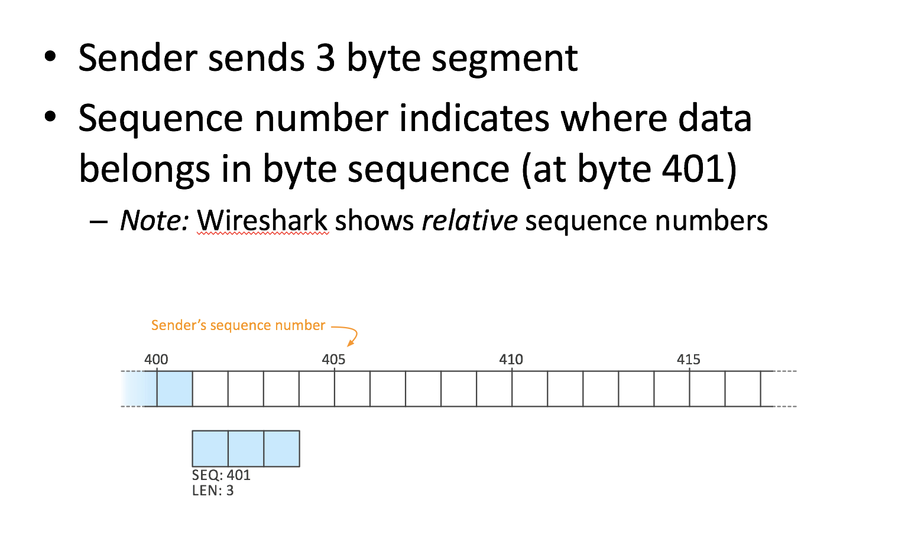
Transmission Control Protocol
Notes:
GO DISCUSS HOW A LAN PLAYS OUT AND HAS A ROUTER

Slide 44
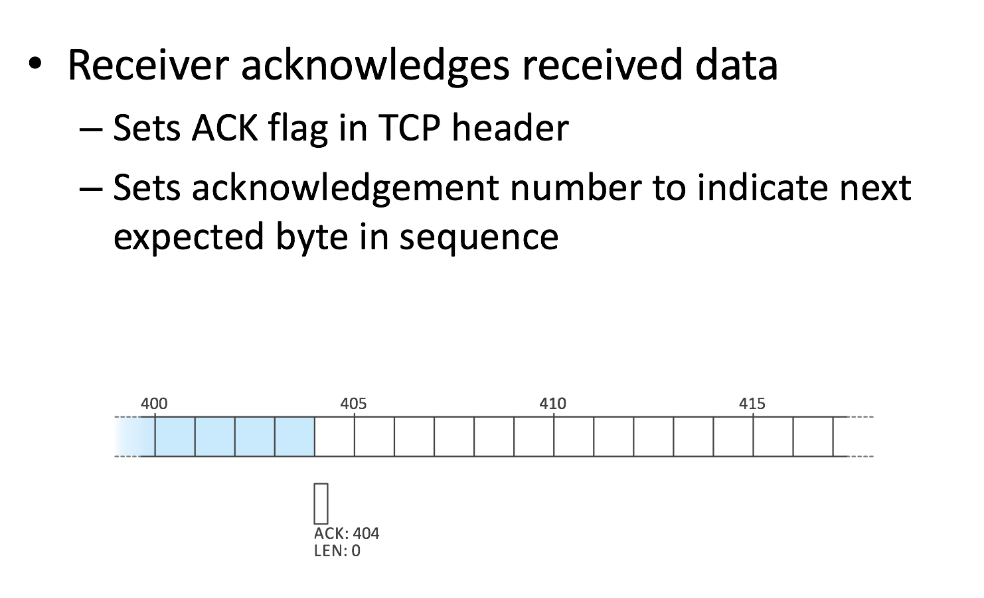
TCP Acknowledgement Numbers
Notes:
GO DISCUSS HOW A LAN PLAYS OUT AND HAS A ROUTER

Slide 45
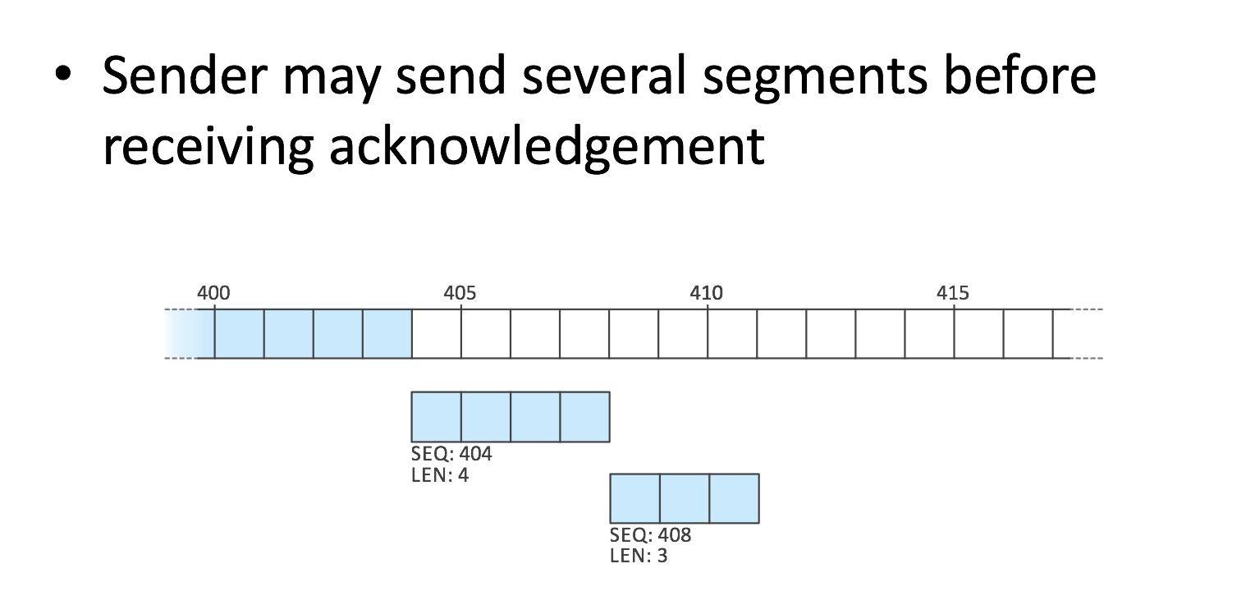
ACKing Multiple Segments
Notes:
GO DISCUSS HOW A LAN PLAYS OUT AND HAS A ROUTER

Slide 46
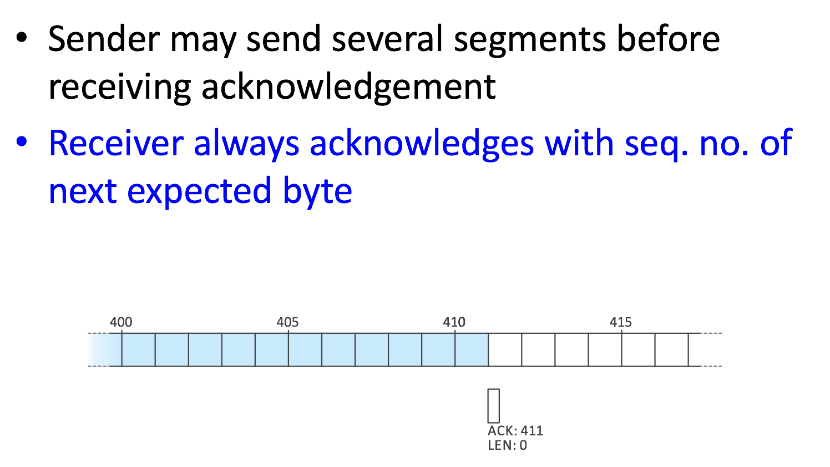
ACKing Multiple Segments
Notes:
GO DISCUSS HOW A LAN PLAYS OUT AND HAS A ROUTER

Slide 47
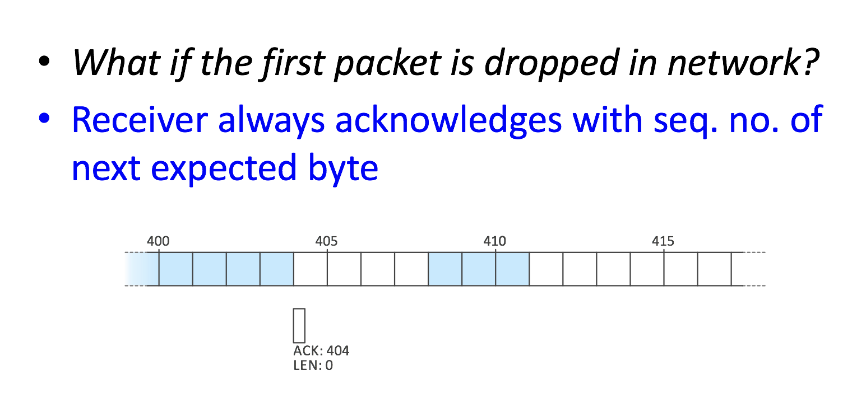
Transmission Control Protocol
Notes:
GO DISCUSS HOW A LAN PLAYS OUT AND HAS A ROUTER

Slide 48
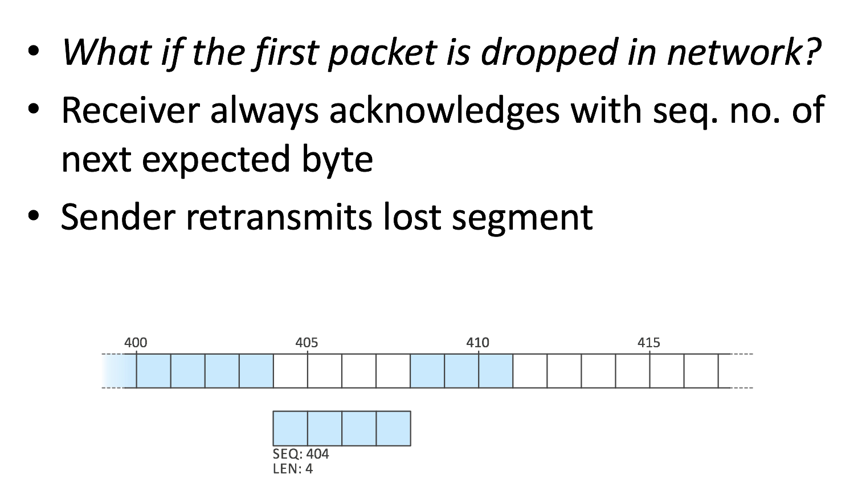
Transmission Control Protocol
Notes:
GO DISCUSS HOW A LAN PLAYS OUT AND HAS A ROUTER

Slide 49
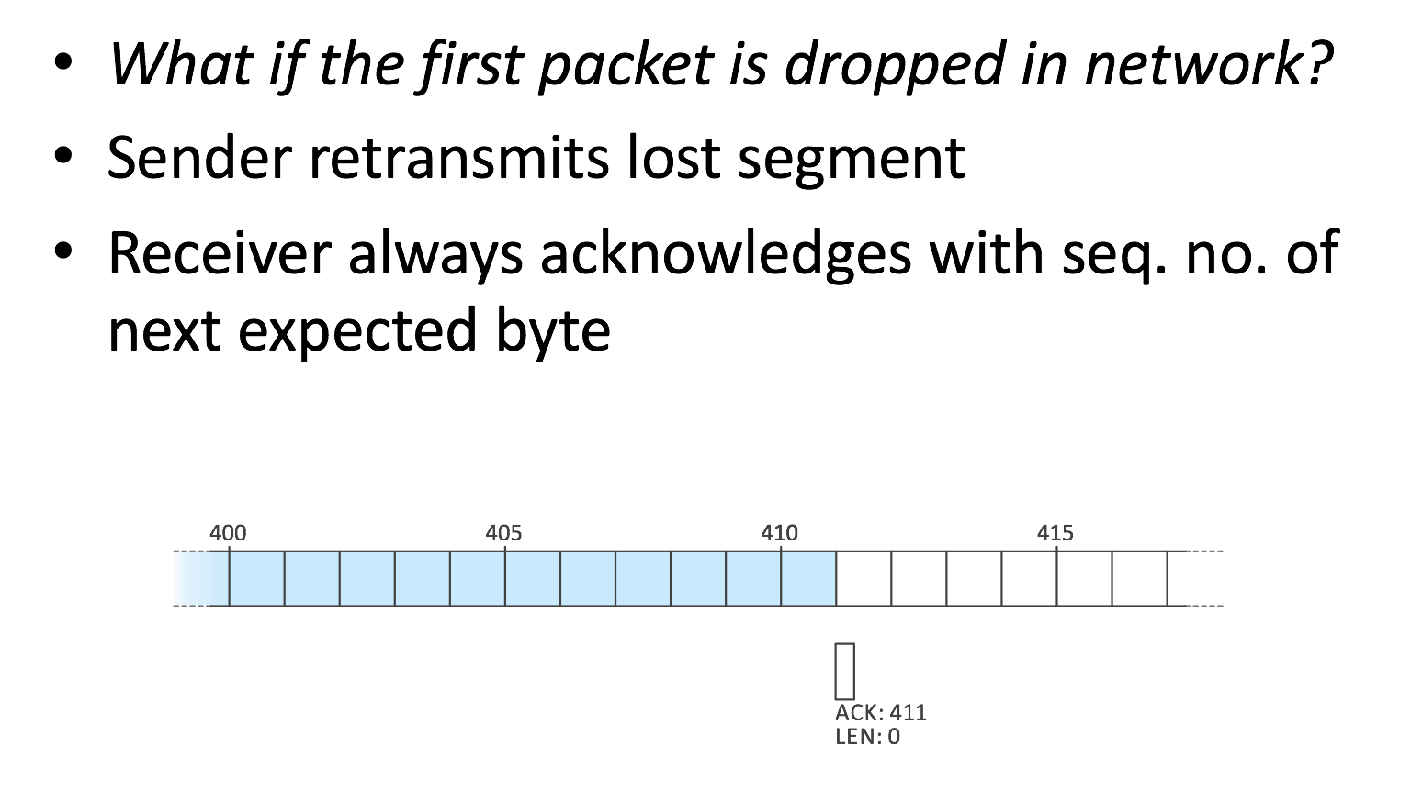
Transmission Control Protocol
Notes:
GO DISCUSS HOW A LAN PLAYS OUT AND HAS A ROUTER

Slide 50
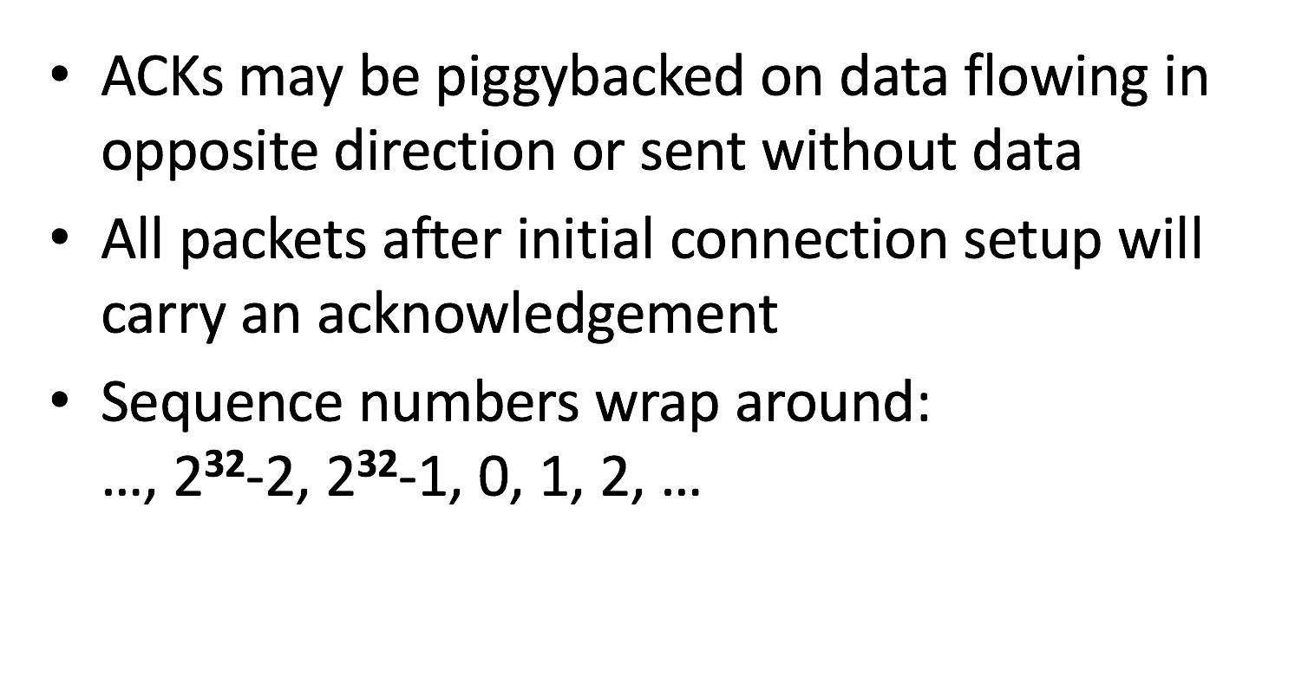
Transmission Control Protocol
Notes:
GO DISCUSS HOW A LAN PLAYS OUT AND HAS A ROUTER

Slide 51
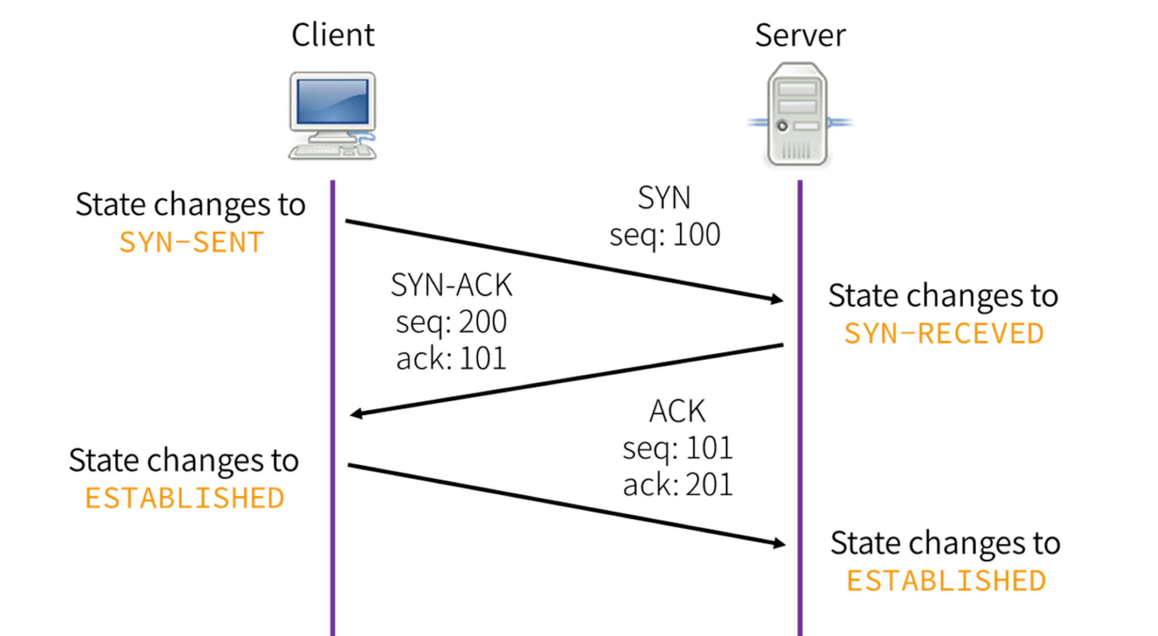
TCP Three Way Handshake
Notes:
GO DISCUSS HOW A LAN PLAYS OUT AND HAS A ROUTER

Slide 52
Ending a Connection
Sends packet with FIN flag set
Must have ACK flag with valid seqnum
Peer receiving FIN packet acknowledges receipt of FIN packet with ACK
FIN “consumes” one byte of seq. number
Eventually other side sends packet with FIN flag set — terminates session
Notes:
GO DISCUSS HOW A LAN PLAYS OUT AND HAS A ROUTER

Slide 53
TCP Connection Reset
TCP designed to handle possibility of spurious TCP packets (e.g. from previous connections)
Packets that are invalid given current state of session generate a reset
If a connection exists, it is torn down
Packet with RST flag sent in response
If a host receives a TCP packet with RST flag, it tears down the connection

Slide 54
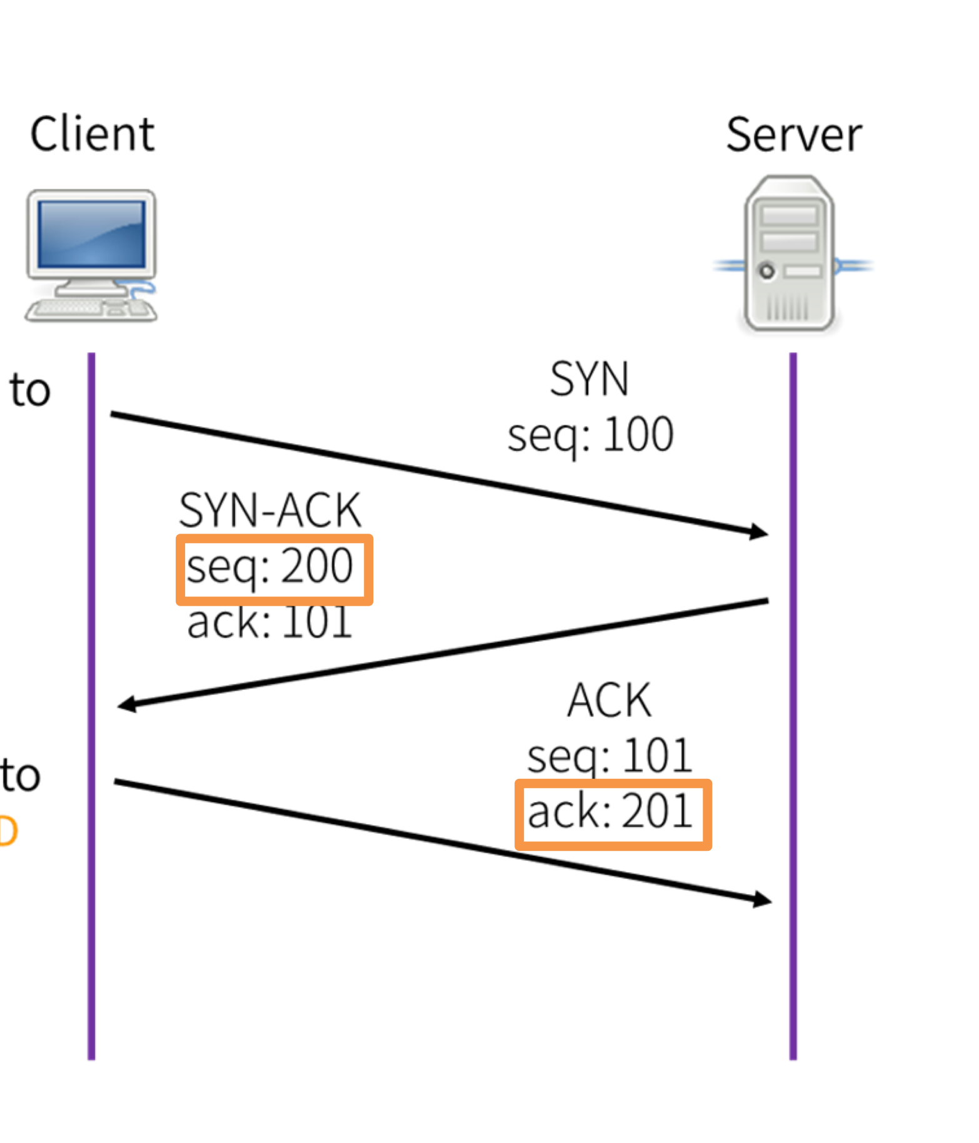
TCP Connection Spoofing
Can we impersonate another host when initiating a connection?
Off-path attacker can send initial SYN to server …
… but cannot complete three-way handshake without seeing the server’s sequence number
1 in 2³² chance to guess right if initial sequence number chosen uniformly at random
Notes:
GO DISCUSS HOW A LAN PLAYS OUT AND HAS A ROUTER

Slide 55
TCP Reset Attack
Can we reset an existing TCP connection?
Need to know port numbers (16 bits)
Initiator’s port number usually chosen random by OS
Responder’s port number may be well-known port of service
There is leeway in sequence numbers B will accept
Must be within window size (32-64K on most modern OSes)
1 in 2¹⁶⁺³²/W (where W is window size) chance to guess right
Notes:
GO DISCUSS HOW A LAN PLAYS OUT AND HAS A ROUTER

Slide 56
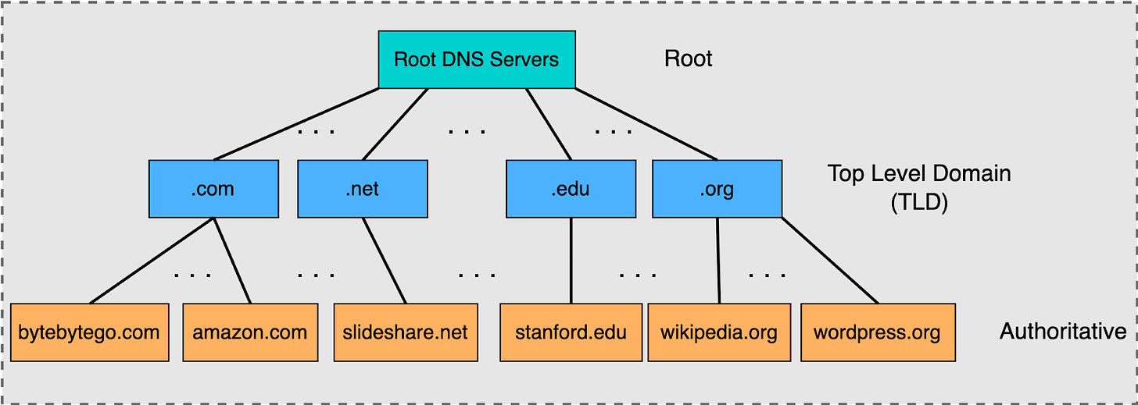
DNS — Domain Name Service
Application-layer protocols (and people) usually refer to Internet host by host name (e.g., google.com)
DNS is a delegatable, hierarchical name space
Notes:
GO DISCUSS HOW A LAN PLAYS OUT AND HAS A ROUTER

Slide 57
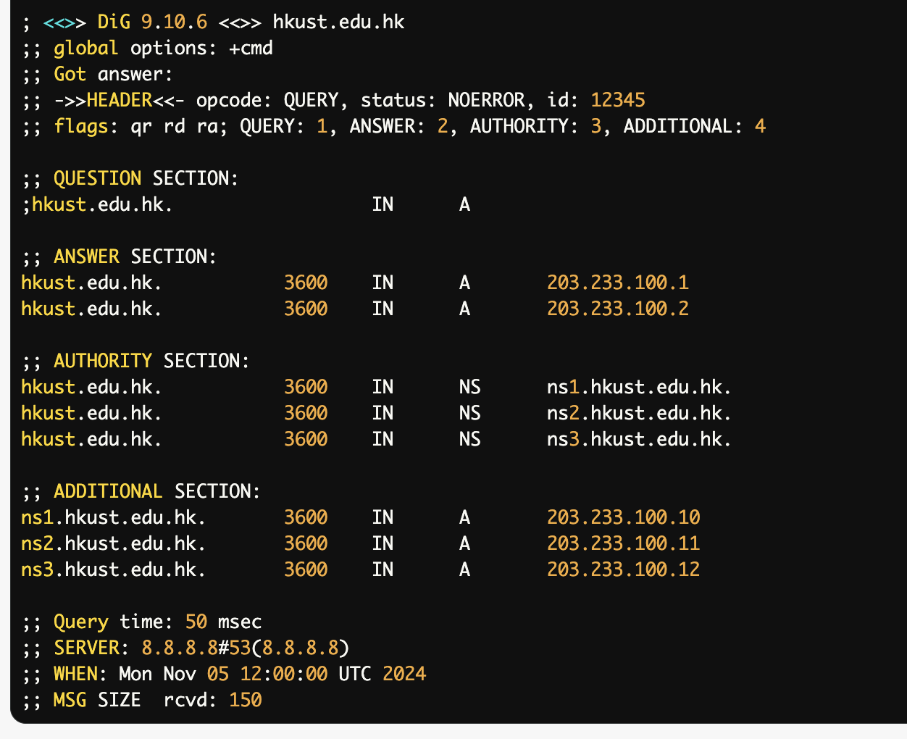
DNS Record
A DNS server has a set of records it authoritatively knows about
$ dig hkust.edu.hk
Notes:
GO DRAW OUT QUERY

Slide 58
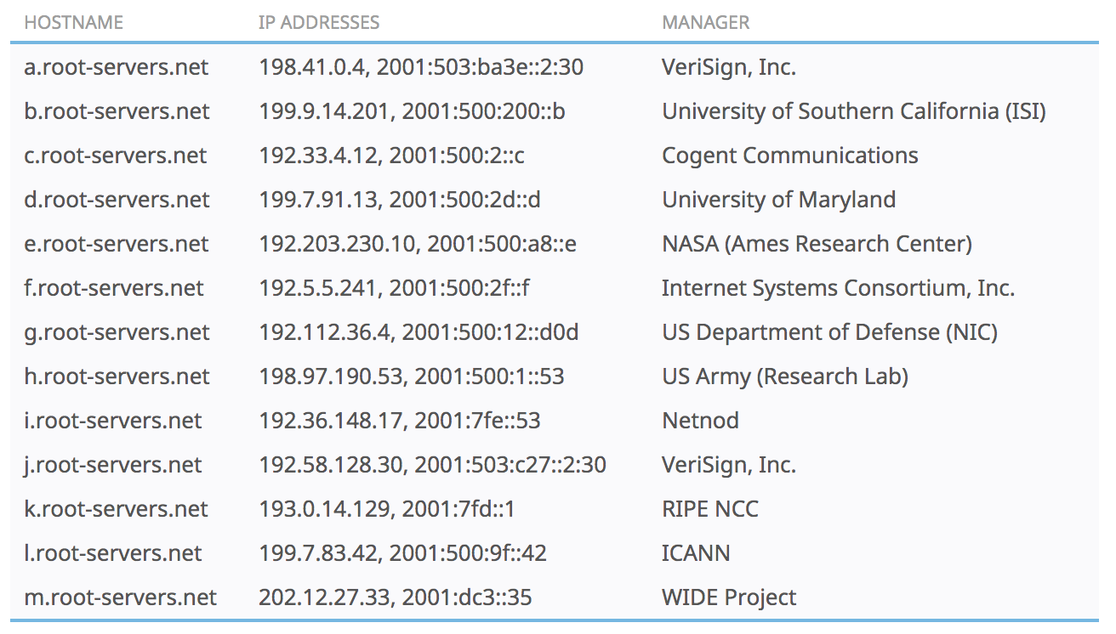
DNS Root Name Servers
In total, there are 13 main DNS root servers, each of which is named with the letters 'A' to 'M'.
Notes:
GO DISCUSS HOW A LAN PLAYS OUT AND HAS A ROUTER

Slide 59
Caching
DNS responses are cached
Quick response for repeated translations
NS records for domains also cached
DNS negative queries are cached
Save time for nonexistent sites, e.g. misspelling
Cached data periodically times out
Lifetime (TTL) of data controlled by owner of data
TTL passed with every record
Notes:
GO DISCUSS HOW A LAN PLAYS OUT AND HAS A ROUTER

Slide 60
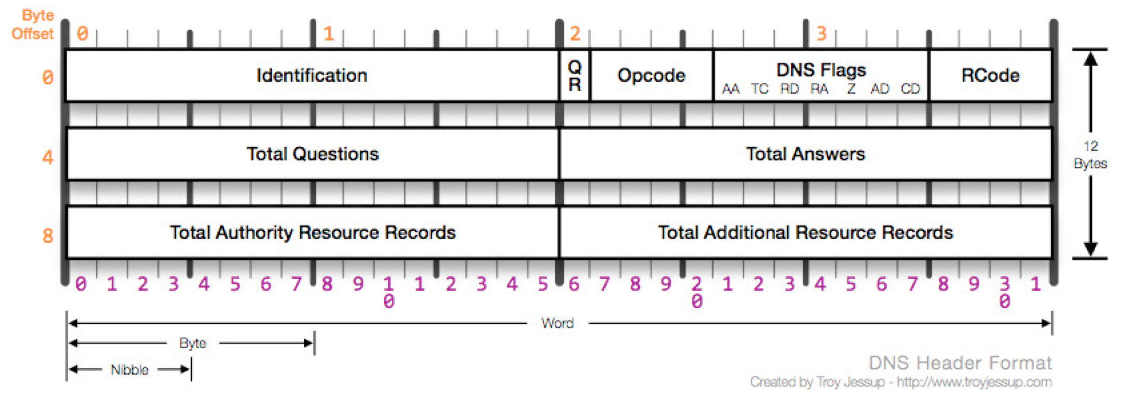
DNS Packet
DNS requests sent over UDP
Four sections: questions, answers, authority, additional records
Query ID:
16 bit random value
Links response to query
Notes:
GO DISCUSS HOW A LAN PLAYS OUT AND HAS A ROUTER

Slide 61
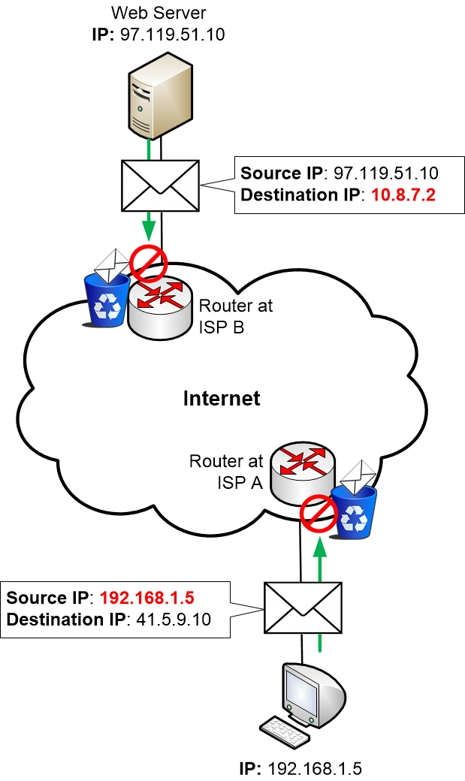
Internet Censorship Technique
Destination IP address blocking, e.g., great firewall, OpenAI/Claude blocking certain regions

Slide 62
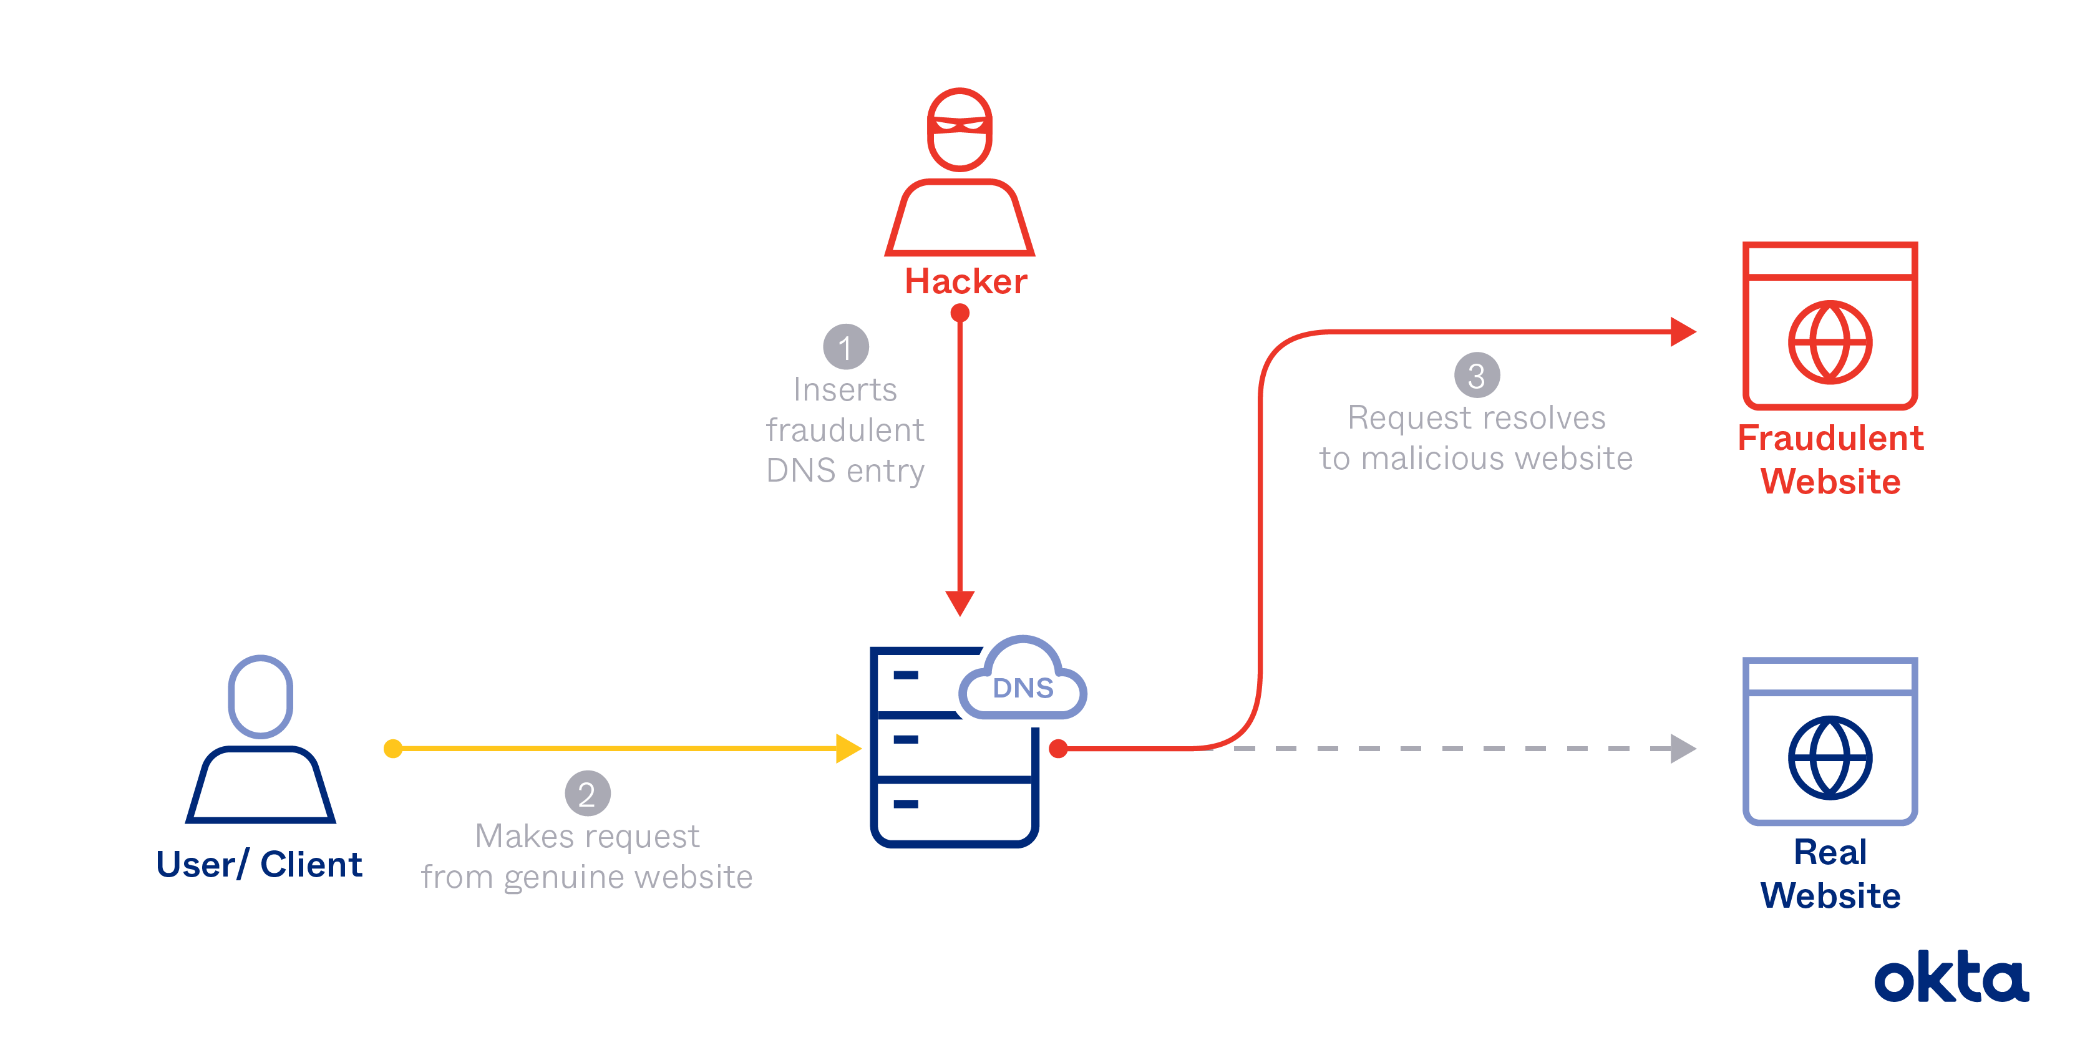
Internet Censorship Technique
DNS poisoning

Slide 63
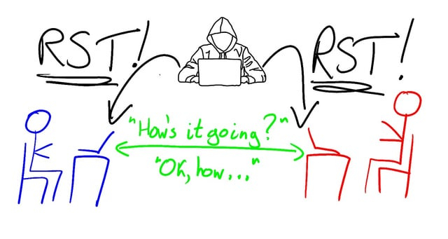
Internet Censorship Technique
TCP Reset Attack

Slide 64
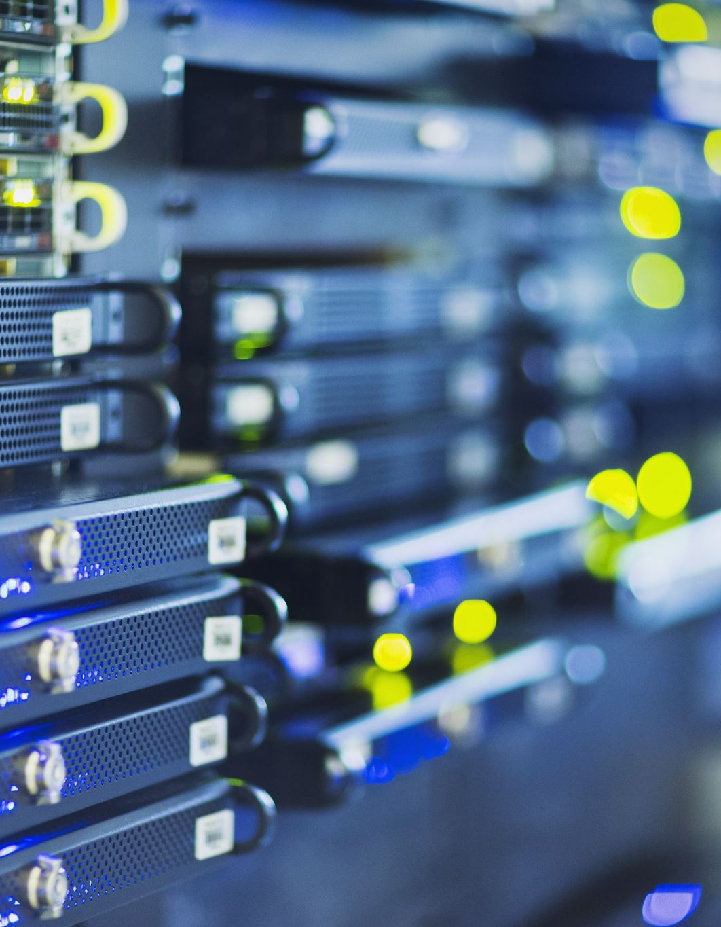
Internet Censorship Technique
Deep packet inspection
  Block packets sent over VPN
Active probing
  Block VPN server IP address
Blocking access to VPN downloads

