Slide 1
Internet Protocol Security (Contd.)
Comp4634 Cybersecurity
Notes:
Before we start any new material, I want to quickly review what we went over last time since we covered most of CS144 in about an hour.

Slide 2
L2: Ethernet
Provides connectivity between hosts on a single Local Area Network
Data is split into ~1500 byte Frames, which are addressed to a device’s
6-byte physical (MAC) address — assigned by manufacturer
Switches forward frames based on learning where different MACs are located. No guarantees that frames are not sent to other hosts!
No security (confidentiality, authentication, or integrity)

Slide 3
ARP: Address Resolution Protocol
ARP lets hosts to find each others’ MAC addresses on a local network. For example, when you need to send packets to the upstream router to reach Internet hosts
Client: Broadcast (all MACs): Which MAC address has IP 192.168.1.1?
Response: I have this IP address (sent from correct MAC)
No built-in security. Attacker can impersonate a host by faking its identity and responding to ARP requests or sending gratuitous ARP announcements

Slide 4
IP: Internet Protocol
Provides routing between hosts on the Internet. Unreliable. Best Effort.
  - Packets can be dropped, corrupted, repeated, reordered
Routers simply route IP packets based on their destination address.
  - Must be simple in order to be fast — insane number packets FWD'ed
No inherent security. Packets have a checksum, but it’s non-cryptographic. Attackers can change any packet.
Source address is set by sender—can be faked by an attacker

Slide 5
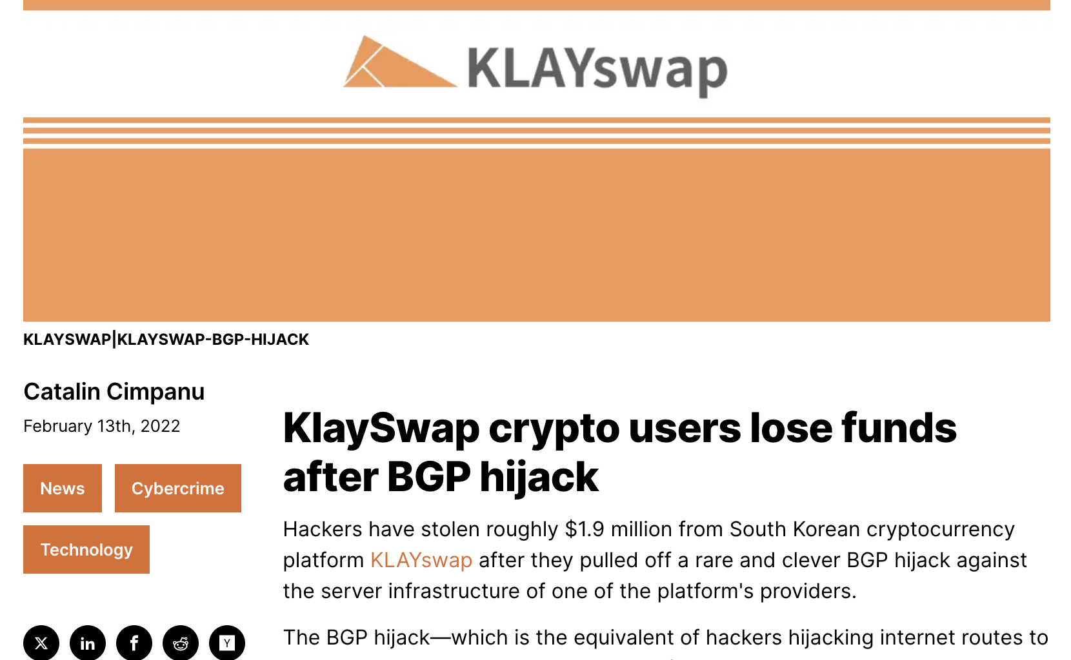
BGP (Border Gateway Protocol)
Internet Service Providers (ISPs) announce their presence on the Internet via BGP. Each router maintains list of routes to get to different announced prefixes
No authentication—possible to announce someone else’s network
Commonly occurs (often due to operator error but also due to attacks)

Slide 6
DNS Security
Users/hosts trust the host-address mapping provided by DNS
Used as basis for many security policies:
Browser same origin policy, URL address bar
Interception of requests or compromise of DNS servers can result in incorrect or malicious responses
Notes:
GO DISCUSS HOW A LAN PLAYS OUT AND HAS A ROUTER

Slide 7
Caching
DNS responses are cached
Quick response for repeated translations
NS records for domains also cached
DNS negative queries are cached
Save time for nonexistent sites, e.g. misspelling
Cached data periodically times out
Lifetime (TTL) of data controlled by owner of data
TTL passed with every record
Notes:
GO DISCUSS HOW A LAN PLAYS OUT AND HAS A ROUTER

Slide 8
DNS Cache Poisoning
DNS query results include Additional Records section
– Provide records for anticipated next resolution step
Early servers accepted and cached all additional records provided in query response
Notes:
Go point out on board why this is…

Slide 9
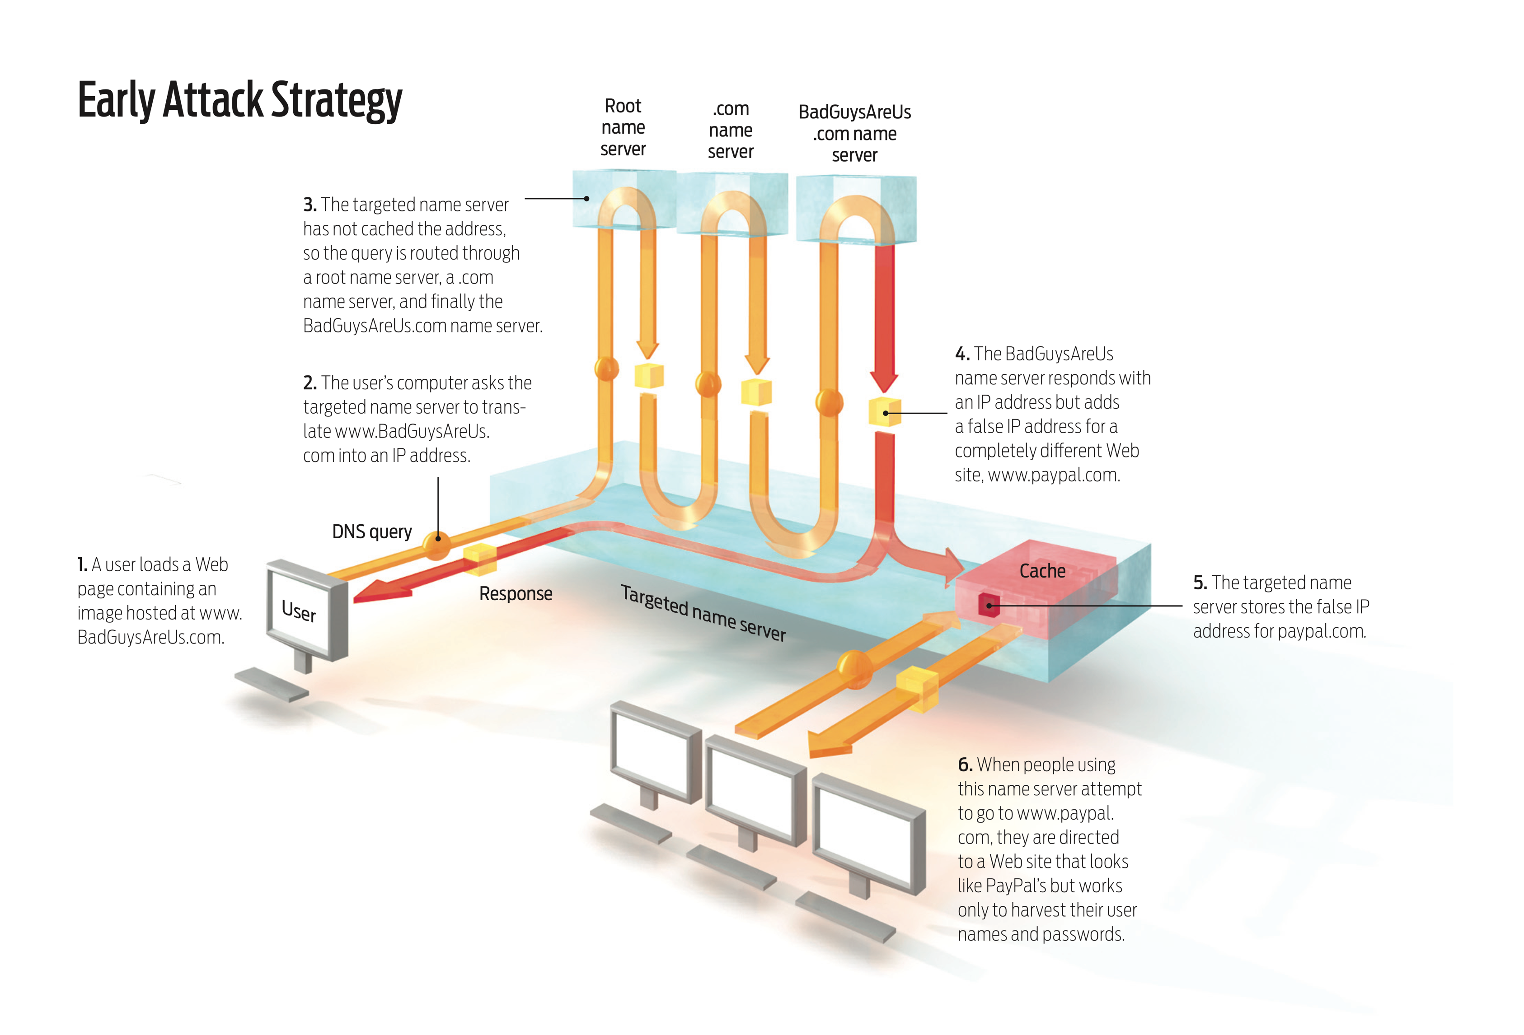
Notes:
GO DISCUSS HOW A LAN PLAYS OUT AND HAS A ROUTER

Slide 10
DNS Spoofing
Scenario: DNS client issues query to server
Attacker would like to inject a fake reply
Attacker does not see query or real response
How does client authenticate response?
Notes:
GO DISCUSS HOW A LAN PLAYS OUT AND HAS A ROUTER

Slide 11
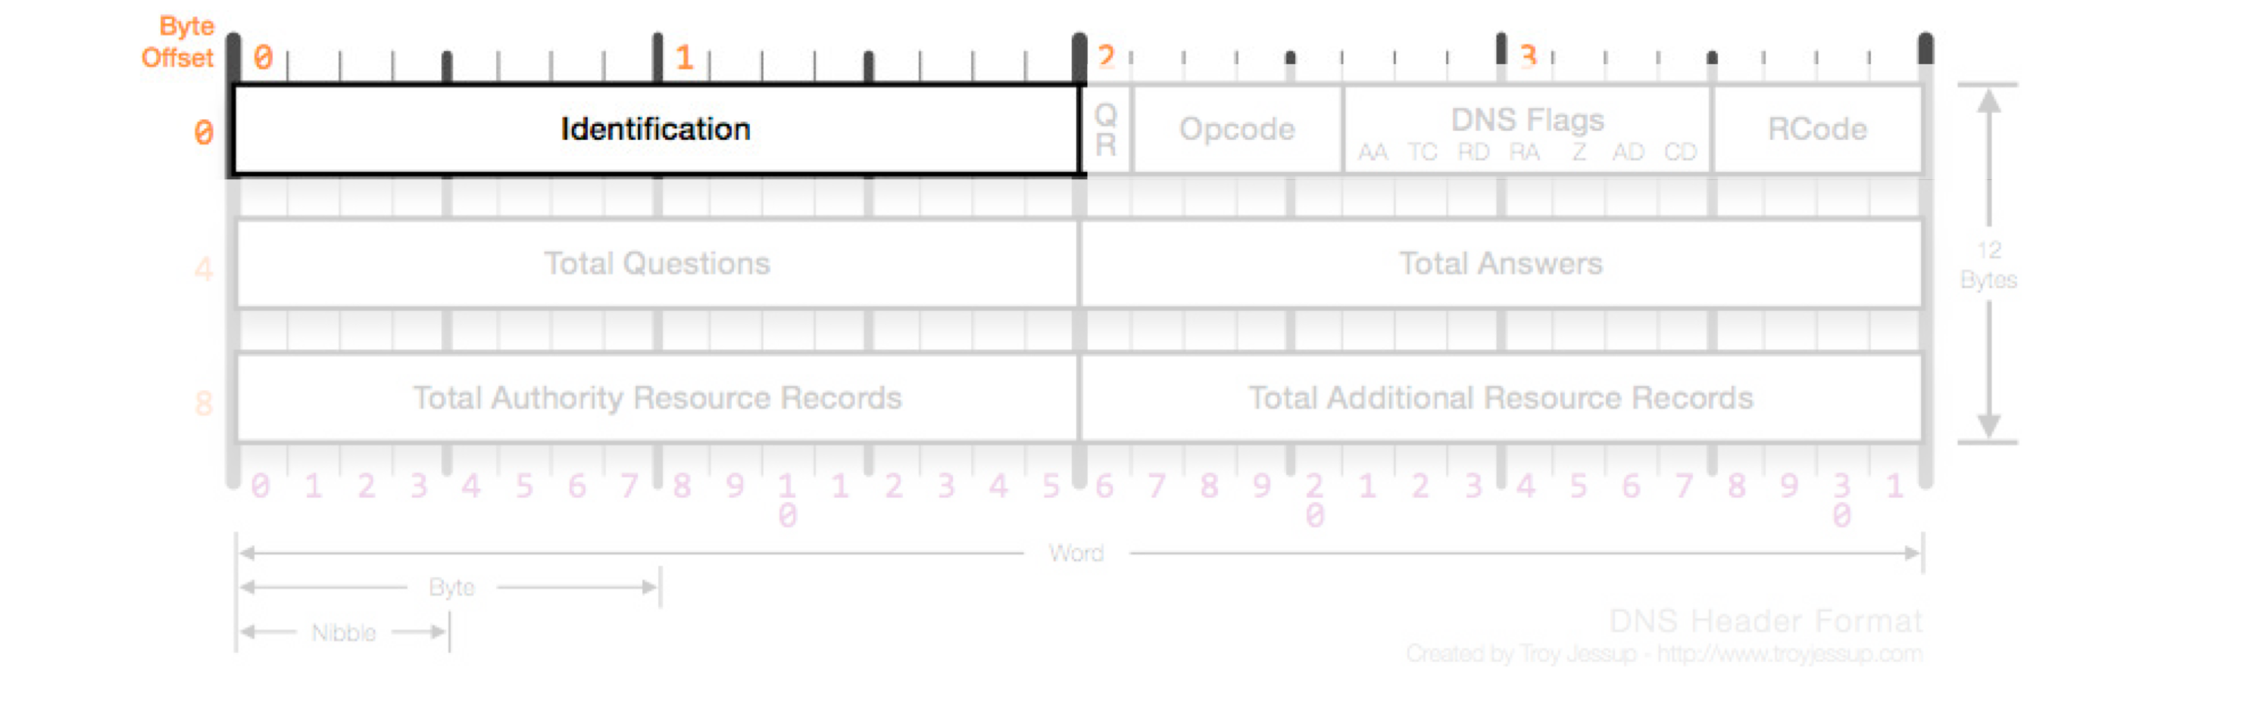
DNS Spoofing
How does client authenticate response?
UDP port numbers must match
Destination port usually port 53 by convention
16-bit query ID must match
Notes:
GO DISCUSS HOW A LAN PLAYS OUT AND HAS A ROUTER

Slide 12
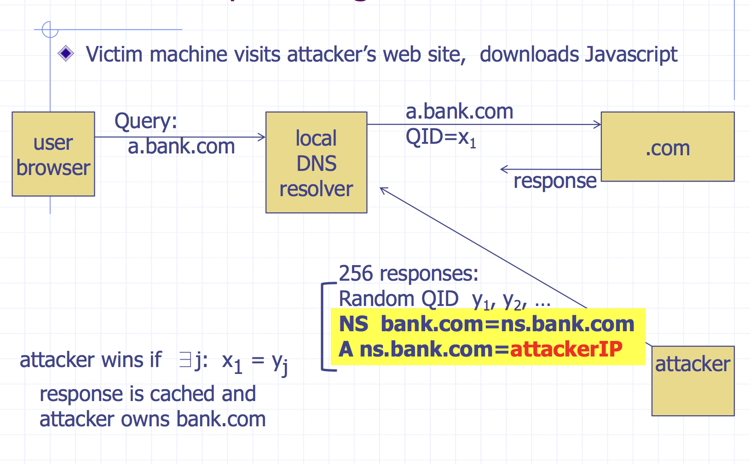
Kaminsky Attack
Notes:
That's the problem, if you're choosing at random and an attacker is choosing at random. If you are using two-to-the-sixteen (65536) samples, and an attacker is sending samples at the rate of the square root of two to the sixteen, which is two to the eight (256), the attacker has a 50 percent chance of success."

Slide 13
Try Again!
Question: what is the success probability of this attack?

Slide 14
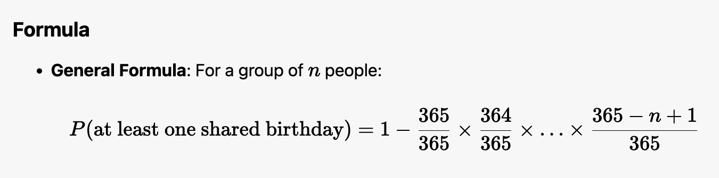
Birthday Attack
Problem definition:
In a group of N people, what is the probability that two people share the same birthday？
Question: how to compute this?
Say we have 22 people in our class, what is the probability?
47%
For n items in a space of n² possibilities, the collision probability is approximately 1/2.

Slide 15
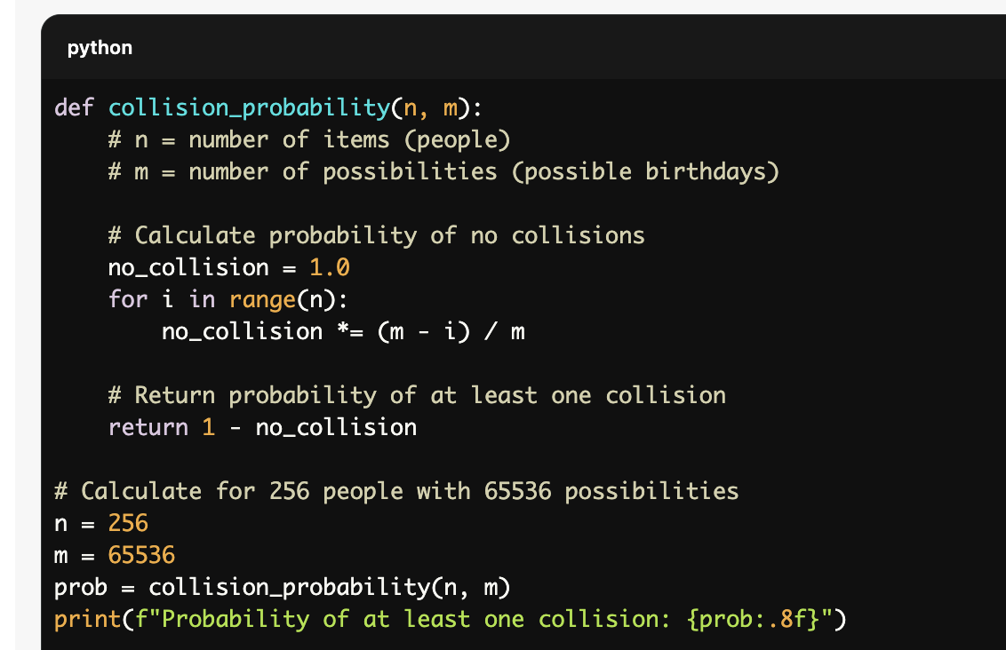
Birthday Attack
How to compute the success probability for Kaminsky attack？

Slide 16
Defenses
Question: what is the minimum number of attempts for a 50% attack?
Increase QueryID space. But how? Don’t want to change packet.
Randomize src port, additional 11 bits of entropy
- Attack now takes several hours
Notes:
GO DISCUSS HOW A LAN PLAYS OUT AND HAS A ROUTER

Slide 17
DNSSEC
Adds authentication and integrity to DNS responses
Authoritative DNS servers sign DNS responses using cryptographic key
Clients can verify that a response is legitimate by checking signature through PKI similar to HTTPS
Most people don’t use DNSSEC and never will. Use TLS instead.
Notes:
GO DISCUSS HOW A LAN PLAYS OUT AND HAS A ROUTER

Slide 18
Network Security Takeaway
Assume the network is out to get you.
If you want any guarantee of any security, use TLS.
Notes:
GO DISCUSS HOW A LAN PLAYS OUT AND HAS A ROUTER

Slide 19
Denial of Service Attacks
Goal: take large site offline by overwhelming it with network traffic such that they can’t process real requests
How: find mechanism where attacker doesn’t have to spend a lot of effort, but requests are difficult/expensive for victim to process
Notes:
GO DISCUSS HOW A LAN PLAYS OUT AND HAS A ROUTER

Slide 20
Types of Attacks
DoS Bug: design flaw that allows one machine to disrupt a service. Generally, a protocol asymmetry, e.g., easy to send request, difficult to create response. Or requires server state.
DoS Flood: control a large number of requests from a botnet of machines you control
Notes:
GO DISCUSS HOW A LAN PLAYS OUT AND HAS A ROUTER

Slide 21
Possible at Every Layer
Link Layer: send too much traffic for switches/routers to handle
TCP/UDP: require servers to maintain large number of concurrent connections or state
Application Layer: require servers to perform expensive queries or cryptographic operations
Notes:
GO DISCUSS HOW A LAN PLAYS OUT AND HAS A ROUTER

Slide 22
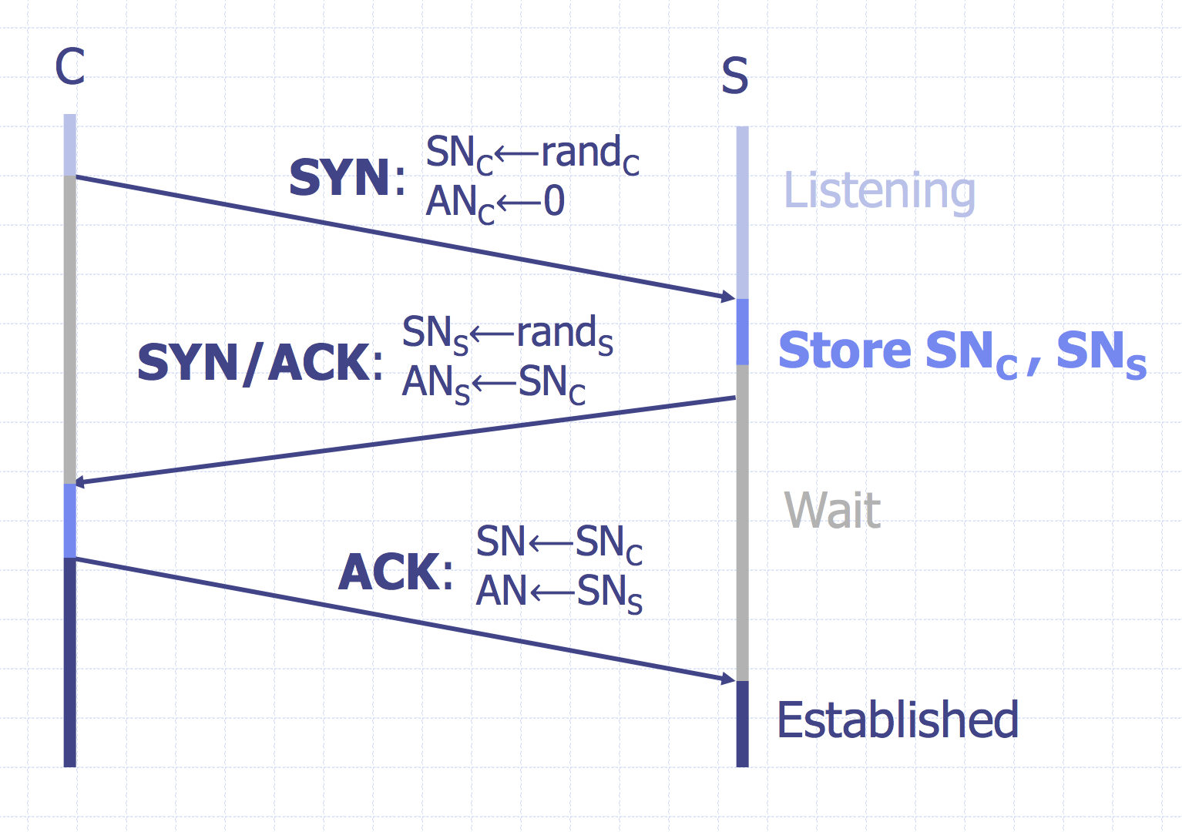
TCP Handshake
Question: what happens if there are many syn request packets?
Notes:
GO DISCUSS HOW A LAN PLAYS OUT AND HAS A ROUTER

Slide 23
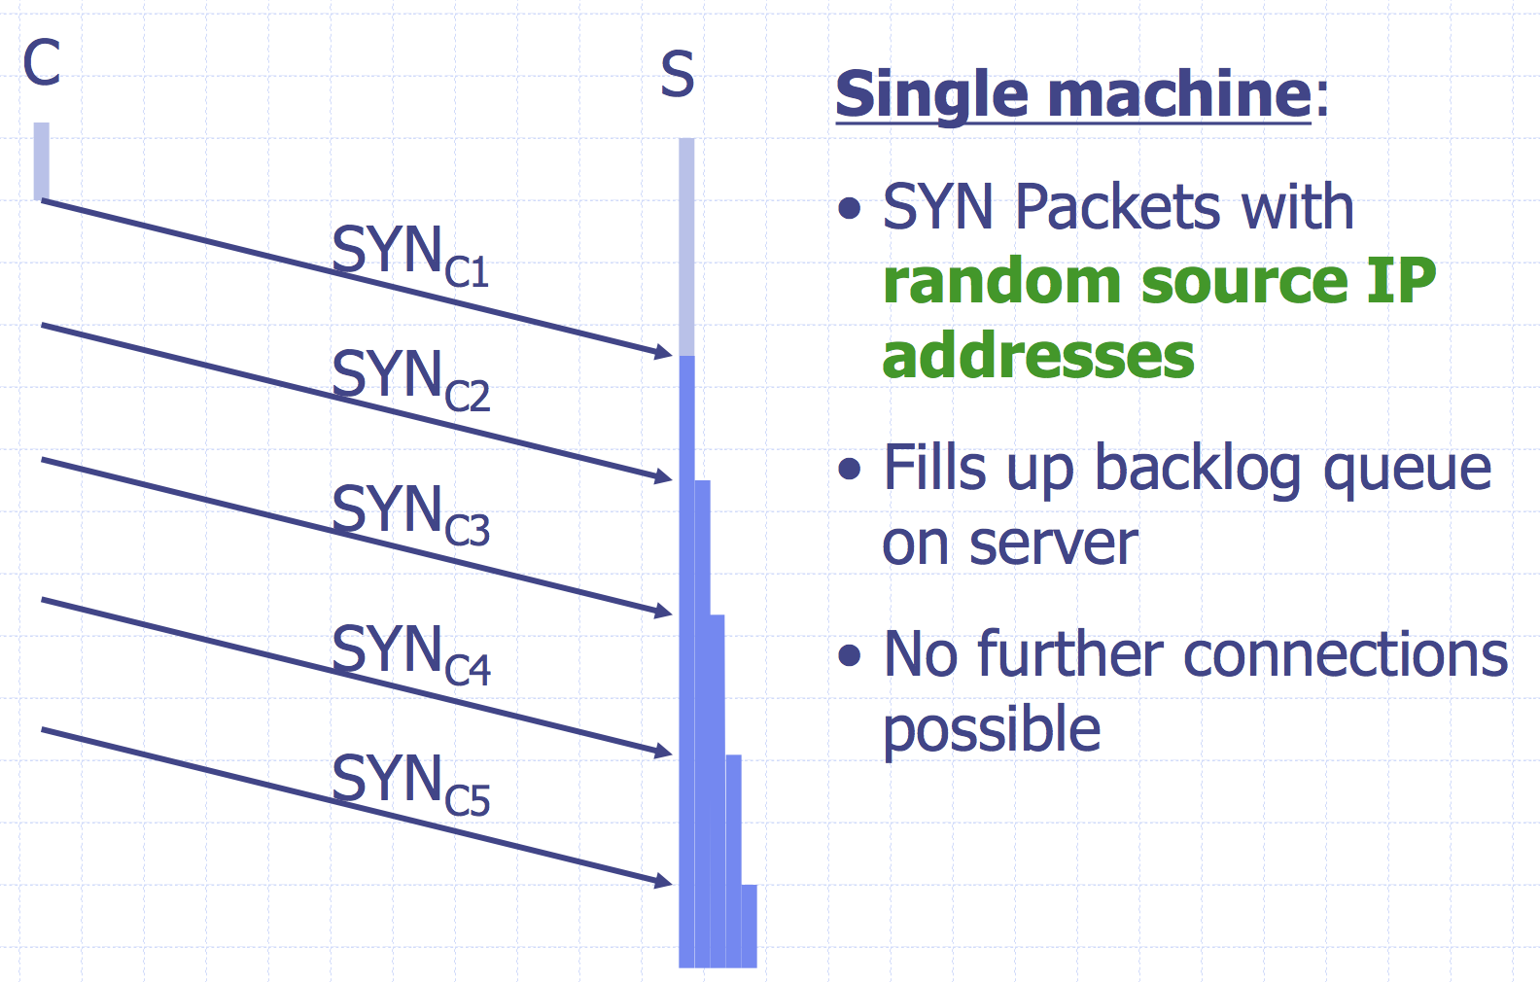
SYN Floods
Notes:
GO DISCUSS HOW A LAN PLAYS OUT AND HAS A ROUTER

Slide 24
Core Problem
Problem: server commits resources (memory) before confirming identify of client (when client responds)
Bad Solution:
- Increase backlog queue size
- Decrease timeout
Real Solution: Avoid state until 3-way handshake completes
Notes:
GO DISCUSS HOW A LAN PLAYS OUT AND HAS A ROUTER

Slide 25
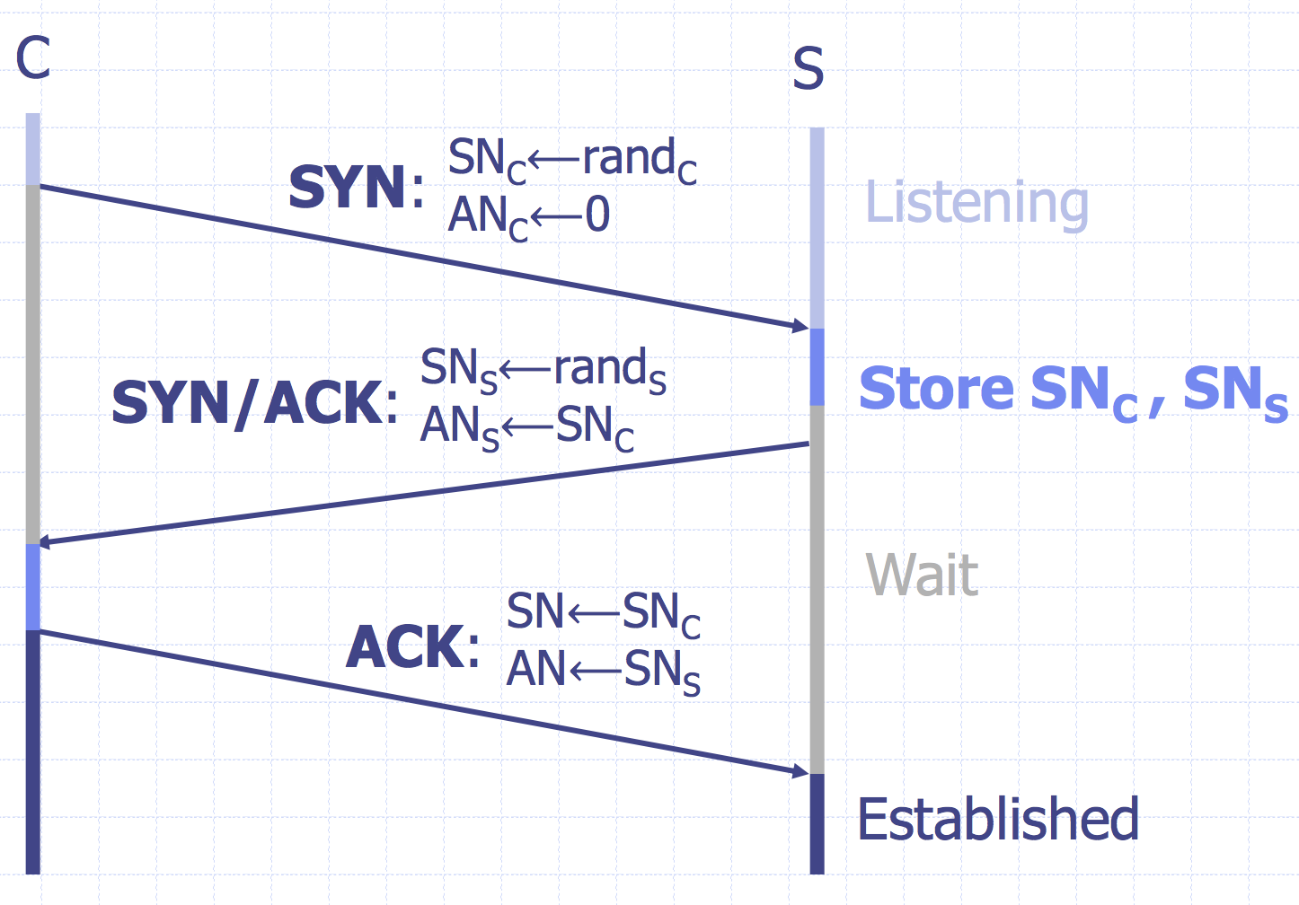
SYN Cookies
Idea: Instead of storing SNc and SNs…
send a cookie back to the client.
L = MACkey (SAddr, SPort, DAddr, DPort, SNC, T)
key: picked at random during boot
T = 5-bit counter incremented every 64 secs.
SNs = ( T || mss || L )
Honest client sends ACK (AN=SNs , SN=SNC+1)
Server allocates space for socket only if valid SNs
Server does not save state
(loses TCP options)
Notes:
GO DISCUSS HOW A LAN PLAYS OUT AND HAS A ROUTER

Slide 26
DoS: Amplification Attacks
Problem: attacker only controls a small number of bots
Why?
a small volume of network traffic in DoS
One query => One response
How to launch DoS with a small number of bots?
Image: Cloudflare

Slide 27
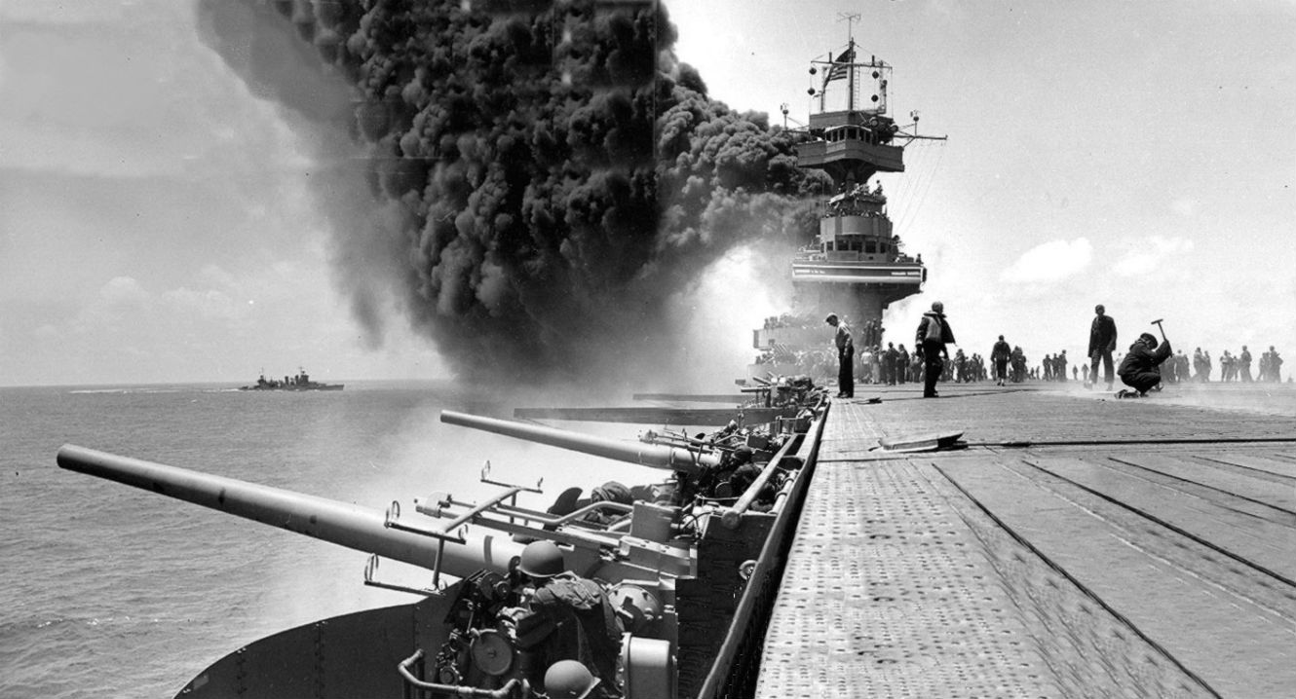
Loss Exchange Ratio
Ratio of loss sustained by the two conflicting sides
Battle of Midway
WWII, US vs. Japan
US lost 1 fleet carrier
Japan lost 4 fleet carriers
1 vs. 4

Slide 28
DoS: Amplification Attacks
Problem: attacker only controls a small number of bots
Why?
a small volume of network traffic in DoS
One query => One response
How to launch DoS with a small number of bots?
High exchange ratio
Image: Cloudflare

Slide 29
DoS: Amplification Attacks
Problem: attacker only controls a small number of bots
Why?
a small volume of network traffic in DoS
One small query => One large response
How to launch DoS with a small number of bots?
High exchange ratio
Image: Cloudflare

Slide 30
Common UDP Amplifiers
Open DNS Resolver: publicly available DNS servers
Google: 8.8.8.8 or 8.8.4.4
OpenDNS: 208.67.222.222 and 208.67.220.220
DNS ANY query: returns all records server has about a domain
NTP(network time protocol) MONLIST query: returns list of last 600 clients who asked for the time recently
Only works if you can receive a big response by sending a single packet — otherwise spoofing doesn’t help you.
Notes:
GO DISCUSS HOW A LAN PLAYS OUT AND HAS A ROUTER

Slide 31
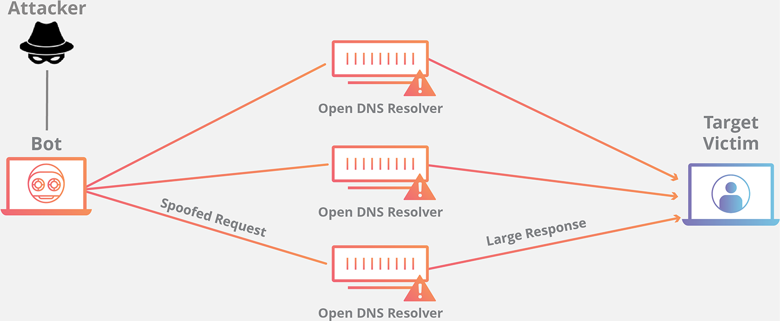
DoS: Amplification Attacks
MX mx1.example.com.
MX mx1.example.com.
MX mx1.example.com.
MX mx1.example.com.
MX mx1.example.com.
MX mx1.example.com.
MX mx1.example.com.
MX mx1.example.com.
A 1.2.3.8
A 1.2.3.9
A 1.2.3.4
A 1.2.3.5
A 1.2.3.6
A 1.2.3.7
A 1.2.3.8
A 1.2.3.9
DNS ANY example.com.
60-70x Increase in Size
Image: Cloudflare

Slide 32
Amplification Attacks
2013: DDoS attack generated 300 Gbps (DNS)
- 31,000 misconfigured open resolvers, each at 10 Mbps
- Source: 3 networks that allowed IP spoofing
2014: 400 Gbps DDoS attacked used 4500 NTP servers
How to ensure all traffic is sent to victim instead of attacker ?
What is the throughput for NTP server?
Notes:
GO DISCUSS HOW A LAN PLAYS OUT AND HAS A ROUTER

Slide 33
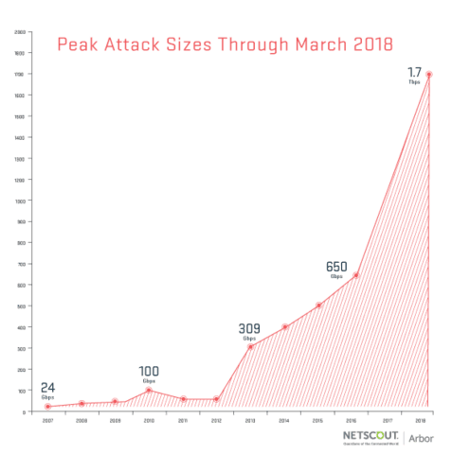
Memcache
Memcache: retrieve large record
The server responds by firing back as much as 50,000 times the data it received.
Exchange ratio:
1vs. 50,000
Exchange ratio:
1vs. 50,000
Notes:
These attacks were different in two ways. The first difference was just the sheer magnitude of the size of attack. The attack against Brian was the largest DDoS attack that Akamai had ever seen—620 Gbps—almost double the prior 363 Gbps.

Slide 34


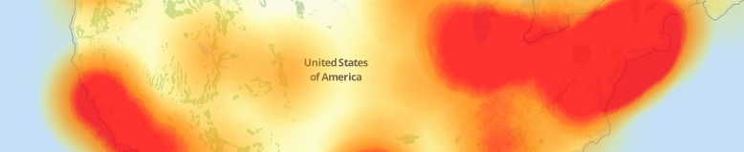









October 21, 2016
Notes:
Sometimes also just organic traffic

Slide 35
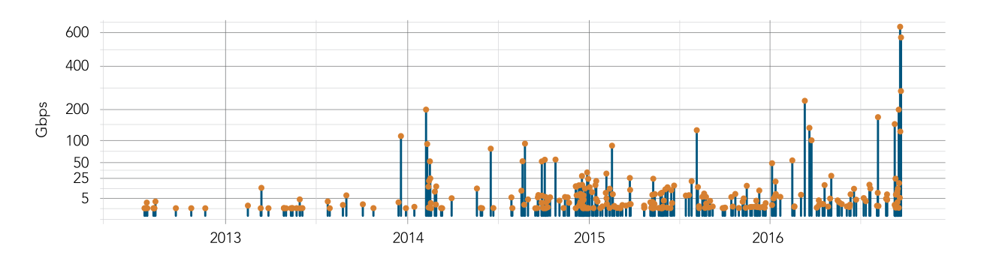
Krebs Graph
“The magnitude of the attacks seen during the final week were significantly larger than the majority of attacks Akamai sees on a regular basis. […] In fact, while the attack on September 20 was the largest attack ever mitigated by Akamai, the attack on September 22 would have qualified for the record at any other time, peaking at 555 Gbps.”
Source: 2017 Akamai State of the Internet
Notes:
These attacks were different in two ways. The first difference was just the sheer magnitude of the size of attack. The attack against Brian was the largest DDoS attack that Akamai had ever seen—620 Gbps—almost double the prior 363 Gbps.

Slide 36
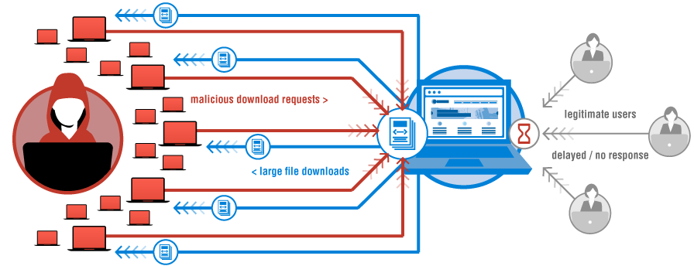

“We are still working on analyzing the data but the estimate at the time of this report is up to 100,000 malicious endpoints. […] There have been some reports of a magnitude in the 1.2 Tbps range; at this time we are unable to verify that claim.”
Image: Verisign
Notes:
This outage was due to a large DDoS attack that targeted a large DNS provider — Dyn. However, while Dyn was one of hte

Slide 37
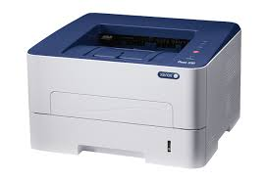
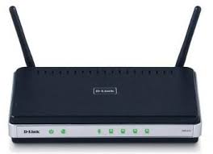
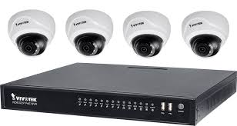

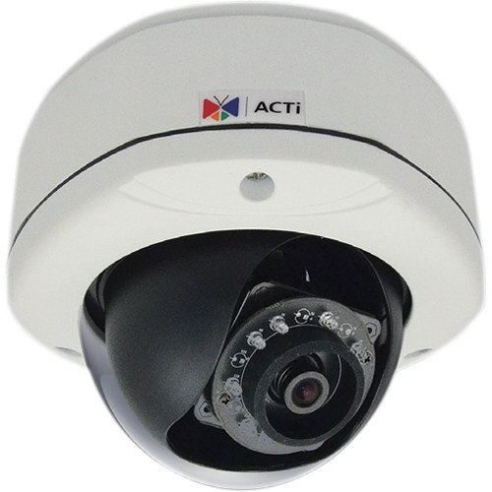
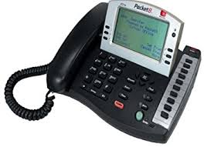
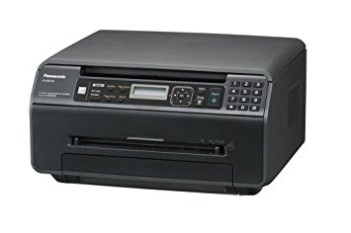

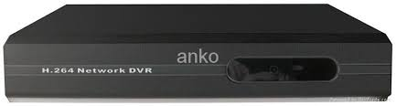
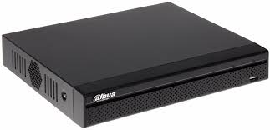
A Botnet of IoT Devices
GRE
HTTP
TLS
Bot Master
OVH/Dyn/Krebs
≈ 200K Hosts
200K IoT devices
Not Amplification.
Flood with SYN, ACK, UDP, and GRE packets

Slide 38
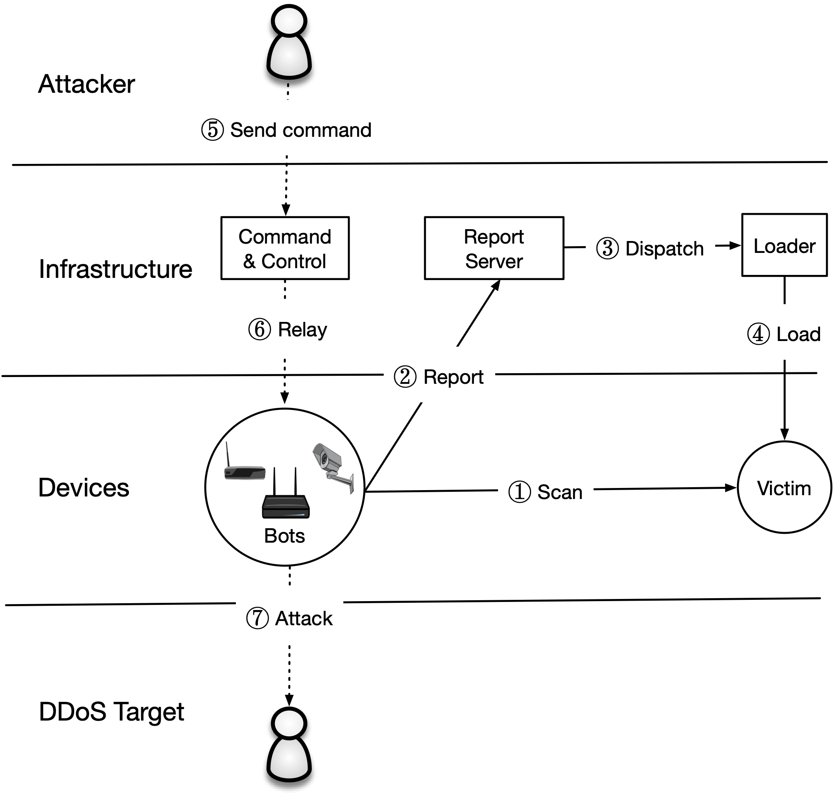
The Mirai Malware
Later, the bot master will issue commands to pause scanning and to start an attack
Attack Command:
  Action (e.g., START, STOP)
  Target IP(s)
  Attack Type (e.g., GRE, DNS, TCP)
  Attack Duration

Slide 39
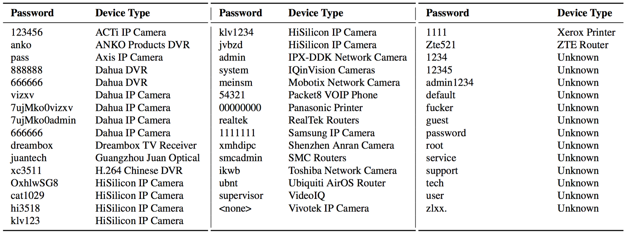
Password Guessing
Notes:
While most folks in the United States weren’t directly affected until the Dyn outage, the attack on Dyn was the third of four very large and somewhat unique DDoS attacks in September and October of 2016.
The first was on September 18 and attacked OVH…

Slide 40
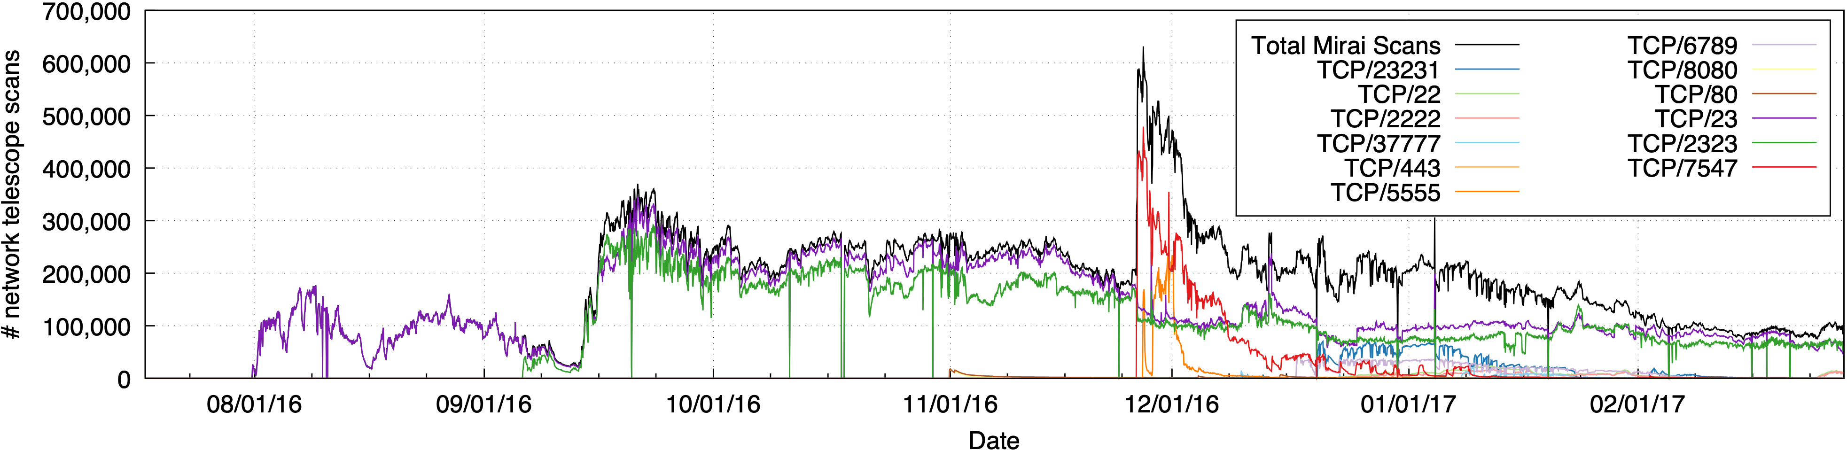
Mirai Population
~600K devices compromised
Notes:
These attacks were different in two ways. The first difference was just the sheer magnitude of the size of attack. The attack against Brian was the largest DDoS attack that Akamai had ever seen—620 Gbps—almost double the prior 363 Gbps.

Slide 41
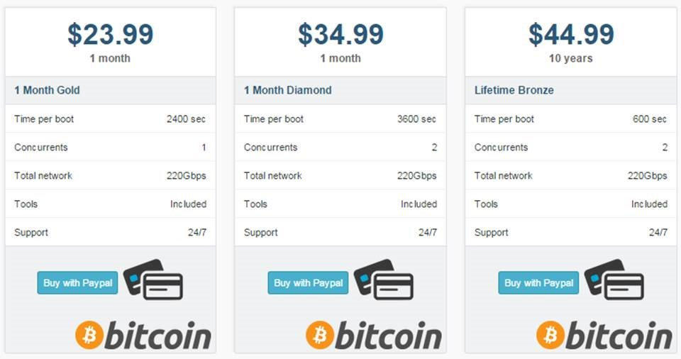
Booter Services
Notes:
GO DISCUSS HOW A LAN PLAYS OUT AND HAS A ROUTER

Slide 42
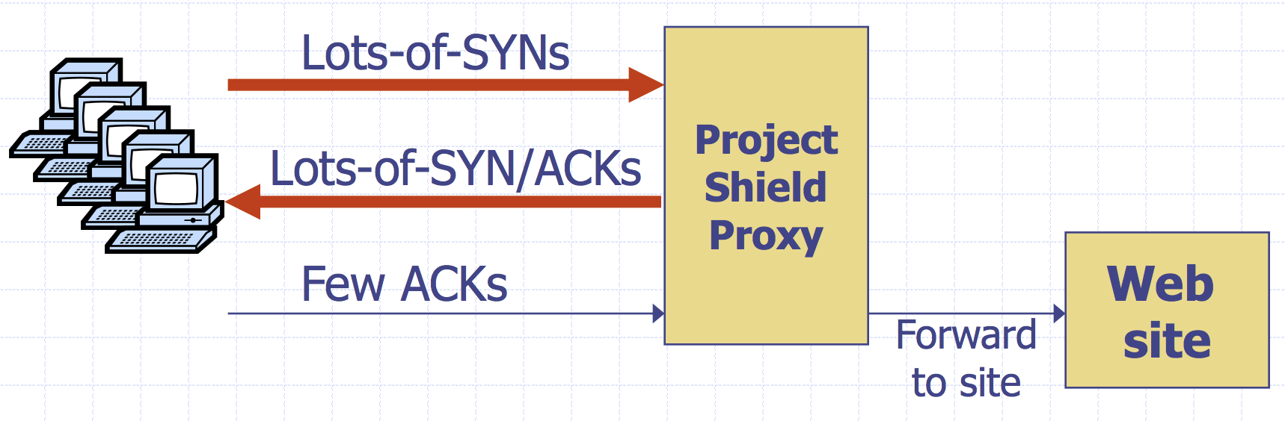
Google Project Shield
DDoS Attacks are often used to censor content. In the case of Mirai, Brian Kreb’s blog was under attack.
Google Project shield uses Google bandwidth to shield vulnerable websites (e.g., news, blogs, human rights orgs)
Notes:
GO DISCUSS HOW A LAN PLAYS OUT AND HAS A ROUTER

Slide 43
Moving Up Stack: GET Floods
Command bot army to:
* Complete real TCP connection
* Complete TLS Handshake
* GET large image or other content
Will bypass flood protections…. but attacker can no longer use random source IPs
Victim site can block or rate limit bots
Why?
Notes:
GO DISCUSS HOW A LAN PLAYS OUT AND HAS A ROUTER

Slide 44
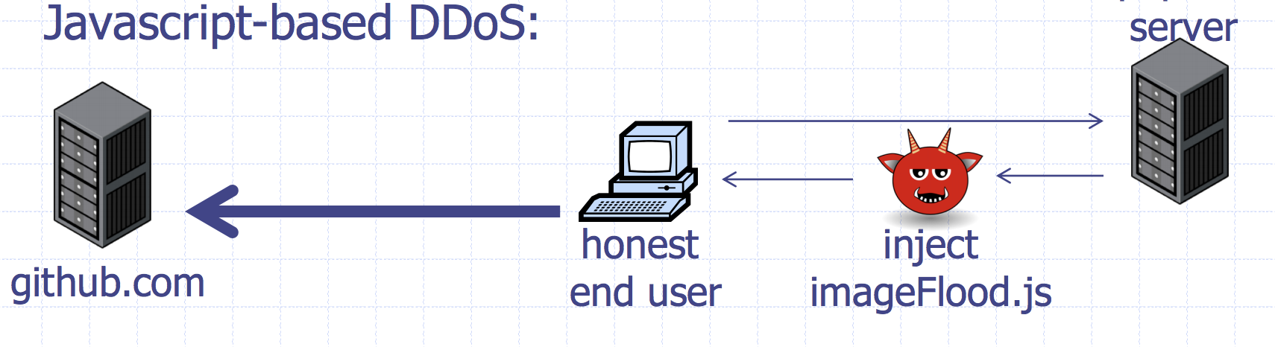
Github Attacks
1.35 Tbps attack against Github caused by javascript injected into HTTP web requests
Notes:
GO DISCUSS HOW A LAN PLAYS OUT AND HAS A ROUTER

Slide 45
Client Puzzles
Idea: What if we force every client to do moderate amount of work for every connection they make?
Example:
1) Server Sends: C
2) Client: find X s.t. LSBn(SHA-1(C||X)) = 0^{n}
Assumption:
Puzzle takes 2^{n} for the client to compute (0.3 s on 1Ghz core)
Solution is trivial for server to check (single SHA-1)
Increase cost for attacker side
Notes:
GO DISCUSS HOW A LAN PLAYS OUT AND HAS A ROUTER

Slide 46
Client Puzzles
Not frequently used in the real world
Benefits:
* Can change n based on amount of attack traffic
Limitations:
* Requires changes to both protocols, clients, and servers
* Hurts low power legitimate clients during attack (e.g., phones)
Notes:
GO DISCUSS HOW A LAN PLAYS OUT AND HAS A ROUTER

