Slide 1
Adversarial Examples and Adversarial Training
Some slides borrowed from Ian Goodfellow

Slide 2
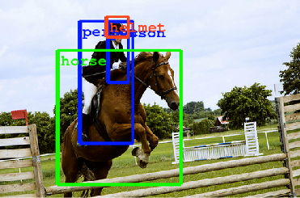
Since 2013, deep neural networks have matched human performance at...
...recognizing objects and faces….
(Szegedy et al, 2014)
(Taigmen et al, 2013)
...solving CAPTCHAS and reading addresses...
(Goodfellow et al, 2013)
(Goodfellow et al, 2013)
and other tasks...

Slide 3
Overview
What are adversarial examples?
Why do they happen?
How can they be used to compromise machine learning systems?
What are the defenses?
How to use adversarial examples to improve machine learning, even when there is no adversary

Slide 4
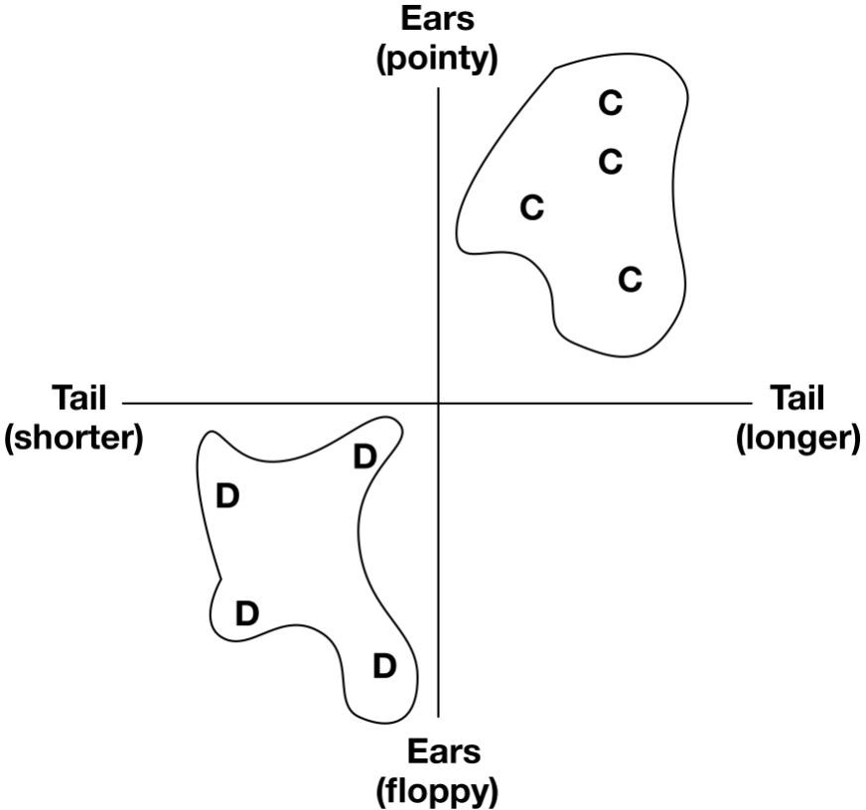
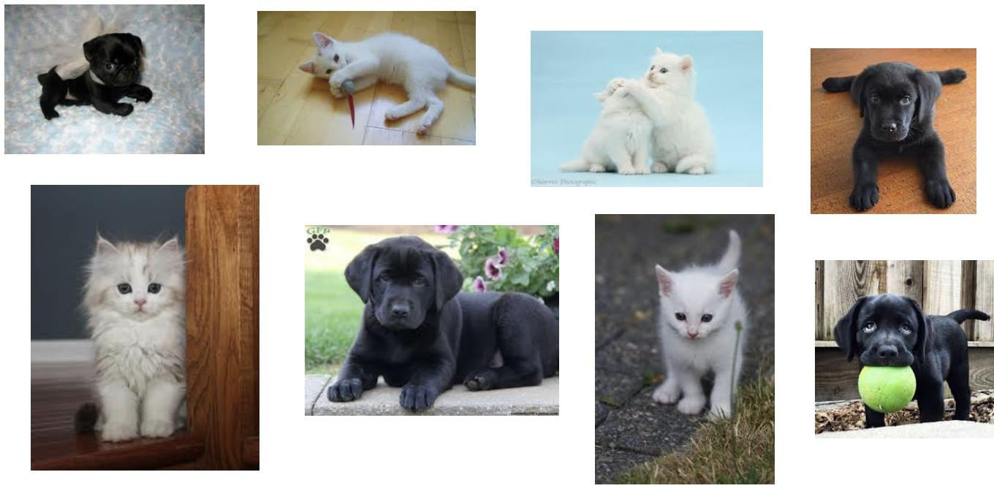
Machine learning is not magic (training time)
Training data
3

Slide 5
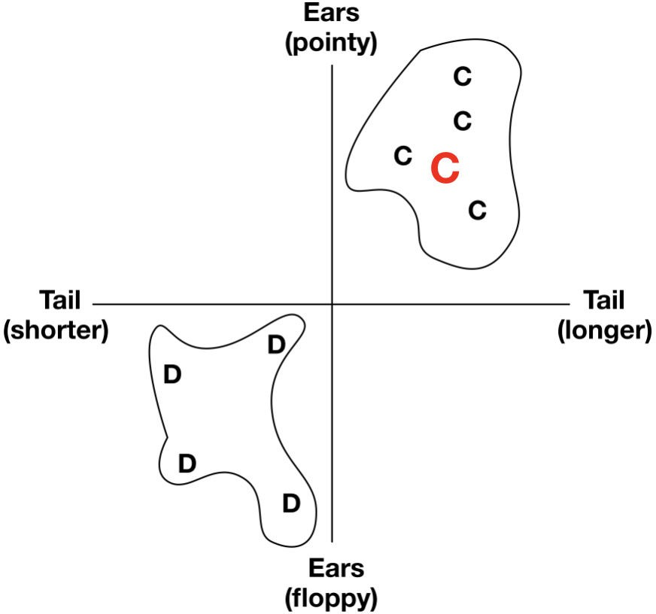
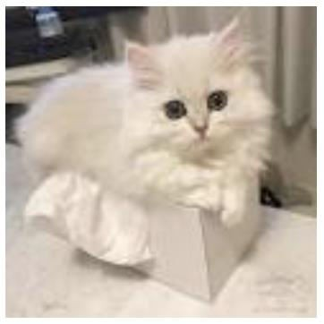
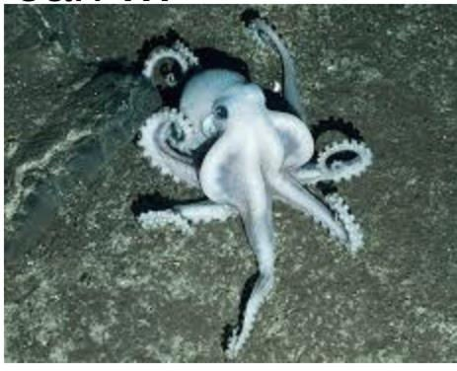
Machine learning is not magic (inference time)
C
?
4

Slide 6
Machine learning is deployed in adversarial settings
Microsoft’s Tay chatbot
YouTube filtering
Training data poisoning
Content evades detection at inference
5

Slide 7
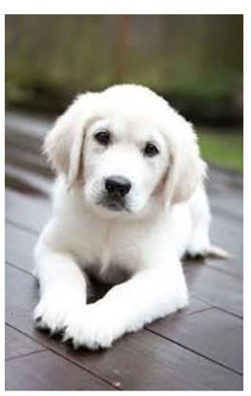
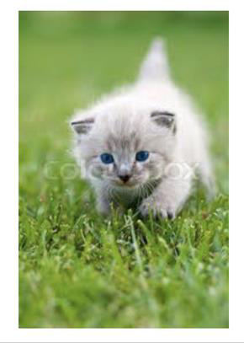
Machine learning does not always generalize well
Training data
Test data
6

Slide 8
Adversarial examples
A particularly vivid illustration of how learned models may or may not generalize correctly
this is not random noise –
special pattern design to “fool”
the model
What’s going on here?
very special patterns, almost imperceptible to people,
can change a model’s classification drastically
The direct issue: this is a potential way to “attack” learned classifiers
The bigger issue: this implies some strange things about generalization
Why do we care?

Slide 9
Some facts about adversarial examples
We’ll discuss many of these facts in detail, but let’s get the full picture first:
It’s not just for gibbons. Can turn basically anything
into anything else with enough effort
It is not easy to defend against, obvious fixes can
help, but nothing provides a bulletproof defense (that we know of)
Adversarial examples can transfer across different networks (e.g., the same adversarial example can fool both AlexNet and ResNet)
Adversarial examples can work in the real world, not just special and very precise pixel patterns
Adversarial examples are not specific to (artificial) neural networks, virtually all learned models are susceptible to them
speed limit: 45
photo is not altered in any way! but the sign is
including your brain, which is a type of learned model

Slide 10
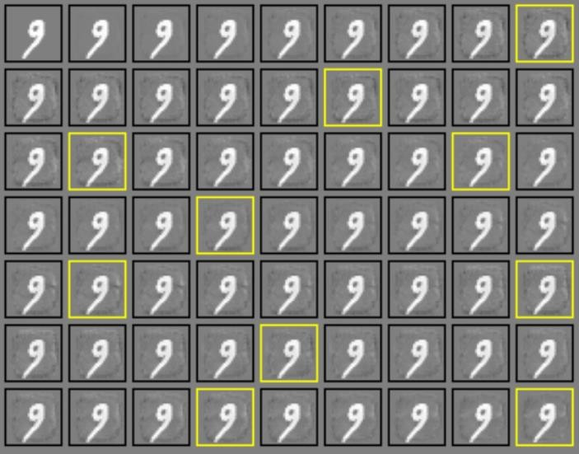
A problem with deep nets?
classified as “0” (90%)
classified as “1” (90%)
linear model (logistic regression)
adversarial examples appear to be a general phenomenon for most learned models (and all high-capacity models that we know of)
Example from: Ian Goodfellow, 2016

Slide 11
Is it due to overfitting?
Overfitting hypothesis: because neural nets have a huge number of parameters, they tend to overfit, making it easy to find inputs that produce crazy outputs
Implication: to fix adversarial examples, stop using neural nets
most evidence suggests that this
hypothesis is false
The mental model:
If this were true, we would expect different models to have very different adversarial examples (high variance)
This is conclusively not the case
If this were true, we would expect low capacity models (e.g., linear models) not to have this issue
Low capacity models also have this
If this were true, we would expect highly nonlinear decision boundaries around adversarial examples
This appears to not be true
adversarial examples are things like this
Slide based on material from Ian Goodfellow (2017)

Slide 12
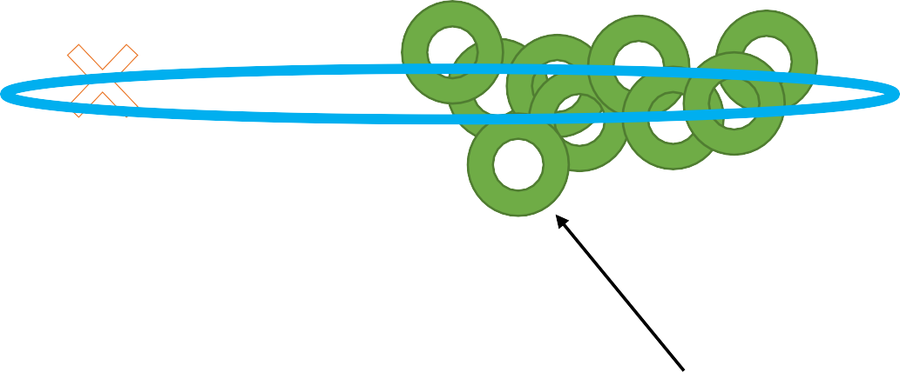
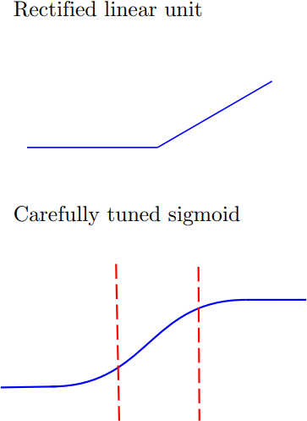
Linear models hypothesis
Linear models hypothesis: because neural networks (and many other models!) tend to be locally linear, they extrapolate in somewhat counterintuitive ways when moving away from the data
this has a somewhat counterintuitive meaning in high dimensions
why so linear?
“realistic images” manifold
adversarial examples are things like this
Consistent with transferability of adversarial examples
Reducing “overfitting” doesn’t fix the problem
Slide based on material from Ian Goodfellow (2017)

Slide 13
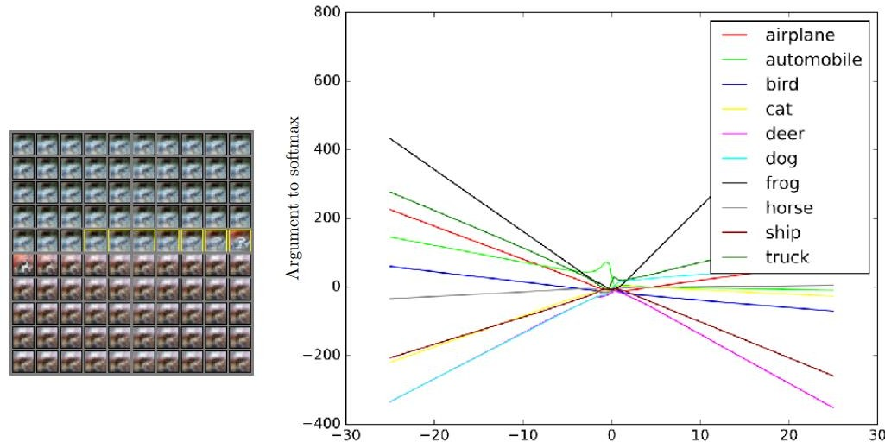
Linear models hypothesis
Experiment 1: vary images along one vector, and see how predictions change
original car image
Slide based on material from Ian Goodfellow (2017)

Slide 14
FGSM (misclassification)
Take a step in the
direction of the gradient of the loss function
𝛿 = 𝜖 𝑠𝑖𝑔𝑛(Δ_{𝑥} 𝑙 𝑤, 𝑥, 𝐹 𝑥 )
Essentially opposite of what SGD step is doing
Paper
Goodfellow, Shlens, Szegedy. Explaining and harnessing adversarial examples. ICLR 2018

Slide 15
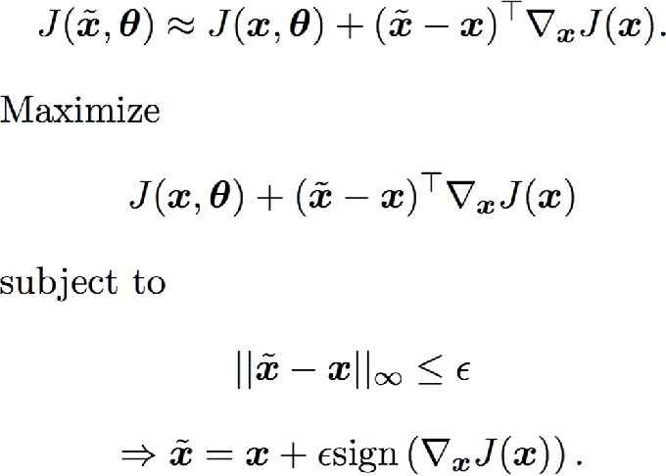
The Fast Gradient Sign Method
FGSM (misclassification)

Slide 16
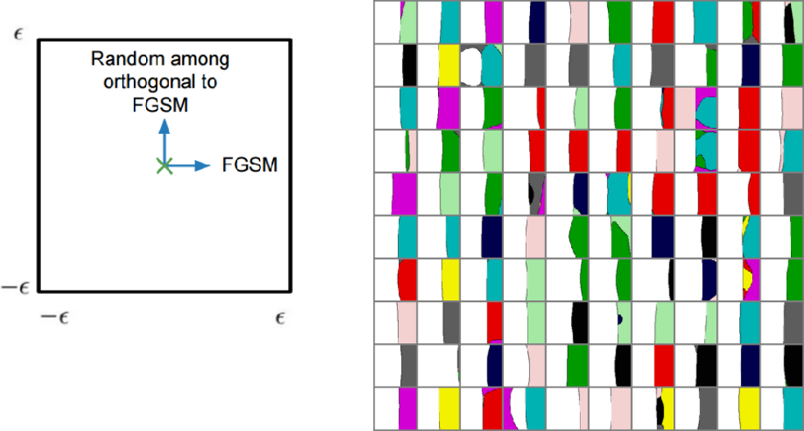
Linear models hypothesis
Experiment 2: vary images along two directions: an adversarial one, and a random one
not much variation orthogonal
to adversarial direction
clean “shift” on one side for adversarial direction, suggesting a mostly linear decision boundary
adversarial direction
Slide based on material from Ian Goodfellow (2017), with Warde-Farley and Papernot

Slide 17
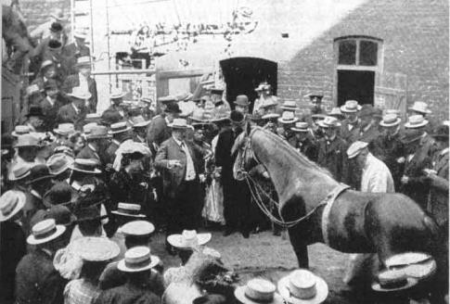
What does this have to do with generalization?
Linear hypothesis is relevant not just for adversarial examples, but for understanding
how neural nets do (and don’t) generalize
When you train a model to classify cats vs. dogs, it is not actually learning what cats
and dogs look like, it is learning about the patterns in your dataset
From there, it will extrapolate in potentially weird ways
Put another way, adversarial examples are not bugs they are features of your learning algorithm
Literally: Andrew Ilyas, Shibani Santurkar, Dimitris Tsipras, Logan Engstrom, Brandon Tran, Aleksander Madry. Adversarial Examples Are Not Bugs, They Are Features. 2019.
Basic idea: neural nets pay attention to “adversarial directions” because it helps them
to get the right answer on the training data!

Slide 18
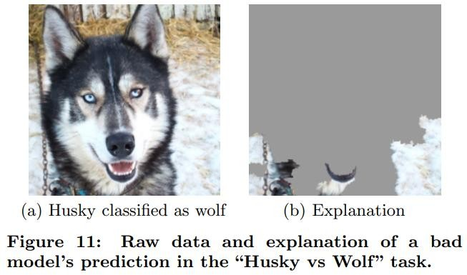
Summary
Neural nets generalize very well on tests sets drawn from the same distribution as the training set
They sometimes do this by being a smart horse
This is not their fault! It’s your fault for asking
the wrong question
They are often not well-calibrated, especially on out-of-distribution inputs
A related (but not the same!) problem is that we can almost always synthesize adversarial examples by modifying normal images to “fool” a neural network into producing an incorrect label
Adversarial examples are most likely not a symptom of overfitting
They are conserved across different models,
and affect low-capacity models
There is reason to believe they are actually due to excessively linear (simple) models attempting to extrapolate + distribution shift

Slide 19
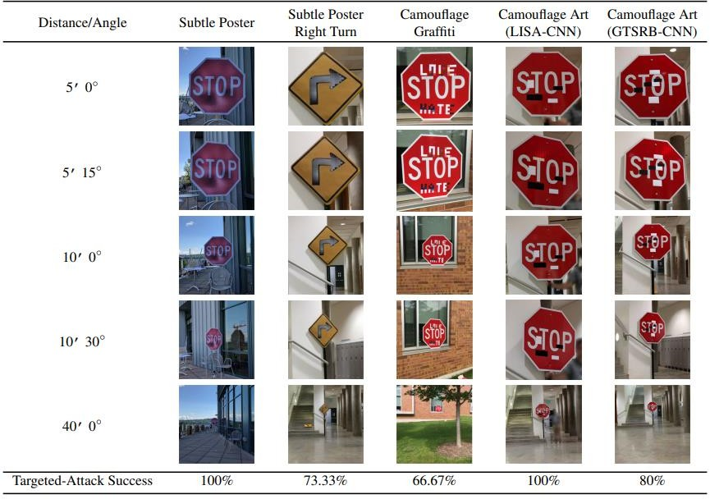
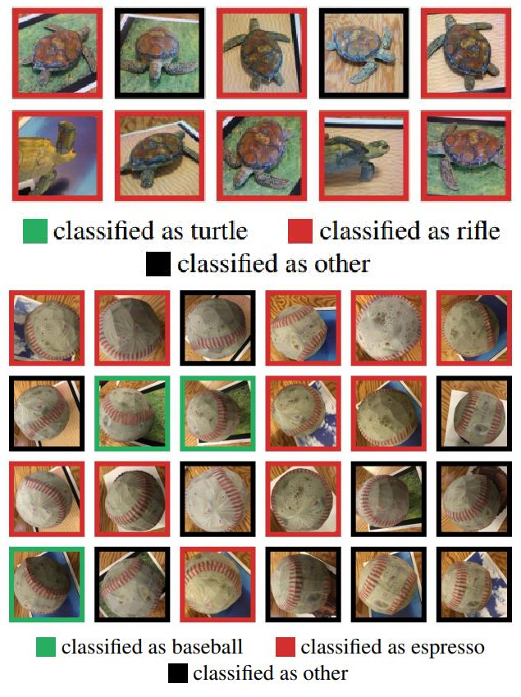
Real-world adversarial examples
all of these turn into 45 mph speed limit signs
Eykholt et al. Robust Physical-World Attacks on Deep Learning Visual Classification. 2018.
Athalye et al. Synthesizing Robust Adversarial Examples. 2017.

Slide 20
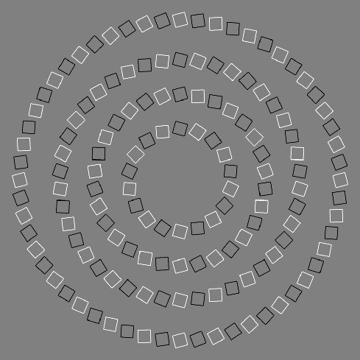
Adversarial Examples in the Human Brain
These are concentric circles, not
intertwined spirals.
(Pinna and Gregory, 2002)

Slide 21
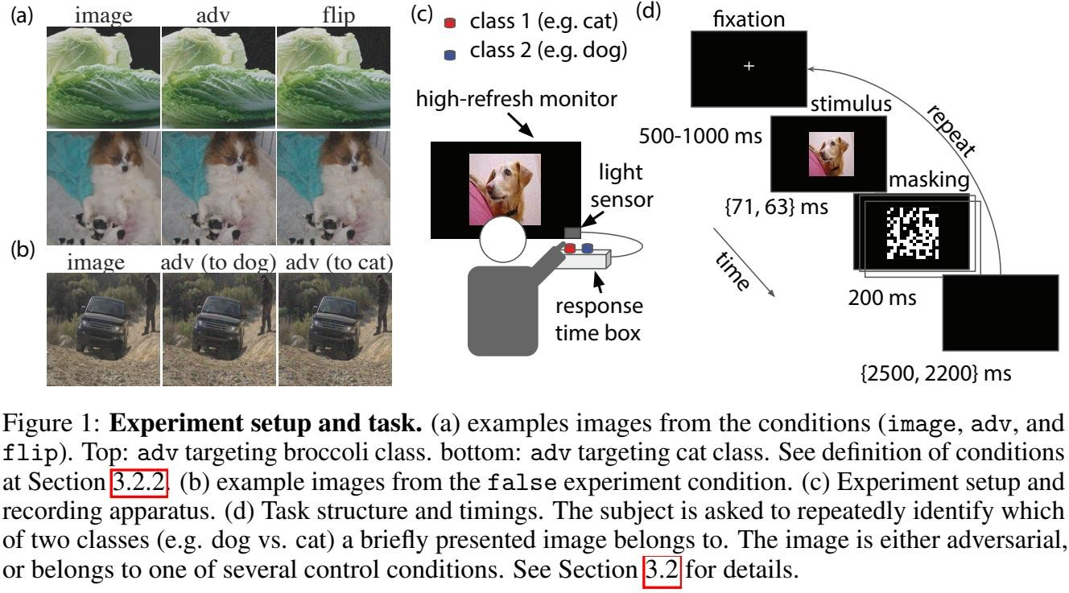
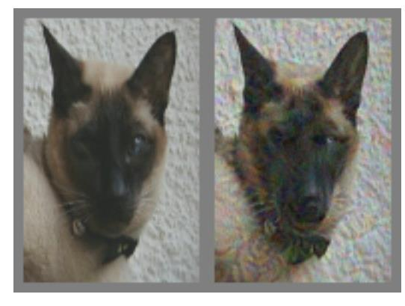
Human adversarial examples?
Elsayed et al. Adversarial Examples that Fool both Computer Vision and Time-Limited Humans. 2018.

Slide 22
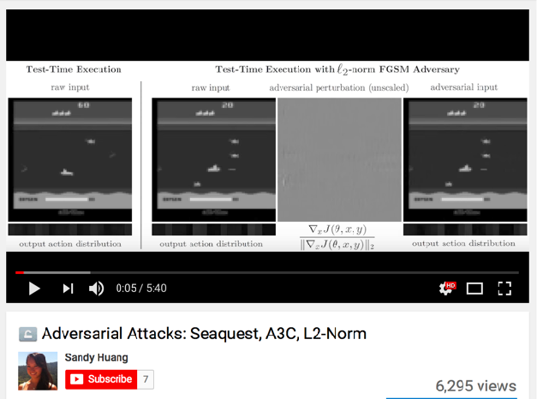
Adversarial Examples for RL
(Huang et al., 2017)

Slide 23
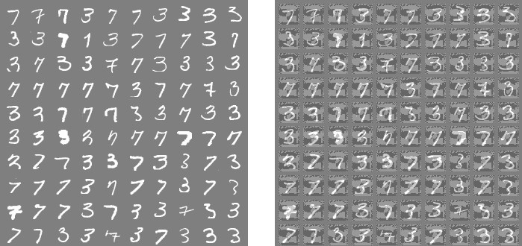
High-Dimensional Linear Models
Clean examples
Adversarial
Weights
Signs of weights

Slide 24
Linear Models of ImageNet
(Andrej Karpathy, “Breaking Linear Classifiers on ImageNet”)

Slide 25
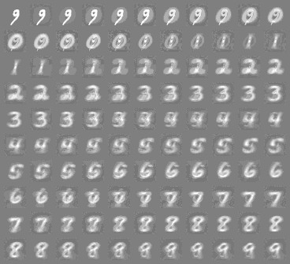
RBFs behave more intuitively

Slide 26
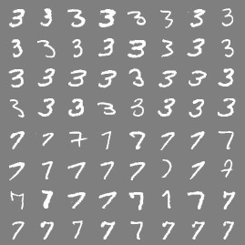
Cross-model, cross-dataset generalization

Slide 27
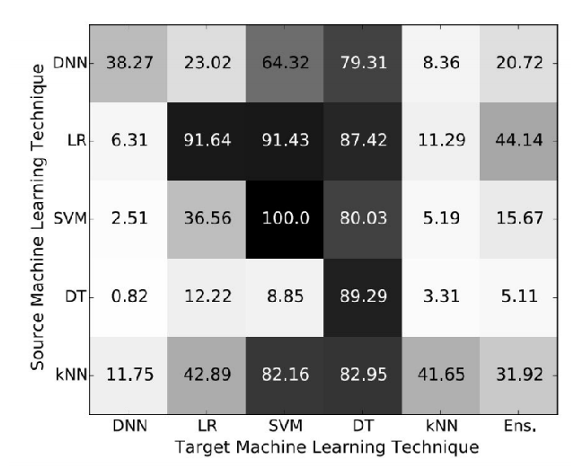
Cross-technique transferability
(Papernot 2016)

Slide 28
Transferability Attack
Target model with unknown weights,
Substitute model mimicking target
Train your own model
machine learning algorithm, training set; maybe non- differentiable
Deploy adversarial examples against the target; transferability property results in them succeeding
model with known,
differentiable function
Adversarial crafting against substitute
Adversarial examples

Slide 29
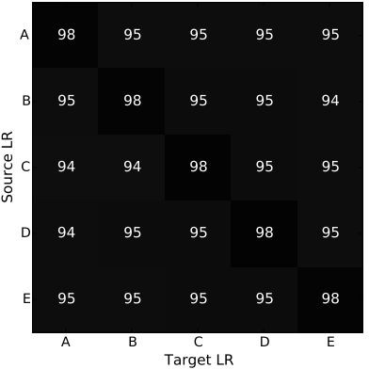
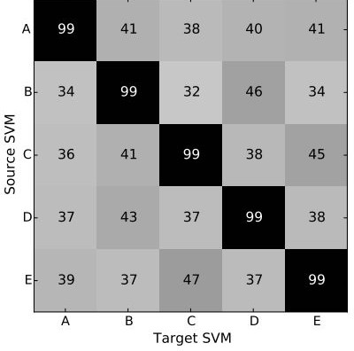
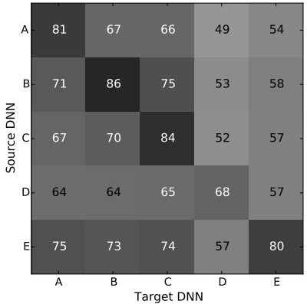
Cross-Training Data Transferability
Strong
Weak
Intermediate
(Papernot 2016)

Slide 30
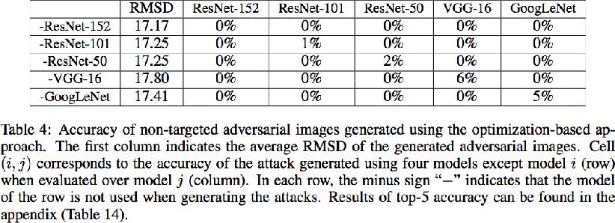
Enhancing Transfer With Ensembles
(Liu et al, 2016)

Slide 31
Practical Attacks
Fool real classifiers trained by remotely hosted API (MetaMind, Amazon, Google)
Fool malware detector networks
Display adversarial examples in the physical world and fool machine learning systems that perceive them through a camera

Slide 32
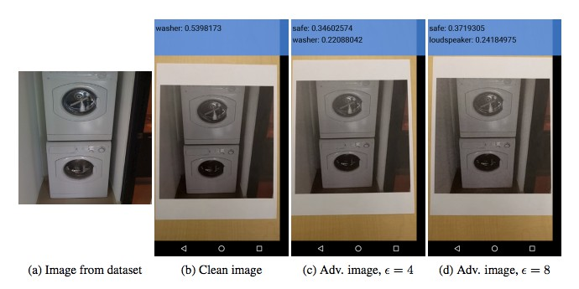
Adversarial Examples in the Physical World
(Kurakin et al, 2016)

Slide 33
Failed defenses
Generative
Removing perturbation with an autoencoder
pretraining
Adding noise at test time
Confidence-reducing
Ensembles
Error correcting codes
perturbation at test time
Multiple glimpses
Weight decay
Various non-linear units
Double backprop
Dropout
Adding noise at train time

Slide 34
Training on Adversarial Examples
10⁰
Train=Clean, Test=Clean
Train=Clean, Test=Adv Train=Adv, Test=Clean Train=Adv, Test=Adv
Test misclassification rate
₁₀—1
₁₀—2
0
50
100 150 200
Training time (epochs)
250
300

Slide 35
Adversarial Training of other Models
Linear models: SVM / linear regression cannot learn a step function, so adversarial training is less useful, very similar to weight decay
k-NN: adversarial training is prone to overfitting.
Takeway: neural nets can actually become more secure than other models. Adversarially trained neural nets have the best empirical success rate on adversarial examples of any machine learning model.

Slide 36
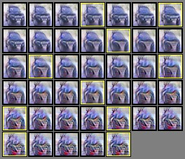
Weaknesses Persist

Slide 37
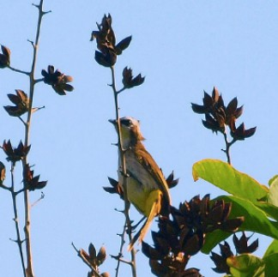
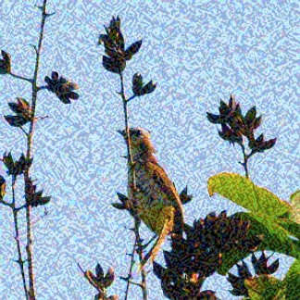
Adversarial Training
Labeled as bird Still has same label (bird)
Decrease probability of bird class

Slide 38
Conclusion
Attacking is easy
Defending is difficult
Adversarial training provides regularization and semi-supervised learning
The out-of-domain input problem is a bottleneck for model-based optimization generally

