Slide 1
Dongdong She Some slides are borrowed from Dan Boneh
Control Hijacking Attacks

Slide 2
Control hijacking attacks
Attacker’s goal:
Take over target machine (e.g. web server)
Execute arbitrary code on target by hijacking application control flow
Examples:
Buffer overflow and integer overflow attacks
Format string vulnerabilities
Use after free

Slide 3
First example: buffer overflows
Extremely common bug in C/C++ programs.
First major exploit: 1988 Internet Worm.
Whenever possible avoid C/C++
Often cannot avoid C/C++ :
Need to understand attacks and defenses
Feb. 2024: White House support for memory safety
Source: web.nvd.nist.gov

Slide 4
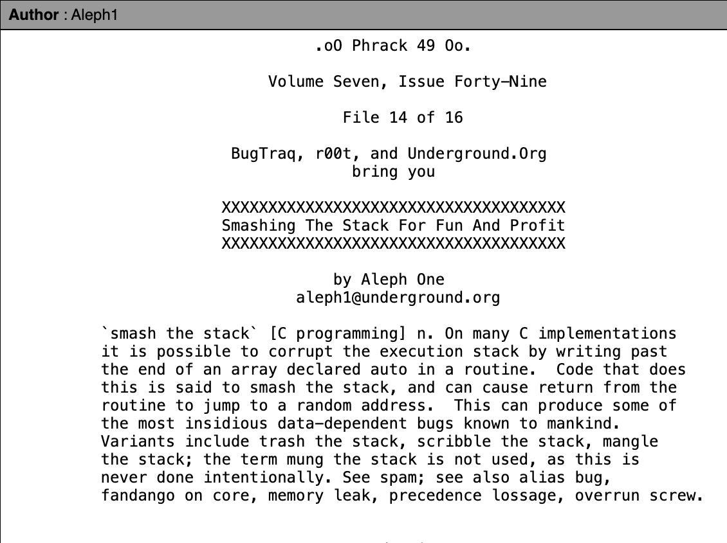
First example: buffer overflows
Phrack : an online magazine by and for hackers since 1985

Slide 5
What is needed
Understanding C functions, the stack, and the heap.
Know how system calls are made
The exec() system call
Attacker needs to know which CPU and OS used on the target machine:
Our examples are for x86-64 running Linux or Windows
Details vary slightly between CPUs and OSs:
Stack Frame structure (Unix vs. Windows, x86 vs. ARM)
Little endian vs. big endian

Slide 6
Linux process memory layout (x86-64)
0x0000 7FFF FFFF FFFF
(128 TB)
user stack
%rsp
(stack pointer)
(esp in 32-bit mode)
shared libraries
A concrete example
0x0000 7F1F6 XXXX XXXX
run time heap
Loaded from executable
(code and global vari)
text and data
0x0000 0000 0040 0040
unused
0
Notes:
Space above 0x0000 7FFF FFFF FFFF is non canonical until 0xFFFF 7FFF FFFF FFFF after which is OS.

Slide 7
Stack Frame
What is rbp, rsp, rip?
high
arguments
return address
rbp
stack base pointer
exception handlers
local variables
Stack
Growth
callee saved registers
rsp
low
(esp in 32-bit mode)
Notes:
rbp: base pointer register

Slide 8
What are buffer overflows?
Suppose a web server contains a function:
void func(char *str) { char buf[128];
strcpy(buf, str); do-something(buf); }
After func() is called stack looks like:
argument: str
return address
stack base pointer
char buf[128]
rsp

Slide 9
What are buffer overflows?
What if *url is too long?
Quiz: what url length could cause overflow?
void func(char *url) { char buf[128];
strcpy(buf, url); do-something(buf); }
argument: str
return address
stack base pointer
Poisoned return address!
Problem: no bounds checking in strcpy()
*str
char buf[128]
rsp

Slide 10
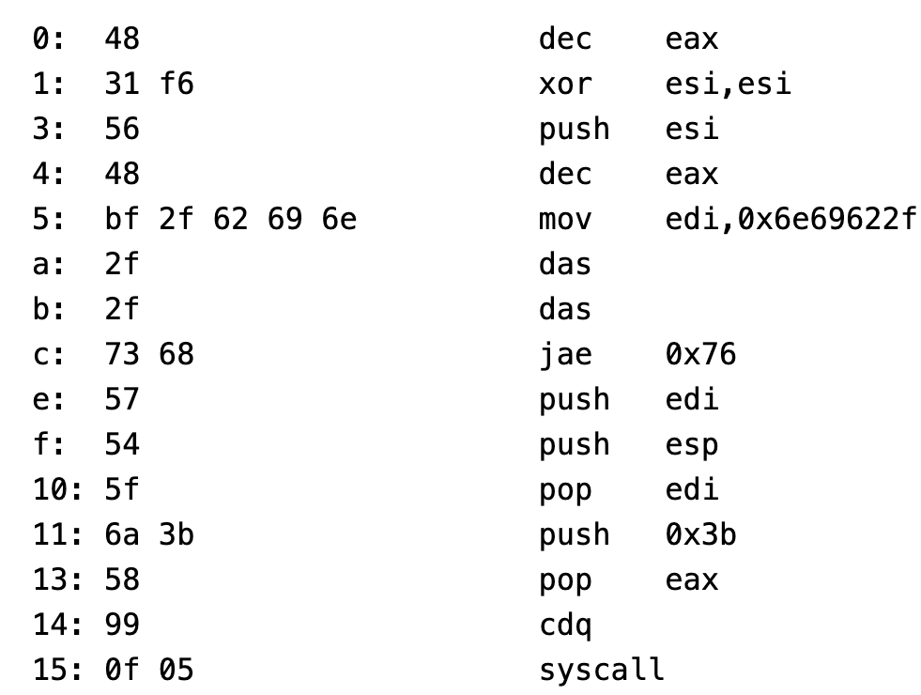
Shell Code
A piece of executable code used as a payload
Often injected from shell
"\x48\x31\xF6\x56\x48\xBF\x2F\x62\x69\x6E\x2F\x2F\x73\x68\x57\x54\x5F\x6A\x3B\x58\x99\x0F\x05"
What is the goal?

Slide 11
Basic stack exploit
Stack
Program P
high
Suppose *url is such that after strcpy stack looks like:
Program P: exec(“/bin/sh”)
When func() exits, the user gets shell !
Note: attack code P runs in stack.
(exact shell code by Aleph One)
return address
char buf[128]
low
Notes:
Aleph one: Elias Levy, moderator of Bugtraq and founder of SecurityFocus. Phrack 49, 1996.

Slide 12
The NOP slide
Stack
Program P
high
Problem: how does attacker determine ret-address?
Solution: NOP slide
Guess approximate stack state when func() is called
Insert many NOPs before program P:
nop (0x90)
NOP Slide
return address
char buf[128]
What is the stack memory layout?
low

Slide 13
Details and examples
How to avoid ‘\0’ byte?
Why?
Some complications:
Program P should not contain the ‘\0’ character.
Overflow should not crash program before func() exits.
(in)Famous remote stack smashing overflows:
Overflow in Windows animated cursors (ANI). LoadAniIcon()
Buffer overflow in Symantec virus detection (May 2016)
overflow when parsing PE headers … kernel vuln.
Notes:
Animated cursor on web page or email message would result in arbitrary code execution. Used for rendering cursors, animated cursors, and icons.
Symantec: https://bugs.chromium.org/p/project-zero/issues/detail?id=820

Slide 14
Many unsafe libc functions
strcpy (char *dest, const char *src)
strcat (char *dest, const char *src)
gets (char *s)
scanf ( const char *format, … ) and many more.
“Safe” libc versions strncpy(), strncat() are misleading
e.g. strncpy() may leave string unterminated.
Windows C run time (CRT):
strcpy_s (*dest, DestSize, *src): ensures proper termination
What would happen?
How to implement?

Slide 15
Buffer overflow opportunities
Exception handlers: (… more on this in a bit)
Overwrite the address of an exception handler in stack frame.
Function pointers: (e.g. PHP 4.0.2, MS MediaPlayer Bitmaps)
Overflowing buf will override function pointer.
Longjmp buffers: longjmp(pos) (e.g. Perl 5.003)
Overflowing buf next to pos overrides value of pos.
Heap or stack
buf[128]
FuncPtr
Notes:
Windows media player bitmaps (skins) – heap overflow, Feb. 2006
setjmp – used for exception handling (jump to global error handling code in case of error). Or for setting a checkpoint.

Slide 16
Heap exploits: corrupting virtual tables
Compiler generated function pointers (e.g. C++ code)
After overflow of buf :
method #1
FP1
vptr
FP2
method #2
FP3
method #3
data
vtable
Object T
NOP slide
shell code
buf[256]
vtable
vptr
data
object T

Slide 17
An example: exploiting the browser heap
Request web page
Web page with exploit
malicious web server
victim browser
Attacker’s goal is to infect browsers visiting the web site
How: send javascript to browser that exploits a heap overflow

Slide 18
A reliable exploit?
<SCRIPT language="text/javascript">
shellcode = unescape("%u4343%u4343%..."); // allocate in heap
overflow-string = unescape(“%u2332%u4276%...”);
cause-overflow(overflow-string ); // overflow buf[ ]
</SCRIPT>
Problem: attacker does not know where browser places shellcode on the heap
???
buf[256]
vtable
ptr
data
shellcode

Slide 19
Heap Spraying [SkyLined]
Idea: 1. use Javascript to spray heap with shellcode (and NOP slides)
2. then point vtable ptr anywhere in spray area
NOP slide
shellcode
heap
vtable
heap spray area

Slide 20
Javascript heap spraying
var nop = unescape(“%u9090%u9090”)
while (nop.length < 0x100000) nop += nop;
var shellcode = unescape("%u4343%u4343%...");
var x = new Array ()
for (i=0; i<1000; i++) {
x[i] = nop + shellcode;
}
Pointing function-ptr almost anywhere in heap will cause shellcode to execute.

Slide 21
Ad-hoc heap overflow mitigations
Better browser architecture:
Store JavaScript strings in a separate heap from browser heap
OpenBSD and Windows 8 heap overflow protection:
In theory: allocate every object on a separate page (eFence, Archipelago’08) ⟹ not practical: too wasteful in physical memory
prevents cross-page overflows
guard pages (non-writable pages in virtual memory)
Notes:
eFence: electric fence, Linux debugging tool. Also works against use after free by marking deallocated memory as not writable. Not as good as Valgrind, but simpler.

Slide 22
Finding overflows by fuzzing
To find overflow:
Run web server on local machine
Use AFL to issue malformed requests (ending with “$$$$$” )
Fuzzers: automated tools for this (next week)
If web server crashes, search core dump for “$$$$$” to find overflow location
Construct exploit (not easy given latest defenses in next lecture)
Notes:
AFL: American Fuzzy Lop

Slide 23
Automated Approaches to Find Vulnerabilities
Simple and effective
Light-weight and scalable
Widely-used in industry
Fuzzing
Static/Dynamic analysis
Formal verification
Symbolic execution
Notes:
The good news is that researchers have come up with many automated approaches to find vulnerabilities, such as static analysis and dynamic analysis, formal verification, symbolic executions and fuzzing. Among them, fuzzing is a very popular approach. It is simple and effective and can scale to large real-world programs. It is also widely used in industry. Linus Torvalds even says fuzzing is improving Linux kernel security.

Slide 24
Wide Application in Industry
Tech companies have built large-scale fuzzing infrastructure with thousands of CPUs
Google: OSS-Fuzz. Find 45,000+ bugs in 650 projects and 4,000 bugs in chromium[1]
Microsoft: OneFuzz
Meta: Rustaceans
[1] https://google.github.io/oss-fuzz/

Slide 25
Diverse Fuzzing Applications
binary fuzzing[1]
kernel fuzzing[2]
network protocol fuzzing[3]
ML system fuzzing[4]
smart contract fuzzing[5]
IoT
Fuzzing[6]
CPU
Fuzzing[7]
[1] Pham et al. Model-based whitebox fuzzing for program binaries. ASE’16.
[2] Schumilo et al. kAFL: Hardware-Assisted Feedback Fuzzing for OS Kernels. Security’17.
[3] Pham et al. AFLNET: A Greybox Fuzzer for Network Protocols. ICST’20.
[4] Deng et al. Fuzzing Deep-Learning Libraries via Automated Relational API Inference. ICSE’22.
[5] Jiang et al. ContractFuzzer: fuzzing smart contracts for vulnerability detection. ASE’18.
[6] Chen et al. IoTFuzzer: Discovering Memory Corruptions in IoT Through App-based Fuzzing. NDSS’18.
[7] Serebryany et al. SiliFuzz: Fuzzing CPUs by proxy. arXiv:2110.11519.
Notes:
Fuzzing has been used in diverse application domains. Such as binary, kernel, network

Slide 26
What is Fuzzing?
Popular software testing technique
Find inputs to trigger vulnerabilities and maximize code coverage
Generate a large number of random inputs
Execute tested program
Monitor any abnormal program behaviors
Notes:
A bit of background fuzzing. What is fuzzing? It is a popular software testing technique. Specifically, it finds a set of inputs that can trigger vulnerabilities and maximize the code coverage by generating a large number of random inputs, then execute tested programs with these inputs to see if there are any abnormal behaviors such as crashes or hangs. A simple example of fuzzing is monkey testing. As shown in the figure on the right. Imagine we have a monkey sitting in front of a computer. Each time, the monkey types a random input. You can see a large number of meaningless inputs generated by the monkey. All these inputs will be sent into tested programs and see if they find abnormal program behaviors.

Slide 27
A General Workflow of Fuzzing
aaaa
bbbb
bbxx
bbbb
…
Seed Scheduling
Seed Mutation
bbxx
Program
cccc
Seed Corpus
Yes
Save?
No
Fuzzing is an iterative searching loop consisting of two steps (seed scheduling and seed mutation)
Notes:
Real-world fuzzer cannot use monkeys’ random generation because most of them are invalid. In order to generate more valid testcases, a real-world fuzzer starts with a valid seed and applies mutation on it. Let’s look at a general workflow of fuzzing. It starts with a set of valid seed corpus, consisting of multiple test cases, we call seed. Then seed scheduling module selects a seed from the corpus. For example, it chooses the seed “bbbb” like this. Next, the seed mutation module mutates the selected seed to generate a new input, “bbxx”. Then the new input “bbxx” are sent into the tested program for dynamic execution. Fuzzer will monitor the dynamic execution of the new input. If there is abnormal or new behaviors found, the new input will be saved and added to the seed; else, discarded. You may find that this process is a loop. Fuzzing is essentially an iterative searching loop consisting of two steps

Slide 28
Popular Fuzzer
AFL, widely used fuzzer
AFL++, integrates academic research into AFL, maintained by community
LibFuzzer, maintained by Google
LibAFL, maintained by commuity

Slide 29
More Control Hijacking Attacks
Control Hijacking

Slide 30
More Hijacking Opportunities
Integer overflows: (e.g. MS DirectX MIDI Lib)
Double free: double free space on heap
Can cause memory mgr to write data to specific location
Examples: CVS server
Use after free: using memory after it is freed
Format string vulnerabilities

Slide 31
Integer Overflows (see Phrack 60)
Problem: what is the value range?
Unsigned int m; (32 bits)
Unsigned short s; (16 bits)
Unsigned char c; (8 bits)

Slide 32
Integer Overflows (see Phrack 60)
Problem: what happens when int exceeds max value?
unsigned int m; (32 bits) unsigned short s; (16 bits) unsigned char c; (8 bits)
c = 0x80 + 0x80 = 128 + 128 ⇒?
s = 0xff80 + 0x80 ⇒?
m = 0xffffff80 + 0x80 ⇒?
Quiz: What happens if on a signed variable?

Slide 33
An example
void func( char *buf1, *buf2, unsigned int len1, len2) {
char temp[256];
if (len1 + len2 > 256) {return -1} // length check
memcpy(temp, buf1, len1); // cat buffers
memcpy(temp+len1, buf2, len2);
do-something(temp); // do stuff
}
What if len1 = 0x80, len2 = 0xffffff80 ?
⇒ len1+len2 = 0
Second memcpy() will overflow heap !!
Notes:
Correct check should also check size of len1 and len2.

Slide 34
An example: a better length check
void func( char *buf1, *buf2, unsigned int len1, len2) {
char temp[256];
// length check
if (len1 > 256) || (len2 > 256) || (len1+ len2 > 256)
return -1;
memcpy(temp, buf1, len1); // cat buffers
memcpy(temp+len1, buf2, len2);
do-something(temp); // do stuff
}
Notes:
Correct check should also check size of len1 and len2.

Slide 35
Integer overflow exploit stats
Dec. 2020: integer underflow in F5 Big IP
if (8190 − nlen <= vlen ) // length check
return -1;
Source: NVD/CVE
Notes:
nlen: current length of data in buffer. vlen: length of data to add to buffer. Problem: nlen can be 8192. (allocated buffer size is 8192)

Slide 36
Format string bugs

Slide 37
Format string problem
Quiz: draw the stack frame of func()
int func(char *user) {
fprintf(stderr, user);
}
Problem: what if *user = “%s%s%s%s%s%s%s” ??
Most likely program will crash: DoS.
If not, program will print memory contents. Privacy?
Full exploit using user = “%n”
Correct form: fprintf( stdout, “%s”, user);

Slide 38
Vulnerable functions
Any function using a format string.
Printing:
printf, fprintf, sprintf, …
vprintf, vfprintf, vsprintf, …
Logging:
syslog, err, warn

Slide 39
Exploit
Which stack variable is leaked?
Dumping arbitrary memory:
Walk up stack until desired pointer is found.
printf( “%08x.%08x.%08x.%08x|%s|”)
Writing to memory:
printf( “hello %n”, &temp) -- writes ‘6’ into temp.
printf( “%08x.%08x.%08x.%08x.%n”) -- difficult to exploit
What value will be written into memory?

Slide 40
Use after free exploits

Slide 41
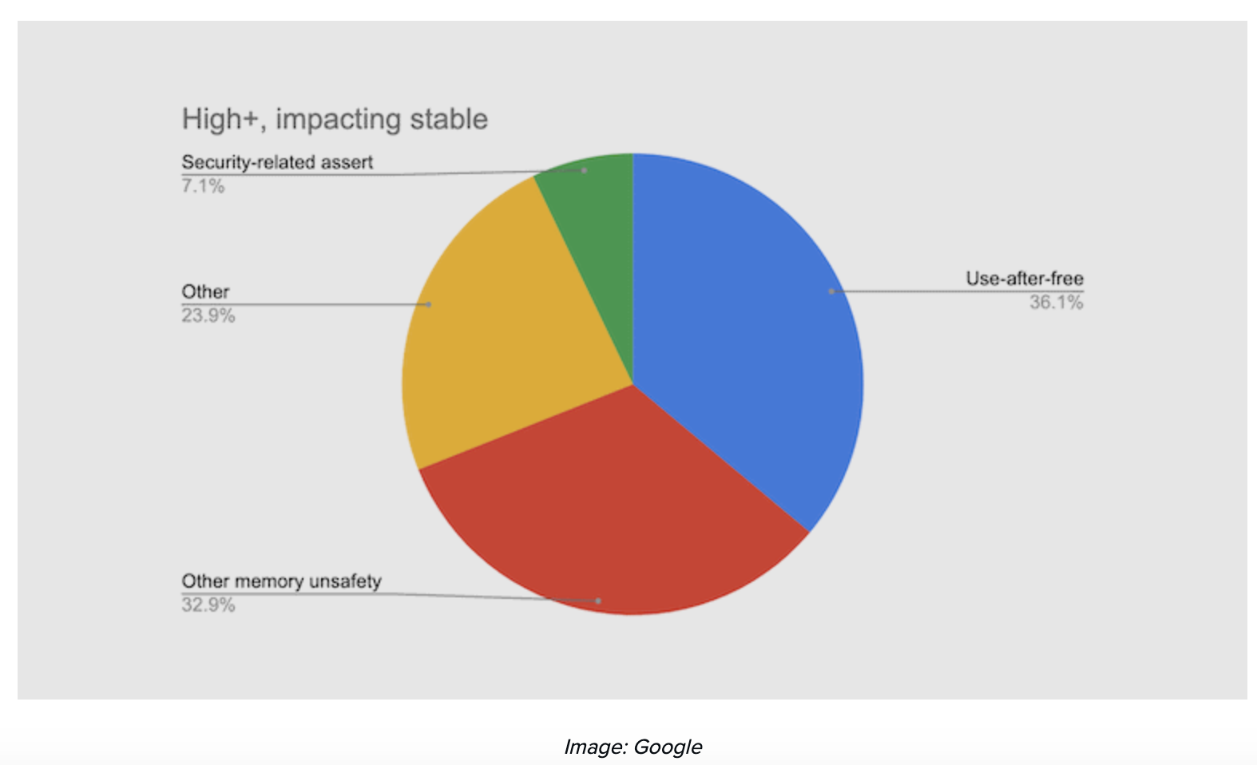
High impact security vulns. in Chrome 2015 – 2020 (C++)
70% due to memory management bugs

Slide 42
IE11 Example: CVE-2014-0282 (simplified)
(IE11 written in C++)
<form id="form"> <textarea id="c1" name="a1" ></textarea> <input id="c2" type="text" name="a2” value="val">
</form>
<script>
function changer() {
document.getElementById("form").innerHTML = "";
CollectGarbage(); // erase c1 and c2 fields
}
document.getElementById("c1").onpropertychange = changer;
document.getElementById("form").reset();
</script>
Loop on form elements:
c1.DoReset()
c2.DoReset()
Notes:
c1.doReset() causes changer() to be called and free object c2.

Slide 43
What just happened?
c1.doReset() free object c2
object c2
doSomething
FP1
vptr
FP2
doReset
FP3
doSomethingElse
data
vtable

Slide 44
What just happened?
c1.doReset() causes changer() to be called and free object c2
What if vtable is non-writable?
object c2
FP1
vptr
FP2
ShellCode
FP3
data
vtable
Use after free !
Suppose attacker allocates a string of same size as vtable
When c2.DoReset() is called, attacker gets shell

Slide 45
The exploit
<script>
function changer() {
document.getElementById(”form").innerHTML = "";
CollectGarbage();
--- allocate string object to occupy vtable location ---
}
document.getElementById("c1").onpropertychange = changer;
document.getElementById("form").reset();
</script>
How to take up the vtable location?
Lesson: use after free can be a serious security vulnerability !!

Slide 46
Next lecture …
DEFENSES
Notes:
Defense against use after free from Usenix Security 2021: https://www.usenix.org/conference/usenixsecurity21/presentation/wickman

Slide 47
THE END

Slide 48
References on heap spraying
[1] Heap Feng Shui in Javascript, by A. Sotirov, Blackhat Europe 2007
[2] Engineering Heap Overflow Exploits with JavaScript M. Daniel, J. Honoroff, and C. Miller, WooT 2008
[3] Interpreter Exploitation: Pointer inference and JiT spraying, by Dion Blazakis

