Slide 1
COMP4634
Security Principles and OS Security
Dongdong She
Some slides are borrowed from Dan Boneh

Slide 2
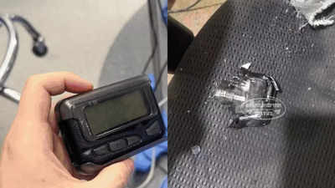
Pager Explosion Attack
Hard supply chain attack
Tamper hardware of the pager
Add a backdoor to trigger
the explosion

Slide 3
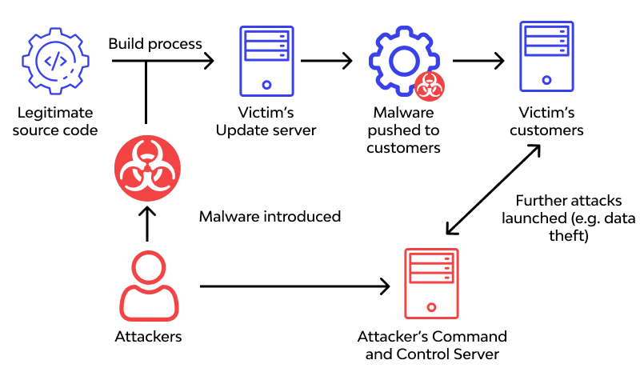
Supply Chain Attack

Slide 4
Vulnerabilities are Inevitable
Any single buffer overflow, use-after-free, or null pointer dereference might allow an attacker to run malicious code
We’re getting better at finding and preventing bugs, but vulnerabilities are still common. There will always be bugs.
Example: In January 2021, Qualys discovered a heap overflow in sudo that allows users to run programs with the security privileges of another user. The bug was introduced in 2011 (CVE-2021-3156) and affected Linux, Mac OS, and BSD.
How does null ptr dereference cause control flow hijack?

Slide 5
Even Safe Languages have Bugs!
Potential memory corruption like buffer overflow
Python language is written in C and has itself had vulnerabilities
CVE-2016-5636: Integer overflow in the get_data function allows attackers to trigger a heap-based buffer overflow in zipimport.c by specifying a negative data size
Bug could be triggered inside of interpreted Python scripts

Slide 6
Systems must be designed to be resilient in the face of both software vulnerabilities and malicious users
Systems must be designed to be resilient in the face of both software vulnerabilities and malicious users

Slide 7
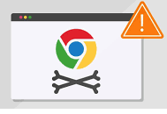
Defense in Depth
Systems should be built with security protections at multiple layers
Example: What if there’s a vulnerability in Chrome’s Javascript interpreter?
Chrome should prevent malicious website from accessing other tabs
OS should prevent access to other processes
(e.g., Password Manager)
HW should prevent permanent malware
installation in device firmware
Network should prevent malware
from infecting nearby computers
Notes:
If you assume that there can be bugs anywhere, you want multiple layers of defense against an attack. Imagine there’s a vulnerability in how Chrome executes javascript…
This layered approach is known as Defense in Depth

Slide 8
Defense in Depth
Systems should be built with security protections at multiple layers
Example: What if there’s a vulnerability in Chrome’s Javascript interpreter?
Chrome should prevent malicious website from accessing other tabs
OS should prevent access to other processes
(e.g., Password Manager)
HW should prevent permanent malware
installation in device firmware
Network should prevent malware
from infecting nearby computers
Notes:
If you assume that there can be bugs anywhere, you want multiple layers of defense against an attack. Imagine there’s a vulnerability in how Chrome executes javascript…
This layered approach is known as Defense in Depth

Slide 9
Principles of Secure Systems
✓ Defense in depth
✓ Principle of least privilege
✓ Privilege separation
✓ Open design (Kerckhoffs's principle)
✓ Keep it simple
Notes:
Defense in Depth is one of the core principles is in building secure systems. Today we’ll talk about the five most important principles.

Slide 10
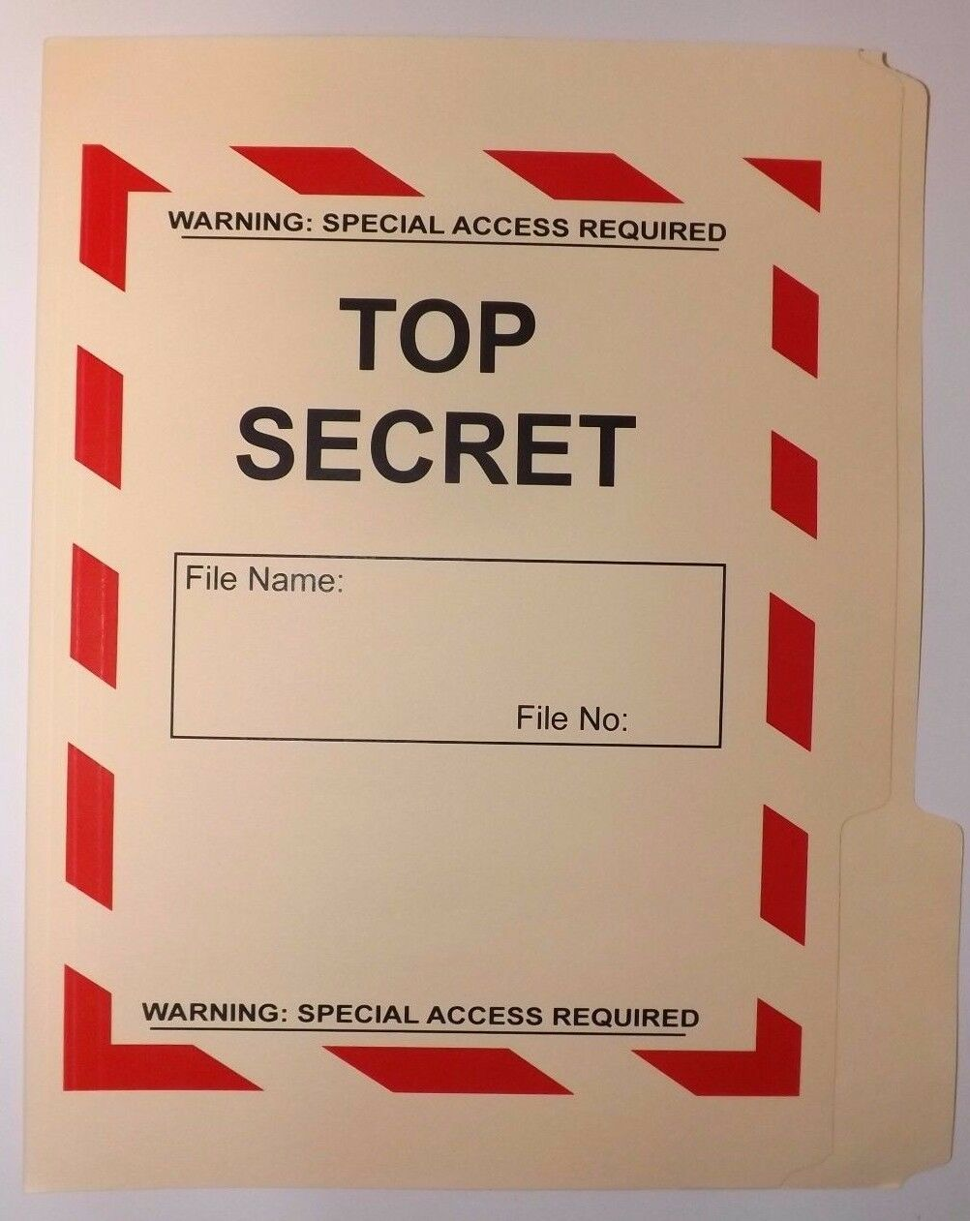
Least Privilege
Users should only have access to the data and resources needed to perform routine, authorized tasks
Real World Examples:
Faculty can only change grades for classes they teach
Only employees with background checks have access to classified documents

Slide 11
Least Privilege (2)
Faculty can only change grades for classes they teach.
Who are we really protecting against?
Faculty themselves — curious or even
malicious — could cause widespread
damage
External attackers — a student would
need to own only the single least secure
faculty member on campus — huge
attack surface

Slide 12
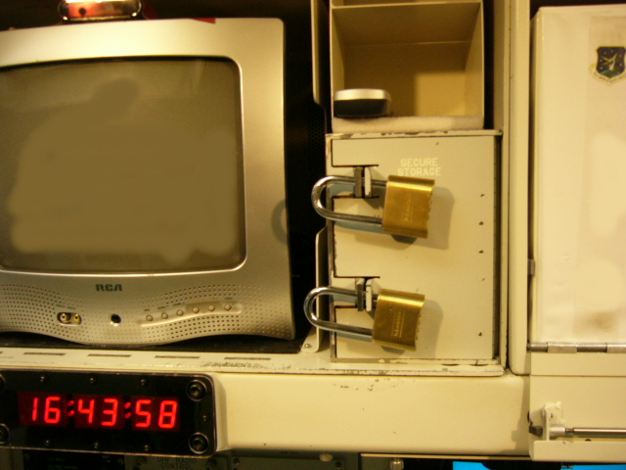
Privilege Separation
Least Privilege requires dividing a system into parts to which we can limit access
Known as Privilege Separation
Segmenting a system into components with the least privilege needed can prevent an attacker from taking over the entire system

Slide 13
Security Subjects
Least privilege and privilege separation apply to more than just users!
UNIX: A User should only be able to read their own files
UNIX: A Process should not be able to read another process’s memory
Mobile: An App should not be able to edit another app’s data
Web: A Domain should only be able to read its own cookies
Networking: Only a trusted Host should be able to access file server
Least Privilege: Users Subjects should only have access to the data and resources needed to perform routine, authorized tasks

Slide 14
Security Policies
Subject (Who?): acting system principals (e.g., user, app, process)
Object (What?): protected resources (e.g., memory, files, HW devices)
Operation (How?): how subjects operate on objects (e.g., read, delete)
Example Security Policies:
UNIX: A User should not be able to delete other users’ files
UNIX: A Process should not be able to read another process’s memory
Mobile: An App should only be able to edit its own data
Web: A Domain should not be able to read another domain’s cookies

Slide 15
UNIX Security Model

Slide 16
UNIX Security Model
Subjects (Who?)
  - Users, processes
Objects (What?)
- Files, directories
- Files: sockets, pipes, hardware devices, kernel objects, process data
Access Operations (How?)
- Read, Write, Execute

Slide 17
UNIX Security Model
Subjects (Who?)
  - Users, processes
Objects (What?)
- Files, directories
- Files: sockets, pipes, hardware devices, kernel objects, process data
Access Operations (How?)
- Read, Write, Execute

Slide 18
UNIX Security Model
Subjects (Who?)
  - Users, processes
Objects (What?)
- Files, directories
- Files: sockets, pipes, hardware devices, kernel objects, process data
Access Operations (How?)
- Read, Write, Execute

Slide 19
UNIX Security Model
Subjects (Who?)
  - Users, processes
Objects (What?)
- Files, directories
- Files: sockets, pipes, hardware devices, kernel objects, process data
Access Operations (How?)
- Read, Write, Execute

Slide 20
UNIX Security Model
Subjects (Who?)
  - Users, processes
Objects (What?)
- Files, directories
- Files: sockets, pipes, hardware devices, kernel objects, process data
Access Operations (How?)
- Read, Write, Execute

Slide 21
UNIX Security Model
Subjects (Who?)
  - Users, processes
Objects (What?)
- Files, directories
- Files: sockets, pipes, hardware devices, kernel objects, process data
Access Operations (How?)
- Read, Write, Execute

Slide 22
Users
UNIX systems have many accounts
  - Service accounts
    - Used to run background processes (e.g., web server)
  - User accounts
    - Typically tied to a specific human
  Every user has a unique integer ID — User ID — UID
  UID 0 is reserved for special user root that has access to everything
  - Many system operations can only run as root
Notes:
One of the foremost concepts of security is the idea of least privilege
1974 classic The Protection of Information in Computer Systems by
Jerome Saltzer and Michael Schroeder. Provided 8 principles that are still quite relevant today.
But what’s the major assumption here? Need to be able to isolate and compartmentalize components. We need to be able to restrict what they have access to and what they can do.

Slide 23
Example Users
You can view the users on your system by looking at /etc/passwd:
root:x:0:0:root:/root:/bin/bash
www-data:x:33:33:www-data:/var/www:/usr/sbin/nologin
backup:x:34:34:backup:/var/backups:/usr/sbin/nologin
systemd-resolve:x:101:103:,,,:/run/systemd/resolve:/usr/sbin/nologin
zakir:x:1001:1001:Zakir Durumeric,,,:/home/zakir:/bin/bash
dabo:x:1009:1009:Dan Boneh,,,:/home/dabo:/usr/sbin/nologin
User name: password placeholder: UID: GID: User name description: home directory: bash shell
What does ”x” mean?
Notes:
One of the foremost concepts of security is the idea of least privilege
1974 classic The Protection of Information in Computer Systems by
Jerome Saltzer and Michael Schroeder. Provided 8 principles that are still quite relevant today.
But what’s the major assumption here? Need to be able to isolate and compartmentalize components. We need to be able to restrict what they have access to and what they can do.

Slide 24
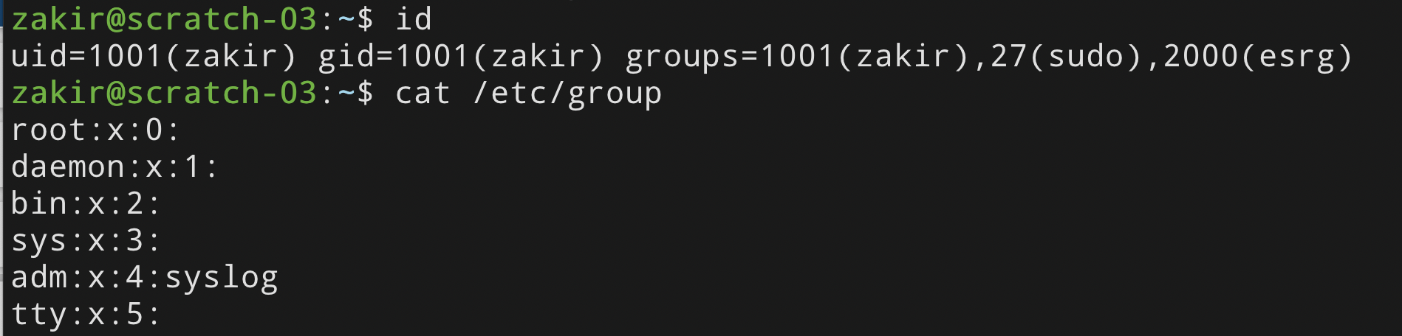
Groups
UNIX has also groups — collections of users who can share files and other system resources
Every group has a group ID (GID) and name
Notes:
One of the foremost concepts of security is the idea of least privilege
1974 classic The Protection of Information in Computer Systems by
Jerome Saltzer and Michael Schroeder. Provided 8 principles that are still quite relevant today.
But what’s the major assumption here? Need to be able to isolate and compartmentalize components. We need to be able to restrict what they have access to and what they can do.

Slide 25
File Ownership
All Linux resources — sockets, devices, files — are managed as files
All files and directories have a single user owner and group owner
zakir@scratch-01:~$ ls -l
  total 8
d rwx rwx --- 5 zakir comp4634-tas 4096 Apr 2 15:56 homework
d rwx rwx --- 5 zakir comp4634-instr 4096 Apr 2 15:56 grades
d rwx rwx r-x 11 zakir comp4634-tas 4096 Dec 28 21:09 lectures
- rwx r-x r-- 1 zakir daao 0 Apr 11 04:15 test.py
User Owner
Group Owner
Notes:
One of the foremost concepts of security is the idea of least privilege
1974 classic The Protection of Information in Computer Systems by
Jerome Saltzer and Michael Schroeder. Provided 8 principles that are still quite relevant today.
But what’s the major assumption here? Need to be able to isolate and compartmentalize components. We need to be able to restrict what they have access to and what they can do.

Slide 26
Access Control
Three subjects have access to a file: user owner, group owner, other
Subjects can have three operations: read, write, execute
Owner can change permissions and group. Root can change user ownership.
zakir@scratch-01:~$ ls -l
  total 8
d rwx rwx --- 5 zakir comp4634-tas 4096 Apr 2 15:56 homework
d rwx rwx --- 5 zakir comp4634-instr 4096 Apr 2 15:56 grades
d rwx rwx r-x 11 zakir comp4634-tas 4096 Dec 28 21:09 lectures
- rwx r-x r-- 1 zakir dabo 0 Apr 11 04:15 test.py
Group
User
Group
User
Other
Notes:
One of the foremost concepts of security is the idea of least privilege
1974 classic The Protection of Information in Computer Systems by
Jerome Saltzer and Michael Schroeder. Provided 8 principles that are still quite relevant today.
But what’s the major assumption here? Need to be able to isolate and compartmentalize components. We need to be able to restrict what they have access to and what they can do.

Slide 27
Access Control Example 1
zakir@scratch-01:~$ ls -l
  total 8
d rwx rwx --- 5 zakir comp4634-tas 4096 Apr 2 15:56 homework
d rwx rwx --- 5 zakir comp4634-instr 4096 Apr 2 15:56 grades
d rwx rwx r-x 11 zakir comp4634-tas 4096 Dec 28 21:09 lectures
- rwx r-x r-- 1 zakir dabo 0 Apr 11 04:15 test.py
Group
User
Group
User
Other
Quiz
Q: What can member of comp4634-tas do to homework?
Notes:
One of the foremost concepts of security is the idea of least privilege
1974 classic The Protection of Information in Computer Systems by
Jerome Saltzer and Michael Schroeder. Provided 8 principles that are still quite relevant today.
But what’s the major assumption here? Need to be able to isolate and compartmentalize components. We need to be able to restrict what they have access to and what they can do.

Slide 28
Access Control Example 2
zakir@scratch-01:~$ ls -l
  total 8
d rwx rwx --- 5 zakir comp4634-tas 4096 Apr 2 15:56 homework
d rwx rwx --- 5 zakir comp4634-instr 4096 Apr 2 15:56 grades
d rwx rwx r-x 11 zakir comp4634-tas 4096 Dec 28 21:09 lectures
- rwx r-x r-- 1 zakir dabo 0 Apr 11 04:15 test.py
Group
User
Group
User
Other
Quiz
Q: If a student has access to this server,
which files can they access?
Notes:
One of the foremost concepts of security is the idea of least privilege
1974 classic The Protection of Information in Computer Systems by
Jerome Saltzer and Michael Schroeder. Provided 8 principles that are still quite relevant today.
But what’s the major assumption here? Need to be able to isolate and compartmentalize components. We need to be able to restrict what they have access to and what they can do.

Slide 29
Access Control Example 3
zakir@scratch-01:~$ ls -l
  total 8
d rwx rwx --- 5 zakir comp4634-tas 4096 Apr 2 15:56 homework
d rwx rwx --- 5 zakir comp4634-instr 4096 Apr 2 15:56 grades
d rwx rwx r-x 11 zakir comp4634-tas 4096 Dec 28 21:09 lectures
- rwx r-x r-- 1 zakir dabo 0 Apr 11 04:15 test.py
Group
User
Group
User
Other
Quiz
Q: What can Dan (dabo) do to test.py?
Notes:
One of the foremost concepts of security is the idea of least privilege
1974 classic The Protection of Information in Computer Systems by
Jerome Saltzer and Michael Schroeder. Provided 8 principles that are still quite relevant today.
But what’s the major assumption here? Need to be able to isolate and compartmentalize components. We need to be able to restrict what they have access to and what they can do.

Slide 30
Access Control Lists (ACLs)
UNIX’s permission model is a simple implementation of a generic access control strategy known as Access Control Lists (ACLs)
Every object has an ACL that identifies what operations subjects can perform.
Each access to an object is checked against the object’s ACL.
 | hw/
Dan | read/write
Zakir | read/write
Amelie | read
Q: What is object, subjects and ACL on this table?
Notes:
One of the foremost concepts of security is the idea of least privilege
1974 classic The Protection of Information in Computer Systems by
Jerome Saltzer and Michael Schroeder. Provided 8 principles that are still quite relevant today.
But what’s the major assumption here? Need to be able to isolate and compartmentalize components. We need to be able to restrict what they have access to and what they can do.

Slide 31
Role Based Access Control (RBAC)
Access control matrices can grow complex as number of subjects, objects, and possible operations grow.
Observation: Users change more often than roles
 | hw/ | exams/ | grades/ | lectures/
comp4634-instr | r/w | r/w | r/w | r/w
comp4634-tas | r/w | read | — | r/w
comp4634-students | read | — | — | read
cs-students | — | — | — | read

Slide 32
UNIX Processes

Slide 33
Processes
Processes are isolated
  Processes cannot access each other’s memory
  Processes run as a specific user
  When you run a process, it runs with your UID’s permissions
  Process can access any files that the UID has access to
  Processes started by root can reduce their privileges by changing their UID to a less privileged UID
Why drop privileges?
Notes:
One of the foremost concepts of security is the idea of least privilege
1974 classic The Protection of Information in Computer Systems by
Jerome Saltzer and Michael Schroeder. Provided 8 principles that are still quite relevant today.
But what’s the major assumption here? Need to be able to isolate and compartmentalize components. We need to be able to restrict what they have access to and what they can do.

Slide 34
Process Example
zakir@scratch-01:~$ ls -l
  total 8
d rwx rwx --- 5 zakir comp4634-tas 4096 Apr 2 15:56 homework
d rwx rwx --- 5 zakir comp4634-instr 4096 Apr 2 15:56 grades
    When you run a command, it runs with all of your privileges.
Why?
    Shell starts with your uid and privilege, then fork the command process
Notes:
One of the foremost concepts of security is the idea of least privilege
1974 classic The Protection of Information in Computer Systems by
Jerome Saltzer and Michael Schroeder. Provided 8 principles that are still quite relevant today.
But what’s the major assumption here? Need to be able to isolate and compartmentalize components. We need to be able to restrict what they have access to and what they can do.

Slide 35
Process User IDs
Every process has three different User IDs:
  Effective User ID (EUID) Now
    - Determines the permissions for process
  Real User ID (RUID) Beginning
    - Determines the user that started the process
  Saved User ID (SUID) Past
  - EUID before change
]
Typically same value
(user who started process)
Show a timeline
Notes:
One of the foremost concepts of security is the idea of least privilege
1974 classic The Protection of Information in Computer Systems by
Jerome Saltzer and Michael Schroeder. Provided 8 principles that are still quite relevant today.
But what’s the major assumption here? Need to be able to isolate and compartmentalize components. We need to be able to restrict what they have access to and what they can do.

Slide 36
Changing User IDs
setuid(x): change the user id of the process permanently
Change rule:
Root: EUID/RUID/SUID => arbitrary values
Unprivileged users: EUID => RUID or SUID
Effective User ID (EUID)
Real User ID (RUID)
Saved User ID (SUID)
What are two possible use cases?
What are two possible use cases?
Privilege escalation
Privilege downgrade
=> x
=> x
=> x

Slide 37
Reducing Privilege through setuid
Apache Web Server must start as root because only root can create a socket that listens on port 80 (a privileged port)
Without any privilege reduction, any Apache bug would result in the attacker having unrestricted server access
Instead, Apache creates children using the following scheme:
if (fork() == 0) {
int sock = socket(“:80”);
setuid(getuid(“www-data”));
}
What are the three UIDs of Apache process when executing each line?
Quiz: can it change it back?

Slide 38
Temporarily Changing UID
Remember: unprivileged users can change EUID back to the RUID or SUID
setuid(x):
Effective UID => x
Real UID => x
Saved UID => x
# EUID = RUID =SUID = 0
seteuid(100);
# EUID=100; RUID/SUID=0;
<perform dangerous operation>
setuid(0)
# EUID = RUID = SUID = 0
Why not use setuid()?
seteuid(x):
Effective UID => x
Real UID (no change)
Saved UID (no change)
Quiz: what are the main differences between setuid and seteuid?

Slide 39
SSH Example
Suppose SSH runs as root and runs the following code:
if (authenticate(uid, pwd) == S_SUCCESS) {
if (fork() == 0) {
seteuid(uid);
exec(“/bin/bash”);
}
}

Slide 40
SSH Example — Vulnerable
Suppose SSH runs as root and runs the following code:
if (authenticate(uid, pwd) == S_SUCCESS) {
if (fork() == 0) {
seteuid(uid);
exec(“/bin/bash”);
}
}
EUID := uid, RUID and SUID unchanged
Attack: user can call setuid(0)
to become root because SUID == 0
Seteuid: temporary modification

Slide 41
SSH Example — Correct Syscall
Suppose SSH runs as root and runs the following code:
if (authenticate(uid, pwd) == S_SUCCESS) {
if (fork() == 0) {
seteuid(uid);
setuid(uid);
exec(“/bin/bash”);
}
}
EUID := uid, RUID := uid, SUID := uid
User cannot change UID
Setuid: permanet modification

Slide 42
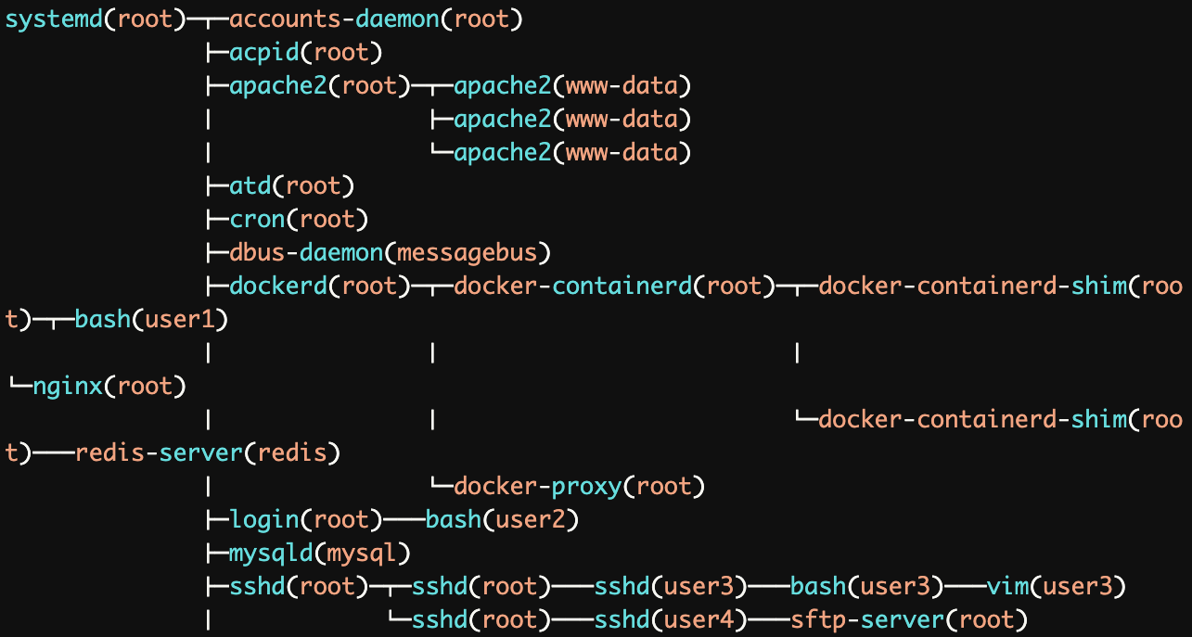
UNIX Process Tree
Main system process starts as root and forks
Output of pstree -u
What is systemd? What is its PID?
Quiz: what does user1, user2, user3, user4 do on this server?

Slide 43
SETUID Bit — Elevating Privileges
The passwd utility allows you to change your password by updating password file /etc/shadow — a file that only root can read/write
Normally, this would not be possible. Why?
UNIX allows you to set EUID of an executable to be the file owner rather than the executing user.

Slide 44
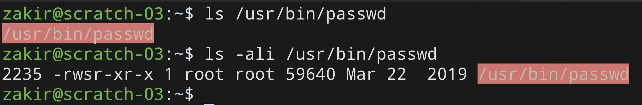
SETUID on passwd
setuid
Q: How does passwd know which user it should
allow the caller change the password for?

Slide 45
setuid vs. setuid (🙀)
setuid syscall (in code):
Allows caller to change User IDs of the process
setuid bit on Executable
Execution runs as owner and group of executable rather than the calling user
setuid(x):
Effective UID => x
Real UID => x
Saved UID => x

Slide 46
Becoming Root User
System configuration files are owned by root
Important system processes run as root
Sometimes, you as a user, need to "become" root to fix problems
  sudo: run a single command as root (requires you to be blessed)
  su: allows you to become root by knowing its password
  sudo su: become root without their password

Slide 47
Worst privilege separation ever?
Traditional UNIX distinguished between privileged processes (EUID == 0) and unprivileged processes (EUID != 0)
Privileged processes bypass all kernel permission checks, while unprivileged processes are subject to full permission checking
Lots of utilities — like ping — depend on setuid
Exceptionally dangerous — a bug in many utilities can lead to compromise
Notes:
For the purpose of performing permission checks, traditional UNIX implementations distinguish two categories of processes: privileged processes (whose effective user ID is 0, referred to as superuser or root), and unprivileged processes (whose effective UID is nonzero). Privileged processes bypass all kernel permission checks, while unprivileged processes are subject to full permission checking based on the process's credentials (usually: effective UID, effective GID, and supplementary group list).

Slide 48
Linux Capabilities
Capabilities segment root powers into components, such that if a program that has one or more capabilities is compromised, damage is limited
CAP_KILL
Bypass permission checks for sending signals
CAP_NET_BIND_SERVICE
Bind a socket to privileged ports (port < 1024).
CAP_SYS_PTRACE
Trace arbitrary processes using ptrace
Notes:
For the purpose of performing permission checks, traditional UNIX implementations distinguish two categories of processes: privileged processes (whose effective user ID is 0, referred to as superuser or root), and unprivileged processes (whose effective UID is nonzero). Privileged processes bypass all kernel permission checks, while unprivileged processes are subject to full permission checking based on the process's credentials (usually: effective UID, effective GID, and supplementary group list).

Slide 49
Overview of UNIX Security Mechanisms
Pros
+ Simple model provides protection for most situations
+ Flexible enough to make most simple systems possible in practice
Cons
- ACLs are coarse-grained — doesn’t account for enterprise complexity
- ACLs don’t handle different applications within a single user account
- Nearly all system operations require root access — people are sloppy
Notes:
For the purpose of performing permission checks, traditional UNIX implementations distinguish two categories of processes: privileged processes (whose effective user ID is 0, referred to as superuser or root), and unprivileged processes (whose effective UID is nonzero). Privileged processes bypass all kernel permission checks, while unprivileged processes are subject to full permission checking based on the process's credentials (usually: effective UID, effective GID, and supplementary group list).

Slide 50
Windows Security Model

Slide 51
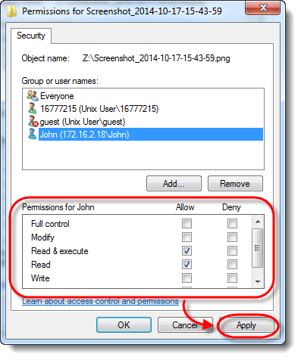
Flexible ACLs
What is Modify permission?
Windows has complex access control options
Objects have full ACLs — possibility for fine-grained permissions
Users can be members of multiple groups; groups can be nested
ACLs support Allow and Deny rules
Notes:
For the purpose of performing permission checks, traditional UNIX implementations distinguish two categories of processes: privileged processes (whose effective user ID is 0, referred to as superuser or root), and unprivileged processes (whose effective UID is nonzero). Privileged processes bypass all kernel permission checks, while unprivileged processes are subject to full permission checking based on the process's credentials (usually: effective UID, effective GID, and supplementary group list).

Slide 52
Object Security Desriptors
Every object has a security descriptor
  - Specifies who can perform what and audit rules
  Contains
  - Security identifiers (SIDs) for the owner and primary group of an object.
  - Discretionary ACL (DACL): access rights allowed users or groups.
  - System ACL (SACL): types of attempts that generate audit records

Slide 53
Tokens
Every process has a set of tokens — its “security context”
  ID of user account
  ID of groups
  ID of login session
  List of OS privileges held by user/groups
  List of restrictions
  Impersonation token can be used temporarily to adopt a different context
Notes:
A capability grants a subject permission to perform a certain action. Unforgeable and transferrable
Capabilities are subject-centric: access control is associated with subjects in the system

Slide 54
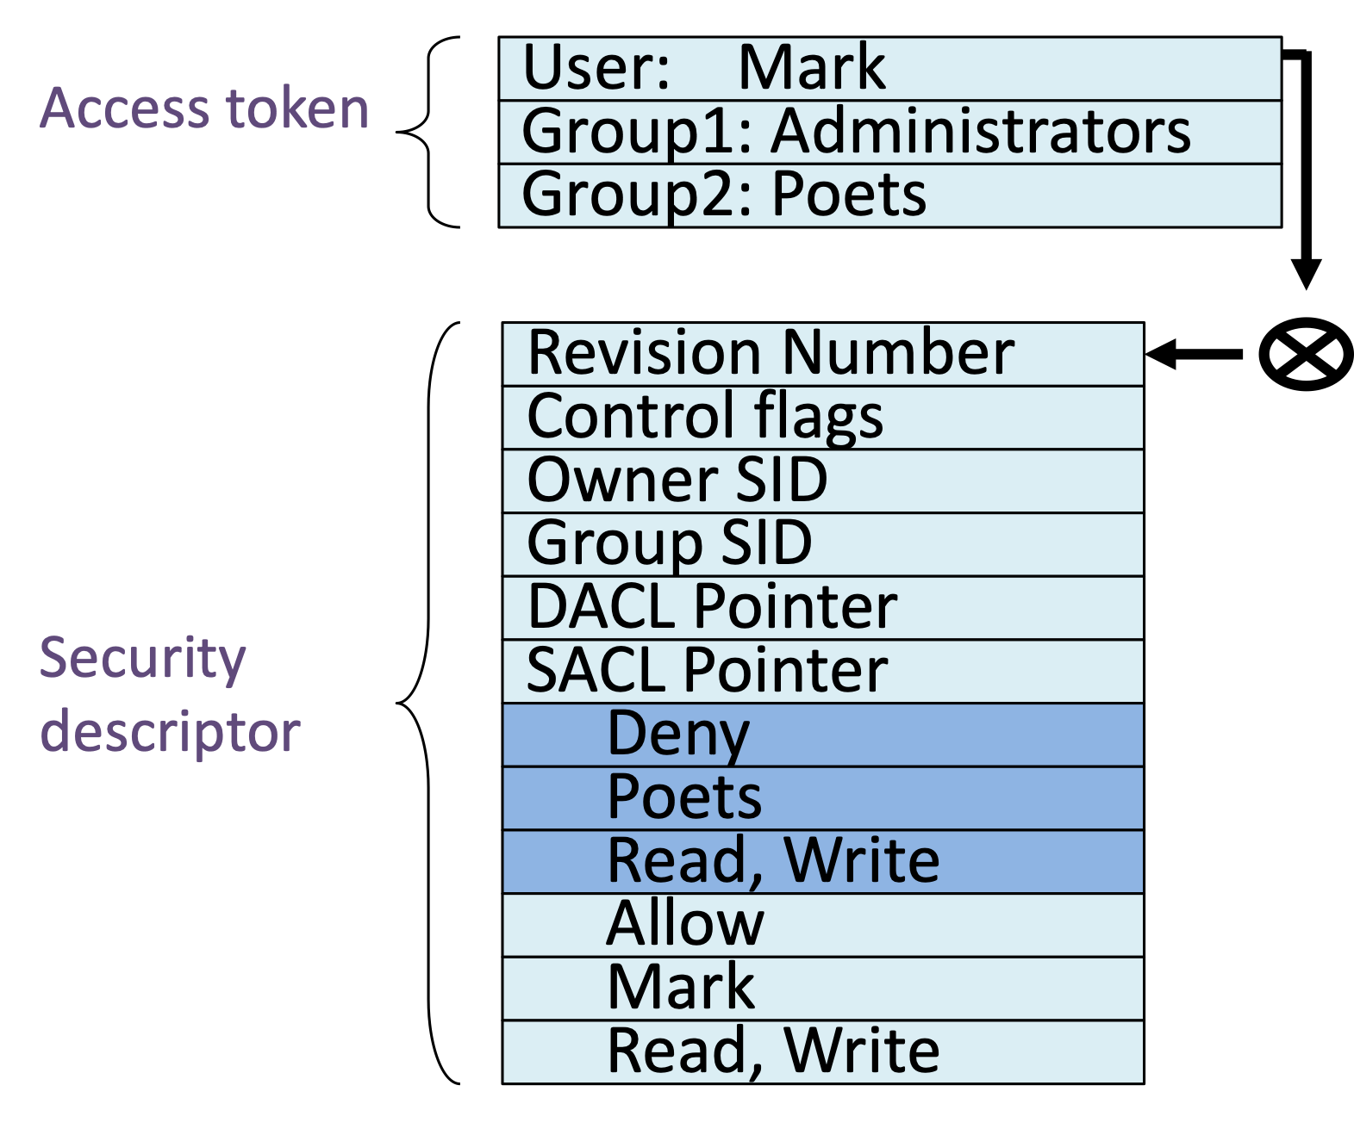
Access Request
When a process wants to access an object, it presents its set of security tokens (security context)
Windows checks whether the security context has access to the object based on the object’s security descriptor
Notes:
A capability grants a subject permission to perform a certain action. Unforgeable and transferrable
Capabilities are subject-centric: access control is associated with subjects in the system
Access control lists are widely used, often with groups
Some aspects of capability concept are used in many systems

Slide 55

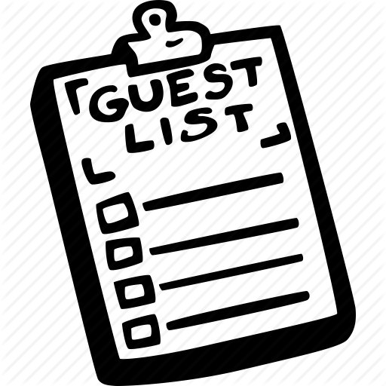
Capabilities vs. ACLs
Capabilities: subject presents an unforgeable ticket that grants access to an object. System doesn’t care who subject is, just that they have access. Like money order, cashier’s check.
ACL: system checks where subject is on list of users with access to the object
Notes:
A capability grants a subject permission to perform a certain action. Unforgeable and transferrable
Capabilities are subject-centric: access control is associated with subjects in the system
Access control lists are widely used, often with groups
Some aspects of capability concept are used in many systems

Slide 56
Weak Protection on Desktops
Relying on user permission provides users with little protection against malicious applications
Malicious application running as you has access to all of your files
Adobe Acrobat can edit, delete, and encrypt/ransom all of your data
Notes:
A capability grants a subject permission to perform a certain action. Unforgeable and transferrable
Capabilities are subject-centric: access control is associated with subjects in the system
Access control lists are widely used, often with groups
Some aspects of capability concept are used in many systems

Slide 57
Mac OS App Sandbox
Mac OS now sandboxes many applications and mediates access to:
Hardware (Camera, Microphone, USB, Printer)
Network Connections (Inbound or Outbound)
App Data (Calendar, Location, Contacts)
User Files (Downloads, Pictures, Music, Movies, User Selected Files)
Access to any resource not explicitly requested in the project definition is rejected by the system at run time.

Slide 58
Android Process Isolation
Android uses Linux and its own kernel application sandbox for isolation
Each application runs with its own UID in its own VM
- Apps cannot interact with one another
- Limit access to system resources (decided at installation time)
Reference monitor checks permissions on intercomponent communication

Slide 59
Chrome Security Architecture

Slide 60
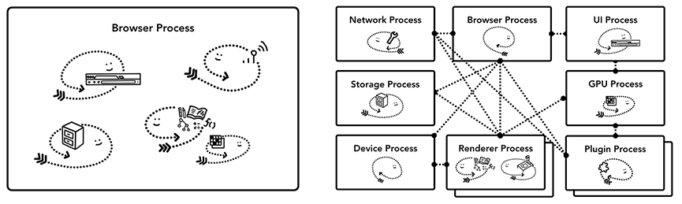
Modern Chrome Architecture
Pre 2006
Modern
Notes:
Prior to Chrome (Pre 2006), most processes operated as a single process. The problem was that renderers are incredibly complex. It's nearly impossible to build a rendering engine that is perfectly secure.
What’s the problem? What can the browser do if it’s compromised on your desktop?

Slide 61
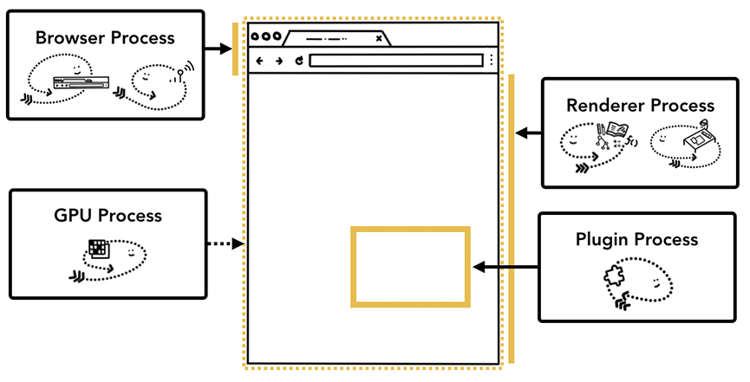
Chrome Processes
Browser Process
Controls "chrome" part of the application
like address bar and, bookmarks. Also
handles the invisible, privileged parts of a
web browser like network requests.
Renderer Process
Controls anything inside of the tab where
a website is displayed.
Plugin Process
Controls any plugins used by the website, for example, flash.
GPU Process
Handles GPU tasks in isolation from other processes. It is separated into different process because GPUs handles requests from multiple apps and draw them in the same surface
Notes:
Restrict access from each rendering engine process to others and to the rest of the system. In some ways, this brings to web browsing the benefits that memory protection and access control brought to operating systems.

Slide 62
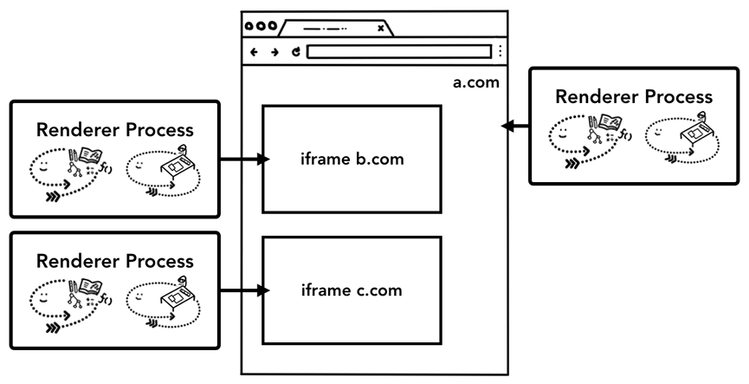
Process-Based Site Isolation
Notes:
Last year, Chrome went a step further….

Slide 63
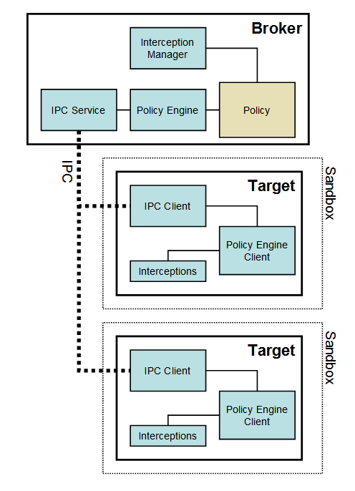
Chrome Architecture
Broker (Main Browser)
Privileged controller/supervisor of the activities of the sandboxed processes
Renderer's only access to the network is via its parent browser process and file system access can be restricted
Notes:
In Chromium, the broker is always the browser process. The broker, is in broad terms, a privileged controller/supervisor of the activities of the sandboxed processes. The responsibilities of the broker process are:
Specify the policy for each target process
Spawn the target processes
Host the sandbox policy engine service
Host the sandbox interception manager
Host the sandbox IPC service (to the target processes)
Renderer's only access to the network is via its parent browser process. Likewise, we can restrict its access to the filesystem using the host operating system's built-in permissions. We run each render process on a separate Windows "Desktop" which is not visible to the user. This prevents a compromised renderer from opening new windows or capturing keystrokes.

Slide 64
Restricted Security Context
Chrome calls CreateRestrictedToken to create a token that has a subset of the user’s privileges.
Assigns the token the user and group S-1-0-0 Nobody. Removes access to nearly every system resource.
As long as the disk root directories have non-null security, no files (even with null ACLs) can be accessed
No network access (on Vista and later)

Slide 65
Windows Integrity Levels
Windows Vista introduced concept of integrity levels to ease development
- untrusted, low, medium, high, system
Most processes run at medium level
Low-integrity level has limited scope, e.g., can read but cannot write files

Slide 66
Principles of Secure Systems
✓ Defense in depth
✓ Principle of least privilege
✓ Privilege separation
✓ Open design
✓ Keep it simple
Notes:
Defense in Depth is one of the core principles is in building secure systems. Today we’ll talk about the five most important principles.

Slide 67
Open Design
“The security of a mechanism should not depend on the secrecy of its design or implementation.”
If the details of the mechanism leaks (through reverse engineering, dumpster diving or social engineering), then it is a catastrophic failure for all the users at once.
If the secrets are abstracted from the mechanism, e.g., inside a key, then leakage of a key only affects one user.
Notes:
Defense in Depth is one of the core principles is in building secure systems. Today we’ll talk about the five most important principles.

Slide 68
Kerckhoff’s Principle
“a crypto system should be secure even if everything about the system, except the key, is public knowledge.”
- Auguste Kerckhoff
Notes:
Defense in Depth is one of the core principles is in building secure systems. Today we’ll talk about the five most important principles.

Slide 69
Principles of Secure Systems
✓ Defense in depth
✓ Principle of least privilege
✓ Privilege separation
✓ Open design
✓ Keep it simple
Notes:
Defense in Depth is one of the core principles is in building secure systems. Today we’ll talk about the five most important principles.

