Slide 1

Comp 4634
Isolation: the confinement principle
Dongdong She
Some slides are borrowed from Dan Boneh

Slide 2
Phishing Email Attack

Slide 3
Running untrusted code
We often need to run buggy/unstrusted code:
programs from untrusted Internet sites:
mobile apps, Javascript, browser extensions
exposed applications: browser, pdf viewer, outlook
legacy daemons: sendmail, bind
honeypots
Goal: if application “misbehaves” ⇒ kill it
Where can we find buggy code?
How to deal with this case?

Slide 4


Approach: confinement
Confinement: ensure misbehaving app cannot harm rest of system
Can be implemented at many levels:
Hardware: run application on isolated hw (air gap)
How to attack machines with air gap protections?
app 1
app 2
Network 2
air gap
network 1
⇒ difficult to manage

Slide 5
Approach: confinement
Confinement: ensure misbehaving app cannot harm rest of system
Can be implemented at many levels:
Virtual machines: isolate OS’s on a single machine
How to launch attack in this case?
OS₁
OS₂
app1
app2
Virtual Machine Monitor (hypervisor)
Hardware

Slide 6

Approach: confinement
Confinement: ensure misbehaving app cannot harm rest of system
Can be implemented at many levels:
Process: System Call Interposition (containers)
Isolate a process in a single operating system
Example of system call monitoring and controlling? From last lecture?
process 1
process 2
Operating System

Slide 7
Approach: confinement
Confinement: ensure misbehaving app cannot harm rest of system
Can be implemented at many levels:
Threads: Software Fault Isolation (SFI)
Isolating threads sharing the same address space
Application level confinement: e.g. browser sandbox for Javascript and WebAssembly
How does SFI work? Memory access policy; segmentation

Slide 8
Implementing confinement
Key component: reference monitor
Mediates requests from applications
Enforces confinement
Implements a specified protection policy
Must always be invoked:
Every application request must be mediated
Tamperproof:
Reference monitor cannot be killed
… or if killed, then monitored process is killed too
Small enough to be analyzed and validated
Monitor and Check
Cannot be bypassed
Cannot be tampered
Why?

Slide 9
A old example: chroot
What is chroot?
A jail on filesystem access
To use do: (must be root)
chroot /tmp/guest root dir “/” is now “/tmp/guest”
su guest EUID set to “guest”
Now “/tmp/guest” is added to every file system accesses:
fopen(“/etc/passwd”, “r”) ⇒ fopen(“/tmp/guest/etc/passwd” , “r”)
⇒ application (e.g., web server) cannot access files outside of jail

Slide 10
Escaping from jails
Early escapes: relative paths
fopen( “../../etc/passwd”, “r”) ⇒ ???
chroot should only be executable by root.
otherwise jailed app can do:
create dummy file “/aaa/etc/passwd” and “/aaa/etc/shadow”
run $ chroot “/aaa”
run $ su root
What is the final path?
Quiz: can we get a root if we don’t know password for root?
(bug in Ultrix 4.0)

Slide 11
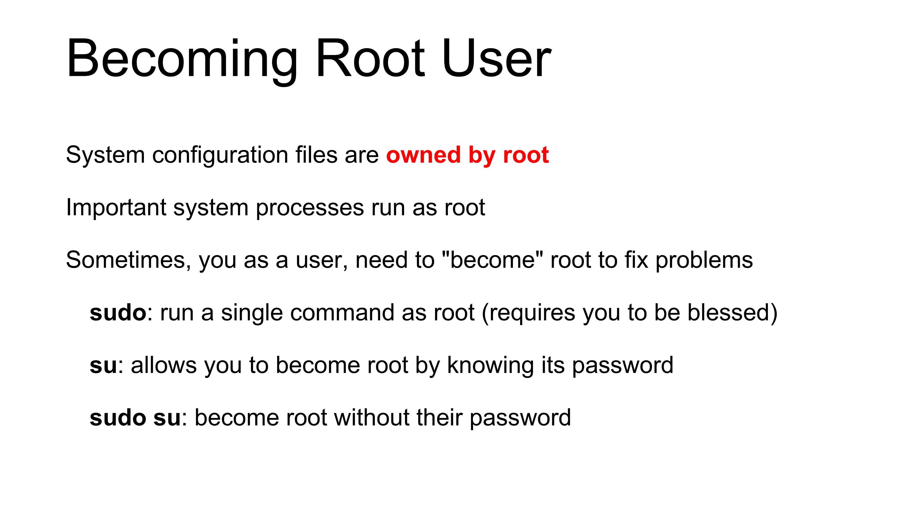
Jailkit
Problem: all utility progs (ls, ps, vim) must live inside jail
jailkit: auto builds files, libs, and dirs needed in jail env
jk_init: creates jail environment
jk_check: checks jail env for security problems
checks for any modified programs,
checks for world writable directories, etc.
jk_lsh: restricted shell to be used inside jail
note: simple chroot jail does not limit network access

Slide 12
Many ways to escape jail as root
Create device that lets you access raw disk
Send signals to non chrooted process
Reboot system
Bind to privileged ports

Slide 13
Freebsd jail
Stronger mechanism than simple chroot
To run: jail jail-path hostname IP-addr cmd
calls hardened chroot (no “../../” escape)
can only bind to sockets with specified IP address and authorized ports
can only communicate with processes inside jail
root is limited, e.g. cannot load kernel modules
Notes:
Can run web server inside of jail. If web server is compromised, damage is limited.

Slide 14
Problems with chroot and jail
Coarse policies:
All or nothing access to parts of file system
Inappropriate for apps like a web browser
Needs read access to files outside jail (e.g., for sending attachments in Gmail)
Does not prevent malicious apps from:
Accessing network and messing with other machines
Trying to crash host OS

Slide 15

System Call Interposition: sanboxing a process
Confinement

Slide 16
System call interposition
Observation: to damage host system (e.g., persistent changes) app must make system calls:
To delete/overwrite files: unlink, open, write
To do network attacks: socket, bind, connect, send
Idea: monitor app’s system calls and block unauthorized calls
Implementation options:
Completely kernel space (e.g., Linux seccomp)
Completely user space (e.g., program shepherding)
Hybrid (e.g., Systrace)
Notes:
GSWTK: generic software wrapper toolkit

Slide 17
Basic of Ptrace()
A powerful syscall to control and inspect process
Read/write process memory (including code region)
Read/write process registers
Intercept signal
Intercept syscall
Show a concrete example

Slide 18
Early implementation (Janus) [GWTB’96]
Linux ptrace: process tracing
process calls: ptrace (… , pid_t pid , …)
and wakes up when pid makes sys call.
Monitor kills application if request is disallowed
user space
monitored
application
(browser)
monitor
fopen(“/etc/passwd”, “r”)
OS Kernel

Slide 19
Example policy
Sample policy file (e.g., for PDF reader)
path allow /tmp/*
path deny /etc/passwd
network deny all
Manually specifying policy for an app can be difficult:
Recommended default policies are available
… can be made more restrictive as needed.

Slide 20
Complications
cd(“/tmp”)
open(“passwd”, “r”)
cd(“/etc”)
open(“passwd”, “r”)
If app forks, monitor must also fork
forked monitor monitors forked app
If monitor crashes, app must be killed
Monitor must maintain all OS state consistent with app
current-working-dir (CWD), UID, EUID, GID
When app does “cd path” monitor must update its CWD
otherwise: relative path requests interpreted incorrectly

Slide 21
Problems with ptrace
Ptrace is not well suited for this application:
Trace all system calls or non
inefficient: no need to trace “close” system call
Monitor cannot abort sys-call without killing app
Security problems: race conditions
Example: symlink: me ⟶ mydata.dat
proc 1: open(“me”)
monitor checks and authorizes
proc 2: me ⟶ /etc/passwd
OS executes open(“me”)
Classic TOCTOU bug: time-of-check / time-of-use
Fun story: how to hack M+ museum with a simple race condition?
time
not atomic

Slide 22
SCI in Linux: seccomp-bpf
Seccomp-BPF: Linux kernel facility used to filter process sys calls
Sys-call filter written in the BPF language (use BPFC compiler)
Used in Chromium, Docker containers, …
…
Chrome renderer process starts
Renderer process renders site
user space
prctl(PR_SET_SECCOMP, SECCOMP_MODE_FILTER, &bpf_policy)
due to exploit:
fopen(“/etc/passwd”, “r”)
OS Kernel
seccomp-bpf
run BPF program … kill process
Notes:
Chrome broker process starts renderer process to render new site. First thing it does is install a BPF filter.
prctl: MODE_FILTER means run BPF program on every syscall (MODE_STRICT only allows a small number of syscalls)

Slide 23
BPF filters (policy programs)
Process can install multiple BPF filters:
once installed, filter cannot be removed (all run on every syscall)
if program forks, child inherits all filters
if program calls execve, all filters are preserved
BPF filter input: syscall number, syscall args., arch. (x86 or ARM)
Filter returns one of:
SECCOMP_RET_KILL: kill process
SECCOMP_RET_ERRNO: return specified error to caller
SECCOMP_RET_ALLOW: allow syscall
Notes:
Process is killed as if by SIGSYS signal: bad system call

Slide 24
Installing a BPF filter
Must be called before setting BPF filter.
Ensures set-UID, set-GID ignored on subequent execve() ⇒ attacker cannot elevate privilege
int main (int argc , char **argv ) {
prctl(PR_SET_NO_NEW_PRIVS , 1);
prctl(PR_SET_SECCOMP, SECCOMP_MODE_FILTER, &bpf_policy)
fopen(“file.txt", “w”);
printf(“… will not be printed. \n” );
}
Kill if call open() for write

Slide 25
Docker: isolating containers using seccomp-bpf
containers
Container: process level isolation
Container prevented from making sys calls filtered by secomp-BPF
Whoever starts container can specify BPF policy
default policy blocks many syscalls, including ptrace
App 1
App 2
App 3
Docker engine
host OS
hardware
Notes:
Chrome: used to sandbox renderes.
Also mention Linux LXC

Slide 26
Docker sys call filtering
Run nginx container with a specific filter called filter.json:
$ docker run --security-opt=“seccomp=filter.json” nginx
Example filter:
“defaultAction”: “SCMP_ACT_ERRNO”, // deny by default
“syscalls”: [
{ "names": ["accept”], // sys-call name "action": "SCMP_ACT_ALLOW", // allow (whitelist) "args": [ ] } , // what args to allow
… ]
Question: is it a whitelist or a blacklist?
Notes:
https://antitree.com/2017/09/docker-seccomp-json-format/

Slide 27
More Docker confinement flags
drop all capabilities
allow to bind to privileged ports
Specify as an unprivileged user: $ docker run --user www nginx
Limit Linux capabilities: $ docker run --cap-drop all --cap-add NET_BIND_SERVICE nginx
Prevent process from becoming privileged (e.g., by a setuid binary)
$ docker run --security-opt=no-new-privileges:true nginx
Limit number of restarts and resources (# open files, # processes):
$ docker run --restart=on-failure:<max-retries> --ulimit nofile=<max-fd> --ulimit nproc=<max-proc> nginx
Notes:
NET_BIND_SERVICE: enabled by default along with many others. Best to drop all capabilities and only add the ones you need.
max-fd: max # file descriptors, max-proc: max # of processes in container. Resource containment is done using Linux control groups (cgroups).
Linux capabilities: list of capabilities assigned to process. Processes with uid == 0 are privileged, but can only do things allowed by the capabilities assigned to them.

Slide 28
Via Virtual Machines
Confinement

Slide 29
Virtual Machine Basis
VM is a software emulation of a physical computer
Host machine: hardware provides resource access
Guest machine: VM itself
Hypervisor: software manages VM
Type1 (Bare-metal): run directly on host’s hardware, e.g., Microsoft Hyper-V, Xen
Type2 (Hosted): run on host’s OS, e.g., VMware Workstation, Oracle VirtualBox

Slide 30
Virtual Machines
VM2
VM1
Apps
Apps
Guest OS 2
Guest OS 1
Virtual Machine Monitor (VMM, hypervisor)
Host OS
Hardware
single HW platform with isolated components

Slide 31
Why so popular?
VMs in the 1960’s:
Few computers, lots of users
VMs allow many users to shares a single computer
VMs 1970’s – 2000: non-existent
VMs since 2000:
Too many computers, too few users
Print server, Mail server, Web server, File server, Database , …
VMs heavily used in private and public clouds

Slide 32
Hypervisor security assumption
Hypervisor Security assumption:
Malware can infect guest OS and guest apps
But malware cannot escape from the infected VM
Cannot infect host OS
Cannot infect other VMs on the same hardware
Requires that hypervisor protect itself and is not buggy
(some) hypervisors are much simpler than a full OS

Slide 33
Problem: covert channels
Covert channel: unintended communication channel between isolated components
Can leak classified data from secure component to public component
Classified VM
Public VM
listener
secret
doc
malware
covert
channel
hypervisor

Slide 34
An example covert channel
Both VMs use the same underlying hardware
To send a bit b ∈ {0,1} malware does:
b= 1: at 1:00am do CPU intensive calculation
b= 0: at 1:00am do nothing
At 1:00am listener does CPU intensive calc. and measures completion time
b = 1 ⇒ completion-time > threshold
Many covert channels exist in running system:
File lock status, cache contents, interrupts, …
Difficult to eliminate all

Slide 35
VM isolation in practice: cloud
Shared resource
Vulnerability: escape VM
Memory management bugs
VM instance
customer 1
VM instance
customer 2
Guest OS
Guest OS
Xen hypervisor
Hardware
Type 1 hypervisor: no host OS
VMs from different customers may run on the same machine
Hypervisor must isolate VMs … but some info leaks
How?
Notes:
On a single core machine: customer 2 can measure customer 1’s CPU utilization.

Slide 36

VM isolation in practice: end-user
Qubes OS: a desktop/laptop OS where everything is a VM
Runs on top of the Xen hypervisor
Access to peripherals (mic, camera, usb, …) controlled by VMs
Disposable VM
Work VM
Personal VM
sketchy PDF:
Debian OS
Windows OS
Debian OS
Xen hypervisor
Hardware
Notes:
VMs are created from template VMs. 30,000 users worldwide. Used by news organizations.

Slide 37
VM isolation in practice: end-user
Qubes OS: a desktop/laptop OS where everything is a VM
Runs on top of the Xen hypervisor
Access to peripherals (mic, camera, usb, …) controlled by VMs
Whonix VM
Vault VM
Work VM
Personal VM
Pwd/U2F Manager
Force all traffic through Tor
Debian OS
Windows OS
Debian OS
Debian OS
Xen hypervisor
Hardware
Notes:
30,000 users worldwide. VMs are created from template VMs.

Slide 38
Every window frame identifies VM source
GUI VM ensures frames are drawn correctly
Notes:
When a dialog pops up, user knows exactly which VM it came from.

Slide 39
VM Introspection: using a VMM for intrusion detection

Slide 40
Intrusion Detection / Anti-virus
How to defend this attack from kernel rootkit?
Runs as part of OS kernel and user space process
Kernel root kit can shutdown protection system
Common practice for modern malware
Better: run IDS as part of VMM, protected from malware
VMM can monitor virtual hardware for anomalies
VMI: Virtual Machine Introspection
VMM checks Guest OS internals
Notes:
IDS = Intrusion Detection System

Slide 41
Infected VM
malware
Guest OS
VMM
IDS
Hardware

Slide 42
Sample checks
How to hide process info?
Stealth root-kit malware:
Creates processes that are invisible to “ps”
Opens sockets that are invisible to “netstat”
1. Lie detector check
Goal: detect stealth malware that hides processes and network activity
Method:
VMM lists processes running in GuestOS
VMM requests GuestOS to list processes (e.g. ps)
If mismatch: kill VM

Slide 43
Sample checks
2. Application code integrity detector
VMM computes hash of user app code running in VM
Compare to whitelist of hashes
Kills VM if unknown program appears
3. Ensure GuestOS kernel integrity
example: detect changes to sys_call_table
4. Virus signature detector
Run virus signature detector on GuestOS memory

Slide 44
Hypervisor detection
Can an OS detect it is running on top of a hypervisor?
Applications:
Malware can detect hypervisor
refuse to run to avoid reverse engineering
Software that binds to hardware can refuse to run in VM
DRM systems may refuse to run on top of hypervisor

Slide 45
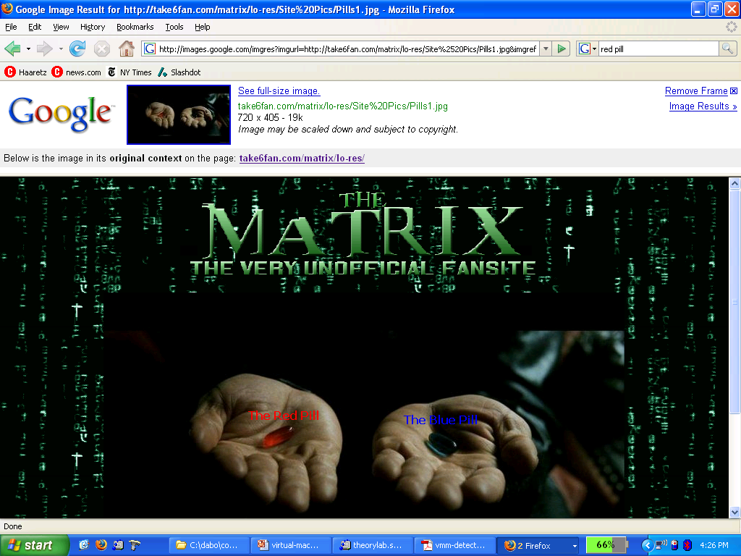
Hypervisor detection

Slide 46
Hypervisor detection (red pill techniques)
VM platforms often emulate simple hardware
VMWare emulates an ancient i440bx chipset
… but report 64GB RAM, dual CPUs, etc.
Hypervisor introduces time latency variances
Memory cache behavior differs in presence of hypervisor
Results in relative time variations for any two operations
Hypervisor shares the TLB with GuestOS
GuestOS can detect reduced TLB size
… and many more methods [GAWF’07]
Why does the time latency exist on VM?
Notes:
http://www.usenix.org/event/hotos07/tech/full_papers/garfinkel/garfinkel.pdf

Slide 47
Hypervisor detection in the browser [HBBP’14]
Can we identify malware web sites?
Approach: crawl web, load pages in a browser running in a VM, look for pages that damage VM
The problem: Web page can detect it is running in a VM How? Using timing variations in writing to screen
Malware in web page becomes benign when in a VM ⇒ evade detection

Slide 48
Hypervisor detection
Bottom line: The perfect hypervisor does not exist
Hypervisors today focus on:
Compatibility: ensure off the shelf software works
Performance: minimize virtualization overhead
Hypervisors do not provide transparency
Anomalies reveal existence of hypervisor
Time discrepancy
CPUID instruction
Hardware inconsistency
Resource limit

Slide 49
Software Fault Isolation: isolating threads
Confinement

Slide 50
Software Fault Isolation [Whabe et al., 1993]
Goal: confine apps running in same address space
Kernel module should not corrupt kernel
Native libraries should not corrupt JVM
Simple solution: runs apps in separate address spaces
Problem: slow if apps communicate frequently
requires context switch per message

Slide 51
Software Fault Isolation
SFI approach: Partition process memory into segments
Locate unsafe instructions: jmp, load, store
At compile time, add guards before unsafe instructions
When loading code, ensure all guards are present
code
segment
data
segment
code
segment
data
segment
app #1
app #2

Slide 52
Segment matching technique
Guard ensures code does not load data from another segment
Designed for MIPS processor. Many registers available.
dr1, dr2: dedicated registers not used by binary
compiler pretends these registers don’t exist
dr2 contains segment ID
Indirect load instruction R12 ⟵ [R34] becomes:
dr1 ⟵ R34
scratch-reg ⟵ (dr1 >> 20) : get segment ID
compare scratch-reg and dr2 : validate seg. ID
trap if not equal
R12 ⟵ [dr1] : do load

Slide 53
Address sandboxing technique
dr2: holds segment ID
Indirect load instruction R12 ⟵ [R34] becomes:
dr1 ⟵ R34 & segment-mask : zero out seg bits
dr1 ⟵ dr1 | dr2 : set valid seg ID
R12 ⟵ [dr1] : do load
Fewer instructions than segment matching
… but does not catch offending instructions
Similar guards placed on all unsafe instructions

Slide 54
Problem: what if jmp [addr] jumps directly into indirect load?
(bypassing guard)
Solution:
This is why jmp instructions need a guard:
jmp guard ensures [addr] does not bypass load guard
Notes:
Defense: clear low order bits of jump address.

Slide 55
Cross domain calls
caller
domain
callee
domain
call stub
draw:
return
call draw
br addr
br addr
ret stub
br addr
br addr
br addr
br addr
Only stubs allowed to make cross-domain jumps
Jump table contains allowed exit points
Addresses are hard coded, read-only segment

Slide 56
SFI Summary
Performance
Usually good: mpeg_play, 4% slowdown
Limitations of SFI: harder to implement on x86 :
variable length instructions: unclear where to put guards
few registers: can’t dedicate three to SFI
many instructions affect memory: more guards needed

Slide 57
Confinement: summary
Many sandboxing techniques:
Physical air gap, Virtual air gap (hypervisor),
System call interposition (SCI), Software Fault isolation (SFI)
Application specific (e.g. Javascript in browser)
Often complete isolation is inappropriate
Apps need to communicate through regulated interfaces
Hardest aspects of sandboxing:
Specifying policy: what can apps do and not do
Preventing covert channels

Slide 58
THE END

