Slide 1
Vulnerabilities and exploitation
concepts and automated techniques
Some slides are borrowed from Brandon Azad

Slide 2
The software world is evolving…
Most software will be written by machines, not people
The distribution of bugs written by LLMs vs people is different The distribution of bugs found by LLMs vs people is different
Software complexity grows ~quadratically; LLMs will not solve security
Bugs, including security bugs, will continue to proliferate
Economics & asymmetric attacker advantage mean exploitation will continue
We need a deeper, fundamental understanding of what security is

Slide 3
Conceptualizing vulnerabilities and exploits

Slide 4
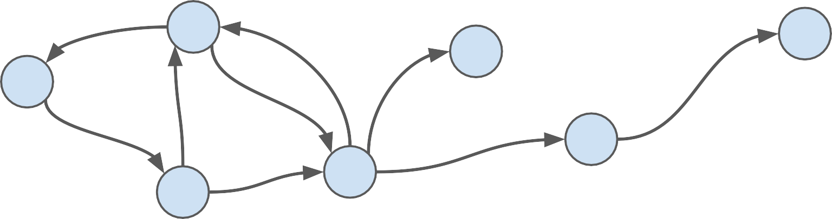
Computer programs: finite state machines

Slide 5
Computer programs: finite state machines
This is a conceptual state machine describing the intended operation of the program

Slide 6
Computer programs: finite state machines
This is a conceptual state machine describing the intended operation of the program
A physical CPU cannot directly execute this abstract state machine

Slide 7
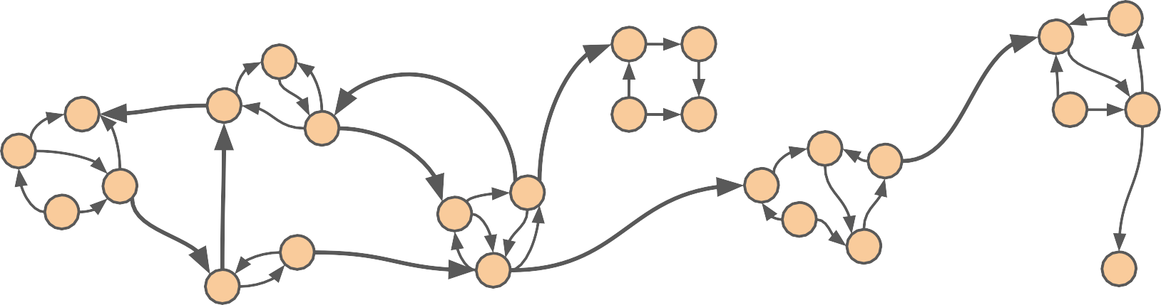
Running code: state machines emulating state machines

Slide 8
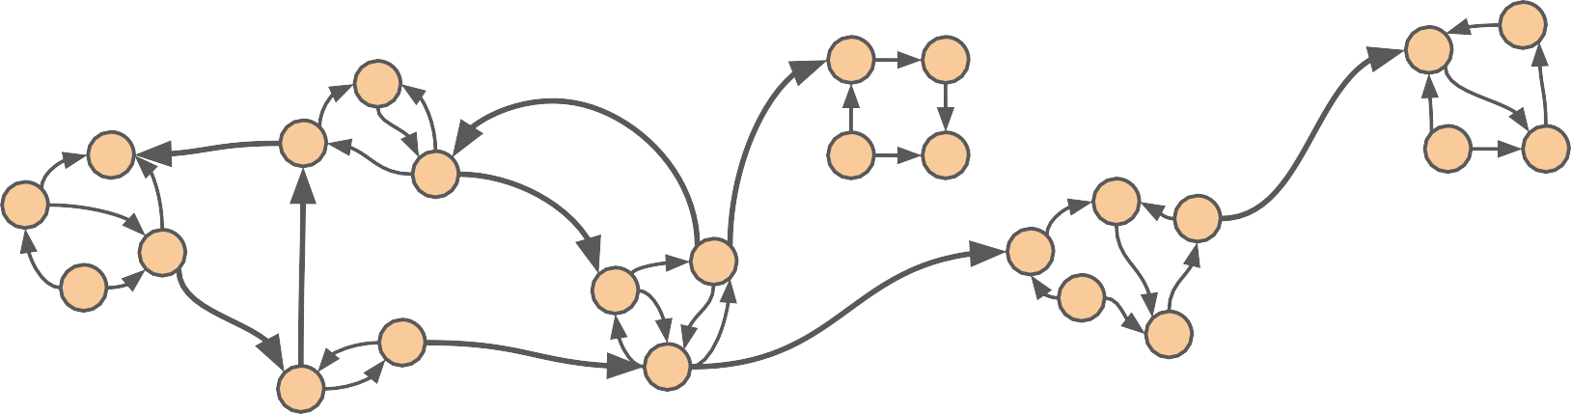

Running code: state machines emulating state machines
This is the intended state machine translated into code that can be run on a physical CPU (C++, Python, etc.)*
* Not quite true: that code still needs to be translated to machine code, which introduces another level of state machines emulating state machines

Slide 9

Running code: state machines emulating state machines
Bugs occur when there are reachable states in the runnable state machine (the code) that have no corresponding state in the intended state machine (the design)*
* Not the full picture: the initial design itself could have issues (design issues) which still count as software bugs

Slide 10
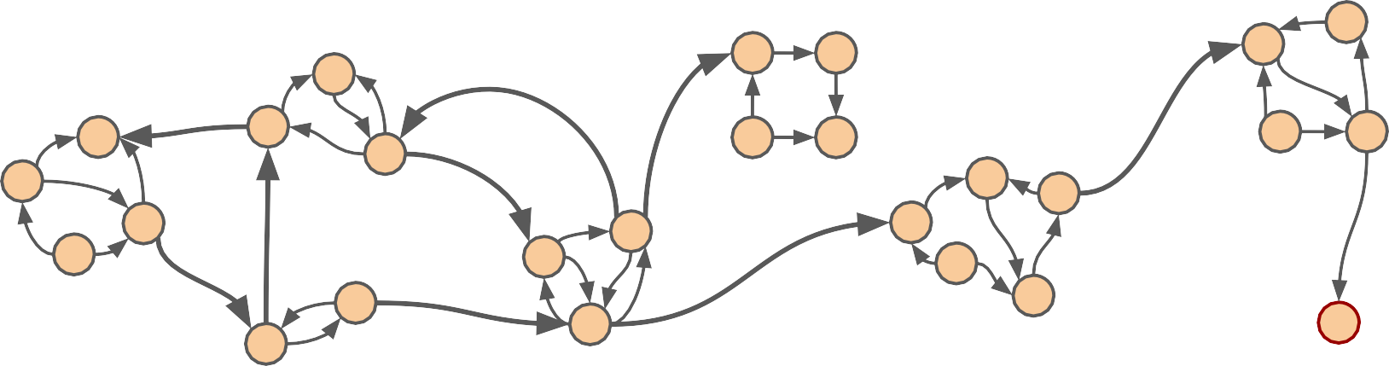
Running code: state machines emulating state machines
Bugs occur when there are reachable states in the runnable state machine (the code) that have no corresponding state in the intended state machine (the design)*

Slide 11
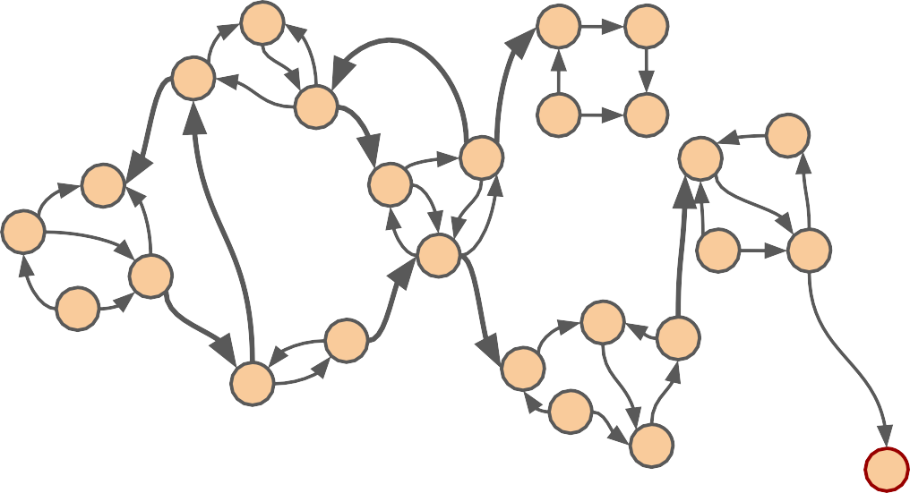
Classifying states

Slide 12
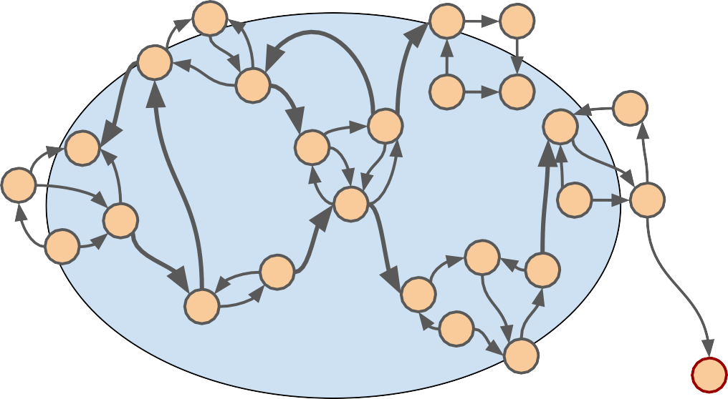
Classifying states
Intended states

Slide 13
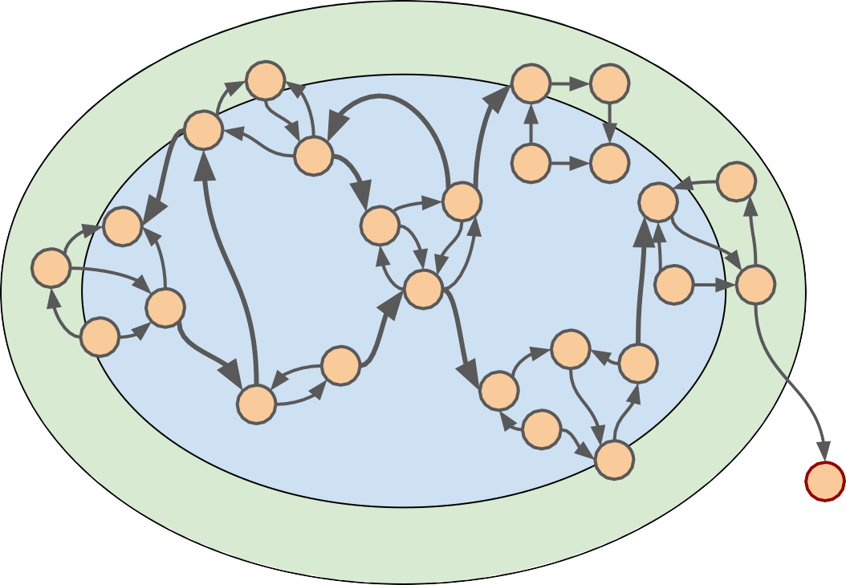
Classifying states
Intended states
Transition states

Slide 14
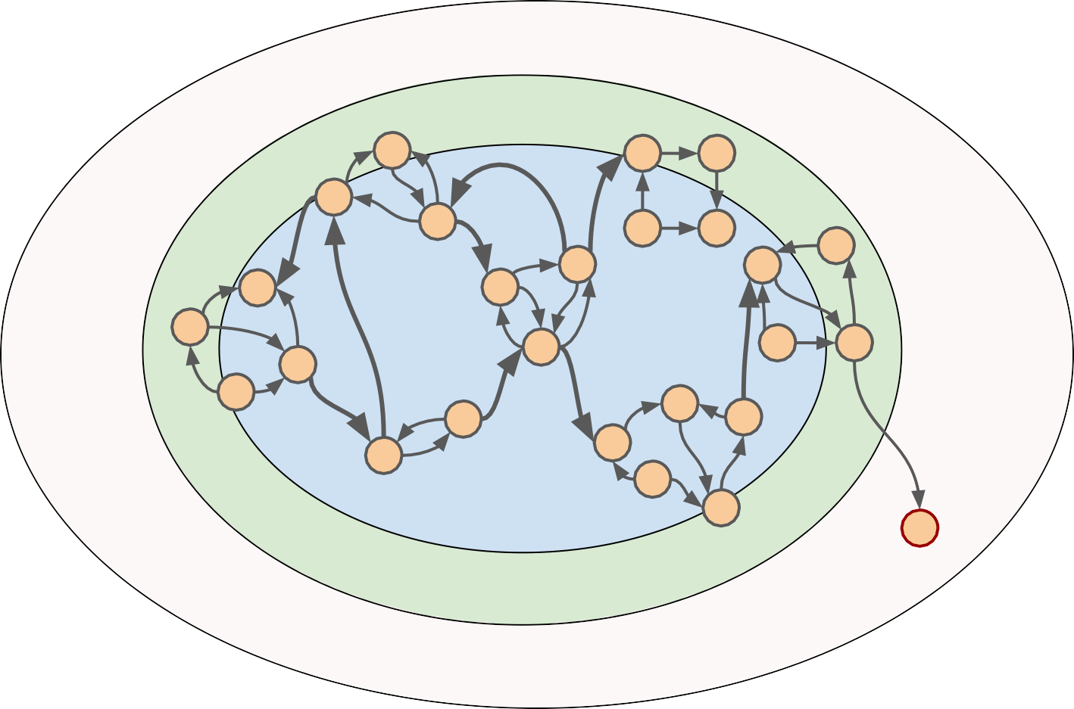
Classifying states
Intended states
Transition states
Unreachable states
Unintended states

Slide 15
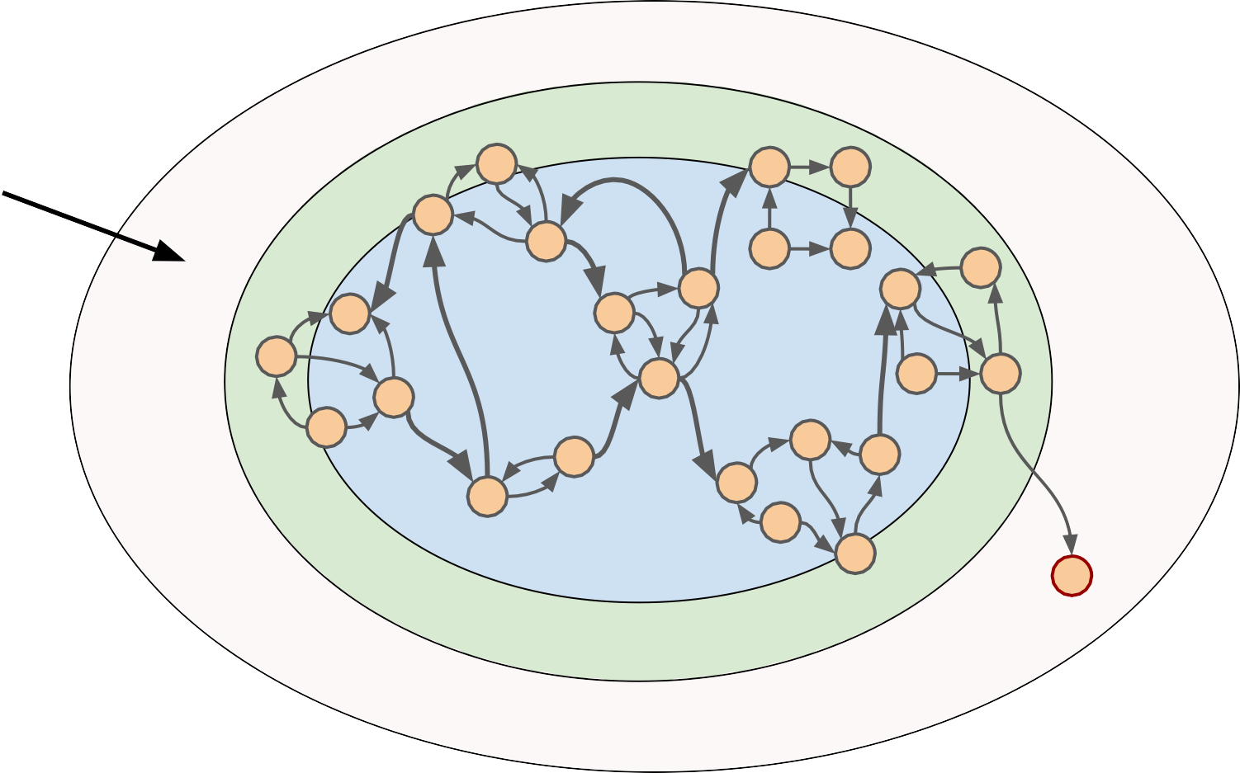
Vulnerabilities
Vulnerabilities live here
Intended states
Transition states
Unreachable states
Unintended states

Slide 16
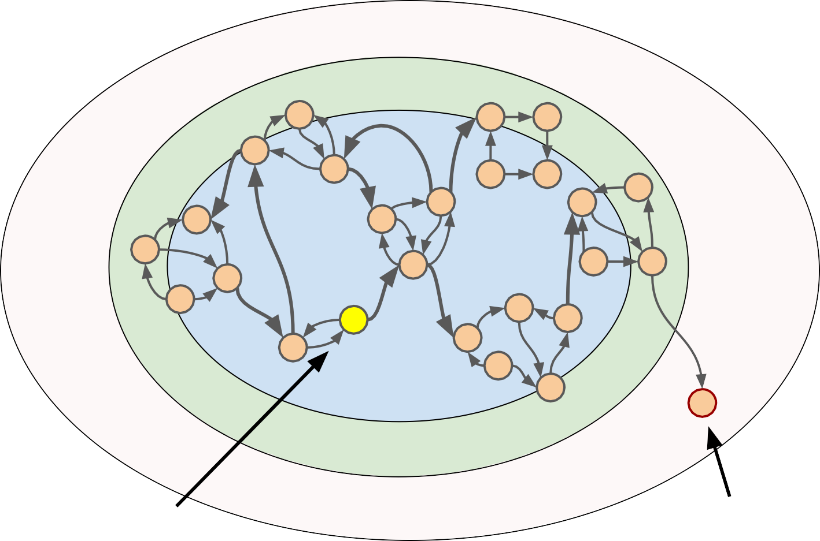
Vulnerabilities
Intended states
Transition states
Initial state
Unintended states
Vulnerable state

Slide 17
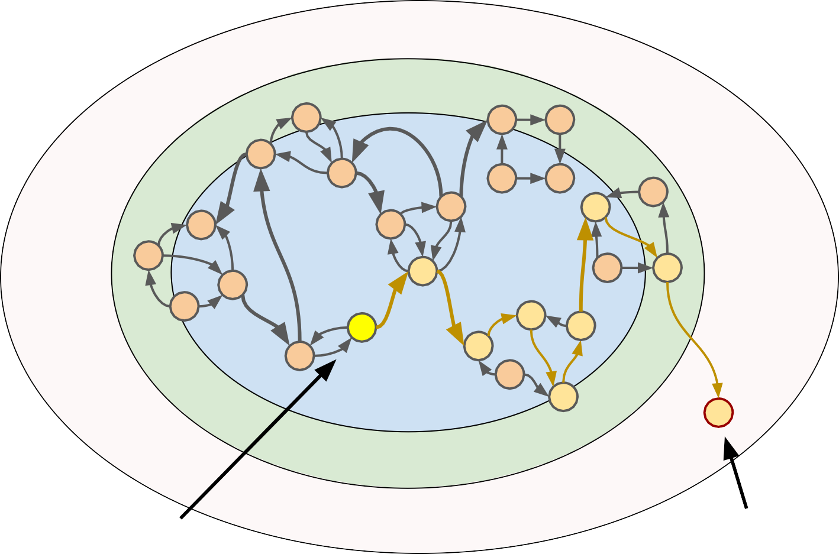
Vulnerabilities
“Triggering the vulnerability” or
“proof-of-concept”
Intended states
Transition states
Initial state
Unintended states
Vulnerable state

Slide 18
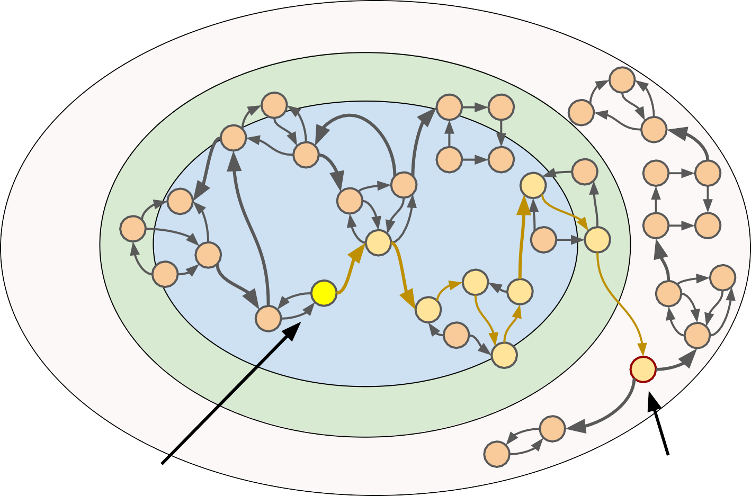
Exploitation
Exploitation is making the program do “interesting” transitions in the unintended state space
Intended states
Transition states
Initial state
Unintended states
Vulnerable state

Slide 19
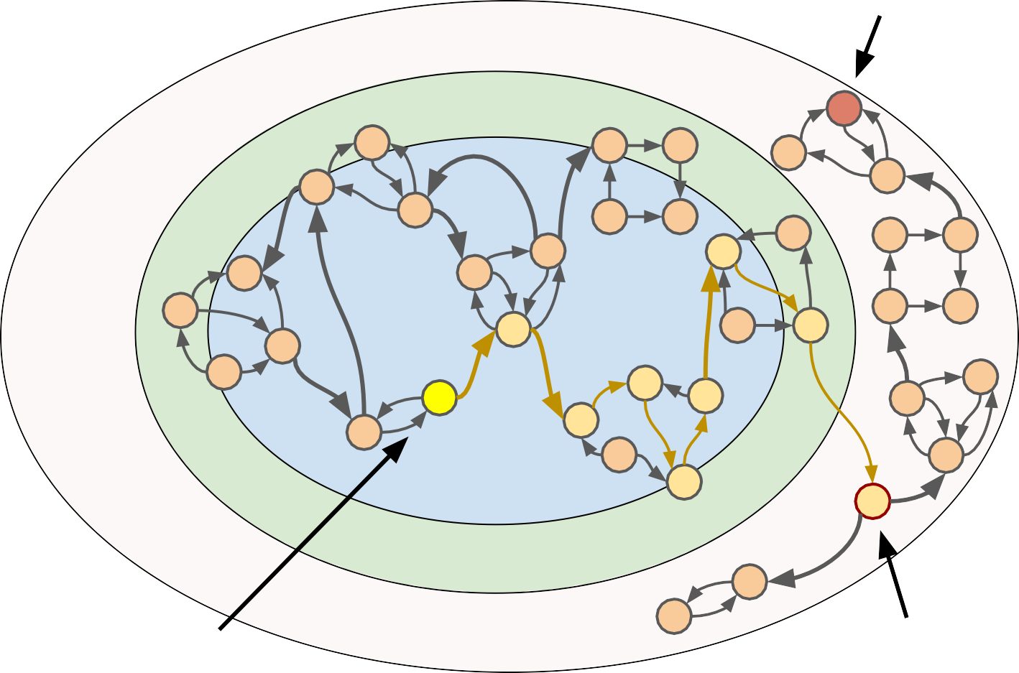
Exploitation
Exploit goal
Exploitation is making the program do “interesting” transitions in the unintended state space
Intended states
Transition states
Initial state
Unintended states
Vulnerable state

Slide 20
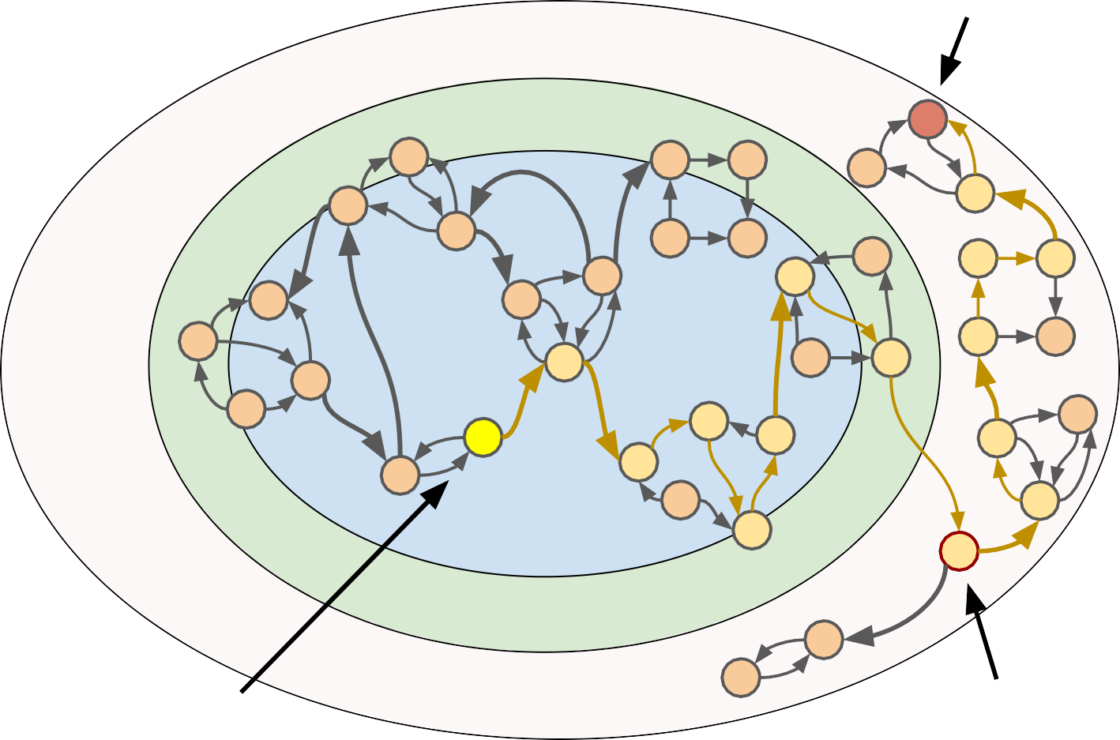
Exploitation
Exploit goal
Exploitation is making the program do “interesting” transitions in the unintended state space
Intended states
Transition states
Initial state
Unintended states
Vulnerable state
http://www.dullien.net/thomas/weird-machines-exploitability.pdf

Slide 21
Common categories of software bugs
Design issue: The conceptual state machine does not meet the intended goals
The firewall’s remote interface is designed with a hardcoded admin password
Functionality bug: The code has bad transitions but only between validly represented states
The save button code is broken, no transition to “saving the file” state
Implementation bug: Code introduces new states not represented in the conceptual state machine
Lack of length checks introduces new “stack corruption” state

Slide 22
Other ways to reach unintended states
Hardware fault: The hardware suffers a glitch that causes a transition to an unintended state even if the code is perfect
A cosmic ray causes a bit flip in a voting machine’s memory, causing a state where one candidate has an impossible number of votes
Transmission error: The code is correct but is corrupted in-flight
A program downloaded from the internet suffers packet corruption, so the program that is run has a different state machine from the one that was sent
This list is not intended to be exhaustive; merely to illustrate the myriad ways that unintended states may enter a system; deciding which ones to defend against is one step of proper threat modeling

Slide 23
Vulnerability terminology
Vulnerability: A bug that has security impact, i.e. is useful to some attacker
Invariant: A property that the code wants to be true; if it can be false, it’s a bug Memory safety: The program always respects rules around memory ownership Logic bug: A vulnerability that is not memory safety (e.g. not UAF or OOB) Design issue: A logic bug that’s part of the fundamental premise of the system Safe language: A language that guarantees memory safety*
* Most safe languages have escape hatches; the distinction is that C (as an example) requires you to manage memory-safety invariants yourself, while Rust manages those invariants for you

Slide 24
Exploitation terminology
Exploit: Something that induces a vulnerable system to do something “bad”
Threat model: The powers we assume an attacker has against the system Security boundary: What integrity we hope a system to hold under an attack Attack surface: What parts of the system attackers can interact with
Exploit primitive: Something “useful” an attacker can make the system do that breaks a security boundary
Exploit technique: Something an attacker can do to transform from one primitive to a more useful one (usually not itself a bug)

Slide 25
Defense terminology
Defense: Anything that makes code more secure or harder to exploit
Mitigation: A defense that improves security even though the bugs are still there
A basic taxonomy:
Remove vulnerabilities - rewrite code in Rust Make vulnerabilities harder to reach - sandboxing Make vulnerabilities harder to exploit - ASLR
Make vulnerabilities costlier to exploit - rapid software updates

Slide 26
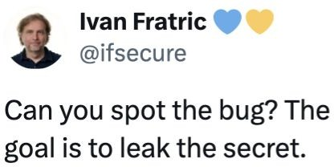
Bugs are subtle
#include <iostream> #include <cstdint>
uint32_t arr[8] = { 0, 10, 20, 30, 40, 50, 60, 70 };
uint32_t secret[8] = { 41414242 };
inline uint32_t *get_safe(uint32_t *arr, uint32_t index) { if (index >= 8) {
return nullptr;
}
return &arr[index];
}
$ clang++ -O1 puzzle.cpp -o puzzle
int main() {
uint32_t index; std::cin >> index;
$ ./puzzle 2
Element: 20
uint32_t *element = get_safe(arr, index); std::cout << "Element: " << *element << std::endl;
return 0;
}
https://x.com/ifsecure/status/1897235201287446996

Slide 27
Bugs are subtle
#include <iostream> #include <cstdint>
uint32_t arr[8] = { 0, 10, 20, 30, 40, 50, 60, 70 };
uint32_t secret[8] = { 41414242 };
inline uint32_t *get_safe(uint32_t *arr, uint32_t index) { if (index >= 8) {
return nullptr;
}
return &arr[index];
}
$ clang++ -O1 puzzle.cpp -o puzzle
int main() {
uint32_t index; std::cin >> index;
$ ./puzzle 2
Element: 20
uint32_t *element = get_safe(arr, index); std::cout << "Element: " << *element << std::endl;
return 0;
}
https://x.com/ifsecure/status/1897235201287446996

Slide 28
Bugs are subtle
#include <iostream> #include <cstdint>
uint32_t arr[8] = { 0, 10, 20, 30, 40, 50, 60, 70 };
uint32_t secret[8] = { 41414242 };
inline uint32_t *get_safe(uint32_t *arr, uint32_t index) { if (index >= 8) {
return nullptr;
}
return &arr[index];
}
$ clang++ -O1 puzzle.cpp -o puzzle
int main() {
uint32_t index; std::cin >> index;
$ ./puzzle 2
Element: 20
uint32_t *element = get_safe(arr, index); std::cout << "Element: " << *element << std::endl;
$ ./puzzle 8
Element: 41414242
return 0;
}
https://x.com/ifsecure/status/1897235201287446996

Slide 29
Bugs are subtle
#include <iostream> #include <cstdint>
uint32_t arr[8] = { 0, 10, 20, 30, 40, 50, 60, 70 };
uint32_t secret[8] = { 41414242 };
inline uint32_t *get_safe(uint32_t *arr, uint32_t index) { if (index >= 8) {
return nullptr;
}
return &arr[index];
}
$ clang++ -O1 puzzle.cpp -o puzzle
int main() {
uint32_t index; std::cin >> index;
$ ./puzzle 2
Element: 20
uint32_t *element = get_safe(arr, index); std::cout << "Element: " << *element << std::endl;
$ ./puzzle 8
Element: 41414242
return 0;
}
https://x.com/ifsecure/status/1897235201287446996

Slide 30
Bugs are subtle
#include <iostream> #include <cstdint>
uint32_t arr[8] = { 0, 10, 20, 30, 40, 50, 60, 70 };
uint32_t secret[8] = { 41414242 };
inline uint32_t *get_safe(uint32_t *arr, uint32_t index) { if (index >= 8) {
return nullptr;
}
return &arr[index];
}
$ clang++ -O1 puzzle.cpp -o puzzle
int main() {
uint32_t index; std::cin >> index;
$ ./puzzle 2
Element: 20
uint32_t *element = get_safe(arr, index); std::cout << "Element: " << *element << std::endl;
$ ./puzzle 8
Element: 41414242
return 0;
}
https://x.com/ifsecure/status/1897235201287446996

Slide 31
Fuzzing

Slide 32
Fuzzing
Find bugs in a program by feeding it random, corrupted, or unexpected data
cat /dev/random | head -c 512 > rand.jpeg; open rand.jpeg
Idea: Random inputs explore a “large” part of the state space
Some unintended states are observable as crashes (SIGSEGV, abort()) The distribution will be different than manual analysis
Works best on programs that parse files or process complex input data

Slide 33
Smarter than random fuzzing
cat /dev/random | head -c 512 > rand.jpeg; open rand.jpeg
How could we do better?
Randomly corrupt real JPEG files
Reference the JPEG spec so that we generate only “JPEG-looking” data Look at the JPEG parser to see how deep we’re getting in the code

Slide 34
Common fuzzing strategies
Mutation-based fuzzing
Randomly mutate test cases from some corpus of input files
Generation-based fuzzing
Generate test cases based on a specification for the input format
Coverage guided fuzzing
Measure code coverage of test cases to guide fuzzing towards new (unexplored) program states
This is neither an exhaustive list nor a rigid taxonomy: fuzzers often employ multiple strategies

Slide 35
Mutation-based fuzzing
Randomly mutate test cases from some corpus of input files
Collect a corpus of inputs that explores as many states as possible
Perturb inputs randomly, possibly guided by heuristics Modify: bit flips, integer increments
Substitute: small integers, large integers, negative integers
Run the program on the inputs and check for crashes
Go back to step 2

Slide 36
Isn’t that too simple to actually work?
This is “I need a fuzzer running in 10 minutes” code in 2025:
void havoc(const uint8_t *buf, size_t size) { switch (rnd(0,4)) {
case 0: buf[rnd(0,size)] ^= 1 << rnd(0,8); case 1: buf[rnd(0,size)] = rnd(0,0x100);
break; break;
case 2: *(uint32_t *)&buf[rnd(0,size-3)] += rnd_small(0,0xffff); break; case 3: *(uint32_t *)&buf[rnd(0,size-3)] -= rnd_small(0,0xffff); break;
}
if (rnd(0,4) != 0) havoc(buf, size);
}
In memory-unsafe codebases, it often finds a bug within minutes

Slide 37
Mutation-based fuzzing
Advantages
Very simple and fast to set up and run
Just need some example inputs and a harness to run the target code
Limitations
Works best against never-been-fuzzed targets
Results depend strongly on the quality of the initial corpus Coverage will be shallow for formats with checksums or validation

Slide 38
Generation-based fuzzing
Generate test cases based on a specification for the input format
Convert a specification of the input format (RFC, etc.) into a generative procedure
Generate test cases according to the procedure and introduce random perturbations
Run the program on the inputs and check for crashes
Go back to step 2

Slide 39
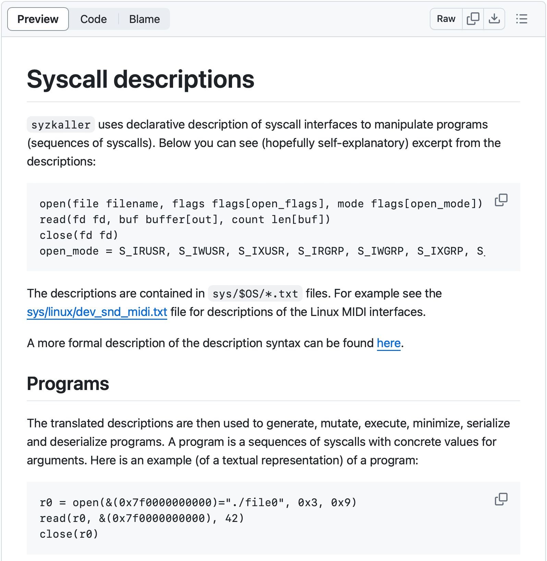
Syzkaller
A kernel system call fuzzer that uses test case generation and coverage
Test cases are sequences of syscalls generated from syscall descriptions
Runs the test case program in a VM
Kernel crashes in the VM indicate potential Local Privilege Escalation (LPE) vulnerabilities
https://github.com/google/syzkaller/blob/master/docs/syscall_descriptions.md

Slide 40
Generation-based fuzzing
Advantages
Can get deeper coverage faster by leveraging knowledge of the input format Input format/protocol complexity is not a limit on coverage depth
Limitations
Requires a lot of effort to set up
Successful fuzzers are often domain-specific
Coverage limited by accuracy of the spec; implementation may diverge

Slide 41
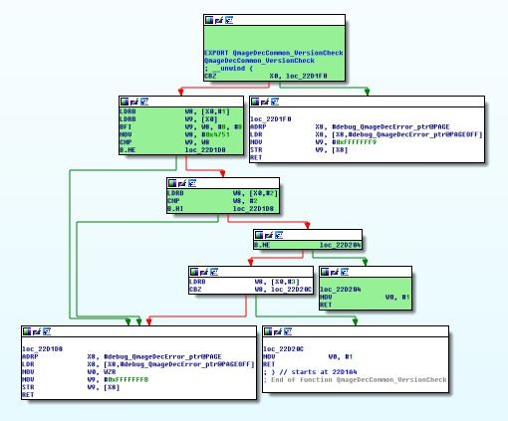
Coverage guided fuzzing
Key insight: code coverage is a useful metric, why not use it as feedback to guide fuzzing?
Prefer test cases that reach new states
Basic block coverage: Has this basic block in the CFG been run?
Edge coverage: Has this branch been taken?
Path coverage: Has this particular path through the program been taken?
https://googleprojectzero.blogspot.com/2020/07/mms-exploit-part-2-effective-fuzzing-qmage.html

Slide 42
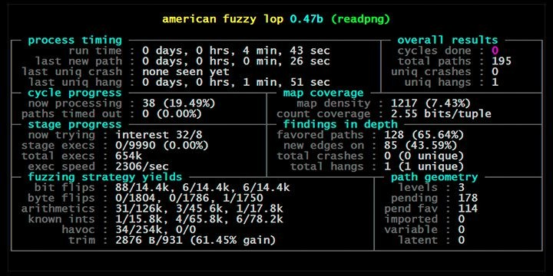
american fuzzy lop (AFL)
Compile the program with instrumentation to measure coverage
Trim the test cases in the queue
to the smallest size that doesn’t change the program behavior
Create new test cases by mutating the files in the queue using traditional fuzzing strategies
If new coverage is found in a mutated file, add it into the queue
Go back to step 2
https://lcamtuf.coredump.cx/afl/README.txt

Slide 43
Coverage guided fuzzing
Advantages
Very good at finding new program states, even if the initial corpus is limited Combines well with other fuzzing strategies
Wildly successful track record
Limitations
Not a panacea to bypass checksums or input validation Still doesn’t find all types of bugs (e.g. race conditions)

Slide 44
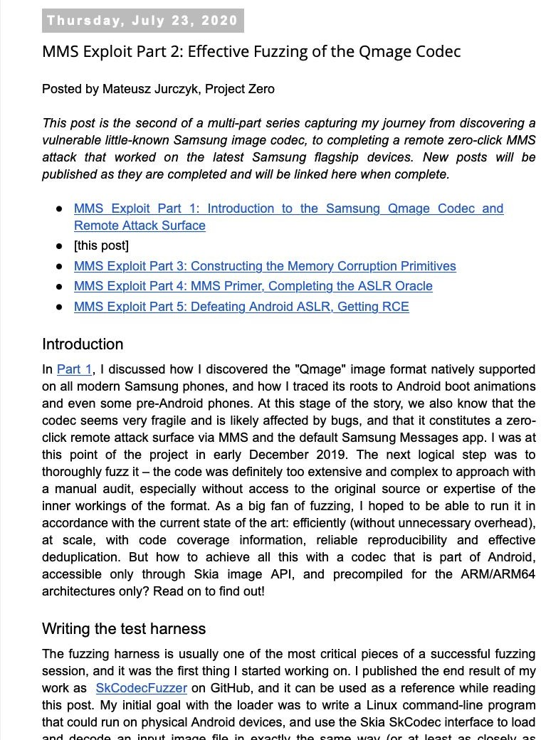
Real world example: Fuzzing the Samsung Qmage codec
In 2019, Mateusz Jurczyk discovered the Qmage image codec included on Samsung smartphones
Reachable via zero-click MMS
The code looks fragile but the library is closed source Very few examples of Qmage files
Mateusz developed a harness to enable large-scale coverage-guided fuzzing of the Qmage codec
https://googleprojectzero.blogspot.com/2020/07/mms-exploit-part-2-effective-fuzzing-qmage.html

Slide 45
Fuzzing the Samsung Qmage image codec: harness
A fuzzing harness was written to call the interesting functions in the library and supply the test case input from the fuzzer
d2s:/data/local/tmp $ ./loader accessibility_light_easy_off.qmg [+] Detected image characteristics:
[+] Dimensions: 344 x 344
[+] Color type: 4
[+] Alpha type: 3 [+] Bytes per pixel: 4
[+] codec->GetAndroidPixels() completed successfully
d2s:/data/local/tmp $
Found bugs by fuzzing on-device, but Mateusz wanted to fuzz at-scale
An emulator (qemu-aarch64) was used to run the harness and Qmage library on a Linux machine
Easier to get 1000 Linux cores than 1000 Samsung Galaxy phones

Slide 46
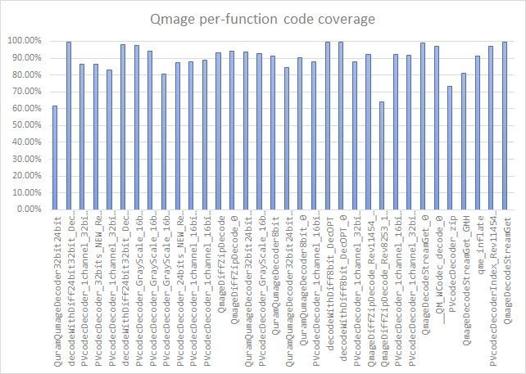
Fuzzing the Samsung Qmage image codec: coverage
Code coverage was collected by modifying qemu-aarch64 to trace executed PC addresses
Coverage feedback compensated for the small number of initial test cases

Slide 47
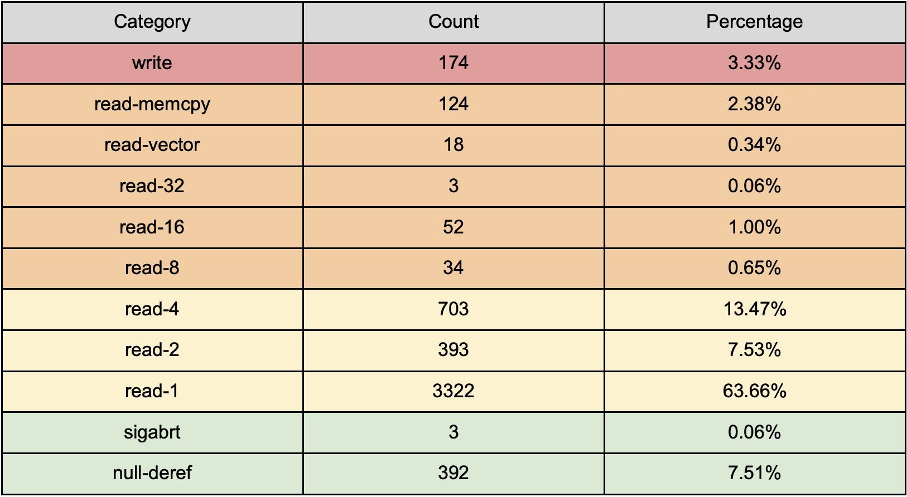
Fuzzing the Samsung Qmage image codec: results
4 weeks of fuzzing at scale
87.3% coverage of the Qmage codec
5218 unique crashes

Slide 48
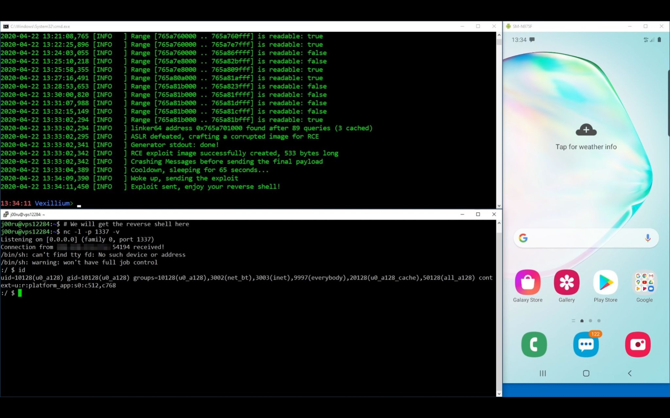
https://www.youtube.com/watch?v=nke8Z3G4jnc

Slide 49
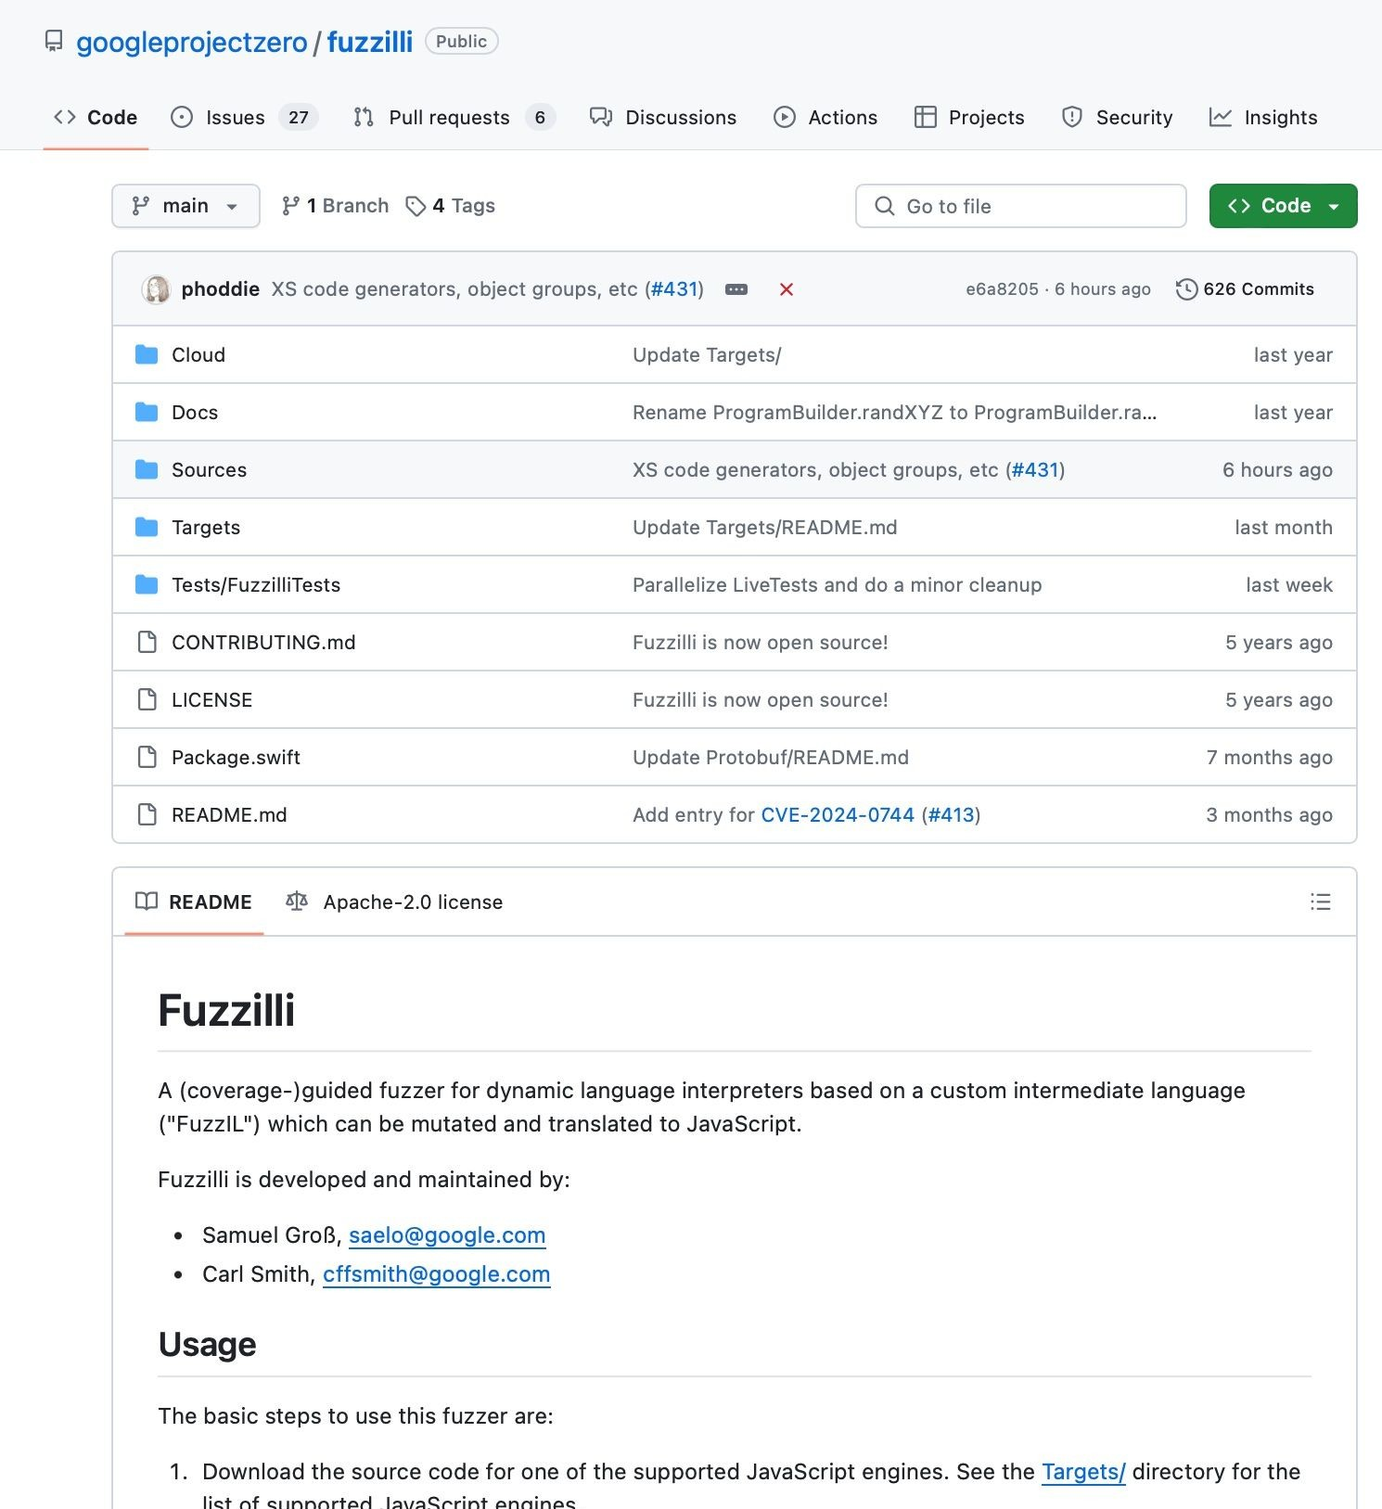
Another cool fuzzer: Fuzzilli
Very successful JavaScript fuzzer
Principle: Translate JavaScript to a dense Intermediate Language (IL), and fuzz the IL
https://github.com/googleprojectzero/fuzzilli

Slide 50

Fuzzing summary
Off-the-shelf fuzzers are excellent at finding bugs
Custom fuzzers are also excellent at finding bugs
Different fuzzers often find different bugs
Easy to get started
Fuzzing doesn’t find all types of bugs
This code parses untrusted data
Should I write a fuzzer?
Yes

Slide 51
Dynamic analysis

Slide 52
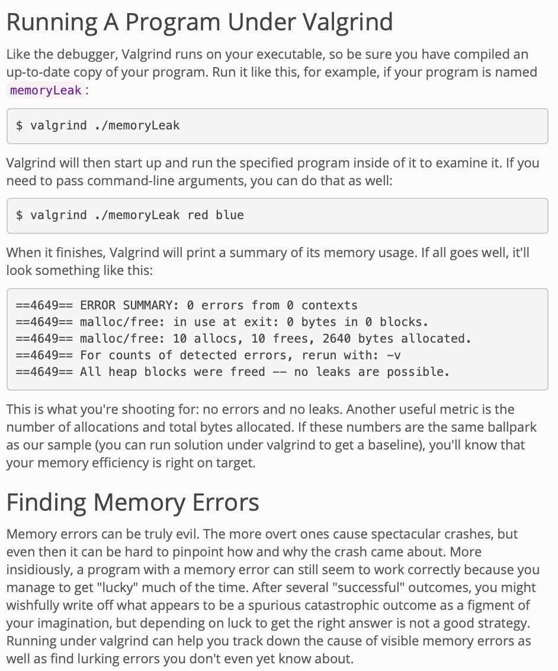
Dynamic analysis
Analyze a program’s behavior by actually running its code
Sometimes combined with compile-time modifications like instrumentation
Can modify the program’s behavior dynamically
Useful for rapid experimentation Often complements fuzzing very well
https://web.stanford.edu/class/cs107/resources/valgrind.html

Slide 53
AddressSanitizer (ASan)
Fast memory error detector for C/C++ using compiler instrumentation and a runtime library that replaces malloc() to surround allocations with redzones
Out-of-bounds accesses Use-after-free
Double-free / invalid free
==9901==ERROR: AddressSanitizer: heap-use-after-free on address 0x60700000dfb5 at pc 0x45917b bp 0x7fff4490c700 sp 0x7fff4490c6f8
READ of size 1 at 0x60700000dfb5 thread T0
#0 0x45917a in main use-after-free.c:5
#1 0x7fce9f25e76c in libc_start_main /build/buildd/eglibc-2.15/csu/libc-start.c:226 #2 0x459074 in _start (a.out+0x459074)
0x60700000dfb5 is located 5 bytes inside of 80-byte region [0x60700000dfb0,0x60700000e000)
freed by thread T0 here:
#0 0x4441ee in interceptor_free projects/compiler-rt/lib/asan/asan_malloc_linux.cc:64 #1 0x45914a in main use-after-free.c:4
#2 0x7fce9f25e76c in libc_start_main /build/buildd/eglibc-2.15/csu/libc-start.c:226
previously allocated by thread T0 here:
#0 0x44436e in interceptor_malloc projects/compiler-rt/lib/asan/asan_malloc_linux.cc:74 #1 0x45913f in main use-after-free.c:3
#2 0x7fce9f25e76c in libc_start_main /build/buildd/eglibc-2.15/csu/libc-start.c:226 SUMMARY: AddressSanitizer: heap-use-after-free use-after-free.c:5 main
Typically 2x slowdown
-fsanitize=address
Not hardened! Don’t turn on in production
https://github.com/google/sanitizers/wiki/AddressSanitizer

Slide 54

AddressSanitizer (ASan)
Fast memory error detector for C/C++ using compiler instrumentation and a
runtime library t
Out-of-bou Use-after-f Double-fre
hat replaces malloc() to surround allocations wit
_{nds accesses} ==9901==ERROR: AddressSanitizer: heap-use-after-free on address 0x6070
bp 0x7fff4490c700 sp 0x7fff4490c6f8
READ of size 1 at 0x60700000dfb5 thread T0
_{ree} #0 0x45917a in main use-after-free.c:5
#1 0x7fce9f25e76c in __libc_start_main /build/buildd/eglibc-2.15/c
#2 0x459074 in _start (a.out+0x459074)
0x60700000dfb5 is located 5 bytes inside of 80-byte region [0x60700000
_{e / invalid free} freed by thread T0 here:
#0 0x4441ee in __interceptor_free projects/compiler-rt/lib/asan/as
#1 0x45914a in main use-after-free.c:4
#2 0x7fce9f25e76c in __libc_start_main /build/buildd/eglibc-2.15/c
previously allocated by thread T0 here:
_{wdown} #0 0x44436e in __interceptor_malloc projects/compiler-rt/lib/asan/
#1 0x45913f in main use-after-free.c:3
h redzones
Pro tip: Once coverage guided fuzzing plateaus, run the generated corpus under ASan to find bugs the fuzzer missed!
0000dfb5 at pc 0x45917b
su/libc-start.c:226
dfb0,0x60700000e000)
an_malloc_linux.cc:64
su/libc-start.c:226
Typically 2x slo
asan_malloc_linux.cc:74
#2 0x7fce9f25e76c in libc_start_main /build/buildd/eglibc-2.15/csu/libc-start.c:226 SUMMARY: AddressSanitizer: heap-use-after-free use-after-free.c:5 main
-fsanitize=address
Not hardened! Don’t turn on in production
https://github.com/google/sanitizers/wiki/AddressSanitizer

Slide 55
ThreadSanitizer (TSan)
Data race detector for C/C++
Similar in principle to AddressSanitizer but for race conditions
High overhead
5-10x memory 5-15x slowdown
WARNING: ThreadSanitizer: data race (pid=19219)
Write of size 4 at 0x7fcf47b21bc0 by thread T1: #0 Thread1 tiny_race.c:4 (exe+0x00000000a360)
Previous write of size 4 at 0x7fcf47b21bc0 by main thread: #0 main tiny_race.c:10 (exe+0x00000000a3b4)
Thread T1 (running) created at:
#0 pthread_create tsan_interceptors.cc:705 (exe+0x00000000c790) #1 main tiny_race.c:9 (exe+0x00000000a3a4)
-fsanitize=thread
Also not hardened!
https://clang.llvm.org/docs/ThreadSanitizer.html

Slide 56
Frida
/* recvfrom.js */
{
onEnter(log, args, state) { log("recvfrom(socket=" + args[0].toInt32()
+ ", buffer=" + args[1]
+ ", length=" + args[2].toInt32()
+ ", flags=" + args[3]
+ ", address=" + args[4]
+ ", address_len=" +
args[5].readPointer().toInt32()
+ ")");
},
}
$ frida-trace -i "recv*" twitter
...
8098 ms recvfrom(socket=70,
buffer=0x32cc018, length=65536, flags=0x0,
address=0xb0420bd8, address_len=16)
Dynamic instrumentation for closed-source binaries
Add printf-debugging Modify behavior
Call internal functions directly to observe behavior
Great way to write a fuzz harness
https://frida.re/docs/quickstart/

Slide 57
Static analysis

Slide 58
Static analysis
Using a tool to analyze a program’s behavior without actually running it
Test whether a certain property holds or find places where it is violated Static analysis can prove properties about the program
E.g., can prove that a program is free of NULL pointer dereferences
Despite lots of work in this area, there’s huge scope for improvements!

Slide 59
Undecidability of static analysis
Goal: Determine whether a given program satisfies a given property
This is theoretically undecidable: it reduces to the halting problem!
def solve_halting_problem(P, a): def new_P():
P(a)
bug()
return static_analyzer_for_bug(new_P)

Slide 60
Soundness and completeness
The best static analyzer can only satisfy one of the following:*
Soundness: Everything that the static analyzer finds is a bug But some bugs may be missed!
Completeness: The static analyzer finds every bug But there may be false positives!
Most static analyzers are neither sound nor complete
* Assuming termination

Slide 61
Data flow analysis
X = 0
Determine the possible values of variables at points in the control flow graph
Approximations are usually needed
Expressing the precise set of possible values may be arbitrarily complex
Y = A
X == Y
Z = Z+1
X = X+1
X == Y
Z = 1
Z == 2
crash
...
crash

Slide 62
Data flow analysis
X = 0
Determine the possible values of variables at points in the control flow graph
Approximations are usually needed
X: {0}
Y = A
X: ⊤; Y: {A}; Z: ⊤
X == Y
X: {A}; Y: {A}; Z: ⊤
X: ⊤; Y: {A}; Z: ⊤
Expressing the precise set of possible values may be arbitrarily complex
Z = Z+1
X = X+1
X: {A}; Y: {A}; Z: ⊤
X: ⊤; Y: {A}; Z: ⊤
X == Y
Z = 1
X: {A}; Y: {A}; Z: ⊤
Z == 2
crash
...
crash

Slide 63
Data flow analysis
X = 0
Determine the possible values of variables at points in the control flow graph
Approximations are usually needed
X: {0}
Y = A
X: ⊤; Y: {A}; Z: ⊤
X == Y
X: {A}; Y: {A}; Z: ⊤
X: ⊤; Y: {A}; Z: ⊤
Expressing the precise set of possible values may be arbitrarily complex
Z = Z+1
X = X+1
X: {A}; Y: {A}; Z: ⊤
X: ⊤; Y: {A}; Z: ⊤
X == Y
Z = 1
X: {A}; Y: {A}; Z: ⊤
Z == 2
crash
...
crash

Slide 64
Taint analysis
static int vipx_ioctl_get_container(struct vs4l_container_list *karg, struct vs4l_container_list user *uarg)
{
...
ret = copy_from_user(karg, uarg, sizeof(*karg));
...
ucon = karg->containers;
size = karg->count * sizeof(*kcon); kcon = kzalloc(size, GFP_KERNEL);
...
karg->containers = kcon;
ret = copy_from_user(kcon, ucon, size); if (ret) {
vipx_err("Copy failed [CONTAINER] (%d)\n", ret); goto p_err_free;
}
for (idx = 0; idx < karg->count; ++idx) { ubuf = kcon[idx].buffers;
size = kcon[idx].count * sizeof(*kbuf); kbuf = kzalloc(size, GFP_KERNEL);
...
kcon[idx].buffers = kbuf;
ret = copy_from_user(kbuf, ubuf, size); if (ret) {
vipx_err("Copy failed [CONTAINER] (%d)\n", ret); goto p_err_free;
}
}
...
return 0; p_err_free:
for (idx = 0; idx < karg->count; ++idx) kfree(kcon[idx].buffers);
kfree(kcon); p_err:
return ret;
}
Identify sources of “tainted” data
User/attacker input Reads from files/network
Check to see if tainted data flows into a “trusted sink”
memcpy(_, _, size) free(ptr)
bzero(_, size)
https://bugs.chromium.org/p/project-zero/issues/detail?id=1978

Slide 65
Taint analysis
static int vipx_ioctl_get_container(struct vs4l_container_list *karg, struct vs4l_container_list user *uarg)
{
...
ret = copy_from_user(karg, uarg, sizeof(*karg));
...
ucon = karg->containers;
size = karg->count * sizeof(*kcon); kcon = kzalloc(size, GFP_KERNEL);
...
karg->containers = kcon;
ret = copy_from_user(kcon, ucon, size); if (ret) {
vipx_err("Copy failed [CONTAINER] (%d)\n", ret); goto p_err_free;
}
for (idx = 0; idx < karg->count; ++idx) { ubuf = kcon[idx].buffers;
size = kcon[idx].count * sizeof(*kbuf); kbuf = kzalloc(size, GFP_KERNEL);
...
kcon[idx].buffers = kbuf;
ret = copy_from_user(kbuf, ubuf, size); if (ret) {
vipx_err("Copy failed [CONTAINER] (%d)\n", ret); goto p_err_free;
}
}
...
return 0; p_err_free:
for (idx = 0; idx < karg->count; ++idx) kfree(kcon[idx].buffers);
kfree(kcon); p_err:
return ret;
}
Identify sources of “tainted” data
User/attacker input Reads from files/network
Check to see if tainted data flows into a “trusted sink”
memcpy(_, _, size) free(ptr)
bzero(_, size)
https://bugs.chromium.org/p/project-zero/issues/detail?id=1978

Slide 66

Taint analysis
static int vipx_ioctl_get_container(struct vs4l_container_list *karg, struct vs4l_container_list user *uarg)
{
...
ret = copy_from_user(karg, uarg, sizeof(*karg));
...
ucon = karg->containers;
size = karg->count * sizeof(*kcon); kcon = kzalloc(size, GFP_KERNEL);
...
karg->containers = kcon;
ret = copy_from_user(kcon, ucon, size); if (ret) {
vipx_err("Copy failed [CONTAINER] (%d)\n", ret); goto p_err_free;
}
for (idx = 0; idx < karg->count; ++idx) { ubuf = kcon[idx].buffers;
size = kcon[idx].count * sizeof(*kbuf); kbuf = kzalloc(size, GFP_KERNEL);
...
kcon[idx].buffers = kbuf;
ret = copy_from_user(kbuf, ubuf, size); if (ret) {
vipx_err("Copy failed [CONTAINER] (%d)\n", ret); goto p_err_free;
}
}
...
return 0; p_err_free:
for (idx = 0; idx < karg->count; ++idx) kfree(kcon[idx].buffers);
kfree(kcon); p_err:
return ret;
}
Identify sources of “tainted” data
User/attacker input Reads from files/network
Check to see if tainted data flows into a “trusted sink”
memcpy(_, _, size) free(ptr)
bzero(_, size)
https://bugs.chromium.org/p/project-zero/issues/detail?id=1978

Slide 67
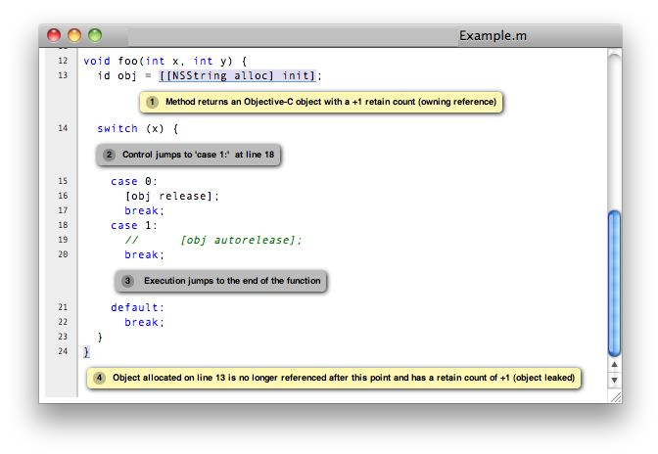
Clang static analyzer
Check for common security issues with a static analysis framework in the compiler
Built in checkers:
Buffer overflows (with taint)
Refcount errors
malloc() integer overflows Insecure API use Uninitialized value use
https://clang-analyzer.llvm.org/images/analyzer_html.png

Slide 68
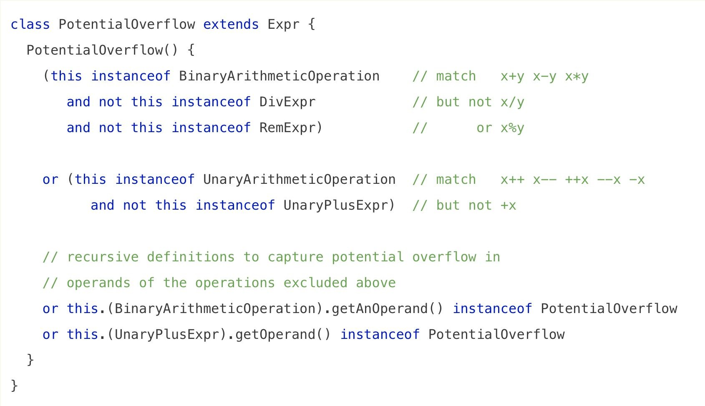
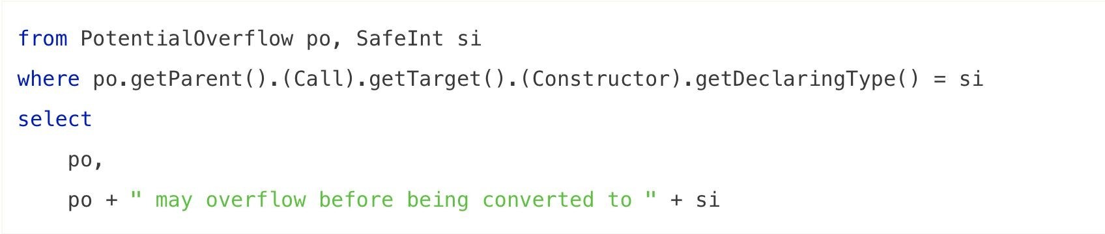
CodeQL (Semmle)
Query language for finding patterns in large codebases
“SQL for searching code”
Works best when you have a specific bad code pattern in mind
https://msrc-blog.microsoft.com/2018/08/16/vulnerability-hunting-with-semmle-ql-part-1/

Slide 69
Finding vulnerabilities with LLMs

Slide 70
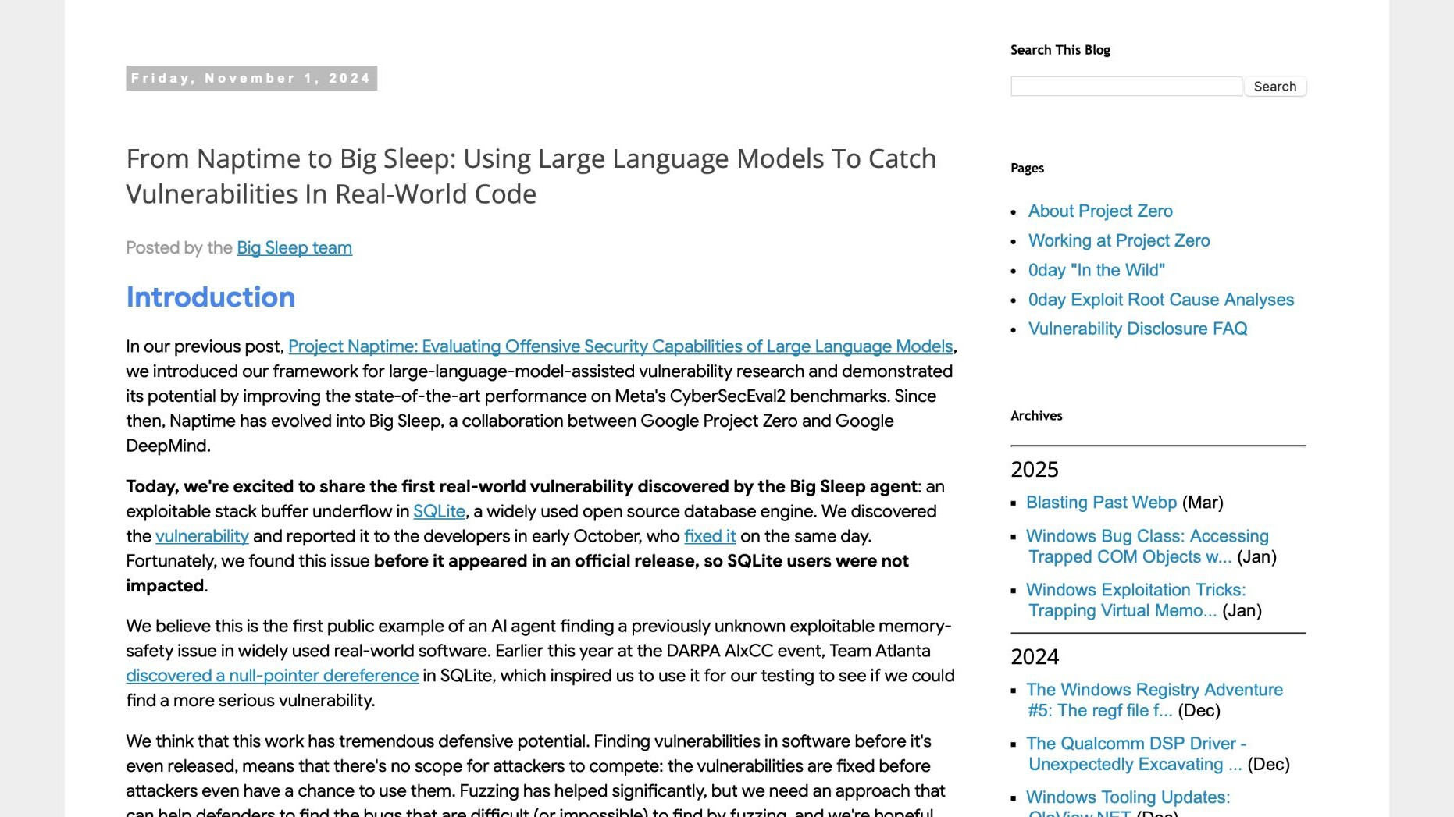
https://googleprojectzero.blogspot.com/2024/10/from-naptime-to-big-sleep.html

Slide 71
Manual analysis

Slide 72
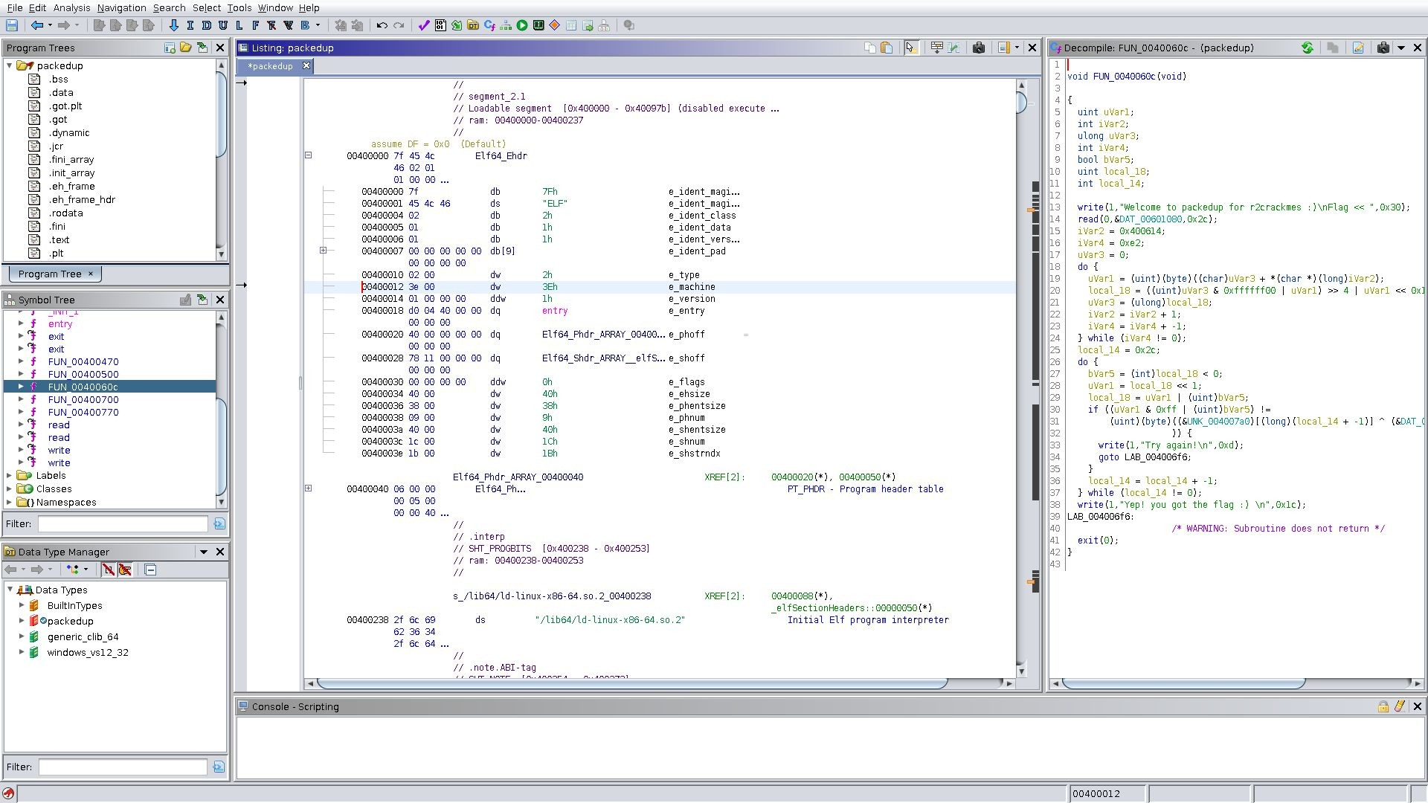
Reverse engineering
Decompile a program to see how it works
Closed source programs often have shallower bugs
https://en.wikipedia.org/wiki/Ghidra#/media/File:Ghidra-disassembly,March_2019.png

Slide 73
Tips for writing (more) secure software

Slide 74
Software tests
One of the most effective ways to reduce bugs
Unit tests: Check that each piece of code behaves as expected in isolation Cover all code, including error handling
Easier than ever to have an LLM auto-generate tests for you
Regression tests: Check that old bugs haven’t been reintroduced If you don’t run regression tests, attackers will run them for you!
Integration tests: Check that modules work together as expected

Slide 75
General tips for more secure software
LLMs are not a panacea; defensively assume there will be big security flaws
Do not use a memory-unsafe language for new codebases
Starting Rust, Swift, etc. is a one-time cost; fixing C++ memory stompers is a cost you’ll pay over and over again forever
Integrate security experts very early in the design process
Better to learn about fundamental flaws early to avoid re-doing everything
Design APIs so that the easiest way to use them is the safe way Engineers using a new API tend to take the path of least resistance

