Slide 1
Introduction to Software Defined Network (SDN)
Hengky “Hank” Susanto, Sing Lab, HKUST

Slide 2
Outline
Introduction.
What is Software-Defined Network?
OpenFlow.
Research Problems in SDN.

Slide 3
Once Upon a Time
“AT&T Eyes Flexibility, Cost Savings With New Network Design”, Wall Street journal, 2014.
  Upgrade their internal network infrastructure (routers and switches) every 18 months to keep up with the current demands for network.
  Cost Billions USD to upgrade.
    Cisco top of the line switch cost $27K USD
  Other high cost: Involved many men power to upgrade the network.
  In Summary: AT&T was eyeing for SDN capable switches (only $11K USD each).

Slide 4
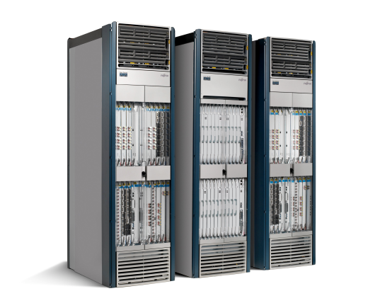
The Networking Industry (2007)
Routing, management, mobility management,
access control, VPNs, …
App
App
App
Million of lines
of source code
Manage by 5400 RFCs
Operating
System
Specialized Packet Forwarding Hardware
500M gates
10Gbytes RAM
Power Hungry
Many complex functions baked into the infrastructure
    OSPF, BGP, multicast, differentiated services,
    Traffic Engineering, NAT, firewalls, MPLS, redundant layers, …
An industry with a “mainframe-mentality”

Slide 5


Reality…!!!! (As 2015)
App
App
App
App
App
Operating
System
App
Operating System
Specialized Packet Forwarding Hardware
Specialized Packet Forwarding Hardware
Closed equipment
  Software bundled with hardware.
  Vendor-specific interfaces.
Over specified : Slow protocol standardization.
Few people can innovate
  Equipment vendors write the code.
  Long delays to introduce new features.
Operating a network is expensive
  More than half the cost of a network.
  Yet, operator error causes most outages.
Buggy software in the equipment
  Routers with 20+ million lines of code
  Cascading failures, vulnerabilities, etc.

Slide 6
Traditional Network Router
Router can be partitioned into control and data plane
  Management plane/ configuration
  Control plane / Decision: OSPF (Open Shortest Path First)
  Data plane / Forwarding
Adjacent Router
Router
Adjacent Router
Management/Policy plane
Configuration / CLI / GUI
Routing
Control plane
Control plane
Static routes
Control plane
OSPF
OSPF
OSPF
Neighbor table
Link state database
IP routing table
Switching
Data plane
Data plane
Data plane
Forwarding table

Slide 7
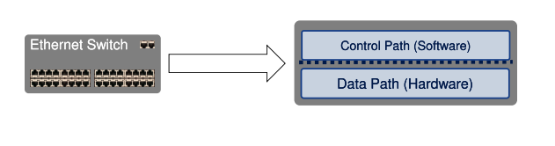
Traditional network Router In Summary
Typical Networking Software
  Management plane
  Control Plane – The brain/decision maker
  Data Plane – Packet forwarder

Slide 8
Imagine IF The Network is……..!!!
Control Plane
SDN Concept: Separate Control plane and Data plane.
Logically-centralized control
Smart
API to the data plane
Separated
Dumb,
fast
Switches
Data Plane

Slide 9
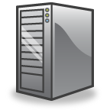
Software-Defined Network with key Abstractions
Network
Virtualization
Well-defined API
Application Plane
Security
Routing
Traffic Engineering
Other Applications
Network Map
Abstraction
Control Plane
Network Operating System
Instructions
Instructions
Instructions
Instructions
Forwarding
Separation of Data
and Control Plane
Forwarding
Forwarding
Data Plane
Forwarding

Slide 10
SDN Basic Concept
Separate Control plane and Data plane entities.
  Network intelligence and state are logically centralized.
  The underlying network infrastructure is abstracted from the applications.
Execute or run Control plane software on general purpose hardware.
  Decouple from specific networking hardware.
  Use commodity servers and switches.
Have programmable data planes.
  Maintain, control and program data plane state from a central entity.
An architecture to control not just a networking device but an entire network.

Slide 11
SDN in Real World – Google’s Story
The industries were skeptical whether SDN was possible.
Google had big problems:
  High financial cost managing their datacenters: Hardware and software upgrade, over provisioning (fault tolerant), manage large backup traffic, time to manage individual switch, and a lot of men power to manage the infrastructure.
  Delay caused by rebuilding connections after link failure.
    Slow to rebuild the routing tables after link failure.
    Difficult to predict what the new network may perform.
Google went a head and implemented SDN.
  Built their hardware and wrote their own software for their internal datacenters.
  Surprised the industries when Google announced SDN was possible in production.
How did they do it?
  Read “B4: Experience with a Globally-Deployed Software Defined WAN”, ACM Sigcomm 2013.

Slide 12
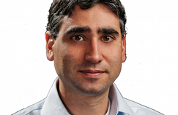
The Origin of SDN
Martin Casado
2006: Martin Casado, a PhD student at Stanford and team propose a clean-slate security architecture (SANE) which defines a centralized control of security (in stead of at the edge as normally done). Ethane generalizes it to all access policies.
The idea of Software Defined Network is originated from OpenFlow project (ACM SIGCOMM 2008).
2009: Stanford publishes OpenFlow V1.0.0 specs.
June 2009: Martin Casado co-founds Nicira.
March 2011: Open Networking Foundation is formed.
Oct 2011: First Open Networking Summit. Many Industries (Juniper, Cisco announced to incorporate.
July 2012: VMware buys Nicira for $1.26B.
Lesson Learned: Imagination is the key to unlock the power of possibilities.

Slide 13



What is OpenFlow?
Application A
Application B
Control Plane (Network OS)
OpenFlow Protocols
Data Plane
Control Path
OpenFlow
Data Path (Hardware)

Slide 14
What is OpenFlow?
Allow separation of control and data planes.
Centralization of control.
Flow based control.
Takes advantage routing tables in Ethernet switches and routers.
SDN is not OpenFlow.
  SDN is a concept of the physical separation of the network control plane from the forwarding plane, and where a control plane controls several devices.
  OpenFlow is communication interface between the control and data plane of an SDN architecture.
    Allows direct access to and manipulation of the forwarding plane of network devices such as switches and routers, both physical and virtual.
    Think of as a protocol used in switching devices and controllers interface.
Notes:
OpenFlow is a communications protocol that gives access to the forwarding plane of a network switch or router over the network

Slide 15
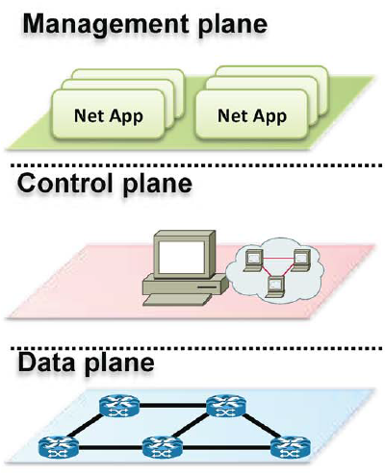
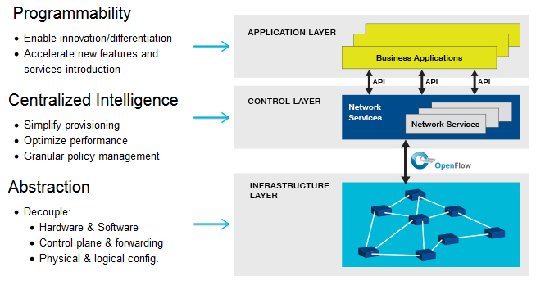
How is OpenFlow related to SDN in The Nut Shell?
OpenFlow allows you to do:
SDN Concept
(Application Plane)
Separation of Data
and Control Plane

Slide 16
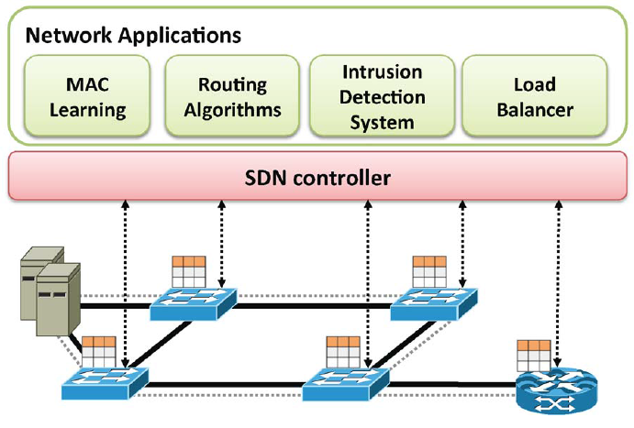
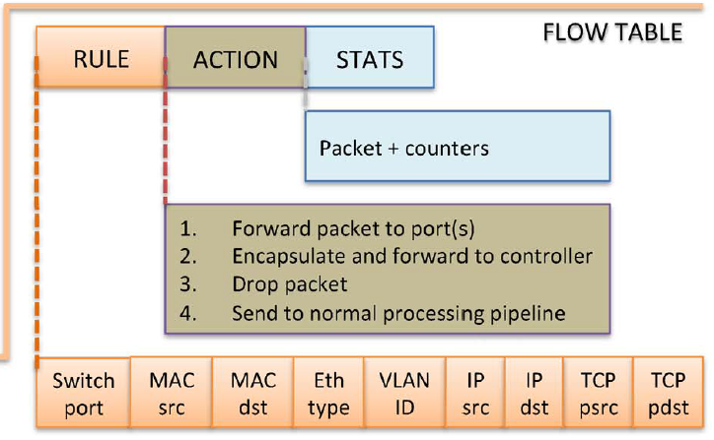
Basic OpenFlow: How Does it Work?
Controller manages the traffic (network flows) by manipulating the flow table at switches.
  Instructions are stored in flow tables.
When packet arrives at switch, match the header fields with flow entries in a flow table.
If any entry matches, performs indicated actions and update the counters.
If Does not match, Switch asks controller by sending a message with the packet header.
Control Plane :
Flow Table (has 3 sections)
Communicate via secure Channel
Flow table
Data Plane
Match the packet header

Slide 17
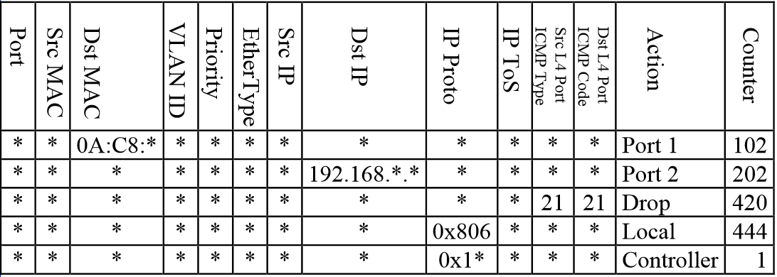
The Actual Flow Table Looks Like
Protocol
QoS

Slide 18
OpenFlow Table: Basic Actions
All: To all interfaces except incoming interface.
Controller: Encapsulate and send to controller.
Local: send to its local networking stack.
Table: Perform actions in the next flow table (table chaining or multiple table instructions).
In_port: Send back to input port.
Normal: Forward using traditional Ethernet.
Flood: Send along minimum spanning tree except the incoming interface.

Slide 19
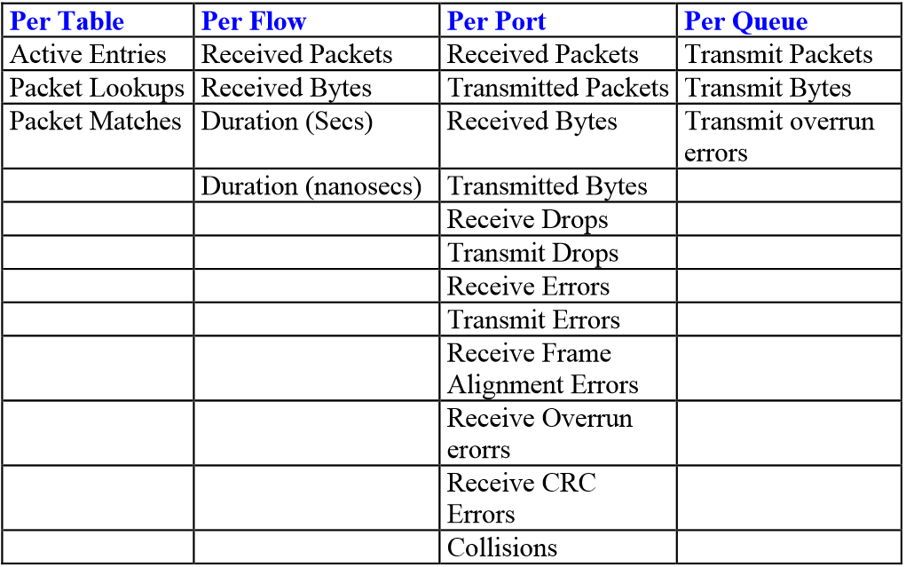
OpenFlow Table: Basic Stats
Provide counter for incoming flows or packets.
Information on counter can be retrieved to control plane.
Can be used to monitor network traffic.

Slide 20
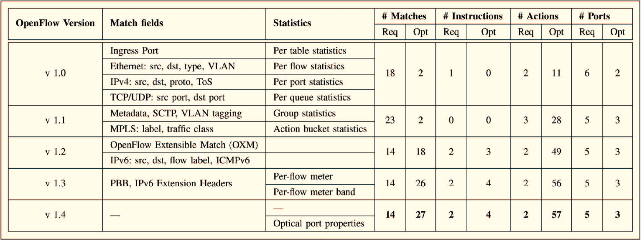
Additional Feature to Rules and Stats
Threshold

Slide 21
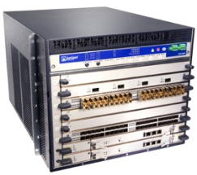
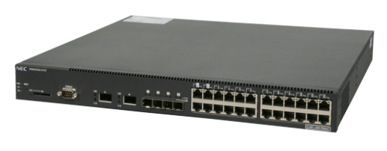
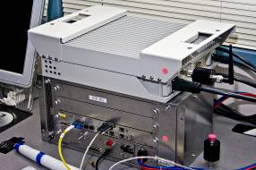
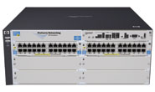
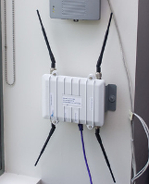

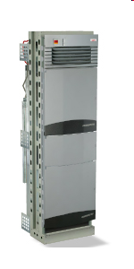

Switches That Support OpenFlow
Available OpenFlow Switches as 2014.
Juniper MX-series
NEC IP8800
WiMax (NEC)
HP Procurve 5400
Netgear 7324
PC Engines
Pronto 3240/3290
Ciena Coredirector
More coming soon...
Notes:
Not only switches but other network components

Slide 22
OpenFlow Switch Software
Indigo: Open source implementation that runs on Mac OS X.
LINC: Open source implementation that runs on Linux, Solaris, Windows, MacOS, and FreeBSD.
Pantou: Turns a commercial wireless router/access point to an OpenFlow enabled switch. OpenFlow runs on OpenWRT. Supports generic Broadcom and some models of LinkSys and TP-Link access points with Broadcom and Atheros chipsets.
Of13softswitch: User-space software switch based on Ericsson TrafficLab 1.1 softswitch.
Open vSwitch: Open Source and popular as 2014.

Slide 23
Open Vswitch Switch Software
Open Source Virtual Switch
Based on Nicira Concept.
Can Run as a stand alone hypervisor switch or as a distributed switch across multiple physical servers.
Default switch in XenServer 6.0, Xen Cloud Platform and supports Proxmox VE, VirtualBox, Xen KVM.
Integrated into many cloud management systems including OpenStack, openQRM, OpenNebula, and oVirt.
Distributed with Ubuntu, Debian, Fedora Linux. Also FreeBSD.

Slide 24
Controller Plane Software
POX: (Python) Out of Date.
IRIS: (Java) Scalability and High Availability
MUL: (C) MūL, is an openflow (SDN) controller. It has a C based multi-threaded infrastructure at its core.
NOX: (C++/Python) NOX was the first OpenFlow controller.
Jaxon: (Java) Jaxon is a NOX-dependent Java-based OpenFlow Controller.
Trema: (C/Ruby) Trema is a full-stack framework for developing OpenFlow controllers in Ruby and C.
Beacon: (Java) Beacon supports both event-based and threaded operation.
Floodlight: (Java) It was forked from the Beacon controller, originally developed by David Erickson at Stanford.
And many more.

Slide 25
Basic OpenFlow Recap
SDN Concept:
OpenFlow:
(Application Plane)
Support different applications: routing, load balancers, monitoring, security, etc.
Programmable: Modify and interact with the network model in control Plane.
Global view of the entire network (the network model).
Centralized per flow based control.
Distributed system that creates a consistent, up-to-date network view (real time).
  Runs on servers (controllers) in the network.
Uses an open protocol to:
  Get state information from switch.
  Give control directives to switch.
Data and Control plane communicate via secure Channel
Packet forwarding according to instruction stored in flow Tables.
Provide statistic on network traffic to controller.
Hardware: (Dump) Switches.

Slide 26
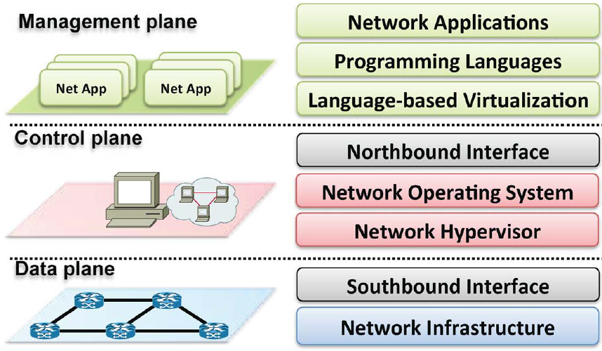
OpenFlow: More Details
SDN Concept
Different layers in OpenFlow
Discussed
(Application Plane)
Routing, load balancers, security, etc.
Make decisions and instructions
Firmware handling instructions from control plane (e.g Open Vswitch) via flow tables.
Hardware (switches)

Slide 27

Network Hypervisor (Virtualization)
Hide complexity (Dump it down)
  Present only the necessary information and avoid too many details.
Network operators “Delegate” control of subsets of network hardware and/or traffic to other network operators or users
Multiple controllers can talk to the same set of switches.
Allow experiments to be run on the network in isolation of each other and production traffic.
Virtualized network model (topology, routing, etc.).
Multiple Controllers scenario is possible
OpenFlow
Switch
Controller 1
OpenFlow
Switch
Controller 2
OpenFlow
Switch

Slide 28
Network Hypervisor (software): FlowVisor
A network hypervisor developed by Stanford.
A software proxy between the forwarding and control planes of network devices.
Allow resources to be sliced (shared) according to defined policies.
  The policy language specifies the slice’s resource limits, flowspace, and controller’s location in terms of IP and TCP port-pair.
  FlowVisor enforces transparency and isolation between slices by inspecting, rewriting, and policing OpenFlow messages as they pass.

Slide 29

Network Hypervisor: Slicing Resources (FlowVisor)
Assigns hardware resources to “Slices”
  Topology
    Network Device or Openflow Instance (DPID)
    Physical Ports.
  Bandwidth
    Each slice can be assigned a per port queue with a fraction of the total bandwidth.
  CPU
    Employs Course Rate Limiting techniques to keep new flow events from one slice from overrunning the CPU.
  Forwarding Tables
    Each slice has a finite quota of forwarding rules per device.
http
Load-balancer
Broadcast
Multicast
dl_dst=FFFFFFFFFFFF
OpenFlow
Protocol
tp_src=80, or
tp_dst=80
OpenFlow
FlowVisor & Policy Control
OpenFlow
Switch
OpenFlow
Protocol
OpenFlow
Switch
OpenFlow
Switch

Slide 30
Northbound Interface
API (interface) to management plane or applications.
Open issue.
No Standardization.
Software based ecosystem.
Considered new theme in SDN as 2015.

Slide 31
Language-based Virtualization
The capability of expressing modularity.
Allowing different levels of abstractions while still guaranteeing desired properties such as protection.
Application developers do not need to think about the sequence of switches where forwarding rules, but rather see the network as a simple ‘‘big switch.’’

Slide 32
Programming Language
Programing language, abstraction, and interfaces to implement SDN.
Ensure multiple tasks of a single application do not interfere with others.
Checking conflicted rules.
Provide higher level programming interface to avoid low level instructions and configuration.
Special abstraction for management requirements (e.g monitoring).
Regular expressions.
Etc.

Slide 33
Network Applications: Software for Data Center Networking
Big Data Apps: Optimize network Utilization.
CloudNaaS: Networking primitives for cloud apps, NOX controller.
FlowComb: Predict Apps workload, uses NOX.
FlowDiff: Detects Operational Problems, FlowVisor Controller.
LIME: Live Network migration, FloodLight Controller.
NetGraph: Graph Queries for network management, uses its own controller.
OpenTCP: Dynamic and programmable TCP adaptation, uses its own controller.
All of them employ OpenFlow to communicate with switches, except OpenTCP.

Slide 34
More Applications for Data Center Networking
Vello Systems:
  Allow overriding layer 2 and layer 3. Live VM migration within and across DCNs.
  Provide view and global cloud for WAN.
  Provide network automation for LAN and WAN connectivity and provisioning.
Mininet (Stanford Univ.)
  Realistic (Realtime) virtual network, running real kernel, switch and application code, on a single machine (VM, cloud or native), in seconds, with a single command.

Slide 35
Research Problems
Scalability:
  Control plane bottleneck.
    Single controller is not sufficient to manage large scale network.
  How many controllers are needed to support large scale network?
  When to scale down?
Multi Controllers.
  Each controller is responsible to a subset of the network.
  Concern with synchronization and communication between controllers.
  How to slice the resources among controllers?
Latency between controllers and switches.
  Less accurate decision?

Slide 36
Research Problems
Slicing Resources (CPU, bandwidth, etc).
  How to allocate resources to different controllers and users?
  Formulated to optimization and fairness problems.
Using SDN to achieve more green DCN.
  No substantial works in this area.
  As 2015, few publications on this subject are published in IEEE ICC and IEEEE Globecom.
  Some software may provide measurement on power usage or capability to turn on/off switches.
    NetFPGA, Mininet and OpenFlow?

Slide 37
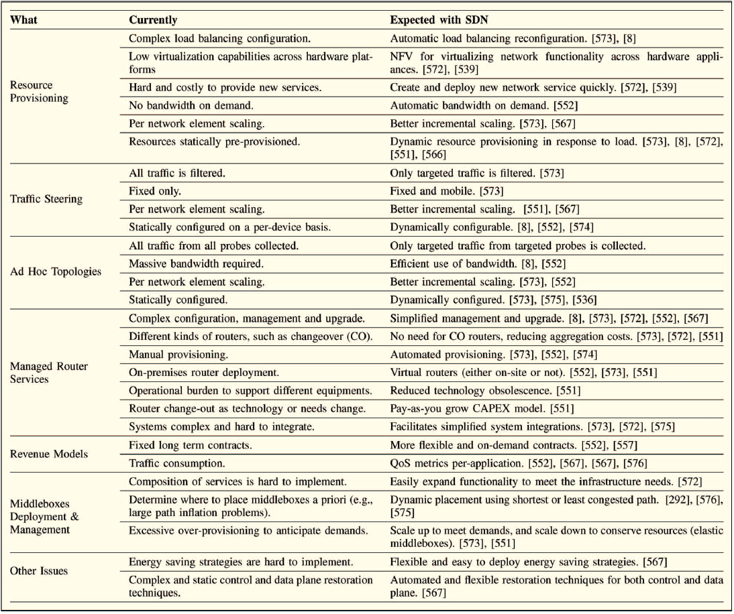
Research themes in SDN, as 2015.

Slide 38
Software-Defined Datacenter
No Clear definition.
  Everyone (in industries) has its own definition.
Bust words from storage related industries.
  Everyone claims has Software-Defined Datacenter product.
My guess is that it is a combination of virtual machine and SDN.
  Servers, storages, and network virtualization.
  Management plane with global view of every component involving datacenter.
  Marketing gimmick
Academic work.
  Just found out: Master thesis by Ville Törhönen, “Designing a Software-Defined Datacenter”. No significant contributions.

Slide 39
Conclusion
Key ideas of SDN:
  Dynamic programmability in forwarding packets.
  Decoupling control and data plane.
  Global view network by logical centralization in control plane.
  Applications can be implemented on top of the control plane.
  SDN is a concept to manage network that leverages OpenFlow protocols.

Slide 40
References:
Sources:
  “Software-Defined Networking: A Comprehensive Survey”, D. Kreutz, F. Ramos, et el. 2015.
  “Survey on Software-Defined Networking”, W. Xia, Y. Wen, et el. 2015.
  Lecture notes : Jennifer Rexford, Scot Shenker, Raj Jain, Bruce Maggs (Duke University), Xenofontas Dimitropoulos (ZTH), Marco Canini (UCL), and unknown Taiwanese scholar.
Supplement Documents:
  “Software-Defined Networking: State of the Art and Research Challenges”, M. Jammal, T. Singh, et el.
  “The Road to SDN: An Intellectual History of Programmable Networks”, N. Feamster, Jenniger Rexford, E. Zegura.
  “A Survey of Software-Defined Networking: Past, Present, and Future of Programmable Network”, B. Astuto, et el.

Slide 41
Question????
Thank you

