Slide 1
C3: Cutting Tail Latency in
Cloud Data Stores via
Adaptive Replica Selection
Marco Canini (UCL)
with Lalith Suresh, Stefan Schmid, Anja Feldmann (TU Berlin)

Slide 2
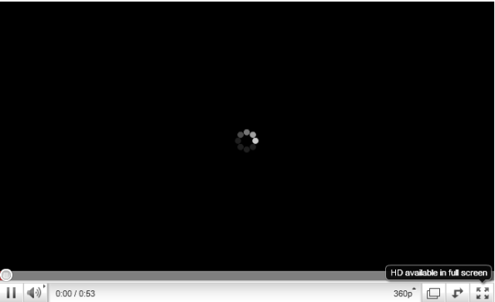


Latency matters
+500ms lead to a revenue
decrease of 1.2%
[Eric Schurman, Bing]
Every 100ms in latency cost them 1% in sales
[Greg Linden, Amazon]
Latency
$$$$

Slide 3
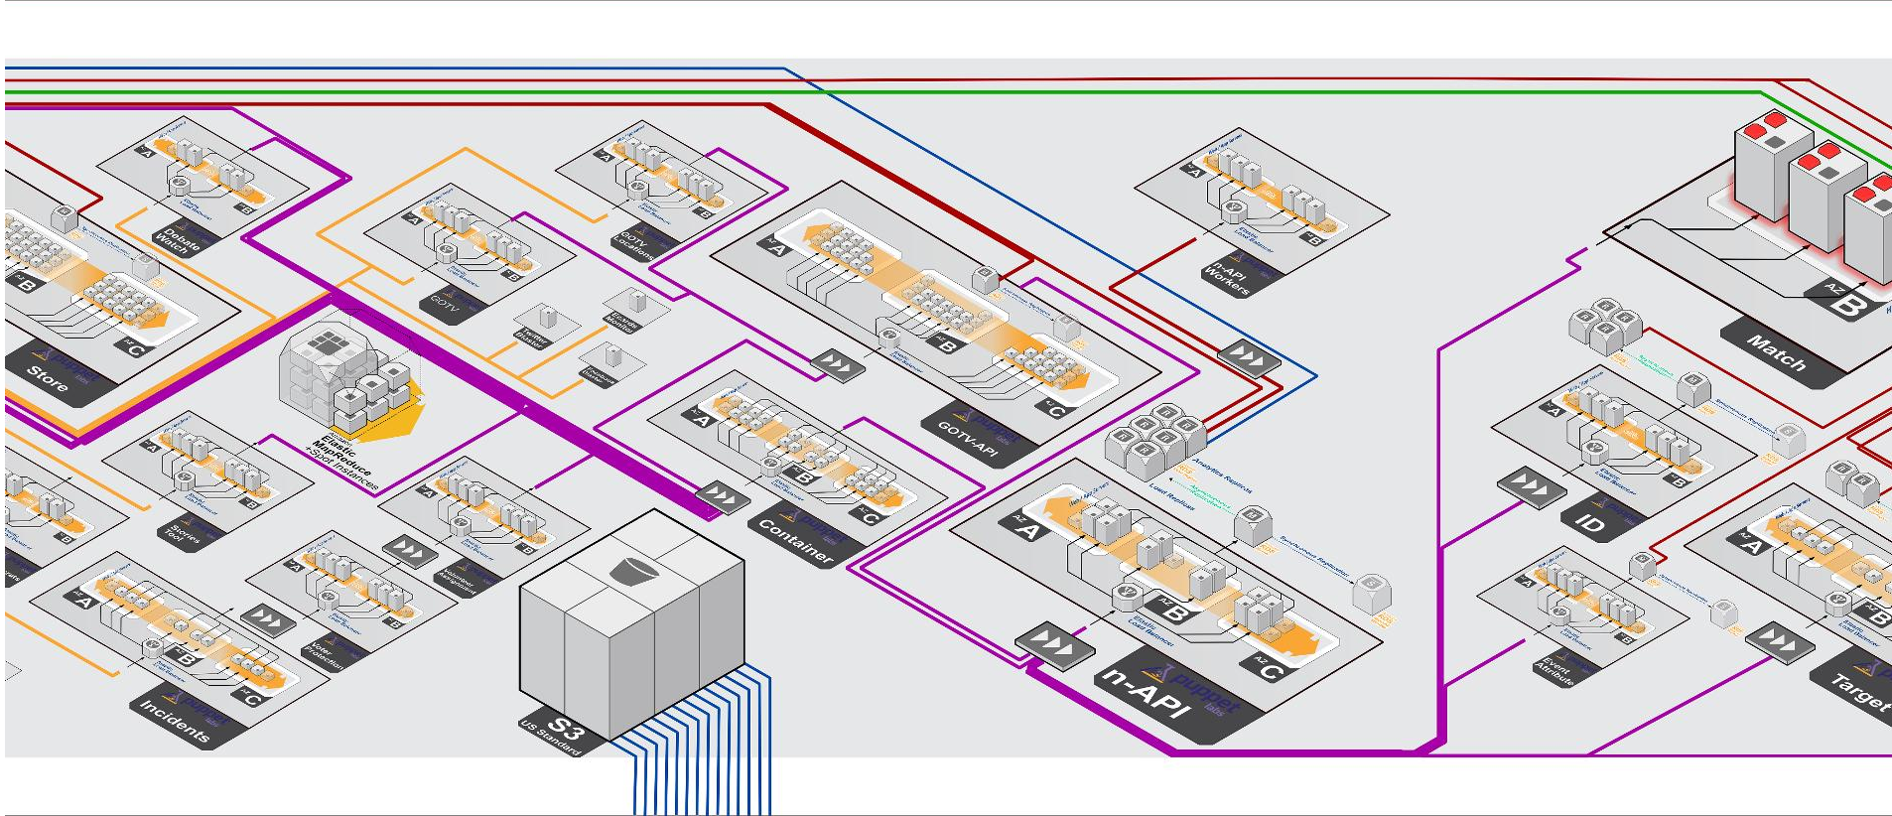

Slide 4
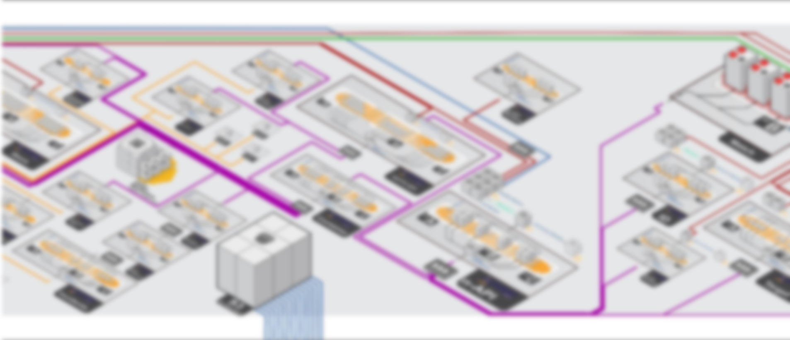
One user request
Tens to Hundreds
of servers involved

Slide 5
Variability of response time at system components inflate end-to-end latencies and lead to high tail latencies
Size and system
complexity
ECDF
Latency
At Bing, 30% of services have
95th percentile > 3 x median latency
[Jalaparti et al. SIGCOMM’13]

Slide 6



Performance fluctuations are the norm
CDF
Resource
contention
Skewed access patterns
Queueing
delays
Background activities

Slide 7
How can we enable datacenter applications*
to achieve more
predictable performance?
* in this work: low-latency data stores

Slide 8

Replica selection
? ? ?
{request}

Slide 9
Replica Selection Challenges
Service-time variations
Herd behavior

Slide 10
Service-time variations
4 ms
Request
5 ms
30 ms

Slide 11
Herd Behavior
Request
Request
? ? ?
Request

Slide 12
Load Pathology in Practice
Cassandra on EC2
  15-node cluster, skewed access pattern,
  workload by 120 YCSB generators
Observe load on most heavily utilized node

Slide 13
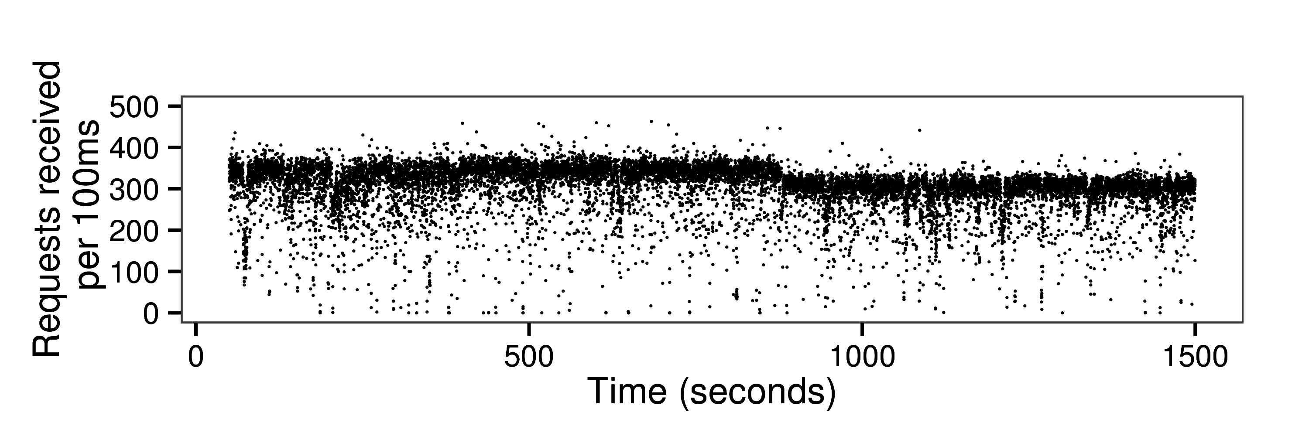
Load Pathology in Practice
99.9th percentile ~ 10x median latency

Slide 14
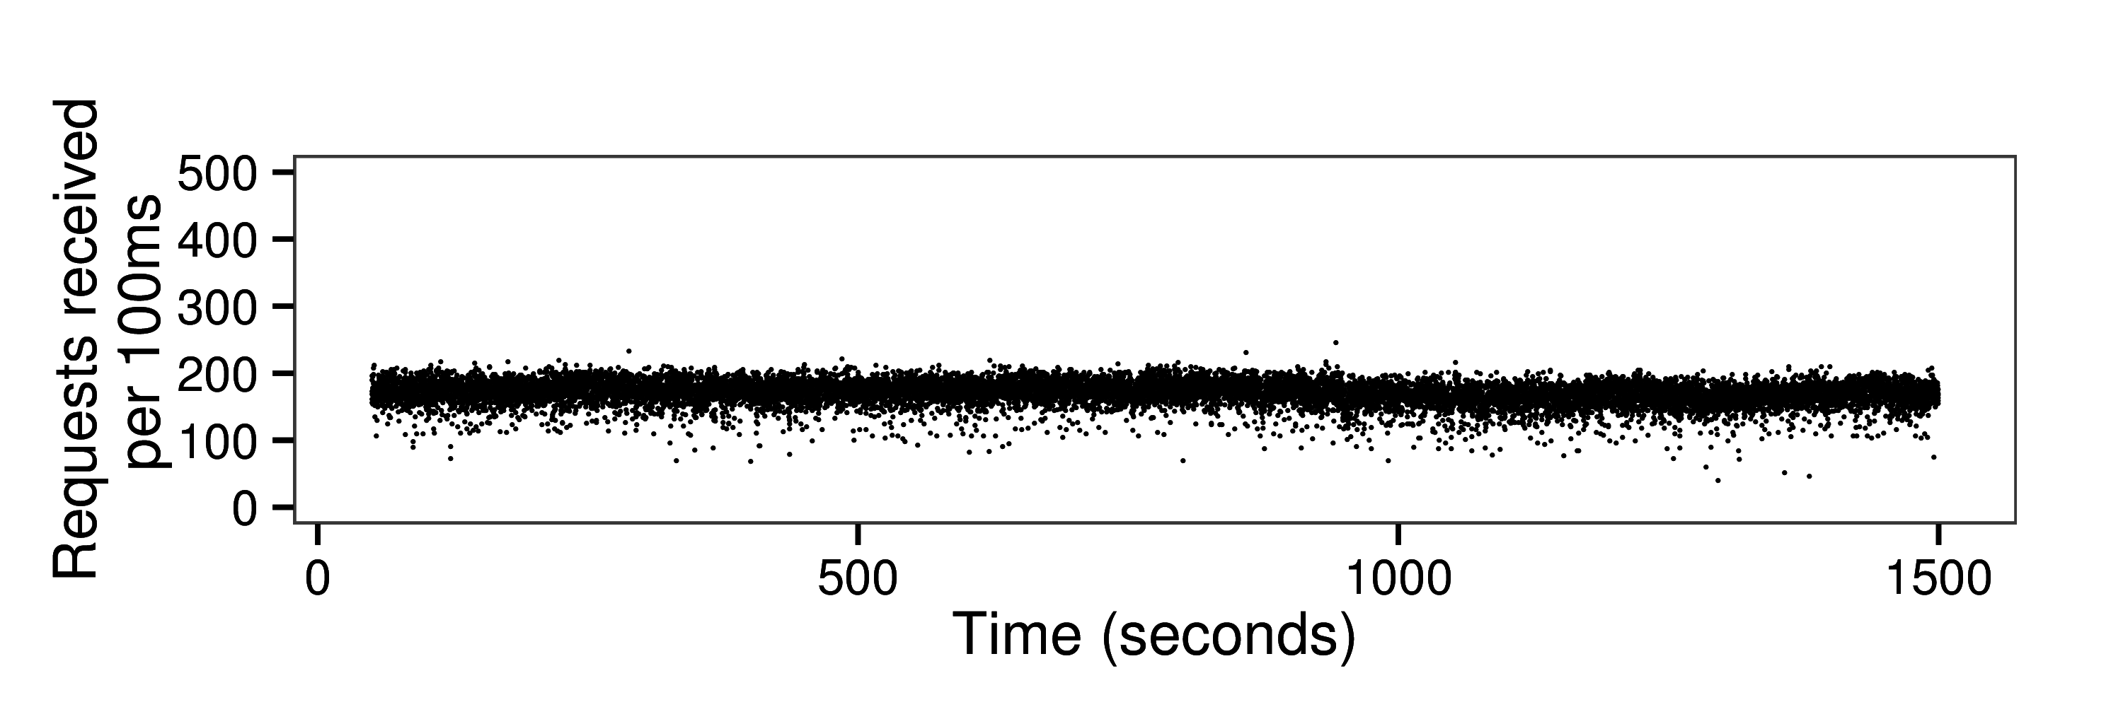
Load Conditioning in Our Approach

Slide 15
C3
Adaptive replica selection mechanism that is robust to service time heterogeinity

Slide 16
C3
Replica Ranking
Distributed Rate Control

Slide 17
C3
Replica Ranking
Distributed Rate Control

Slide 18
Client
µ⁻¹ = 2 ms
Server
Client
Server
Client
µ⁻¹ = 6 ms

Slide 19

Client
µ⁻¹ = 2 ms
Server
Client
Server
Client
µ⁻¹ = 6 ms
Balance product of queue-size and service time
{$q∙μ^{−1}$ }

Slide 20
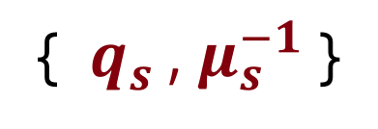
Server-side Feedback
Servers piggyback {$q_{s}$} and {$μ_{s}^{−1}$} in every response
Client
Server
{ $q_{s}$, $μ_{s}^{−1}$ }
Clients maintain EWMAs of these metrics

Slide 21
Server-side Feedback
Servers piggyback {$q_{s}$} and {$μ_{s}^{−1}$} in every response
Concurrency compensation

Slide 22

Server-side Feedback
Servers piggyback {$q_{s}$} and {$μ_{s}^{−1}$} in every response
Concurrency compensation
$${\hat{q}}_{s}=1+{os}_{s}∙w+q_{s}$$
outstanding requests

Slide 23

Select server
with min ${\hat{q}}_{s}∙μ_{s}^{−1}$ ?

Slide 24
Select server
with min ${\hat{q}}_{s}∙μ_{s}^{−1}$ ?
Potentially long queue sizes
Hampers reactivity

Slide 25
Penalizing Long Queues

Slide 26
Scoring Function
Clients rank server according to
$$Ψ_{s}=R_{s}−μ^{−1}+{\left({\hat{q}}_{s}\right)}^{3}∙μ^{−1}$$

Slide 27
C3
Replica Ranking
Distributed Rate Control

Slide 28
Need for distributed rate control
Replica ranking insufficient
Avoid saturating individual servers?
Non-internal sources of performance fluctuations?

Slide 29
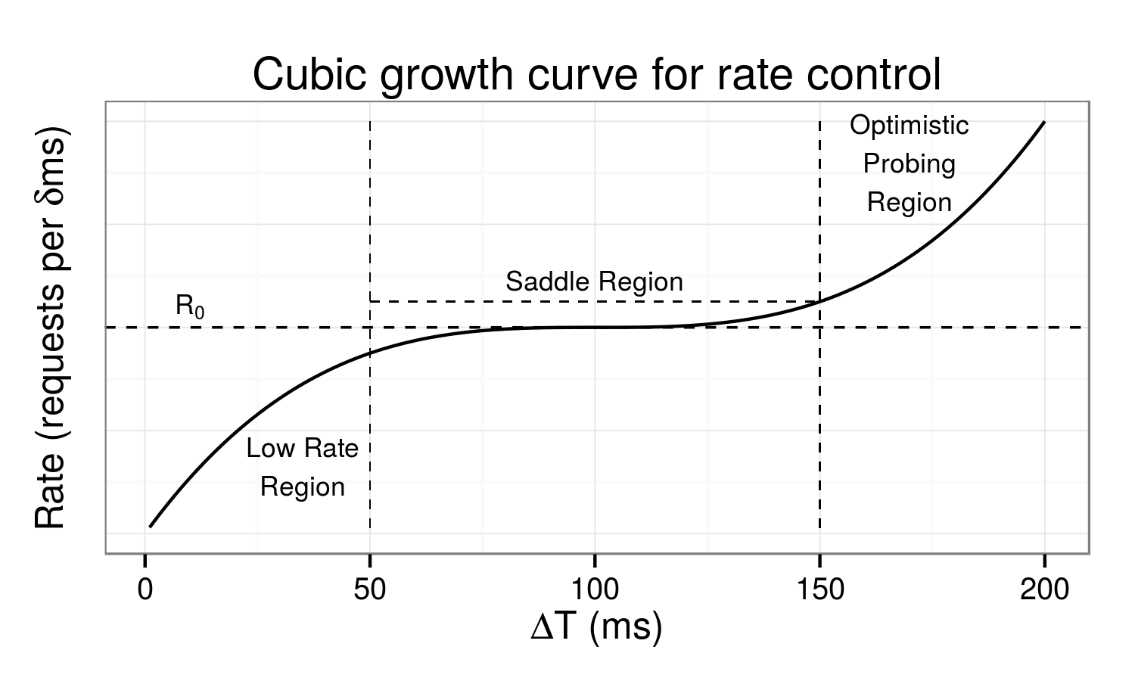
Cubic Rate Control
Clients adjust sending rates according to cubic function
If receive rate isn’t increasing further, multiplicatively decrease

Slide 30
Putting everything together
On receiving a request:
Client sorts replica servers by ranking function
Select first replica server which is within rate limit
If all replicas have exceeded rate limit, retain in backlog queue until a replica server is available

Slide 31

C3 implementation in Cassandra

Slide 33
R1
Read ( “key” )
A
R2
R3

Slide 34
R1
?
?
?
Read ( “key” )
A
R2
R3

Slide 35
Dynamic snitching
R1
Read ( “key” )
A
R2
@Snitch,
Who is the best replica?
R3

Slide 36
C3 Implementation
Replacement for Dynamic Snitching
Scheduler and backlog queue per replica group
~400 lines of code

Slide 37
Evaluation
Amazon EC2
Controlled Testbed
Simulations

Slide 38
Evaluation
Amazon EC2
15-node Cassandra cluster
Workloads generated using YCSB
Read-heavy, update-heavy, read-only
500M 1KB records (larger than memory)
Compare against Cassandra’s Dynamic Snitching

Slide 39
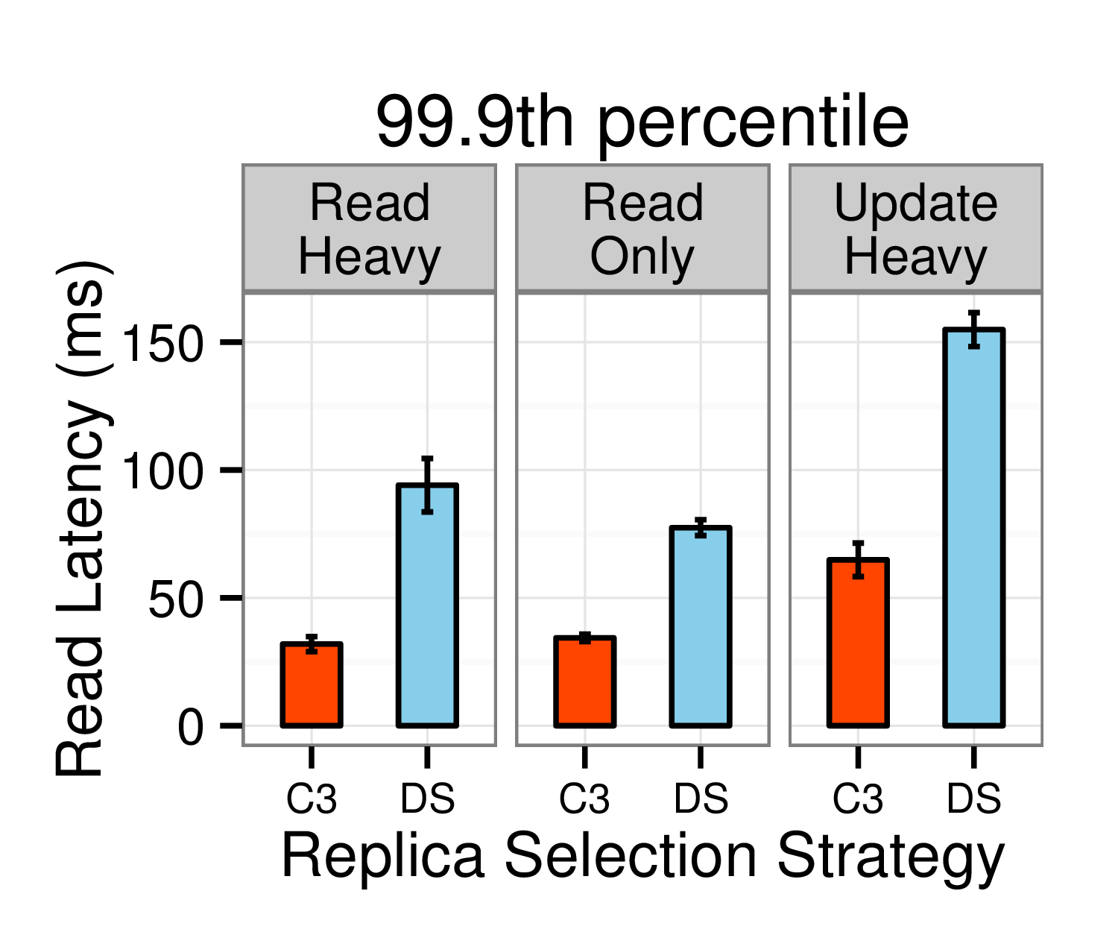
2x – 3x improved
99.9th percentile
latencies

Slide 40
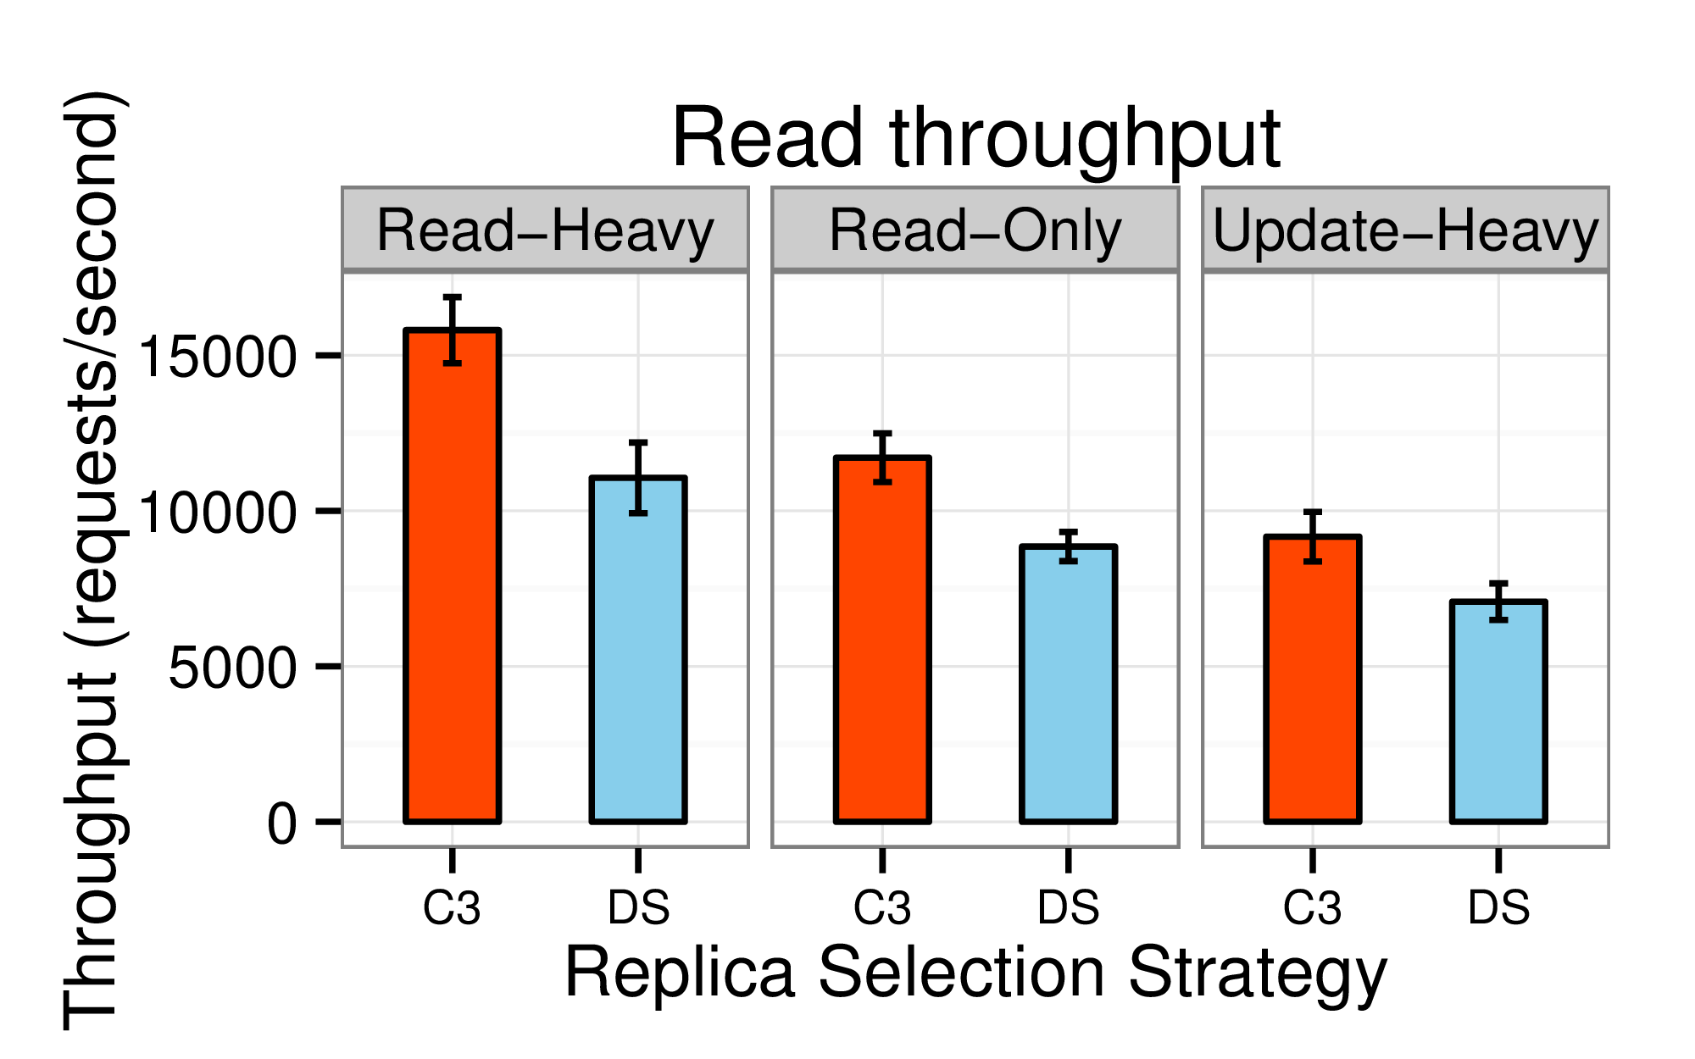
Up to 43%
improved
throughput

Slide 41
Improved
load
conditioning

Slide 42
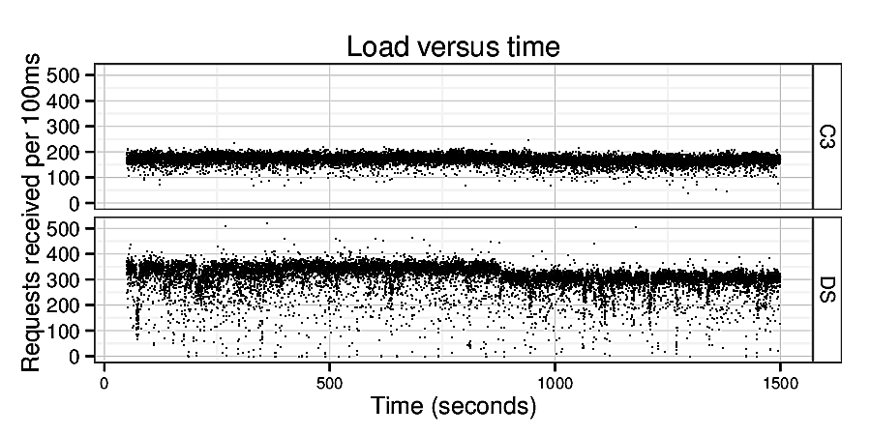
Improved
load
conditioning

Slide 43
How does C3 react to
dynamic workload changes?
Begin with 80 read-heavy workload generators
40 update-heavy generators join the system after 640s
Observe latency profile with and without C3

Slide 44
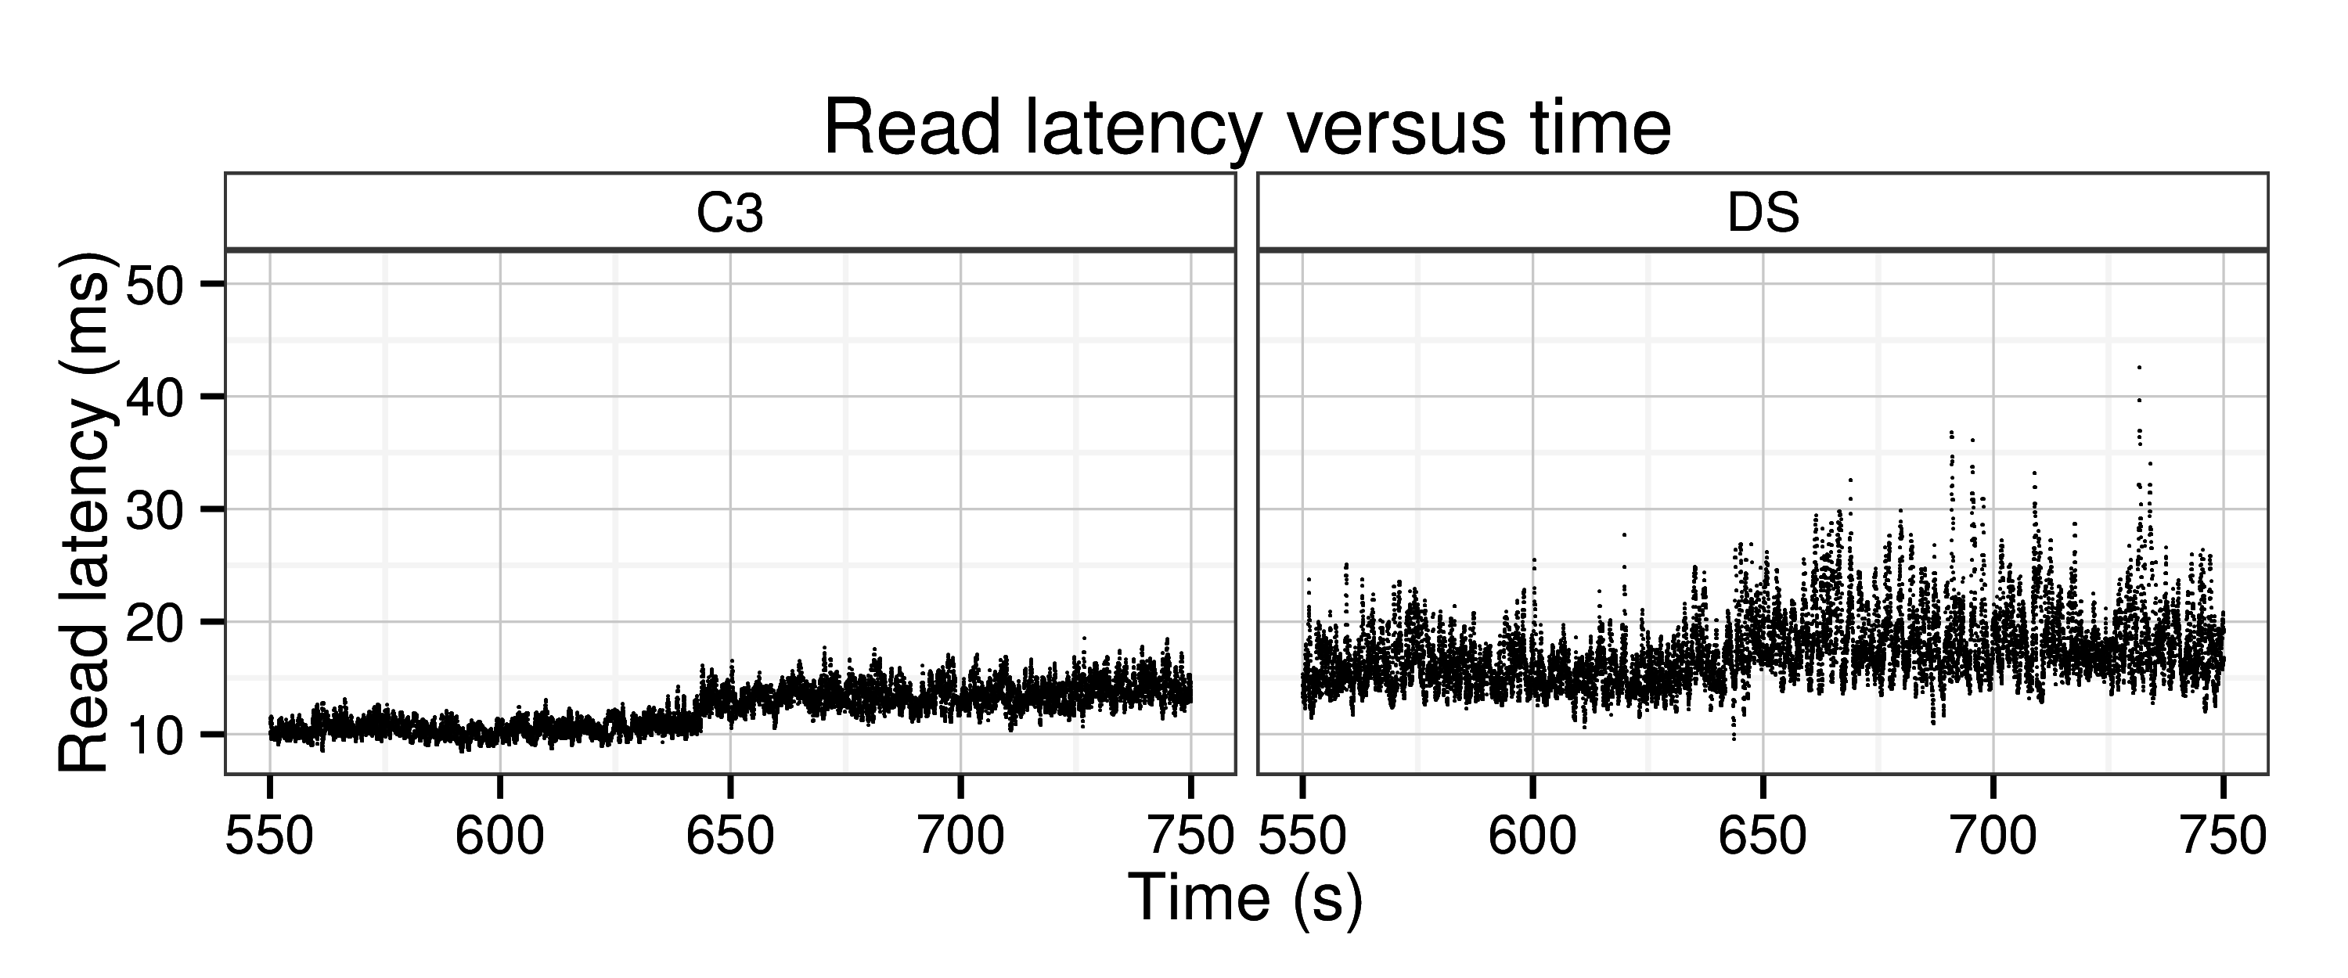
Latency profile degrades gracefully with C3

Slide 45
Summary of other results
Higher system load
Skewed record sizes
SSDs instead of HDDs
> 3x better 99th
percentile latency
> 50% higher throughput

Slide 46
Ongoing work
Stability analysis of C3
Deployment in production settings at Spotify and SoundCloud
Study of networking effects

Slide 47
Summary
C3 combines careful replica ranking and
distributed rate control to:
Reduce tail, mean, and median latencies
Improve load conditioning and throughput

Slide 48
Thank you!
Client
Server
{ q_{s} , 1/µ_{s} }

