Slide 1
Mining Top-K Association Rules
Comparison
Please go to the following link for the most updated version: https://www.dropbox.com/s/2u6g3z6ichv3t6c/TopKRules.pptx?dl=0
Group11 (LEUNG Chung Yin)

Slide 2
Once upon a time…
Philippe Fournier-Viger1
Cheng-Wei Wu2
Vincent S. Tseng2

Slide 3
Traditional way
Difficult to set minsup
⬇0.1: No Rules Found…
⬆0.1: >10000 Rules…
How to tune?
Read 10K rules?

Slide 4
Traditional way
Big Task
Find Frequent Itemsets
Find Association Rules using frequent itemsets (Another Big Task)
Big Task
Ex. ABCD is frequent A → BCD, B→ACD,… AB→CD, AC→BC,…
Store every count?
Exponential!

Slide 5
TopKRules (Idea)
Scan DB: Record each item’s tidset (Set of transaction ID)
Gen Base Rules r into L
Loop all rules in L LeftExpansion RightExpansion Until L is empty

Slide 6
TopKRules (Idea)
An auto increased minsup

Slide 7
TopKRules (Idea)
Always Set minsup = lowest support of TopK rules

Slide 8
TopKRules (Base)
Items: A, B, C, D
Base Rules (Totally 4C2 = 12):
A→B, A→C, A→D, B→C, B→D, C→D,
B→A, C→A, D→A, C→B, D→B, D→C

Slide 9
TopKRules (Base)
Ex. Rule A→B
Record 2 things:
tidset(A) ꓵ tidset(B)
tidset(A)
(Covered Transactions)
(Evidenced Transactions)
Count Support Efficiently

Slide 10
TopKRules (Left Expansion)
Ex. Rule A→B
∀ distinct item c from covered transactions in Rule A→B
If c ⊈ RHS AND c > all items in LHS
Then put A⋃{c}→B to L

Slide 11
TopKRules (Right Expansion)
Ex. Rule A→B
∀ distinct item c from covered transactions in Rule A→B
If c ⊈ LHS AND c > all items in RHS
Then put A→B⋃{c} to L

Slide 12
TopKRules (Duplicated Rules)
Duplication Examples:
A→C
A→C
Left Expand
Right Expand
AB→C
A→CD
Right Expand
Same!
left Expand
AB→CD
AB→CD

Slide 13
TopKRules (Duplicated Rules)
If a rule is Right Expanded,
Don’t Left Expand it.

Slide 14
At the same year…
Philippe Fournier-Viger1
Vincent S. Tseng2

Slide 15
Something weird…

Slide 16
1. AB→C
2. AB→CD
3. A→CD

Slide 17
Redundant!
1. AB→C
2. AB→CD
3. A→CD
Least Items → Most Items

Slide 18
TNR
TopK Non-redundant Rules

Slide 19
TNR (Strategies)
TopKRules
Attemp to add
New Rule A→B

Slide 20
TNR (Case1)
TopKRules
New Rule A→B
Throw away if redundant

Slide 21
TNR (Case2)
TopKRules
New Rule A→B
Throw a redundant and add the new one

Slide 22
TNR (Case2)
Can we throw this??
Old Rule
Throw a redundant and add the new one

Slide 23
TNR (Case2)
Can we throw this??
Already Pruned Search Space
Using Old Rule’s minsup!

Slide 24
TNR (Case2)
New Parameter Δ
k’ = k + Δ

Slide 25
TNR (Case2)
If # of Case2 > Δ Then it is Approximation

Slide 26
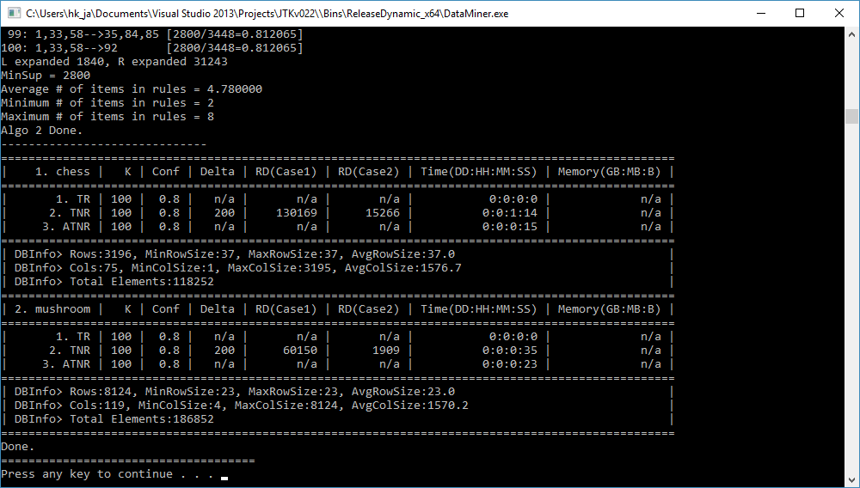
Results

Slide 27
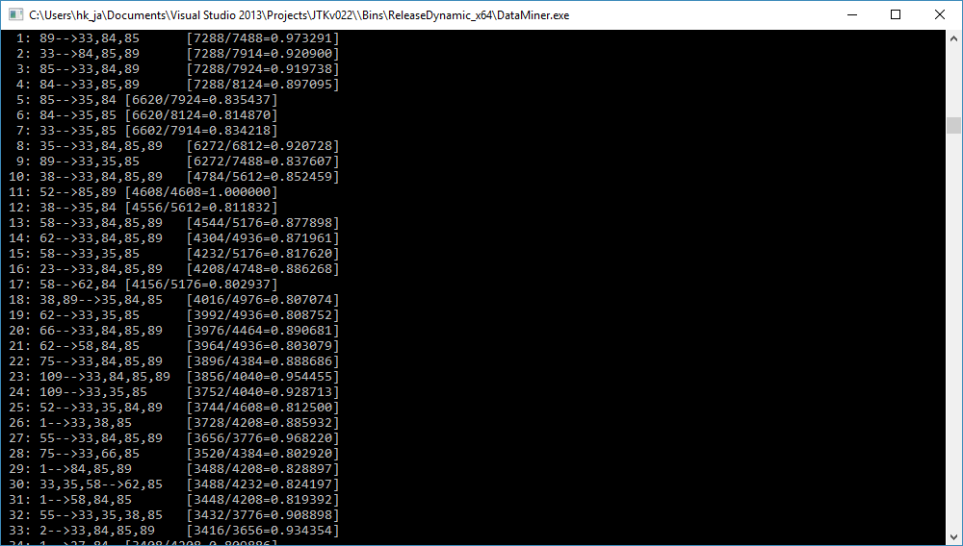
Results

Slide 28
Results
TR is very fast, full of redundant
TNR is slow, no redundant
Never get a good Δ…
For k>2000, TNR is super slow.
Acceptable RAM usage

Slide 29
Can we do better?

Slide 30
ATNR
Approximate TopK Non-redundant Rules

Slide 31
ATNR(Reason)
Recall Case2 in TNR:
Redundant Rules added to the TopK list
Prevent it?
Search Space Reordering

Slide 32
ATNR(Idea)
Fix LHS
Keep Right Expand Until Not Frequent
Repeat
Reduce Case 2

Slide 33
ATNR(Property)
Ex. Rule A→B
Support = $\frac{\left|tidset(A) ꓵ tidset(B)\right|}{\left|tidset(A)\right|}$
What if A is fixed?
Then Support is monotonic!

Slide 34
ATNR(Problem)
minsup NOT set perfectly

Slide 35
ATNR(Problem)
Reasons: (Like EM)
Not increase immediately
Right Expand skip good minsup
An Approximation Again…
But NO need to tune Δ!

Slide 36
Limitations
Measures Limited:
Lift/Interest/Gini

Slide 37
Very Similar Papers…
2015 IJIRT | Volume 1 Issue 12 | ISSN: 2349-6002:
TECHNIQUE FOR MINING TOP-K ASSOCIATION RULES
http://www.ijirt.org/vol1/paperpublished/IJIRT102265_PAPER.pdf
2016 IJETST- Vol.||03||Issue||01||Pages 3491-3500||January|| ISSN 2348-9480:
An Efficient Algorithm to Mine Non Redundant Top K Association Rules
http://dx.doi.org/10.18535/ijetst/v3i01.12

Slide 38
Thank You

