Slide 1
Introduction to Transfer Learning for 2012 Dragon Star Lectures
Qiang Yang
Hong Kong University of Science and Technology
Hong Kong, China
http://www.cse.ust.hk/~qyang

Slide 2

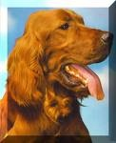
Traditional Machine Learning
Training
Data
Unseen Data
What if…
Classifier
(…,long, T)
good!
Notes:
Picture of fortunetelling, font

Slide 3
A Major Assumption in Traditional
Machine Learning
Training and future (test) data
  follow the same distribution, and
  are in same feature space

Slide 4

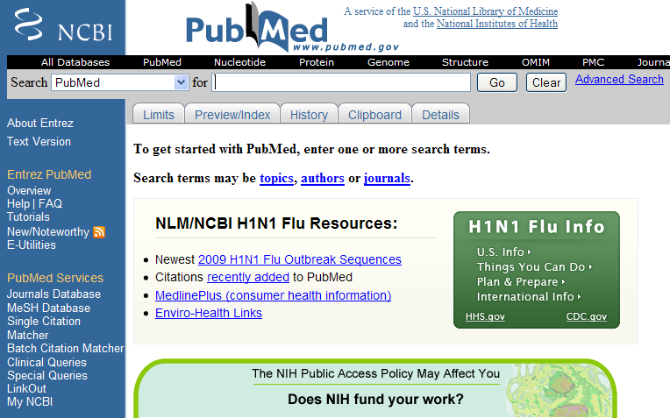
When distributions are different
Part-of-Speech tagging
Named-Entity Recognition
Classification
Notes:
4
Move to front? As distribution. Animation: applictation/tracking

Slide 5
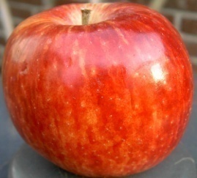
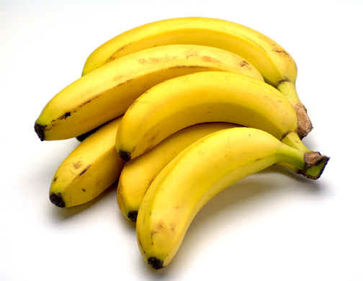
When Features are different
Heterogeneous: different feature spaces
Training: Text
Future: Images
The apple is the pomaceous fruit of the apple tree, species Malus domestica in the rose family Rosaceae ...
Apples
Banana is the common name for a type of fruit and also the herbaceous plants of the genus Musa which produce this commonly eaten fruit ...
Bananas

Slide 6
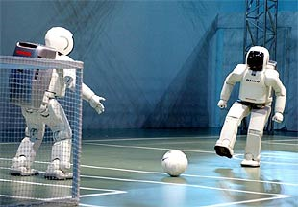
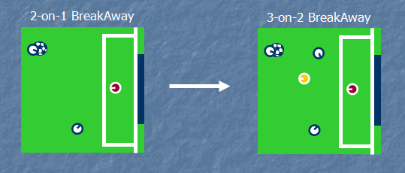
Reinforcement Learning
L. Torrey, J. Shavlik, S. Natarajan, P. Kuppili & T. Walker (2008).
Transfer in Reinforcement Learning via Markov Logic Networks. AAAI'08 Workshop on Transfer Learning for Complex Tasks, Chicago, IL.
Notes:
State why?

Slide 7
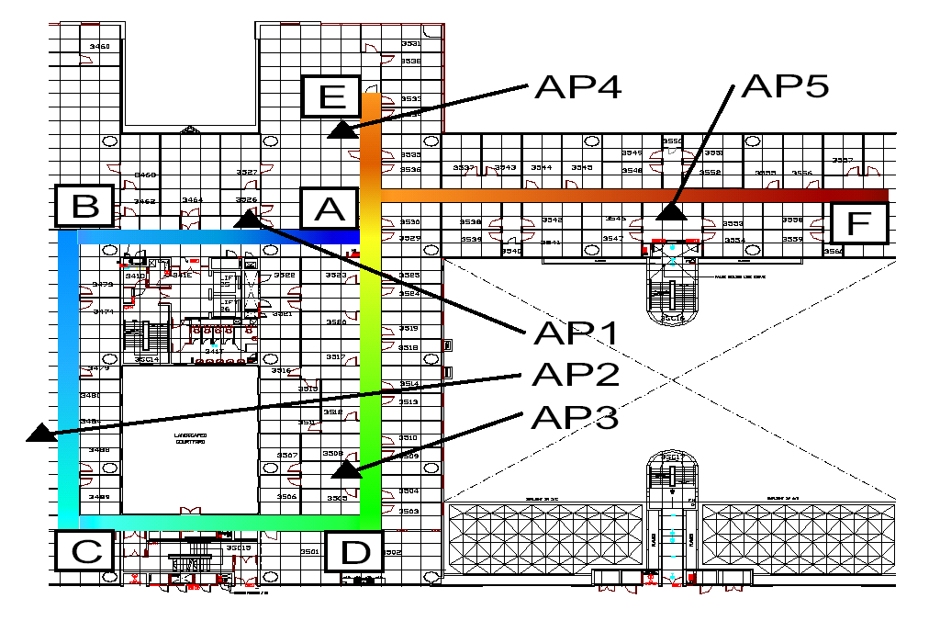

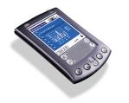
Motivating Example:
Indoor WiFi Localization
Where is the Mobile Device?
-30dBm | -70dBm | -40dBm

Slide 8
Indoor WiFi Localization (cont.)
Contour of signal strength values in the building
Time Period 1
Time Period 2
Y coordinate
Device A
X coordinate
Device B
WiFi signal strength may be a function of time or devices, depending on later factors

Slide 9
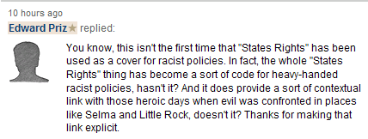


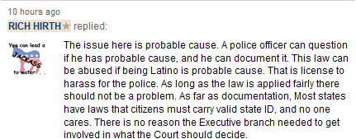
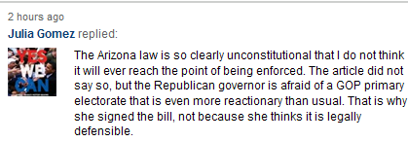

Motivating Example:
Sentiment Classification

Slide 10


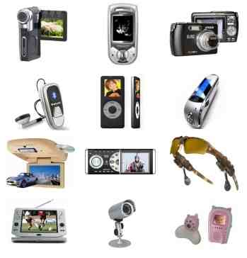
Traditional Supervised Learning
DVD
DVD
Training
Test
Classifier
82.55%
1, Sufficient labeled data are required to train classifiers.
2, The trained classifiers are domain-specific.
Electronics
Electronics
Training
Test
Classifier
84.60%

Slide 11
Traditional Supervised Learning (cont.)
Drop!
Electronics
Electronics
Training
Test
Classifier
84.60%
DVD
Electronics
Training
Test
Classifier
72.65%

Slide 12
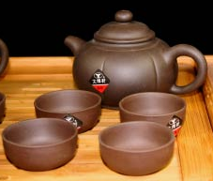
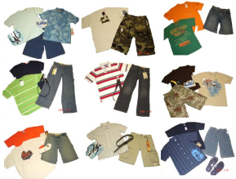
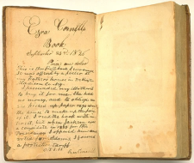
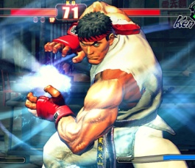

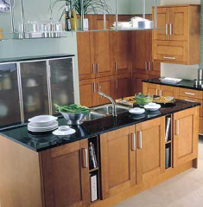
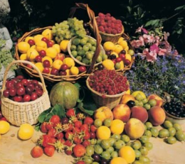
Traditional Supervised Learning (cont.)
Impractical!
Electronics
Tea
DVD
Clothes
Book
Video game
Hotel
Kitchen
Fruit

Slide 13
Domain Difference
Electronics | Video Games
(1) Compact; easy to operate; very good picture quality; looks sharp! | (2) A very good game! It is action packed and full of excitement. I am very much hooked on this game.
(3) I purchased this unit from Circuit City and I was very excited about the quality of the picture. It is really nice and sharp. | (4) Very realistic shooting action and good plots. We played this and were hooked.
(5) It is also quite blurry in very dark settings. I will never buy HP again. | (6) The game is so boring. I am extremely unhappy and will probably never buy UbiSoft again.

Slide 14
Transfer Learning?
People often transfer knowledge to novel situations
  Chess → Checkers
  C++ → Java
  Physics → Computer Science
Transfer Learning:
  The ability of a system to recognize and apply knowledge and skills learned in previous tasks to novel tasks (or new domains)
Notes:
Seems the changes is involved in moving to new tasks is more radical than moving to new domains.

Slide 15
Transfer Learning: Source Domains
Learning
Input
Output
Source Domains
 | Source Domain | Target Domain
Training Data | Labeled/Unlabeled | Labeled/Unlabeled
Test Data |  | Unlabeled

Slide 16
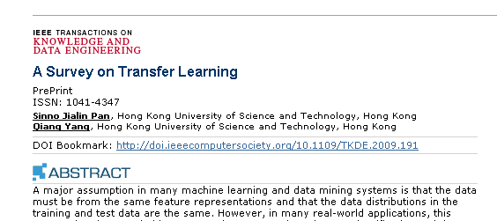
An overview of
various settings of
transfer learning
Source Domain
Self-taught Learning
Case 1
No labeled data in a source domain
Inductive Transfer Learning
Target Domain
Labeled data are available in a source domain
Labeled data are available in a target domain
Source and target tasks are learnt simultaneously
Multi-task Learning
Case 2
Transfer Learning
Labeled data are available only in a source domain
Assumption: different domains but single task
Transductive Transfer Learning
Domain Adaptation
No labeled data in both source and target domain
Assumption: single domain and single task
Unsupervised Transfer Learning
Sample Selection Bias /Covariance Shift

Slide 17
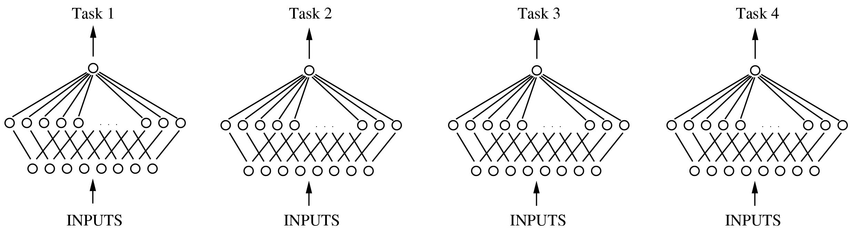
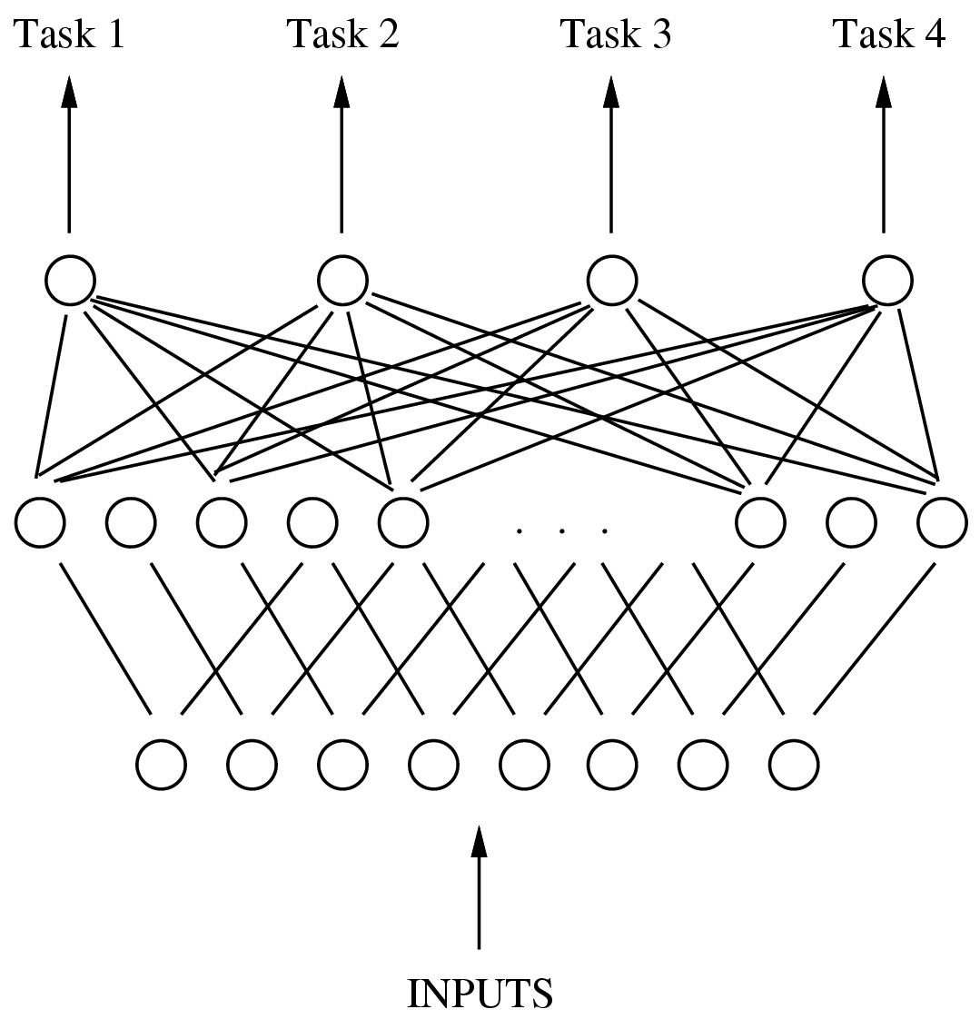
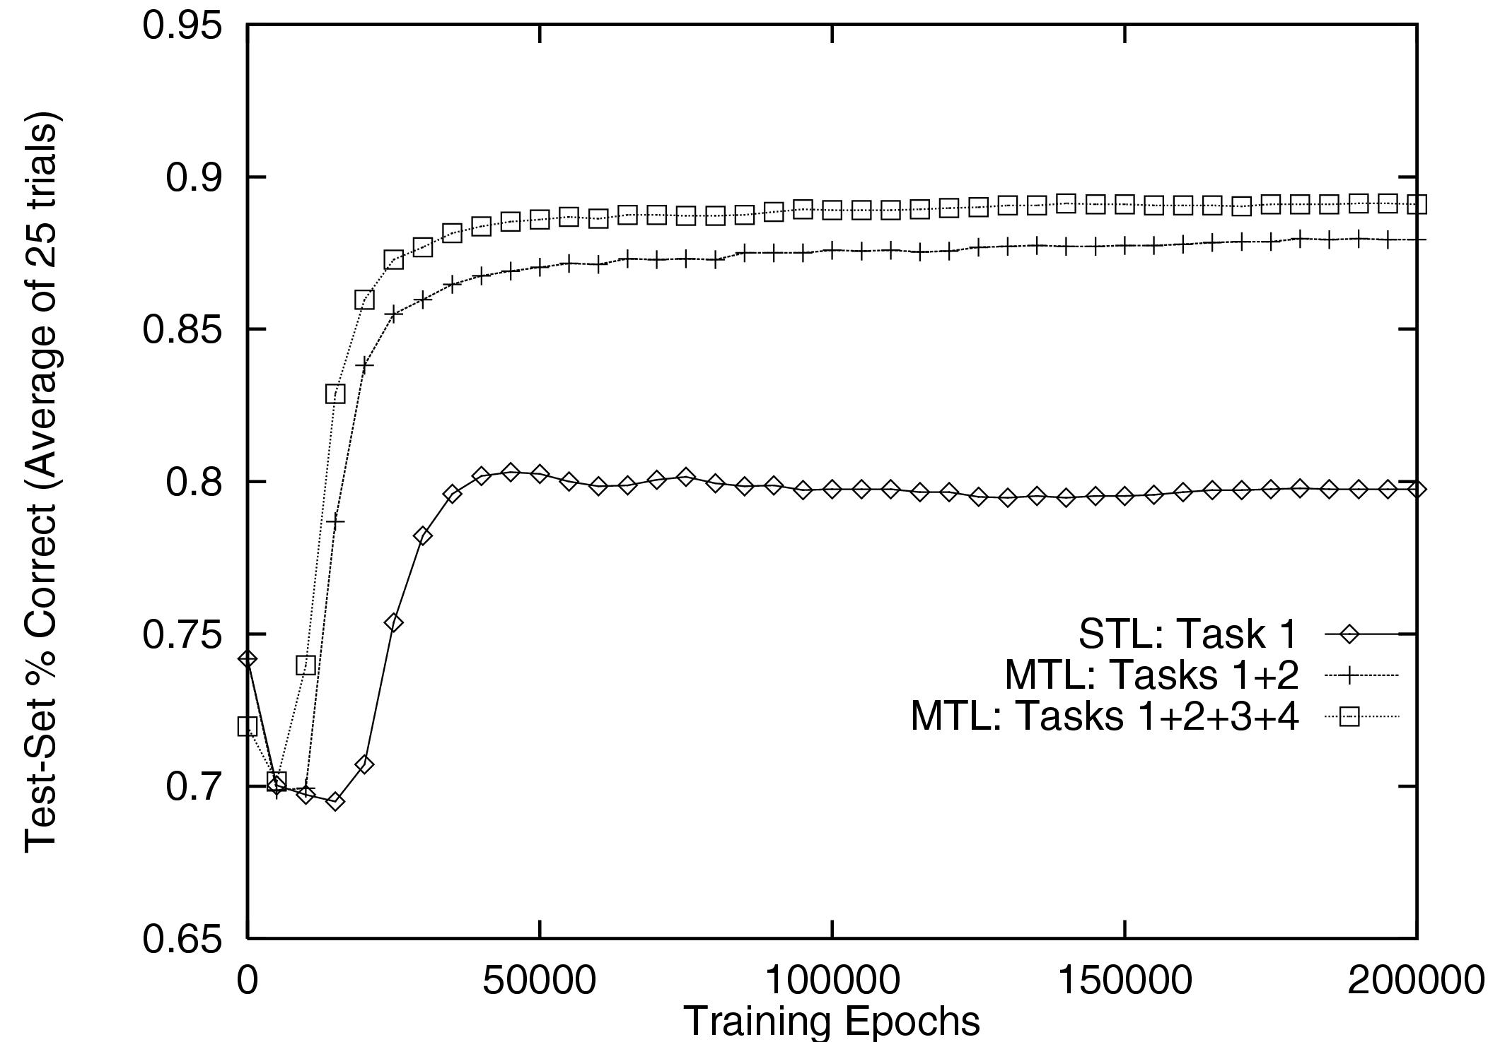
Rich Caruana: Multitask Learning. Machine Learning 28(1): 41-75 (1997)
TS3 10:00am Multi-task Learning Tutorial by
Jieping Ye and Jiayu Zhou;
CP10, 3:30-4:40. Transfer Learning Session
CP4, Yesterday, Multi-source, Multi-task
One man’s noise is another man’s music

Slide 18
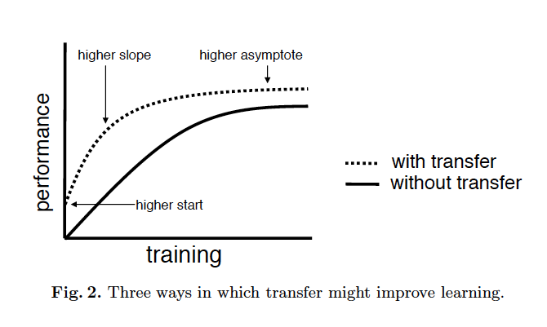
Transfer Learning Evaluation from (Lisa Torrey and Jude Shavlik, 2009)

Slide 19
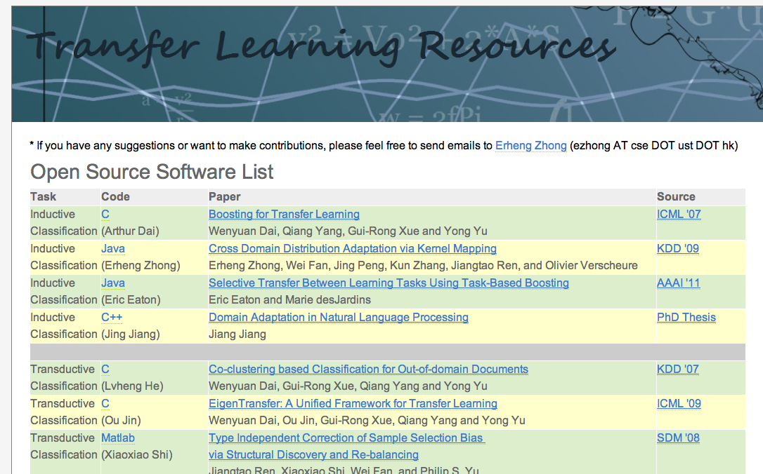
Transfer Learning Resources
http://www.cse.ust.hk/TL

Slide 20
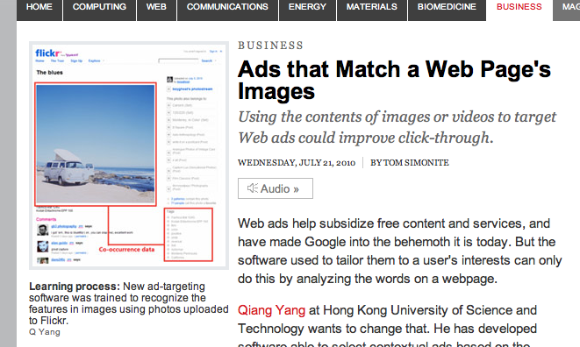
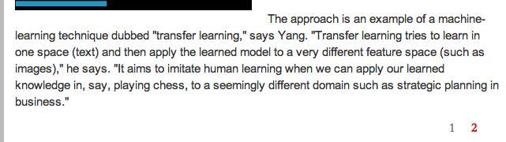
Transfer Learning in the News
MIT Technology
Review July 2010

Slide 21
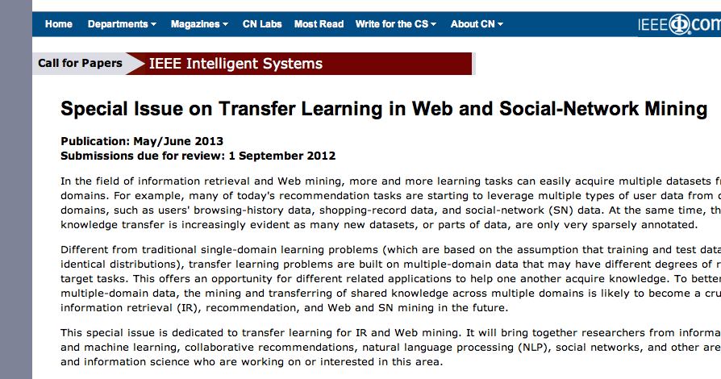
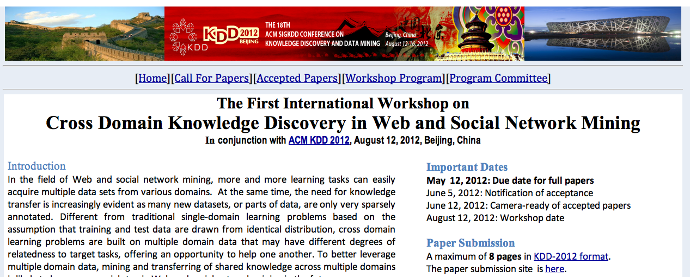
Special Issues

Slide 22
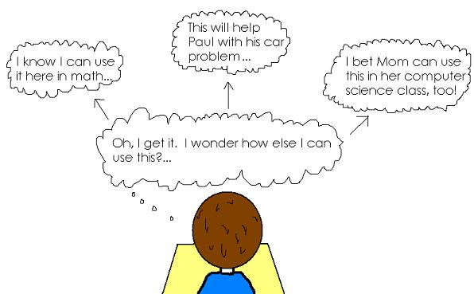
Educational Psychology Theory: Transfer of Learning (TOL)
Courtesy of Amanda Jones

Slide 23
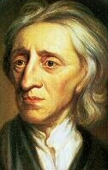
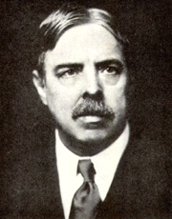
Locke 1700
Thorndike 1901
Transfer of Learning
Transfer of learning is the effect that prior learning has on later learning.
In 1700, the British empiricist philosopher, John Locke, proposed a theory of transfer called The Doctrine of Formal Discipline. It was challenged two centuries later by American psychologist, Edward L. Thorndike, with his Theory of Identical Elements. Thorndike founded educational psychology.
Courtesy of psych.fullerton.edu/navarick/transfer.ppt

Slide 24
Transfer of Learning
Doctrine of Formal Discipline
Locke: “...that having got the way of reasoning, which that study necessarily brings the mind to, they might be able to transfer it to other parts of knowledge as they shall have occasion.”
Theory of Identical Elements
Thorndike maintained that transfer takes place to the extent that the original task is similar to the transfer task.
It depends on how how many “elements” the two tasks have in common.
Courtesy of psych.fullerton.edu/navarick/transfer.ppt

Slide 25
Transfer of Learning: Factors that Affect Transfer
Initial acquisition of knowledge is necessary for transfer.
  Rote learning (memorizing isolated facts) does not tend to facilitate transfer, learning with understanding does
  Transfer is affected by degree to which students learn with understanding
Context plays a fundamental role.
  Knowledge learned that is too tightly bound to context in which it was learned will significantly reduce transfer
Courtesy of Amanda Jones

Slide 26
TOL: Near vs. Far
Near transfer: transfer in very similar contexts
  When a mechanic repairs an engine in a new model of car, but with design similar to prior models
Far transfer: transfer between contexts that seem alien to one another
  A chess player may apply basic strategies to financial investment practices or policies
Low road transfer: when stimulus conditions in the transfer context are similar to those in a prior context of learning to trigger semi-automatic responses
  When a person rents a truck for the first time to move, he/she finds that the familiar steering wheel and shift evoke useful car-driving responses
High road transfer: depends on abstraction from the learning A person familiar with chess but new to politics might carry over the chess principle of control of center, contemplating what it would mean to control the political center
Courtesy of Amanda Jones

Slide 27
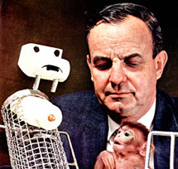
Transfer of Learning
Learning Sets
Harry Harlow’s Monkey Experiments: 1950s
The monkeys became “experts” at solving this type of problem. The first few problems took a lot of trials to solve—blind trial-and-error like Thorndike’s cats in the problem box.
After 300 problems (not trials on the same problem), they solved each problem within 2 trials, the absolute minimum, using a “win-stay, lose-shift” strategy.
If the first object they chose was correct, the chose it on every trial. If it was wrong, they shifted to the other object on Trial 2, and then stuck with it.

Slide 28
Transfer of Learning
Learning Sets
100
75
50
Problems 289 - 344
Problems 33 - 132
Percent Correct Responses
Problems 1 - 8
1 2 6
Trials
Monkeys show transfer of learning (Thorndike)

Slide 29
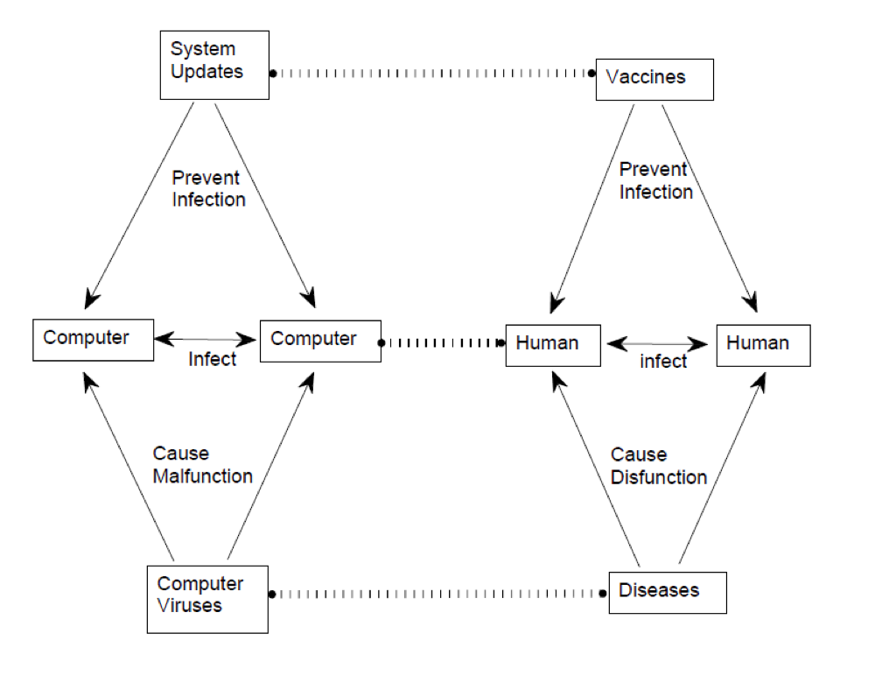
Learning by Analogy (1950 - )
Learning by Analogy: an important branch of AI
Using knowledge learned in one domain to help improve the learning of another domain

Slide 30
Learning by Analogy
Gentner 1983: Structural Correspondence
  Mapping between source and target:
    mapping between objects in different domains
    e.g., between computers and humans
    mapping can also be between relations
    Anti-virus software vs. medicine
Falkenhainer，Forbus, and Gentner (1989）
  Structural Correspondence Engine： incremental transfer of knowledge via comparison of two domains
Case-based Reasoning (CBR）
  e.g.,（CHEF） [Hammond, 1986] ，AI planning of recipes for cooking, HYPO (Ashley 1991), …

Slide 31
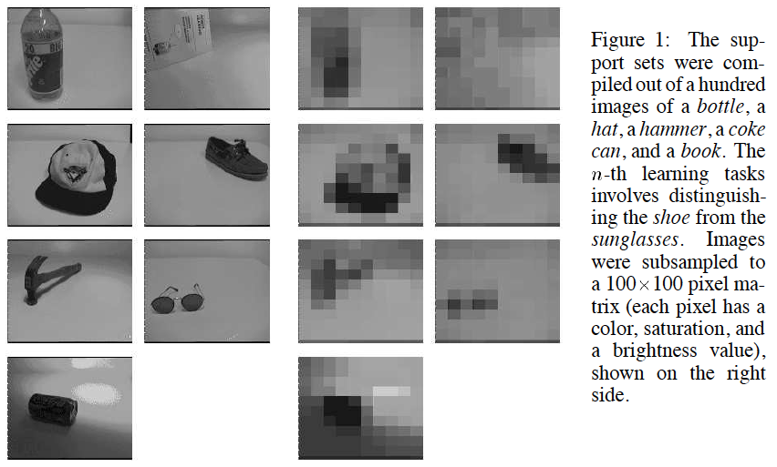
Lifelong Learning [S. Thurn: Is Learning The n-th Thing Any Easier Than Learning The First? (NIPS 1996)]
Intuition: humans learn with more than just training data
  Thus we can learn with a single example
Human vs. machine learning: lifelong learning
  Learning representations
  Learning distance functions

Slide 32
Transfer Learning Surveys
Sinno Jialin Pan and Qiang Yang. A survey on transfer learning. IEEE Transactions on Knowledge and Data Engineering, 22(10):1345–1359, October 2010.
Jing Jiang. A Literature Survey on Domain Adaptation of Statistical Classifiers.
Matthew E. Taylor and Peter Stone. Transfer Learning for Reinforcement Learning Domains: A Survey, JMLR V10(Jul):1633--1685, 2009.

Slide 33
Reinforcement Learning
Lisa Torrey, Jude Shavlik, S. Natarajan, P. Kuppili & T. Walker (2008). Knowledge Transfer in Reinforcement Learning via Markov Logic Networks. AAAI'08 Workshop on Transfer Learning for Complex Tasks.
Lisa Torrey and Jude Shavlik, Transfer Learning. 2009.
Lisa Torrey and Peter Stone. JMLR. (see prev. page)

Slide 34
Transfer Learning via Ensemble Learning
Jing Gao, Wei Fan, Jing Jiang, and Jiawei Han. Knowledge transfer via multiple model local structure mapping. In Proceeding of the 14th ACM SIGKDD international conference on Knowledge discovery and data mining, KDD ’08, pages 283–291, New York, NY, USA, 2008. ACM.

Slide 35
Lifelong Learning
S. Thurn: Is Learning The n-th Thing Any Easier Than Learning The First? (NIPS 1996)

