Slide 1
Introduction to Transfer Learning (Part 2) For 2012 Dragon Star Lectures
Qiang Yang
Hong Kong University of Science and Technology
Hong Kong, China
http://www.cse.ust.hk/~qyang

Slide 2
Domain Adaptation in NLP
Selected Methods
Applications
Domain adaptation for statistical classifiers [Hal Daume III & Daniel Marcu, JAIR 2006], [Jiang and Zhai, ACL 2007]
Structural Correspondence Learning [John Blitzer et al. ACL 2007] [Ando and Zhang, JMLR 2005]
Latent subspace [Sinno Jialin Pan et al. AAAI 08]
Automatic Content Extraction
Sentiment Classification
Part-Of-Speech Tagging
NER
Question Answering
Classification
Clustering
Notes:
For example, the idea of Structural Correspondence Learning comes from Tong zhang’s multi-task learning paper
ACL… consistency

Slide 3
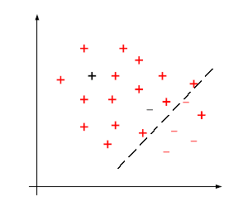
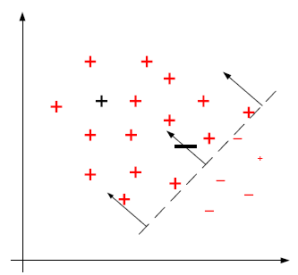

Instance-transfer Approaches
[Wu and Dietterich ICML-04]
[J.Jiang and C. Zhai, ACL 2007]
[Dai, Yang et al. ICML-07]
  Cross-domain POS tagging,
  entity type classification
  Personalized spam filtering
Uniform weights
Correct the decision boundary by re-weighting
Differentiate the cost for misclassification of the target and source data
Loss function on the target domain data
Loss function on the source domain data
Regularization term
Notes:
Stress test data have label
Animation…

Slide 4
TrAdaBoost [Dai, Yang et al. ICML-07]
Misclassified examples:
  increase the weights of the misclassified target data
  decrease the weights of the misclassified source data
Hedge ( )
[Freund et al. 1997]
AdaBoost
[Freund et al. 1997]
Evaluation with 20NG: 22%→8%
http://people.csail.mit.edu/jrennie/20Newsgroups/
To decrease the weights of the misclassified data
To increase the weights of the misclassified data
Source domain
labeled data
target domain
labeled data
The whole training data set
Classifiers trained on
re-weighted labeled data
Target domain
unlabeled data

Slide 5
Locally Weighted Ensemble [Jing Gao, Wei Fan, Jing Jiang, Jiawei Han: Knowledge transfer via multiple model local structure mapping. KDD 2008]
Training set 1
C₁
Training set 2
C₂
Test example
……
……
Training set k
C_{k}
Graph-based weights approximation
Weight of a model is proportional to the similarity between its neighborhood graph and the clustering structure around x.
Notes:
1. The basic idea is to build a linear combination of base models for each target instance (The upper half of the slide). Note: the combination coefficients for different target instances can be different.
2. The weight of each model is decided by the similarity between its neighborhood graph and the clustering structure around x. The neighborhood graph is built like this:
a. the model will predict the label of each target instance
b. if the pseudo labels of two target instances are the same, they are linked.
3. The figure in the right corner is a toy example. It shows that model-1 captures 3 out of 4 links of the clustering structure while model-2 captures only 2, and hence model-1 has higher weight for x.

Slide 6
Transductive Transfer Learning
Instance-transfer Approaches
Sample Selection Bias / Covariance Shift
[Zadrozny ICML-04, Schwaighofer JSPI-00]
Input: A lot of labeled data in the source domain and no labeled data in the
target domain.
Output: Models for use in the target domain data.
Assumption: The source domain and target domain are the same. In addition,
and are the same while and may be
different caused by different sampling process (training data and test data).
Main Idea: Re-weighting (important sampling) the source domain data.

Slide 7


Sample Selection Bias/Covariance Shift
To correct sample selection bias:
How to estimate ?
One straightforward solution is to estimate and ,
respectively. However, estimating density function is a hard problem.
weights for source domain data

Slide 8


Sample Selection Bias/Covariance Shift
Kernel Mean Match (KMM)
[Huang et al. NIPS 2006]
Main Idea: KMM tries to estimate directly instead of estimating
density function.
It can be proved that can be estimated by solving the following quadratic
programming (QP) optimization problem.
Theoretical Support: Maximum Mean Discrepancy (MMD) [Borgwardt et al.
BIOINFOMATICS-06]. The distance of distributions can be measured
by Euclid distance of their mean vectors in a RKHS.
To match means between training and test data in a RKHS

Slide 9
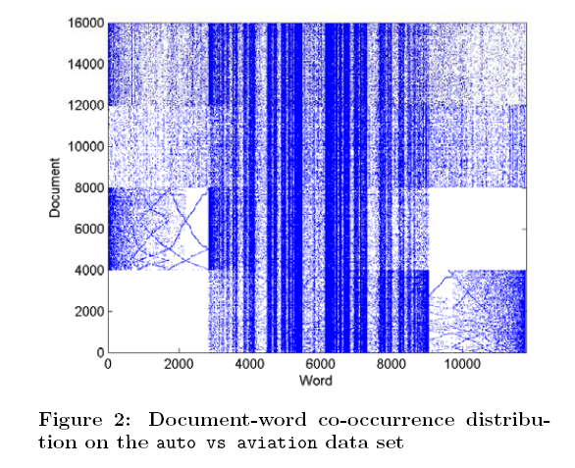
Feature Space: Document-word co-occurrence
Source
D_S
Knowledge
transfer
Target
D_T

Slide 10
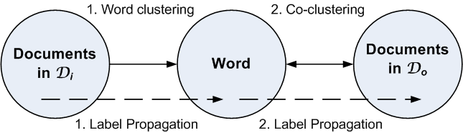
Co-Clustering based Classification (KDD 2007)
Co-clustering is applied between features (words) and target-domain documents
Word clustering is constrained by the labels of in-domain (Old) documents
  The word clustering part in both domains serve as a bridge
10
Notes:
Co-clustering based Classification is another algorithm developed by us. This work was published in KDD 2007.
The main idea of our algorithm is to build better feature representations for classification in the target domain, with the help of labeled information from another domain.
We model our algorithm using co-clustering. In our algorithm, word clustering based on in-domain documents, and co-clustering based on out-of-domain documents are performed simultaneusly. Then, the word clusters are served as a new feature representation to help the classification.

Slide 11
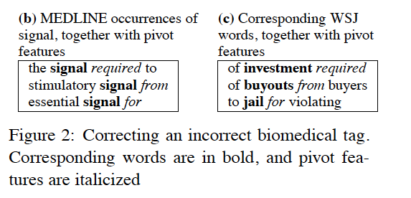
Structural Correspondence Learning [Blitzer et al. ACL 2007]
SCL: [Ando and Zhang, JMLR 2005]
  Define pivot features: common in two domains
  Build Latent Space built from Pivot Features, and do mapping
  Build classifiers through the non-pivot Features

Slide 12
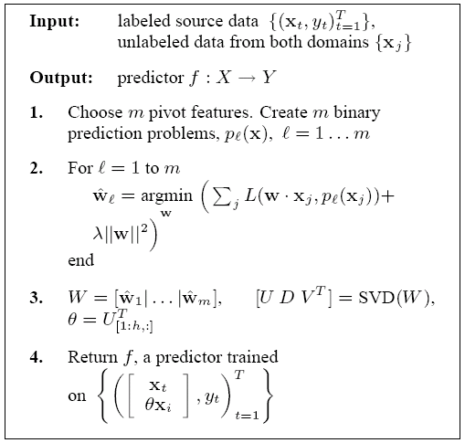
SCL
[Blitzer et al. EMNLP-06, Blitzer et al. ACL-07, Ando and Zhang JMLR-05]
a) Heuristically choose m pivot features, which is task specific.
b) Transform each vector of pivot feature to a vector of binary values and then create corresponding prediction problem.
Learn parameters of each prediction problem
Do Eigen Decomposition on the matrix of parameters and learn the linear mapping function.
Use the learnt mapping function to construct new features and train classifiers onto the new representations.
Courtesy of Sinno Pan

Slide 13
Self-Taught Learning
Feature-representation-transfer Approaches
Unsupervised Feature Construction
[Raina et al. ICML-07]
Three steps:
Applying sparse coding [Lee et al. NIPS-07] algorithm to learn higher-level representation from unlabeled data in the source domain.
Transforming the target data to new representations by new bases learnt in the first step.
Traditional discriminative models can be applied on new representations of the target data with corresponding labels.
Courtesy of Sinno Pan

Slide 14
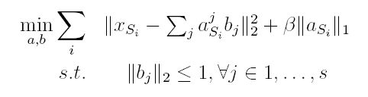

Unsupervised Feature Construction
[Raina et al. ICML-07]
Step1:
Input: Source domain data and coefficient
Output: New representations of the source domain data
and new bases
Step2:
Input: Target domain data , coefficient and bases
Output: New representations of the target domain data
Courtesy of Sinno Pan

Slide 15
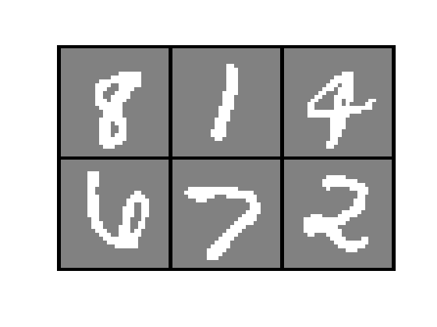
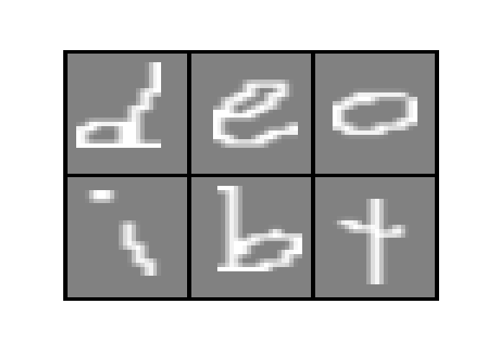
“Self-taught Learning”
[Raina et al. Self-Taught Learning ICML-07]
+
?
Labeled Digits
Unlabeled English characters
+
?
Labeled Webpages
Unlabeled newspaper articles
+
?
Labeled Russian Speech
Unlabeled English speech

Slide 16

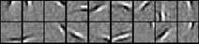
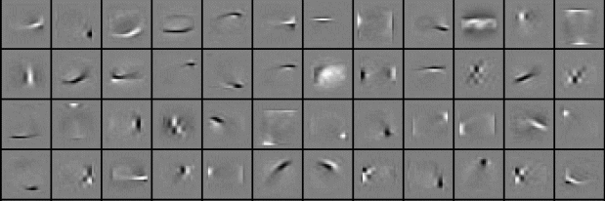
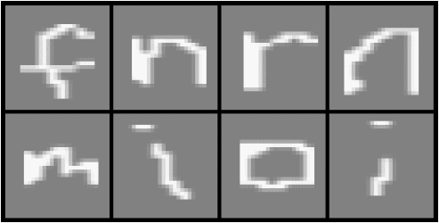
Examples of Higher Level Features Learned
Natural images.
Learnt bases: “Edges”
Handwritten characters.
Learnt bases: “Strokes”
Notes:
The learned features can be understood as basic strokes of written characters
16

Slide 17
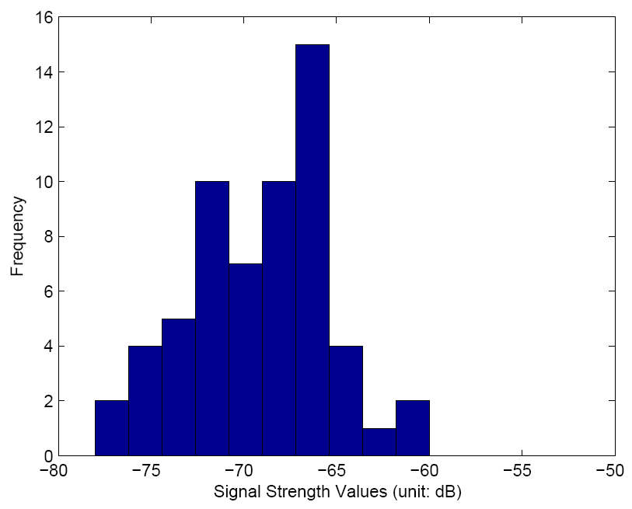
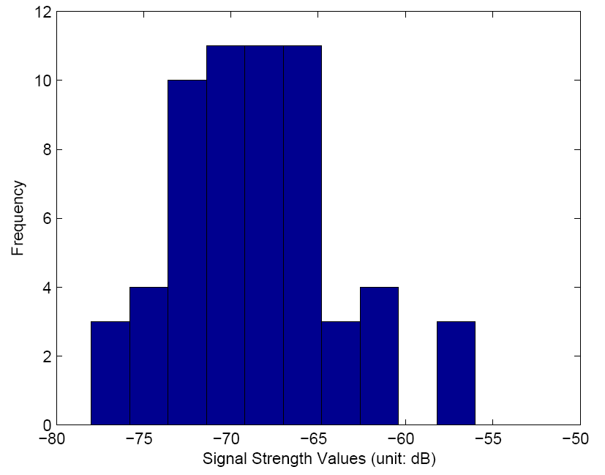
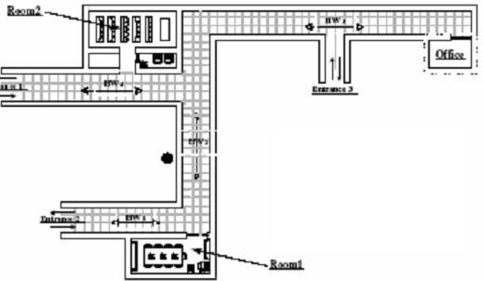

Latent Feature Space TL Methods: Temporal Domain Distribution Changes
The mapping function f learned in the offline phase can be out of date.
Recollecting the WiFi data is very expensive.
How to adapt the model ?
Time
Night time period
Day time period
Notes:
17

Slide 18
Transfer Component Analysis: Sinno Pan et al., IEEE Trans. NN 2011
If two domains are related, …
Observations
Source Domain
data
Target Domain
data
Latent factors
Common latent factors across domains

Slide 19
Motivation (cont.)
Observations
Source domain
data
Target domain
data
Latent factors
Some latent factors may preserve important properties (such as variance, local topological structure) of the original data, while others may not.

Slide 20
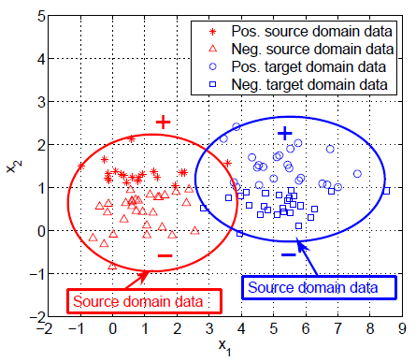
PCA: Only Maximizing the Data Variance
Principal Component Analysis (PCA) [Jolliffe. 02] aims to find a low-dimensional latent space where the variance of the projected data is maximized.
Con: it may not reduce the difference between domains.

Slide 21


Learning the Transform Mapping
High level optimization problem
How to estimate distance between distributions in the latent space?
How to solve the resultant optimization problem?

Slide 22
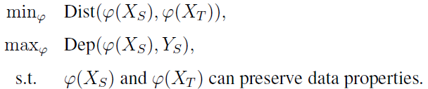
Semi-Supervised TCA
To measure the distance between domains using MMD
High level objectives:
To measure label dependence using Hilbert-Schmidt Independence Criterion (HSIC)

Slide 23
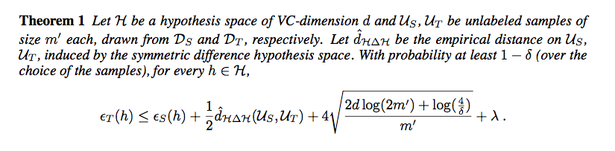
Blitzer, et al. Learning Bounds for Domain Adaptation. NIPS 2007
m’=number of examples
d(u_S, u_T) = domain distance
1-δ=confidence
ε=error

Slide 24


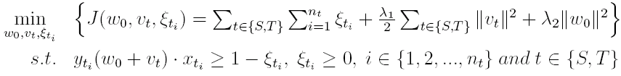
Inductive Transfer Learning
Model-transfer Approaches
Regularization-based Method
[Evgeiou and Pontil, KDD-04]
Assumption: If t tasks are related to each other, then they may share some
parameters among individual models.
Assume be a hyper-plane for task , where and
Encode them into SVMs:
Common part
Specific part for individual task
Regularization terms for multiple tasks

Slide 25
Inductive Transfer Learning
Structural-transfer Approaches
TAMAR
[Mihalkova et al. AAAI-07]
Assumption: If the target domain and source domain are related, then there
may be some relationship between domains that are similar, which can be used for transfer learning
Input:
Relational data in the source domain and a statistical relational model, Markov Logic Network (MLN), which has been learnt in the source domain.
Relational data in the target domain.
Output: A new statistical relational model, MLN, in the target domain.
Goal: To learn a MLN in the target domain more efficiently and effectively.

Slide 26
TAMAR [Mihalkova et al. AAAI-07]
Two Stages:
Predicate Mapping
  Establish the mapping between predicates in the source and target domain. Once a mapping is established, clauses from the source domain can be translated into the target domain.
Revising the Mapped Structure
  The clause-mapping from the source domain directly may not be completely accurate and may need to be revised, augmented , and re-weighted in order to properly model the target data.

Slide 27
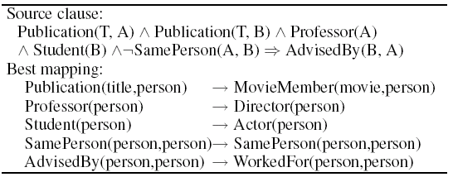
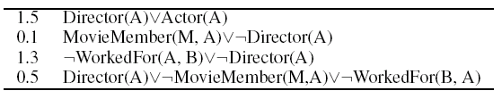
TAMAR [Mihalkova et al. AAAI-07]
Source domain (academic domain)
Target domain (movie domain)
Student (B)
AdvisedBy
Professor (A)
Actor(A)
WorkedFor
Director(B)
Publication
Publication
MovieMember
MovieMember
Paper (T)
Movie(M)
Mapping
Revising

