Slide 1
Towards Heterogeneous Transfer Learning
Qiang Yang
Hong Kong University of Science and Technology
Hong Kong, China
http://www.cse.ust.hk/~qyang

Slide 2
TL Resources
http://www.cse.ust.hk/TL

Slide 3
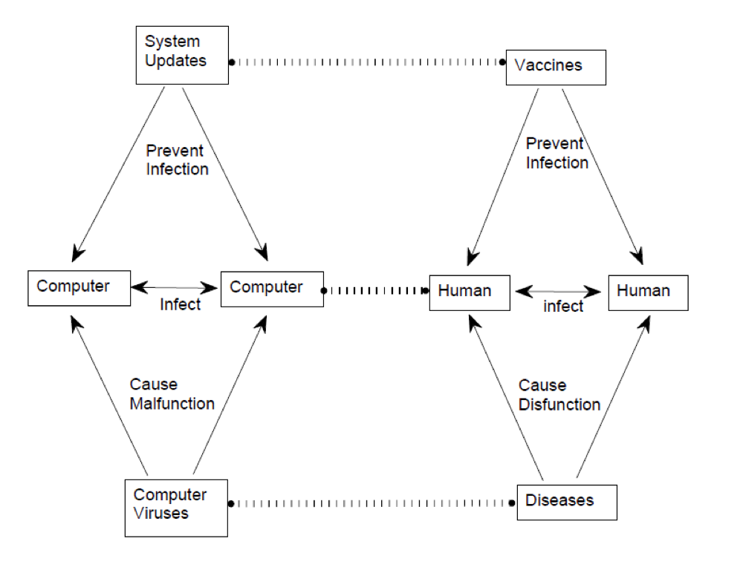
Learning by Analogy
Learning by Analogy: an important branch of AI
Using knowledge learned in one domain to help improve the learning of another domain

Slide 4
Learning by Analogy
Gentner 1983: Structural Correspondence
  Mapping between source and target:
    mapping between objects in different domains
    e.g., between computers and humans
    mapping can also be between relations
    Anti-virus software vs. medicine
Falkenhainer，Forbus, and Gentner (1989）
  Structural Correspondence Engine： incremental transfer of knowledge via comparison of two domains
Case-based Reasoning (CBR）
  e.g.,（CHEF） [Hammond, 1986] ，AI planning of recipes for cooking, HYPO (Ashley 1991), …

Slide 5
Challenges with LBA
（ACCESS）: find similar case candidates
  How to tell similar cases？
  Meaning of ‘similarity’？
MATCHING: between source and target domains
  Many possible mappings？
  To map objects, or relations？
  How to decide on the objective functions？
EVALUATION： test transferred knowledge
  How to create objective hypothesis for target domain?
  How to ？
Access, Matching and Eval:
  decided via prior knowledge
  mapping fixed
Our problem：
  How to learn the similarity automatically？

Slide 6
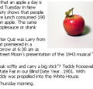
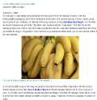


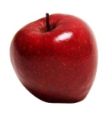

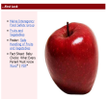
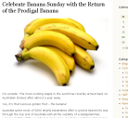
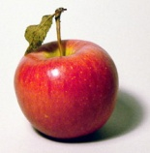
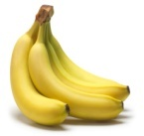
Heterogeneous Transfer Learning
Feature Spaces
Instance Alignment ?
Data Distribution?
Heterogeneous Transfer Learning
Multi-view Learning
Traditional Machine Learning
Transfer Learning across Different Distributions
Multiple Domain Data
Heterogeneous
Homogeneous
Yes
No
Different
Same
Source
Domain
Apple is a fr-uit that can be found …
Banana is the common name for…
Target
Domain
HTL

Slide 7
Cross-language Classification
WWW 2008: X.Ling et al.
Can Chinese Web Pages be Classified with English Data Sources?
Classifier
learn
classify
Labeled English Web pages
Unlabeled Chinese Web pages
Cross-language Classification
Notes:
Then, we are still trying to train a classifier, but we only have labeled English data, instead of Chinese data. Our target is the same , to classify the unlabeled Chinese data. This is so-called cross-language classfiication. It is surely different from classical text classification, Since the training and test data are in different languages.

Slide 8

Heterogeneous Transfer Learning: with a Dictionary
  [Bel, et al. ECDL 2003]
  [Zhu and Wang, ACL 2006]
  [Gliozzo and Strapparava ACL 2006]
DICTIONARY
Labeled documents
in English (abundant)
Translation Error
Topic Drift
Labeled documents
in Chinese (scarce)
TASK: Classifying documents
in Chinese
Notes:
(This slide is to connect with AK’s translated learning.) In heterogeneous transfer learning, we need to exploit the relations between two heterogeneous feature spaces. For example, suppose that we want to classify some Chinese documents, however as training data we only have a few labeled Chinese documents. Therefore it’s desirable to transfer the knowledge learned from some different feature space, i.e., labeled English documents, which is relatively abundant. To bridge these two feature spaces, the most obvious scenario is that we have access to co-occurrence data (a dictionary) of the two feature spaces, such that we can estimate the feature-level transfer probabilities by their co-occurrence frequencies.

Slide 9
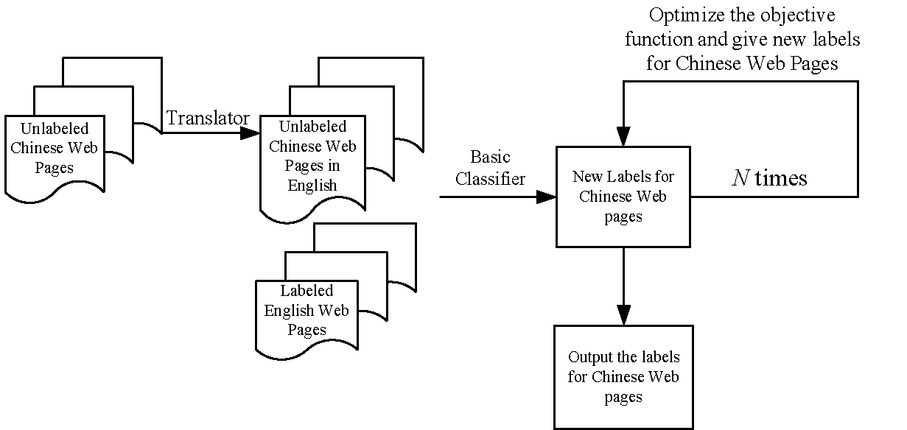

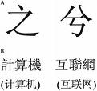


Information Bottleneck
[Ling, Xue, Yang et al. WWW2008]
Improvements: over 15%
Domain Adaptation
C
E
E
C
9

Slide 10
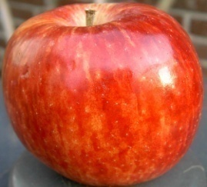
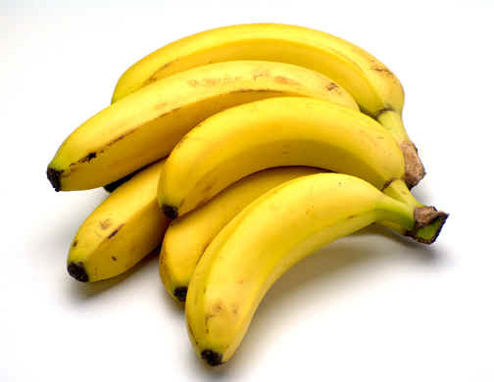
HTL Setting: Text to Images
Source data: labeled or unlabeled
Target training data: labeled
Training: Text
Testing: Images
The apple is the pomaceous fruit of the apple tree, species Malus domestica in the rose family Rosaceae ...
Apple
Banana is the common name for a type of fruit and also the herbaceous plants of the genus Musa which produce this commonly eaten fruit ...
Banana

Slide 11
HTL for Images: 3 Cases
Source Data Unlabeled, Target Data Unlabeled
  Clustering
Source Data Unlabeled, Target Data Training Data Labeled
  HTL for Image Classification
Source Data Labeled, Target Training Data Labeled
  Translated Learning: classification

Slide 12

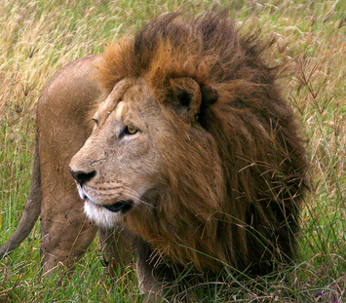

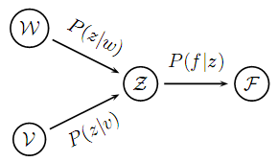
Annotated PLSA Model for Clustering
Caltech 256 Data | Heterogeneous Transfer Learning
Average Entropy Improvement | 5.7%
From Flickr.com
SIFT Features
Words from Source Data
Topics
Image features
… Tags
Lion
Animal
Simba
Hakuna
Matata
FlickrBigCats
…
Image instances in target data
12
Notes:
Use apple?
12

Slide 13
“Heterogeneous transfer learning for image classification”
  Y. Zhu, G. Xue, Q. Yang et al.
  AAAI 2011

Slide 14
HTL Setting: Text to Images
Source data: labeled or unlabeled
Target training data: labeled
Training: Text
Testing: Images
The apple is the pomaceous fruit of the apple tree, species Malus domestica in the rose family Rosaceae ...
Apple
Banana is the common name for a type of fruit and also the herbaceous plants of the genus Musa which produce this commonly eaten fruit ...
Banana

Slide 15
A Picture is Worth ? Words?

Slide 16
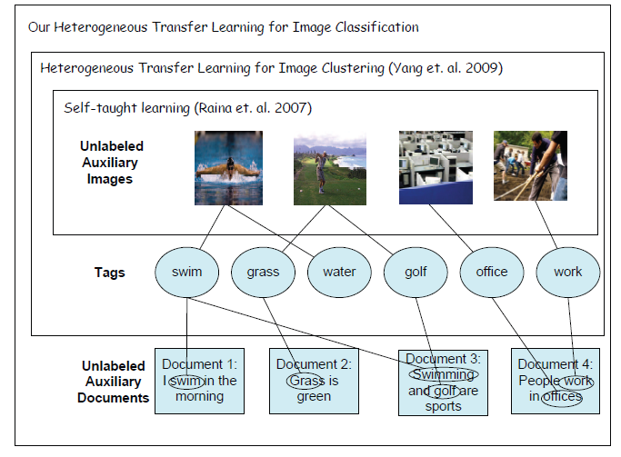
Y. Zhu, G. Xue, Q. Yang et al. Heterogeneous transfer learning for image classification. AAAI 2011
Target data
Unlabeled Source data
A few labeled images as training samples
Testing samples: not available during training.

Slide 17
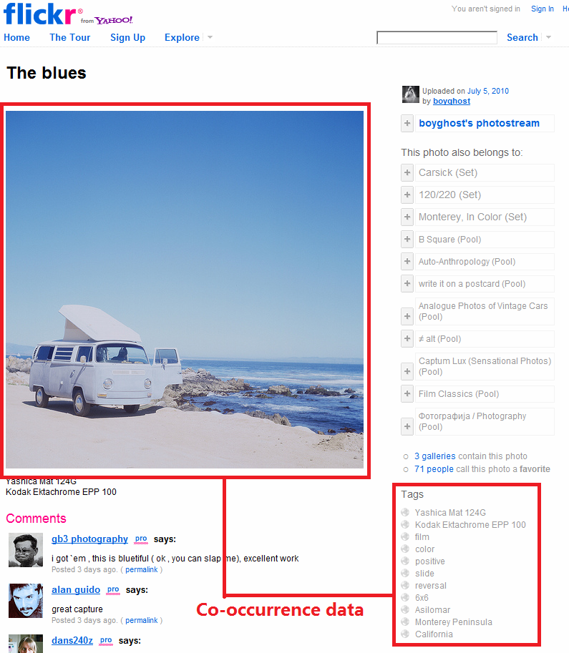
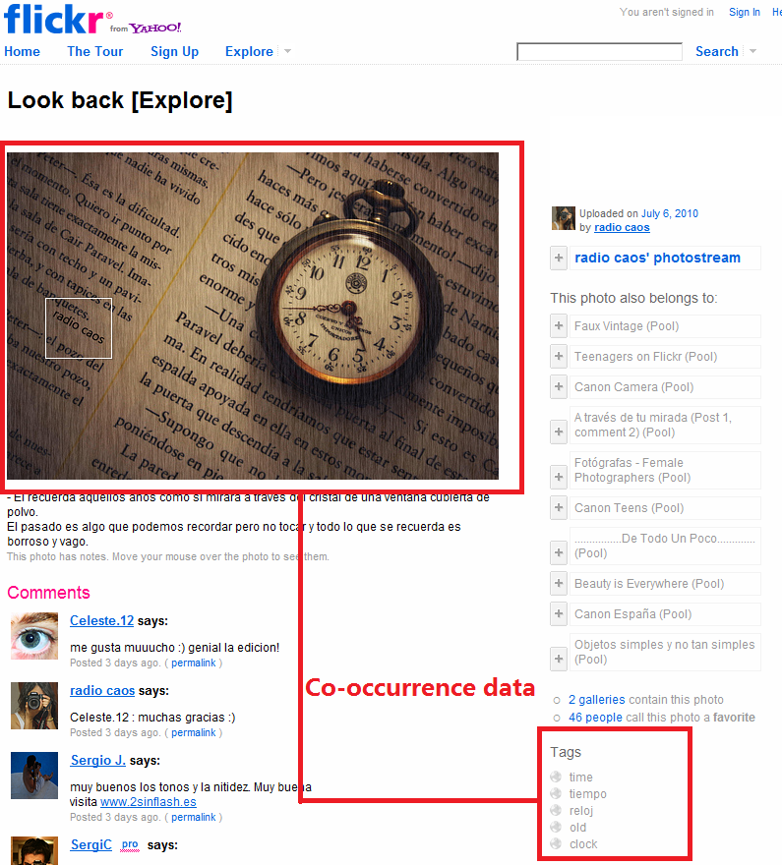
Social Media Data as a Bridge
Notes:
To tackle the problem, in this paper, we proposed to used the co-occurrence data in the WWW acting as a bridge between the different feature spaces.
The co-occurrence data here refers to the data containing the co-occurrence of both text and images. Co-occurrence data are abundant via . For example, we can obtain those data social photo sharing sites, such as Flickr. The image and the correspondent user annotation are the co-occurrence data.

Slide 18
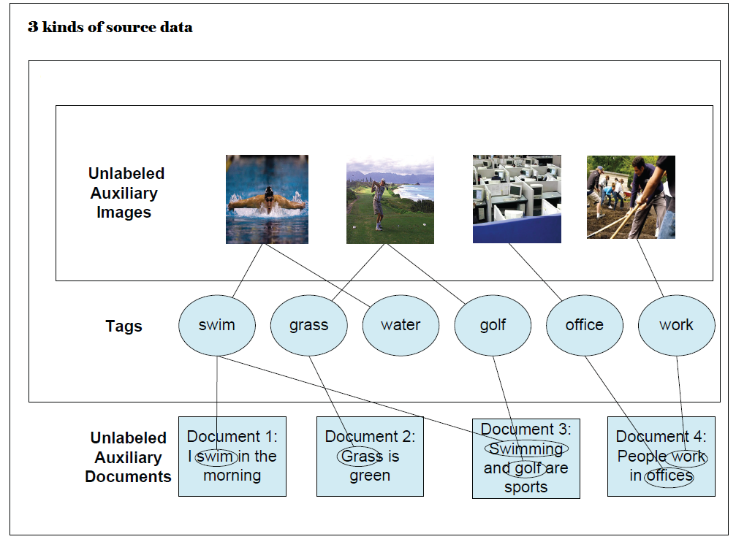
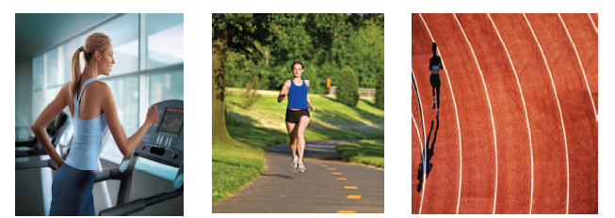
The Heterogeneous Transfer Learning Framework
Learn latent representation for auxiliary images
Using all source data
Latent Representation
Target images
Projected representation of target images

Slide 19






Latent Feature Learning by Collective matrix factorization
tags
tags
gym
blue
road
country
track
Olympic
 |  |  |  | √ | √
 |  | √ | √
√ | √
images
.44 | .21 | .34
.37 | .26 | .36
.15 | .34 | .49
.07 | .38 | .40 | .31 | .05 | .40
.05 | .13 | .29 | .47 | .03 | .28
.02 | .30 | .37 | .24 | .06 | .38
~
images
After co-factorization
Cosine similarity
Based on image latent factors
?
?
.36
0.34
The latent factors
for tags are the same
=
?
0.32
gym
blue
road
country
track
Olympic
tags
 |  |  | √
 |  | √ | √ |  | √
 | √ | √ |  |  | √
~
.08 | .69 | .22
.38 | .41 | .43
.43 | .28 | .48
.07 | .38 | .40 | .31 | .05 | .40
.05 | .13 | .29 | .47 | .03 | .28
.02 | .30 | .37 | .24 | .06 | .38
documents
documents
Notes:
In this slide, the # of latent factors is 3.

Slide 20
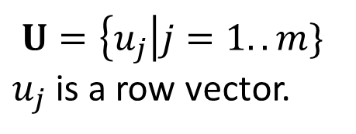
Optimization:
Collective Matrix Factorization (CMF)
G1 - `image-features’-tag matrix
G2 – document-tag matrix
W – words-latent matrix
U – `image-features’-latent matrix
V – tag-latent matrix
R(U,V, W) - regularization to avoid over-fitting
The latent semantic view of images
The latent semantic view of tags

Slide 21
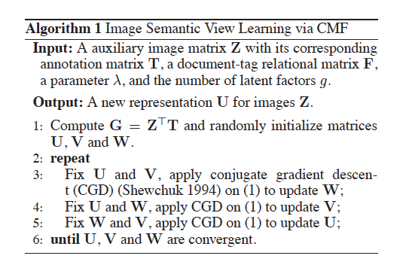
HTL Algorithm

Slide 22
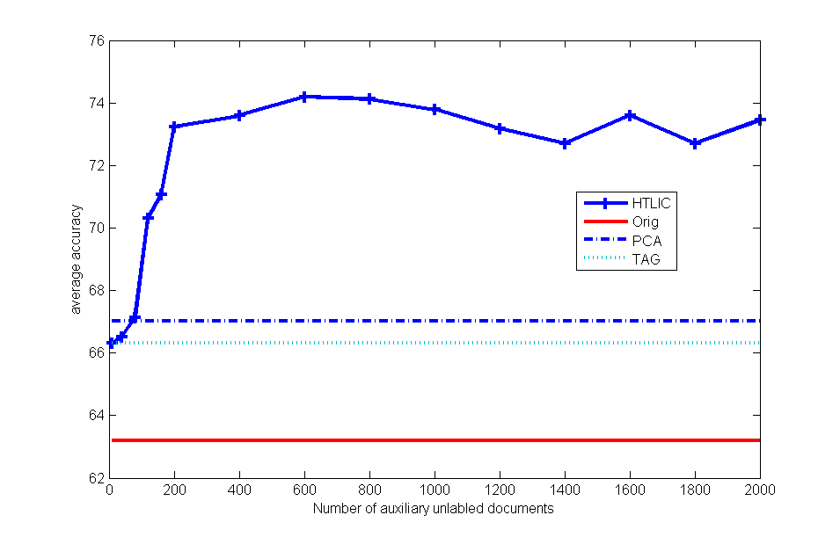
Experiment: # documents
To reach 75% accuracy, need about 100 labeled images
But this is achieved with 200 Text Documents.
Thus, each image = 2 text documents=1,000 words
Yes: one image is indeed worth 1000 words!
Accuracy
# documents

Slide 23
Experiment: # documents
Accuracy
When more text documents are used in learning, the accuracy increases.
# documents

Slide 24
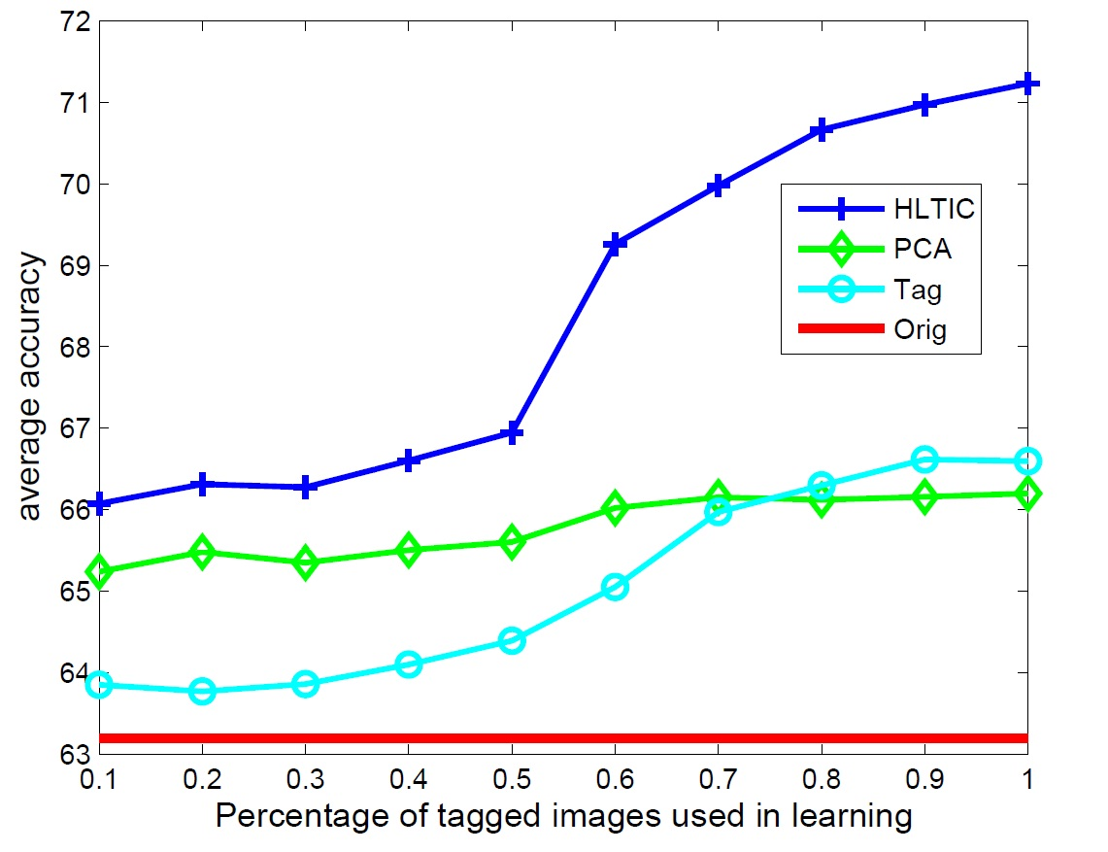
Experiment: # Tagged images
Accuracy
# Tagged Images

Slide 25
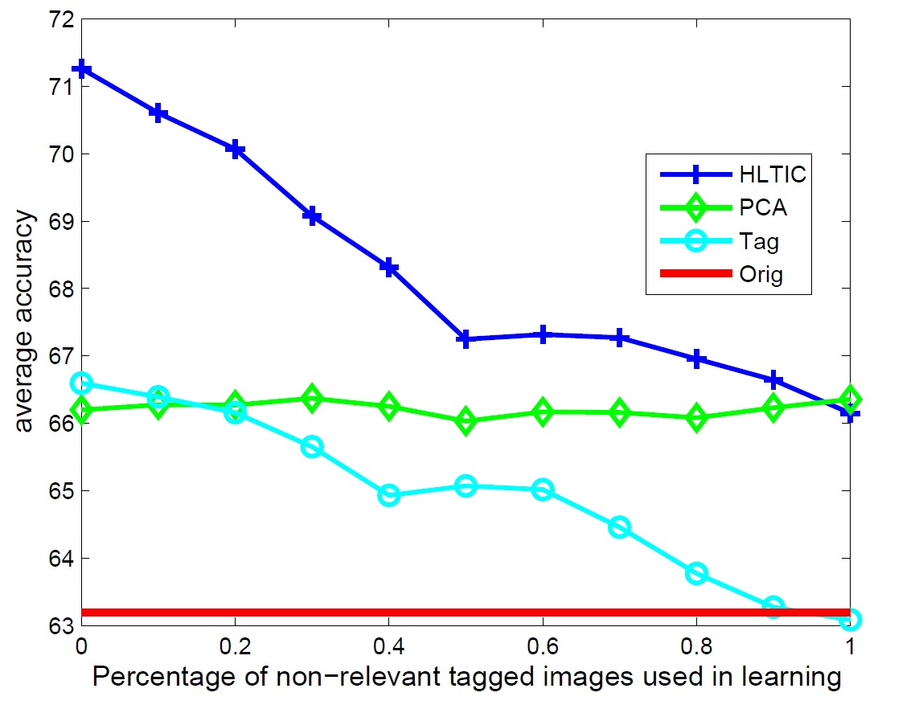
Experiment: Noise
Accuracy
We considered the “noise” of the tagged image.
When the tagged images are totally irrelevant, our method reduced to PCA; and the Tag baseline, which depends on tagged images, reduced to a pure SVM.
Amount of Noise

Slide 26
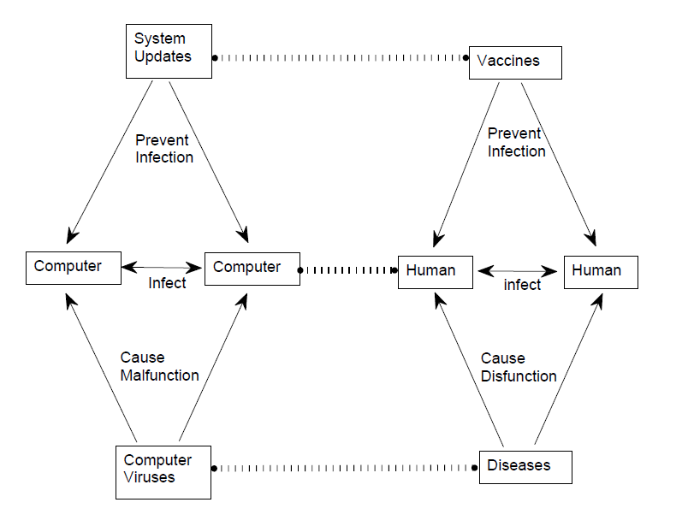
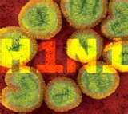

Structural Transfer Learning
?

Slide 27
Structural Transfer
Transfer Learning from Minimal Target Data by Mapping across Relational Domains
  Lilyana Mihalkova and Raymond Mooney
  In Proceedings of the 21st International Joint Conference on Artificial Intelligence (IJCAI-09), 1163--1168, Pasadena, CA, July 2009.
  ``use the short-range clauses in order to find mappings between the relations in the two domains, which are then used to translate the long-range clauses.’’
Transfer Learning by Structural Analogy.
  Huayan Wang and Qiang Yang.
  In Proceedings of the 25th AAAI Conference on Artificial Intelligence (AAAI-11). San Francisco, CA USA. August, 2011.
  Find the structural mappings that maximize structural similarity

Slide 28

Structural Transfer [H. Wang and Q. Yang AAAI 2011]
Goal:
Learn a correspondence structure between domains
Use the correspondence to transfer knowledge
mother
son
女儿
daughter
父亲
儿子
father
母亲
English
Chinese (汉语）
Notes:
28
However, sometimes such co-occurrence data (dictionary) are not readily available or too costly to obtain, then how can we still do transfer learning between the two different feature spaces? In other words, can we transfer knowledge between two different feature spaces, even if there is no input or prior knowledge that can relate them directly or in an obvious way?
To make this formal, we consider two heterogeneous domains, each domain contains many entities, which can be either features (dimensions) or samples (data points).
We assume that within-domain comparisons between the entities are allowed, but cross-domain comparisons are not. That is, we have (dis)similarity functions defined within each domain, but not across the domains. Note that this general formulation includes the case where we have two different feature spaces but no co-occurrence data.

Slide 29
Transfer Learning by Structural Analogy
Algorithm Overview
  Select top W features from both domains respectively (Song 2007).
  Find the permutation (analogy) to maximize their structural dependency.
    Iteratively solve a linear assignment problem (Quadrianto 2009)
    Structural dependency is max when structural similarity is largest by some dependence criterion (e.g., HSIC, see next…)
  Transfer the learned classifier from source domain to the target domain via analogous features
Structural Dependency: ?

Slide 30
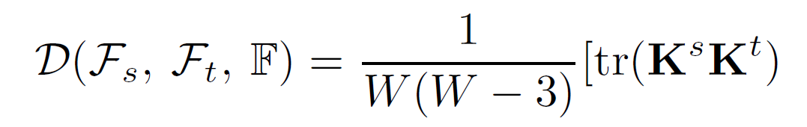
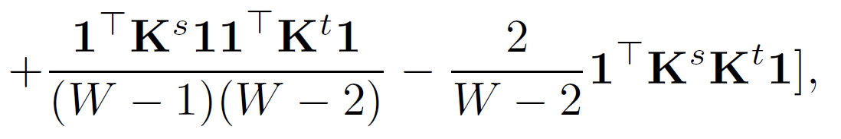
Transfer Learning by Structural Analogy
Hilbert-Schmidt Independence Criterion (HSIC) (Gretton 2005, 2007; Smola 2007)
  Estimates the “structural” dependency between two sets of features.
  The estimator (Song 2007) only takes kernel matrices as input, i.e., intuitively, it only cares about the mutual relations (structure) among the objects (features in our case).
Cross-domain
Feature correspondence
feature dimension
We compute the kernel matrix by taking the inner-product between the “profile” of two features over the dataset.

Slide 31
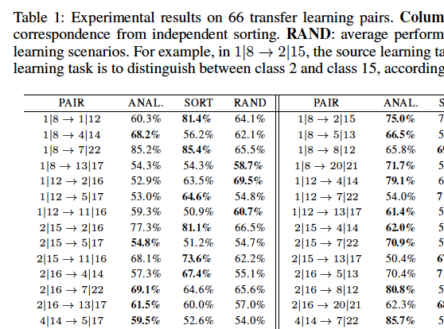
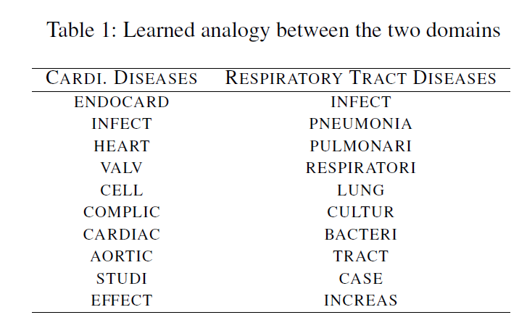
Transfer Learning by Structural Analogy
Ohsumed Dataset
  Source: 2 classes from the dataset, no labels in target dataset
  A linear SVM classifier trained on source domain achieves 80.5% accuracy on target domain.
  More tests in the table (and paper)

Slide 32
Conclusions and Future Work
Transfer Learning
  Instance based
  Feature based
  Model based
Heterogeneous Transfer Learning
  Translator: Translated Learning
  No Translator:
    Structural Transfer Learning
Challenges

Slide 33
References
http://www.cse.ust.hk/~qyang/publications.html
Huayan Wang and Qiang Yang. Transfer Learning by Structural Analogy. In Proceedings of the 25th AAAI Conference on Artificial Intelligence (AAAI-11). San Francisco, CA USA. August, 2011. (PDF)Yin Zhu, Yuqiang Chen, Zhongqi Lu, Sinno J. Pan, Gui-Rong Xue, Yong Yu and Qiang Yang. Heterogeneous Transfer Learning for Image Classification. In Proceedings of the 25th AAAI Conference on Artificial Intelligence (AAAI-11). San Francisco, CA USA. August, 2011. (PDF)
Qiang Yang, Yuqiang Chen, Gui-Rong Xue, Wenyuan Dai and Yong Yu. Heterogeneous Transfer Learning for Image Clustering via the Social Web. In Proceedings of the 47th Annual Meeting of the ACL and the 4th IJCNLP of the AFNLP (ACL-IJCNLP'09), Sinagpore, Aug 2009, pages 1–9. Invited Paper (PDF)
Wenyuan Dai, Yuqiang Chen, Gui-Rong Xue, Qiang Yang, and Yong Yu. Translated Learning. In Proceedings of Twenty-Second Annual Conference on Neural Information Processing Systems (NIPS 2008), December 8, 2008, Vancouver, British Columbia, Canada. (Link

