Slide 1
Adaptive Transfer Learning and Its Application on Cross-Domain Recommendation
Bin Cao
Microsoft Research Asia

Slide 2
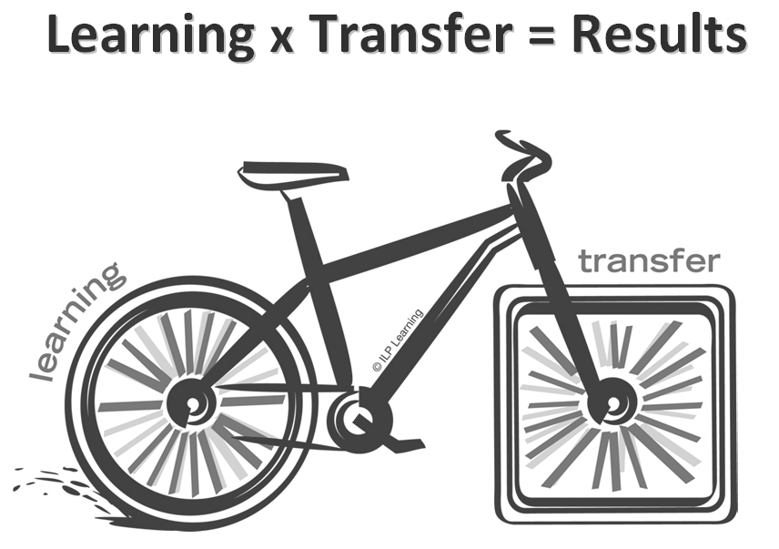
Transfer Learning

Slide 3
Transfer Learning? (DARPA’05)
Transfer Learning: The ability of a system to recognize and apply knowledge and skills learned in previous tasks to novel tasks (in new domains)
  It is motivated by human learning. People can often transfer knowledge learnt previously to novel situations
  Chess → Checkers
  Mathematics → Computer Science
  Table Tennis → Tennis
Notes:
Seems the changes is involved in moving to new tasks is more radical than moving to new domains.

Slide 4
Traditional ML vs. TL
[P. Langley 06]
Traditional ML in
multiple domains
Transfer of learning
across domains
training items
test items
test items
training items
Humans can learn in many domains.
Humans can also transfer from one domain to other domains.
Notes:
Generality means human can learn to perform a variety of tasks.

Slide 5
Why Transfer Learning?
In some domains, labeled data are in short supply.
In some domains, the calibration effort is very expensive.
In some domains, the learning process is time consuming.
How to extract knowledge learnt from related domains to help learning in a target domain with a few labeled data?
How to extract knowledge learnt from related domains to speed up learning in a target domain?
Transfer learning techniques may help!

Slide 6

When p(Training) != p(Test)
A questionnaire example
Question: How much do you like the University’s canteen?
Can the conclusion be generalized to all students?
Notes:
canteen

Slide 7
An overview of
various settings of
transfer learning
Self-taught Learning
Case 1
No labeled data in a source domain
Inductive Transfer Learning
Labeled data are available in a source domain
Labeled data are available in a target domain
Source and target tasks are learnt simultaneously
Multi-task Learning
Case 2
Transfer Learning
Labeled data are available only in a source domain
Assumption: different domains but single task
Transductive Transfer Learning
Domain Adaptation
No labeled data in both source and target domain
Assumption: single domain and single task
Unsupervised Transfer Learning
Sample Selection Bias /Covariance Shift

Slide 8
Transfer Learning: Problem Definition
A source task and a target task
  The source task have sufficient labeled data
  The target task has limited labeled data
We only cares about the performance on the target task. (different from multi-task)
Examples:
  Out-dated labeling data
  Learning with auxiliary data

Slide 9
Negative Transfer
The Key Assumption in Transfer Learning:
  The source task is related to the target task
However, the assumption may not hold
  How much related it is?
  What if it is not related at all?
Negative Transfer
  The use of source task may hurt the performance of the target task.

Slide 10
How to Avoid Negative Transfer?
Do cross validation
  Need more labeled data and computational expensive
Build model based on Weak Assumption
  Strong assumption are hard to satisfied
Take the similarity between tasks into consideration
Bayesian model may be better
  Avoid model selection
  More robust with less labeled data
Notes:
Several ideas for avoid negative transfer, red ones are the ideas in the paper

Slide 11
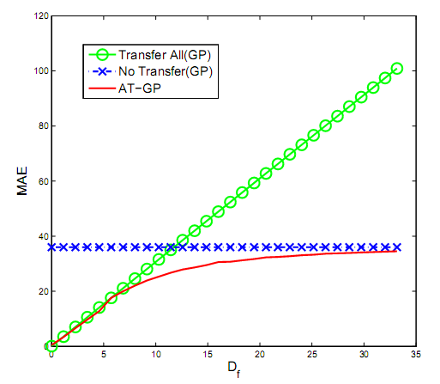
Our Goal: A Toy Example
As good as Transfer All when the source and target tasks are very similar.
Not worse than No Transfer when the source and target tasks are not related at all.
Distance between the source and target tasks

Slide 12
Gaussian Process: A Brief Introduction
Gaussian Processes (GP):
  Definition: A GP is a collection of random variables {y}, any finite number of which have joint Gaussian Distribution
A Gaussian process is fully specified by its mean function m(x) and covariance function k(x,x’), x and x’ are the input features.
Learning by maximizing the log marginal likelihood of observation y given x:
  maximize log P(y|x)
Notes:
Here its represent Gaussian process. A Gaussian process is like a generalization of multivariate Gaussian distribution. So it also has a mean and covariance. But unlike Gaussian distribution, it is infinite case here and therefore it is mean function and covariance function rather than a mean vector and covariance matrix.

Slide 13


Adaptive Transfer Learning
A nonparametric Bayesian approach based on Gaussian process
  Consider the similarity between the source and target tasks as a distribution rather than a single value

Slide 14
Handle Negative Correlation
The source and target tasks can have negative correlation.
Weight = 1
0< Weight < 1
-1< Weight < 1

Slide 15
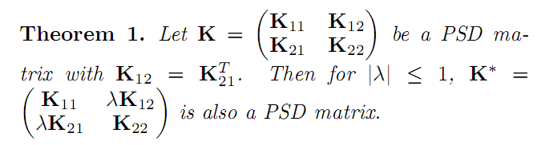
Kernel Validity
We can show this form of kernel is valid kernel.

Slide 16

Discriminative Learning
  Joint learning may bias the model towards the source task.
  Optimize the parameter w.r.t the target tasks
  The model is still a Gaussian process!
  General and advanced learning algorithms for GP can be applied.
maximize

Slide 17
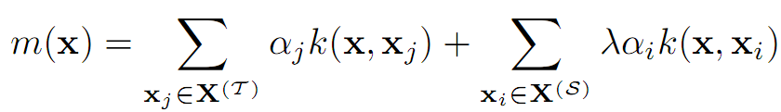


Inference for Data x in the Target task
Both mean and variance can be predicted
  The influence of data in the target have a discount factor
  λ = 1 if the source and the target are the same
  λ = 0 if they are not related at all
A value smaller than 1

Slide 18
A Toy Example
Target Task
100-dim regression problems
An inductive transfer learning problem
X-axis: the distance between two tasks
Y-axis: the mean absolute error
Source Tasks
Notes:
Definition of inductive transfer: the source and target domains are the same, the source and target tasks are different but may be related.
This figure shows how the mean absolute error (MAE) on 450 target test data changes at different distance between the source and target tasks. The results are compared with the transfer all scheme (directly use all of the training data) and the no transfer scheme (only use training data in the target task). As we can see, when the two tasks are very similar, the AT-GP model performance is as good as transfer all, while when the tasks are very different, the AT-GP model is no worse than no transfer.

Slide 19
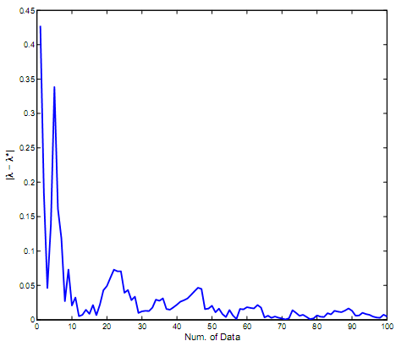
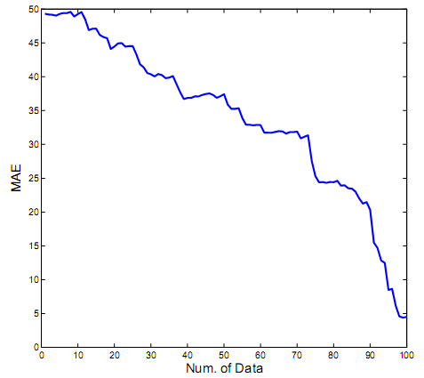
Why Transfer Can Work?
Figure up:
  X-axis: the number of labeled data in the target task
  Y-axis: the error of task similarity (learned by the model)
Figure bottom:
  X-axis: the number of labeled data in the target task
  Y-axis: the performance (MAE) of the target task
Learning the task similarity is easier than learning a task well!
Notes:
The ground truth of the task similarity is unknown, so we approximate it by the value obtained with sufficient number of labeled data.
Figure (4) shows the experimental results on learning ¸ under a varying number of labeled data in the target task. It is interesting to observe that the number of data required to learn the similarity well (up figure) is much less than the number of data required to learn the task well (bottom figure). This indicates why transfer learning works.

Slide 20
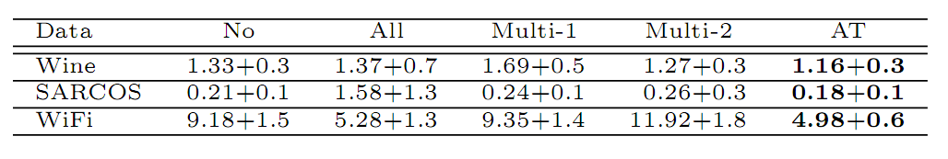
Experimental Results
Baselines
  No: no-transfer method
  All: consider two tasks as the same
  Multi-1,2: two multi-task methods [Lawrence, N et al. 2004; Bonilla, E et al. 2008, ]
AT: Adaptive transfer

Slide 21
Cross-Domain Collaborative Filtering

Slide 22







Recommender Systems

Slide 23


Why We need recommendations?

Slide 24
Collaborative Filtering (CF)
Collaborative filtering vs. Content Filtering
CF: user feedback
Input
  User, item, feedback
  e.g. a rating matrix
Output
  Predicted ratings
Users | Item a | Item b | Item c | Item d
1 | 5 | 1 | 3 | 4
2 | 4 | 2 | ?
3 | 5 |  | ? | 3
4 | ? | 3
Notes:
Infer users’ interests based on users’ previous feedback
vs. content filtering

Slide 25

Previous Work
Algorithms
  Memory based approaches (KNN)
  Model based approaches (PLSA, MFs, etc.)
  Hybrid approaches
Benchmarks
  MoiveLens
  Eachmovie
  Netflix prize [2006-2009]

Slide 26
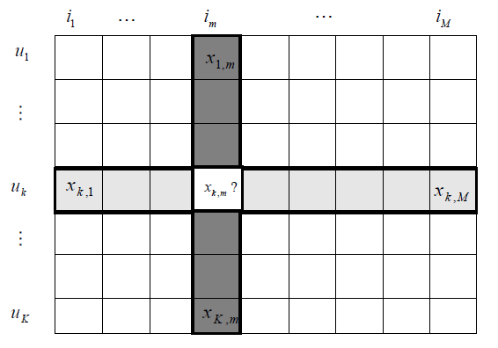
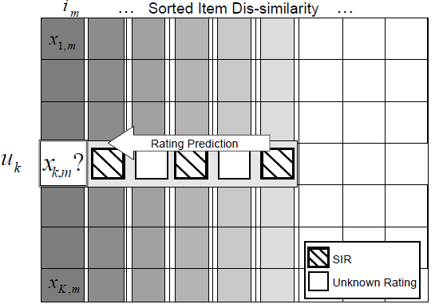
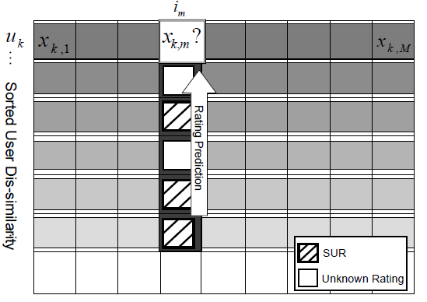
Memory-based Methods
Leveraging information from other users/items
  User-based Approach
  Item-based Approach

Slide 27
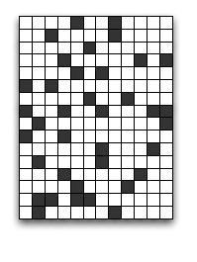
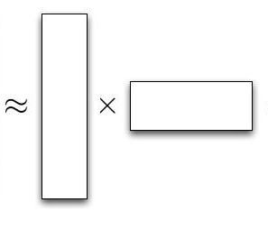
Matrix Factorization Based Methods
Using latent factors to model user feedback
Item
User

Slide 28
Challenges: Sparseness problem
Performance ⬅ Data
Data sparseness problems
  The cold-start problem
  Limited explicit feedback
  The long tail phenomenon
Num. of parameters increases with more data (users/items)!
Performance
Data
Notes:
Summarize the challenge in two problems, ( + other my previous work)
More detials

Slide 29
Auxiliary Data
Types
  Content data
  Context data
  Social data
  Data from related tasks
Issues to use auxiliary data
  Inconsistent problem: data from different distributions

Slide 30



Multi-Domain Collaborative Filtering
Items span multiple heterogeneous domains for many recommendation systems.
Domain A
Domain B
Domain C
Users
Items

Slide 31
Collective Link Prediction
Jointly consider multiple domains together
Learning the similarity of different domains
  Idea behind learning: consistency cross domains indicates the similarity.
    If the user similarities between two domains are consistent, than the domains are similar.
Consider link functions

Slide 32
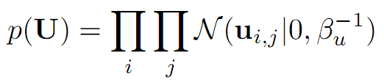
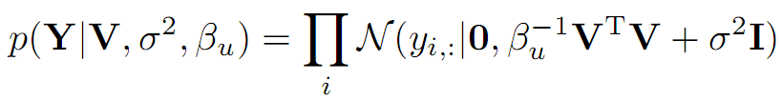
Collaborative Filtering via Gaussian Processes
Matrix Factorization
Gaussian Process Models
Y = UV^{T} + E
E_{ij} ~ N(0, σ²)
Kernel K

Slide 33
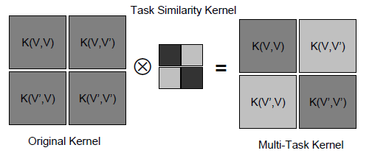
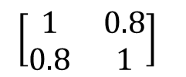
Collective Link Prediction
Based on Gaussian process models
Key part is the kernel modeling item relation as well as task relation
Items in
task A
Items in
task B
task A
task B
task A
task B
Notes:
Darkness indicates the similarity. The kernel represent the item similarity matrix. The items between two different domains would be less similar even if they share many users who like them.

Slide 34
Rating Bias
Rating bias exists in the data
  Users tend to rate more items they like
Assumptions in Gaussian processes
  Observations follow Gaussian distributions
  Similar assumptions in the models minimizing L2 loss
Existing of bias breaks the underlying assumption!

Slide 35

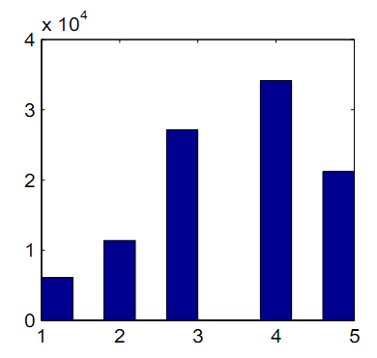
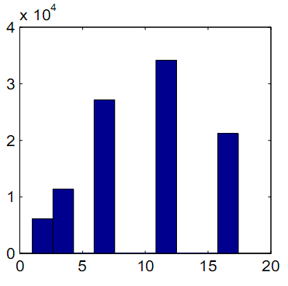
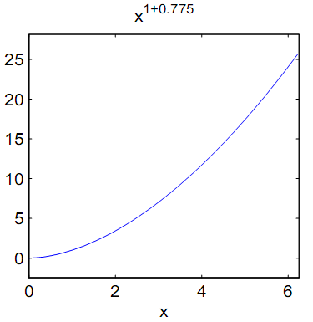
Reducing Skewness
Use link function to reduce the skewness
The skewness of the distribution drop from -0.5 to 0.0002

Slide 36
Link Functions
Bias may be different in different domains
  Add link function for different domains
Warped Gaussian Processes [Snelson et al.’03]
Form of link function
  Monotonic (easy to obtain inverse function)
  Can correct the bias

Slide 37

Making Prediction
Similar to memory-based approach
Similarity between items
Mean of prediction
Similarity between tasks

Slide 38
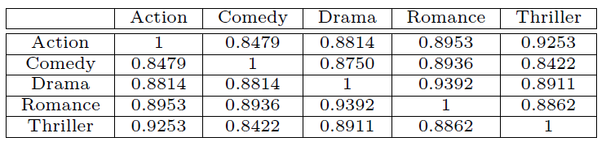
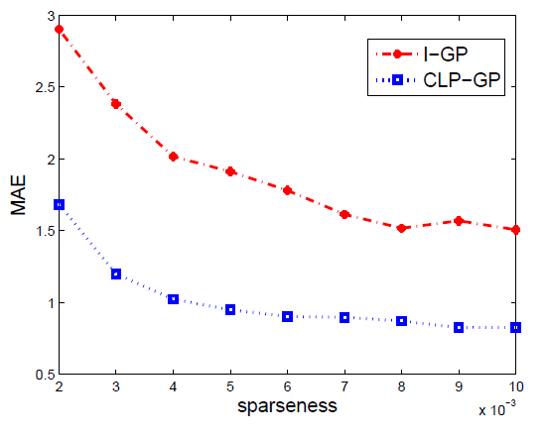
Experimental Results
x-axis: Mean absolute error
Y-axis: Sparseness (sparsity of the rating matrix)
Notes:
The left figure is the case where all task are sparse and evaluated on all tasks; the right figure is the case only the target task is sparse and evaluated on the target task.
The figure shows the performance changes of the algorithms. We can observe that the performance gain increases
as the sparseness becomes serious (from right to left), which is consistent with our intuition.

Slide 39
References
Pan, S. J., & Yang, Q. (2010). A Survey on Transfer Learning. IEEE Transactions on Knowledge and Data Engineering, 22(10), 1345-1359. doi:10.1109/TKDE.2009.191
Zhang, Y., Cao, B., & Yeung, D. Y. (2010). Multi-Domain Collaborative Filtering. Proceedings of the 26th Conference on Uncertainty in Artificial Intelligence (UAI), Catalina Island, California, USA.
Cao, B., Liu, N. N., & Yang, Q. (2010). Transfer learning for collective link prediction in multiple heterogenous domains. Proceedings of the 27th International Conference on Machine Learning, Haifa, Israel.
Cao, B., Pan, S. J., Zhang, Y., Yeung, D.-Y., & Yang, Q. (2010). Adaptive Transfer Learning. AAAI. Retrieved from http://dblp.uni-trier.de/db/conf/aaai/aaai2010.html#CaoPZYY10

Slide 40
References
Koren, Yehuda. “Collaborative filtering with temporal dynamics.” Proceedings of the 15th ACM SIGKDD international conference on Knowledge discovery and data mining - KDD ’09 (2009): 447.
Das, A.S., M. Datar, A. Garg, and S. Rajaram. “Google news personalization: scalable online collaborative filtering.” In Proceedings of the 16th international conference on World Wide Web, 271–280. ACM New York, NY, USA, 2007.
Linden, G., B. Smith, and J. York. “Amazon.com recommendations: item-to-item collaborative filtering.” IEEE Internet Computing 7, no. 1 (January 2003): 76-80.
Davidson, James, Benjamin Liebald, and Taylor Van Vleet. “The YouTube Video Recommendation System.” Design (2010): 293-296.

Slide 41
Reference
Salakhutdinov, R., & Mnih, A. (2008). Probabilistic matrix factorization. Advances in neural information processing systems, 20, 1257–1264.
Salakhutdinov, R., & Mnih, A. (2008). Bayesian probabilistic matrix factorization using Markov chain Monte Carlo. Proceedings of the 25th international conference on Machine learning (pp. 880–887). ACM.
Lawrence, N. D., & Urtasun, R. (2009). Non-Linear Matrix Factorization with Gaussian Processes. In L. Bottou & M. Littman (Eds.), Proceedings of the 26th International Conference on Machine Learning (pp. 601-608).

Slide 42
Reference
http://www.cse.ust.hk/TL/index.html
http://www1.i2r.a-star.edu.sg/~jspan/SurveyTL.htm
http://www1.i2r.a-star.edu.sg/~jspan/conferenceTL.htm

