Slide 1
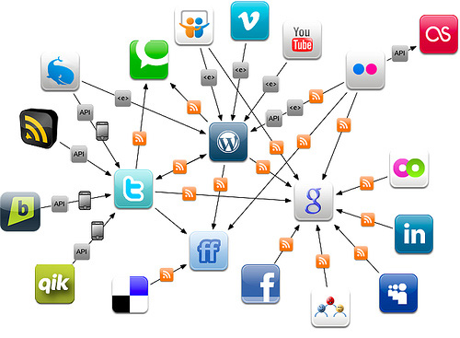
Link Prediction and Collaborative Filtering
@caobin

Slide 2
Outline
Link Prediction Problems
  Social Network
  Recommender system
Algorithms of Link Prediction
  Supervised Methods
  Collaborative Filtering
Recommender System and The Netflixprize
References

Slide 3
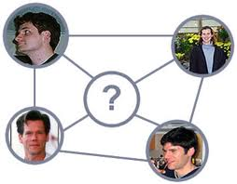
Link Prediction Problems
Link Prediction is the task to predict the missing links in graphs.
Applications
  Social Network
  Recommender systems

Slide 4
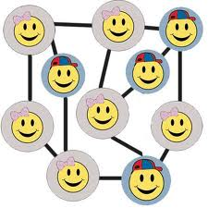
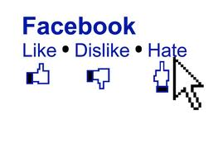
Links in Social Networks
A social network is a social structure of people, linked(directly or indirectly) to each other through a common relation or interest
Links in Social network
  Like, dislike
  Friends, classmates, etc.
Notes:
4

Slide 5
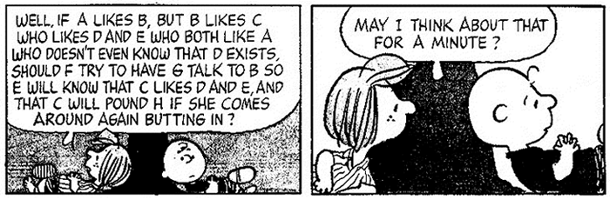
Link Prediction in Social Networks
Given a social network with an incomplete set of social links between a complete set of users, predict the unobserved social links
Given a social network at time t predict the social link between actors at time t+1
(Source: Freeman, 2000)

Slide 6




Link Prediction in Recommender Systems
Recommender Systems

Slide 7
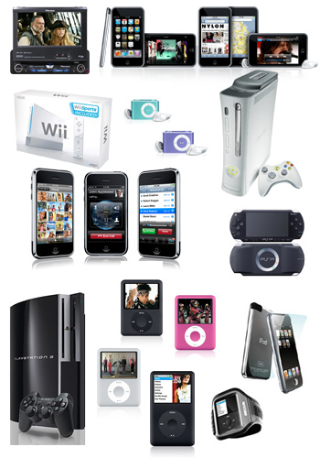

Link Prediction in Recommender Systems
Users and items form a bipartite-graph
Predict links between users and items

Slide 8
Predicting Link Existence
Predicting whether a link exists between two items
  web: predict whether there will be a link between two pages
  cite: predicting whether a paper will cite another paper
  epi: predicting who a patient’s contacts are
Predicting whether a link exists between items and users

Slide 9
Everyday Examples of Link Prediction/Collaborative Filtering...
Search engine
Shopping
Reading
Social
....
Common insight: personal tastes are correlated:
  If Alice and Bob both like X and Alice likes Y then Bob is more likely to like Y
  especially (perhaps) if Bob knows Alice

Slide 10
Example: Linked Bibliographic Data
P₁
P₁
P₁
P₃
P₃
P₃
P₂
P₂
I₁
P₂
I₁
Objects:
A₁
A₁
Papers
Papers
P₄
Links:
P₄
Authors
P₄
Authors
Citation
Citation
Institutions
Institutions
Co-Citation
Co-Citation
Author-of
Author-of
Attributes:
Author-affiliation
Author-affiliation

Slide 11

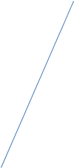























Example: linked movie dataset
collection
favorites
friend
similar
User
rate
1-5
Movie
genre
age, location, joined(t)
list
comment
rate
1-3
review
comment
actor, director, writer

Slide 12

How to do link prediction?
How can you do recommendation based on this item?

Slide 13
Link Prediction using supervised learning methods
P₁
P₃
Feature Extractor
P₂
[1, 2, 0, …, 1] +1
[0, 0, 1, …, 1] -1
…
Supervised Learning

Slide 14
Supervised Learning Methods [Liben-Nowell and Kleinberg, 2003]
Link prediction as a means to gauge the usefulness of a model
Proximity Features: Common Neighbors, Katz, Jaccard, etc
No single predictor consistently outperforms the others

Slide 15
supervised learning methods [Hasan et al, 2006]
Citation Network (BIOBASE, DBLP)
Use machine learning algorithms to predict future co-authorship (decision tree, k-NN, multilayer perceptron, SVM, RBF network)
Identify a group of features that are most helpful in prediction
Best Predictor Features: Keyword Match count, Sum of neighbors, Sum of Papers, Shortest Distance

Slide 16
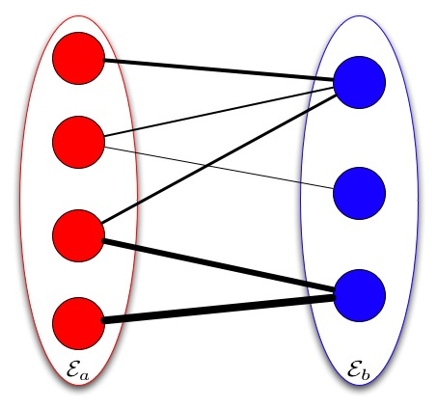
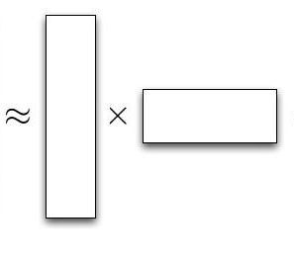
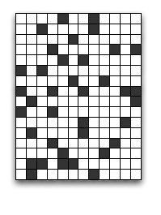
Link Prediction using Collaborative Filtering
Find the background model that can generate the link data

Slide 17
Link Prediction using Collaborative Filtering
 | Item 1 | Item 2 | Item 3 | Item 4 | Item 5
User 1 | 8 | 1 | ? | 2 | 7
User 2 | 2 | ? | 5 | 7 | 5
User 3 | 5 | 4 | 7 | 4 | 7
User 4 | 7 | 1 | 7 | 3 | 8
User 5 | 1 | 7 | 4 | 6 | ?
User 6 | 8 | 3 | 8 | 3 | 7

Slide 18
Challenges in Link Prediction
Data!!!
Cold Start Problem
Sparsity Problem

Slide 19
Link Prediction using Collaborative Filtering
Memory-based Approach
  User-base approach [Twitter]
  item-base approach [Amazon & Youtube]
Model-based Approach
  Latent Factor Model [Google News]
Hybrid Approach

Slide 20
Memory-based Approach
Few modeling assumptions
Few tuning parameters to learn
Easy to explain to users
  Dear Amazon.com Customer, We've noticed that customers who have purchased or rated How Does the Show Go On: An Introduction to the Theater by Thomas Schumacher have also purchased Princess Protection Program #1: A Royal Makeover (Disney Early Readers).

Slide 21
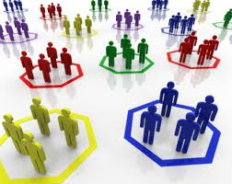
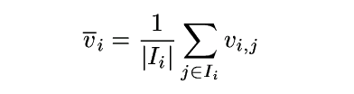
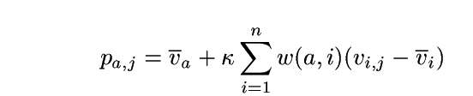
Algorithms: User-Based Algorithms (Breese et al, UAI98)
v_{i,j}= vote of user i on item j
I_{i} = items for which user i has voted
Mean vote for i is
Predicted vote for “active user” a is weighted sum
normalizer
weights of n similar users

Slide 22
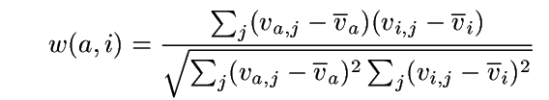
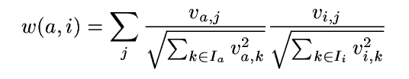
Algorithms: User-Based Algorithms (Breese et al, UAI98)
K-nearest neighbor
Pearson correlation coefficient (Resnick ’94, Grouplens):
Cosine distance (from IR)

Slide 23
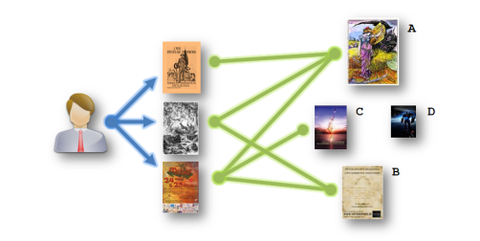
Algorithm: Amazon’s Method
Item-based Approach
  Similar with user-based approach but is on the item side

Slide 24
Item-based CF Example: infer (user 1, item 3)
 | Item 1 | Item 2 | Item 3 | Item 4 | Item 5
User 1 | 8 | 1 | ? | 2 | 7
User 2 | 2 | ? | 5 | 7 | 5
User 3 | 5 | 4 | 7 | 4 | 7
User 4 | 7 | 1 | 7 | 3 | 8
User 5 | 1 | 7 | 4 | 6 | ?
User 6 | 8 | 3 | 8 | 3 | 7

Slide 25
How to Calculate Similarity (Item 3 and Item 5)?
 | Item 1 | Item 2 | Item 3 | Item 4 | Item 5
User 1 | 8 | 1 | ? | 2 | 7
User 2 | 2 | ? | 5 | 7 | 5
User 3 | 5 | 4 | 7 | 4 | 7
User 4 | 7 | 1 | 7 | 3 | 8
User 5 | 1 | 7 | 4 | 6 | ?
User 6 | 8 | 3 | 8 | 3 | 7

Slide 26
Similarity between Items
Item 3 | Item 4 | Item 5
? | 2 | 7
5 | 7 | 5
7 | 4 | 7
7 | 3 | 8
4 | 6 | ?
8 | 3 | 7
How similar are items
3 and 5?
  How to calculate
  their similarity?
Notes:
Each row in the table are the ratings one user on the items
26

Slide 27
Similarity between items
Item 3 | Item 5
? | 7
5 | 5
7 | 7
7 | 8
4 | ?
8 | 7
Only consider users who have rated
both items
For each user:
Calculate difference in ratings for the
two items
Take the average of this difference over
the users
Can also use Pearson Correlation Coefficients as in user-based approaches
sim(item 3, item 5) = cosine( (5, 7, 7), (5, 7, 8) )
= (5*5 + 7*7 + 7*8)/(sqrt(5²+7²+7²)* sqrt(5²+7²+8²))
Notes:
Each row in the table are the ratings one user on the items
27

Slide 28
Prediction: Calculating ranking r(user1,item3)
Item 2
8
1
Item 1
Item 3
Item 5
7
Where α is a normalization factor, which is
1/[the sum of all sim(item_{i},item₃)].
Item 4
2
Notes:
Showing five items, Item 3 is the one we need to know for User 1. Distances to Item 3 indicate similarity. Numbers in yellow boxes give ratings for User 1 for other items.
Blue area shows nearest neighbours, items that are most similar to Item 3 based on past ratings by other users.
28

Slide 29
Algorithm: Youtube’s Method
Youtube also adopt item-based approach
Adding more useful features
  Num. of views
  Num. of likes
  etc.

Slide 30
Algorithm: Models-based Approaches
Latent Factor Models:
  PLSA
  Matrix Factorization
  Bayesian Probabilistic Models

Slide 31
Latent Factor Models
Models with latent classes of items and users
  Individual items and users are assigned to either a single class or a mixture of classes
Neural networks
  Restricted Boltzmann machines
Singular Value Decomposition (SVD)
  matrix factorization
  Items and users described by unobserved factors
  Main method used by leaders of Netflixprize competition

Slide 32
Algorithm: Google New’s Method (PLSA)
A method for collaborative filtering based on probability models generated from user data
Models users iϵI and items jϵJ as random variable
The relationships are learned from the joint probability distributions of users and items as a mixture distribution
Hidden variables tϵT are introduced to capture the relationship
The Corresponding t’s can be intuited as groups or clusters of users with similar interests
Formally the model can be written as
p(j|i; θ) = ∑ p(t | i; θ) p(j | t)

Slide 33
Matrix Factorization (SVD)
Dimension reduction technique for matrices
Each item summarized by a
d-dimensional vector q_{i}
Similarly, each user summarized by p_{u}
Choose d much smaller than number of items or users
  e.g., d = 50 << 18,000 or 480,000
Predicted rating for Item i by User u
  Inner product of q_{i} and p_{u}

Slide 34
serious
Braveheart
The Color Purple
Amadeus
Lethal Weapon
Sense and Sensibility
Ocean’s 11
Geared towards
females
Geared towards
males
The Lion King
Dumb and Dumber
The Princess
Diaries
Independence Day
escapist
Notes:
This graph shows a hypothetical layout of movies in two dimensions.
In the example, the horizontal dimension contrasts “chick flicks” from “macho movies”, while the vertical dimension measures the seriousness of the movie.
In a real application of SVD, an algorithm would determine the layout, so it night not be easy to label the axes.
Feel free to disagree with my placement of the various movies.

Slide 35
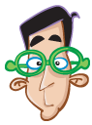


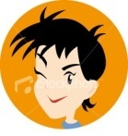


serious
Braveheart
The Color Purple
Amadeus
Lethal Weapon
Sense and Sensibility
Ocean’s 11
Geared towards
females
Geared towards
males
Dave
The Lion King
Dumb and Dumber
The Princess
Diaries
Independence Day
Gus
escapist
Notes:
Users fall into the same space as movies, where a user’s position in a dimension reflects the user’s preference for (or against) movies that score high on that dimension.
For example, Gus tends to like male-oriented movies, but dislikes serious movies. Therefore, we would expect him to love “Dumb and Dumber” and hate “The Color Purple”.
Note that these two dimensions do not characterize Dave’s interests very well; additional dimensions would be needed.

Slide 36
Regularization for MF
Want to minimize sum of squared error (SSE) for Test data
One idea: Minimize SSE for Training data
  Want large d to capture all the signals
  But, Test RMSE begins to rise for d > 2
Regularization is needed
  Allow rich model where there are sufficient data
  Shrink aggressively where data are scarce
Minimize
Notes:
To avoid over fitting, we employ “regularization”, which dampens estimates based on insufficient data.
The last term on the slide performs the regularization, with lambda controlling the magnitude of the shrinkage.

Slide 37
serious
Braveheart
The Color Purple
Amadeus
Lethal Weapon
Sense and Sensibility
Ocean’s 11
Geared towards
females
Geared towards
males
The Lion King
Dumb and Dumber
The Princess
Diaries
Independence Day
Gus
escapist
37
Notes:
Consider Gus.
This slide shows the position for Gus that best explains his ratings for the Training data—i.e., that minimizes his sum of squared errors.
If Gus has rated hundreds of movies, we could probably be confident of that we have estimated his true preferences accurately.
But what if Gus has only rated a few movies—say the ten on this slide? We should not be so confident.

Slide 38
serious
Braveheart
The Color Purple
Amadeus
Lethal Weapon
Sense and Sensibility
Ocean’s 11
Geared towards
females
Geared towards
males
The Lion King
Dumb and Dumber
The Princess
Diaries
Independence Day
Gus
escapist
38
Notes:
We hedge our bet by tethering Gus to origin with an elastic cord that tries to pull Gus back towards the origin.
If Gus has rated hundreds of movies, he stays about where the data places him.

Slide 39
serious
Braveheart
The Color Purple
Amadeus
Lethal Weapon
Sense and Sensibility
Ocean’s 11
Geared towards
females
Geared towards
males
The Lion King
Dumb and Dumber
The Princess
Diaries
Independence Day
Gus
escapist
39
Notes:
But if he has hated only a few dozen, he is pulled back towards the origin.

Slide 40
serious
Braveheart
The Color Purple
Amadeus
Lethal Weapon
Sense and Sensibility
Ocean’s 11
Geared towards
females
Geared towards
males
The Lion King
Gus
Dumb and Dumber
The Princess
Diaries
Independence Day
escapist
40
Notes:
And if he has rated only a handful, he is pulled even further.

Slide 41
Temporal Effects
User behavior may change over time
  Ratings go up or down
  Interests change
  For example, with addition of a new rater
Allow user biases and/or factors to change over time

Slide 42
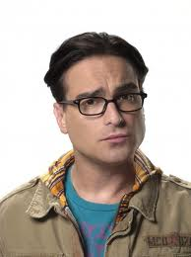
serious
Braveheart
The Color Purple
Amadeus
Lethal Weapon
Sense and Sensibility
Ocean’s 11
Geared towards
females
Geared towards
males
The Lion King
Dumb and Dumber
The Princess
Diaries
Independence Day
escapist
42

Slide 43
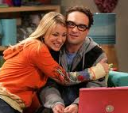
serious
Braveheart
The Color Purple
Amadeus
Lethal Weapon
Sense and Sensibility
Ocean’s 11
Geared towards
females
Geared towards
males
The Lion King
Dumb and Dumber
The Princess
Diaries
Independence Day
escapist
43

Slide 44
serious
Braveheart
The Color Purple
Amadeus
Lethal Weapon
Sense and Sensibility
Ocean’s 11
Geared towards
females
Geared towards
males
The Lion King
Dumb and Dumber
The Princess
Diaries
Independence Day
Gus
escapist
44

Slide 45

Netflixprize

Slide 46
“We’re quite curious, really. To the tune of one million dollars.” – Netflix Prize rules
Goal to improve on Netflix’s existing movie recommendation technology
Contest began October 2, 2006
Prize
  Based on reduction in root mean squared error (RMSE) on test data
  $1,000,000 grand prize for 10% drop
  Or, $50,000 progress for best result each year

Slide 47
Data Details
Training data
  100 million ratings (from 1 to 5 stars)
  6 years (2000-2005)
  480,000 users
  17,770 “movies”
Test data
  Last few ratings of each user
  Split as shown on next slide
Notes:
Although I use the term “movies” throughout this talk, it refers to DVDs of all types besides made-for-theater movies, including seasons of popular TV series such as Seinfeld, children’s videos, concerts, etc.

Slide 48
Data about the Movies
Count | Avg rating | Most Loved Movies
137812 | 4.593 | The Shawshank Redemption
133597 | 4.545 | Lord of the Rings: The Return of the King
180883 | 4.306 | The Green Mile
150676 | 4.460 | Lord of the Rings: The Two Towers
139050 | 4.415 | Finding Nemo
117456 | 4.504 | Raiders of the Lost Ark
Most Rated Movies
Miss Congeniality
Independence Day
The Patriot
The Day After Tomorrow
Pretty Woman
Pirates of the Caribbean
Highest Variance
The Royal Tenenbaums
Lost In Translation
Pearl Harbor
Miss Congeniality
Napolean Dynamite
Fahrenheit 9/11

Slide 49
Major Challenges
Size of data
  Places premium on efficient algorithms
  Stretched memory limits of standard PCs
99% of data are missing
  Eliminates many standard prediction methods
  Certainly not missing at random
Training and test data differ systematically
  Test ratings are later
  Test cases are spread uniformly across users
49

Slide 50
Major Challenges (cont.)
Countless factors may affect ratings
  Genre, movie/TV series/other
  Style of action, dialogue, plot, music et al.
  Director, actors
  Rater’s mood
Large imbalance in training data
  Number of ratings per user or movie varies by several orders of magnitude
  Information to estimate individual parameters varies widely
50
Notes:
The two challenges on this slide are central to the whole endeavor as they clearly conflict with each other.
Number 4 points us towards building very big models.
Number 5 tells us that it will be easy to over fit—at least for some users and some movies.

Slide 51
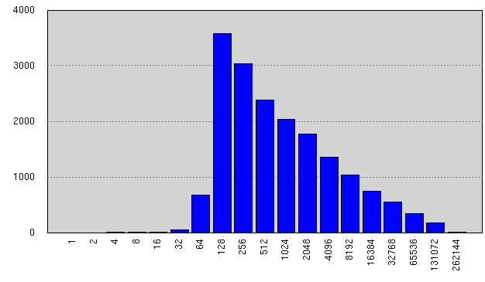
Ratings per Movie in Training Data
Avg #ratings/movie: 5627
Notes:
Although some movies were rated tens of thousands of times, most were rated fewer than 1,000 times and many were rated fewer than 200 times.
We are obviously limited in what we can learn about those movies.

Slide 52
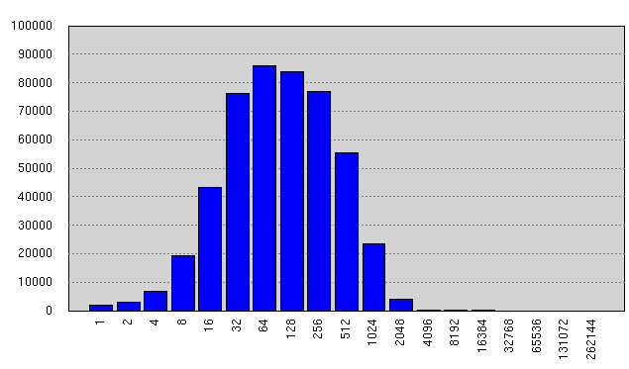
Ratings per User in Training Data
Avg #ratings/user: 208
Notes:
The problem is worse for users.
While the mean number of ratings per user is 208, about 15 percent of users rated fewer than 25 movies in the training data.
And those users contribute almost 15 percent of the test data.

Slide 53
The Fundamental Challenge
How can we estimate as much signal as possible where there are sufficient data, without over fitting where data are scarce?

Slide 54
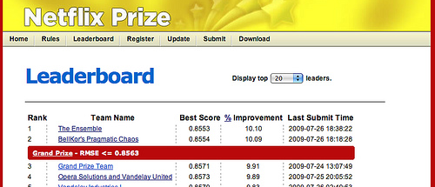
Test Set Results
The Ensemble: 0.856714
BellKor’s Pragmatic Theory: 0.856704
Both scores round to 0.8567
Tie breaker is submission date/time
54

Slide 55
Lessons from Netflixprize
Lesson #1: Data >> Models
Lesson #2: The Power of Regularized SVD Fit by Gradient Descent
Lesson #3: The Wisdom of Crowds (of Models)

Slide 56
References
Koren, Yehuda. “Factorization meets the neighborhood: a multifaceted collaborative filtering model.” In Proceeding of the 14th ACM SIGKDD international conference on Knowledge discovery and data mining, 426–434. ACM, 2008. http://portal.acm.org/citation.cfm?id=1401890.1401944
Koren, Yehuda. “Collaborative filtering with temporal dynamics.” Proceedings of the 15th ACM SIGKDD international conference on Knowledge discovery and data mining - KDD ’09 (2009): 447. http://portal.acm.org/citation.cfm?doid=1557019.1557072.
Das, A.S., M. Datar, A. Garg, and S. Rajaram. “Google news personalization: scalable online collaborative filtering.” In Proceedings of the 16th international conference on World Wide Web, 271–280. ACM New York, NY, USA, 2007. http://portal.acm.org/citation.cfm?id=1242610.
Linden, G., B. Smith, and J. York. “Amazon.com recommendations: item-to-item collaborative filtering.” IEEE Internet Computing 7, no. 1 (January 2003): 76-80. http://ieeexplore.ieee.org/lpdocs/epic03/wrapper.htm?arnumber=1167344.
Davidson, James, Benjamin Liebald, and Taylor Van Vleet. “The YouTube Video Recommendation System.” Design (2010): 293-296.

