Slide 1


EigenTransfer: A Unified Framework for Transfer Learning
Wenyuan Dai, Ou Jin, Gui-Rong Xue, Qiang Yang and Yong Yu
Shanghai Jiao Tong University &
Hong Kong University of Science and Technology
Notes:
Hello, everyone.
I’ll introduce our work : EigenTransfer.
We proposed a framework to handle several transfer learning tasks based on Graph Spectra.

Slide 2
Outline
Motivation
Problem Formulation
Graph Construction
Simple Review on Spectral Analysis
Learning from Graph Spectra
Experiments Result
Conclusion
Notes:
Here is the outline.

Slide 3
Motivation
Notes:
Firstly, the motivation.

Slide 4
Motivation
A variety of transfer learning tasks have been investigated.
Lifelong Learning (Thrun, 1996)
Cross-domain Learning (Wu et al., 2004)
Multi-task Learning (Caruana, 1997)
Cross-category Learning (Raina et al., 2006)
Self-taught Learning (Raina et al., 2007)
General Framework
Notes:
In recent years, many works on transfer learning have been proposed. There are variety of transfer learning task has been investigated.
Such as these works and task.
The lifelong learning, the multi-task learning, cross-domain learning, cross-category learning, and self-taught learning.
But there is a lack of general frameworks to handle some or many of these tasks. And here, our work wants to proposed a framework handle some of them.

Slide 5
Motivation
Difference
  Different tasks
  Different approaches & algorithms
Common
Auxiliary Data
Target Data (Training)
Target Data (Test)
Common parts or relation
Notes:
Everyone knows that they are different. They are different tasks. They used different approaches. And they used different algorithms. In a word, they are different.
But, certainly there are some common things between them since they are all transfer learning. As we know, transfer learning always use a auxiliary data to help learning from target training data and classify the target test data.
Why it works? There must be some common parts or relation between auxiliary data and the target data. So here, we want to utilize this relation.

Slide 6
Motivation
We can have a graph:
Features
Auxiliary Data
Training Data
Test Data
Labels
New Representation
Notes:
It is intuitively obvious that we can express the relation by a graph. So we can have a graph such as this one. We have links between features and auxiliary, training data and test data. There are also the links between training data and the labels. Perhaps also have the links between auxiliary data and the labels if it has.
And then, a graph is not enough. Make classification on a graph is hard. Here we have another weapon which can extract the new representation of the target data from this graph.
By the new representation we can back to the traditional classification problem.

Slide 7
Motivation
We can get the new representation of Training Data and Test Data by Spectral Analysis.
Then we can use our traditional non-transfer learner again.
Notes:
From the title of our paper, you may already know that we used the spectral analysis to get the new representation from the graph. It is a proper way, which is just similar to what it did in spectral clustering.
After we have the new representation, we can use no-transfer learner again. Everything we learned from supervised learning can still be used.

Slide 8
Problem Formulation
Notes:
The motivation and the basic idea is clearly now. And we make it more formal from here.

Slide 9
Problem Formulation
Target Training Data: with labels
Target Test Data: without labels
Auxiliary Data:
Task
  Cross-domain Learning
  Cross-category Learning
  Self-taught Learning
Notes:
Here just give some mathematic symbols.
We have the target training data with labels and the target test data without labels. Certainly, there are some auxiliary data help us. In some tasks, it has labels. While in some tasks, it doesn’t have labels.
The tasks, we discuss here, are these three one. The cross-domain learning, the cross-category learning and the self-taught learning. Although we only discuss three one here, the framework may use on other situations. Once we can express what we know as a graph, we can use it easily.

Slide 10
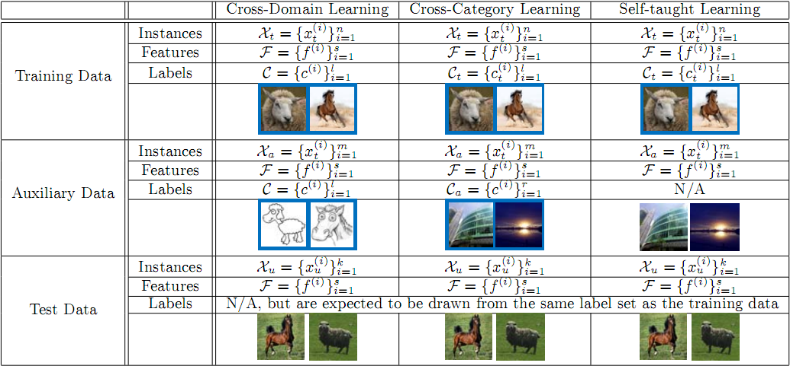
Problem Formulation
Notes:
This picture may be more clearly. On this three tasks, we have training data, test data and auxiliary data. For all these three tasks, all the data are in the same feature space.
The difference is that,
For the cross-domain learning, target data and auxiliary data share the same labels since they are from the same categories.
And for the cross-category learning, since target data and auxiliary data are in different categories, they have different labels.
While, the third one, self-taught learning, its auxiliary data has no labels.
The main problem is clearly, learning from the training data, with the help of auxiliary data, to classify the test data.

Slide 11
Graph Construction
Notes:
We have defined the data, the tasks and the relations. We can construct the graph to express all these information.

Slide 12
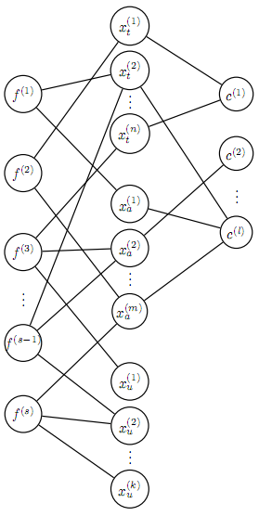
Graph Construction
-( )-
-( )-
-( )-
-( 1 )-
-( 1 )-
Cross-domain Learning
Notes:
The left side is the links in symbols and the right side is the graph.
For cross-domain learning, we have to link from training, test, auxiliary data to the features. The weight of the edges are just same to the weight of the feature vectors. Specifically, we are dealing text classification problem here. The edges are just the TF values of the tokens.
There are also edges between training data, auxiliary data and the labels.

Slide 13
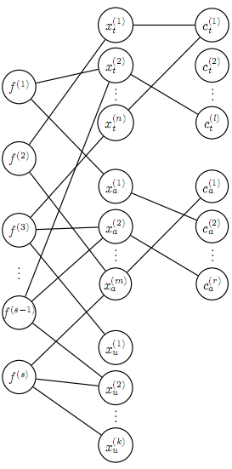
Graph Construction
-( )-
-( )-
-( )-
-( 1 )-
-( 1 )-
Cross-category Learning
Notes:
For the cross-category learning, auxiliary data are in the different categories. So they should link to different labels here.

Slide 14
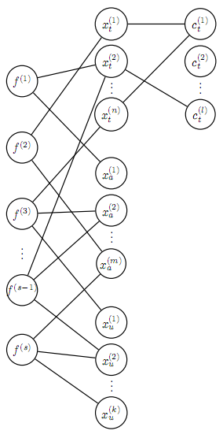
Graph Construction
-( )-
-( )-
-( )-
-( 1 )-
Self-taught Learning
Notes:
While, this is the graph for self-taught learning. The difference is that it has no links between auxiliary data and the labels.

Slide 15
Graph Construction
 | Token | Token | …
Doc
Doc
…
 | Doc | Feature | Label
Doc | ?
Feature |  | ? | 0
Label |  | 0 | 0
Doc-Token Matrix
Adjacency Matrix
Notes:
The graph is expressed as a matrix. Maybe intuitively, you may think it is a token-document matrix, since everyone did the work on this. But it is wrong. We need a adjacency matrix of the graph. It looks like this one. We have many zeros here. The links between docs and the links between features is not used in our work. But there may have some information of these in some tasks.

Slide 16
Simple Review on Spectral Analysis
Notes:
Then we should do the spectral analysis on the matrix we have got. Here we make a brief review on it.

Slide 17
Simple Review on Spectral Analysis
G is an undirected weighted graph with weight matrix W, where .
D is a diagonal matrix, where
Unnormalized graph Laplacian matrix:
Normalized graph Laplacians:
Notes:
Here we first have a graph G. It is a undirected weighted graph. Its weight matrix is W, where the W is symmetric and non-positive.
D is the degree matrix. Dii is just means the degree of node I of G.
The unnormalized graph laplacian matrix is defined as D minus W.
The values derive from this matrix is much influenced by its scale. So we’d better do normalization on it. While these two are two candidate of normalization way.

Slide 18
Simple Review on Spectral Analysis
Calculate the first k eigenvectors
The New representation:
 | v₁ | v₂ | v₃
Node1
Node2
Node3
Node4
…
New Feature Vector of the Node2
Notes:
Then the process is to calculate the first k eigenvectors which have the smallest eigen values. And the new representation of the nodes are get from this way. Such as for the node 2, these vector is just the new feature vector for it.
Some one explains it as a expression of the N-cut of the graph. And if we deal with the unnormalized form, it just a expression cut of the graph. For the details you may find them on some materials of Spectral analysis.

Slide 19
Learning from Graph Spectra
Notes:
What we do is just similar to this.

Slide 20
Learning from Graph Spectra
Graph G
Adjacency matrix of G:
Graph Laplacian of G:
Solve the generalized eigenproblem:
The first k eigenvectors form a new feature representation.
Apply traditional learners such as NB, SVM
Notes:
We have the graph G, the weight matrix W.
Then we get the graph laplacian.
To get the normalized version Lrw, we just need to solve this generlized eigenproblem.
We take the first k eigenvectors and extract the new representation just map to training data and test data.
It is just some feature vectors. And we still can use the traditional learners. It also reduced the dimension of the learning problem.

Slide 21
Learning from Graph Spectra
 | Doc | Feature | Label
Doc
Feature
Label
 | Doc | Feature | Label
Doc
Feature
Label
 | v1 | v2
Train
Test
Auxiliary
Feature
Label
Train | v₁ | v₂
Test | v₁ | v₂
Classifier
Notes:
Here is picture show of the process. We have W, then calculate L, calculate eigenvectors, and list them as column. Extract the row which training and test data corresponding to. Then train the classify by the training data, and test the test data.

Slide 22
Learning from Graph Spectra
The only problem remain is the computation time.
Which is lucky:
  Matrix L is sparse
  There are fast algorithms for sparse matrix for solving eigen-problem. (Lanczos)
The final computational cost is linear to
Notes:
Now the only problem remain is the computation time since the matrix is so big. We may have many documents, many features. The number of dimension maybe so huge.
But it is lucky that the matrix L is sparse, and there are fast algorithms for solving eigen-problem on sparse matrix.
The final computational cost is linear to the number of non-zero elements of L multiply k, where k is the number of eigen-vectors we need.
In practice, k is determined by cross-validation on training data. And the best value of k is just 60 or 70. It is not so big.

Slide 23
Experiments
Notes:
The theory has been exclaimed. Let’s show the results of the experiments.

Slide 24
Experiments
Basic Progress
Sample
15 Positive Instances &
15 Negative Instances
Training Data
Test Data
Auxiliary Data
Repeat 10 times
Calculate average
Baseline
New Training Data
New Test Data
Result
CV
Classifier
(NB/SVM/TSVM)
Notes:
The basic process of our experiments is shown this picture.
First, we randomly select the category as training data and test data. Then sample 15 positive one and 15 negative one for training. After generating graph, solve the eigen-problem, we can get the new representation of training data and test data.
Then we train a classifier with the original training data and test on test data as the baseline. We also make a additional baseline for cross domain learning, which train the classifier with training data and all the auxiliary data together.
After these, we make a cross validation on the training data to determine the number of eigen-vectors we will use. Since the training data is so small, this process is fast enough. Then we can train the new classifier by the new training data which still have 15 positive instances and 15 negative instances. Then classify the new test data. We tried on Naïve Bayes, SVM and TSVM.
We make this process on same category for 10 times and calculate the average and the variance. That is the final result.

Slide 25
Experiments
Cross-domain Learning
Data
  SRAA
  20 Newsgroups (Lang, 1995)
  Reuters-21578
Target data and auxiliary data share the same categories(top directories), but belong to different domains(sub-directories).
Notes:
The data we used for cross-domain learning is shown here.
They all have a hierarchical. We take target data and auxiliary data from the same categories, but they belong to different domains.

Slide 26
Experiments
Cross-domain result with NB
Notes:
This is the result with NB. The y axis is the error rate. And the x axis is the different categories we test. The last one is the average.
The blue one is Non-transfer baseline, the red one is trained by target training data and the auxiliary data. While the orange one is our method.
We can see that it improves much.
But there is just one that didn’t.

Slide 27
Experiments
Cross-domain result with SVM
Notes:
This is the result on SVM. It improves much too.

Slide 28
Experiments
Cross-domain result with TSVM
Notes:
And this is the result on TSVM.
On some of these, Eigen Transfer improves a littler, or none, since the TSVM also used the information on the target test data.

Slide 29
Experiments
Cross-domain result on average
 | Non-Transfer | Simple Combine | EigenTransfer
NB | 0.250±0.036 | 0.239±0.000 | 0.134±0.031
SVM | 0.190±0.039 | 0.213±0.000 | 0.095±0.018
TSVM | 0.140±0.038 | 0.145±0.000 | 0.101±0.019
Notes:
But it is interesting that, we can see the average result in detail here. The Eigen transfer result on SVM is better than with TSVM. Since there is no need to do semi-supervised learning on new representation. It has already handle the information.

Slide 30
Experiments
Cross-category Learning
Data
  20 Newsgroups (Lang, 1995)
  Ohscal data set from OHSUMED (Hersh et al. 1994)
Random select two categories as target data. Take the other categories as auxiliary labeled data.
Notes:
For cross-category learning, the data we used are these two.
We select two categories as target data, and all the others as auxiliary labeled data.

Slide 31
Experiments
Cross-category result with NB
Notes:
This is the result on NB. Since the auxiliary data are with different labels. So there is only one baseline here.

Slide 32
Experiments
Cross-category result with SVM
Notes:
The result with SVM

Slide 33
Experiments
Cross-category result with TSVM
Notes:
The result with TSVM

Slide 34
Experiments
Cross-category result on average
 | Non-Transfer | EigenTransfer
NB | 0.186±0.038 | 0.099±0.025
SVM | 0.131±0.032 | 0.065±0.016
TSVM | 0.104±0.010 | 0.091±0.013
Notes:
It is similar that on TSVM improves litter than on SVM and NB. But we can see the same situation here, the eigentransfer result on SVM is better than TSVM.

Slide 35
Experiments
Self-taught Learning
Data
  20 Newsgroups (Lang, 1995)
  Ohscal data set from OHSUMED (Hersh et al. 1994)
Random select two categories as target data. Take the other categories as auxiliary without labeled data.
Notes:
For self-taught learning. We use the same data as cross category learning. Here we just drop the labels.

Slide 36
Experiments
Self-taught result with NB
Notes:
Same to the previous one. The result on NB

Slide 37
Experiments
Self-taught result with SVM
Notes:
The result on SVM

Slide 38
Experiments
Self-taught result with TSVM
Notes:
And the result on TSVM

Slide 39
Experiments
Self-taught result on average
 | Non-Transfer | EigenTransfer
NB | 0.189±0.038 | 0.107±0.032
SVM | 0.126±0.030 | 0.070±0.017
TSVM | 0.106±0.011 | 0.098±0.024
Notes:
It is also the same that this one is better.

Slide 40
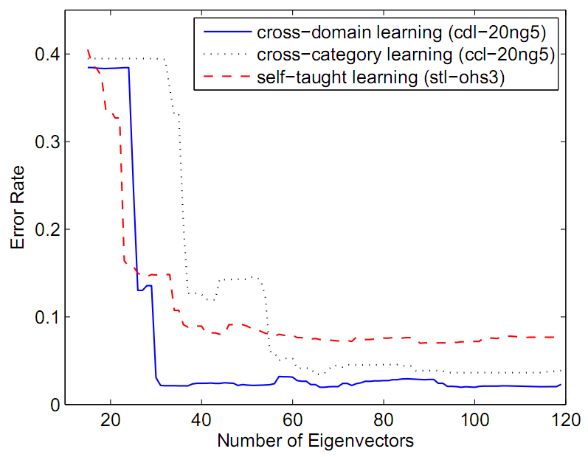
Experiments
Effect of the number of Eigenvectors
Notes:
We also did some experiments to show the effect of the number of eigenvectors.
The x-axis is number of eigenvectors and the y axis is the error rate. 40 or 50 eigen vectors is enough here.

Slide 41
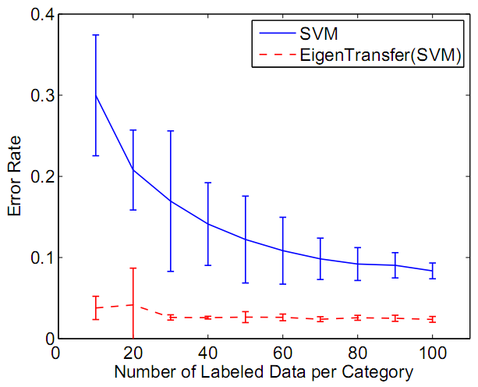
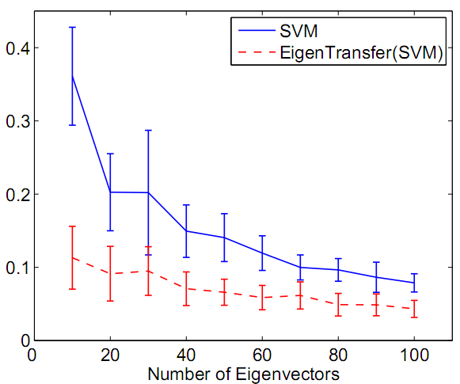
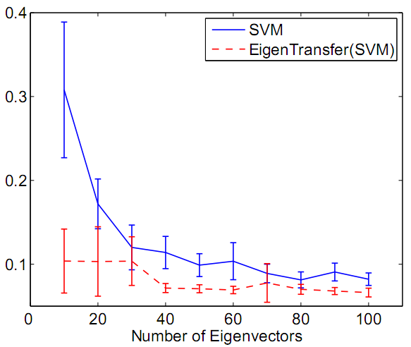
Experiments
Labeled Target Data
Notes:
This three graph show the result on three different data. While effect of number of labeled target data.
The x-axis is the number of labeled data per category, while the y-axis is the error rate.
The previous result is based on 30 labeled data. And we can see that little labeled data is enough for our method. And it is still better than traditional method even if the labeled data increases.

Slide 42
Conclusion
We proposed a general transfer learning framework.
It can model a variety of existing transfer learning problems and solutions.
Our experimental results show that it can greatly outperform non-transfer learners in many experiments.
Notes:
Finally, the conclusion.
We proposed a general transfer learning framework which handled cross-domain learning, cross-category learning and self-taught learning. It may also handle the learning problem, which can expressed the relation between target data and auxiliary data as graph.
Our experimental results show that it can greatly outperform non-transfer learner in many experiments.

Slide 43
Thank you!
Notes:
That’s all. Thank you for your attention.
Do you have any questions?

