Slide 1

Source-Selection-Free
Transfer Learning
Evan Xiang, Sinno Pan, Weike Pan, Jian Su, Qiang Yang

Slide 2

Transfer Learning
Supervised
Learning
Lack of labeled training data always happens
Transfer
Learning
When we have some related source domains

Slide 3
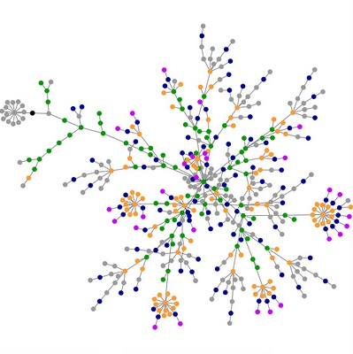

Where are the “right” source data?
We may have an extremely large number of choices of potential sources to use.

Slide 4
Outline of Source-Selection-Free Transfer Learning (SSFTL)
Stage 1: Building base models
Stage 2: Label Bridging via Laplacian Graph Embedding
Stage 3: Mapping the target instance using the base classifiers & the projection matrix
Stage 4: Learning a matrix W to directly project the target instance to the latent space
Stage 5: Making predictions for the incoming test data using W

Slide 5

SSFTL – Building base models
vs.
vs.
vs.
vs.
vs.
vs.
vs.
vs.
vs.
vs.
vs.
From the taxonomy of the online information source, we can “Compile” a lot of base classification models

Slide 6


SSFTL – Label Bridging via Laplacian Graph Embedding
Problem
Since the label names are usually short and sparse, , in order to uncover the intrinsic relationships between the target and source labels, we turn to some social media such as Delicious, which can help to bridge different label sets together.
Neighborhood matrix
for label graph
However, the label spaces of the based classification models and the target task can be different
Bob
History
Tom
Travel
M
John
Finance
vs.
q
Gary
Tech
q
Steve
Sports
mismatch
Laplacian Eigenmap [Belkin & Niyogi,2003]
vs.
Projection matrix
V
m-dimensional latent space
vs.
vs.
q
vs.
vs.
m
The relationships between labels, e.g., similar or dissimilar, can be represented by the distance between their corresponding prototypes in the latent space, e.g., close to or far away from each other.

Slide 7
SSFTL – Mapping the target instance using the base classifiers & the projection matrix V
vs.
0.1:0.9
vs.
Target Instance
vs.
“Ipad2 is released in March, …”
For each target instance, we can obtain a combined result on the label space via aggregating the predictions from all the base classifiers
0.6:0.4
0.3:0.7
vs.
vs.
0.7:0.3
0.2:0.8
Then we can use the projection matrix V to transform such combined results from the label space to a latent space
Tech
= <Z₁, Z₂, Z₃, …, Z_{m}>
Probability
Projection matrix
Finance
V
m-dimensional latent space
Travel
Sports
q
History
q
Label space
m
However, do we need to recall the base classifiers during the prediction phase?
The answer is No!

Slide 8




SSFTL – Learning a matrix W to directly project the target instance to the latent space
Target Domain
vs.
vs.
Projection matrix
Labeled & Unlabeled Data
vs.
V
vs.
q
vs.
m
For each target instance, we first aggregate its prediction on the base label space, and then project it onto the latent space
Loss on unlabeled data
Loss on labeled data
Learned Projection matrix
W
Our regression model
d
m

Slide 9


SSFTL – Making predictions for the incoming test data
Target Domain
Learned Projection matrix
The learned projection matrix W can be used to transform any target instance directly from the feature space to the latent space
Incoming Test Data
W
d
m
vs.
vs.
Projection matrix
vs.
V
vs.
q
Therefore, we can make prediction directly for any incoming test data based on the distance to the label prototypes, without calling the base classification models
vs.
m

Slide 10
Experiments - Datasets
Building Source Classifiers with Wikipedia
  3M articles, 500K categories (mirror of Aug 2009)
  50, 000 pairs of categories are sampled for source models
Building Label Graph with Delicious
  800-day historical tagging log (Jan 2005 ~ March 2007)
  50M tagging logs of 200K tags on 5M Web pages
Benchmark Target Tasks
  20 Newsgroups (190 tasks)
  Google Snippets (28 tasks)
  AOL Web queries (126 tasks)
  AG Reuters corpus (10 tasks)

Slide 11
SSFTL - Building base classifiers Parallelly using MapReduce
Input
Map
Reduce
vs.
vs.
1
3
…
…
1
2
3
…
…
vs.
vs.
2
1
2
…
…
If we need to build 50,000 base classifiers, it would take about two days if we run the training process on a single server.
Therefore, we distributed the training process to a cluster with 30 cores using MapReduce, and finished the training within two hours.
The training data are replicated and assigned to different bins
3
In each bin, the training data are paired for building binary base classifiers
These pre-trained source base classifiers are stored and reused for different incoming target tasks.

Slide 12
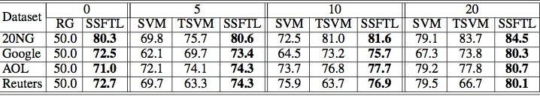
Experiments - Results
Unsupervised SSFTL
Semi-supervised SSFTL
-Parameter setttings-
Source models: 5,000
Unlabeled target data: 100%
lambda_2: 0.01
Our regression model
Notes:
Table 1, compared to SVM and TSVM, SSFTL can achieve
much better classification accuracy on the target test data. An
interesting result is that SSFTL can also achieve satisfiable
classification performance without any labeled data, which is
much higher than Random Guessing (RG).

Slide 13
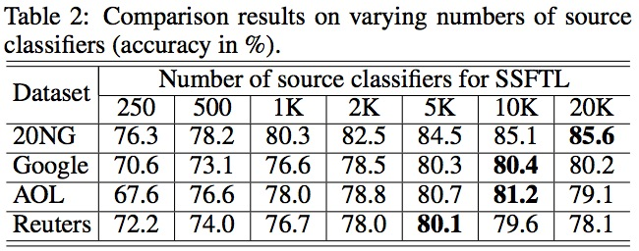
Experiments - Results
For each target instance, we first aggregate its prediction on the base label space, and then project it onto the latent space
-Parameter setttings-
Mode: Semi-supervised
Labeled target data: 20
Unlabeled target data: 100%
lambda_2: 0.01
Loss on unlabeled data
Our regression model
Notes:
In the second experiment, we aim to verify the impact of
the number of source classifiers to the overall performance
of SSFTL, where we set λ2 = 0.01 and use 20 labeled target
data. From Table 2, we can find that, when the number
of source classifiers increases, the performance of SSFTL increases
in company with the number. When it is equal to
or larger than 5, 000

Slide 14
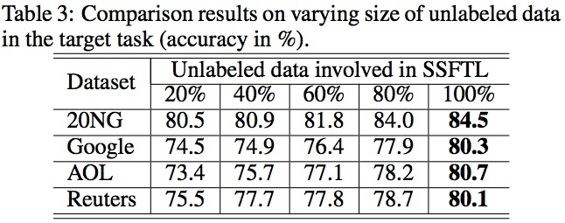
Experiments - Results
-Parameter setttings-
Mode: Semi-supervised
Labeled target data: 20
Source models: 5,000
lambda_2: 0.01
Our regression model
Notes:
the third experiment, we further verify the performance
of SSFTL when the proportion of unlabeled data involved in
learning varies, as shown in Table 3. In this experiment, we
use 5, 000 source classifiers, 20 labeled target data and set
λ2 = 0.01. The results suggest that the classification performance
of SSFTL increases as the amount of unlabeled
data grows.

Slide 15
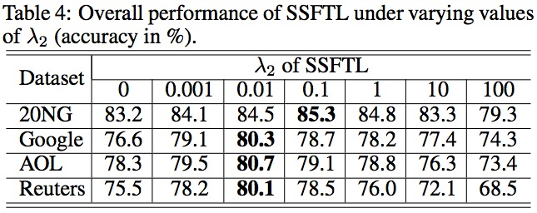
Experiments - Results
Supervised SSFTL
Semi-supervised SSFTL
-Parameter setttings-
Labeled target data: 20
Unlabeled target data: 100%
Source models: 5,000
Our regression model
Notes:
we verify the impact of different
values of λ2 on the overall classification performance of SSFTL.
The result is shown in Table 4. In this experiment, we use 5, 000 source classifiers and 20 labeled data. As can be
seen, the proposed SSFTL performs best and is stable when
λ2 falls in the range [0.001, 0.1]. When λ2 = 0, the semisupervised
SSFTL method is reduced to a supervised regularized
least squares regression (RLSR) model, and when the
value of λ2 is large, e.g. λ2 = 100, the result of SSFTL is
similar to those of unsupervised SSFTL as shown in Table 1.

Slide 16
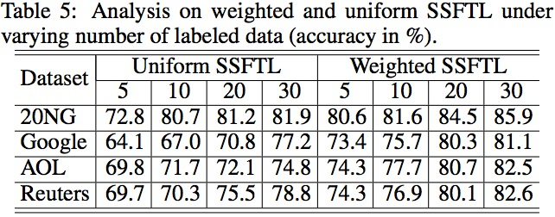
Experiments - Results
For each target instance, we first aggregate its prediction on the base label space, and then project it onto the latent space
-Parameter setttings-
Mode: Semi-supervised
Labeled target data: 20
Source models: 5,000
Unlabeled target data: 100%
lambda_2: 0.01
Loss on unlabeled data
Our regression model
Notes:
In the last experiment, we verify the effectiveness of our
proposed weighted strategy of auxiliary source classifiers introduced
at the end of Section 2. We compare the classification
performance of SSFTL using the weighted strategy with
that using the uniform weighting strategy. In this experiment,
we set λ2 = 0.01, use 5, 000 source classifiers and vary the
number of labeled target data. As can be seen from Table 5,
SSFTL using the weighted strategy can perform much better
than that using the uniform weighting strategy. With this simple
weighted strategy, we are able to “filter” unrelated source
classifiers and identify useful ones for transfer.
Table 5

Slide 17
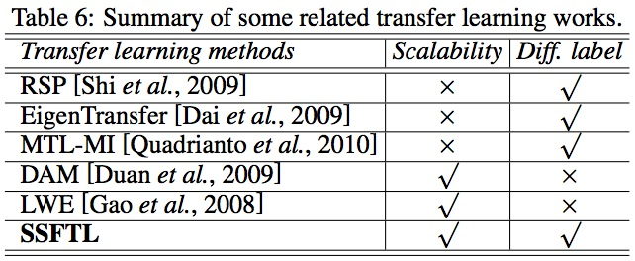
Related Works

Slide 18
Conclusion
Source-Selection-Free Transfer Learning
  When the potential auxiliary data is embedded in very large online information sources
No need for task-specific source-domain data
  We compile the label sets into a graph Laplacian for automatic label bridging
SSFTL is highly scalable
  Processing of the online information source can be done offline and reused for different tasks.

Slide 19
Q & A

