Slide 1


Congestion-mitigating Spatiotemporal Routing in Road Networks
Libin Wang, HKUST
Raymond Chi-Wing Wong, HKUST
Christian S. Jensen, Aalborg University

Slide 2
Outline
Motivation
Definition
Methodology
Experiments
Conclusion

Slide 3
Outline
Motivation
Definition
Methodology
Experiments
Conclusion

Slide 4



Motivation: route planning
Route planning plays a critical role in many spatial applications

Slide 5
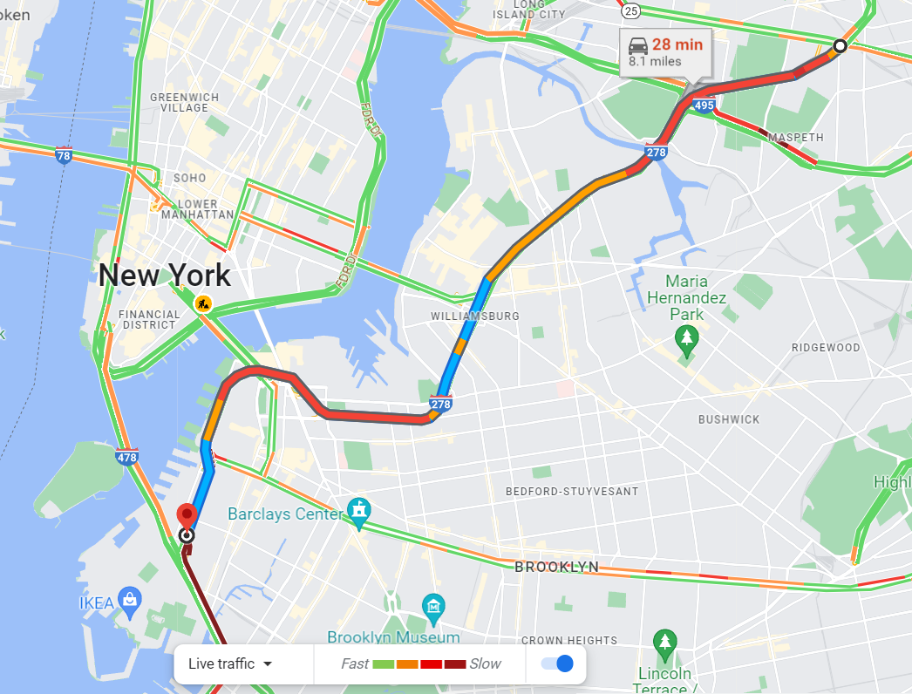
Background: one single objective
The recommended fastest route
Notes:
However,

Slide 6
Motivation: single selfish objective
The fastest route for each individual routing query
  Shortest path solutions: SIGMOD18, SIGMOD20, VLDB20, SIGMOD21, ICDE23…
These selfish route choices can make the global traffic congested
Use slightly longer routes to mitigate congestion
Notes:
In online mapping platforms, the most popular routing strategy is to recommend the fastest route for each individual query. There have been substantial research efforts on finding shortest paths efficiently. If everyone uses the locally optimal route, such local route recommendations can make the global traffic congested.

Slide 7
Related work
They focus on providing diversified routes but not reducing congestion
Alternative paths
  EJOR00, JEA13, TKDE18, SIGSPATIAL19, VLDBJ20, VLDB20, TKDE21
Congestion avoidance heuristics
  TITS13, TVT13, ITSC14, Ad Hoc Networks16, UNet17, ICDE23
They are inefficient (e.g., several minutes) in processing each online query and have no theoretical guarantees from a global view
Notes:
For some related work about minimizing traffic congestion, we consider two categories. The first one is to use alternative paths. However,

Slide 8
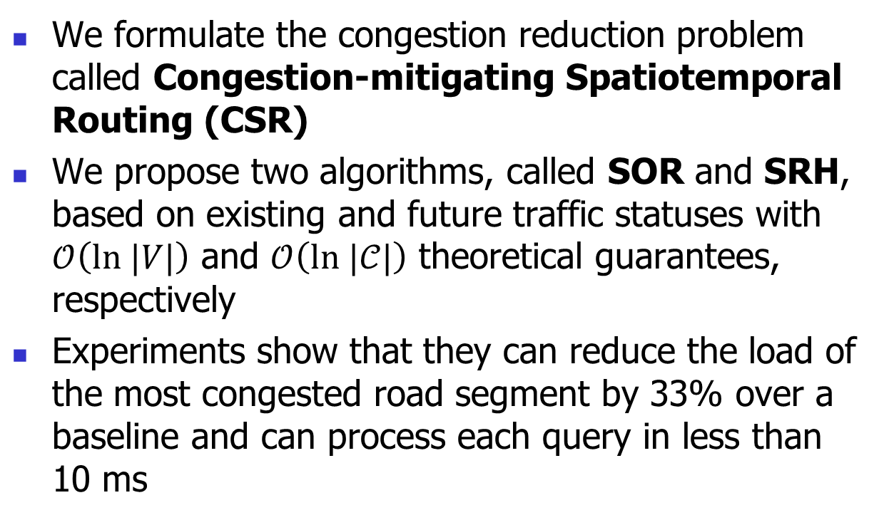
Contributions
We formulate the congestion reduction problem called Congestion-mitigating Spatiotemporal Routing (CSR)
We propose two algorithms, called SOR and SRH, based on existing and future traffic statuses with $𝒪\left(ln |V|\right)$ and $𝒪\left(ln |𝒞|\right)$ theoretical guarantees, respectively
Experiments show that they can reduce the load of the most congested road segment by 33% over a baseline and can process each query in less than 10 ms

Slide 9
Outline
Motivation
Definition
Methodology
Experiments
Conclusion

Slide 10



















Definition: road network
Edge weights $w_{e}∈ℝ^{+}$ represent roads’ travel times
Let $γ_{p}=\sum_{i=1}^{k}{w_{e_{i}}}$ be the travel time of the path $p=(e_{1},e_{2},…,e_{k})$
  The travel time of the path $(e_{1})$, i.e., $γ_{{(e}_{1})}=1.3$
$$e_{1}$$
$$A$$
$$B$$
$$1.3$$
$$e_{2}$$
$$0.1$$
$$0.1$$
$$e_{4}$$
$$E$$
$$1$$
$$F$$
$$e_{5}$$
$$e_{3}$$
$$1$$
$$e_{6}$$
$$0.2$$
$$C$$
$$D$$
Notes:
We abstract a road network from the previous example. It can be represented by a connected directed graph. Let E,F be the bridge in red. Let node ABCD be the area ABCD, respectively. We are actually planning routes in a road network where edge weights are travel times. Let gamma p be the travel time of the path p. It is the sum of travel times of edges. For example, the travel time of the path e one is 1.3

Slide 11

Definition: the fastest path
The fastest path $p^{∗}$ from an origin $o$ to a destination $d$ has the shortest travel time
  The fastest path from $A$ to $B$ is the path $(e_{2},e_{3},e_{4})$ with its travel time of 1.2
$$e_{1}$$
$$A$$
$$B$$
$$1.3$$
$$e_{2}$$
$$0.1$$
$$0.1$$
$$e_{4}$$
$$E$$
$$1$$
$$F$$
$$e_{5}$$
$$e_{3}$$
$$1$$
$$e_{6}$$
$$0.2$$
$$C$$
$$D$$
Notes:
The fastest path from an origin to a destination has the shortest travel time among all paths from the same origin to the same destination. For example, if the origin is A and the destination is B, the fastest path is e two, e three, e four since its travel time of 1.2 is smaller than the travel time of e one.

Slide 12
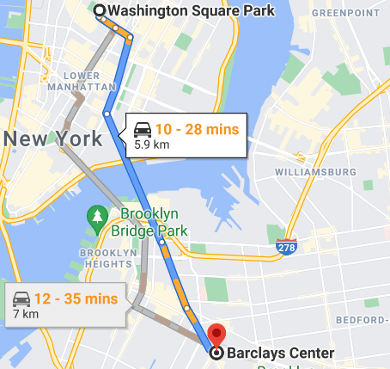

Definition: routing query
A routing query $q=(o_{q},d_{q})$ is issued at some time $t∈ℝ^{+}$ with its origin $o_{q}$ and its destination $d_{q}$
A
The routing query can be also answered by some detour paths (e.g., the gray line)
B
Notes:
Next, we define the routing query. … It has three parameters, the time t when it is issued, the origin oq and the destination dq. It is answered by a path from the origin to the destination. This path is not necessarily the fastest path but some detour paths. We allow this detour path to have slightly longer travel time, for which we have to impose the detour constraint on its travel time.

Slide 13


Definition: detour constraint
Detour constraint:
  $γ_{p}≤\left(1+α\right)γ_{p^{∗}}$, where $γ_{p^{∗}}$ is the shortest travel time and $α≥0$ is the detour factor
$$e_{1}$$
Let $α=0.1$
A query $q=(A,B)$ can be answered by
the fastest path $(e_{2},e_{3},e_{4})$ with its $γ_{\left(e_{2},e_{3},e_{4}\right)}=1.2$
the path $(e_{1})$ since $γ_{(e_{1})}=1.3≤\left(1+α\right)γ_{\left(e_{2},e_{3},e_{4}\right)}=1.2×1.1=1.32$
$$A$$
$$B$$
$$1.3$$
$$e_{2}$$
$$0.1$$
$$0.1$$
$$e_{4}$$
$$E$$
$$1$$
$$F$$
$$e_{5}$$
$$e_{3}$$
$$1$$
$$e_{6}$$
$$0.2$$
$$C$$
$$D$$
Notes:
The detour constraint requires that the travel time of the path should not be longer than one plus alpha times the shortest travel time. It has one user-defined parameter alpha, which is nonnegative. For example, suppose that alpha is 0.1. For the query A, B can be answered by the fastest path e_2, e_3, e_4 with its travel time 1.2. It can also be answered by the path e_1 since its travel time of 1.3 is smaller than one plus alpha times the fastest travel time, which is 1.2 times 1.1 equal to 1.32

Slide 14


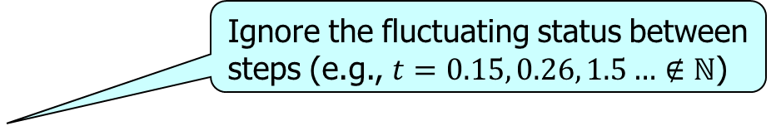




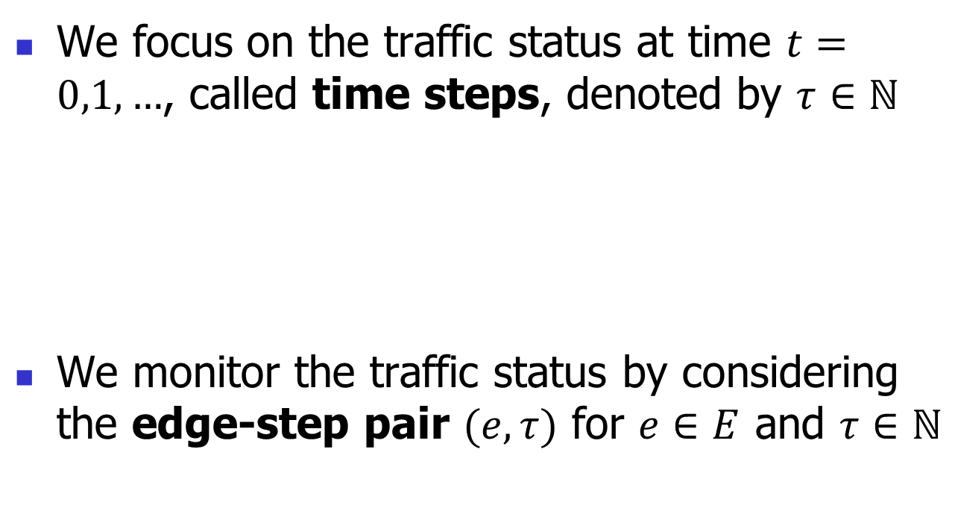

Definition: time step & edge-step pair
We focus on the traffic status at time $t=0,1,…$, called time steps, denoted by $τ∈ℕ$
We monitor the traffic status by considering the edge-step pair $(e,τ)$ for $e∈E$ and $τ∈ℕ$
Ignore the fluctuating status between steps (e.g., $t=0.15, 0.26, 1.5…∉ℕ$)
$$τ=0$$
$$τ=1$$
$$τ=2$$
$$……$$
$$t=0$$
$$t=1.5$$
$$Time t$$
Notes:
We will next define some concepts about the traffic status. We only monitor the traffic status at the time when t is integers, called time steps, denoted by tau. In the time axis, we could receive queries at any time, but we only care about the traffic status at the time steps. In practice, the interim of two consecutive steps can be one minute so that we can ignore the fluctuating status between steps. We will monitor the traffic status w.r.t. the edge-steps for all edges and all steps.

Slide 15



Definition: time step
At step $τ=0$ (or $t=0$), we receive 2 queries $q_{1}=q_{2}=(A,B)$ and they follow the fastest path $(e_{2},e_{3},e_{4})$
$$2×$$
$$e_{1}$$
$$A$$
$$B$$
$$1.3$$
$$e_{2}$$
$$0.1$$
$$0.1$$
$$e_{4}$$
$$E$$
$$1$$
$$F$$
$$e_{5}$$
$$e_{3}$$
$$1$$
$$e_{6}$$
$$0.2$$
$$C$$
$$D$$
Notes:
Let’s consider the following example. At time t=0 also the step tau=0, suppose that we receive 2 routing queries A B and they follow the path e2 e3 e4. Now there are two cars beside the node A at time t=0.

Slide 16




Definition: time step
At time $t=0.1$, suppose that we receive another 2 queries $q_{3}=q_{4}=(C,D)$ and they follow the fastest path $(e_{5},e_{3},e_{6})$
$$e_{1}$$
$$A$$
$$B$$
$$1.3$$
$$e_{2}$$
$$0.1$$
$$0.1$$
$$e_{4}$$
$$E$$
$$1$$
$$F$$
$$e_{5}$$
$$e_{3}$$
$$1$$
$$e_{6}$$
$$0.2$$
$$C$$
$$D$$
$$2×$$
$$2×$$
Notes:
At time t=0.1, suppose that we receive another 2 routing queries C D and they follow the path e5 e3 e6. There are also two cars beside C. The previous two cars will travel to the node E since the travel time of e2 is exactly 0.1. But t=0.1 is not a step, so we do not care about the positions of cars.

Slide 17
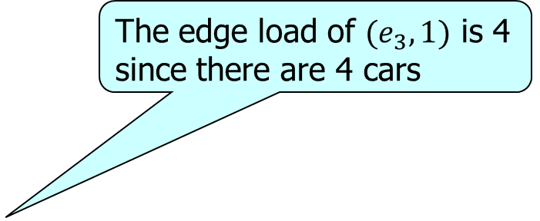





Definition: time step
At step $τ=1$ (or $t=1$), we need to monitor the traffic status
The edge load of $(e_{3},1)$ is 4 since there are 4 cars
$$e_{1}$$
$$A$$
$$B$$
$$1.3$$
$$e_{2}$$
$$0.1$$
$$0.1$$
$$e_{4}$$
$$E$$
$$1$$
$$F$$
$$e_{5}$$
$$e_{3}$$
$$1$$
$$e_{6}$$
$$0.2$$
$$C$$
$$D$$
$$2×$$
$$2×$$
Notes:
At time=1 and the step tau=1, we need to consider the traffic status w.r.t. the edge-step pairs (e,1) for all edges E. Specifically, we can find that all the four cars will travel to some positions on the edge e3. The number of cars at the edge e and the step tau will be the edge load of this edge-step pair.

Slide 18
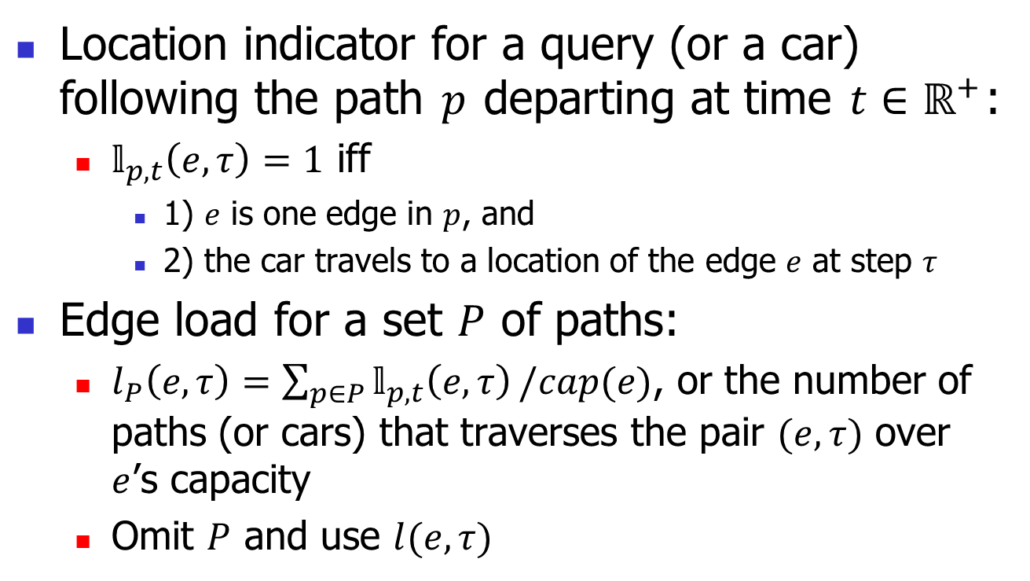
Definition: edge load (traffic status)
Location indicator for a query (or a car) following the path $p$ departing at time $t∈ℝ^{+}$:
  $𝕝_{p,t}\left(e,τ\right)=1$ iff
    1) $e$ is one edge in $p$, and
    2) the car travels to a location of the edge $e$ at step $τ$
Edge load for a set $P$ of paths:
  $l_{P}\left(e,τ\right)=\sum_{p∈P}{𝕝_{p,t}\left(e,τ\right)}/cap(e)$, or the number of paths (or cars) that traverses the pair $(e,τ)$ over $e$’s capacity
  Omit $P$ and use $l(e,τ)$
the path 𝑝 traverses the pair (𝑒,𝜏)
Notes:
To formally define the edge load of the edge-step pair, we first define the location indicator for a query following the path p departing at time t. The location indicator for the edge-step pair e, tau is one. or we simply say that the path p traverses the edge-step pair e, tau. If e is one edge in p, and the travel location lies on e at step tau. This can be imagined by a car following the path p and travels to the edge e at step tau. The edge load for a set P of path is defined to be the number of paths that traverses the pair e tau.

Slide 19



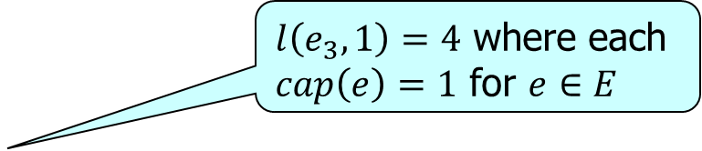
Definition: edge load
At step $τ=1$, we monitor the traffic status by considering the edge load $l(e,1)$ for $e∈E$
$$e_{1}$$
$l\left(e_{3},1\right)=4$ where each $cap\left(e\right)=1$ for $e∈E$
$$A$$
$$B$$
$$1.3$$
$$e_{2}$$
$$0.1$$
$$0.1$$
$$e_{4}$$
$$E$$
$$1$$
$$F$$
$$e_{5}$$
$$e_{3}$$
$$1$$
$$e_{6}$$
$$0.2$$
$$C$$
$$D$$
$$2×$$
$$2×$$
Notes:
At time=1 and the step tau=1, we need to consider the traffic status w.r.t. the edge-step pairs (e,1) for all edges E. Specifically, we can find that all the four cars are now in the edge e3. The number of cars at the edge e and the step tau will be the edge load of this edge-step pair.

Slide 20



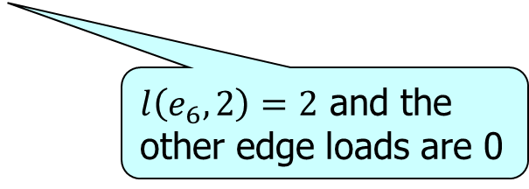



Definition: edge load
At step $τ=2$, we monitor the traffic status by considering the edge load $l(e,2)$ for $e∈E$
$$e_{1}$$
$$A$$
$$B$$
$$1.3$$
$$e_{2}$$
$$0.1$$
$$0.1$$
$$e_{4}$$
$$E$$
$$1$$
$$F$$
$$2×$$
$$e_{5}$$
$$e_{3}$$
$$1$$
$$e_{6}$$
$$0.2$$
$$C$$
$$D$$
$l\left(e_{6},2\right)=2$ and the other edge loads are 0
$$2×$$
Notes:
At time t=2 and step tau=2, we can find the edge load l(e6,2)=4 since there are two cars in e6. And all the other edge loads are 0.

Slide 21




















Definition: maximum edge load
All edge loads of all edge-step pairs
$$τ=1$$
$$e_{1}$$
$$A$$
$$B$$
The maximum edge load $l\left(e_{3},1\right)=4$
$$0.1$$
$$1.3$$
$$e_{2}$$
$$0.1$$
$$e_{4}$$
$$E$$
$$1$$
$$F$$
$$e_{5}$$
$$e_{3}$$
$$q_{1},q_{2}:\left(e_{2},e_{3},e_{4}\right), t=0$$
$$1$$
$$l(e,τ)$$
$$0.2$$
$$e_{6}$$
$$q_{3},q_{4}:\left(e_{5},e_{3},e_{6}\right),t=0.1$$
$$C$$
$$D$$
$$2×$$
$$2×$$
$$4$$
$$τ=2$$
$$3$$
$$e_{1}$$
$$2$$
$$A$$
$$B$$
$$0.1$$
$$1.3$$
$$1$$
$$e_{2}$$
$$0.1$$
$$e_{4}$$
$$0$$
$$E$$
$$1$$
$$F$$
$$(e_{1},0)$$
$$(e_{1},1)$$
$$(e_{2},0)$$
$$(e_{3},1)$$
$$(e_{6},2)$$
$$(e,τ)$$
$$e_{5}$$
$$e_{3}$$
$$1$$
$$2×$$
$$e_{6}$$
$$0.2$$
$$C$$
$$2×$$
$$D$$
Notes:
We can also use such a figure to illustrate the edge loads. The horizontal axis represents the edge-step pair, and the vertical axis represents the edge load. In the previous example, there are two cars following the path e2e3e4 departing at t=0. The edge loads incurred by them will be represented by grep blocks. They traverse the edge-step pairs e2,0 and e3,1. There are also two cars following the path e5e3e6 departing at t=0.1. The edge loads incurred by them will be represented by black blocks. They traverses the edge-step pairs e3,1 and e6,2.

Slide 22
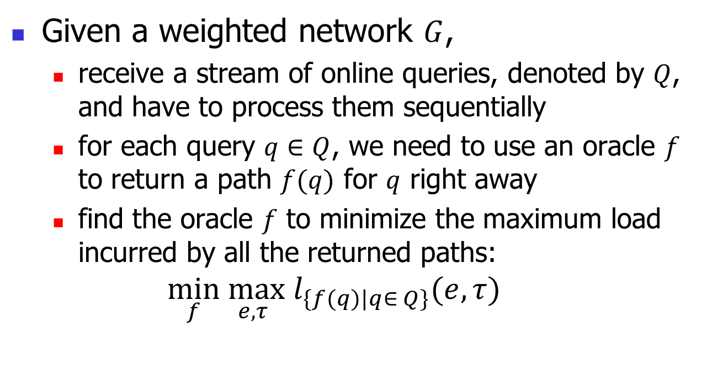
Congestion-Mitigating Spatiotemporal Routing (CSR) problem
Given a weighted network $G$,
  receive a stream of online queries, denoted by $Q$, and have to process them sequentially
  for each query $q∈Q$, we need to use an oracle $f$ to return a path $f(q)$ for $q$ right away
  find the oracle $f$ to minimize the maximum load incurred by all the returned paths:
  $$\min_{f}\max_{e,τ} l_{\{f(q)|q∈ Q\}}(e,τ)$$
The set of all the returned paths
Notes:
In sum, given a network G,

Slide 23
Outline
Motivation
Definition
Methodology
Experiments
Conclusion

Slide 24
Two ideas
Spatiotemporal Oblivious Routing (SOR)
  Compare different route options based on existing edge loads
Spatiotemporal Routing with History (SRH)
  Use prediction results learnt from history to consider existing and future edge loads
Notes:
The two ideas corresponds two algorithms. The first one is spatiotemporal oblivious routing, called SOR. It uses.. The second one is SRH.

Slide 25
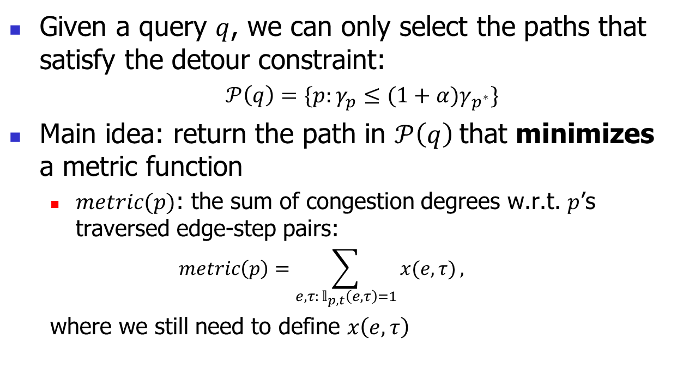
SOR: main idea
Given a query $q$, we can only select the paths that satisfy the detour constraint:
  $𝒫\left(q\right)=\{p:γ_{p}≤(1+α)γ_{p^{∗}}\}$
Main idea: return the path in $𝒫\left(q\right)$that minimizes a metric function
  $metric(p)$: the sum of congestion degrees w.r.t. $p$’s traversed edge-step pairs:
  $$metric\left(p\right)=\sum_{e,τ: 𝕝_{p,t}\left(e,τ\right)=1}{x(e,τ)},$$
  where we still need to define $x\left(e,τ\right)$
Notes:
I will first introduce SOR. Given a query q, we first define a path set P(q) which includes all the paths that satisfy the detour constraint. In other words, their travel times are smaller than one plus alpha times the shortest travel time. Then, we have to define a metric function to evaluate these paths. For each path, we first consider minimizing the sum of edge load w.r.t. the edge-step pairs.

Slide 26

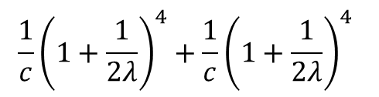





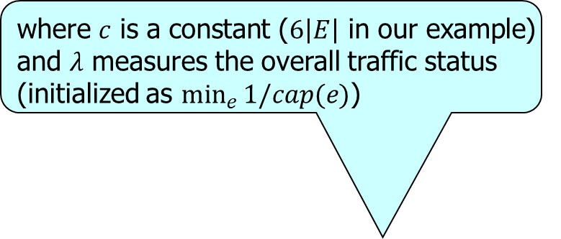




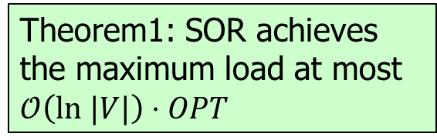


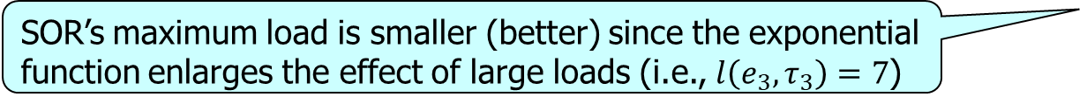




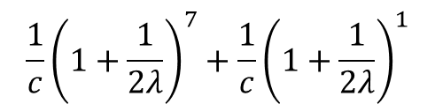

SOR: congestion degree
where 𝑐 is a constant ($6\left|E\right|$ in our example) and 𝜆 measures the overall traffic status (initialized as $min_{e}{1/cap(e)}$)
There are four pairs $\left(e_{1},τ_{1}\right),\left(e_{2},τ_{2}\right),\left(e_{3},τ_{3}\right),\left(e_{4},τ_{4}\right)$ with loads $l\left(e_{1},τ_{1}\right)=4,l\left(e_{2},τ_{2}\right)=4,l\left(e_{3},τ_{3}\right)=7,l\left(e_{4},τ_{4}\right)=1$
Path $p_{1}$ traverses $\left(e_{1},τ_{1}\right),\left(e_{2},τ_{2}\right)$ and $p_{2}$ traverses $\left(e_{3},τ_{3}\right),\left(e_{4},τ_{4}\right)$
Naïve idea: $x\left(e,τ\right)=l(e,τ)$
Our SOR: $x\left(e,τ\right)=\frac{1}{c}{\left(1+\frac{1}{2λ}\right)}^{l(e,τ)}$
$$\frac{1}{c}{\left(1+\frac{1}{2λ}\right)}^{4}+\frac{1}{c}{\left(1+\frac{1}{2λ}\right)}^{4}$$
$$metric(p_{1})$$
$$l\left(e_{1},τ_{1}\right)+l\left(e_{2},τ_{2}\right)=8$$
$$metric(p_{2})$$
$$l\left(e_{3},τ_{3}\right)+l\left(e_{4},τ_{4}\right)=8$$
$$\frac{1}{c}{\left(1+\frac{1}{2λ}\right)}^{7}+\frac{1}{c}{\left(1+\frac{1}{2λ}\right)}^{1}$$
$$metric\left(p_{1}\right)=metric(p_{2})$$
$$metric\left(p_{1}\right)<metric(p_{2})$$
Path choice
choose $p_{2}$ to break ties
$$p_{1}$$
New loads
$$l\left(e_{3},τ_{3}\right)=l\left(e_{3},τ_{3}\right)+1=8$$
$$l\left(e_{1},τ_{1}\right)=l\left(e_{1},τ_{1}\right)+1=5$$
Theorem1: SOR achieves the maximum load at most $𝒪\left(ln |V|\right)⋅OPT$
$$l\left(e_{4},τ_{4}\right)=l\left(e_{4},τ_{4}\right)+1=2$$
$$l\left(e_{2},τ_{2}\right)=l\left(e_{2},τ_{2}\right)+1=5$$
Maximum load
$$max_{e,τ}{l(e,τ)}=8$$
$$max_{e,τ}{l(e,τ)}=7<8$$
SOR’s maximum load is smaller (better) since the exponential function enlarges the effect of large loads (i.e., $l\left(e_{3},τ_{3}\right)=7$)
Notes:
The edge load will be the power. Here, c is a constant setting to the number of edge-step pairs equal to U times the number of edges. U is the maximum number of steps in a path. If one step represents one minute, U is usually 180 in experiments, corresponding to 180 minutes and 3 hours. Lambda is an estimate for the optimal solution. There are two strengths of using this function. First, the exponential function is a soft max function. We will choose the path p1 since. It also…

Slide 27
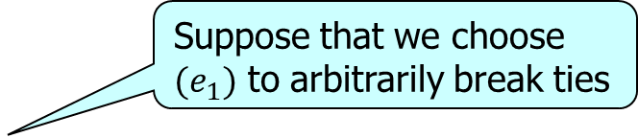
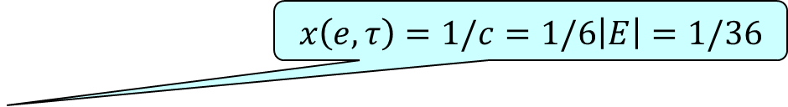
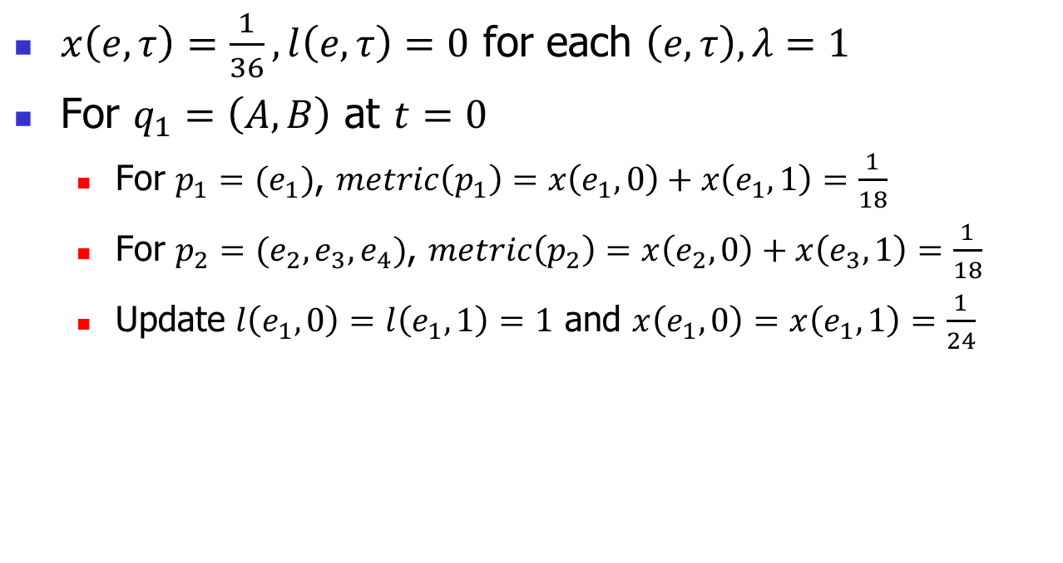
SOR: example
$$x\left(e,τ\right)=1/c=1/6\left|E\right|=1/36$$
$x\left(e,τ\right)=\frac{1}{36},l\left(e,τ\right)=0$ for each $\left(e,τ\right), λ=1$
For $q_{1}=\left(A,B\right)$ at $t=0$
  For $p_{1}=(e_{1})$, $metric\left(p_{1}\right)=x\left(e_{1},0\right)+x\left(e_{1},1\right)=\frac{1}{18}$
  For $p_{2}=(e_{2},e_{3},e_{4})$, $metric\left(p_{2}\right)=x\left(e_{2},0\right)+x\left(e_{3},1\right)=\frac{1}{18}$
  Update $l\left(e_{1},0\right)=l\left(e_{1},1\right)=1$ and $x\left(e_{1},0\right)=x\left(e_{1},1\right)=\frac{1}{24}$
Suppose that we choose $(e_{1})$ to arbitrarily break ties
$$e_{1}$$
$$A$$
$$B$$
$$1.3$$
$$e_{2}$$
$$0.1$$
$$0.1$$
$$e_{4}$$
$$E$$
$$1$$
$$F$$
$$e_{5}$$
$$e_{3}$$
$$1$$
$$e_{6}$$
$$0.2$$
$$C$$
$$D$$

Slide 28
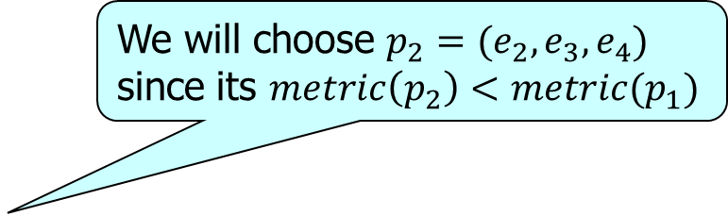

SOR: example
We will choose $p_{2}=(e_{2},e_{3},e_{4})$ since its $metric\left(p_{2}\right)<metric(p_{1})$
For $q_{2}=\left(A,B\right)$ at $t=0$
  For $p_{1}=(e_{1})$, $metric\left(p_{1}\right)=x\left(e_{1},0\right)+x\left(e_{1},1\right)=\frac{1}{12}$
  For $p_{2}=(e_{2},e_{3},e_{4})$, $metric\left(p_{2}\right)=x\left(e_{2},0\right)+x\left(e_{3},1\right)=\frac{1}{18}$
  Update $l\left(e_{2},0\right)=l\left(e_{3},1\right)=1$ and $x\left(e_{2},0\right)=x\left(e_{3},1\right)=\frac{1}{24}$
$$e_{1}$$
$$2×$$
$$A$$
$$B$$
$$1.3$$
$$e_{2}$$
$$0.1$$
$$0.1$$
$$e_{4}$$
$$E$$
$$1$$
$$F$$
$$e_{5}$$
$$e_{3}$$
$$1$$
$$e_{6}$$
$$0.2$$
$$C$$
$$D$$

Slide 29

















SOR: example
For $q_{3}=q_{4}=\left(C,D\right)$ at $t=0.1$
  we can only choose $\left(e_{5},e_{3},e_{6}\right)$
  update $l\left(e_{3},1\right)=3$ and $l\left(e_{6},2\right)=2$
The maximum load is 3
$$q_{1}:(e_{1})$$
$$e_{1}$$
$$q_{2}:(e_{2},e_{3},e_{4})$$
$$A$$
$$B$$
$$l(e,τ)$$
$$1.3$$
$$q_{3}:(e_{5},e_{3},e_{6})$$
$$e_{2}$$
$$0.1$$
$$0.1$$
$$e_{4}$$
$$q_{4}:(e_{5},e_{3},e_{6})$$
$$E$$
$$1$$
$$F$$
$$3$$
$$e_{5}$$
$$e_{3}$$
$$1$$
$$2$$
$$e_{6}$$
$$1$$
$$0.2$$
$$C$$
$$D$$
$$0$$
$$(e_{1},0)$$
$$(e_{1},1)$$
$$(e_{2},0)$$
$$(e_{3},1)$$
$$(e_{6},2)$$
$$2×$$
$$(e,τ)$$
Notes:
We can plot such a figure showing all the edge loads. We can see that the maximum load of the edge-step pair e3 1 is 3.

Slide 30
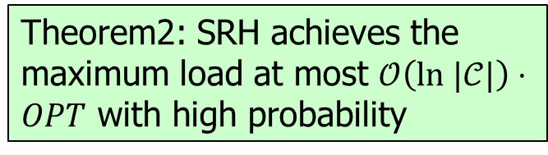
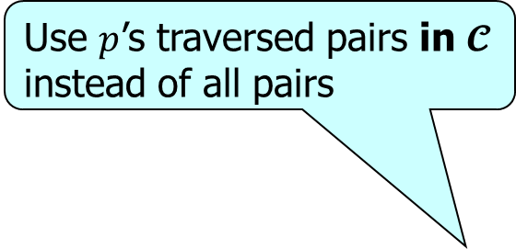
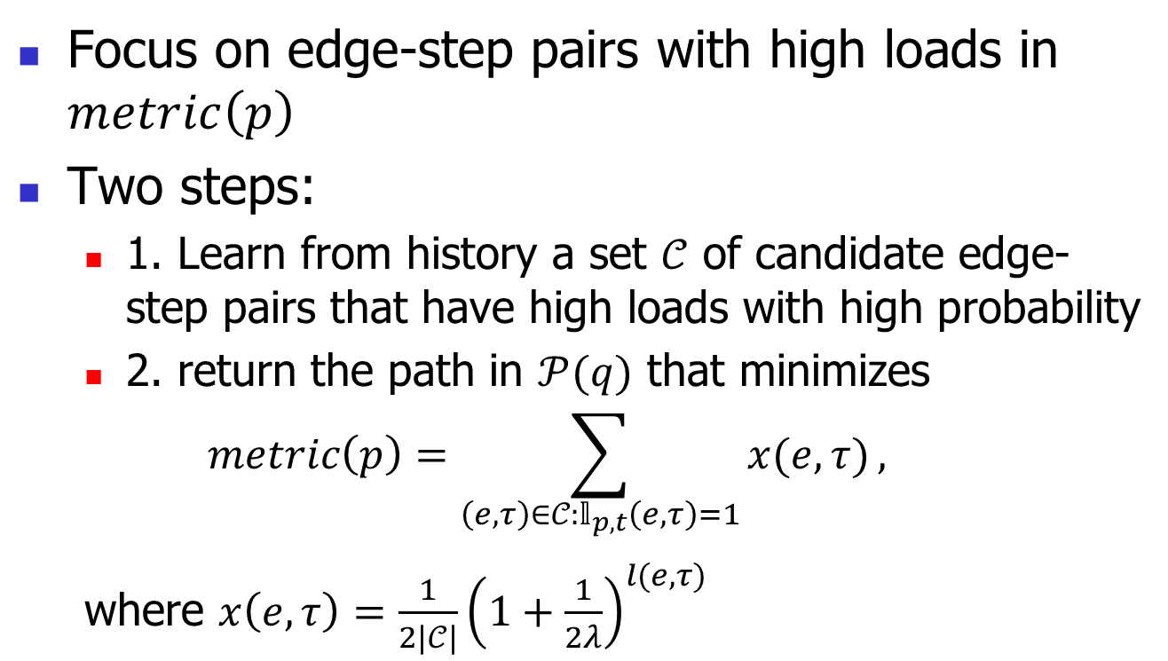
SRH: main idea
Focus on edge-step pairs with high loads in $metric\left(p\right)$
Two steps:
  1. Learn from history a set $𝒞$ of candidate edge-step pairs that have high loads with high probability
  2. return the path in $𝒫(q)$ that minimizes
  $$metric\left(p\right)=\sum_{\left(e,τ\right)∈𝒞:𝕝_{p,t}\left(e,τ\right)=1}{x(e,τ)},$$
  where $x\left(e,τ\right)=\frac{1}{2|𝒞|}{\left(1+\frac{1}{2λ}\right)}^{l(e,τ)}$
Use $p$’s traversed pairs in $𝓒$ instead of all pairs
Theorem2: SRH achieves the maximum load at most $𝒪\left(ln |𝒞|\right)⋅OPT$ with high probability
Notes:
The idea of the second algorithm is that if we learn…

Slide 31
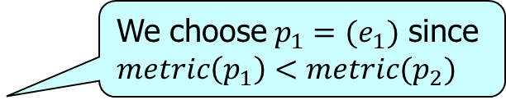
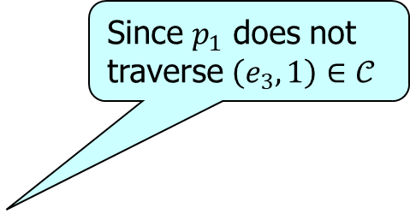
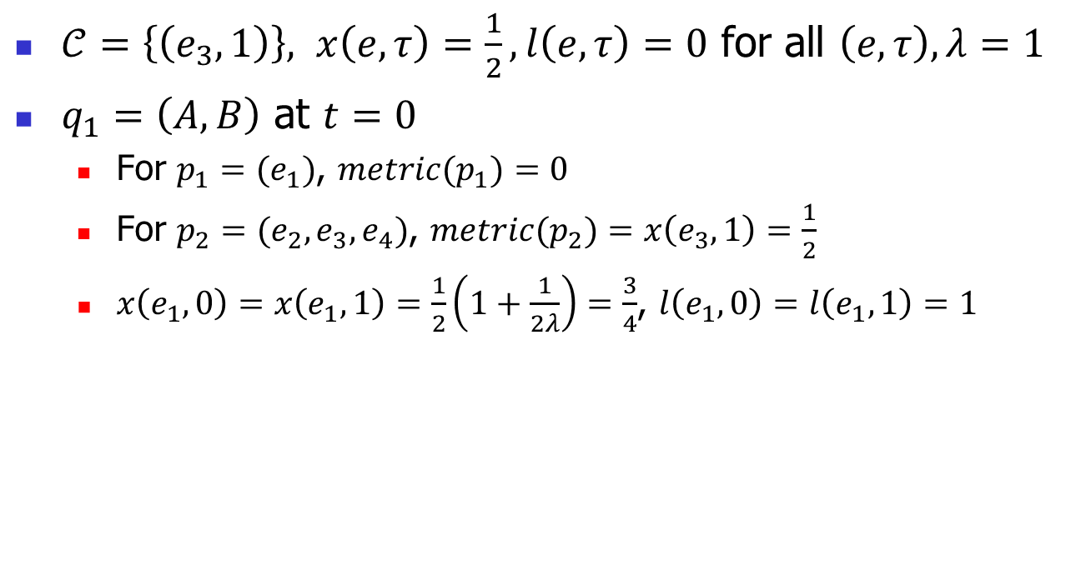
SRH: example
Since $p_{1}$ does not traverse $\left(e_{3},1\right)∈𝒞$
$𝒞=\left\{\left(e_{3},1\right)\right\}, x\left(e,τ\right)=\frac{1}{2},l\left(e,τ\right)=0$ for all $\left(e,τ\right), λ=1$
$q_{1}=\left(A,B\right)$ at $t=0$
  For $p_{1}=(e_{1})$, $metric(p_{1})=0$
  For $p_{2}=(e_{2},e_{3},e_{4})$, $metric(p_{2})=x\left(e_{3},1\right)=\frac{1}{2}$
  $x\left(e_{1},0\right)=x\left(e_{1},1\right)=\frac{1}{2}\left(1+\frac{1}{2λ}\right)=\frac{3}{4}$, $l\left(e_{1},0\right)=l\left(e_{1},1\right)=1$
We choose $p_{1}=(e_{1})$ since $metric\left(p_{1}\right)<metric(p_{2})$
$$e_{1}$$
$$A$$
$$B$$
$$1.3$$
$$e_{2}$$
$$0.1$$
$$0.1$$
$$e_{4}$$
$$E$$
$$1$$
$$F$$
$$e_{5}$$
$$e_{3}$$
$$1$$
$$e_{6}$$
$$0.2$$
$$C$$
$$D$$

Slide 32



SRH: example
$𝒞=\{\left(e_{3},1\right)\}$
$q_{2}=\left(A,B\right)$ at $t=0$
  For $p_{1}=(e_{1})$, $metric(p_{1})=0$
  For $p_{2}=(e_{2},e_{3},e_{4})$, $metric(p_{2})=x\left(e_{3},1\right)=\frac{1}{2}$
  $x\left(e_{1},0\right)=x\left(e_{1},1\right)=\frac{3}{4}\left(1+\frac{1}{2λ}\right)=\frac{9}{8}$, $l\left(e_{1},0\right)=l\left(e_{1},1\right)=2$
We choose $p_{1}=(e_{1})$ since $metric\left(p_{1}\right)<metric(p_{2})$
$$e_{1}$$
$$2×$$
$$A$$
$$B$$
$$1.3$$
$$e_{2}$$
$$0.1$$
$$0.1$$
$$e_{4}$$
$$E$$
$$1$$
$$F$$
$$e_{5}$$
$$e_{3}$$
$$1$$
$$e_{6}$$
$$0.2$$
$$C$$
$$D$$

Slide 33

















SRH: example
For $q_{3}=q_{4}=\left(C,D\right)$ at $t=0.1$, we can only choose $\left(e_{5},e_{3},e_{6}\right)$
  Update $l\left(e_{3},1\right)=l\left(e_{6},2\right)=2$
$$2×$$
The maximum load is 2
$$e_{1}$$
$$l(e,τ)$$
$$A$$
$$B$$
$$q_{1},q_{2}:\left(e_{1}\right),$$
$$1.3$$
$$q_{3},q_{4}:\left(e_{5},e_{3},e_{6}\right)$$
$$e_{2}$$
$$0.1$$
$$0.1$$
$$e_{4}$$
$$4$$
$$E$$
$$1$$
$$F$$
$$3$$
$$e_{5}$$
$$e_{3}$$
$$2$$
$$1$$
$$e_{6}$$
$$1$$
$$0.2$$
$$0$$
$$C$$
$$D$$
$$(e_{1},0)$$
$$(e_{1},1)$$
$$(e_{2},0)$$
$$(e_{3},1)$$
$$(e_{6},2)$$
$$2×$$
$$(e,τ)$$
Notes:
We can find that the maximum load is 2. Compared to SOR, its maximum load is smaller.

Slide 34
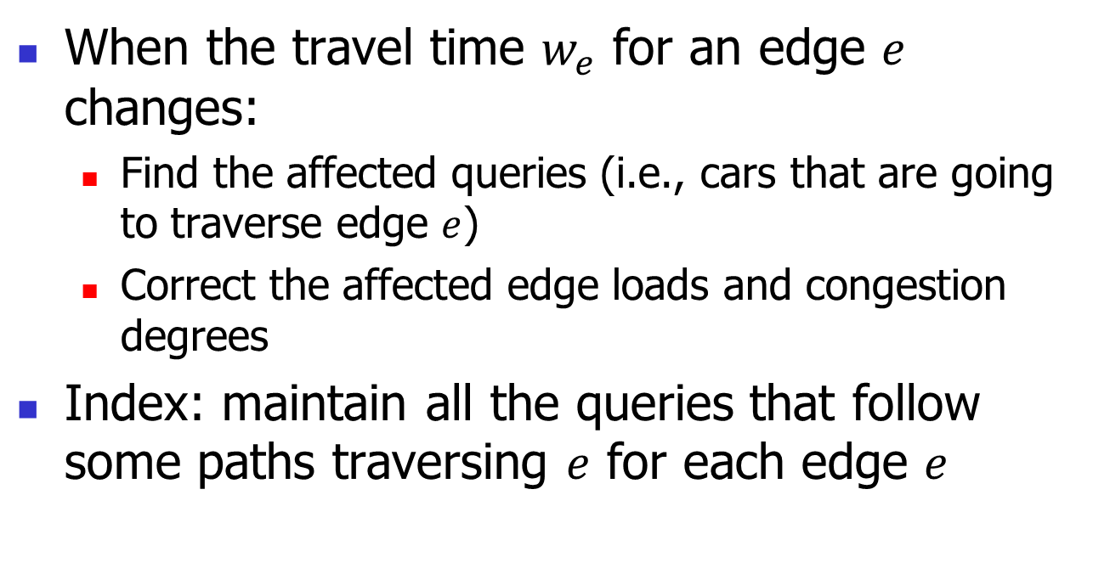
Dynamic Edge Weights
When the travel time $w_{e}$ for an edge $e$ changes:
  Find the affected queries (i.e., cars that are going to traverse edge $e$)
  Correct the affected edge loads and congestion degrees
Index: maintain all the queries that follow some paths traversing $e$ for each edge $e$

Slide 35
Outline
Motivation
Definition
Methodology
Experiments
Conclusion

Slide 36
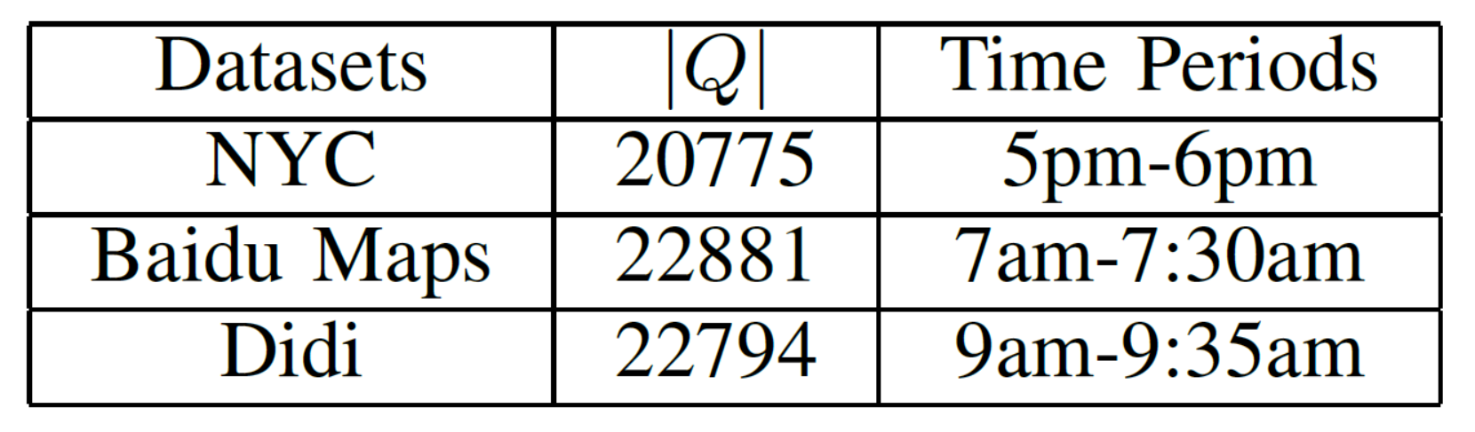
Experimental setting
Real Datasets:
  TLC Trip Record Data on NYC network
  Q-Traffic Data from Baidu Maps on Beijing network
  Didi Taxi Trip Data on Beijing network
Algorithms:
  SRH, SOR, ShortestPath (Dijkstra’s algorithm) [NM59], IPM (alternative paths) [EOR00], BR (entropy heuristics) [Ad Hoc Networks16], GRO (batch optimization) [ICDE23]
Notes:
For experiments, we use three real datasets. The first one is…
We compared our SRH and SOR with three algorithms. The first one is the representative for the alternative path IPM. It will produce alternative paths by applying a penalty weights on the edges used in some paths. BR is a state-of-the-art congestion avoidance strategy in transportation area. It collects the statistics about the edge loads and use some metric functions based on the entropy. Shortest path directly returns the shortest path by using the travel time as the edge weights.

Slide 37
Experimental results
Dataset: Baidu
SOR can reduce the load of baselines by 33% and SRH is the best one
SOR and SRH answer each routing query efficiently within 10 ms
Notes:
We have normalized the edge loads. If the edge load is one, it means that all the cars can have a free flow speed. If it is larger than one, it means that the number of cars on this edge exceeds its capacity. In the left figure, we can see that… In the right figure, we can see that

Slide 38
Load distribution
Dataset: NYC
Others can result in an edge load of 2 (or greater), which doubles the roads’ travel time
SRH and SOR make many edge-step pairs have smaller edge loads
Notes:
Here are two figures about the load distribution. In the left figure, we can find that… In the right figure, we can find that

Slide 39
Outline
Motivation
Definition
Methodology
Experiments
Conclusion

Slide 40
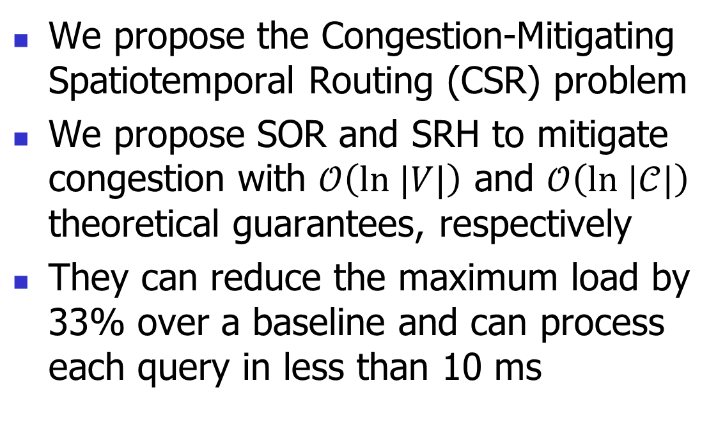
Conclusion
We propose the Congestion-Mitigating Spatiotemporal Routing (CSR) problem
We propose SOR and SRH to mitigate congestion with $𝒪\left(ln |V|\right)$ and $𝒪\left(ln |𝒞|\right)$ theoretical guarantees, respectively
They can reduce the maximum load by 33% over a baseline and can process each query in less than 10 ms

Slide 41
Q & A
Thank you for listening!

