Slide 1



Reverse Regret Query
Weicheng Wang (HKUST)
Raymond Chi-Wing Wong (HKUST)
H. V. Jagadish (University of Michigan)
Min Xie (Shenzhen Institute of Computing Sciences)
Notes:
Hello, everyone. I am xxx from Hong Kong university of science and technology.
To begin with, I would like to express my gratitude to XXX.
Thanks for their contribution to this work.

Slide 2
Outline
Introduction
Problem Definition
Algorithms
Experiments
Conclusion

Slide 3
Outline
Introduction
Problem Definition
Algorithms
Experiments
Conclusion

Slide 4


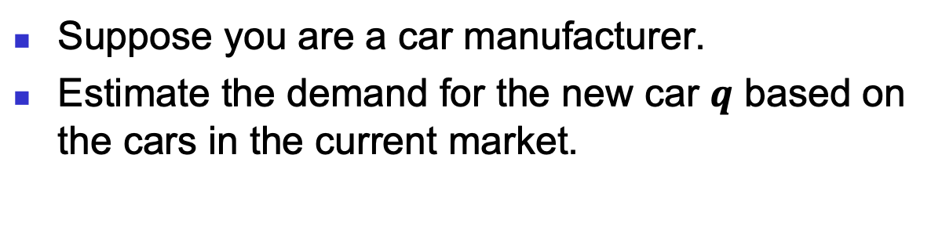
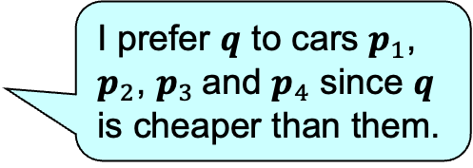
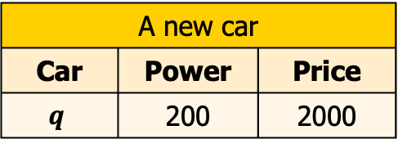
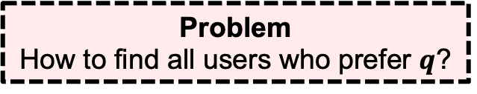
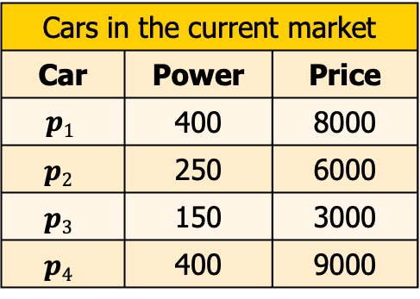
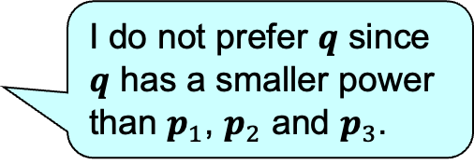
Introduction
Suppose you are a car manufacturer.
Estimate the demand for the new car $q$ based on the cars in the current market.
Cars in the current market
Car | Power | Price
$$p1$$ | 400 | 8000
$$p2$$ | 250 | 6000
$$p3$$ | 150 | 3000
$$p4$$ | 400 | 9000
I prefer 𝒒 to cars $p_{1}$, $p_{2}$, $p_{3}$and $p_{4}$ since 𝒒 is cheaper than them.
I do not prefer 𝒒 since 𝒒 has a smaller power than $p_{1}$, $p_{2}$ and $p_{3}$.
A new car
Car | Power | Price
$$q$$ | 200 | 2000
Problem
How to find all users who prefer $q$?
Notes:
Let me start with an example.
Suppose you are a car manufacturer, and you know the cars in the current market.
Now there is a new car
Obviously, the demand is based on the users' preference on this new car.
And, based on the cars in the current market, different users may have different preference on the new car
So the problem is how to find all users who prefer q.
to solve this problem,
we first need to define what is a user prefers a new car.

Slide 5
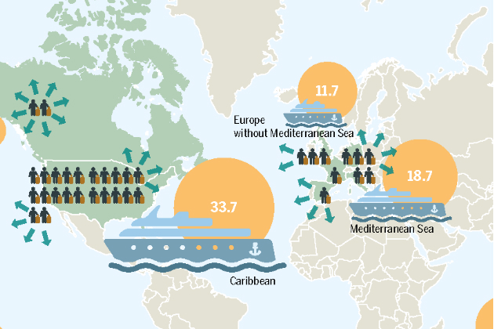
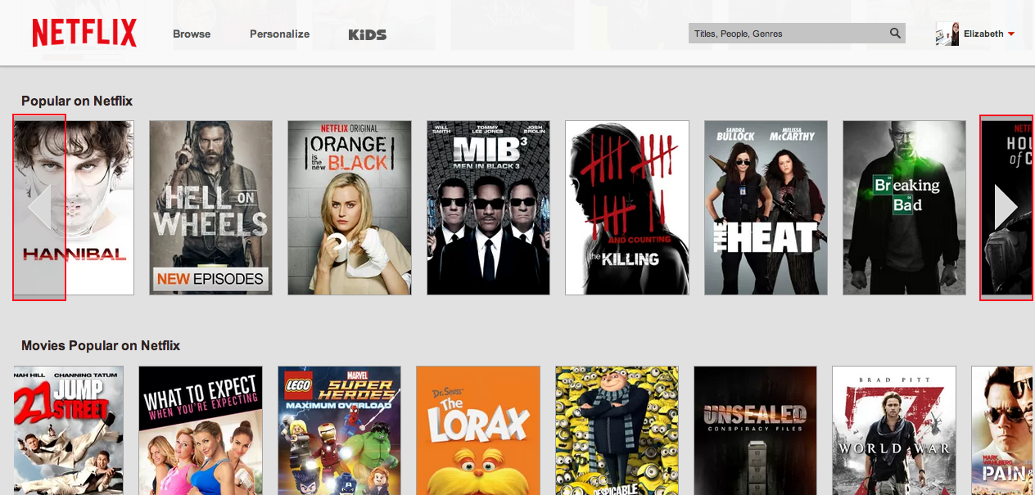
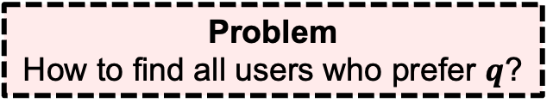


Introduction
Motivating examples
  Tourism: A tour operator wants to estimate the popularity of a new vacation package $q$based on the current existing vacation packages.
  Movie: A streaming provider expects to estimate viewership demand of a new movie $q$according to the current movies in the market.
Tourism
Movie
Problem
How to find all users who prefer $q$?
How to define “a user prefers $q$”?
Notes:
The forward version is to

Slide 6
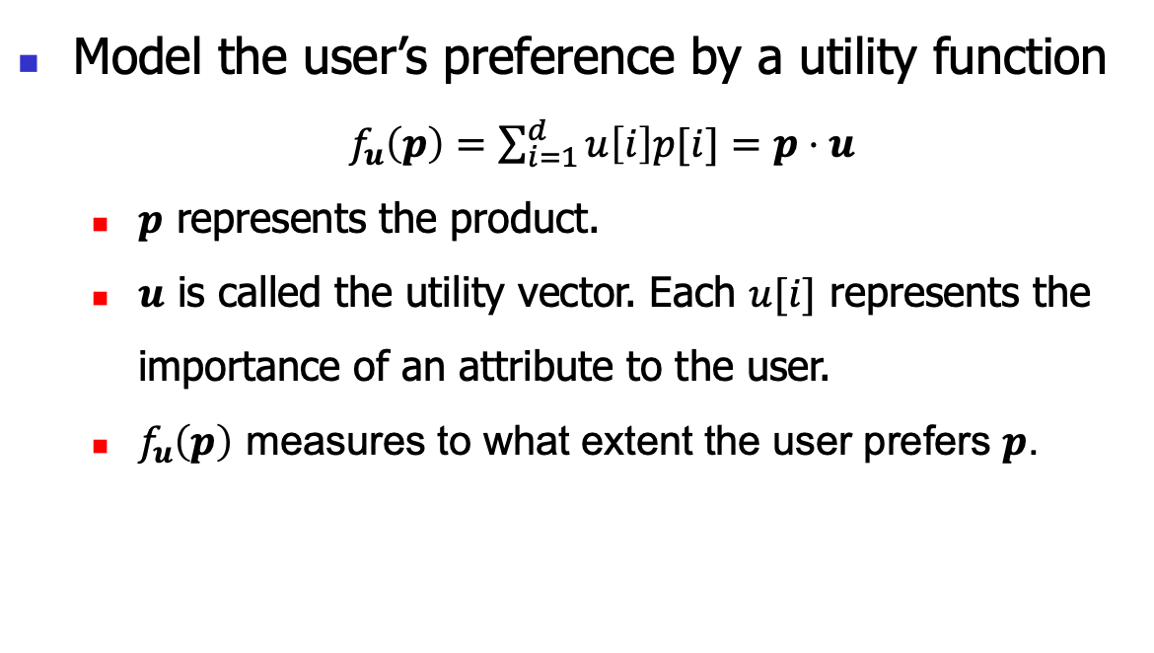
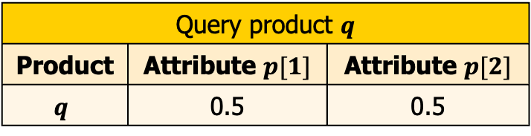
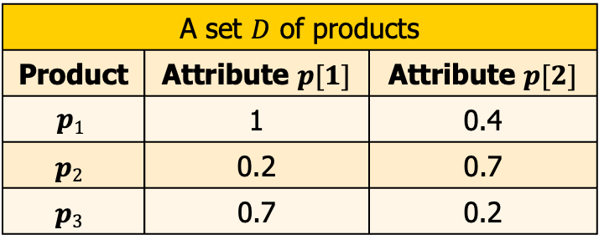
  Regret Ratio
A set $D$ of products
Product | Attribute $p[1]$ | Attribute $p[2]$
$$p1$$ | 1 | 0.4
$$p2$$ | 0.2 | 0.7
$$p3$$ | 0.7 | 0.2
Query product $q$
Product | Attribute $p[1]$ | Attribute $p[2]$
$$q$$ | 0.5 | 0.5
Model the user’s preference by a utility function
  $f_{u}\left(p\right)=\sum_{i=1}^{d}{u\left[i\right]p[i]}=p⋅u$
  $p$ represents the product.
  $u$ is called the utility vector. Each $u[i]$ represents the importance of an attribute to the user.
  $f_{u}\left(p\right)$ measures to what extent the user prefers $p$.
A higher score indicates the product is more preferred by the user.
Notes:
We utilize the concept called regret ratio.
Here is A set $D$ of products
which corresponds to the cars in the current market
Here is the query product which corresponds to the new car.

Slide 7

  Regret Ratio
A set $D$ of products
Product | Attribute $p[1]$ | Attribute $p[2]$
$$p1$$ | 1 | 0.4
$$p2$$ | 0.2 | 0.7
$$p3$$ | 0.7 | 0.2
Query product $q$
Product | Attribute $p[1]$ | Attribute $p[2]$
$$q$$ | 0.5 | 0.5
Model the user’s preference by a utility function
  $f_{u}\left(p\right)=\sum_{i=1}^{d}{u\left[i\right]p[i]}=p⋅u$
$$f_{u}\left(p\right)=0.5 × p\left[1\right]+0.5 × p\left[2\right] (u=\left(0.5, 0,5\right))$$
Notes:
We utilize the concept called regret ratio.
Here is A set $D$ of products in the market
Here is the query product in the market
The proportion of the score difference between $q$ and $p^{∗}$ to the score of $p^{∗}$, where $p^{∗}$ is the product with the highest score in $D$.

Slide 8
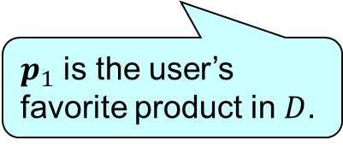
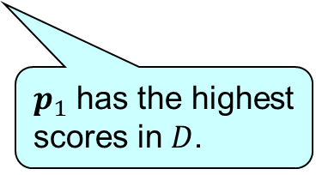
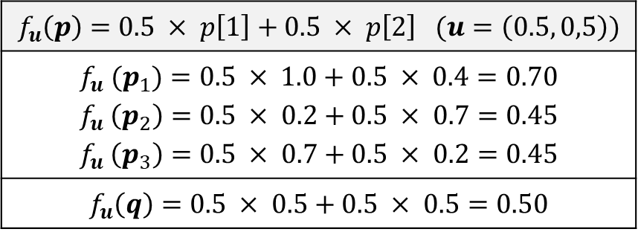
  Regret Ratio
A set $D$ of products
Product | Attribute $p[1]$ | Attribute $p[2]$
$$p1$$ | 1 | 0.4
$$p2$$ | 0.2 | 0.7
$$p3$$ | 0.7 | 0.2
Query product $q$
Product | Attribute $p[1]$ | Attribute $p[2]$
$$q$$ | 0.5 | 0.5
Model the user’s preference by a utility function
  $f_{u}\left(p\right)=\sum_{i=1}^{d}{u\left[i\right]p[i]}=p⋅u$
$$f_{u}\left(p\right)=0.5 × p\left[1\right]+0.5 × p\left[2\right] (u=\left(0.5, 0,5\right))$$
$$f_{u} (p_{1})=0.5 × 1.0+0.5 × 0.4=0.70$$ $$f_{u} \left(p_{2}\right)=0.5 × 0.2+0.5 × 0.7=0.45$$ $$f_{u} \left(p_{3}\right)=0.5 × 0.7+0.5 × 0.2=0.45$$
$$f_{u}\left(q\right)=0.5 × 0.5+0.5 × 0.5=0.50$$
$p_{1}$ has the highest scores in $D$.
$p_{1}$ is the user’s favorite product in $D$.
Notes:
We utilize the concept called regret ratio.
Here is A set $D$ of products in the market
Here is the query product
The proportion of the score difference between $q$ and $p^{∗}$ to the score of $p^{∗}$, where $p^{∗}$ is the product with the highest score in $D$.

Slide 9
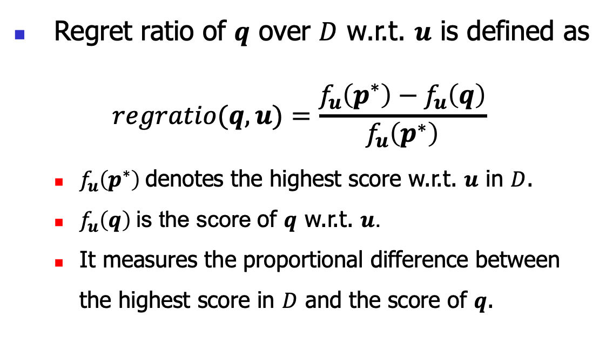
  Regret Ratio
A set $D$ of products
Product | Attribute $p[1]$ | Attribute $p[2]$
$$p1$$ | 1 | 0.4
$$p2$$ | 0.2 | 0.7
$$p3$$ | 0.7 | 0.2
Query product $q$
Product | Attribute $p[1]$ | Attribute $p[2]$
$$q$$ | 0.5 | 0.5
Regret ratio of $q$ over $D$ w.r.t. $u$ is defined as
$$regratio(q,u)=\frac{f_{u}\left(p^{∗}\right)−f_{u}\left(q\right)}{f_{u}\left(p^{∗}\right)}$$
  $f_{u}\left(p^{∗}\right)$denotes the highest score w.r.t. $u$ in $D$.
  $f_{u}\left(q\right)$is the score of $q$ w.r.t. $u$.
  It measures the proportional difference between the highest score in $D$ and the score of $q$.
Notes:
We define the regret ratio of the query product as follows.
Intuitively,
The proportion of the score difference between $q$ and $p^{∗}$ to the score of $p^{∗}$

Slide 10
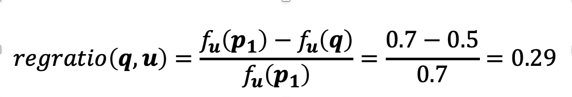
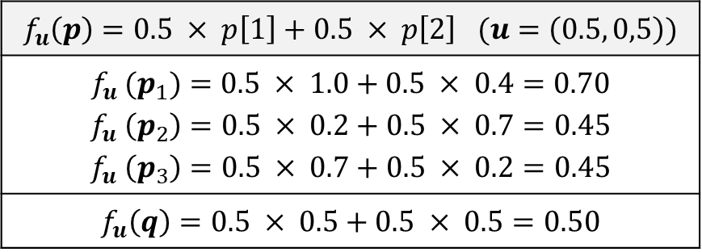
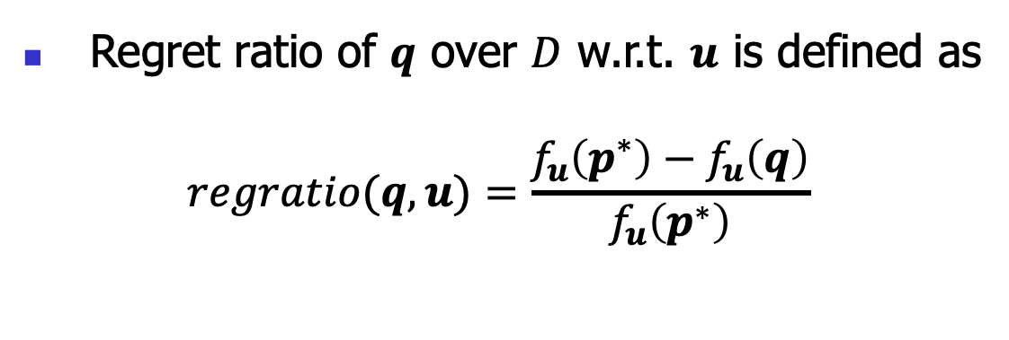
  Regret Ratio
A set $D$ of products
Product | Attribute $p[1]$ | Attribute $p[2]$
$$p1$$ | 1 | 0.4
$$p2$$ | 0.2 | 0.7
$$p3$$ | 0.7 | 0.2
Query product $q$
Product | Attribute $p[1]$ | Attribute $p[2]$
$$q$$ | 0.5 | 0.5
Regret ratio of $q$ over $D$ w.r.t. $u$ is defined as
$$regratio(q,u)=\frac{f_{u}\left(p^{∗}\right)−f_{u}\left(q\right)}{f_{u}\left(p^{∗}\right)}$$
$$f_{u}\left(p\right)=0.5 × p\left[1\right]+0.5 × p\left[2\right] (u=\left(0.5, 0,5\right))$$
$$f_{u} (p_{1})=0.5 × 1.0+0.5 × 0.4=0.70$$ $$f_{u} \left(p_{2}\right)=0.5 × 0.2+0.5 × 0.7=0.45$$ $$f_{u} \left(p_{3}\right)=0.5 × 0.7+0.5 × 0.2=0.45$$
$$f_{u}\left(q\right)=0.5 × 0.5+0.5 × 0.5=0.50$$
Notes:
Continue our example.

Slide 11


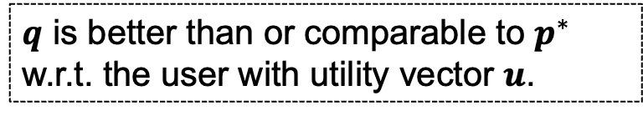

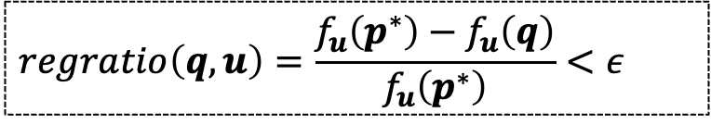

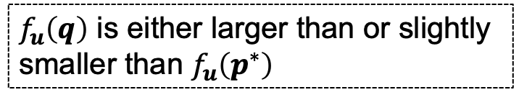

  Regret Ratio
A set $D$ of products
Product | Attribute $p[1]$ | Attribute $p[2]$
$$p1$$ | 1 | 0.4
$$p2$$ | 0.2 | 0.7
$$p3$$ | 0.7 | 0.2
Query product $q$
Product | Attribute $p[1]$ | Attribute $p[2]$
$$q$$ | 0.5 | 0.5
Consider a user with utility vector $u$
$$regratio\left(q,u\right)=\frac{f_{u}\left(p^{∗}\right)−f_{u}\left(q\right)}{f_{u}\left(p^{∗}\right)}<ε$$
$ε$ is a given threshold.
$$f_{u}\left(p^{∗}\right)−f_{u}\left(q\right)<εf_{u}\left(p^{∗}\right)$$
${(1−ε)f}_{u}\left(p^{∗}\right)<f_{u}\left(q\right)$
$f_{u}\left(q\right)$ is either larger than or slightly smaller than $f_{u}\left(p^{∗}\right)$
$q$ is better than or comparable to $p^{∗}$ w.r.t. the user with utility vector $u$.
The user’s favorite product.
The user with utility vector $u$ prefers $q$.
Notes:
Now consider a user with a utility function
Now suppose the regret ratio is smaller than a given threshold
Let us derive this inquality.
First we move the denominator to the right hand side.
Then, let's put the highest score in the product set on the left hand side.
And the score of q on the right hand side.
to the user's favorite product in the set
So this is the way we define a user prefers the query product

Slide 12
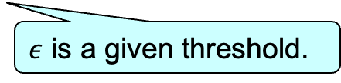
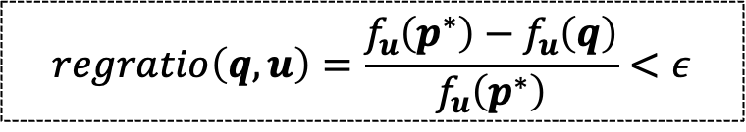

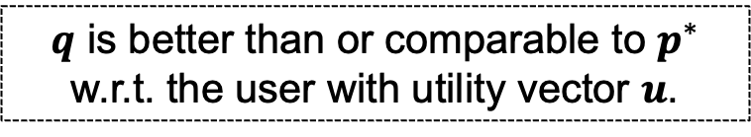
  Regret Ratio
A set $D$ of products
Product | Attribute $p[1]$ | Attribute $p[2]$
$$p1$$ | 1 | 0.4
$$p2$$ | 0.2 | 0.7
$$p3$$ | 0.7 | 0.2
Query product $q$
Product | Attribute $p[1]$ | Attribute $p[2]$
$$q$$ | 0.5 | 0.5
Consider a user with utility vector $u$
$$regratio\left(q,u\right)=\frac{f_{u}\left(p^{∗}\right)−f_{u}\left(q\right)}{f_{u}\left(p^{∗}\right)}<ε$$
$ε$ is a given threshold.
$q$ is better than or comparable to $p^{∗}$ w.r.t. the user with utility vector $u$.
The user’s favorite product.
The user with utility vector $u$ prefers $q$.
Notes:
$f_{u}\left(q\right)$ is either larger than or slightly smaller than $f_{u}\left(p^{∗}\right)$

Slide 13
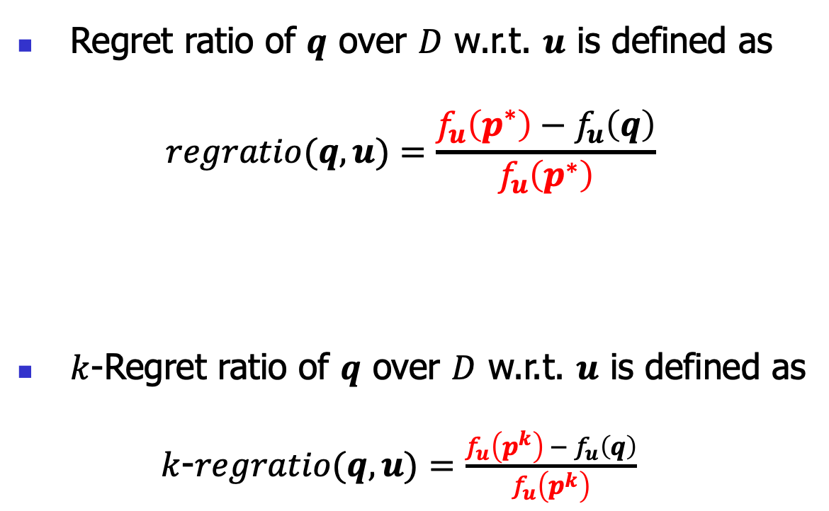
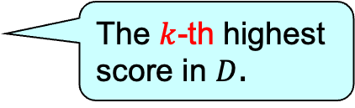

  Regret Ratio
A set $D$ of products
Product | Attribute $p[1]$ | Attribute $p[2]$
$$p1$$ | 1 | 0.4
$$p2$$ | 0.2 | 0.7
$$p3$$ | 0.7 | 0.2
Query product $q$
Product | Attribute $p[1]$ | Attribute $p[2]$
$$q$$ | 0.5 | 0.5
Regret ratio of $q$ over $D$ w.r.t. $u$ is defined as
$$regratio(q,u)=\frac{f_{u}\left(p^{∗}\right)−f_{u}\left(q\right)}{f_{u}\left(p^{∗}\right)}$$
$k$-Regret ratio of $q$ over $D$ w.r.t. $u$ is defined as
$k$-$regratio(q,u)=\frac{f_{u}\left(p^{k}\right) − f_{u}\left(q\right)}{f_{u}\left(p^{k}\right)}$
The highest score in $D$
To broaden our setting and accommodate various scenarios
The $k$-th highest score in $D$.
Notes:
We use the highest score in D as the pivot for comparison
We also extend the pivot from the highest score to the k-th highest score
This is called the k regret ratio.

Slide 14
Outline
Introduction
Problem Definition
Algorithms
Experiments
Conclusion
Notes:
Based on the k regret ratio, we can formally define our problem.

Slide 15
Problem Definition
(Reverse Regret Query)
Notes:
For the multi-criteria decision-making problem, it has two versions

Slide 16

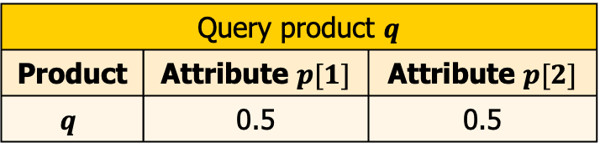
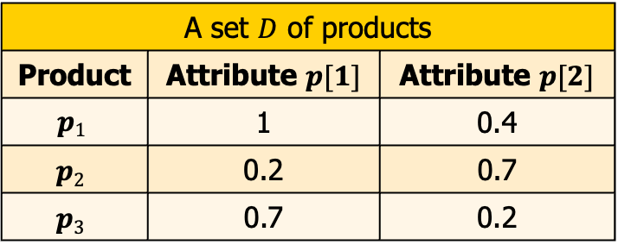
Problem Definition
(Reverse Regret Query) Given a product set $D$, a query product $q$,
A set $D$ of products
Product | Attribute $p[1]$ | Attribute $p[2]$
$$p1$$ | 1 | 0.4
$$p2$$ | 0.2 | 0.7
$$p3$$ | 0.7 | 0.2
Query product $q$
Product | Attribute $p[1]$ | Attribute $p[2]$
$$q$$ | 0.5 | 0.5
Notes:
For the multi-criteria decision-making problem, it has two versions

Slide 17

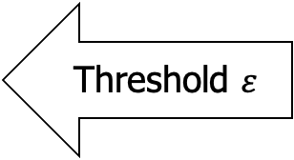
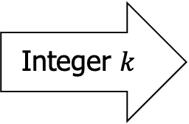
Problem Definition
(Reverse Regret Query) Given a product set $D$, a query product $q$, an integer $k$, and a threshold $ε$,
A set $D$ of products
Product | Attribute $p[1]$ | Attribute $p[2]$
$$p1$$ | 1 | 0.4
$$p2$$ | 0.2 | 0.7
$$p3$$ | 0.7 | 0.2
Query product $q$
Product | Attribute $p[1]$ | Attribute $p[2]$
$$q$$ | 0.5 | 0.5
Threshold $ε$
Integer $k$
Notes:
For the multi-criteria decision-making problem, it has two versions

Slide 18


Problem Definition
(Reverse Regret Query) Given a product set $D$, a query product $q$, an integer $k$, and a threshold $ε$, we want to find all utility vectors $u$ such that $k$-$regratio\left(q,u\right)<ε$.
A set $D$ of products
Product | Attribute $p[1]$ | Attribute $p[2]$
$$p1$$ | 1 | 0.4
$$p2$$ | 0.2 | 0.7
$$p3$$ | 0.7 | 0.2
Query product $q$
Product | Attribute $p[1]$ | Attribute $p[2]$
$$q$$ | 0.5 | 0.5
Threshold $ε$
Integer $k$
$$\text{All} u \text{such} \text{that} k\text{−}regratio\left(q,u\right)<ε$$
Notes:
For the multi-criteria decision-making problem, it has two versions

Slide 19
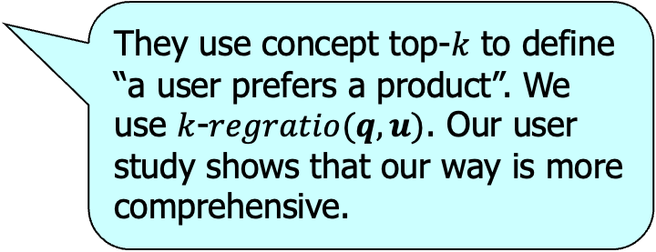
Problem Definition
Related Work
  Regret minimization query
    VLDB 2010
    SIGMOD 2018
  Reverse top-k query
    ICDE 2010
    SIGMOD 2013
    SIGMOD 2017
They find products which may be of interest to a user. We find users which may be interested in a product.
They use concept top-$k$ to define “a user prefers a product”. We use $k$-$regratio(q,u)$. Our user study shows that our way is more comprehensive.
Notes:
in contrast,

Slide 20
Problem Definition
Contribution
  We propose problem Reverse Regret Query
  We propose algorithms
    Sweeping (for a special case)
    E-PT (for the general case)
    A-PC (for the general case)
  We conduct experiments to show that our algorithms are better than the best-known existing ones.
Notes:
in contrast,

Slide 21
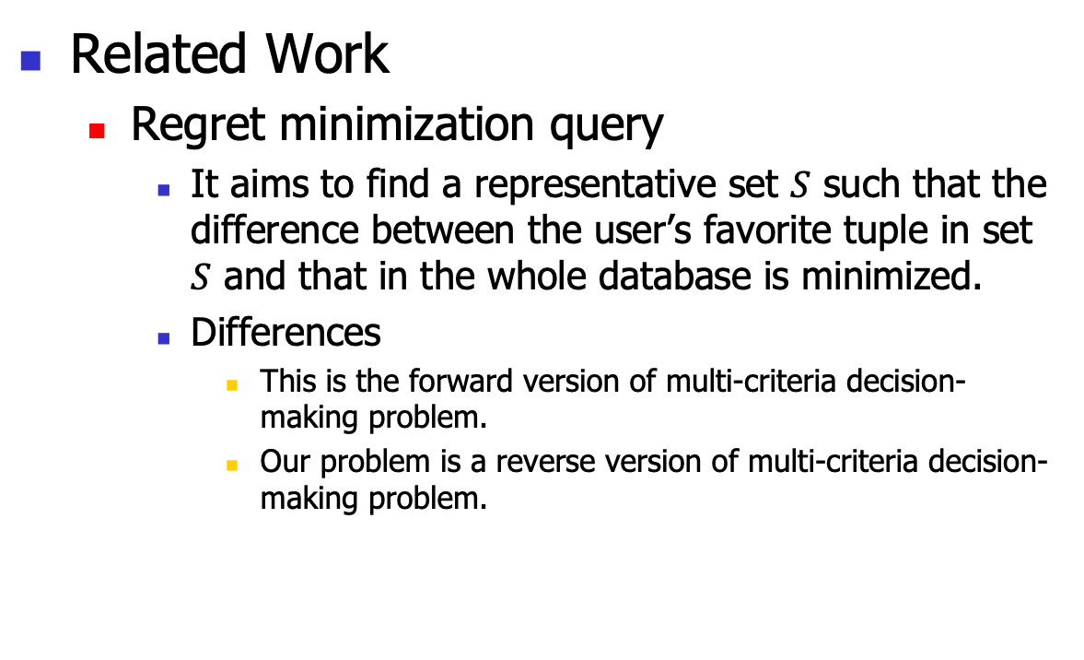
Problem Definition
Related Work
  Regret minimization query
    It aims to find a representative set $S$ such that the difference between the user’s favorite tuple in set $S$ and that in the whole database is minimized.
    Differences
      This is the forward version of multi-criteria decision-making problem.
      Our problem is a reverse version of multi-criteria decision-making problem.
Notes:
in constrast,

Slide 22
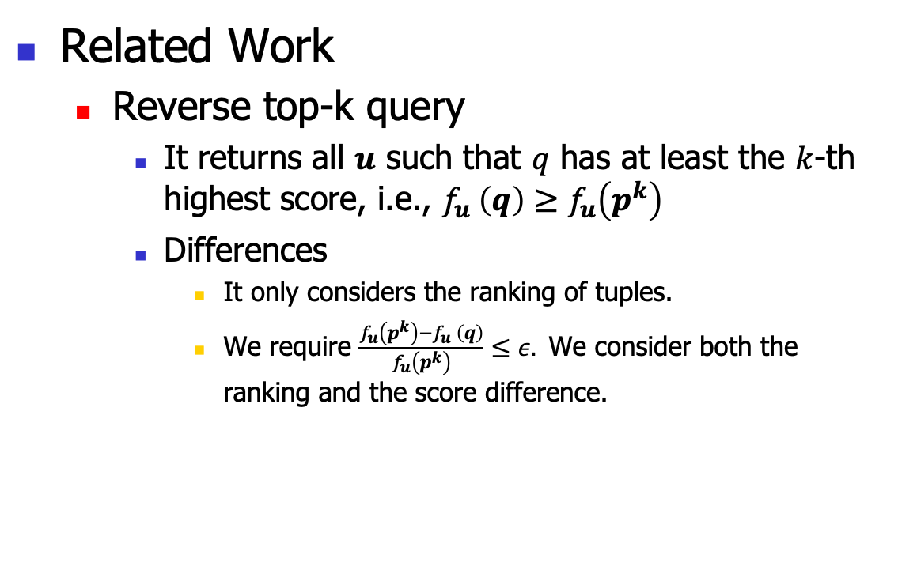
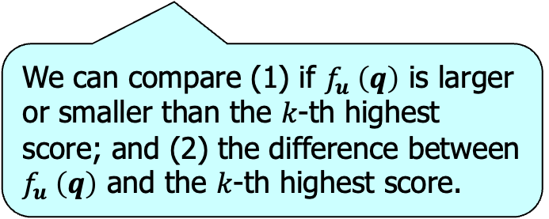
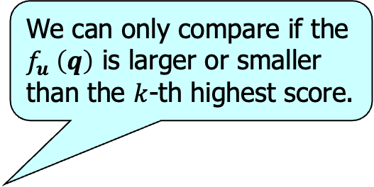
Problem Definition
We can only compare if the $f_{u} \left(q\right)$ is larger or smaller than the $k$-th highest score.
Related Work
  Reverse top-k query
    It returns all $u$ such that $q$ has at least the $k$-th highest score, i.e., $f_{u} \left(q\right)≥f_{u}\left(p^{k}\right)$
    Differences
      It only considers the ranking of tuples.
      We require $\frac{f_{u}\left(p^{k}\right)−f_{u} \left(q\right)}{f_{u}\left(p^{k}\right)}≤ε.$ We consider both the ranking and the score difference.
We can compare (1) if $f_{u} \left(q\right)$ is larger or smaller than the $k$-th highest score; and (2) the difference between $f_{u} \left(q\right)$ and the $k$-th highest score.
Notes:
in constrast,

Slide 23
Outline
Introduction
Problem Definition
Algorithms
Experiments
Conclusion

Slide 24

Algorithms
Special case: (two attributes)
  Algorithm Sweeping.
General case: ($d≥2$ attributes)
  Algorithm E-PT.
  Algorithm A-PC.
Notes:
We proposed several algorithms
We study our problem progressively.
First, we look in a special case
Then we consider the general case

Slide 25

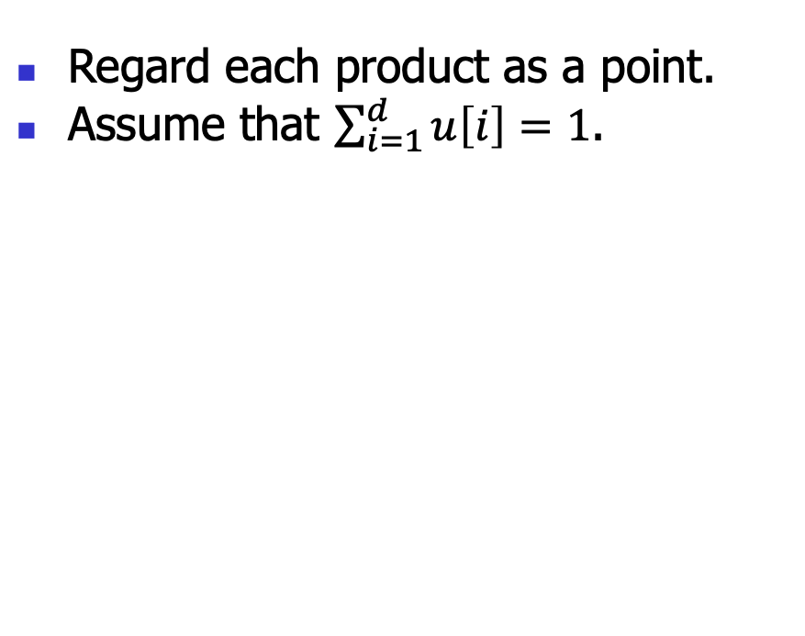


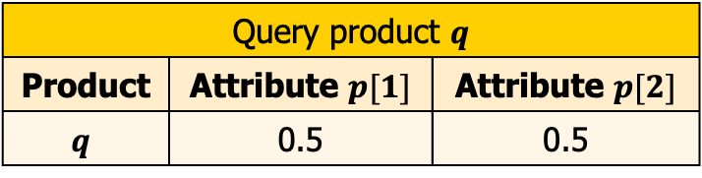

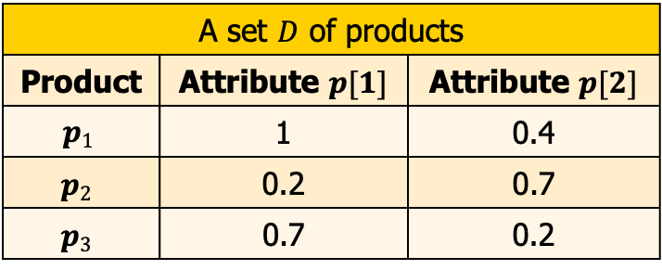


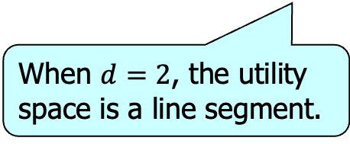
Intuition
A set $D$ of products
Product | Attribute $p[1]$ | Attribute $p[2]$
$$p1$$ | 1 | 0.4
$$p2$$ | 0.2 | 0.7
$$p3$$ | 0.7 | 0.2
Query product $q$
Product | Attribute $p[1]$ | Attribute $p[2]$
$$q$$ | 0.5 | 0.5
Regard each product as a point.
Assume that $\sum_{i=1}^{d}{u\left[i\right]=1}$.
We call the domain of the utility vector the utility space.
$$X_{1}$$
The utility space is a polyhedron.
$$p_{2}$$
$$q$$
$$p_{3}$$
$$p_{1}$$
$$X_{2}$$
When $d=2$, the utility space is a line segment.
Notes:
Due to the time limitation, I will only show the intuition of all the algorithms.
All the tuples can be represented as a point in the d-dimensional space.

Slide 26



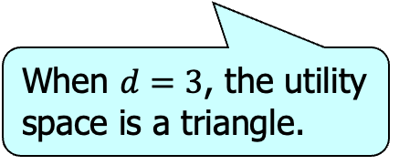
Intuition
A set $D$ of products
Product | Attribute $p[1]$ | Attribute $p[2]$
$$p1$$ | 1 | 0.4
$$p2$$ | 0.2 | 0.7
$$p3$$ | 0.7 | 0.2
Query product $q$
Product | Attribute $p[1]$ | Attribute $p[2]$
$$q$$ | 0.5 | 0.5
Regard each product as a point.
Assume that $\sum_{i=1}^{d}{u\left[i\right]=1}$.
We call the domain of the utility vector the utility space.
$$X_{3}$$
The utility space is a polyhedron.
Problem
How to find all qualified utility vectors in the utility space?
$$X_{1}$$
$$X_{2}$$
When $d=3$, the utility space is a triangle.
Notes:
Due to the time limitation, I will only show the intuition of all the algorithms.
All the tuples can be represented as a point in the d-dimensional space.

Slide 27
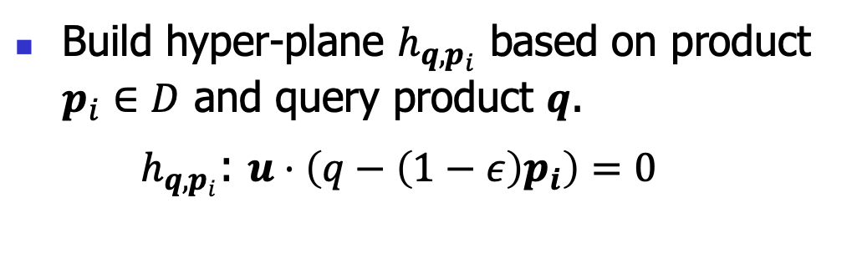
Intuition
A set $D$ of products
Product | Attribute $p[1]$ | Attribute $p[2]$
$$p1$$ | 1 | 0.4
$$p2$$ | 0.2 | 0.7
$$p3$$ | 0.7 | 0.2
Query product $q$
Product | Attribute $p[1]$ | Attribute $p[2]$
$$q$$ | 0.5 | 0.5
Build hyper-plane $h_{q, p_{i}}$ based on product $p_{i}∈D$ and query product $q$.
$h_{q, p_{i}}$: $u⋅\left(q−\left(1−ε\right)p_{i}\right)=0$
$$X_{1}$$
$$p_{2}$$
$$q$$
$$p_{3}$$
$$p_{1}$$
$$X_{2}$$
Notes:
Now the problem is how to find the qualified utility vectors in the utility space.

Slide 28

Intuition
A set $D$ of products
Product | Attribute $p[1]$ | Attribute $p[2]$
$$p1$$ | 1 | 0.4
$$p2$$ | 0.2 | 0.7
$$p3$$ | 0.7 | 0.2
Query product $q$
Product | Attribute $p[1]$ | Attribute $p[2]$
$$q$$ | 0.5 | 0.5
Build hyper-plane $h_{q, p_{i}}$ based on product $p_{i}∈D$ and query product $q$.
$h_{q, p_{i}}$: $u⋅\left(q−\left(1−ε\right)p_{i}\right)=0$
$$h_{q,p_{2}}$$
$$X_{1}$$
$$p_{2}$$
$$q$$
$$X_{2}$$
Notes:
It divides the utility space into two half-spaces

Slide 29
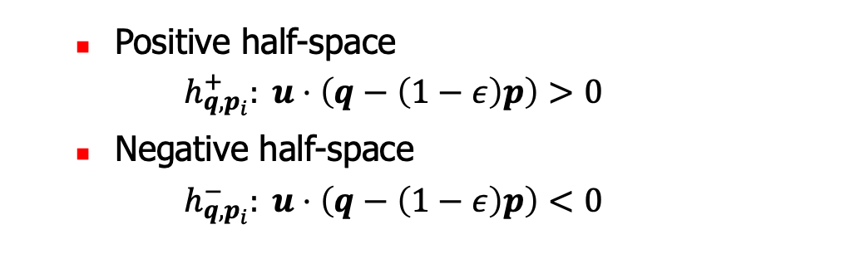


Intuition
A set $D$ of products
Product | Attribute $p[1]$ | Attribute $p[2]$
$$p1$$ | 1 | 0.4
$$p2$$ | 0.2 | 0.7
$$p3$$ | 0.7 | 0.2
Query product $q$
Product | Attribute $p[1]$ | Attribute $p[2]$
$$q$$ | 0.5 | 0.5
Build hyper-plane $h_{q, p_{i}}$ based on product $p_{i}∈D$ and query product $q$.
$h_{q, p_{i}}$: $u⋅\left(q−\left(1−ε\right)p_{i}\right)=0$
The norm towards the positive half-space.
$$h_{q,p_{2}}$$
$$h_{q,p_{2}}^{−}$$
$$X_{1}$$
  Positive half-space
  $$h_{q, p_{i}}^{+}: u⋅\left(q−\left(1−ε\right)p\right)>0$$
  Negative half-space
  $$h_{q, p_{i}}^{−}: u⋅\left(q−\left(1−ε\right)p\right)<0$$
$$p_{2}$$
$$h_{q,p_{2}}^{+}$$
$$q$$
$$X_{2}$$
Notes:
It divides the utility space into two half-spaces
the formular of the positive half-space is associated with the
Greater-than symbol
smaller-than symbol

Slide 30



Intuition
A set $D$ of products
Product | Attribute $p[1]$ | Attribute $p[2]$
$$p1$$ | 1 | 0.4
$$p2$$ | 0.2 | 0.7
$$p3$$ | 0.7 | 0.2
Query product $q$
Product | Attribute $p[1]$ | Attribute $p[2]$
$$q$$ | 0.5 | 0.5
Build a hyper-plane $h_{q, p_{i}}$ based on each product $p_{i}∈D$ and query product $q$.
$$X_{1}$$
$$X_{2}$$
Notes:
We can slightly derive this formula
It means that the score of q is larger or slightly smaller than the k-th highest score
It means that the score of q is much smaller than the k-th highest score

Slide 31









Intuition
A set $D$ of products
Product | Attribute $p[1]$ | Attribute $p[2]$
$$p1$$ | 1 | 0.4
$$p2$$ | 0.2 | 0.7
$$p3$$ | 0.7 | 0.2
Query product $q$
Product | Attribute $p[1]$ | Attribute $p[2]$
$$q$$ | 0.5 | 0.5
Build a hyper-plane $h_{q, p_{i}}$ based on each product $p_{i}∈D$ and query product $q$.
All hyper-planes divide the utility space into partitions.
  Each partition is covered by some positive and negative half-spaces.
$$h_{q,p_{1}}$$
$$h_{q,p_{2}}$$
$$X_{1}$$
$$h_{q,p_{3}}$$
$$c_{1}$$
$$c_{2}$$
$$c_{3}$$
Partition | Covering half-spaces
$$c_{1}$$ | $h_{q, p_{1}}^{+}$, $h_{q, p_{2}}^{−}$, $h_{q, p_{3}}^{+}$
$$c_{4}$$
$$X_{2}$$
The norm towards the positive half-space.
Notes:
We can slightly derive this formula
There is a norm not towards the parittion

Slide 32

Intuition
A set $D$ of products
Product | Attribute $p[1]$ | Attribute $p[2]$
$$p1$$ | 1 | 0.4
$$p2$$ | 0.2 | 0.7
$$p3$$ | 0.7 | 0.2
Query product $q$
Product | Attribute $p[1]$ | Attribute $p[2]$
$$q$$ | 0.5 | 0.5
Build a hyper-plane $h_{q, p_{i}}$ based on each product $p_{i}∈D$ and query product $q$.
All hyper-planes divide the utility space into partitions.
  Each partition is covered by some positive and negative half-spaces.
$$h_{q,p_{1}}$$
$$h_{q,p_{2}}$$
$$X_{1}$$
$$h_{q,p_{3}}$$
$$c_{1}$$
$$c_{2}$$
$$c_{3}$$
Partition | Covering half-spaces
$$c_{1}$$ | $h_{q, p_{1}}^{+}$, $h_{q, p_{2}}^{−}$, $h_{q, p_{3}}^{+}$
$$c_{2}$$ | $h_{q, p_{1}}^{−}$, $h_{q, p_{2}}^{−}$, $h_{q, p_{3}}^{+}$
$$c_{3}$$ | $h_{q, p_{1}}^{−}$, $h_{q, p_{2}}^{+}$, $h_{q, p_{3}}^{+}$
$$c_{4}$$ | $h_{q, p_{1}}^{−}$, $h_{q, p_{2}}^{+}$, $h_{q, p_{3}}^{−}$
$$c_{4}$$
$$X_{2}$$
The norm towards the positive half-space.
Notes:
We can slightly derive this formula
It means that the score of q is larger or slightly smaller than the k-th highest score
It means that the score of q is much smaller than the k-th highest score

Slide 33






Intuition
A set $D$ of products
Product | Attribute $p[1]$ | Attribute $p[2]$
$$p1$$ | 1 | 0.4
$$p2$$ | 0.2 | 0.7
$$p3$$ | 0.7 | 0.2
Query product $q$
Product | Attribute $p[1]$ | Attribute $p[2]$
$$q$$ | 0.5 | 0.5
  $$h_{q, p_{i}}^{−}: u⋅\left(q−\left(1−ε\right)p_{i}\right)<0$$
Find all partitions that are covered by $<k$ negative half-spaces.
  $u⋅\left(q−p_{i}\right)<−u⋅εp_{i}$
Suppose a partition $c$ is covered by $<k$ negative half-spaces $h_{q, p_{i}}^{−}$
  $\frac{f_{u}\left(p_{i}\right)−f_{u}\left(q\right)}{f_{u}\left(p_{i}\right)}>ϵ$
$$p^{1}$$
$$…$$
$$p^{s}$$
..
$$p^{k}$$
$$p^{k+1}$$
…
$∀u∈c$, there are $<k$ products $p_{i}∈D$ such that $\frac{f_{u}\left(p_{i}\right)−f_{u}\left(q\right)}{f_{u}\left(p_{i}\right)}>ϵ$
$∀u∈c$, $\frac{f_{u}\left(p^{k}\right)−f_{u}\left(q\right)}{f_{u}\left(p^{k}\right)}<ϵ$, where ${f_{u}(p}^{k})$ is the $k$-th highest score in $D$
$∀u∈c$, $k$-$regratio\left(q,u\right)<ε$
Notes:
Wait a second, what does the negative half-space tell?
Here is the definition of the negative half-space.
Let us slightly derive this formula
move the term with epsilon to the right hand side
Let the right hand side with epsilon only
Propotional difference
because of this, our goal becomes to find

Slide 34



Intuition
A set $D$ of products
Product | Attribute $p[1]$ | Attribute $p[2]$
$$p1$$ | 1 | 0.4
$$p2$$ | 0.2 | 0.7
$$p3$$ | 0.7 | 0.2
Query product $q$
Product | Attribute $p[1]$ | Attribute $p[2]$
$$q$$ | 0.5 | 0.5
Lemma
Suppose a partition $c$ is covered by $<k$ negative half-spaces $h_{q, p_{i}}^{−}$.
$∀u∈c$, $k$-$regratio\left(q,u\right)<ε$
Find all partitions that are covered by $<k$ negative half-spaces.
Notes:
Here is a lemma based on the partitions and half-spaces.

Slide 35


Intuition
A set $D$ of products
Product | Attribute $p[1]$ | Attribute $p[2]$
$$p1$$ | 1 | 0.4
$$p2$$ | 0.2 | 0.7
$$p3$$ | 0.7 | 0.2
Query product $q$
Product | Attribute $p[1]$ | Attribute $p[2]$
$$q$$ | 0.5 | 0.5
Find all partitions that are covered by $<k$ negative half-spaces.
Partition | Covering half-spaces
$$c_{1}$$ | $h_{q, p_{1}}^{+}$, $h_{q, p_{2}}^{−}$, $h_{q, p_{3}}^{+}$
$$c_{2}$$ | $h_{q, p_{1}}^{−}$, $h_{q, p_{2}}^{−}$, $h_{q, p_{3}}^{+}$
$$c_{3}$$ | $h_{q, p_{1}}^{−}$, $h_{q, p_{2}}^{+}$, $h_{q, p_{3}}^{+}$
$$c_{4}$$ | $h_{q, p_{1}}^{−}$, $h_{q, p_{2}}^{+}$, $h_{q, p_{3}}^{−}$
$$h_{q,p_{1}}$$
$$h_{q,p_{2}}$$
$$X_{1}$$
$$h_{q,p_{3}}$$
$$c_{1}$$
$$c_{2}$$
$$c_{3}$$
$$c_{4}$$
$$X_{2}$$
Notes:
We can slightly derive this formula
It means that the score of q is larger or slightly smaller than the k-th highest score
It means that the score of q is much smaller than the k-th highest score

Slide 36



Intuition
A set $D$ of products
Product | Attribute $p[1]$ | Attribute $p[2]$
$$p1$$ | 1 | 0.4
$$p2$$ | 0.2 | 0.7
$$p3$$ | 0.7 | 0.2
Query product $q$
Product | Attribute $p[1]$ | Attribute $p[2]$
$$q$$ | 0.5 | 0.5
Find all partitions that are covered by $<k$ negative half-spaces.
Suppose $k=2$
Partition | Covering half-spaces | # of negative half-spaces
$$c_{1}$$ | $h_{q, p_{1}}^{+}$, $h_{q, p_{2}}^{−}$, $h_{q, p_{3}}^{+}$ | 1
$$c_{2}$$ | $h_{q, p_{1}}^{−}$, $h_{q, p_{2}}^{−}$, $h_{q, p_{3}}^{+}$ | 2
$$c_{3}$$ | $h_{q, p_{1}}^{−}$, $h_{q, p_{2}}^{+}$, $h_{q, p_{3}}^{+}$ | 1
$$c_{4}$$ | $h_{q, p_{1}}^{−}$, $h_{q, p_{2}}^{+}$, $h_{q, p_{3}}^{−}$ | 2
$$h_{q,p_{1}}$$
$$h_{q,p_{2}}$$
$$X_{1}$$
$$h_{q,p_{3}}$$
$$c_{1}$$
$$c_{2}$$
$$c_{3}$$
$$c_{4}$$
$$X_{2}$$
Each returned partition contains all possible utility functions based on which $k$-$regratio\left(q,u\right)<ε$.
Notes:
We can slightly derive this formula
It means that the score of q is larger or slightly smaller than the k-th highest score
It means that the score of q is much smaller than the k-th highest score

Slide 37

Algorithms
Special case: (two attributes)
  Algorithm Sweeping. It is an exact algorithm with linear time cost.
General case: ($d≥2$ attributes)
  Algorithm E-PT. It is an exact algorithm that returns all qualified utility vectors.
  Algorithm A-PC. It is an approximate algorithm that may miss some qualified utility vectors but runs faster than E-PT. It guarantees to find qualified utility vectors with certain confidence.
Notes:
We proposed several algorithms
We study our problem progressively.
First, we look in a special case
Then we consider the general case

Slide 38
  Algorithm E-PT
Major Idea
  Build a P-Tree to index the partitions in the utility space.
  Find qualified partitions based on the leaves

Slide 39


  Algorithm E-PT
A set $D$ of products
Product | Attribute $p[1]$ | Attribute $p[2]$
$$p1$$ | 1 | 0.4
$$p2$$ | 0.2 | 0.7
$$p3$$ | 0.7 | 0.2
Query product $q$
Product | Attribute $p[1]$ | Attribute $p[2]$
$$q$$ | 0.5 | 0.5
For each product $p∈D$
  A hyper-plane $h_{q, p_{i}}$ is build and divides the utility space.
$$h_{q,p_{1}}$$
$$X_{1}$$
Root
$$X_{2}$$

Slide 40




  Algorithm E-PT
A set $D$ of products
Product | Attribute $p[1]$ | Attribute $p[2]$
$$p1$$ | 1 | 0.4
$$p2$$ | 0.2 | 0.7
$$p3$$ | 0.7 | 0.2
Query product $q$
Product | Attribute $p[1]$ | Attribute $p[2]$
$$q$$ | 0.5 | 0.5
For each product $p∈D$
  A hyper-plane $h_{q, p_{i}}$ is build and divides the utility space.
  Update P-tree based on the partitions.
$$h_{q,p_{1}}$$
$$h_{q,p_{2}}$$
$$X_{1}$$
Root
$$h_{q, p_{1}}^{+}$$
$$h_{q, p_{1}}^{−}$$
$$X_{2}$$

Slide 41

  Algorithm E-PT
A set $D$ of products
Product | Attribute $p[1]$ | Attribute $p[2]$
$$p1$$ | 1 | 0.4
$$p2$$ | 0.2 | 0.7
$$p3$$ | 0.7 | 0.2
Query product $q$
Product | Attribute $p[1]$ | Attribute $p[2]$
$$q$$ | 0.5 | 0.5
For each product $p∈D$
  A hyper-plane $h_{q, p_{i}}$ is build and divides the utility space.
  Update P-tree based on the partitions.
$$h_{q,p_{1}}$$
$$h_{q,p_{2}}$$
$$X_{1}$$
Root
$$h_{q, p_{1}}^{+}∩h_{q, p_{2}}^{−}$$
$$h_{q, p_{1}}^{−}$$
$$X_{2}$$

Slide 42
  Algorithm E-PT
A set $D$ of products
Product | Attribute $p[1]$ | Attribute $p[2]$
$$p1$$ | 1 | 0.4
$$p2$$ | 0.2 | 0.7
$$p3$$ | 0.7 | 0.2
Query product $q$
Product | Attribute $p[1]$ | Attribute $p[2]$
$$q$$ | 0.5 | 0.5
For each product $p∈D$
  A hyper-plane $h_{q, p_{i}}$ is build and divides the utility space.
  Update P-tree based on the partitions.
$$h_{q,p_{1}}$$
$$h_{q,p_{2}}$$
$$X_{1}$$
Root
$$h_{q, p_{1}}^{+}∩h_{q, p_{2}}^{−}$$
$$h_{q, p_{1}}^{−}$$
$$X_{2}$$

Slide 43



  Algorithm E-PT
A set $D$ of products
Product | Attribute $p[1]$ | Attribute $p[2]$
$$p1$$ | 1 | 0.4
$$p2$$ | 0.2 | 0.7
$$p3$$ | 0.7 | 0.2
Query product $q$
Product | Attribute $p[1]$ | Attribute $p[2]$
$$q$$ | 0.5 | 0.5
For each product $p∈D$
  A hyper-plane $h_{q, p_{i}}$ is build and divides the utility space.
  Update P-tree based on the partitions.
$$h_{q,p_{1}}$$
$$h_{q,p_{2}}$$
$$X_{1}$$
$$h_{q,p_{3}}$$
Root
$$h_{q, p_{1}}^{+}∩h_{q, p_{2}}^{−}$$
$$h_{q, p_{1}}^{−}$$
$$X_{2}$$
$$h_{q, p_{1}}^{−}∩h_{q, p_{2}}^{+}$$
$$h_{q, p_{1}}^{−}∩h_{q, p_{2}}^{−}$$

Slide 44


  Algorithm E-PT
A set $D$ of products
Product | Attribute $p[1]$ | Attribute $p[2]$
$$p1$$ | 1 | 0.4
$$p2$$ | 0.2 | 0.7
$$p3$$ | 0.7 | 0.2
Query product $q$
Product | Attribute $p[1]$ | Attribute $p[2]$
$$q$$ | 0.5 | 0.5
For each product $p∈D$
  A hyper-plane $h_{q, p_{i}}$ is build and divides the utility space.
  Update P-tree based on the partitions.
$$h_{q,p_{1}}$$
$$h_{q,p_{2}}$$
$$X_{1}$$
$$h_{q,p_{3}}$$
Root
$$h_{q, p_{1}}^{+}∩h_{q, p_{2}}^{−}∩h_{q, p_{3}}^{+}$$
$$h_{q, p_{1}}^{−}$$
$$X_{2}$$
$$h_{q, p_{1}}^{−}∩h_{q, p_{2}}^{+}$$
$$h_{q, p_{1}}^{−}∩h_{q, p_{2}}^{−}∩h_{q, p_{3}}^{+}$$

Slide 45


  Algorithm E-PT
A set $D$ of products
Product | Attribute $p[1]$ | Attribute $p[2]$
$$p1$$ | 1 | 0.4
$$p2$$ | 0.2 | 0.7
$$p3$$ | 0.7 | 0.2
Query product $q$
Product | Attribute $p[1]$ | Attribute $p[2]$
$$q$$ | 0.5 | 0.5
For each product $p∈D$
  A hyper-plane $h_{q, p_{i}}$ is build and divides the utility space.
  Update P-tree based on the partitions.
$$h_{q,p_{1}}$$
$$h_{q,p_{2}}$$
$$X_{1}$$
$$h_{q,p_{3}}$$
Root
$$h_{q, p_{1}}^{+}∩h_{q, p_{2}}^{−}∩h_{q, p_{3}}^{+}$$
$$h_{q, p_{1}}^{−}$$
$$X_{2}$$
$$h_{q, p_{1}}^{−}∩h_{q, p_{2}}^{+}$$
$$h_{q, p_{1}}^{−}∩h_{q, p_{2}}^{−}∩h_{q, p_{3}}^{+}$$
$$h_{q, p_{1}}^{−}∩h_{q, p_{2}}^{+}∩h_{q, p_{3}}^{+}$$
$$h_{q, p_{1}}^{−}∩h_{q, p_{2}}^{+}∩h_{q, p_{3}}^{−}$$

Slide 46


  Algorithm E-PT
A set $D$ of products
Product | Attribute $p[1]$ | Attribute $p[2]$
$$p1$$ | 1 | 0.4
$$p2$$ | 0.2 | 0.7
$$p3$$ | 0.7 | 0.2
Query product $q$
Product | Attribute $p[1]$ | Attribute $p[2]$
$$q$$ | 0.5 | 0.5
For each product $p∈D$
  A hyper-plane $h_{q, p_{i}}$ is build and divides the utility space.
  Update P-tree based on the partitions.
$$h_{q,p_{1}}$$
$$h_{q,p_{2}}$$
$$X_{1}$$
$$h_{q,p_{3}}$$
Suppose $k$=2
Root
$$h_{q, p_{1}}^{+}∩h_{q, p_{2}}^{−}∩h_{q, p_{3}}^{+}$$
$$h_{q, p_{1}}^{−}$$
$$X_{2}$$
$$h_{q, p_{1}}^{−}∩h_{q, p_{2}}^{+}$$
$$h_{q, p_{1}}^{−}∩h_{q, p_{2}}^{−}∩h_{q, p_{3}}^{+}$$
$$h_{q, p_{1}}^{−}∩h_{q, p_{2}}^{+}∩h_{q, p_{3}}^{+}$$
$$h_{q, p_{1}}^{−}∩h_{q, p_{2}}^{+}∩h_{q, p_{3}}^{−}$$
Notes:
There is no more hyper-plane. We stop

Slide 47
  Algorithm E-PT
A set $D$ of products
Product | Attribute $p[1]$ | Attribute $p[2]$
$$p1$$ | 1 | 0.4
$$p2$$ | 0.2 | 0.7
$$p3$$ | 0.7 | 0.2
Query product $q$
Product | Attribute $p[1]$ | Attribute $p[2]$
$$q$$ | 0.5 | 0.5
Acceleration
  Hyper-plane Reduction
    Insert some of the hyper-planes into the P-Tree
  Insertion Order
    Design an order to insert the hyper-planes into the P-Tree
  Relationship Checking
    Check the relationships between hyper-planes and partitions
  Lazy Split
    The way to organize the partitions in the P-Tree
$$h_{q,p_{1}}$$
$$h_{q,p_{2}}$$
$$X_{1}$$
$$h_{q,p_{3}}$$
$$X_{2}$$
Notes:
Based on this intuition, we designed three algorithms
with different method and acceleration strategies.
The details can be found in our full paper.

Slide 48







Sweeping
The partitions are ordered sub-segments in the utility space.
Find pivot hyper-planes and prune some partitions based on the hyper-planes‘ position.
$$X_{1}$$
$$c_{1}$$
$$c_{2}$$
$$c_{3}$$
$$c_{4}$$
$$c_{5}$$
$$X_{2}$$
Notes:
We can slightly derive this formula
It means that the score of q is larger or slightly smaller than the k-th highest score
It means that the score of q is much smaller than the k-th highest score

Slide 49








Sweeping
Conduct a sweep along the utility space to find qualified partitions.
  $$c_{1}→c_{2}→c_{3}→c_{4}→c_{4}$$
$$X_{1}$$
$$c_{1}$$
$$c_{2}$$
$$c_{3}$$
$$c_{4}$$
$$c_{5}$$
$$X_{2}$$
Notes:
The utility space is a line segment

Slide 50













E-PT
  Build a P-Tree to index the partitions in the utility space.
  Find qualified partitions based on the leaves.
Root
$$c_{1}$$
$$h_{q, p_{1}}^{−},h_{q, p_{2}}^{−}$$
$$h_{q, p_{1}}^{+}$$
$$h_{q, p_{1}}$$
$$c_{1}$$
$$c_{2}∪c_{3}$$
$$c_{2}$$
$$h_{q, p_{2}}^{−}$$
$$h_{q, p_{2}}^{+}$$
$$c_{3}$$
$$h_{q, p_{2}}$$
$$c_{2}$$
$$c_{3}$$
Notes:
We can slightly derive this formula
It means that the score of q is larger or slightly smaller than the k-th highest score
It means that the score of q is much smaller than the k-th highest score

Slide 51
A-PC
  Sample utility vectors in the utility space.
Notes:
We can slightly derive this formula
It means that the score of q is larger or slightly smaller than the k-th highest score
It means that the score of q is much smaller than the k-th highest score

Slide 52
A-PC
  Sample utility vectors in the utility space.
  Refine utility vectors.
Notes:
We can slightly derive this formula
It means that the score of q is larger or slightly smaller than the k-th highest score
It means that the score of q is much smaller than the k-th highest score

Slide 53




A-PC
  Sample utility vectors in the utility space.
  Build partitions based on the sampled utility vectors.
$$h_{q, p_{1}}$$
$$c_{2}$$
$$c_{3}$$
$$h_{q, p_{2}}$$
Notes:
We can slightly derive this formula
It means that the score of q is larger or slightly smaller than the k-th highest score
It means that the score of q is much smaller than the k-th highest score

Slide 54
  Algorithm
Three algorithms with different methods and acceleration strategies.
Algorithm | Method | Acceleration Strategy
Sweeping | Line sweep | Partition Reduction Checking Cost Reduction
E-PT | Tree index | Hyper-plane Reduction Insertion Order Design Relationship Checking Lazy Index Construction
A-PC | Sampling | Sample Refinement Partition Direct Construction
Notes:
Based on the major idea, we design three algorithms
with different acceleration strategies.
Due to the time limitation, I will omit the details.
The details can be found in our full paper.

Slide 55
Outline
Introduction
Problem Definition
Algorithm
Experiments
Conclusion

Slide 56
Experiments
Datasets
  Synthetic Datasets
Dataset | # of Attributes | Size
Correlated | 4 | 400,000
Anti-Correlated | 4 | 400,000
Independent | 4 | 400,000
Notes:
our experiments were conducted on both synthetic

Slide 57


Experiments
Datasets
  Synthetic Datasets
  Real Datasets
  Randomly generate products
They are used as the product set $D$.
Dataset | # of Attributes | Size
Island | 2 | 63,383
Weather | 4 | 178,080
Car | 4 | 69,052
NBA | 5 | 16,916
They are used as the query product $q$.
Notes:
Based on the attribute range in each dataset

Slide 58






Experiments
Case Study
Query car $q$
Car | Price | Power
$$q$$ | 39600 | 306
A Car Set
Car | Price | Power
$$p1$$ | 9800 | 163
$$p_{2}$$ | 1500 | 75
$$p_{3}$$ | 3600 | 69
$$p_{4}$$ | 2200 | 109
$$p_{5}$$ | 14500 | 125
$$p_{6}$$ | 2000 | 105
$$p_{7}$$ | 2799 | 140
$$p_{8}$$ | 17999 | 190
$$p_{9}$$ | 1750 | 75
$$p_{10}$$ | 7550 | 136
$$p_{11}$$ | 1850 | 102
$$p_{12}$$ | 10400 | 160
… | … | …
Set $k=3, ε=0.01$
The partition takes 21% of the utility space. It potentially can have 21% market.
$$X_{1}$$
$$(0.79, 0.21) → (1.0, 0.0)$$
$$X_{2}$$
Notes:
Here are the results.

Slide 59

Experiments
User Study
  We find some cars.
    These cars are not among the top-$k$ cars.
    The $k−regratio$ of these cars are smaller than $ε$.
  There are about 60% of cars that are preferred by the participants.
Notes:
claiming that these results would be of interest to them.

Slide 60
Experiments
Algorithms
  Our algorithms
    Sweeping
    E-PT
    A-PC
  Existing algorithms
    LP-CTA (SIGMOD 2017)
    PBA+ (SIGMOD 2022)
Measurement
  The execution time
Notes:
Algorithms xxx

Slide 61
Experiments
Results
Island Dataset
Car Dataset
Notes:
Here are the results.

Slide 62
Experiments
Results
Island Dataset
Car Dataset
Car Dataset
Our algorithms take the shortest execution time. They are an order of magnitude faster than existing ones in most cases.
Notes:
Here are the results.

Slide 63
Experiments
Results
Vary dimension
Vary size
Vary type
Notes:
Here are the results.

Slide 64
Experiments
Results
Vary dimension
Vary size
Vary type
Our algorithms take the shortest execution time. They are an order of magnitude faster than existing ones in most cases.
Notes:
Here are the results.

Slide 65
Outline
Introduction
Problem Definition
Algorithm
Experiments
Conclusion

Slide 66
Conclusion
We studied problem Reverse Regret Query
We proposed algorithms
  Sweeping (for a special case)
  E-PT (for the general case)
  A-PC (for the general case)
We conducted experiments to show that our algorithms are better than the best-known existing ones.

Slide 67
Q & A
Looking for an academic job.
wwangby@connect.ust.hk

