Slide 1
EAR-Oracle: On Efficient Indexing for Distance Queries between Arbitrary Points on Terrain Surface
Bo Huang, Victor Junqiu Wei, Raymond Chi-Wing Wong, Bo Tang
Published in SIGMOD 2023
Presented by Victor Junqiu Wei
Prepared by Victor Junqiu Wei

Slide 2
Introduction
Terrain Surface and Geodesic Distance
  Terrain Surface: vertices, edges, faces
  Geodesic Distance Between two arbitrary points s and t

Slide 3
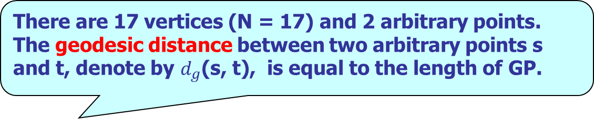
Introduction
There are 17 vertices (N = 17) and 2 arbitrary points.
The geodesic distance between two arbitrary points s and t, denote by $d_{g}$(s, t), is equal to the length of GP.

Slide 4
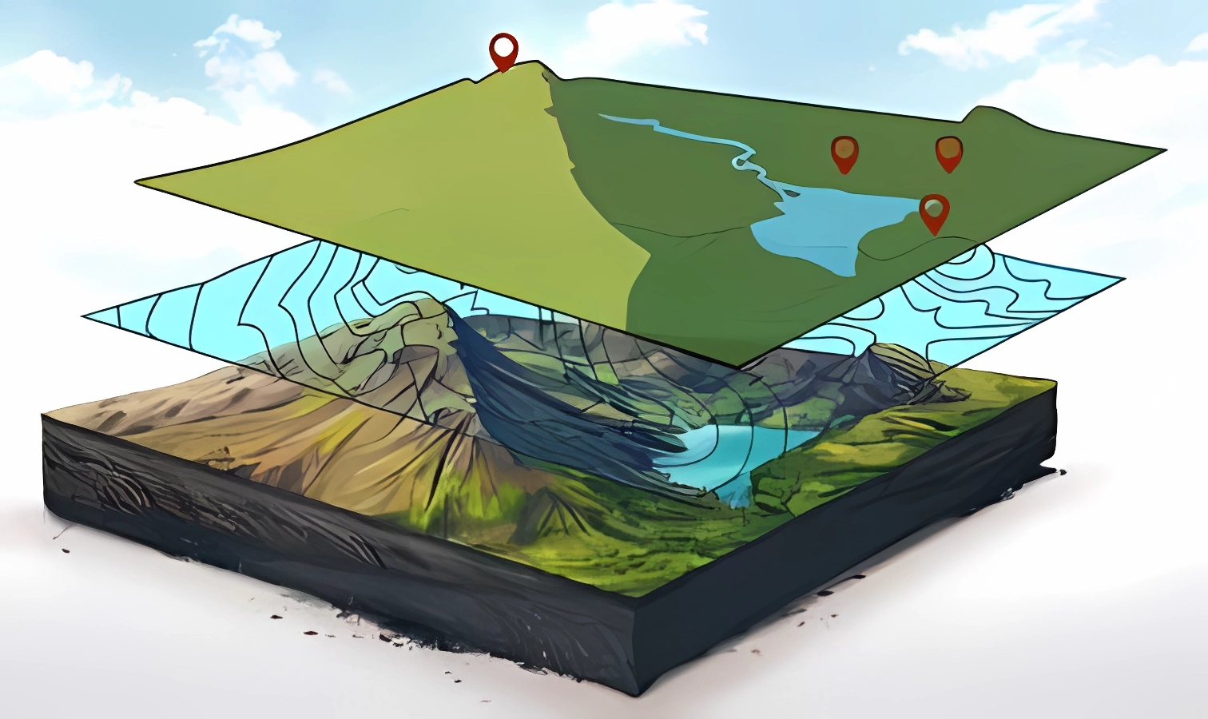
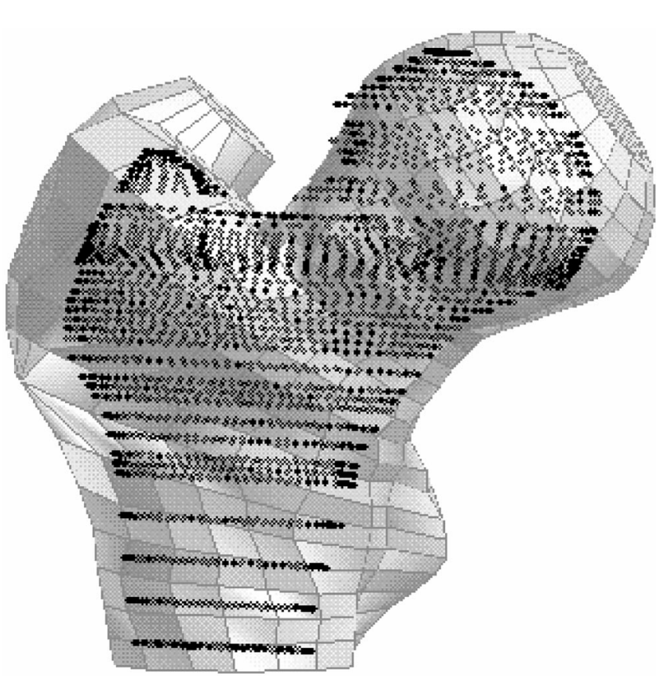
Introduction
Geodesic distances are very important to many high-level applications:
  Geographical Information System (GIS):
    compute the travel cost between two places;
    study travel patterns of animals based on residential sites.
  Spatial data mining:
    check spatial co-location patterns;
    Clustering objects on terrain surfaces.
  Scientific 3D modeling:
    analyze key features based on distances between reference points.
  etc.

Slide 5
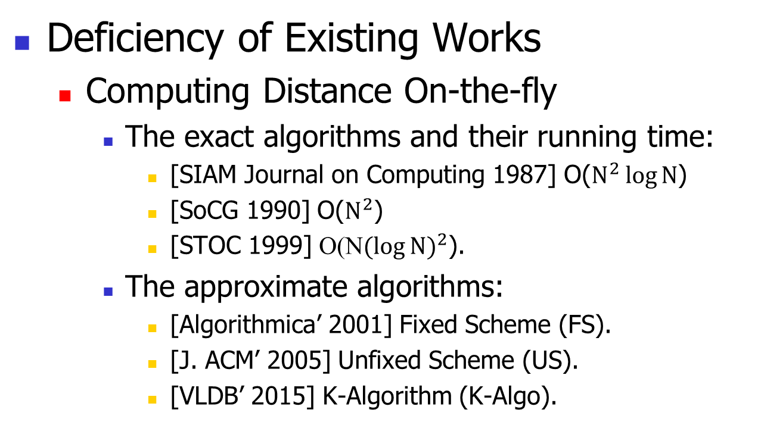
Introduction
Deficiency of Existing Works
  Computing Distance On-the-fly
    The exact algorithms and their running time:
      [SIAM Journal on Computing 1987] O($N^{2}\log{N}$)
      [SoCG 1990] O($N^{2}$)
      [STOC 1999] O(N${(\log{N})}^{2}$).
    The approximate algorithms:
      [Algorithmica’ 2001] Fixed Scheme (FS).
      [J. ACM’ 2005] Unfixed Scheme (US).
      [VLDB’ 2015] K-Algorithm (K-Algo).
  N is the number of vertices on the terrain surface.
  Both of them have an O(N log N) running time.

Slide 6
Introduction
  More than 3 hours pre-processing time and 256 GB memory for a terrain with 10,243 vertices due to a large amount of auxiliary points introduced.
Deficiency of Existing Works
  Index-Based Algorithms
    [ESA’ 2011] Steiner-Point Oracle (SP-Oracle).
    [SIGMOD’ 2017] Space-Efficient Oracle (SE-Oracle).
  Algorithms for Other Queries.
    kNN [VLDBJ08, VLDB08], Reverse kNN [CIKM12], etc.

Slide 7
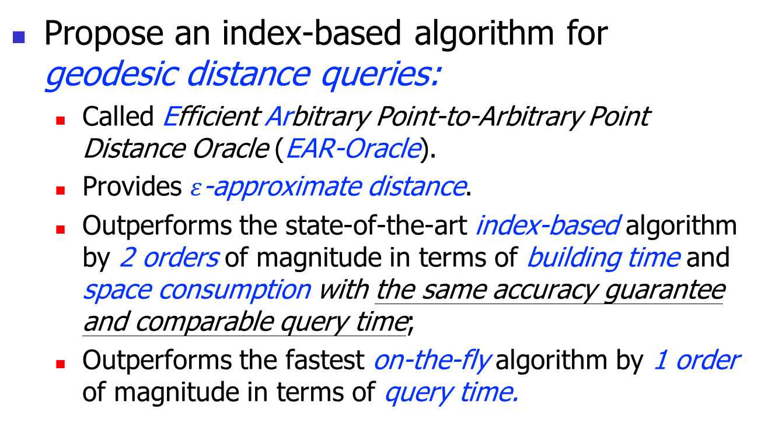
Our Contribution
Propose an index-based algorithm for geodesic distance queries:
  Called Efficient Arbitrary Point-to-Arbitrary Point Distance Oracle (EAR-Oracle).
  Provides $ε$-approximate distance.
  Outperforms the state-of-the-art index-based algorithm by 2 orders of magnitude in terms of building time and space consumption with the same accuracy guarantee and comparable query time;
  Outperforms the fastest on-the-fly algorithm by 1 order of magnitude in terms of query time.

Slide 8
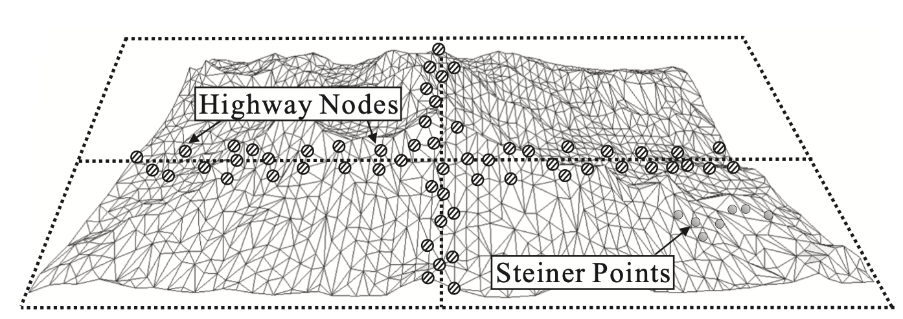

EAR-Oracle (Preprecessing)
Partition the terrain surface into several boxes in 2D ($x$-$y$ plane):
  When the query source s and the query destination t are close (in the same box), they have spatial coherence;
  When the query source s and the query destination t are distant (in different boxes), their geodesic path will go through certain boundaries of some boxes.
On-the-fly algorithms have good performance.

Slide 9

EAR-Oracle (Preprecessing)
Partition the terrain surface into several boxes in 2D ($x$-$y$ plane):
  These terrain vertices near the boundaries are called highway nodes;
A subset of terrain vertices (The amount of highway nodes is small).

Slide 10
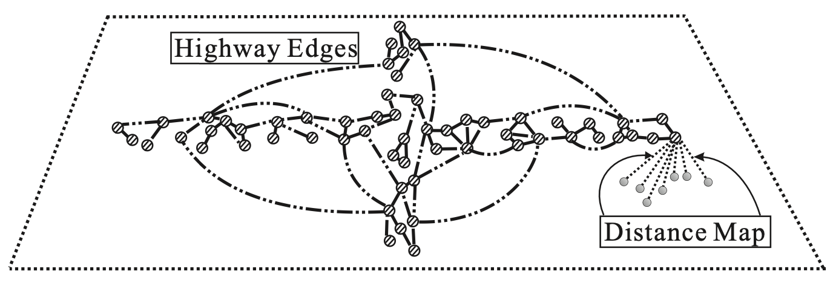

EAR-Oracle (Preprecessing)
Partition the terrain surface into several boxes in 2D ($x$-$y$ plane):
  Construct a highway network G to index distances between highway nodes:
    A lightweight highway network with accuracy guarantee:
u and v are two arbitrary vertices on G.
$$d_{g}(u,v)≤d_{G}\left(u, v\right)≤{\left(1+ε\right)d}_{g}\left(u, v\right)$$

Slide 11

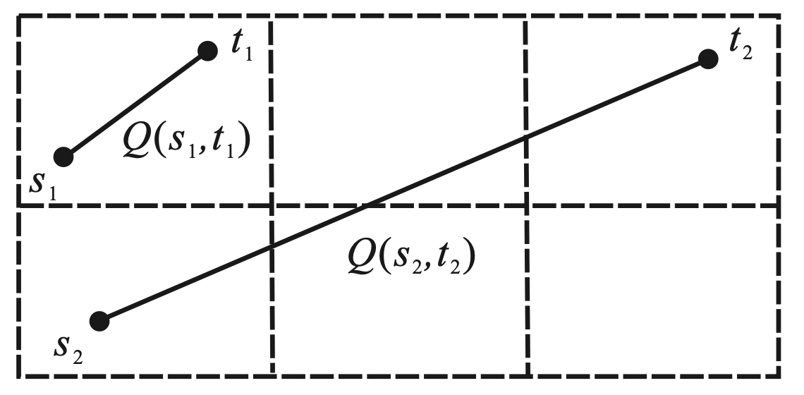

EAR-Oracle (Query Processing)
We are given two arbitrary surface points $s$ and $t$. The geodesic distance query $Q(s,t)$ taken $s$ as the source and $t$ as the destination is called A2A query.
Based on the partition, the queries could be divided into two types:
  The inner-box query ($Q(s_{1},t_{1})$ in the example);
  The inter-box query ($Q(s_{2},t_{2})$ in the example).
Two types of distance queries

Slide 12

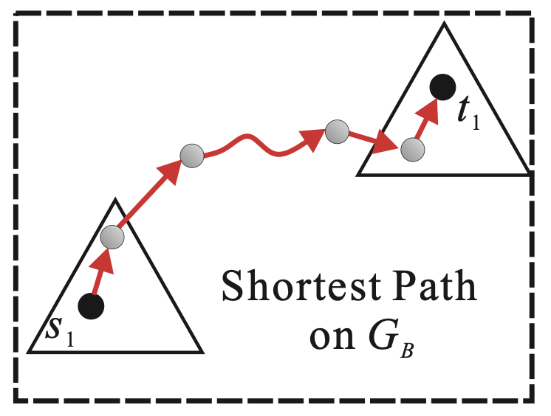

EAR-Oracle (Query Processing)
The inner-box query ($Q(s_{1},t_{1})$):
  Adopt on-the fly algorithm.
Efficient due to spatial coherence.
Inner-box query example

Slide 13



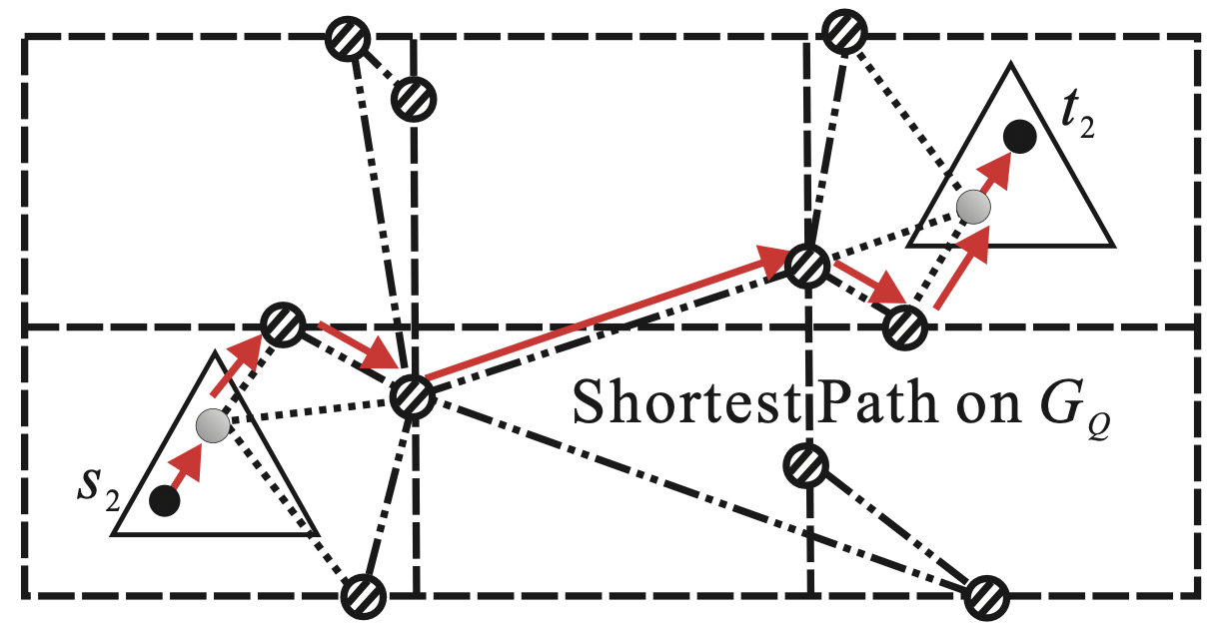

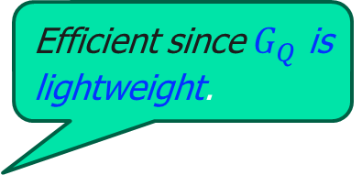
EAR-Oracle (Query Processing)
The inter-box query ($Q(s_{2},t_{2})$):
  Construct a query graph $G_{Q}$ by adding edges to the highway network;
  Perform Dijkstra’s algorithm on query graph $G_{Q}$.
Efficient since $G_{Q}$ is lightweight.
Inter-box query example

Slide 14
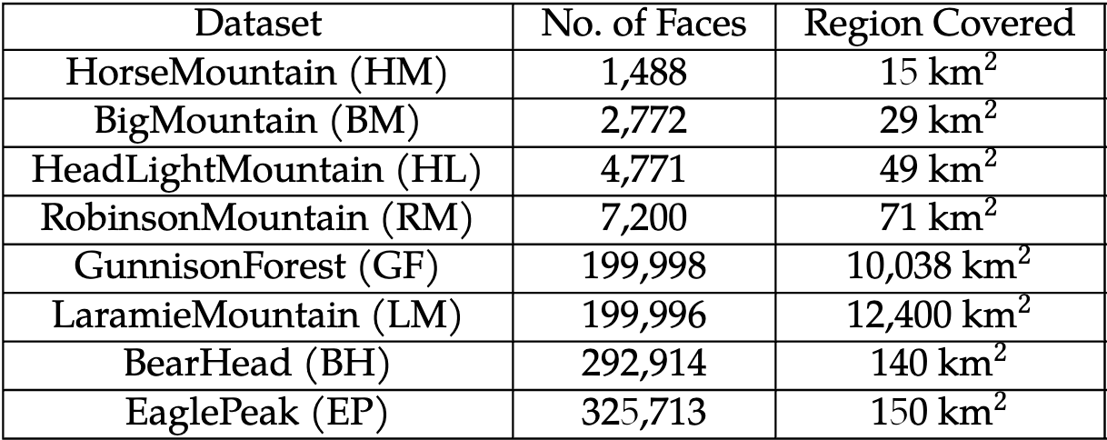
Experimental Result
Datasets:
  We adopt several real terrain surfaces:
Measures:
  Building Time, Space Consumption, Query Time and Relative Error.

Slide 15
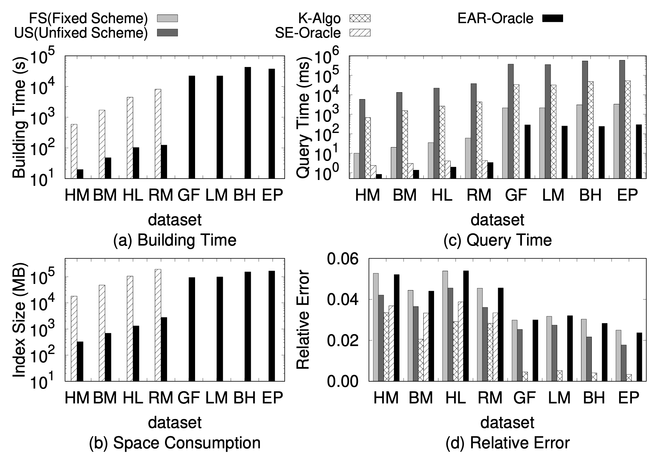
Experimental Result
EAR-Oracle outperforms the best index-based algorithm SE-Oracle by 2 orders of magnitude in terms of building time and space consumption. EAR-Oracle outperforms all on-the-fly algorithms by more than 1 order of magnitude in terms of query time. All tested algorithms have small relative error.

Slide 16
Q&A

Slide 17
Introduction
Terrain Surface and Geodesic Distance
  Application 1 – Geographical Information System (GIS)
  Application 2 – Computer Graphics and Vision
  Application 3 – Scientific Data 3D Modeling
  Application 4 – 3D Virtual Game
  Application 5 – Spatial Data Mining

Slide 18
Introduction
Terrain Surface and Geodesic Distance
  Application 1 – Geographical Information System (GIS)
POIs: landmarks and residential sites of animals.
Geodesic distances between POIs: measure travel time/cost and study the migration patterns of animals.

Slide 19
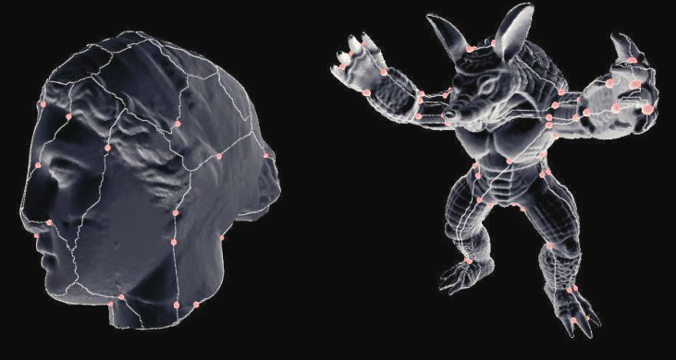
Introduction
Terrain Surface and Geodesic Distance
  Application 2 – Computer Graphics and Vision
POIs: reference points in the 3D model
Geodesic distances between the reference points: capture the features of a model.
The geodesic distance-based feature is used to measure similarity.

Slide 20
Introduction
Terrain Surface and Geodesic Distance
  Application 3 – Scientific Data 3D Modeling
  Scientists model their studied objects such as organs with 3D models.
  POIs: reference points which corresponds to the functional units.
  Geodesic distances between the reference points: make analysis together with the MRI images.

Slide 21
Introduction
Terrain Surface and Geodesic Distance
  Application 4 – 3D Location-Based Virtual Game
  Application 5 – Spatial Data Mining
    Inner-/Inter- Cluster Distance
    In the mountainous area, the geodesic distance is a good metric.
  E.g., INGRESS.
  POIs: portals
  Geodesic distances:
  measure travel cost.

Slide 22
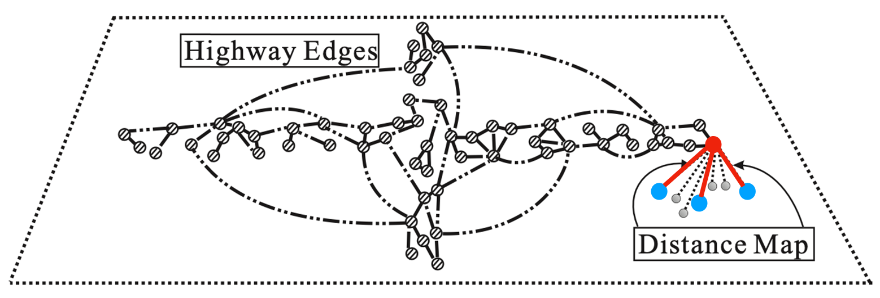

EAR-Oracle (Preprecessing)
Partition the terrain surface into several boxes in 2D ($x$-$y$ plane):
  Build a distance map to index distances between highway nodes and Steiner points:
    For each box, index the distance between each highway node on its boundaries and Steiner points (auxiliary points) introduced on each face inside the box;

Slide 23

EAR-Oracle Pre-processing Phase
Build a base graph (denoted by $G_{B}$) for distance metric approximation:
There is no efficient algorithm for exact solution on weighted terrain surfaces.

Slide 24
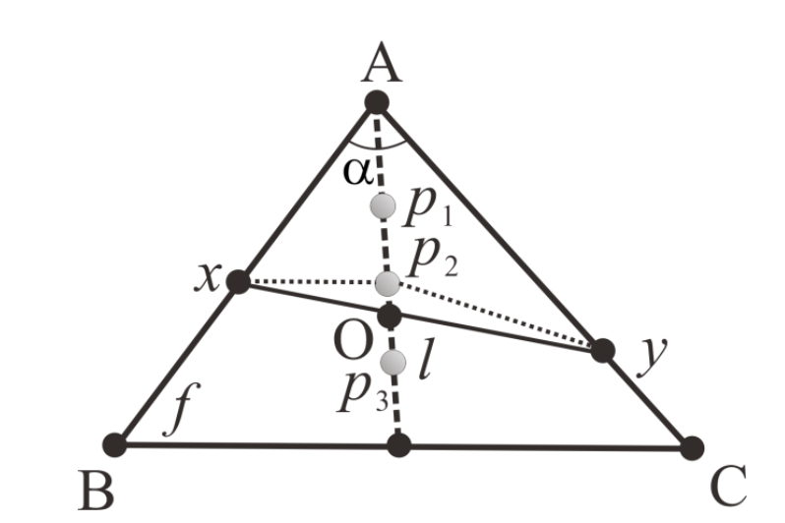


EAR-Oracle Pre-processing Phase
Build a base graph (denoted by $G_{B}$) for distance metric approximation:
  Place $m$ Steiner points uniformly on each angle-bisector of each face:
    Used to approximate the path inside a single face.
Example of base graph for $m$=3.

Slide 25
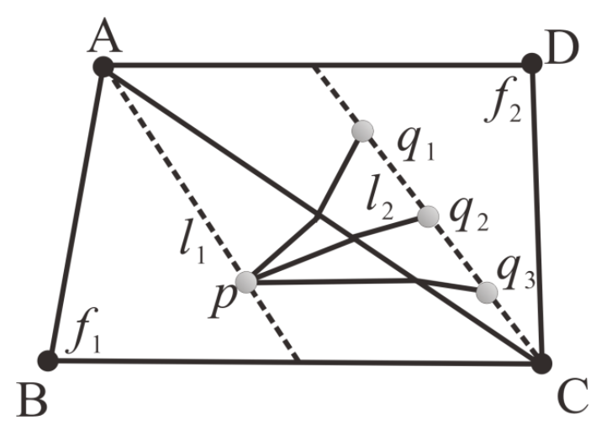


EAR-Oracle Pre-processing Phase
Build a base graph (denoted by $G_{B}$) for distance metric approximation:
  Connect edges between Steiner points on adjacent faces; The weighted geodesic paths are calculated based on the Snell’s Law;
Example of base graph for $m$=3.

Slide 26

EAR-Oracle (Query Processing)
The inter-box query ($Q(s_{2},t_{2})$):
  it is three-fold:
    From $s_{2}$ to highway node (distance map);
    From highway node to highway node (highway network);
    From highway node to $t_{2}$ (distance map).
2
1
3
Inter-box query example

Slide 27
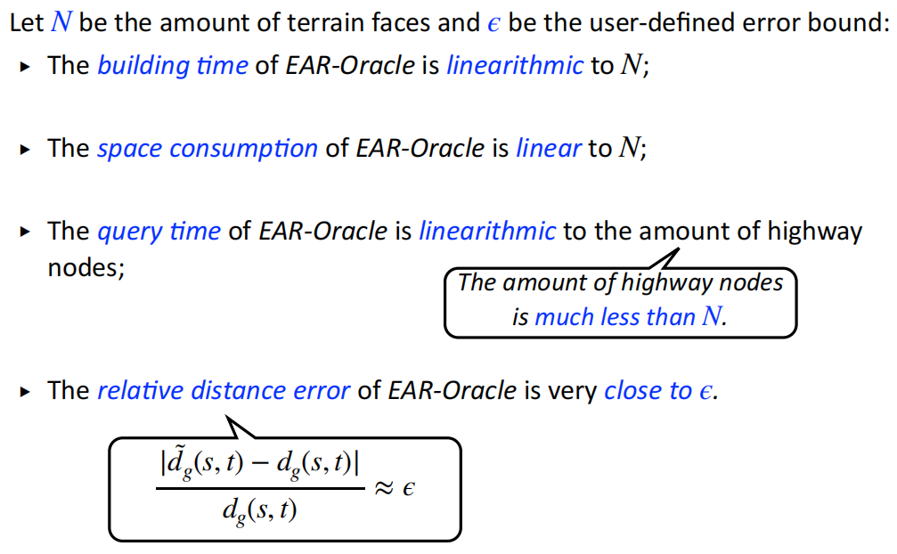
EAR-Oracle (Theoretical Analysis)

Slide 28
Conclusion
We propose EAR-Oracle:
  A index-based algorithm for Arbitrary point-to-Arbitrary point geodesic distance queries;
  Outperforms the state-of-the-art algorithms;
  Can scale up to terrain surfaces with millions of faces;
  Quality guarantee on result.

